Slide 1
Connective Tissue/Autoimmune Diseases
Todd Walter DNAP, CRNA
todwal@msn.com
All material placed on Blackboard, the Program Website (www.smumn.edu/nap), distributed electronically or distributed in printed form is intended only for the use of the individual student enrolled in the course. Distribution and/or sharing this material with any other student, individual or organization are strictly prohibited without the written consent of the course instructor, Program Director and the Academic Dean of the Twin Cities campus.

Slide 2
Connective Tissue Disorders
Classification: pattern of inheritance, cluster of s/s, radiologic/histologic features
ID of mutations provides framework for understanding manifestations of the disease
Provided tests for prenatal diagnosis
Mutations not always reliable predictors of clinical outcomes

Slide 3
Connective Tissue Disorders
Current classifications overemphasize the etiologic differences between genetic diseases apparent in infants vs similar diseases that appear later in life.

Slide 4
Composition of Connective Tissues
Complex macromolecules
Most abundant components: 3 similar fibrillary collagens (types I, II, and III)
Tensile strength similar to steel wires

Slide 5
Distribution of Collagens
Distribute in tissue-specific manner
Type I: most of the protein of dermis, ligaments, tendons, and demineralized bone
Type II: most abundant protein of cartilage
Type I and III: most abundant proteins of large blood vessels

Slide 6
Turnover of Connective Tissues
Embryonic development: appear as early as the four-cell blastocyte
Wit development of blood vessels/skeleton, rapid increase in the synthesis, degradation, and re-synthesis of connective tissue
Turnover continues at slower pace throughout postnatal development, then spikes during the growth spurt of puberty

Slide 7
Turnover of Connective Tissues
Age, malnutrition, physical inactivity, low-gravitational stress: rate of degradation begins to exceed rate of synthesis- tissues shrink
Starvation: large fraction of collagen in skin and other connective tissues degraded to provide amino acids for gluconeogenesis

Slide 8
Other
RA and OA: extensive degradation of articular cartilage collagen
Glucocorticoids weaken most tissues by decreasing collagen synthesis
Many pathologic states: collagen deposited in excess
Most injuries to tissues, inflammatory and immune responses stimulate deposition of collagen fibrils- fibrotic scars

Slide 9
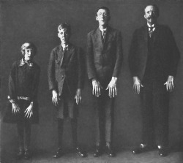
Marfan Syndrome
http://www.marfansyndrome.info/marfan-genetics.html

Slide 10
Classification
Triad of features:
Skeletal
Cardiopulmonary
Ocular

Slide 11
Incidence and Inheritance
1:3,000/5,000 births
Most racial ethnic groups
Mutations generally inherited as autosomal dominant traits, but ¼ of patients have sporadic new mutations
Mean age of survival is 32 years

Slide 12
Skeletal Effects
Long, thin extremities
Arachnodactyly
Joint hypermobility
High-arched palate, pedal arches, pes planus
Severe chest deformities: pectus excavatum, pectus carinatum, asymmetry
CT/MRI of lumbar sacral region: enlargement of neural canal, thinning of pedicles/laminae, widening of foramins, or anterior meningocele

Slide 13
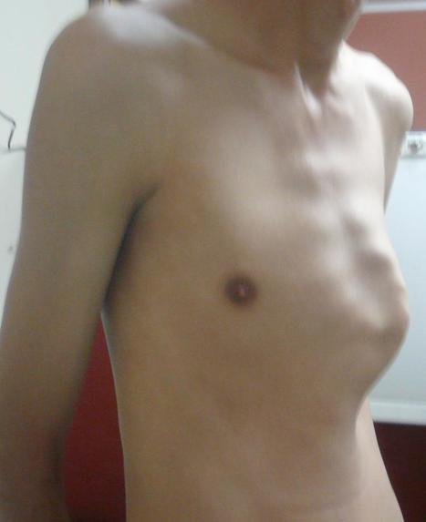
Skeletal Effects (rib cage changes)
https://www.scoop.it/t/pectus-carinatum/?&tag=pectus+carinatum+operation
https://www.mayoclinic.org/diseases-conditions/pectus-excavatum/multimedia/pectus-excavatum/img-20007723

Slide 14
Kyphoscoliosis
https://www.spineuniverse.com/image-library/severe-progressive-kyphoscoliosis-clinical-photo

Slide 15
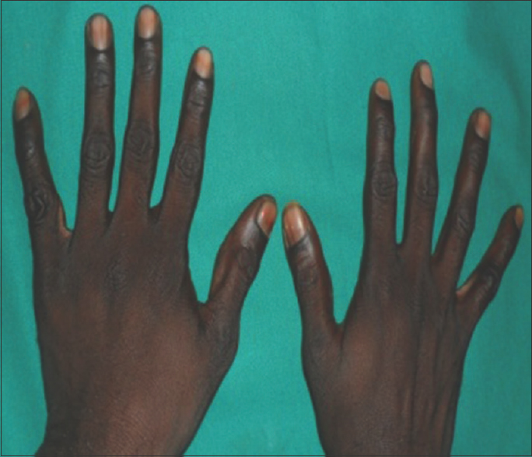
Arachnodactyly
http://www.myhealthyfeeling.com/arachnodactyly-pictures-diagnosis-causes/
http://www.jpbsonline.org/article.asp?issn=0975-7406;year=2017;volume=9;issue=1;spage=73;epage=77;aulast=Sivasankari

Slide 16
Ocular Effects
Ectopia lentis- dislocation of the lens
May contribute to the formation of cataracts
Ocular globe is elongated
Most patients are myopic
Retinal detachment can occur

Slide 17
Ectopia lentis

Slide 18
Cardiovascular Effects
Major source of morbidity, mortality
Mitral valve prolapse
Dilation of the aortic root and sinuses of Valsalva
Dilation can be accelerated by physical/emotional stress, pregnancy
Aortic dissection/rupture
Cardiac conduction abnormalities: BBB

Slide 19
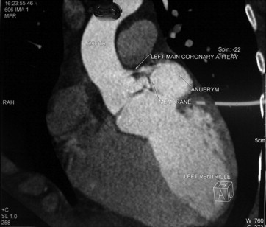
Sinus of Valsalva Aneurysm
http://www.annalscts.com/article/viewFile/1400/2025/5279
http://www.journals.elsevierhealth.com/article/S1561-8811(13)00003-5/fulltext

Slide 20
Other Effects
Patients are typically thin with little subcutaneous fat; adults may develop centripedal obesity
Striae may occur over the shoulders and buttocks
Development of spontaneous pneumothorax
Inguinal and incisional hernias are common

Slide 21
Anesthetic Management
Pre-op eval should focus on cardiopulmonary abnormalities
Avoid TMJ dislocation
Careful positioning (hypermobile joints)
Avoid sustained increase in SBP
Invasive monitoring/TEE should be considered in select patients
High index of suspicion should be maintained for the development of pneumothorax

Slide 22
Ehlers-Danlos Syndrome

Slide 23
Incidence and Inheritance
1:5,000
Group of inherited connective tissue disorders
Various manifestations
Almost all characterized by joint hypermobility
Defined based on extent to which joints, skin, other tissues involved, mode of inheritance, biochemical analysis

Slide 24
Types
At least 11 types
Type I (severe) and Type II (less severe): hypermobility of joints, skin velvety in texture, hyper-extensible, easily scarred
Type III (hypermobile): joints more involved than skin
Type IV (vascular): skin more involved; predisposed to sudden death from rupture of large blood vessels or other hollow organs

Slide 25
Skin
Varies from thin and velvety to dramatically hyperextensible, easily torn or scarred
Vascular-type EDS: extensive scars, hyperpigmentation develops over bony prominences
May be able to visualize subQ blood vessels
Easy bruising may occur in several types of EDS

Slide 26
Ligaments/Joints
Laxity and hypermobility of joints
Varies from mild to unreducible dislocations of hips and other large joints
Severe forms require surgical repair
May develop progressive difficulty with age

Slide 27
Other Features
Mitral valve prolapse (Type I)
Hernias (Type I)
Pes planus and mild to moderate scoliosis are common
Extreme joint laxity and repeated dislocations may lead to degenerative arthritis
Ocular-scoliotic type: eye may rupture with minimal trauma
Sclerae may appear blue
Kyphoscoliosis can cause respiratory impairment

Slide 28
Diagnosis
Large degree of variability among members of same family carrying the same mutation
Some patients have increased fractures; difficult to distinguish from osteogenesis imperfecta

Slide 29
Complications
GI tract, uterus, vasculature well-endowed with type III collagen- spontaneous rupture of bowel, uterus, major arteries
Premature labor and excessive bleeding at delivery
Dilation of trachea
Increased incidence of pneumothorax

Slide 30
Complications
Mitral regurgitation/prolapse
Cardiac conduction abnormalities
May exhibit extensive bruising with minor trauma

Slide 31
Anesthetic Management
Preop assessment: note any CV manifestations, bleeding problems
Trauma during laryngoscopy must be minimized
Invasive lines- hematoma formation may be extensive
Infiltration of IV may go unnoticed due to laxity of the skin

Slide 32
Anesthetic Management
Avoid high airway pressures during assisted or controlled ventilation
Regional anesthesia is not recommended due to bleeding tendency/formation of hematomas
Surgical complications may include hemorrhage and postoperative wound dehiscence

Slide 33
Scleroderma (Systemic Sclerosis)

Slide 34
Epidemiology
Acquired sporadic disease
Worldwide distribution, affecting all races
9-19 cases per million per year (U.S.)
Females more affected than males
More pronounced in childbearing years, declines after menopause
Can present at any age (30-50 years)

Slide 35
Genetics
Non-Mendelian pattern of inheritance
Genetic contribution to disease susceptibility
Risk of other autoimmune disease (SLE, RA) increased
Multiple genetic loci involved

Slide 36
Types
Diffuse cutaneous: progressive skin induration, risk of pulmonary fibrosis, acute renal involvement
Limited cutaneous: slowly progressive. May have calcinosis cutis, Raynaud’s phenomenon, esophageal dysmotility, sclerodactyly, and telegiectasia

Slide 37
Pathogenesis
Vasculopathy
Cellular and humoral autoimmunity
Progressive visceral and vascular fibrosis in multiple organs

Slide 38
Pathology
Distinguishing hallmark of Ssc is a combination of widespread capillary loss and obliterative vasculopathy of small arteries and arterioles, together with fibrosis in the skin and internal organs
Fibrosis found in skin, lungs, GI tract, heart, tendon sheath, perifascicular tissue, some endocrine organs

Slide 39
Fibrosis
Consequence of autoimmunity and vascular damage
Characterized by progressive replacement of normal tissue architecture with dense connective tissue
Results in irreversible accumulation of scar tissue

Slide 40
Skin
Dermal sclerosis due to collagen accumulation causes obliteration of hair follicles, sweat glands, and eccrine and sebaceous glands
Fixed flexion contractures of the fingers
Face may assume a characteristic appearance with taut and shiny skin, loss of wrinkles and occasionally expressionless face
Microstomia
Breakdown of atrophic skin- ulcerations

Slide 41
Lungs
Leading cause of death
Interstitial fibrosis and vascular damage
Progressive thickening of alveolar septae
Loss of pulmonary blood vessels- impairs gas exchange, contributes to worsening of pulmonary HTN
Autopsy: multiple PE, evidence of myocardial fibrosis

Slide 42
Lungs
Less frequent manifestations:
Aspiration pneumonia
Pulmonary hemorrhage
Obliterative bronchiolitis
Restrictive ventilator defect due to chest wall fibrosis
Spontaneous pneumothorax
Increased incidence of lung cancer

Slide 43
Lungs
Can be asymptomatic until disease is advanced
Most frequent symptoms: exertional dyspnea, fatigue, reduced exercise tolerance
Chronic dry cough
PFTs: reduction in forced vital capacity or Dlco
With exercise, patients show decrease in PO₂

Slide 44
GI Tract
Xerostomia, reduced oral aperture, periodontal disease, resorption of mandibular condyles is frequent
Lower esophagus frequently involved
Vascular lesions often present
Decreased peristaltic activity
GERD
Dysmotility, bowel obstruction
Chronic reflux: associated with esophageal inflammation, ulcerations, stricture formation, Barrett’s metaplasia

Slide 45
Cardiac
More frequent with diffuse SSc
Prominent involvement of myocardium and pericardium
Arteriolar lesions: concentric intimal hypertrophy and luminal narrowing- may affect conduction system
Frequency of atherosclerotic CAD comparable to general population

Slide 46
Cardiac
Endocardium, myocardium, pericardium may be affected separately or together
May see: pericardial effusions, atrial and ventricular tachycardias, conduction abnormalities, valvular regurgitation, hypertrophy, and heart failure
Myocarditis may occur

Slide 47
Musculoskeletal
Carpal tunnel syndrome (frequent)
Generalized arthralgias and stiffness
Joint mobility progressively impaired (hands)
Contractures develop at proximal interphalangeal joints and wrists
dcSSC: large joint contractures
Movement at elbows, shoulders, knees frequently reduced

Slide 48
Other
May develop dry eyes, dry mouth
Hypothyroidism is common
Sensory trigeminal neuropathy
Pregnancy is associated with increased rate of adverse fetal outcomes- CV abnormalities may worsen during pregnancy

Slide 49
Treatment
Antifibrotic therapy: D-penicillamine
Vascular therapy: nifedipine, diltiazem, angiotensin II receptor blockers, alpha-1 adrenergic blockers, sildenafil, serotonin reuptake inhibitors, topical NTG, IV prostaglandins, low-dose ASA, dipyridamole, calcium channel blockers
GI therapy: proton pump inhibitors, hyperalimentation, octreotide, metoclopramide

Slide 50
Anesthetic Management
Preop evaluation should focus on organ systems involved
Airway exam
A-line insertion- Raynaud’s
May have contracted intravascular volume
Reflux
Decreased pulmonary compliance

Slide 51
Anesthetic Management
Things that increase pulmonary resistance need to be prevented
May require period of postoperative ventilator support
Renal disease must be considered when selecting drugs
Regional anesthesia may be difficult
Keep warm
Eyes lubricated

Slide 52
Human Immune System
Innate Immunity
• Inherited & provides 1st line defense
• Mounts initial response to any infection
• Recognizes targets that are common to many pathogens
• Has no specific memory
• Neutrophils, eosinophils, basophils, macrophages, monocytes, NK cells, mast cells, epithelial cells, complement system, cytokines

Slide 53
Human Immune System
Adaptive Immunity
• Characterized by antigen-specific responses to a foreign antigen or pathogen; delayed time course
• Develops immunological memory & is activated more rapidly with repeated exposure
• Consists of humoral (B lymphocytes) & cellular components (T lymphocytes)

Slide 54
Active vs. Passive Immunity
Active
• Pathogen deliberately administered to stimulate immune response & antibody production
• Vaccines
Passive
• Protection from another individual’s antibodies
• inutero-transfer, breast milk, immunoglobulin products, RhoGAM

Slide 55
Inadequate Innate Immunity

Slide 56
Neutropenia
• Neutrophil granulocyte count < 1500/mm³
• Counts < 500/mm³ place patients at significant risk of infection
• Organisms: Staph, Pseudomonas, E. coli, Klebsiella
• Tx: broad-spectrum antibiotics

Slide 57
Neutropenia in Infants/Children
• Neutropenic syndromes
• Neonatal sepsis most common cause with 1st days of life
• Cyclic neutropenia
• Kostmann’s syndrome
• Neoplastic disease

Slide 58
Neutropenia in Adults
• Cancer (chemotherapy)
• AIDS treatment
• Reflects impact of drug on cell lines in bone marrow (see improvement once drug is discontinued)
• Drugs associated with neutropenia: injectable gold salts, chloramphenicol,
anti-thyroid meds, analgesics, tricyclics, phenothiazines

Slide 59
Neutropenia in Adults (continued)
• Autoimmune-related neutropenia seen with collagen vascular or autoimmune disorders (SLE and RA)
• Felty’s syndrome: RA, splenomegaly, neutropenia
• Sepsis
• Alcoholic patients
• Myeloproliferative/myelodysplastic disorders
• AIDS

Slide 60
Abnormalities of Phagocytosis
• Chronic granulomatous disease: genetic disorder
• Staph aureus & certain gram-negative bacteria responsible for most infections in these patients
• Leukocyte adhesion deficiency
• Chédiak-Higashi syndrome
• Neutrophil-specific granule deficiency syndrome
• Management: antibiotics &/or recombinant Granulocyte Colony Stimulating Factor (rG-CSF)—may require a course before surgery

Slide 61
rG-CSF
• Myeloid growth factor
• Stimulates proliferation &differentiation of progenitors committed to neutrophil lineage
• Activates phagocytic activity of mature neutrophils
• Prolongs neutrophil survival in the circulation
• Can mobilize hematopoietic stem cells in peripheral blood
• Reduces episodes of febrile neutropenia, requirements for broad-spectrum antibiotics, infections, and length of stay.

Slide 62
Excessive Innate Immunity

Slide 63
Neutrophilia
• Absolute neutrophil count > 7000/mm3
• Signs/symptoms usually seen if > 100,000/mm3
• Spleen leukostasis splenic infarction
• Lung leukostasis decreased oxygen-diffusing capacity
• Can accumulate in skin (chloromas)
• Associated with major bacterial infections
• If > 50K – noninfectious, malignant disease (myeloproliferative)
• Expected side effect of glucocorticoid therapy

Slide 64
Misdirected Innate Immunity

Slide 65
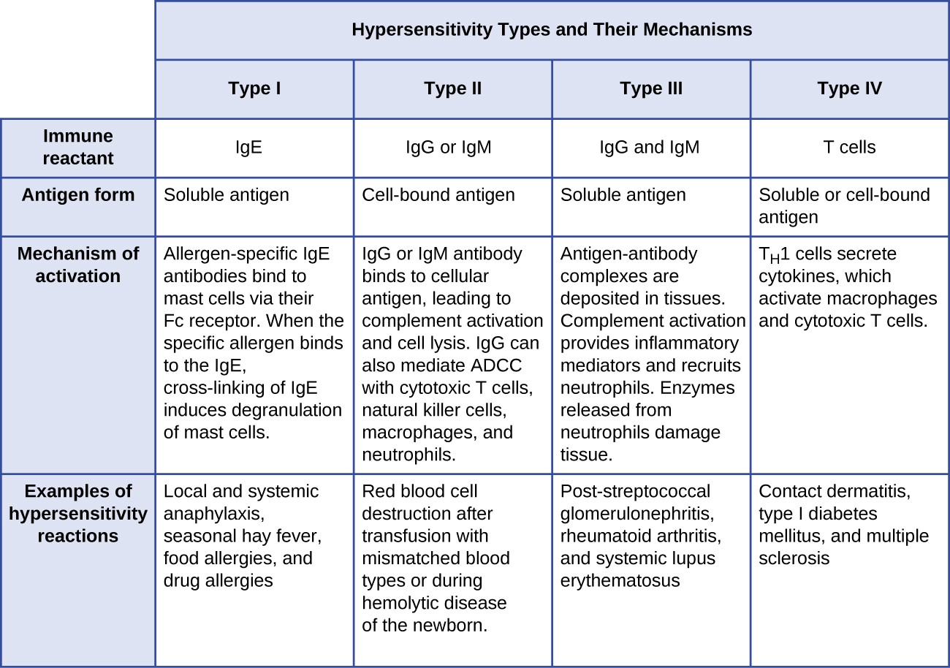
Hypersensitivity
https://courses.lumenlearning.com/microbiology/chapter/hypersensitivities/

Slide 66
Anaphylaxis (Vargo Anesthesia App
• Exposure to antigen stimulates production of antigen-specific IgE antibodies
• Antibodies bind to surface of mast cells & basophils, which primes cells to rx to next exposure to antigen
• Complement activation marks cells for destruction & recruit other immune cells
• “In reality, the IgE - coated mast cells and basophils are grenades of histamine, and with re-exposure, the antigen is equivalent to pulling out the grenade clip.”
• Histamine release hypotension, HR & contractility & coronary vasoconstriction
• Reactions can be mild to critical anaphylactic shock & death
• Anaphylactoid = are not IgE mediated, occur through a direct nonimmune - mediated release of mediators from mast cells &/or basophils or result from direct complement activation

Slide 67
Anaphylaxis (Vargo Anesthesia App)
• MRs & other meds do not need pre-exposure d/t development of allergic cross - reactivity (quat ammonium group)
• Anaphylaxis to MRs 5-10x more common than other drugs; ≥ 60% of people allergic to one MR may react to others
• Onset seconds—2 hours; usually occurs 30-60 mins after induction, rather than at induction
• Anaphylaxis rx to any med 37:100,000 hospitalized pts
• Peri-op anaphylaxis occurrence girls = boys; women > men

Slide 68
Anaphylaxis (Vargo Anesthesia App)
Cardiac Considerations
• Greater density of myocardial mast cells in ischemic heart disease or dilated cardiomyopathy may lead to more severe rx
• Pts with conduction defects, ­vagal tone or taking sympatholytic meds may not become tachycardic
• Pts on 𝜷-blockers may have inadequate response to epi & can become severely hypertensive d/t unopposed ⍺-adrenergic tone & reflex vagotonic effects
• ACE inhibitors may cause ­rx & cause pts to be less responsive to epi

Slide 69
Anaphylaxis Triggers
Muscle relaxants 69%
Aminosteroid (roc, vec & pancuronium) anaphylactic
Benzylisoquinolines (atracurium & cis-atracurium) anaphylactoid
Antibiotics 15% (cephalosporins, pcns, vanco, quinolones)
Latex 12.6 % (peds)
IV dyes & contrast 3-4%
Benzos 2%
Propofol 1.2% & 1:15,000 anesthetics (no correlation with egg allergy)

Slide 70
Anaphylaxis S/S
Some signs may be absent in an anesthetized patient:
Hypoxemia, difficulty breathing, tachypnea.
Rash/hives.
Hypotension (may be severe).
Tachycardia.
Bronchospasm/wheezing.
Increase in peak inspiratory pressure (PIP).
Angioedema (potential airway swelling).

Slide 71
http://web.stanford.edu/dept/anesthesia/em/semv3.1_digital.pdf?_ga=2.51019626.217556929.1518796696-1904781871.1518796696
This is the link to the Stanford Emergency Manual.

Slide 72
Differential diagnoses to rule out
Consider and rule out other causes:
• Pulmonary embolus, air emboli, aspiration
• Myocardial infarction, pericardial tamponade, dysrhythmias
• Anesthetic overdose
• Pneumothorax
• Hemorrhage or hypovolemia
• Septic or cardiogenic shock

Slide 73
Anaphylaxis Treatment from Stanford
Discontinue potential allergens: muscle relaxants, latex, antibiotics, colloids, protamine, blood, contrast, chlorhexidine.
Discontinue volatile anesthetic if hypotensive. Consider amnestic agent.
Increase to 100% O2, high flow.
Give IV fluid bolus. May require many liters!
Give epinephrine IV in escalating doses every two minutes. Start at 10-100 μg IV and increase dose every 2 minutes until clinical improvement is noted. Start early epinephrine infusion. May require large doses > 1 mg.
IF no improvement: continue treatment, but consider other causes (Go To Hypotension, event #15, and Hypoxemia, event #16 – consider Differential Diagnoses).
Consider vasopressin bolus IV or norepinephrine infusion.
Treat bronchospasm with albuterol and epinephrine (if severe).
Consider additional IV access and invasive monitors (arterial line).
If signs of angioedema, consider early intubation to secure airway.
After stable consider H1 antagonist (e.g. Diphenhydramine 25-50 mg IV), H2 antagonist (e.g. Ranitidine 50 mg IV), and corticosteroids (e.g. Methylprednisolone 125 mg IV).

Slide 74
Once patient is stable…
Consider
Send serum tryptase level (peaks <60 min post-event).
Send serum histamine (peaks <30 min post-event).
If the event was severe, consider keeping patient intubated & sedated
Can recur after initial treatment: Consider monitoring patient for 24 hours post-recovery.
5. Refer the patient for post-operative allergy testing.

Slide 75
Angioedema
• Characterized by episodic subcutaneous & submucosal edema in face, extremities & GI tract
• 2 types:
• Release of mast cell mediators urticaria, bronchospasm, flushing & hypotension
• Release of bradykinin without S/S of allergic rx
• Most common hereditary form results from autosomal dominant deficiency or dysfunction of C1 esterase inhibitor
• Leads to release of vasoactive mediators that vascular permeability & produce edema via bradykinin

Slide 76
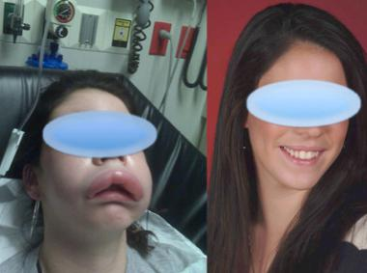
Angioedema
https://emedicine.medscape.com/article/135208-overview

Slide 77
Angioedema
• Can experience repeated bouts of facial and/or laryngeal edema lasting 24-72 hours
• Usually begins in 2nd decade of life
• Triggers: menses, trauma, infection, stress, estrogen-containing oral contraceptives, dental surgery
• Abdominal attacks: severe pain, N/V/D
• Angiotensin-converting enzyme (ACE) inhibitors can precipitate angioedema in 0.1-0.7% of patients; unexpected attacks after prolonged ACE inhibitor use
Long-term treatments
• Anabolic steroids/Androgens: danazoland stanozolol
• Antifibrinolytics (ℇ-aminocaproic acid, tranexamic acid or aprotinin)

Slide 78
Angioedema Treatment
Prophylaxis before stimulating procedures or any surgery requiring intubation (androgens or C1 inhibitor concentrate)
Preferred tx for acute attack
• C1 inhibitor concentrate
• Icatibant (synthetic bradykinin receptor antagonist
• Ecallantide (recombinant plasma kallikrein inhibitor)
• FFP
Not useful for acute episodes: catecholamines, androgens, antihistamines, antifibrinolytics
Tracheal intubation may be difficult or impossible; trach may also be difficult

Slide 79
Anesthetic Management
• Ensure availability of IV infusion of C1 inhibitor concentrate
• Minimize trauma to the oropharynx
• Difficult airway cart & may need tracheotomy
• Regional anesthesia well tolerated
• Anesthetic drugs

Slide 80
Emergency Airway Management (that call to the ER that every CRNA dreads!)
• Supplemental oxygen
• Consider ETT size, may need smaller
• Consider surgical airway
• C1 (protease inhibitor) inhibitor replacement available

Slide 81
Inadequate Adaptive Immunity

Slide 82
Defects of Antibody Production
• Amyloidosis — amyloid accumulation in heart, vascular smooth muscle, kidneys, adrenal gland, GI tract, peripheral nerves & skin
• Macroglossia classical feature, upper airway obstruction
• Intraventricular conduction delays, R side failure, sudden death
• Nephrotic syndrome, delayed gastric emptying
• Cold autoimmune diseases — abnormal IgM or IgA that agglutinate with body temp
• X-linked agammaglobulinemia — no functional antibodies produced
• Selective IgA deficiency
• Waldenstrom’s macroglobulinemia (type of non-Hodgkin’s lymphoma)

Slide 83
Severe Combined Immunodeficiency Syndromes (SCIDS)
• Characterized by gross functional impairment of both humoral and cell- mediated immunity
• Susceptible to fungal, bacterial, and viral infections
• Most common form: X-linked; also autosomal recessive defect
• Incidence: 1:100,000 to 1:1,000,000
• Affected infants survival-rare beyond 1 year if not treated with bone marrow transplant

Slide 84
Adenosine Deaminase Deficiency
• Deficiency of adenosine deaminase enzyme (normally present in lymphocytes) causes toxic levels of purine intermediates to accumulate, causing T cell death
• Profound lymphopenia & rib/hip skeletal abnormalities
• Tx: BMT or stem cell transplantation from an HLA-compatible donor

Slide 85
Ataxia-telangiectasia
• Syndrome: cerebellar ataxia, oculocutaneous telangiectasias, chronic sinopulmonary disease, immunodeficiency
• Production of defective lymphocytes
• High risk of leukemia, lymphoma & breast CA in women
• Chronic lung disease major source of M & M
• Treatment: supportive, IVIG, no bone marrow transplant d/t injurious effects of radiation

Slide 86
Eosinophilia
• Sustained absolute eosinophil count > 1000 to 1500/μL
• Seen in: parasitic infestations, systemic allergic disorders, collagen vascular diseases, forms of dermatitis, drug reactions, and tumors
• Hypereosinophilia: > 5000/μL (associated with tissue damage)
• Irreversible endomyocardial fibrosis (restrictive cardiomyopathy) is common
• Widespread organ dysfunction and heart disease
• Treatment: corticosteroids and hydroxyurea, leukopheresis

Slide 87
Anesthesia and Immunocompetence

Slide 88
Neuroendocrine Stress Response
• Surgical stress: release of catecholamines, cortisol, and corticotropin
• Positive: minimizes inflammatory response to surgical trauma
• Negative: increases risk of infection & tumor proliferation d/t impairing both innate & adaptive immune response
• Surgical excision may allow CA cells to enter systemic circulation
• Tumor cell express adrenergic 𝜷-receptors to initiate & control CA cell proliferation; epi & norepi released d/t stress binds to tumor 𝜷cells, proliferation & survival
• Current research includes giving 𝜷-blockers to reduce progression of solid tumors
• Immunosuppression meds affect CA spread
• Surgery-induced angiogenesis promotes tissue repair but also tumor growth & mets

Slide 89
Anesthetic agent considerations
• Volatile gas suppress NK cells & macrophages, restrict T-cell proliferation & CA cell apoptosis
• Opioids impair suppress NK cells, decrease immune response & increase infection risk
• Ketamine & thiopental depress NK cell activity & are assoc with metastasis
• Propofol has minimal effects of NK cells & inhibits COX2 & PGE2 in tumor cells
• Regional & neuraxial anesthesia may help preserve immune function
• Regional vs. IV MS associated with measurable reductions in cancer recurrence; local anesthetics may also have anti-tumor properties

Slide 90
Perioperative Effects on Immune System
• Acute pain stimulates HPA axis & SNS, contributing to per-op immune suppression & tumor promoting effects of surgery
• Hypothermia induces thermoregulatory vasoconstriction, suppresses NK cells and lymphocyte function
• Tissue hypoxia impairs oxidative killing and impairs wound healing
• Increases in cortisol and catecholamines cause hyperglycemia

Slide 91
Autoimmune Diseases

Slide 92
Autoimmune Disease
Need to demonstrate that immune response to a self-antigen causes the observed pathology
Autoimmune diseases form a spectrum, from those specifically affecting a single organ to systemic disorders with involvement of many organs

Slide 93
Organ Specific vs Systemic
Organ specific
Pemphigus vulgaris
Autoimmune hemolytic anemia
ITP
Goodpasture’s syndrome
Myasthenia gravis
Systemic
SLE (systemic lupus erythmatosis)

Slide 94
Treatment
Focus on:
Supressing the induction of autoimmunity
Restoring normal regulatory mechanisms, or
Inhibiting the effector mechanism

Slide 95
Systemic Lupus Erythmatosis
90%- women of childbearing age
People of all ages, genders, ethnic groups
Prevalence in the U.S.: 10-400/100,000
Highest: black women
Lowest: white men

Slide 96
Pathogenesis
Autoimmune disease in which organs and cells undergo damage initially mediated by tissue-binding autoantibodies and immune complexes
Multigenic: normal alleles of multiple genes each contribute a small amount to abnormal immune/inflammation/tissue damage responses
If enough predisposing variations are present, disease results

Slide 97
Overview
May involve one or several organ systems
Over time additional manifestations may occur
Severity varies from mild and intermittent to severe and fulminant
Experience exacerbations interspersed with periods of quiescence
Permanent myalgias/arthralgias present most of the time

Slide 98
Musculoskeletal
Intermittent polyarthritis- mild to disabling
Characterized by soft tissue swelling and tenderness in joints (hands, wrists, knees)
Myositis with muscle weakness, elevated creatine kinase levels, muscle necrosis, inflammation

Slide 99
Cutaneous
Lupus dermatitis
Some lesions can be disfiguring, particularly face and scalp
Most common rash: photosensitive, slightly raised erythema to face (butterfly pattern), ears, chin, V region of neck and chest, upper back, arms
Raynaud’s

Slide 100
Renal
Nephritis
May develop nephrotic syndrome
HTN
Glomerulonephritis: if untreated, ESRD w/in 2 years of diagnosis
Accelerated atherosclerosis becomes important after several years of the disease; need to control systemic inflammation, BP, hyperlipidemia, hyperglycemia

Slide 101
CNS
Most common manifestation of CNS lupus: cognitive dysfunction, including difficulties with memory and reasoning
HA is common
Seizures of many types
Psychosis
Myelopathy

Slide 102
Vascular Occlusions
Prevalence of TIA, stroke, MI risk increases in patients with SLE
If patient has antiphospholipid antibodies: hypercoagulability and acute thrombotic events
Chronic disease associated with accelerated atherosclerosis

Slide 103
Pulmonary
Most common: pleuritic with or without pleural effusion
Pulmonary infiltrates
Life-threatening: interstitial inflammation leading to fibrosis, shrinking lung syndrome, intra-alveolar hemorrhage

Slide 104
Cardiac
Pericarditis most frequent manifestation
Myocarditis
Fibrinous endocarditis
Valvular insufficiencies (mitral or aortic)
Embolic events

Slide 105
Hematologic
Most frequent: anemia (normochromic normocytic)
Hemolysis
Leukopenia
Thrombocytopenia

Slide 106
Gi
Nausea
Vomiting
Diarrhea
Diffuse abdominal pain
Vasculitis of the intestine: perforations, ischemia, bleeding, sepsis

Slide 107
Ocular
Sjogren’s syndrome
Nonspecific conjunctivitis
Retinal vasculitis
Optic neuritis
Cataracts: from glucocorticoid therapy

Slide 108
Treatment
Antimalarials
Analgesics
Glucocorticoids
Methotrexate
Azathioprine
Tacrolimus
Belimumab
Mycophenolate mofetil

Slide 109
Anesthetic Management
Influenced by magnitude of organ system dysfunction
Drugs used to treat SLE
Airway: mucosal ulcers, cricoarytenoid arthritis, recurrent laryngeal nerve palsy may be present

Slide 110
Rheumatoid Arthritis

Slide 111
Definition
Chronic inflammatory disease of unknown etiology marked by a symmetric peripheral polyarthritis
Results in joint damage and physical disability
Systemic disease: may result in a variety of extraarticular manifestations- fatigue, subQ nodules, lung involvement, pericarditis, peripheral neuropathy, vasculitis, hematologic abnormalities

Slide 112
Clinical Features
Incidence increases between 25-55 years of age
Presenting symptoms result from inflammation of the joints, tendons, bursae
Earliest involved joints: small joints of the hands and feet
Affects approximately 0.5-1% of the adult population worldwide
Genetic factors contribute to occurrence/severity

Slide 113
Head/Neck
Atlantoaxial involvement of the cervical spine- can lead to compressive myelopathy and neurologic dysfunction
Can lead to instability of C1 on C2
Does not affect the thoracic or lumbar spine

Slide 114
Constitutional
Weight loss
Fever
Malaise/depression
Fatigue

Slide 115
Nodules
SubQ nodules occur in 30-40% of patients
Firm, non-tender
Adherent to periosteum, tendons, or bursae
Develop in areas of the skeleton subject to repeated trauma or irritation
May also occur in lungs, pleura, pericardium, peritoneum
Typically benign

Slide 116
Pulmonary
Pleural disease is most common pulmonary manifestation
Pleuritic chest pain, dyspnea, pleural friction rub, effusion
Effusions tend to be exudative
Interstitial lung disease may occur
PFTs show restrictive pattern

Slide 117
Cardiac
Most frequent site of involvement: pericardium
Occurs in less than 10% of patients
Cardiomyopathy may result from necrotizing or granulomatous myocarditis, CAD, or diastolic dysfunction
Mitral regurgitation most common valvular abnormality

Slide 118
Vasculitis
Most common in patients with longstanding disease
Incidence is rare (< 1%)
Cutaneous signs vary: petechiae, purpura, digital infarcts, gangrene, ulcerations

Slide 119
Drug Therapy
NSAIDS
Corticosteroids
Disease-modifying antirheumatic drugs (MTX, sulfasalazine, antimalarials, D-Penicillamine, azathioprine, minocycline)
Gold

Slide 120
Anesthetic Managment
Evaluate organ involvement
Meds
PFTs
Labs
Evaluate airway

Slide 121
Polymyositis/Dematomyositis

Slide 122
Signs/Symptoms
Inflammatory myopathies
Severe muscle weakness and pain
May have skin rash, periorbital edema
Restrictive lung disease
Myocardial fibrosis may lead to CHF
Medications

Slide 123
Anesthetic Management
Careful positioning and eye protection
Prepare for difficult intubation
High risk for aspiration
Prolonged NMB effect
Increased risk of hyperkalemia after succinylcholine
Discuss the possibility of need for postoperative ventilator support

Slide 124
Sarcoidosis

Slide 125
Signs/Symptoms
Epitheloid-cell granulomata
Usually time-limited (80-85%(
Lymphocytes + macrophages = lung injury
Many systems affected: lungs, reticuloendothelial, skin, eyes, myocardium
Lymph-rich areas most affected
Fever, fatigue, anorexia, weight loss, chills, night sweats, dyspnea, blindness
Medications

Slide 126
Anesthetic Management
May require smaller ETT
May or may not be on immunosuppressants and/or steroids
Obstructive vs restrictive disease

Slide 127
Epidermolysis Bullosa

Slide 128
Epidermolysis Bullosa
Genetic disorder of mucous membranes and skin
Predominantly affects oropharynx, esophagus, and skin
3 types: simplex, junctional, dystrophic

Slide 129
Signs/Symptoms
Junctional- survival past childhood rare
Generalized blistering bullae
Scarring
Fusion of digits (dystrophic form)
Microstomia
Teeth often dysplastic
Malnutrition
Electrolyte disturbances
Hypoalbuminemia

Slide 130
Anesthetic Management
Supplemental steroids
Difficult airway
Avoid trauma to skin and mucous membranes
No tape or adhesive
Risk of pulmonary aspiration due to esophageal stricture

Slide 131
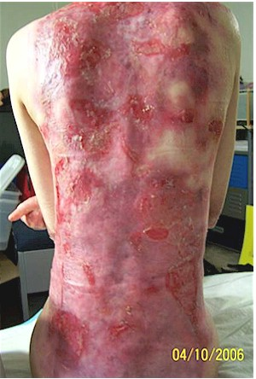
EB
https://medical-dictionary.thefreedictionary.com/epidermolysis+bullosa
http://www.beltina.org/health-dictionary/epidermolysis-bullosa-types-treatment-symptoms.html

Slide 132
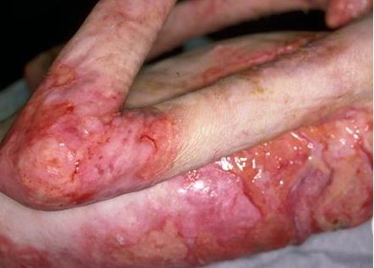
EB
https://healthsurgical.com/epidermolysis-bullosa.html

Slide 133
Osteoarthritis

Slide 134
Osteoarthritis
Most common joint disease in the U.S.
Degenerative process that affects articular cartilage
Minimal inflammatory reaction in the joints
Cause is likely due to joint trauma from biomechanical stress, joint injury, or abnormal joint loading resulting from neuropathy
Pain usually present with motion
Knees and hips common sites
Not an autoimmune disorderMay see bony enlargements at the joints of the fingers
May be degenerative changes to the vertebral bodies and intervertebral discs

Slide 135
Treatment
Physical therapy
Exercise
Simple analgesics (acetaminophen, NSAIDS)
No steroids
Application of heat
Joint replacement

