Slide 1
Anesthesia for Orthopedics and Spine

Slide 2
Describe anesthetic considerations during the preoperative period, the intraoperative period and the postoperative period for patients undergoing orthopedic and spinal surgery
Explain the different positions & tables used in orthopedic surgery and the potential nerve injuries encountered
Describe when a tourniquet should be used in orthopedic surgeries and its’ placement
Calculate the optimal pressure of a limb tourniquet and state how long it may be inflated before injury occurs.
Explain the physiological responses and systemic effects caused by the use of tourniquets
Describe tourniquet pain and the nerve fibers that are responsible
Describe a fat emboli, how it is diagnosed, signs and symptoms and treatment
Describe the anesthetic considerations for hip fractures, joint replacements, extremity procedures, amputations, joint manipulation & examination, re-implantation of limbs & digits, and operation of the spine
Describe scoliosis and kyphoscoliosis and the physiologic considerations
Identify the anesthetic considerations for scoliosis and kyphoscoliosis
Describe how the CRNA would do an intraoperative awake test and the potential complications
Describe the pulmonary concerns for scoliosis and kyphoscoliosis
Identify the cardiovascular changes seen in patients with scoliosis and kyphoscoliosis

Slide 3
Anesthetic considerations in orthopedic surgery-
Assessment and considerations
Preop Assessment
  What is the injury or condition
    Elective or Emergent/inpatient/ outpt
      Joint replacement, arthroscopy
      Fracture or trauma
      Infectious process
        I and D of previous incision, infection in the bone, tumor in bone
Preexisting conditions
  Rheumatoid, heart disease, chronic diseases – on Steroids? Airway issues?
    Optimize patient prior to surgery
    Cardiac assessment
      Safe? Balance risk vs benefit
      Recent Stent?
      Coagulation status***
Labs
  CBC, UA, CRP, K+, glucose, standard for majority ,also BUN, creat, pregnancy test if female in childbearing years
Potential for blood loss?
Positioning
…Anesthetic plan
Risk Prevention: SCIP Surgical Care Improvement Project-group that finds ways for improving surgical care by defining guidelines for areas to improve outcomes
  Surgical site infection Antibx cefazolin 1hour prior to incision, Vanco 2 hours before incision
  Postoperative thromboembolism-pneumatic stockings –meds- cpm , get pts up asap
  Intraop and postop glucose management
  Core Temperature
Notes:
Medical decisions to reverse coagulation differs among practitioners.. Risk vs benefit must be thought through… for example unless it is a life threatening emergency, time should be taken to optimize coagulation status for the benefit of the patient. Cardiac stents.. Recent Stroke… might be more risk to interrupt anticoagulation to perform an elective orthopedic procedure. Most orthopedic procedures are considered intermediate bleeding risk and advise to stop warfarin 4-5 days before surgery and restart 2 days after or bridge with LMWH- patients with high risk for thromboembolism and and recent stent should continue aspirin perioperativiely

Slide 4
Multiple decisions and actions to optimize care….
Nerve block
Iv Medications
Pain-
Fluid management
Blood loss
Hemodynamics-
Airway – Position, length of procedure, Body habitus, aspiration risk factors
General-ETT
General-LMA
MAC with Supplemental block
Comorbidities
Neuraxial block
Safety
Positioning
Be aware and monitor for potential complications
SCIP

Slide 5
Arthritic Syndromes-Rheumatoid Arthritis& Ankylosing Spondylitis
Thorough airway assessment
RA affects the cervical spine, temporomandibular joint , larynx, and pulmonary system
Rheumatoid nodules causes inflammation of the intervertebral discs and dura which is at the atlantoaxial joint causing subluxation
ROM is affected by the synovium of the temporomandibular joint
Concomitant pulmonary diseases such as pleural effusion, interstitial lung disease, obliterative bronchiolitis, upper lobe fibrosis, and vasculitis
Restrictive lung disease!
AS involves chronic inflammation with the spinal column as the primary target
AS patients may also have cardiac valvular dysfunction, conduction delays, bundle branch blocks, and restrictive lung diseases
Notes:
Before we talk about specifc care plans for othopedic surgery lets talk about conditions that very often comprise the population who often require orthopedic surgery

Slide 6
Arthritic Syndromes-Rheumatoid Arthritis& Ankylosing Spondylitis
Anesthetic management
  Prepare for possibility of difficult airway and have necessary equipment
  Assess range of motion preop and assess comfort of patient head and neck before induction. Maintain position intraop and postop until patient is awake.
  Determine need for stress dose steroids
  Pad bony prominences well
  Mainly results in restrictive lung disease which means decreased pulmonary and chest wall compliance!
  Decreased lung volumes

Slide 7
Kyphoscoliosis
Pulmonary considerations
  Vital capacity is a reliable prognostic indicator of perioperative respiratory reserve
  Post op ventilatory support usually needed for patients with VC <40% of predicted
  Lung volumes are reduced sometimes up to 65%
  Chest wall continues to lose compliance as they age
  Patients will have an acute decrease in respiratory function for 7-10 days after surgery
  Gas exchange abnormality: v/q misdistribution results in hypoxemia
  Prolonged hypoxia, hypercapnia, and pulmonary vascular constriction may result in irreversible pulmonary vascular changes and pulmonary hypertension

Slide 8
Kyphoscoliosis
Cardiovascular considerations
  Right ventricular hypertrophy and hypertensive pulmonary vascular changes
  Scoliosis also associated with congenital heart conditions including mitral valve prolapse, coarctation of the aorta, and cyanotic heart disease

Slide 9
Kyphoscoliosis
Congenital and neuromuscular diseases 10-25%
Idiopathic 75-90%
Severity is determined by the angle of scoliosis called the Cobb angle.
Surgical correction for Cobb angles >50⁰ with intent to halt cardiac and respiratory dysfunction ; does not reverse; improved only modestly
Prognosis worse in patients with scoliosis from neuromuscular disease (may need post op ventilatory support)
Notes:
Surgical correction is major surgery with harrington rods

Slide 10
Spinal Cord Disorders

Slide 11
Spinal Cord Disorders-Acute Spinal Cord Injury
Clinical manifestations depend on site of injury and extent of injury
Flacid paralysis and loss of sensation below level of injury
Spinal Shock-can last up to 1-3 weeks
  Reduced BP
    Loss of sympathetic nervous system activity and decrease in SVR
    Bradycardia more severe with cervical injury
    Cervical fx or dislocation requires immobility of the neck and neck flexion

Slide 12
Spinal Cord Disorders-Acute Spinal Cord Injury-Anesthetic Management
If cervical- Airway management precautions
  Avoid any movement
  Stabilize head during laryngoscopy
  Awake fiberoptic with topical anesthetic
  Videoscope
  RSI- or non RSI depending on situation
  Fluid to attenuate hypotension and vasodilation
  Succinylcholine ok for first few hours after

Slide 13
Spinal Cord Disorders-Chronic Spinal Cord injury
Impaired alveoalr ventilation
Chronic UTI and renal failure
Anemia
Altered thermoregulation
Depression
Chronic pain
C3-5 innervated diaphragm will have tracheostomy

Slide 14
Spinal Cord Disorders-Chronic Spinal Cord injury-anesthetic management
Prevention of autonomic hyperreflexia
Succinylcholine will likely provoke hyperkalemia (especially in first 6 months after injury) {first 24 hours after injury ok..Stoelting… Barash says first 48 hours ok..then avoid}

Slide 15
Spinal Cord Disorders-Autonomic Hyperreflexia
Appears following spinal shock and in association with return of spinal cord reflexes
  Can be be initiated by cutaneous or visceral stimulation below the level of the spinal cord injury
  Usually above T6 unlikely below T10
  Surgery and distention of bladder or rectum are common stimuli
  Stimulation produces afferent impulses that enter spinal cord causing stimulation and vasoconstriction
  This stimulation would normally be inhibited from higher centers but cannot travel due to cord damage
  Hypertension and bradycardia
  Vasodilation above lesion
  Pulmonary edema from increased afterload
  Cerebral hemorrhage from hypertension
  Loss of consciousness, seizures, and dysrhythmias common

Slide 16
Spinal Cord Disorders-Autonomic Hyperreflexia
Prevention is key
Spinal block better than Epidural because of the denser block of the nerves
Nitroprusside available

Slide 17
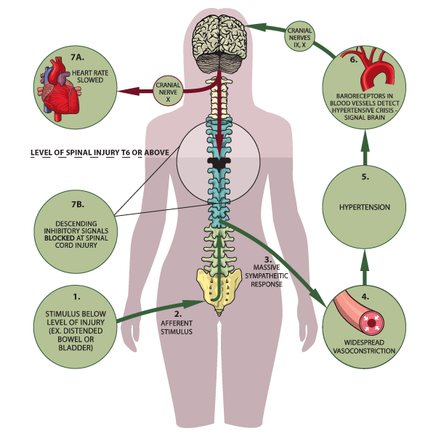
https://s-media-cache-ak0.pinimg.com/originals/b0/0a/d3/b00ad39a3ae2081a2ada665ef1e51241.png

Slide 18
Spinal Cord Disorders-Spinal Cord Tumors
Intramedullary tumors-gliomas and ependymomas
Extramedullary tumors
  Intra or extra dural
  Neurofibromas and meningiomas mostly intradural
  Other mass lesions metastatic disease (extradural), abscesses and hematomas
Spinal cord compression
Intraoperative monitoring

Slide 19
Spinal Cord Disorders-Cervical Disk Disease
Cervical decompression
Direct laryngoscopy ok if extension ok in exam or without symptoms
Videoscope
Maintain neutrality
Anterior or posterior approach
Retraction can cause injury to ipsilateral recurrent laryngeal nerve
  Monitor cuff pressure
  May need to let air out of cuff during retraction

Slide 20
Spinal Cord Disorders-Lumbar Disk Disease
Surgical laminectomy
Microdiskectomy
Decompression
Fusion

Slide 21
Spine
Most common diagnosis is disc herniation and spinal stenosis anywhere from C2-3 to L5-S1 vertebrae
Minimally invasive- Percutaneous endoscopic lumbar discectomy, vertebroplasty and kyphoplasty-
  Interventional radiology with local anesthesia and sedation
    Risks of oversedation in the prone position
  Complex spinal surgery- includes transforaminal lumbar interbody fusion (TLIF) multilevel fusions with instrumentation via anterior or posterior approach
    Anterior approach of the thoracic spine requires thoracotomy with lung isolation- Other anterior approach can be accomplished laparoscopic

Slide 22
Spine – anesthetic management
Anesthetic challenges
  Anesthetic Choices…- Neuro monitoring? TIVA? Muscle relaxant? Mayfield Tongs?
  Airway control, positioning, fluid and blood transfusion management, hemodynamic control and postoperative analgesia
    Airway control-
      mostly prone position- secure tube well.. Consider oral gastric tube, consider antisialoagogue( glycopyrrolate)
      Cervical spine- stable? Difficult airway? Rheumatoid arthritis? Check neck range of motion preop- have difficult airway supplies available
      Thoracic spine- lung isolation?

Slide 23
Spine – anesthetic management
Anesthetic challenges
  Positioning
    Prone positioning can INCREASE intraabdominal or intrathoracic pressure, this will DECREASE VENOUS RETURN REDUCE ARTERIAL FILLING AND REDUCE CARDIAC OUTPUT
    IVC obstruction leads to reduced cardiac output and increases blood loss
      This can be minimized with certain positioning devices allowing the belly to hang free
    Prone positioning increases systemic vascular resistance and pulmonary vascular resistance which lead to a DECREASE IN STROKE VOLUME AND CARDIAC INDEX
    RESPIRATORY EFFECTS OF PRONE Position
      Increased FRC and Increased ventilation/perfusion matching and therefore improved oxygenation
      Compression of the abdomen however, will cause decreased FRC and increased airway pressures.. If patient positioned correctly, this should can be avoided or minimized.
Notes:
Zone 2 wil be reduced and zone three will be increased
Increased intra-abdominal pressure forces blood from the IVC into the extradural venous plexus causing increased bleeding into the surgical field

Slide 24
Spine – anesthetic management
Anesthetic challenges
  Positioning
      CNS dynamics- can be altered with significant head injury
        Head rotation should be avoided when turning…60 degrees will compress the contralateral vertebral artery restricting blood flow; 80 degrees will completely occlude
        Head rotation can also occlude the carotid artery and jugular vein on the upper side of the neck during head rotation.
        Disconnect prior to turning. Reconnect after turn and auscultate lung sounds to prove proper ETT placement and that the tube has not migrated endobronchially
        Avoid pressure on eyes.. Keep head at or above level of heart to decreased risk for postoperative vision loss
          Direct pressure on periorbital region of the eye can cause increased intraocular pressure and blindness as the result of central retinal artery occlusion. The cause of ischemic optic neuropathy (ION) is unclear
            Risk factors include: males, anemia from blood loss greater than 1 liter, surgery over 5 hours, intraoperative hypotension
            Occurs typically within 24-48 hours after surgery
            Palpate and visualize eyes every 15 minutes and document

Slide 25
Spine – anesthetic management
Anesthetic challenges
  Blood and Fluid Management
    How many levels, positioning, Patient condition-( anemia, cardiovascular disease –may not allow as much blood loss before transfusion) cell saver? Long case? Fluid warmer
    Thoracic spine has larger blood loss
    Re-do’s usually have higher blood loss
    Surgeon technique has large impact on blood loss
    Always walk around to check blood in canister! Pay attention to irrigation and what is happening on the field
    Consider colloid replacement with large losses.. Know your allowable blood loss
    Inform surgeon with sudden dramatic unanticipated sustained hypotension may need fluid resuscitation if a large vessel was damaged, or could be a venous air embolism
  Pain Control
    Patients may be on narcotics for pain prior to surgery; may require more narcotic
    Use long acting narcotic for inpatient cases; titrate to effect; respiratory rate and vital signs

Slide 26
Spine – anesthetic management
Anesthetic challenges
    Spinal cord monitoring
      Evaluate spinal cord integrity
        Wake up test and neurophysiologic monitoring
          Wake up test
            After spinal instrumentation, patient is awakened from anesthesia
              Anesthesia is usually administered with a balanced technique with opiods, volatile, propofol to permit patient to tolerate ETT.
              Patient is asked to move both hands and then both feet.
              If patient does not respond with feet, the rod is repositioned and the wake-up test is repeated
              Patient is educated prior to surgery to ease anxiety
              Hazards of wake-up test include recall, pain, air embolism, dislocation of spinal instrumentation, and accidental tracheal extubation or removal of IV lines
          Neurophysiologic monitoring
            Used alone or in adjunct to wake-up test
              Somatosensory stimulation follows the dorsal column pathway of proprioception and vibration: pathways supplied by the posterior spinal artery(low dose volatile or avoid)
              Motor evoked potentials monitor motor pathways supplied by the anterior spinal artery (avoid Muscle relaxants)
              Combined use of SSEP and MEP may detect early spinal cord ischemia

Slide 27
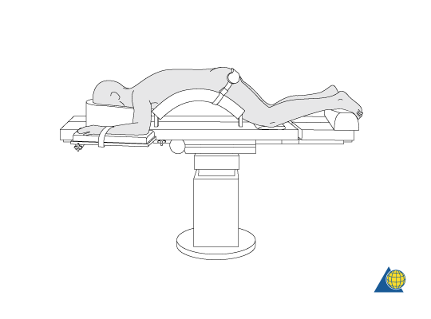
The abdomen should hang free to avoid high intraabdominal pressure and subsequent venous pressure causing excessive bleeding of the spine.
The arms/shoulders should be resting comfortably in a 90-90° position of the shoulder and elbow.
Adequate padding needs to be provided to elbows and knees to avoid pressure sores
The toes should hang free
The head is best placed in a face mask to avoid pressure on the eyes and have the endotracheal tube free with the neck in neutral position.
Avoid having the head lower than the rest of the body to reduce the risk of postoperative blindness (due to high hydrostatic pressure in the eyes leading to reduced blood perfusion).
Positioning should attempt to maintain/increase thoracic kyphosis and optimize lumbar lordosis.
It must be possible to obtain radiographic images in both AP and lateral planes at all times.
Wilson Frame on a regular table
Notes:
Check for brachial plexus(may be stretched)
Check for ulnar nerve pressure
Check eyes/nose
Check neck neutrality

Slide 28
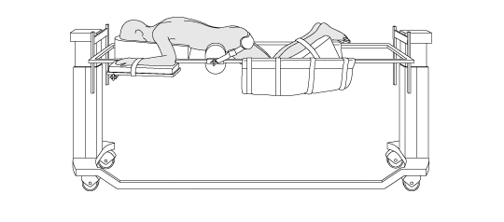
Jackson Table

Slide 29
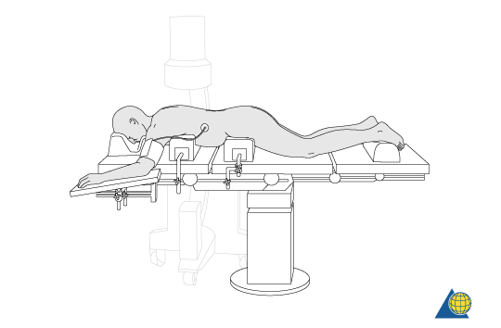
Orthopedic tables and positioning-continued
Bolsters on a regular table

Slide 30
Tourniquet
Diminishes blood loss
Can allow for easier visualization for the surgeon
  Consists of a pneumatic inflatable cuff, connective tubing a pressure device and a timer
  Surgeon or tech uses an eschmarch to exsanguinate blood out of limb at which point the cuff is inflated to 70-90mmhg above systolic for upper limbs and twice systolic for lower extremities
  Cuff should be carefully applied to the proximal part of the limb at the greatest circumference because the muscle bulk at that site is the greatest, and if gives a greater protection against nerve injury
  If tourniquet needs to be inflated over 2 hours, then it should be deflated for 5 min (10-30 min in some sources) every 30 min with documentation

Slide 31
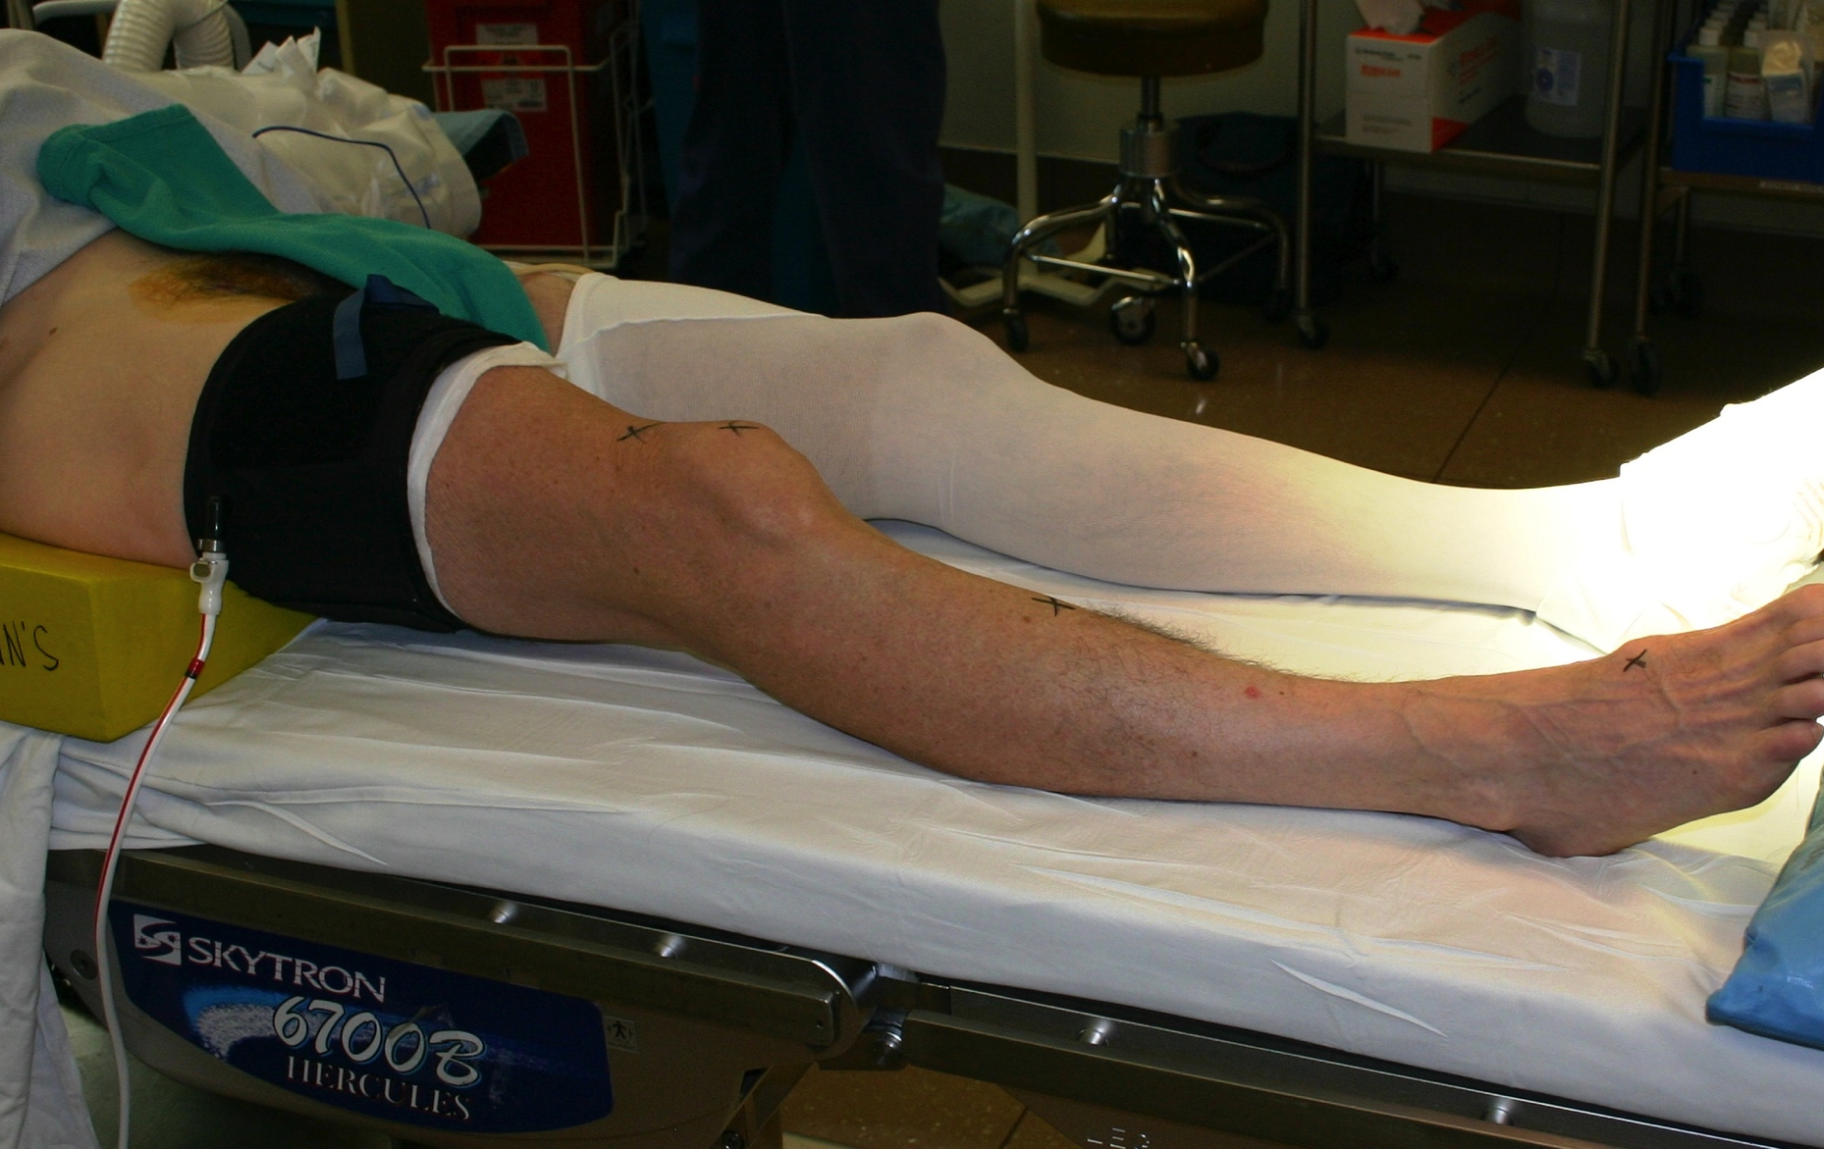
Tourniquet-continued
http://totalknee.org/wp-content/uploads/2013/01/IMG_0225.jpg

Slide 32
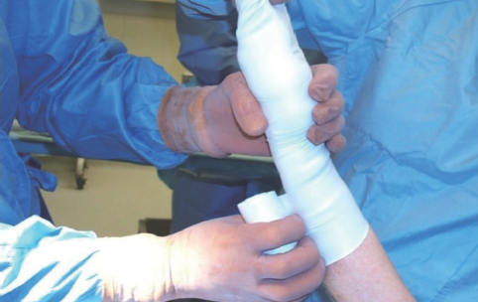
Tourniquet-continued
http://www.annalscts.com/article/viewFile/2418/3284/9383

Slide 33
Tourniquet-continued
Safety Measures for Preventing tourniquet complication
  Apply where nerves are best protected
  Test equipment prior to use
  Do not use longer than 2 hours
  Two layers of padding under cuff (elastic stockinet)
  Use widest cuff possible(wider cuff-can use lower pressure)
  Tourniquet size should overlap 3-6 inches in circumference
Should be able to place two fingers between cast padding and cuff
Extremity should be exsanguinated when possible with an escmarch
Pressure should be 70-90 above systolic for upper and twice systolic for lower
Use 300 mmhg pressure on Bier Blocks

Slide 34
Tourniquet-continued
Physiologic changes caused by tourniquets
  Neurologic
    Abolition of somatosensory evoked potential and nerve conduction occurs within 30 min
    Application for more than 60 minutes causes tourniquet pain and hypertension
    Evidence of nerve injury may occur at the skin level underlying the edge of the tourniquet
    Application longer than 2 hours may result in postoperative neuropraxia
  Muscle Changes
    Cellular hypoxia develops within 2 minutes
    Cellular creatinine value declines
    Progressive cellular acidosis occurs
    Endothelial capillary leak develops after 2 hours
  Systemic Effects-inflation
    Elevation in arterial and pulmonary artery pressures develops worse without vapor on board
  Systemic Effects-Release
    Transient fall in core temp
    Transient metabolic acidosis
    Transient fall in central venous oxygen tension occurs, but systemic hypoxemia is unusual
    Acid metabolites (thromboxane) are released into the central circulation
    Transient fall in pulmonary and systemic arterial pressures occur
    Transient increase in ETCO2

Slide 35
Tourniquet-Pain
  Pain despite seemingly adequate anesthesia with regional techniques
During General will appear “lighter” with an increase in HR and BP requiring intervention from the pain
Occurs about 45-60 minutes after inflation of the tourniquet
Ischemic pain is similar to thrombotic vascular occlusion and peripheral vascular disease
Symptoms are a dull aching that progress to burning and excruciating pain that requires general anesthesia
Once pain begins it is resistant to narcotics or analgesics
Neural and metabolic factors responsible for tourniquet pain are still unknown
    Researchers have identified the nerve fibers responsible for the aching and burning pain are the activation of slow conducting unmyelinated C fibers
    Pinprick tingling and buzzing sensation are from the activation of the larger faster myelinated A-delta fibers
    Cfibers are more difficult to block with local anesthetics
  Additions to local anesthesia solutions including opioids, ketorolac and melatonin have shown some efficacy
  Sedation with dexmedetomidine is also effective
  Release of tourniquet immediately reduces pain
  **Be careful with oversedation with narcotics for tourniquet pain. Will result in respiratory depression when released

Slide 36
Upper extremity
Hands, Wrist: Ganglion cyst, Carpal tunnel release, fractures
  Bier Block (IV Regional), Digital Block, axillary brachial plexus block
    + sedation+/- benzo +/-narcotic +/- propofol infusion
Fractures and dislocations of the distal radius, carpus and metacarpals
  brachial plexus block via axillary approach + General if bone graft from iliac crest
Radius, Ulna, Humerus:
  Supraclavicular block: for distal forearm
  Axillary block
  Interscalene block: for upper arm and shoulder
    + sedation+/- benzo +/-narcotic +/- propofol infusion
Usually use upper arm tourniquet for forearm, wrist and hand surgeries

Slide 37
Upper extremity
Shoulder: Acromial impingement, Rotator cuff tears, acromioclavicular disease; bursitis; bicipital tendinitis; dislocations
  Mostly arthroscopic and outpatient
    Arthroscopic risks of shoulder surgery include tension pneumothorax associated from use of mechanical irrigation pumps and power saver suction-
    Interscalene block +/- General anesthesia with ETT or LMA depending on provider comfort and patient risk factors
    Positioned Beach Chair/ Semi sitting or Lateral Decubitus
total shoulder arthroplasty
  One or two day hospital stay becoming shorter stays
    Interscalene continuous catheter infusion vs one shot block +/- general anesthesia vs sedation depending on provider comfort, expertise, patient risk factors
    Beach Chair or Lateral Decub

Slide 38
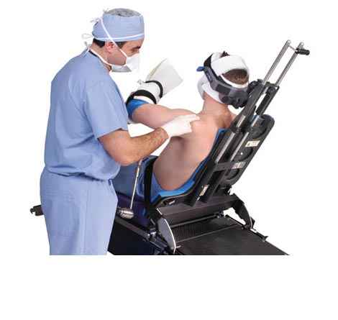
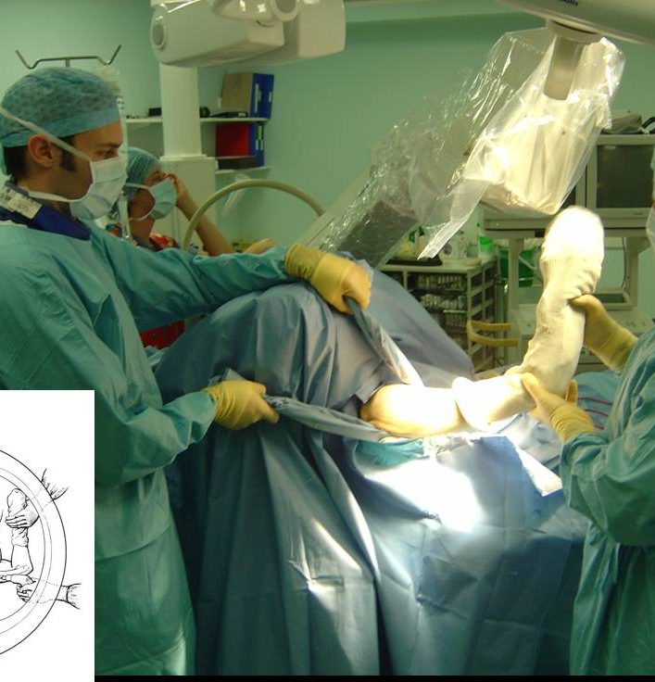
Orthopedic tables and positioning-Beach chair
http://www.melydmedical.com/wp-content/uploads/2013/05/allen-pchair-b.jpg
https://encrypted-tbn2.gstatic.com/images?q=tbn:ANd9GcT0IwPhqg4MEJVicl1--lQj2hyOvz_nUDit_1cAk0UN_Pvj3HDsGQ

Slide 39
Shoulder positioning
Increased risk of venous air embolism
Risk of cervical injury if patient’s head comes dislodged from headrest
Careful attention to pressure on eyes and ears; ETT displacement or extubation from manipulation
Brachial plexus injury from excessive stretch of shoulder from fixed head/neck
Risk for complications from MMA cement if cementing humoral component in place
Reaming of the shaft bone increases risk of fat or bone marrow embolism
Sitting position may result in detrimental cerebral damage to patients experiencing hypotension
Visual loss risk may be higher if using deliberate hypotensive techniques
  Cerebral perfusion and blood supply to the cranial nerves and the optic nerve, is diminished
  Intraoperative cerebral ischemia has been reported
  Significant hydrostatic gradient between the brain the site of blood pressure measurement
    2 mmhg per inch of height differential

Slide 40
Shoulder positioning
Hypotensive bradycardiac episodes (HBE) are common
  Defined as decreased heart rate of 30 beats within 5 min, heart rate less than 50 beats per/min and/or a decrease in SBP of more than 30 mmhg within 5 min or SBP<90
    Most common mechanism to cause of HBE is the Bezold- Jarisch reflex
      Inhibitory reflex mediated through cardiac sensory receptors with a vagal efferent limb
    Enhanced venous pooling leads to an increase in sympathetic tone and a low volume hyper contractile ventricle
    Cardiac hyper contractions lead to activation of the Bezold-Jarisch reflex with an abrupt autonomic withdrawal of sympathetic response and activation of vagal tone
      Can lead to profound hypotension difficult to rapidly reverse

Slide 41
Lower extremity-Pelvis and Hip Procedures
Pelvis or Acetabulum fracture: Open Reduction Internal Fixation (ORIF)
  GETA consider epidural for postop pain control
  May need to approach anteriorly via exploratory laparotomy by general surgeon
  Approach may be anteriorly, lateral, or posterior, or combination
  Fracture table or Jackson table
  Cell saver for anticipated blood loss
  Type and Cross
  2 large IV’s/Arterial Line/CVP/ +/- PAC depending on patient
  May have other injuries if trauma
  CBC/BUN;Creat/ to rule out renal injury
  Postop: +/- ICU depending on stability blood loss etc

Slide 42
Lower Extremity-Hip Procedures
Total Hip Arthroplasty; Arthrodesis; synovectomy
  Regional+/- intrathecal narcotic or GETA
    Lateral Decubitus or Supine
    Blood loss: 500-1000 more with revisions
      Surgeon dependent ; longer OR time = more blood loss
      Regional =less blood loss
      deliberate hypotension = less blood loss ( weigh risk vs benefit)
    Embolization of air, fat, bone fragments, and cement may occur during insertion of the femoral prosthesis, Systemic hypotension and pulmonary HTN may occur. ****
Hip arthroscopy: impingement; loose body; infection; cysts
  Outpatient
  General LMA or GETA

Slide 43
Lower extremity-
ORIF femur, tibia, ankle and foot; intramedullary nailing of femur and tibia; closed reduction and external fixation of femur and tibia; distal tibial and ankle procedures; repair nonunion malunion of femur and tibia; ankle arthroscopy
Proximal Femur fracture: nondisplaced/displaced or intertrochanteric
  Blood loss minimal <100ml if nondisplaced otherwise expect 500ml+
Distal Femur: Will come to OR in balanced traction if acute
  EBL 750+
  Cell Saver
Intramedullary Nailing of Femoral Shaft
Usually short in duration so blood loss is minimal
Subarachnoid or epidural block or General Anesthesia
Closed procedures less painful than open
Can be outpatient or inpatient depending on many factors
Tourniquet for knee and below to minimize blood loss

Slide 44
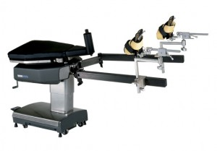
Fracture table
http://medsourcerental.com/wpmed/wp-content/uploads/2012/11/Orthovision_Fracture_Table-300x209.jpg
Notes:
Many fracture OR tables are not conducive to induction. May need to induce on cart or hospital bed, secure endotracheal tube or place spinal block with sedation, then transfer to OR table
Fractures where a spinal will be placed: may need to sedate patient to be able to get them to sit up for spinal. Ketamine+ versed is a great choice in this scenerio
Or may place spinal in lateral position

Slide 45
Knee arthoscopy and ACL repair
General vs Regional
Outpatient
  Pt preference
  Peripheral block + general for ACL (more painful)
    Femoral block or continuous catheter
  Intra-articular injection local anesthetic +opioids, steroids

Slide 46
Lower Extremity-Knee
Arthroplasty, arthrodesis, ORIF of patellar fractures, repair/reconstruction of ligaments, patellar realignment, arthroscopy, arthrotomy, tendon repair -knee, leg
TKA: Supine; tourniquet or no tourniquet
  Inpatient for 1-2 days, thromboprophylaxis
  SAB +/- narcotic +/- femoral nerve block, adductor canal block for adjunct preferred over GETA because of pain control; General with adductor canal or femoral another option –Isobaric preferred to hyperbaric because hyperbaric produces more profoud block than needed
Arthroscopy- ACL most painful of outpatient arthroscopy, consider adjunct block (adductor canal, femoral) for postop pain. Pain is minimal on other arthroscopic procedures. Use multi-modal pain medications and anti-emetics to facilitate recovery.
  Outpatient
  GETA or LMA

Slide 47
Cement
Methyl Methacrylate cement (MMA)
  Is used to cement prosthesis
    Is placed inside the bone canal
    Not used on all joint replacements
      If not used- term is “press-fit”
    Physiologic changes seen with MMA are termed bone cement implantation syndrome (BCIS)
      Syndrome is characterized by hypoxia, hypotension, cardiac arrhythmias, increased pulmonary vascular resistance, unexpected loss of consciousness (when under regional) and cardiac arrest
      Theories of etiology include histamine release, complement activation, endogenous cannabinoid-mediated vasodilation, emboli formed during cementation and during prosthesis insertion
        Occurs most often with hips but can occur with any cementing process
        Usually occurs during femoral reaming, acetabular or femoral cementing or occasionally after tourniquet deflation (air can also be entrained during this time (avoid N20)
        If BCIS is suspected give 100% O2 and treat aggressively with volume and alpha agonists
        Cardiovasular collapse in presence of BCIS should be treated as right sided heart failure
        Fall in ETCO2 may be first sign of significant BCIS during general anesthesia; regional may include dyspnea and altered sensorium

Slide 48
Cement
Risk factors for developing BCIS:
Preexisting cardiovascular disease
Preexisting pulmonary hypertension
ASA 3 or higher
Surgical technique
New York classification 3 or 4
Canadian Heart Association classification 3 or 4
Pathologic fracture
Intertrochanteric fracture; Long-stem arthroplasty

Slide 49
Fat Embolism
Fat Embolus Syndrome
  Associated with multiple traumatic injuries and surgery involving long-bone fractures.
    Risk Factors include: Male gender (20-30 yr) hypovolemic shock, intramedullary instrumentation, rheumatoid arthritis, total hip arthroplasty using the technique of cementing femoral stems and bilateral total knee surgery
    Major Signs include: presence of axillary or subconjunctival petechiae, significant hypoxemia, central nervous system depression in excess of that expected
    Minor signs include: tachycardia, hyperthermia, retinal fat emboli on fundoscopic examination, urinary fat globules and an unexplained decrease in hematocrit or platelets increased erythrocyte sedimentation rate and fat globules in sputum
  Symptoms usually occur 12 to 40 hours after the injury and can range from mild dyspnea to frank coma
  Decreased arterial oxygen tension is the most consistent abnormal laboratory value
  Treatment requires early recognition of the syndrome, reversal of possible aggravating factors such as hypovolemia, early surgical stabilization of fracture sites and aggressive respiratory support
  Corticosteroid therapy is controversial but may be beneficial

Slide 50
Arthroscopy
Usually outpatient, using peripheral nerve blocks + TIVA with LMA if not contraindicated or general with ETT
Knee arthroscopy- meniscus, anterior cruciate ligament (ACL), loose body removal
Hip Arthroscopy
Shoulder Arthroscopy-Beach Chair, interscalene Block or catheter, ETT or LMA, some MAC with block
Use pain adjuncts like toradol, IV tylenol, local anesthetics and nerve blocks and anti-emetics to facilitate discharge home.
Risks are subcutaneous emphysema, pneumomediastinum, tension pneumothorax with shoulder scope. Absorption of irrigation fluid from long case include fluid overload, pulmonary edema and hyponatremia if using irrigation of sterile water.

Slide 51
Venous Thromboembolism
Major cause of death after surgery or trauma to the lower extremities
Without prophylaxis, venous thrombosis develops in 40%- 80% of orthopedic patients
1%-28% show clinical evidence of pulmonary embolism
Fatal PE occurs 0.8%-8% of patients
  Highest incidence are in those with hip fracture
Practitioners must balance risk of thromboembolism with risk of bleeding
Risks are cumulative as many factors may be present such as advanced age, prolonged immobility, prior history of thromboembolism
Current recommendations for Major joint replacement include LMWH, warfarin, fondaparinux(Arixtra-chemically related to LMWH), or rivaroxaban(Xarelto (has no affect on platelets- highly selective Xa inhibitor)

Slide 52
Neuraxial Anesthesia in patients receiving antithrombotic therapy
Balance risk of thromboembolic and hemorrhagic complications
Current recommendations are to apply neuraxial guidelines to deep plexus and deep peripheral blocks
INR ≤ 1.4
Asa, NSAIDs, COX-2-no contraindications
SQ heparin -<5000units-no contraindication
IV heparin- wait 2 hours after DC to administer block-wait 1 hour after block to restart
LMWH(without additional antiplatelet meds) –wait 12 hours after last dose to perform block if 0.5mg/kg BID(prophylactic dose)
  Wait 24 hours for all other LMWH doses
  LMWH postop-wait 24 hours to give
  Epidural removal- wait 2 hours after removal to give LMWH dose
GPIIb/IIIa- Abcixiamb (Reopro) wait 48 hours, Eptifibatide(integrelin) and Triofiban (aggrastat) 8 hours
Do not perform neuraxial block in patients on more than one antiplatelet drug.

Slide 53
Recommendations for management of patients receiving neuraxial blockade and anticoagulant drugs
Warfarin
  D/C 4-5 days before spinal procedure and evaluate INR
  daily INR evaluation
  INR <1.5 may remove catheter
Antiplatelet Medication
  No contraindications with aspirin or other NSAIDs
  Clopidogrel and prasugrel should be d/c 5-7 days and Ticlid 14 days prior to procedure
  GPIIbIIIa inhibitors d/c to allow recovery of platelets (8 hours for Tirofiban and Eptifibatide, 24-48 hours for abciximab)

Slide 54
Microvascular Surgery Replantation & Revascularization
Re attach and re-establish blood flow through a severed body part
Usually an upper extremity
Long cases; patient needs to lie still
Goal is to improve blood flow to anastomosis
  Increase the perfusion pressure
  Prevent hypothermia; hypothermia causes peripheral vasoconstriction, sympathetic activation of shivering, increasing oxygen demand and consumption and altered coagulation
  Use of vasodilators and sympathetic blockade
  Use of local anesthetic and papaverine topically may relax smooth muscle
  Avoiding over zealous fluid causing edema
  Too much blood product administration can cause increased blood viscosity and decreases flow
  Phenylephrine to support BP does not compromise blood flow to tissue being implanted and is not contraindicated (according to literature)
  Regional or General but may be difficult for patient to remain still for long period of time.. Combined General and Regional optimal

Slide 55
EXPAREL
EXPAREL (bupivacaine liposome injectable suspension) is a liposome injection of bupivacaine, an amide-type local anesthetic, indicated (bupivacaine liposome injectable suspension) for administration into the surgical site to produce postsurgical analgesia.
Indicated for single-dose administration into the surgical site to produce postsurgical analgesia
DepoFoam® drug delivery system slowly delivers bupivacaine over time to extend the pharmacologic effect of EXPAREL

Slide 56
Exparel
EXPAREL administration precautions
Do not admix EXPAREL with other drugs prior to administration
When administering lidocaine or other non-bupivacaine based local anesthetics into the surgical site, wait at least 20 minutes before administering EXPAREL
Allow topical antiseptics or preps to dry before administering EXPAREL into the same surgical site
When administering bupivacaine HCl before EXPAREL, use no more than 50% of the total EXPAREL dose (266 mg) (e.g., 50 mL of 0.25% and 25 mL of 0.5% bupivacaine HCl both equate to a total dose of 125 mg)The toxic effects of these drugs are additive and their administration should be used with caution including monitoring for neurologic and cardiovascular effects related to toxicity.

Slide 57
contraindications
EXPAREL is contraindicated in obstetrical paracervical block anesthesia
EXPAREL has not been studied for use in patients younger than 18 years of age
Non-bupivacaine-based local anesthetics, including lidocaine, may cause an immediate release of bupivacaine from EXPAREL if administered together locally. The administration of EXPAREL may follow the administration of lidocaine after a delay of 20 minutes or more. Formulations of bupivacaine other than EXPAREL should not be administered within 96 hours following administration of EXPAREL
Monitoring of cardiovascular and neurological status as well as vital signs should be performed during and after injection of EXPAREL as with other local anesthetic products
Because amide-type local anesthetics, such as bupivacaine, are metabolized by the liver, EXPAREL should be used cautiously in patients with hepatic disease. Patients with severe hepatic disease, because of their inability to metabolize local anesthetics normally, are at a greater risk of developing toxic plasma concentrations
In clinical trials, the most common adverse reactions (incidence =10%) following EXPAREL administration were nausea, constipation, and vomiting
http://www.exparel.com

