Slide 1
Carotid Disease
Melinda Stone CRNA, MS
All material placed on Blackboard, the Program Website (www.smumn.edu/nap), distributed electronically or distributed in printed form is intended only for the use of the individual student enrolled in the course. Distribution and/or sharing this material with any other student, individual or organization are strictly prohibited without the written consent of the course instructor, Program Director and the Academic Dean of the Twin Cities campus.

Slide 2
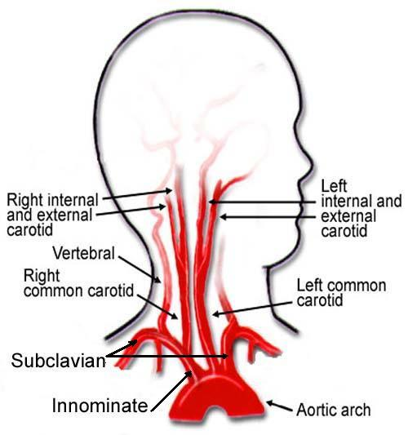

Slide 3
Risk Factors for Carotid Disease
Recognize that patients are likely to be systemic vasculopaths
Same risk factors for other vascular diseases:
Increased age
HTN
Smoking
Hyperlipidemia
Diabetes

Slide 4
Preoperative Care
Adequate cardiovascular assessment (EKG, Echo, labs…)
Usually continue antithrombotics
Control of hypertension (meds)
Neurologic assessment (note baseline)
Hx of TIAs/CVAs
Anxiolysis

Slide 5
Causes of Occlusion
Decrease in blood flow to brain related to stenosis or total occlusion
Distal embolization related to plaque that has broken off

Slide 6
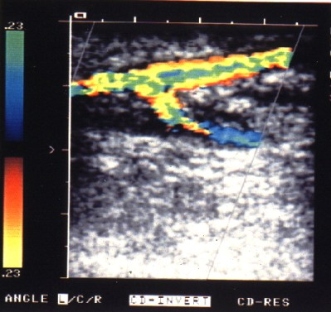
Carotid Assessment
Duplex ultrasound
Doppler recordings allow assessment of flow at stenosis
Allows imaging of arterial anatomy

Slide 7
Symptoms
TIA
Stroke
Asymptomatic bruit
Amaurosis fugax

Slide 8
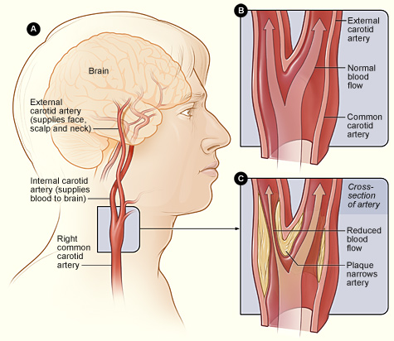

Slide 9
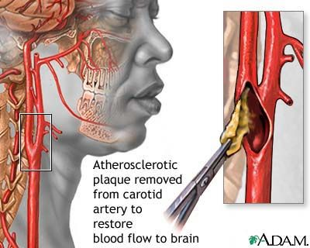

Slide 10
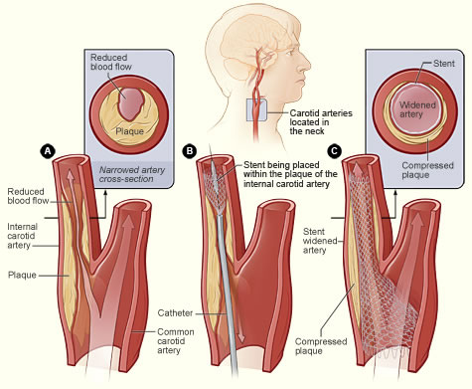

Slide 11
Monitoring
Standard monitors/2 IV’s
Additional
Arterial line
MUST control BP
EEG
Chg’s are associated with ischemia
Some studies show EEG doesn’t detect neuro problems
Somatosensory evoked potentials (SSEP)

Slide 12
Monitoring
Cerebral blood flow (MAP-ICP=CPP)
Internal carotid stump pressure
Minimum of 50 mmHg, or a shunt needs to be placed
Jugular venous oxygen saturation
Glucose levels
ETCO₂ within normal limits
Temperature
Cerebral protection vs. postop shivering

Slide 13
Anesthetic Technique
REGIONAL + MAC (sedation)
Block of C2-C4 with subcutaneous infiltration of local anesthetic or by cervical plexus block
More stable blood pressure
Less need for vasoactive medications
Decreased incidence of stroke
Decreased incidence of MI
Ability to continuously monitor neurologic status ( only reliable neuro exam)

Slide 14
Anesthetic Technique
GENERAL ANESTHESIA (TIVA vs. Volatile Agent)
Decreases CMRO₂ to protect the brain from ischemia
Narcotics
Blunt response to laryngoscopy and incision
Etomidate
Ideal induction agent for cardiovascular patients
Propofol
Allows for early neuro assessment

Slide 15
Anesthetic Technique (GETA)
Barbiturates are cerebroprotective
Lidocaine IV or Tracheal / LITA tube
Beta blocker to control HR and BP
Esmolol
Metoprolol
Control BP
NTG
Nipride
Nicardipine
Phenylephrine

Slide 16
Clamping the Carotid
Administer heparin prior to clamping
Traction on the vessel may cause stimulation of the baroreceptor reflex (carotid sinus reflex)
Hypotension AND Severe bradycardia
Local anesthetic injected into the carotid sinus should alleviate these problems
Generally want BP slightly elevated to maintain cerebral perfusion

Slide 17
Clamping the Carotid
Shunts
Decrease ischemic problems with the cross clamp
Can increase the risk of an embolic event
EEG can aid in determining whether or not brain is being adequately perfused
Not identify intraoperative embolic events
Must have patent Circle of Willis to adequately perfuse brain
SSEP’s another aid to see if brain is being perfused.

Slide 18
Brain Protective Practice
Mild hypertension will increase cerebral perfusion pressure
Mild hypercarbia will dilate cerebral vessels.
May only increase flow to “normal” areas (steal phenomenon)
General anesthesia will decrease CMRO₂
Decrease the potential for ischemia

Slide 19
Medications for Brain Protection
Decrease CMRO₂
Pentothal
Propofol
Hypothermia
Free radical scavenger

Slide 20
Blood Pressure Control
Vasopressor (phenylephrine drip)
Keep blood pressure slightly greater than baseline (20% above patient’s normal) during clamp time.
Avoid hypotension

Slide 21
Emergence/Postoperative care
Control hypertension once clamp is off
Neurologic assessment ASAP after emergence
Document MAE
Observe for hematoma / postoperative bleeding

Slide 22
Emergence/Postoperative care
Recurrent laryngeal nerve damage
Hoarseness
Tongue deviation
Drooping of the lip
Hypertension caused by:
Rule these out prior to medication for BP control
Hypoxia
ETT
Pain
Bladder distension

Slide 23
Postoperative Bleeding
Hematoma formation is an indication that the patient needs to return to the OR
Hematoma may form visibly at incision or spread internally
May be difficult intubation

