Slide 1
Anesthesia for Aortic Procedures
Melinda Stone, APRN, CRNA, MSN
Priniciples II, March 25th 2020

Slide 2
Vascular Disease
Atherosclerosis is the most common cause of occlusive disease.
This disease forms plaques that may obstruct the vessel lumen and thereby cause decreased blood flow distal to the obstruction.
The pathologic process that affect arteries: plaque formation which obstructs the lumen (stenosis), thrombosis (which can cause ischemia), embolism, and weakening of arterial wall which then form the aneurysm.
Cigarette smoking and diabetes are the major risk factors.
The mortality rate associated with patients with vascular disease are 2-6x higher then in the general population.
Relationship between inflammation and the development of atherosclerosis.
Treatment can include medical management or surgical.
Notes:
Surgical can include bypass’s, endarterectomy, thrombectomies, endovacular stenting,
Byass: fem-fem, fem-pop, axillo-femoral,aorto-femoral.

Slide 3
Vascular disease
Atherosclerotic process should be expected to be found everywhere, not just in peripheral. Estimated that 42% of patients presenting for AAA repair have significant CAD.
Anesthesia for a vascular patient should focus on detection of myocardial ischemia. (ECG, TEE, Arterial line, ?pulmonary artery pressure).
Assuming the global nature of the atherosclerotic disease, cerebral and coronary autoregulation occurs at higher then normal pressures.

Slide 4
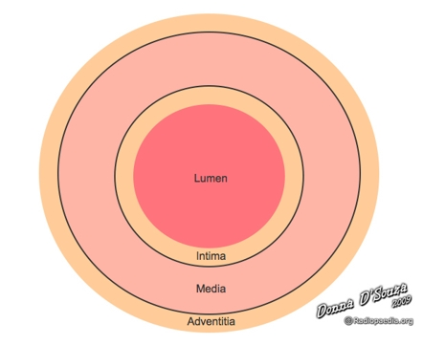
Aneurysms
An aneurysm is a dilation of all three layers of an artery
Intima
Media
Adventitia
Dissection is a tear between 2 layers
Pseudo aneurysm is a rupture of only the intima and media, the adventitia forms a blood clot

Slide 5
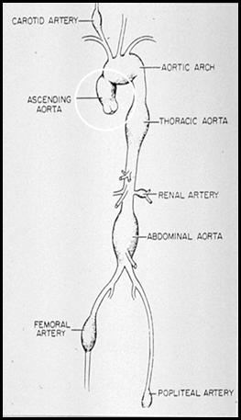
Aortic Aneurysm
Aneurysms may occur anywhere along the length of the aorta
ascending aorta
aortic arch
descending aorta
abdominal aorta

Slide 6
Abdominal Aortic Aneurysm (AAA)
Incidence of AAA is estimated to range between 3-10% for patients older then 50. Improved detection of AAA is a result of increased screening of asymptomatic aneurysms by MRI, CT and ultrasound.
Occurrence of AAA has also increased due to the aging population and vascular changes that occur with increased age.
Risk factors for AAA: smoking, male, older, family history, CAD, high cholesterol, COPD, htn, PVD, Caucasian, increased height.
Smoking is the highest independent risk factor. There is a 5 fold incidence increase in AAA when a person smokes.
Elective AAA is the most frequent vascular surgical procedure.

Slide 7
AAA
Data suggests that risk of rupture is low for AAA <4cm in diameter, but risk dramatically increases for AAA’s with a >5cm or greater diameter.
Mortality estimates of a ruptured AAA is 35-94%.
Surgical intervention is indicated when >0.5cm increase in less then 6 months or patients who are symptomatic and 5.0 cm or greater.
Signs and symptoms: commonly asymptomatic, dull back pain or abdominal pain, possible syncope. Progression of symptoms include a tearing or ripping sensation, flank or retroperitoneal bleeding
Diagnostic tests: MRI/CT/ultrasound

Slide 8
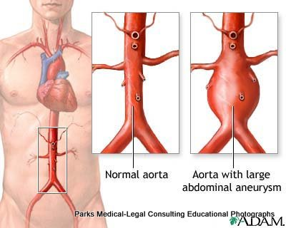
AAA
Surgical repair includes 3 approaches
Midline vertical incision (open): good for visualization, high loss of fluids, pain
Retroperitoneal approach (open): alternative to midline, good visualization, decrease in fluid loss and pain.
Endovascular: transfer femoral approach

Slide 9
AAA
Pre op for non-emergent: Careful evaluation of co-existing disease is warranted
Cardiac disease – 50% of patients have CAD
HTN: autoregulation curve higher
Diabetes: optimize blood sugars
Renal dysfunction: optimize renal status
Pulmonary risk factors (esp. for COPD)
Assessment of peripheral perfusion
Candidate for Epidural placement
Labs (CBC, coags, BMP, type and screen), diagnostic (us,ct,mri)
Notes:
Preexisting renal insufficiency?
Methods for renal protection
*HYDRATION*
Dopamine
Fenoldopam
Mannitol
Furosemide

Slide 10
AAA
Monitors: standard and extended. Arterial line, 2 large bore IV’s, TEE.
May have an echo report or cath lab report to assess cardiac function.
Foley
Vasoactive drips: dopamine?, phenylephrine, ntg?
Blood tubing primed with NS and on warmer.
SSEP or MEP
Air warming device

Slide 11
AAA
Anesthesia concerns
Fluid and blood loss: surgical approach, length of surgery, and experience of surgeon. Be prepared for large amounts of fluid and blood loss with open procedures. Be prepared, but not expecting of large fluid loss with endovascular. 3:1 crystalloid to blood replacement, replace fluids at 10ml/kg/hr.
HD: swings in HD’s common. Control blood pressure to be within 20% of baseline. Control heart rate and avoid tachycardia.
Renal preservation: mortality rate is 4-5 times higher in patients that develop acute kidney injury. Maintain hydration, avoid hypotension, use mannitol/lasix/?dopamine.

Slide 12
AAA
Anesthesia types: general or regional
General for open procedures. Use balanced technique – watch use of high inhalation agent (myocardial depression). Use narcotics. Keep patient paralyzed.
Regional: epidural with mac. Good for myocardial protection, excellent muscle relaxation, good post op pain control.
Can combine

Slide 13
AAA
Induction
Induce as you would a cardiac patient
Drugs chosen are not as important as the manner in which they are given, so slowly and gently
Minimize blood pressure and heart rate changes
Minimize stimulation during intubation
Use etomidate if needed
Slow – smooth induction and intubation

Slide 14
AAA
Positioning
Supine for trans-abdominal procedures
Careful positioning of the extremities
Monitor for longer procedures
Retroperitoneal approach
Torso tilted 30-45 degrees
Often on bean bag
Left arm suspended on an over-body sling

Slide 15
AAA
Anesthesia Concerns intraoperative
Renal protection: keep urine output at 0.5 – 1ml/kg/hr *. Best assessment of fluid status is via TEE. Keep patient hydrated.
Fluid loss: high amounts of loss with open procedures and keep in mind the third spacing as well. Replace as needed. Monitor blood loss.
Maintain adequate neuromuscular blockade, monitor TOF.
Prudent treatment of blood pressure changes.
Maintain body temp.

Slide 16
AAA
Aortic cross clamping: one of the most challenging situations for anesthesia
Heparin given (5-10000 units, surgeon will confirm dose). Check ACT in 3 min.
HD changes with cross clamp: if patient has adequate cardiac reserve you may see minimal changes.
The clamp causes: acute left ventricular strain. HYPERTENSION above the clamp, HYPOTENSION below the clamp. There is an increase in afterload which increases myocardial wall tension. Increase in SVR and increase in MAP. Cardiac output will either decrease or stay the same. Because the clamp decreases the ventricular function, myocardial ischemia can occur. Below the clamp there is decreased perfusion and can cause hypoxia to kidneys, spinal cord and abdominal viscera.
Higher the clamp has to go=more severe the consequences

Slide 17
AAA
Aortic Cross Clamp
Metabolic Alterations: tissues distal to the clamp when accumulate lactate and anaerobic metabolites.
Mesenteric traction syndrome: decreased bp, decreased SVR, tachycardia and increase in CO.
Renal insufficiency and failure: common with suprarenal and juxta renal. 40% decrease in blood flow.
Spinal cord ischemia: interruption of blood flow to great radicular artery (artery of adamkiewicz) can cause paraplegia. (SSEP, MEP, short clamp time, higher perfusion pressures, CSF drainage)
Ischemic colon injury: due to manipulation of inferior mesenteric artery.

Slide 18
AAA
Spinal cord ischemia: incidence of immediate paraplegia is 0-3%, post op neurological injuries vary 2-20%, delayed paraplegia as high as 25%.
Primary pre op risk for paraplegia includes type II aneurysms, emergency procedures, renal failure, number of sacrificed segmental segments.
Results from the hypo perfusion to the artery of Adamkiewicz also known as the greater radicular artery. Originates from intercostal branch between T8 and L2 and provides the majority of the blood flow to the arterial spinal artery – which profuse the ventral aspect of the spinal cord which is responsible for motor control.
Spinal cord perfusion pressure can be estimated by calculating ABP-ICP.

Slide 19
AAA
Renal considerations: incidence of renal dysfunction 10-20%
Major causes are size and type of aneurysm, ischemic time, degree of pre op renal dysfunction
Intraop hypotension has ben identified as an independent predictor of post op renal dysfunction and MAP of 60 or greater is warranted.
Maintaining intravascular volume and stable circulatory status to prevent.

Slide 20
AAA
Aortic cross clamp
Treatment: Increase depth of anesthesia, vasodilators. Mannitol can help with renal preservation.
Supra renal cross clamp: decreased profusion to kidneys by up to 80%. If clamp time >30 min the patient has a high risk of renal failure.
Intraoperative oliguria and post op renal dysfunction are common after this surgery. Watch your urine output during clamp time and maintain 0.5-1.0 ml/kg/hr.
Hemodynamic changes will continue past clamp time.

Slide 21
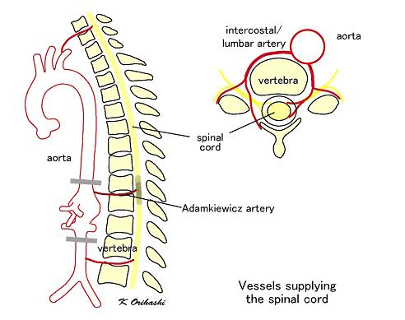
AAA

Slide 22
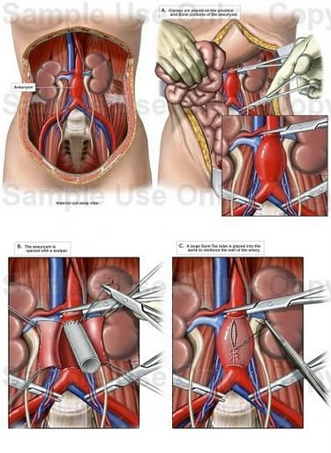
AAA

Slide 23
AAA
Unclamping
Have phenylephrine and cacl available to prepare for hypotension.
Maintain fluid status: appropriate fluid loading prior to clamping can help with “decamping shock.”
Washout of metabolites and hypovolemia can cause decrease in CO.
Turn off vasodilator.
Ask surgeon to reclamp if necessary.
Reverse heparin when patient is stable.

Slide 24
AAA

Slide 25
Ruptured AAA
High mortality rate associated with ruptured/dissecting AAA: 80-90%.
Heart disease and hypotension are associated with poor prognosis.
Classic triad of symptoms: hypotension, back pain, abdominal pulsatile mass
A dissecting AAA is an emergency and need to get patient on the table ASAP. Brief pre op when patient arrives to OR. 2 Large IV’s and arterial line. Send a type and cross - have blood in room.
RSI with intubation: assume a full stomach.
Primary focus is on HD stability.

Slide 26
Ruptured AAA
Fluid resuscitation: begin with crystalloids, blood as it becomes available.
Cell saver in the room
Labs: hgb, coags, calcium (large amounts of citrate are in blood bank products and bind calcium)
Arterial line access, central line.

Slide 27
AAA
Emergence: extubate unless contraindicated
Expect and try to control hypertension and tachycardia
Pain control post op

Slide 28
Thoracic AAA
Classified by type, shape, and location
True aneurysm: involves all three layers of the arterial wall
False aneurysm: only involve adventitia
Fusiform: spindle shape
Saccular: spherical dilation
Dissection: spontaneous tear in the intima that permits the flow of blood through false passage along the longitudinal axis.
DeBakey and Stanford classicization's.

Slide 29
Thoracic AAA
Linked to atherosclerosis (most often in descending aorta and most often classified as fusiform).
Less common causes are mechanical, inflammatory or infectious processes.
Symptoms are often linked to site of the lesion and compression of on adjacent structures.
High rate of mortality with rupture.
Early detection and intervention make a significant contribution to long term survival.
Surgical approach and method depend on location.

Slide 30
Thoracic AAA
Stanford: Type A or B depending on if ascending or descending aorta is involved. Type A requires immediate surgical intervention. Type B can be medically managed and monitored.
DeBakey: Type I, II, or III.

Slide 31
Thoracic AAA
Surgical Approaches:
Resection of the ascending aorta and graft replacement will need CPB.
Transverse arch compromise cerebral perfusion: so CPB with some hypothermia
Descending: aortic cross clamp

Slide 32
Endovascular Aortic Aneurysm Repair
Developed in 1991. Created for a less invasive approach to aortic aneurysm repair.
Involves a deployment of an endovascular stent graft within the aortic lumen. The graft restricts blood flow to the portion of the aorta where the aneurysm exists.
Can be performed on descending thoracic aortic aneurysms or AAAs.
Cannulation of both femoral arteries, guidewire to the level of the aneurysm, sheath over the guide wire, and positioned using fluro, the proximal end of the sheath must extend beyond the aneurysm, then the sheath is deployed.
No cross clamping, improved hd stability, decreased embolic events, decreased blood loss and stress response. Decreased renal dysfunction and decreased pain level.

Slide 33
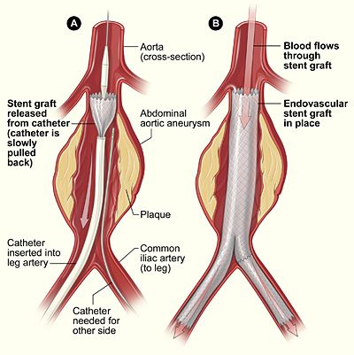
Endovascular Aortic Aneurysm Repair
Heparin 50-100 units/kg given for systemic anticoagulation
Anesthesia technique: general or neuroaxial
Arterial line, 2 large bore peripheral IV’s. ? dedicated flush line on warmer.
Be ready to convert to open at any point.
Maintain HD (less dramatic then open). Still need some analgesia.

