Slide 1
Thoracic Surgery

Slide 2
Goals of Thoracic Surgery
Improve Oxygenation and quality of life
Anesthesia goals are to help the patient accomplish this goal by :
Adequately assessing lung function prior to surgery to evaluate the risk during surgery and in the postoperative phase
Making sure patients are adequately prepared for surgery optimizing lung function
Monitoring Patients during surgery to optimize hemodynamcis
Providing adequate visualization for the surgeon by using one lung ventilation
Providing techniques to better match V/Q during surgery with one lung ventilation

Slide 3
Preoperative Assessment
H&P – know of diseases and risk factors which may influence surgical outcome
Optimize patient condition – treat underlying infections, use bronchodilators correct dehydration, electrolyte imbalance, cessation of smoking
Timing of smoking cessation is important – within 2 months of cessation – bronchial secretions increase-increasing risk of complications ;however with advanced lung cancer, pt should not wait longer than two months for surgery
PFts
Traditional FEV1 is not specific enough to predict postoperative risk
PPO FEV1(Predicted Post Operative) is a test that calculates current FEV1 multiplied by the fraction of functioning lung or the fraction of lung segments that will function after surgery and is more specific

Slide 4
Preop Continued
Diffusion Capacity
D_{LCO} measures the lungs ability to transport gas across the alveolar-capillary membrane –Pt holds breath of carbon monoxide for 10 seconds and exhales. The measurement of exhaled Carbon monoxide is calculated with predicted values
D_{LCO} <60% = increased complications
The predicted postoperative product is the FEV1 multiplied by D_{LCO}
VO₂ max is maximal O2 consumption during exercise(strong predictor)
VO₂ >20ml/kg/min low postoperative risk (If pt can climb 5 flights of stairs can assume is at least this value)
VO₂ <10ml/kg/min high risk of postoperative death (If pt cannot climb one flight of stairs this is the estimate)
V/Q tests
Radioisotope IV dye shows perfusion to all areas of lung- calculations are then made to determine pulmonary function once diseased areas are removed

Slide 5
Preop continued
Chest Xray
Hyperinflation and increased A-P diameter with COPD
Infection or pleural effusions may be present
Locate masses near large vessels or mediastinum to predict airway difficulty or potential large blood losses
ABGs
Measure on room air preoperatively to predict postop complications
PaCO2 >45 is indicative of poor ventilatory function but not postop complications
Preoperative hypoxemia (SPO2 <90%) is more indicative of postop complications
EKG
Right Ventricular hypertrophy will show low QRS waves and poor R wave progression

Slide 6
Assess Patient Risk
All patients should be assessed an exercise tolerance, have an estimate (Predicted Post Operative) PPOFEV 1, discuss postoperative analgesia, and consider smoking cessation
COPD – Many patients who will undergo thoracic surgery have a history of COPD. These patients will often have right ventricular failure from increase pulmonary vascular resistance may need further cardiac testing. ABG’s, chest physiotherapy, and bronchodilators should be employed preop
Cancer-These patients have many risk factors – Considerations include the 4 M’s- Mass effects, Metabolic effects, Metastases and chemotherapy Medications that may have damaged lungs
If patients have a PPO FEV1 <40%
D_{LCO}, V/Q scan, and VO₂ max should be checked
High Risk Candidates-FEV1<2L or <40% of predicted,PPOFEV1 <40% predicted D_{LCO} <40% predicted, VO₂ max <10 ml/kg/min, inability to climb one flight of stairs, Oxygen desaturation >4% during exercise
Low Risk Candidates-FEV1 >2L or 80% of predicted, PPOFEV1 at least 80% of predicted normal, VO₂ max >20 ml/kg/min, ability to climb 5 flights of stairs

Slide 7
Monitoring
Sudden changes during thoracic surgery require close intraoperative monitoring
Pulmonary Artery Catheter
Helpful in patients with severe cardiovascular disease
Will not be accurate if surgery on the right lung and is collapsed
Can be more risky than helpful
CVP
Not required but helpful for central venous access and to help with management of fluid status
Arterial line
Needed to identify changes in blood pressure with manipulation
Needed to analyze blood gases
Should be placed in dependent arm for stabilization
Helpful when placed in right arm during mediastinoscopy – because it detects compression of the innominate artery-preventing decreased cerebral blood flow
SPO2 monitor on the right is also helpful for detection of innominate artery compression

Slide 8
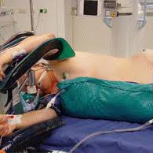
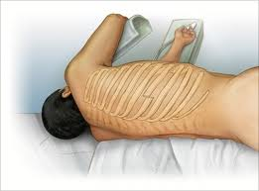
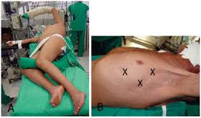
Lateral Decubitus Position
https://encrypted-tbn2.gstatic.com/images?q=tbn:ANd9GcRktx_CFZWEIasF2JeJbC_IhQqFQfq0KN44CtLKh2vGt04_lq4A
https://encrypted-tbn1.gstatic.com/images?q=tbn:ANd9GcSJnqbiZqosVqhw6jv2BFubV0UvFfi9JjU4AjKqJJDNjXLXCcxbpQ

Slide 9
Lateral Decubitus Positioning
Most frequent position for thoracic surgery
Roll is placed just below the dependent axilla to prevent compression of the neurovascular bundle and forward rotation of the humeral head
Keep dependent arm on padded armboard < 90⁰
Keep nondependent arm on a sling with the shoulder < 90⁰ to prevent brachial plexus strain
Keep head and neck neutral ( may need extra height under pillow/gel donut to accomplish this) keep in mind to watch the dependent ear to make sure there is no pressure if using gel donut
Prevent lateral flexion of head – can compress jugular vein and vertebral artery
Watch fibular head of the dependent leg and nondependent leg to prevent peroneal nerve damage-

Slide 10
Physiology of Lateral Decubitus Position-V/Q
Normal upright Lung
Perfusion of dependent lung is due to gravity
Perfusion is greatest at the base
Alveoli in apex of the lung are partially distended.. this makes filling and compressing more difficult- compliance is decreased- that is.. At a particular pressure change they expand with less volume because they are starting out partially filled
Alveoli in the dependent lung are more compliant- that is… at a particular pressure change they expand by a greater volume because they are starting out at a lower resting volume- they also have a decreased surface tension from surfactant which also increases compliance
Therefore…. Ventilation is greater in the dependent lung
The greater perfusion and greater ventilation in the dependent lung makes gas exchange most efficient here

Slide 11
Physiology of Lateral Decubitus Position-V/Q
Anesthetized Lateral Position, Chest Closed, Spontaneous Ventilation
Induction of anesthesia causes V/Q mismatch even with spontaneous respiration
A change in distribution of ventilation –FRC is reduced
The weight of the mediastinum and displacement of the diaphragm by the abdomen further decreases FRC in dependent lung- where perfusion is best
Uneven reduction of FRC between lungs- dependent lung has lower compliance because of the lower volume from the decrease in FRC- forcing the ventilation to increase in the noncompliant lung
V/Q mismatch

Slide 12
Physiology of Lateral Decubitus Position-V/Q
Anesthetized, Paralyzed, Mechanically Ventilated Patient
The diaphragm is no longer counteracting the force of the abdominal viscera and ventilation of the lower lung is further decreased further reducing FRC
Ventilation is much less resistant in the nondependent lung so that’s where airflow is favored.
The perfusion continues to be favorable in the dependent region
V/Q is mismatched even more!

Slide 13
Physiology of Lateral Decubitus Position-V/Q
Anesthetized Open-Chest
The open chest reduces resistance even more favoring gas flow to the nondependent lung
Mediastinum shifts downward from loss of negative intrapleural pressure in the open lung
Ventilation is decreased in dependent lung
Blood flows through atelectic alveoli and gas is not exchanged
The least ventilated lung continues to have the most blood flow causing shunt
This scenario creates the largest V/Q mismatch

Slide 14
One Lung Ventilation (Thoracic surgery alone is not an absolute indication of OLV) (Box 28-3 Nagelhout)
Absolute Indications
Relative indications
Isolation from one lung to another
Infection
Massive hemorrhage
Control of distribution of ventilation
Bronchopleural fistula
Bronchopleural cutaneous fistula
Surgical opening of major conduction airway
Giant unilateral lung cyst or bulla
Tracheobronchial tree disruption
Life-threatening hypoxemia related to unitlateral lung disease
Surgical exposure – high priority
Surgical exposure- medium priority
Middle and lower lobectomies ad subsegmental resections
Esophageal resection
Procedures on the thoracic spine
Thoracic aortic aneurysm
Pneumonectomy
Thoracoscopy
Upper lobectomy
Mediastinal exposure

Slide 15
Methods of OLV
Single lumen endobronchial tube
Developed in 1931 to isolate infectious lung
Disadvantage is that you can not suction or ventilate the other side
Difficult in the right bronchus due to the angle and occlusion of the upper lobe
Can still use in emergent situations
Bronchial blockers
Catheters with inflatable balloon to block the bronchus
Useful with potential difficult intubation or with patients already intubated
Can be placed through nasal endotracheal tubes
Can be used for pediatric video-assisted thoracoscopy procedures
Univent tube
ETT with port for bronchial blocker
Used with fiberoptic bronchoscope
Larger than a normal ETT

Slide 16
Double Lumen Tubes
Made of two bonded lumens
Tracheal lumen
Bronchial lumen
Carlens tube
Carinal hook
Left bronchus
White
Carinal hook
Right sided bronchus
Robertshaw
No carinal hook
Can use in Right or Left Bronchus
Very large and are not suitable for use in children
Smallest tube 26 = to size 7.5 ETT
Size is determined by height
Sizes 26,28,35,37,39,41
Usually 35,37 for females 39,41 for males

Slide 17
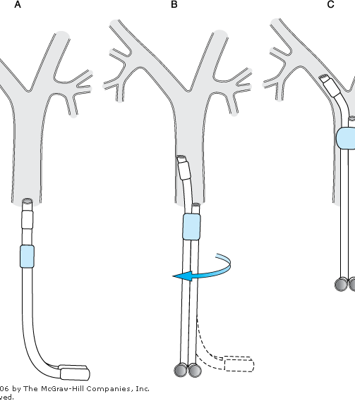
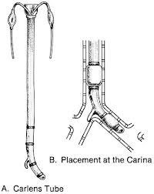
Different pictures of DLTs
https://encrypted-tbn1.gstatic.com/images?q=tbn:ANd9GcQRnTV9JVFSAUjtQvvuA_miVjHVRcjYE6xk0nAqvNTM_SenBWVm
http://bentollenaar.com/_MM_Book/Ch.24_files/image020.gif

Slide 18
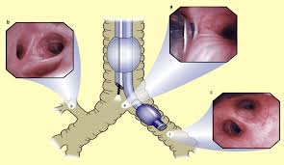
https://encrypted-tbn0.gstatic.com/images?q=tbn:ANd9GcSif0eGavG3rg8_UnWeL6diCPeS_dnpcCBDacowK7X8AUcIFgw9
Placement of Left Dual lumen tube
Picture of right and left bronchus through fiberoptic bronchoscope

Slide 19
Double Lumen Tubes- continued
Right Sided DLT
Slight movements can dislodge placement of tube
Bronchial lumen can obstruct right upper lobe-less distance from carina to right upper lobe 2.5 cm compared to 4-5 cm on the left
Left Sided DLT
Is thought to be safer to use for both left and right thoracotomies unless there is a contraindication
Contraindications for DLTs include:
Internal lesions of the trachea or main bronchi
Compression of the trachea or main bronchi by an external mass
Presence of a descending thoracic aortic aneurysm ( can erode the left main bronchus)
Difficult airway –choose a blocker or other means
Increased risk of aspiration with DLT because of difficulty in placement increasing length of time for laryngoscopy

Slide 20
Placement of Dual Lumen Tubes
Use most comfortable blade
Lubricate tube
Hold tube with tip toward ceiling
Advance tube through cords and immediately turn 90⁰ toward bronchial lumen your intubating
Remove stylet
Continue to advance to around 27-29 cm or until resistance is met
Inflate the tracheal cuff with 5-10 ml of air and 1-3 ml of air in the bronchial cuff
Confirm placement with bronchoscope
Secure tube
Reconfirm placement after lateral positioning

Slide 21
Complications of DLTs
Same risk as ETT +plus
Hypoxemia with malposition of tube
Rupture of thoracic aneurysm with a left DLT if it compresses the left mainstem bronchus
Damage to the vocal cords or arytenoid cartilages if using a DLT with a carinal hook
Vocal cord paralysis
Vocal cord lesions and hoarseness
Barotrauma if inserted too deeply ventilating only one lobe
Carinal hook loss in bronchus
Bronchial rupture from overinflating bronchial cuff

Slide 22
Physiology of OLV
In two lung ventilation
When the patient is Left Lateral Decubitus (Left side down) the left lung is the dependent lung. Total blood flow to the dependent lung in this position is 55% in dependent to 45% to nondependent
When the patient is RLD position (Right side down) The right lung is the dependent lung. Blood flow to right dependent lung is 65% while nondependent lung is 35%
Because of the slight difference it averages to the following :
Average blood flow is 60%to dependent lung and 40% to nondependent lung

Slide 23
OLV Physiology
When the patient is lateral pulmonary blood flow (in two lung ventilation) to the dependent lung is 60% the nondependent lung receives less blood flow and ventilation is greater causing V/Q mismatch
When the nondependent lung is deflated in OLV ; blood flow to this area becomes shunt flow (perfusion without ventilation)
If HPV did not exist one would expect this reduction to be 40% BUT…….
Hypoxic Pulmonary Vasoconstriction (HPV)takes place
This constriction is triggered from alveolar hypoxia,(not arterial hypoxemia) only takes place in the proximal pulmonary arteries (usually, in general circulation, hypoxemia causes vasodilation)
In OLV the overventilated/underperfused lung is deflated forcing more alveolar hypoxia then constriction and blood flow is diverted to the now better ventilated dependent lung
HPV helps V/Q matching
HPV response decreases blood flow during OLV by 50% ; instead of 60:40, now blood flow is 80:20
Actual Shunt flow changes from 10% in two lung ventilation to 27% in OLV

Slide 24
Factors that influence HPV
Factors the reduce HPV
If the fraction of shunting is too high or too low HPV is less effective (<20% or >80%)
When 80% of lung is hypoxic HPV increases PVR causing Right ventricular strain and failure
Hypovolemia may reduce HPV by trigger of adrenergic vasoconstriction and flow is reduced to well-ventilated lung
Hypervolemia or high CO can override HPV by recruitment of constricted vessels
Too high of Vt or peep may over distend alveoli and reduce perfusion by creating a “zone 1” scenerio (keep Vt 6ml/kg)
Inhalation agents >1.5 MAC
Acidosis
Alkalosis
Hypocapnia
Hypothermia
Vasodilating drugs ; NTG nitroprusside, dobutamine, nifedipine,nicardipine, verapamil, ispproterenol
Vasoconstrictors; dopamine, epinephrine, and phenylephrine constrict normally oxygenated pulmonary vessels and reestablish the shunt flow

Slide 25
Anesthetic management during OLV
Choice of Anesthetic
Volatiles less than 1.5 MAC OK (bronchodilate and decrease airway irritability)
Avoid N2O
Increases PVR
Traps air in bullous or emphysema lungs
Avoid long acting muscle relaxants (Pancuronium)
Intermediate relaxants have better recovery
Frequent monitoring of neuromuscular function
Always reverse neuromuscular relaxants
(Keep in mind muscle weakness is common in long surgeries)

Slide 26
Anesthetic Management continued
Main goal is to maintain adequate oxygenation while maintaining visualization of lung for the surgeon
Limit Vt to 6 ml/kg
Use peep (not too much)
Keep PIP <25 cm H2O
Reduce FIO2 to lessen the effects of absorptive atelectasis
Avoid hypocapnia (reduces HPV)
Normal ETCO2 (28-32)
SHOULD HYPOXEMIA OCCUR DURING OLV
Check for malposition of tube (listen, check with bronchoscope)
Check for physiologic causes ie: bronchospasm, decreased CO, hypoventilation, low FIO2, pneumothorax of dependent lung
CPAP to deflated lung (too much will inflate lung) start at 2 cm
PEEP to dependent lung (not too much or may reduce CO and cause more V/Q mismatch -zone 1 scenario)
If these mechanisms fail early ligation of pulmonary artery if it is planned will help diminish shunt flow
If not planned on ligation- resume two lung ventilation- give pauses for surgeon to get to areas between ventilations ( communicate with surgeon)
After lung resection , the operative lung is reinflated and checked for air leaks (keep PIP less than 30-40)
Following reexpansion of the lung- deflate bronchial cuff

Slide 27
Analgesia for Thoracic Surgery
Very Painful surgery
Leads to pneumonia and atelectasis
Balance between comfort and respiratory depression
Pain lasts average of one year after surgery (50% of pts)
PCA pump for constant level of pain control
Adjuncts such as NMDA blocker (ketamine)
Thoracic epidural analgesia (most effective in pain control)
Place at T6 to T8 level
Paravertebral nerve blocks at level of incision plus 1-2 levels above and below
Good short term pain relief reducing opioids
Can be highly vascular area-careful of toxicity
Other methods include cryoanalgesia and
Intrapleural catheter with local anesthetic (placed by the surgeon before closure)

Slide 28
Complications after Thoracotomy
ALI Acute Lung Injury – associated factors
Right pneumonectomy
Intraoperative overhydration
High airway pressures during OLV
Preoperative alcohol abuse-(decreased immunity)
Females
Poor PPO lung function
Trauma
Infection
Chemotherapy
Mediastinal lymphatic damage
Transfusion of FFP
Serum cytokines
O2 toxicity
OLV > 100 min

Slide 29
Complications after Thoracotomy
Acute lung Injury
is defined as a diffuse lung injury characterized by hypoxemia, non cardiogenic pulmonary edema, low lung compliance, and widespread capillary leakage. This is caused by any stimulus of local or systemic inflammation, usually sepsis.
During and after surgery, the effects of lung manipulation, hyperinflation, surgical trauma, ischemia, and reperfusion induces inflammatory mediators at the alveolar-endothelial barrier causing leakage of fluid.
Stretching of capillaries by fluid overload or impaired pulmonary venous return may cause failure of the microvessels disturbing permeability
Dysrhythmias
Common (usual rhythm is afib) other common is SVT
Increases mortality
Is associated with fluids > 2000ml intraoperatively
Beta blockers, and cardioversion if unstable

Slide 30
Complications after Thoracotomy
Low Cardiac Output
From hypovolemic blood loss (intra and postop) output through chest tube should not be >500ml/day If>200 ml/hr loss exploration is needed
From right sided heart failure (increased PVR)
From pericardial effusion
From dysrhythmias
Increased PVR
Can be caused from loss of pulmonary vasculature
Can lead to right to left shunt and hypoxemia
Treat and prevent if possible
vasodilators
correct hypoxemia, acidosis, and hypercarbia

Slide 31
Complications after Thoracotomy
Respiratory Complications
Atelectasis
Pneumonia
Respiratory failure
Torsion of respiratory lobes
Pulmonary edema
Bronchopleural fistula- communication between bronchus and pleural space
Causes bubbling in chest tube from gas escape
Can lose Vt through this mechanism of low resistance
Can compromise gas exchange
Treat with conservative management if defect is small
May place chest tube if not one already or need further surgical correction ie: sealing agent to close defect or further resection
If defect so large interferes with gas exchange may need to replace DLT

Slide 32
Complications after Thoracotomy
Nerve injuries
Phrenic nerve –passes through mediastinum
Left recurrent laryngeal nerve-vulnerable during dissection of aortopulmonary lymph node and mediastinal procedures
Spinal cord injury if intercostal artery is injured or if epidural hematoma caused by surgical dissection between pleura and epidural space
Thoracic duct (largest lymphatic vessel in the body)injury
Occurs during a left thoracotomy or placement of left sided central line
Symptoms
drainage of chyle(milky bodily fluid consisting of lymph, fats, and fatty acids) in chest tube
Weight loss
Sepsis

Slide 33
Mediastinal Masses
Types of Mediastinal masses 4 T’s( Box 28-8 Nagelhout)
Thymoma
Thyroid
Teratoma
“Terrible” lymphoma
Symptoms of mediastinal masses can include
Changes in CO- from compression of great vessels
Syncope, sweats orthopnea, superior vena cava obstruction
Obstruction of airflow
Cough
Hoarseness
Atelectasis
Central nervous system changes
Inability to lie flat
Surgical treatment or diagnosis of mediastinal masses include
Thoracotomy
Thoracoscopy
Mediastinoscopy

Slide 34
Mediatinal Masses
Anterior mediastinal tumors
Compress trachea or bronchi-increased airway resistance
Collapse of the airway can occur because of changes in airway dynamics
Positioning supine
Induction of anesthesia
Positive pressure ventilation
Intraoperative manipulation may cause trauma edema or bleeding further occluding the airway
Placement of ETT past mass may sometimes be necessary (if possible)
Locate mass on CT before induction for airway plan-awake fiberoptic may be a good choice
Spontaneous respiration is best
If PPV is used assure ability to ventilate before giving long acting muscle relaxants

Slide 35
Mediastinoscopy
Incision made in suprasternal notch
Scope is passed anterior to the trachea
Vessels such as left common carotid artery, left subclavian artery, innominate artery, innominate veins, the vagus nerve, the left recurrent laryngeal nerve, the thoracic duct, the superior vena cava, and the aortic arch are all in close proximity
Complications include: pneumothorax, hemorrhage from a tear of major vessels, arrhythmias, bronchospasm, laceration of the esophagus, and chylothorax (thoracic duct laceration)
http://onctalk.com/wp-content/uploads/2007/02/mediastinoscopy-figure.jpg

Slide 36
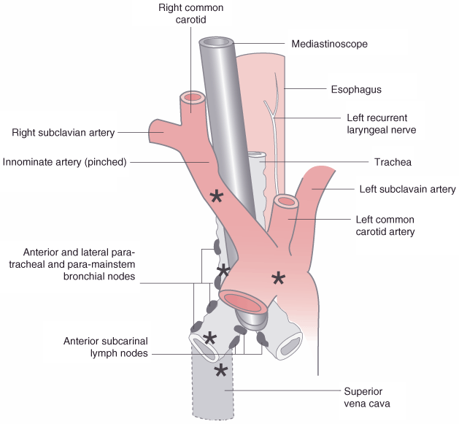
Mediastinoscopy
http://www.noranaes.org/logbook/resources/Ebooks/Miller1/Miller%20-%20Anesthesia%206th%20Ed/das/book/body/0/1255/f049034.gif
Decreased cerebral blood flow can occur from pressure on the innominate artery
Pressure on the innominate artery reduces blood flow to
right common carotid artery
right vertebral artery
Subclavian flow to the right arm
MONITOR PULSE OXIMETER OR ARTERIAL CATHETER ON RIGHT ARM to monitor compression on innominate artery
Place BP cuff on left arm to avoid interruption of right arm monitoring

Slide 37
Thoracoscopy
Common procedures include:
Drainage and examination of the pleural space
Debridement of an empyema
Removal of foreign bodies
Placing chemotherapeutic agent into pleural space
Pleurodesis with abrasion or talc
Stapling of blebs
Diagnostic biopsies and cancer staging
Evaluation of bronchopleural fistula

Slide 38
Thoracoscopy Management
Sometimes done with epidural anesthesia alone or General anesthesia with DLT/bronchial blocker
Advantage of general is
if regional is suboptimal you do not have to convert mid surgery or if open thoracotomy is needed general anesthesia and OLV is established
Can deflate operative lung and optimize V/Q
Can apply CPAP and PEEP
Arterial line should be placed except in extremely healthy patients
Easier pain management than thoracotomy because of smaller incisions and the ribs are not spread

Slide 39
Bullae
Destruction of alveolar tissue and consolidation of alveoli into large pockets causes air filled spaces of lung tissue
PPV increases bullae
N2O increases bullae
Air trapping occurs
Enlarged bullae compresses normal lung tissue and vasculature resulting in
Hypoxemia
Polycythemia
Cor pulmonale
Ruptured bullae can cause
Pneumothorax
Tension pneumothorax and cardiopulmonary collapse
Place chest tube- will show large leak
Ventilation may be difficult

Slide 40
Bullae Treatment
Thoracotomy to resect bullous tissue
DLT
No N2O
To reduce risk of rupture spontaneous ventilation is preferred until the chest is opened if tolerated
Small Vt and increased rate in order to keep PIP below 10-20 cm H2O
Jet ventilation also reduces risk of barotrauma or rupture of bullae
After resected bullae; re-expansion, gas exchange, and compliance of lung greatly improve

Slide 41
Bibliography
Nagelhout JJ, Plaus KL. (Ed.) Nurse Anesthesia. 4th ed. Philadelphia: Elsevier Health Sciences; 2010. pp630-648
Miller, R.D. (Ed.) Miller’s Anesthesia. 7th ed. New York: Churchill Livingstone; 2010. Volume 2,pp1819-1882

