Slide 1
Anesthesia for Other Vascular Surgery and Vascular Disease
Melinda Stone CRNA, MS
All material placed on Blackboard, the Program Website (www.smumn.edu/nap), distributed electronically or distributed in printed form is intended only for the use of the individual student enrolled in the course. Distribution and/or sharing this material with any other student, individual or organization are strictly prohibited without the written consent of the course instructor, Program Director and the Academic Dean of the Twin Cities campus.

Slide 2
Peripheral Vascular Disease
Incidence increases with age
>70% of persons older than 75
Systemic disease process with similar risk factors as:
Ischemic heart disease
Diabetes
HTN
Tobacco use
Family hx
Dyslipidemia

Slide 3
Peripheral Vascular Disease
S/S
Intermittent claudication
Pain at rest
Decreased/absent pulses
Ischemia of the limb
Ulceration
May be chronic or acute occlusion, or vasculitis

Slide 4
Peripheral Vascular Disease
When medical therapies are unsuccessful, surgical or endovascular revascularization procedures may be necessary
Patients are at risk for cardiac events during these procedures
Caution with β-blockers

Slide 5
Renal Artery Stenosis
Causes activation of the renin-angiotensin system, which causes:
Vasoconstriction
Sodium retention
Hypertension
Atherosclerosis causes 2/3 of renal artery stenosis

Slide 6
Renal Artery Stenosis
Treatments include:
Percutaneous renal artery angioplasty
Aortorenal bypass
Transaortic renal endarterectomy
Control of intravascular volume and intraoperative blood pressure are vital

Slide 7
Aortoiliac Occlusive Disease
Causes circulatory problems of the lower extremities
Commonly causes claudication
Signs include diminished or absent popliteal and pedal pulses, and decreased capillary refill
Treatment: bypass the occlusion
aorto-fem bypass
fem-fem bypass
fem-pop bypass

Slide 8
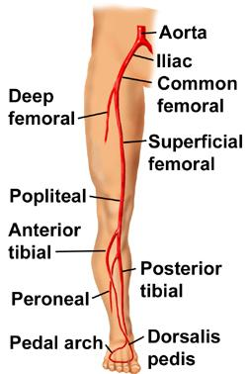

Slide 9
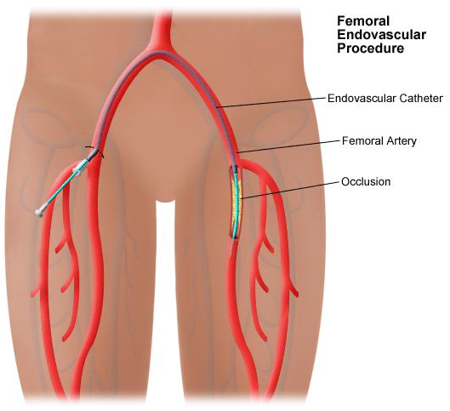

Slide 10
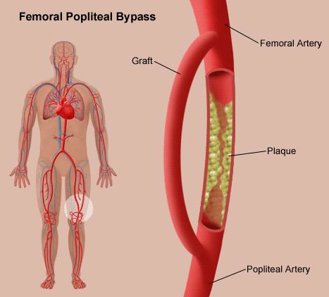

Slide 11
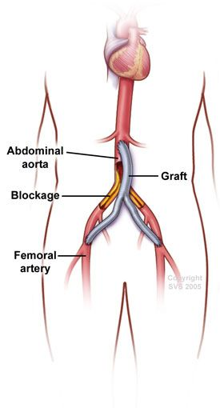

Slide 12
Visceral Artery Stenosis
Causes “intestinal angina” which leads to weight loss
More common in women than men
Etiologic factor: Atherosclerosis is most common
Treatment includes:
Aortoiliac and/or aortomesenteric bypass
Transaortic endarterectomy

Slide 14
Anesthesia for Peripheral Vascular Procedures (Non-Aortic)
Anesthesia care is similar to procedures involving the aorta as pre-existing pathology is similar
Preoperative assessment is the same
Blood loss is less extensive
Hemodynamic status is less labile related to clamp
Third space volume replacement is less extensive

Slide 15
Peripheral Atherosclerosis
Incidence increases with age (esp. >70 yrs)
Risk factors:
Diabetes
HTN
CAD
Other atherosclerotic lesions
Smoking
High Cholesterol
Obesity
Family history

Slide 16
Symptoms
Intermittent claudication progressing to pain at rest
Decreased pulses
Increased capillary refill time
Mottling
Ulceration, infection, gangrene, amputation

Slide 17
Acute Arterial Occlusion
Severe extremity ischemia
Intense pain, paresthesia, and motor weakness
May require immediate surgical intervention
If pt. on antiplatelet meds-check INR/bleeding time

Slide 18
Systemic Vasculitis
Inflammation of the blood vessel walls

Slide 19
Takayasu’s Arteritis
Rare, idiopathic, chronic progressive occlusive vasculitis of the large vessels
Usually Asian women <40 yr
Treatment is corticosteriods
Can effect CNS, CVS, Lungs, Kidneys, and Musculoskeletal system—usually affects aorta and aortic branches

Slide 20
Takayasu’s Arteritis
Anesthetic considerations
Steroid therapy
Anticoagulation
Caution with head extension
Positioning
Keep BP normal or ↑slightly

Slide 21
Thromboangiitis Obliterans (Buerger’s Disease)
Occlusion of medium and small vessels of the extremities
Claudication
Usually associated with tobacco use
Anesthetic considerations
Keep them warm
Careful positioning

Slide 22
Wegner’s Granulomatosis
Necrotizing granulomas in inflamed vessels
Pts are usually on chronic steroids

Slide 23
Wegner’s Granulomatosis
Systems involved
CNS
Resp-possible airway narrowing
CV
Renal
Anesthetic considerations
Multiple organ involvement
May have granulomas in airway
Do neuro exam preop

Slide 24
Temporal Arteritis
Inflammation of the arteries in the head and neck
Headache, scalp tenderness, jaw claudication
Treatment is corticosteriods
Anesthesia considerations
Steroids
Careful positioning

Slide 25
Polyarteritis Nodosa
Vaculitis involving the small- and medium-sized arteries
Especially kidneys, skin, and nerves
Patients are usually 30-40 yrs old
Men>Women
Associated with Hep B infection

Slide 26
Polyarteritis Nodosa
Anesthetic considerations
Consider renal or cardiac involvement
Steroids
HTN usually present

Slide 27
Henoch-Schonlein Purpura
Inflammation of the arterioles and capillaries of the skin, kidneys, GI tract, & large joints
Common in kids especially following respiratory infection
Steroid treatment

Slide 28
Kawasaki Disease
Vasculitis with involvement of coronary arteries and medium-sized muscular arteries.
Occurs in kids
Cardiac system frequently involved

Slide 29
Raynaud Phenomenon
Episodic vasospastic ischemia of the digits
Secondary causes
Connective tissue diseases
Peripheral arterial occlusive disease
Neurologic syndromes
Trauma
Drugs

Slide 30
Raynaud Phenomenon
Anesthetic considerations
Careful with vasoconstictors
Keep warm
Careful positioning

Slide 31
Moyamoya Disease
Rare, progressive disease of kids and young adults
Involves occlusion of internal carotid, middle and anterior cerebral arteries
Surgical interventions

Slide 32
Moyamoya Disease
Anesthesia considerations
Preserve CBF
Keep them deep
Normocarbia
Normovolemic
Keep BP in tight range
Pts may be anticoagulated

Slide 33
Coronary-Subclavian Steal Syndrome
Rare complication from using the internal mammary artery for CABG
Development of proximal incomplete stenosis of the left SC artery produces reversal of blood flow through the patent internal mammary graft
Anesthesia considerations
Same as with patients with ischemic heart disease

Slide 34
Klippel-Trenaunay-Weber Syndrome
Venous malformations of the extremities, neck and trunk.
“Local gigantism”
Anesthetic Considerations
Risk of bleeding
No neuraxial blockade due to spinal AVMs

Slide 35
Behcet’s Disease
Relapsing inflammatory disorder causing oral, genital, and GI ulcers and uveitis
Treatment is steroids
Anesthesia considerations
Positioning
Steroid stress dose
Neuro exam

Slide 36
Deep Vein Thrombosis
Clot formation in a vessel
Predisposition
Venous stasis
Trauma
Abnormality of venous wall
Hypercoagulable state
Morbid obesity
Advanced age

Slide 38
Treatment
Heparin
Once stabilized, then Warfarin
Recommended INR 2.0-3.0

Slide 39
Regional Anesthesia
DVT is decreased by up to 50% in total hip or knee replacement surgery
Hypothesis-the vasodilation increases blood flow
Pain control encourages early ambulation

Slide 40
Pulmonary Embolism
Clinical manifestations of pulmonary embolism are nonspecific
May have rapid breathing
Unexplained hypoxemia
↓BP, ↑HR
Pleuritic or substernal chest pain
Cough with or without hemoptysis
Bronchospasm

Slide 41
Pulmonary Embolism
Diagnosis
Ventilation Perfusion scan
CT
MRI
TEE
Treatment
Heparin
Coumadin

Slide 43
Fat Embolism
Appears typically 12-72 hours after a long bone fracture
S & S
Arterial hypoxemia
Mental confusion
Petechiae over neck, shoulders, and chest
Treatment
Manage ARDS
Administer corticosteriods

Slide 44
A-V Fistula Formation for Dialysis
Upper extremity vessels
Usually 5-8000 units of heparin
May use tissue or synthetic graft
Protamine used only occasionally
Anesthetic considerations
Can usually be performed under MAC

Slide 46
Case Studies
Case study #1

Slide 47
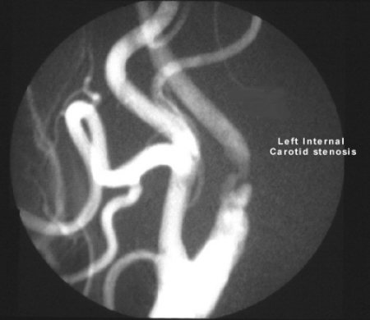
This 73 year-old presented with intermittent right-sided weakness lasting for approximately 30-min.
Clinical examination at assessment was normal except for a left-sided carotid bruit.
Both a carotid color-flow doppler and a carotid angiogram were performed. These showed a 60% stenosis of the left internal carotid artery.

Slide 48
Additional Information
Weight 94 kg
Peripheral edema is present
Chronic renal insufficiency
Labs
Glucose 155
BUN 62 mg/dL
K+ 5.1 meq/l
Cr 3.6 mg/dL

Slide 49
Case Studies
Case study #2

Slide 50
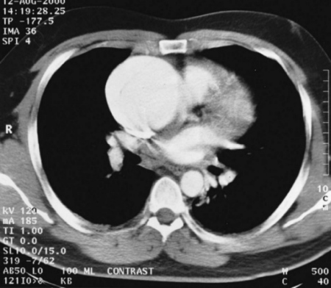
This 70 year-old man presented with sudden onset of central chest pain that radiated through to his back.
Examination-showed a reduction in the BP in his right arm compared to his left. He had no neuro compromise. On cardiac auscultation-early diastolic murmur.
The diagnosis of aortic dissection was suspected. A Type A dissection was confirmed on a CT scan.

Slide 51
History and Physical
Weight 105 kg
CAD-MI 6 months ago
CHF, JV distension and bi-basilar rales are present
Insulin dependent diabetes
Insulin dose this morning after breakfast
Must go to the OR now

Slide 52
Case Studies
Case study #3

Slide 53
History
Mary, a 44 year old, woke up this morning with left leg weakness and slightly cool to touch
BP 160/88 in her right arm
Labs
K+ 3.8
Hgb 11.9
Plt 354

Slide 54
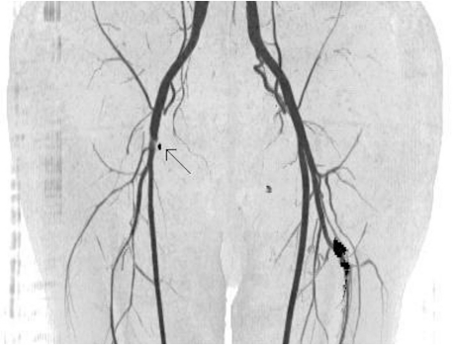
Additional Information
Her youngest child is 3 months old
Parents are alive and healthy
No previous surgeries

