Slide 1
Anesthetic management of hepatic disorders and cholelithiasis
Todd Walter DrAP, CRNA, APRN
Principles of Anesthesia II

Slide 2
Objectives
Describe hepatic blood flow and function of hepatic system.
Describe effects of anesthesia on hepatic function.
Describe types of hepatitis and anesthetic considerations.
Discuss hepatobiliary pathophysiology, symptoms, and anesthetic implications.
Describe anesthetic management considerations for procedures of the hepatobiliary system.

Slide 3
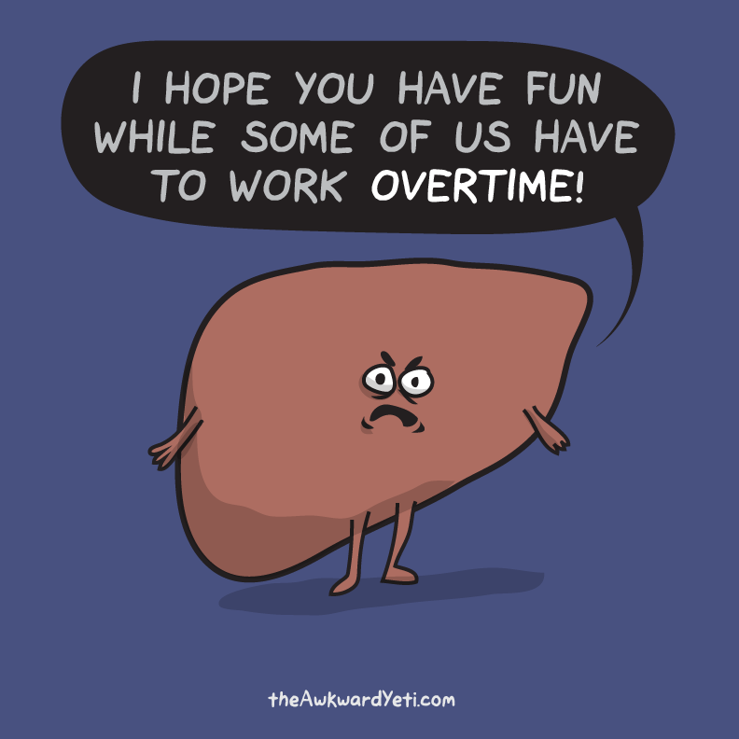
NewYearsEve.png (792×792) (theawkwardyeti.com)

Slide 4
Hepatobiliary A & p review
Largest internal organ and metabolic HQ.
Divided into 4 lobes and subdivided into multiple segments.
Receives 25-30% of CO, 75% via portal vein, 25% via hepatic artery. (but about 50% of O₂ supply from each).
Functional unit is the Hepatic Lobule or Acinus.
Acinus forms around portal canal – portal venule, hepatic arteriole, bile duct, lymphatic vessel, and nerves.
50,000 – 100,000 Acini in normal liver.
Liver also functions as a blood reservoir.

Slide 5
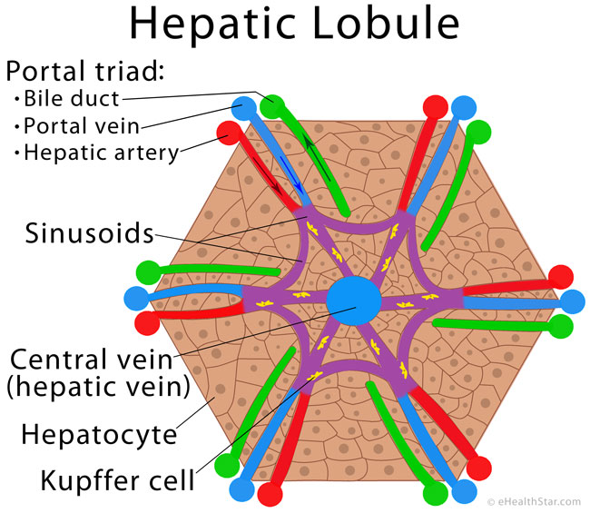
A & p review
Hepatic Lobule or Acinus
https://www.ehealthstar.com/wp-content/uploads/2016/03/Hepatic-lobule.jpg

Slide 6
Hepatobiliary function
Super filter
Kupffer cells (macrophages) lining hepatic sinus remove 99% of bacteria from intestines.
Endothelial cells allow diffusion of large plasma proteins creating lymph (1/2 of total body production) with high protein concentration.
Bile canaliculi between hepatocytes empty into bile ducts.
Filtered blood empties into hepatic veins and on to the Vena Cava.

Slide 7
Hepatic physiologic functions
Very few proteins NOT produced by Liver
Immunoglobulins, vWf, and tissue factor III (Factor VIII is made in liver but not by hepatocites)

Slide 8
Hepatic physiologic functions (proteins formed)
Procoagulants – All but those listed prior, Vit K needed for Factors II, VII, IX, and X, bile from liver needed for Vit K absorption.
Anticoags – Antithrombin and proteins S, C, and Z (also Vit K dependent)
Fibrinolytics – Plasminogen
Thrombopoietin – Platelet production stimulator
Plasma Proteins – Albumin and α-1 acid glycoprotein
Pseudocholinesterase - ↓ production prolongs Anectine duration

Slide 9
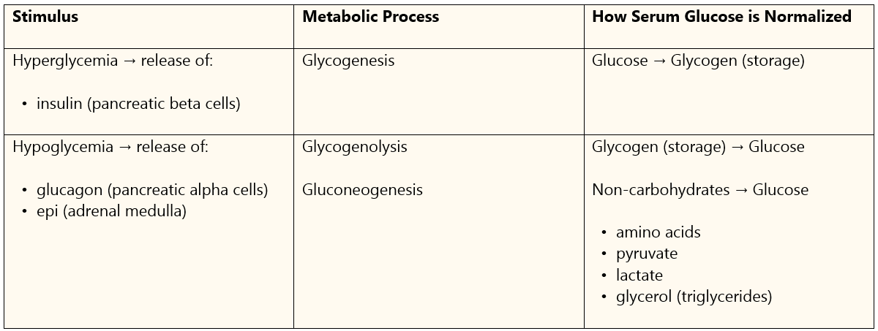
Hepatic physiologic functions (Metabolism)
Carbohydrates: Important Glucose regulator and clears insulin
From Apexanesthesia.com

Slide 10
Hepatic physiologic functions (Metabolism)
Proteins converted to Carbs and fats by amino acid deamination
Process causes ammonia → converted to urea → excreted by kidney
Hepatic failure → ↑ ammonia → hepatic encephalopathy
Energy stored (triglycerides) and released (beta-oxidation)
Synthesis of cholesterol, phospholipids, and lipoproteins
Bilirubin (from RBC breakdown in spleen) conjugated with glucuronic acid and excreted in stool

Slide 11
Hepatic physiologic functions Drug Metabolism
Metabolism by biotransformation
Phase I: oxidation, reduction, hydrolysis, deamination, methylation, and sulfoxidation (cytochrome P450)
Makes metabolite more hydrophilic, ready to conjugate
Phase II: Conjugation
Makes it able to be eliminated in urine or feces

Slide 12
Hepatic physiologic functions Drug Metabolism
Medications dependent on liver extraction:
Lidocaine
Morphine
Propranolol
Meperidine
Low HBF or liver disfunction will slow clearance, prolong effect

Slide 13
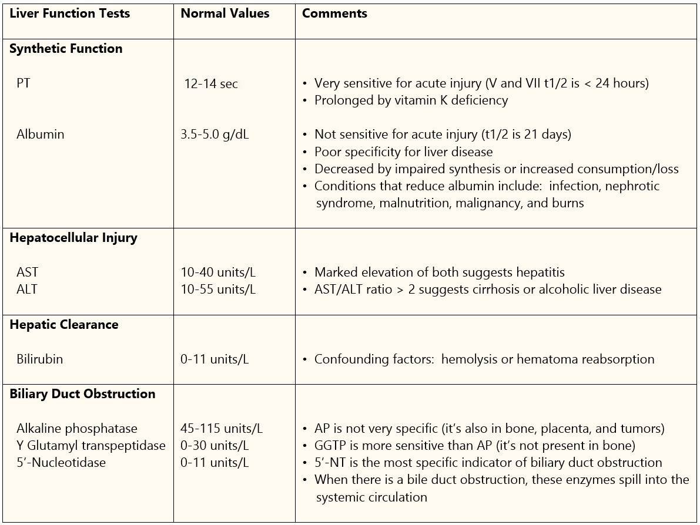
Lab tests of liver function
From Apexanesthesia.com

Slide 14
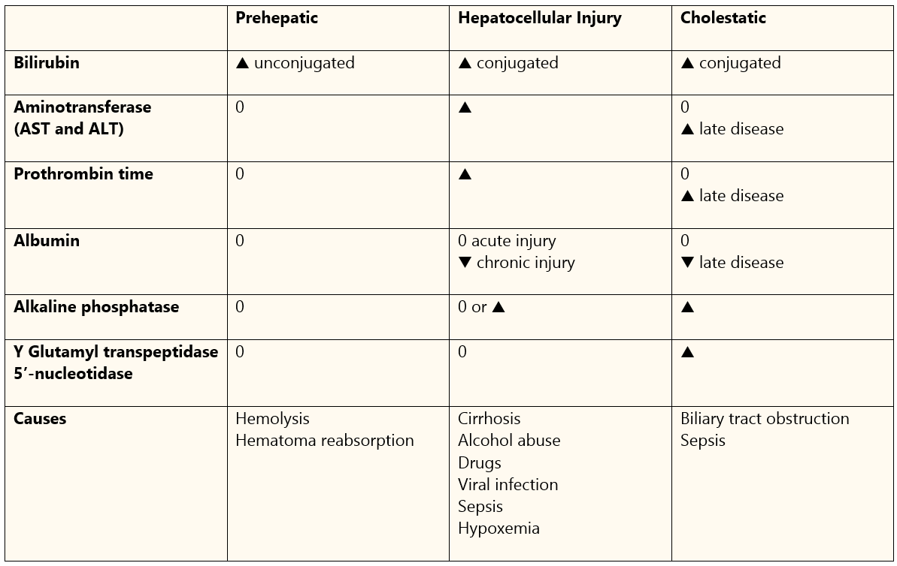
Lab tests of liver function
From Apexanesthesia.com

Slide 15
Hepatic circulation
Hepatic artery pressure ≈ aortic pressure
Portal vein pressure ≈ 6-10 mmHg (low pressure allows reservoir function)
Portal HTN occurs with ↑ vascular resistance → ↓PV bld flow.
Portal perfusion pressure = Portal vein pressure – Hepatic vein pressure
From: Apexanesthesia.com

Slide 16
Anesthetic effect on liver function
Volatile Anesthetics
Desflurane → moderate ↓ Hepatic artery and Portal vein flow.
Iso & Sevo → minimal ↓ Hepatic artery and Portal vein flow.
Sevo converts to fluoride ions in liver, Nephrotoxic but no damage has been found.
The issue is more often not what our anesthetics are doing to the liver but how poor liver function effects our anesthetics.

Slide 17
Anesthetic effect on liver function
Opioids may cause a spasm of the Oddi sphincter causing backup of bile and biliary colic. May also see false-positive cholangiogram.
Mechanical vent may cause ↓ hepatic blood flow from high airway pressure venous return and reduced CO.
Laparoscopic surgery due to inflated abdomen → ↓ blood flow.
Other factors include surgical manipulation, hypotension, hemorrhage, and vasoactive drugs.

Slide 18
Anesthetic effect on liver function
Regional anesthesia
Spinal block at T5 can reduce HBF
Sympathectomy
Hypotension

Slide 19
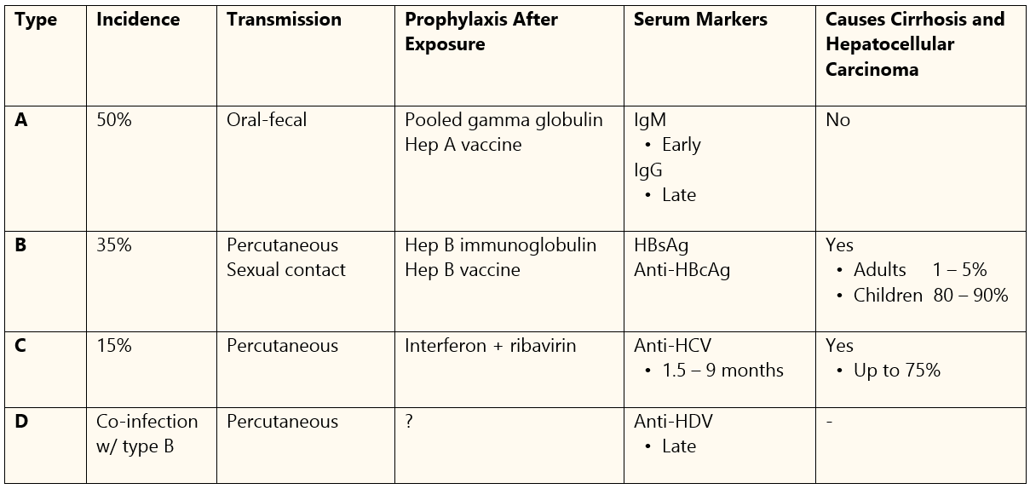
hepatitis
Viral – A comparison:
E – very rare in US

Slide 20
hepatitis
Drug-induced
Due to idiosyncratic reaction to a drug or OD and toxicity
Genetic predisposition critical determinant
Other risk factors: age, gender, other exposures, hx or family hx of drug reactions, liver disease, and comorbidities.
Acetaminophen OD
Alcoholic hepatitis is most common form of drug-induced hepatitis.
Halothane induced hepatitis – 20% metabolized compared to 0.02% of des and 0.2% iso

Slide 21
hepatitis
May be acute or chronic
Acute typically due to virus
Chronic – occurs in 1-10% of HBV and 10-40% of HCV but not with HAV
Most often due to alcohol
Progressive disease → hepatocyte destruction, cirrhosis, failure
Symptoms – marked fatigue, jaundice, thrombocytopenia, glomerulonephritis, myocarditis, arthritis, neuropathy, and ultimately multiorgan failure.

Slide 22
Hepatitis
Anesthetic management
Mild or early stage – no added risk or concerns
Acute onset – delay elective procedures
Be aware of fast or slow recovery from anesthesia due to either over-active metabolism or inhibited metabolism of medications.
Prolonged PT – increased bleeding potential
Decreased albumin levels – may need to give albumin or FFP, Vit K

Slide 23
Hepatitis
Anesthetic management
Avoid hepatotoxic drugs or drugs that inhibit CYP450 isoenzymes
acetaminophen, tetracycline, PCN, sulfonamides, and amiodarone
Propranolol is good B-blocker
Avoid PEEP
Caution with Roc – may last a long time
Best MR options Succ, atracurium, mivacron (potential for prolonged effect)

Slide 24
Hepatitis
Virus lasts long time on surfaces. Fairly easy to transmit.
Protect yourself!!

Slide 25
Anesthetic management of alcoholism
MAC ↓ if acutely intoxicated
MAC ↑ with chronic alcoholic not currently intoxicated
Benzo’s ↑ effect; NMDA’s ↓ effect
Aspiration risk – impaired pharyngeal reflexes, ? Full stomach

Slide 26
Anesthetic management of alcoholism
Alcohol Withdrawal Syndrome
Sy’s begin 6-8 hrs after bld alc level returns to normal (about sx time)
Early sy’s – tremors, hallucinations, nightmares
Later - ↑ SNS (tachycard, HTN, dysrhythmia), N/V, insomnia, confusion, agitation
Tx – ETOH, β-blockers, α-2 agonists
Delirium Tremens (DTs) – 2-4 days later, during postop on floor or at home
Sy’s – seizures, tachycard, hypo- or hypertension, combative
Tx – Benzos and B-blockers

Slide 27
Cirrhosis
Etiologies
From Apexanesthesia.com
Primary cause of liver function deterioration = hepatocyte necrosis

Slide 28
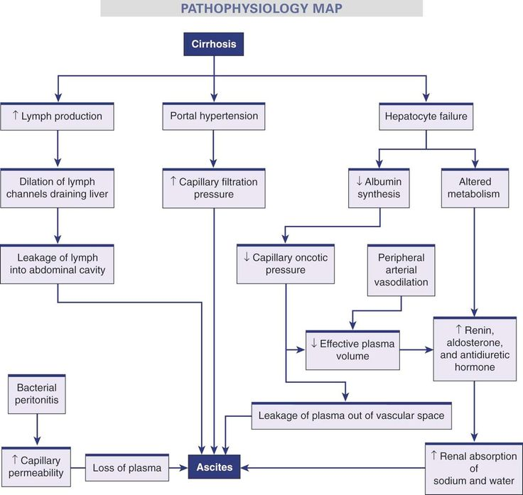
Cirrhosis
Pathophysiology
https://i.pinimg.com/736x/b6/69/73/b6697355497fba7aa49dd87edf5ff939.jpg

Slide 29
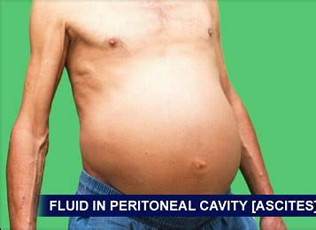
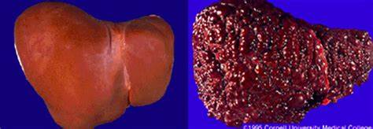
Cirrhosis
Blockage of blood flow through liver by necrotic hepatocytes leads to Portal HTN.
This causes a backup of blood in the venous system.
May lead to esophageal or stomach varices.
Use great caution when doing ‘benign’ procedures - EGD

Slide 30
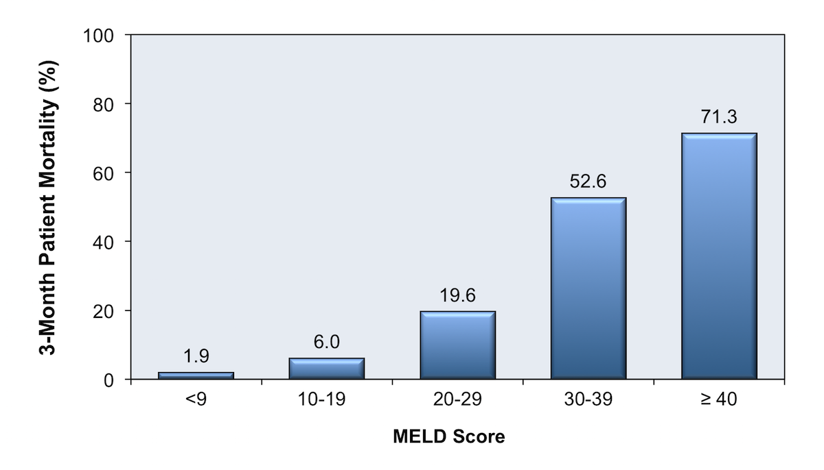
Cirrhosis
2 scoring systems to determine end-stage liver disease and potential for mortality:
MELD – Model of End-stage Liver Disease
Predicts 90-day mortality
Assesses bilirubin, INR, and serum create
More often used for transplant determination
Child-Pugh Score – looks at albumin, PT, bilirubin, ascites, and encephalopathy
Class A (5-6 points) – 10% risk of periop mortality
Class B (7-9 points) – 30% risk of mortality
Class C (10-15 points) – 80% risk of mortality
May proceed with class A or B but postpone Class C
https://cdn.hepatitisc.uw.edu/doc/89-1/3-month-mortality-based-on-meld-score.jpg

Slide 31
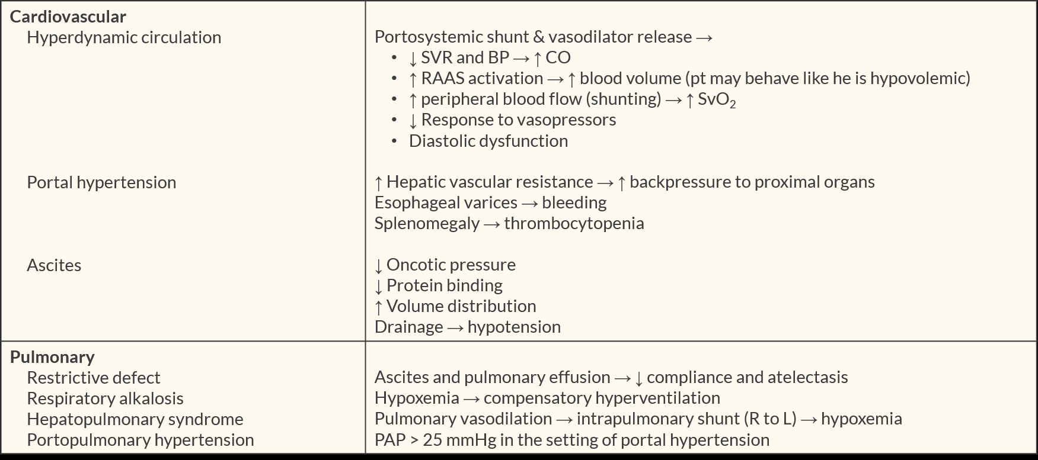
Cirrhosis
Physiologic changes with End-stage Liver Disease
From Apexanesthesia.com

Slide 32
Cirrhosis
Physiologic changes with End-stage Liver Disease (cont.)
From Apexanesthesia.com

Slide 33
Cirrhosis
Anesthetic Considerations
Preop eval is crucial to determine extent of liver damage.
Monitoring – routine with mild dysfunction
ECG 5 lead to monitor ST segment
A-line and maybe CV line with moderate to severe dysfunction
A-line good for intraop lab draws
Anticipate large bld loss potential – 2 large Ivs
Have bld and products crossmatched and ready

Slide 34
Cirrhosis
Anesthetic Considerations – technique and meds
Focus on maintaining BP and CO
General is good but monitor closely
Regional is also good but check coags prior to prevent complications
Propofol is good, Benzo’s may last longer – go light with them
RSI may be needed due to impaired gastric function and ascites
Be cautious with succ due to reduced plasma cholinesterase
NMDAs will last longer, may want Cisatra – alternate metabolism
Caution with opioids – increased and prolonged resp depression

Slide 35
Cirrhosis
Portal HTN and esophageal varices
varices are very common with cirrhosis and end-stage liver disease
Avoid placing anything down the esophagus, including esoph steth
Not a good time to tube the goose
Rupture of varices can quickly lead to rapid, massive blood loss
Tx with Balloon or endoscopic sclerosis
Hepatorenal Syndrome (HRS) – Ascites → ↑ fluid retention → impaired Renin-angiotensin system → ↓ renal perfusion → renal failure
Poor prognosis – transplant only tx

Slide 36
Cirrhosis
TIPS procedure (transjugular intrahepatic portosystemic shunt)
Partial bypass of hepatic circ from portal vein (inflow) to hepatic vein (outflow).
Reduces portal HTN, reduces size and number of varices, and can reduce ascites.
High potential for bleeding during procedure, be prepared
TIPS is contraindicated with heart failure, pulmonary HTN, + severe tricuspid regurg
Long procedures – A-line, CVP, large IV, monitor bld status, ABG’s

Slide 37
Tips anesthetic management (cont)
Keep PaCO₂ 40-45, maintains HBF
Avoid N₂O
Caution with fluid admin – LR metabolized to bicarb in liver → alkylosis
Pts with liver disease retain Na, Caution with saline, check Na levels
Maintain UO >50ml/hr, use mannitol
Complications: Pneumo, Jugular injury, dysrhythmias, liver laceration, gall bladder perf, stent embolization to lung, renal failure from dye, encephalopathy

Slide 38
Hepatic encephalopathy
Precipitating Events
Constipation
Dehydration
GI bleed
Infection, sepsis
Excessive protein intake
Hypokalemia, Hypoglycemia, Hypoxia, Hypothyroid
Metabolic Alkalosis
Anemia
Azotemia/Uremia
Hepatic malignancy
TIPS procedure
Vascular occlusion

Slide 39
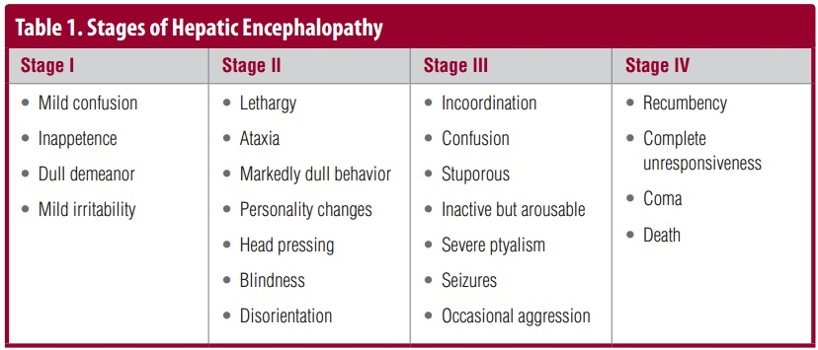
Hepatic encephalopathy
http://neurologynetworks.com/sites/default/files/HE%20stages%20table.jpg

Slide 40
Carcinoid Syndrome
Carcinoid tumors begin in GI tract
Tumors contain many GI peptides that may be released into circulation
When large amount of peptides released (10% of cases)
– Carcinoid Syndrome
Sy – most often – flushing (sudden onset) and diarrhea
May also see hypotension, HTN, and bronchoconstriction
Most often see overproduction of serotonin – diarrhea

Slide 41
Carcinoid Syndrome
Carcinoid Crisis – life threatening
Sy – intense flushing, diarrhea, abdominal pain, tachycardia, HTN, or ↓BP
May be spontaneous or triggered by stress, chemo, or biopsy of tumor
Anesthetic agents that may trigger –
Succ, mivacurium, atracurium, tubocurarine, epi, norepi, dopamine, isoprel, and thiopental
Safe anesthetics – Propofol, etomidate, vec, roc, cisatracurium, narcotics,
all inhaled agents

Slide 42
Carcinoid Syndrome
Treatment
Avoid triggers
Support for symptoms
Serotonin receptor antagonists (5-HT antagonist – Zofran) or somatostatin analogues (Lanreotide) – usually need an infusion (short ½ life)
A combo of H₁ and H₂-receptor antagonists for flushing
For bronchoconstriction use Octreotide and histamine blockers
Surgery is only cure

Slide 43
Carcinoid Syndrome
Anesthetic Management
General needed
Avoid histamine releasers or other triggers
Need A-line for continuous BP monitoring
Give Octreotide preop and just before tumor manipulation
Zofran is very good for these pts
May be slow to wake up, may need ICU
May use epidural for postop pain but slow infusion and monitor carefully

Slide 44
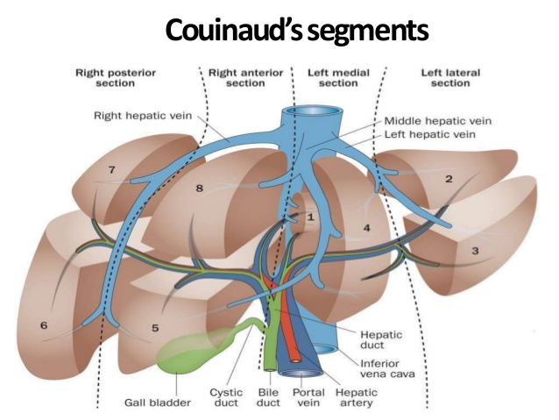
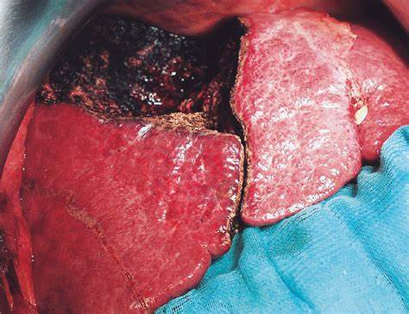
Liver resection (partial hepatectomy, lobectomy)
https://image.slidesharecdn.com/radiologicalanatomyofliversegments-190310102350/95/radiological-anatomy-of-liver-segments-6-638.jpg?cb
https://jamanetwork.com/data/Journals/SURG/9435/sot9013f4.png

Slide 45
Liver resection (partial hepatectomy, lobectomy)
Most often done for removal of tumors. Primary or metastatic.
Common in men >50 yrs old, associated with HBV or cirrhosis.
Need 25-30% of liver remaining for adequate regeneration postop.
Cirrhosis means regeneration less likely.
Approach may be transabdominal or thoracoabdominal.
If Rt lobectomy or near portal vein – high possibility of air embolus.
Also clamping of portal vein may cause hemodynamic compromise.

Slide 46
Liver resection (partial hepatectomy, lobectomy)
Preop considerations
Labs: CBC, coags, LFTs, albumin, CRT, BUN, Glu, bilirubin, lytes, type and cross
CXR, US, CT, or MRI as needed
Standard monitors + A-line, CVP, 2 large IVs, ? Cell saver, rapid infuser
Hx of comorbidities, medications
Consider reduced liver function with med choice
Anticipate large bld loss, have RBCs, FFP, and platelets ready in room

Slide 47
Liver resection (partial hepatectomy, lobectomy)
Introp considerations
Minimize fluid admin prior to resection – keeps venous pres low, CVP < 5mmHg
General anesth. With RSI, why?
Propofol is fine but if unstable preop consider etomidate + ketamine
Epidural is good for post-op pain but check coags prior.
ICU postop until stable and to monitor bleeding

Slide 48
Liver resection (partial hepatectomy, lobectomy)
Possible Complications
Decreased liver function - ↑ PT, INR postop usually normal in 5 days
Pulmonary issues (pneumonia, atelectasis & effusion) >90% of pts
Hemorrhage, DIC
Lytes imbalance
Hypoglycemia
Hypothermia – open abdomen for long period of time.

Slide 49
Liver transplant
Only effective long-term tx for ESLD
Most common indication – Hep C, then alcoholism and malignancy
Understanding pathophys of ESLD essential to anesthetic plan
MELD score most often used to determine wait list placement

Slide 50
Liver transplant
Surgical Phase | Surgical Considerations | Anesthetic Considerations
Preoperative | Transplant eval (psych, MELD score, & UNOS listing | Preop eval, vascular access, bld product cross match RSI recommended, TEG or ROTEM ready
Dissection | Surgical incision, mobilization of liver and vasculature, isolation of bile duct | Hemodynamic compromise from loss of ascites, hemorrhage, ↓venous return, goal Hgb >7, Plts > 40,000, fibrinogen >100, MA (TEG) >45, maintain low CVP
Anhepatic | Clamping of hepatic artery + portal vein, removal of liver, anastomosis of IVC + portal vein of donor liver | Hemodynamic compromise from IVC clamp, tx with sympathomimetics, metabolic (lactic) acidosis, hypocalcemia (citrate intox), hyperK, hypothermia, hypoglycemia, Just prior to clamping IVC - ↑ CVP to ≈ 10 Lower K with Hypervent, D50+insulin, bicarb, albuterol, Lasix and CVVHD
Reperfusion | Anastomosis of hepatic artery + biliary system, reperfusion of transplant liver | Hemodynamic instability, dysrhythmias, hyperK, hypoCa, acidosis, embolism, ↓SVR, ↑PVR, cardiac arrest. For hyperK give bicarb + CaCl, avoid high CVP Post-reperfusion syndrome (see Apex)
Posttransplantation | Hemostasis, eval of graft function, US for vascular patency | ICU admission, early or late extubation, hemodynamic management, pain control (epidural and/or PCA) Sy of poor graft – instability and lack of bile

Slide 51
Hepatobiliary system
Hepatocytes
Secrete – cholesterol, bilirubin, bile salts, lecithin, water, and electrolytes
Hepatocytes and Ductal cells produce 500-1500 ml/day of bile
Bilirubin is waste metabolite of heme
Bile from hepatocytes → Canaliculi → bile ducts → common hepatic duct joined by cystic duct from gallbladder to form common bile duct which joins with pancreatic duct to form hepatopancreatic duct or Ampulla of Vater

Slide 52
Hepatobiliary system
After eating – Gall bladder contracts releasing bile into duodenum
Contraction regulated by cholecystokinin released from duodenal cells
Vagal stimulation also plays a role

Slide 53
Hepatobiliary system
3 Functions of bile
Emulsify and enhance absorption of fats & fat-soluble vitamins
Provide excretory path for bilirubin, drugs, toxins, and IgA
Maintain duodenal alkalization

Slide 54
Hepatobiliary system
Hepatobiliary Tract
Biliary tract – liver’s excretory conduit
Gallbladder – bile storage
Rt and Lt lobe of liver
Sphincter of Oddi separates biliary tract from intestines
Biliary and pancreatic tracts empty into duodenum via Ampula of Vater

Slide 55
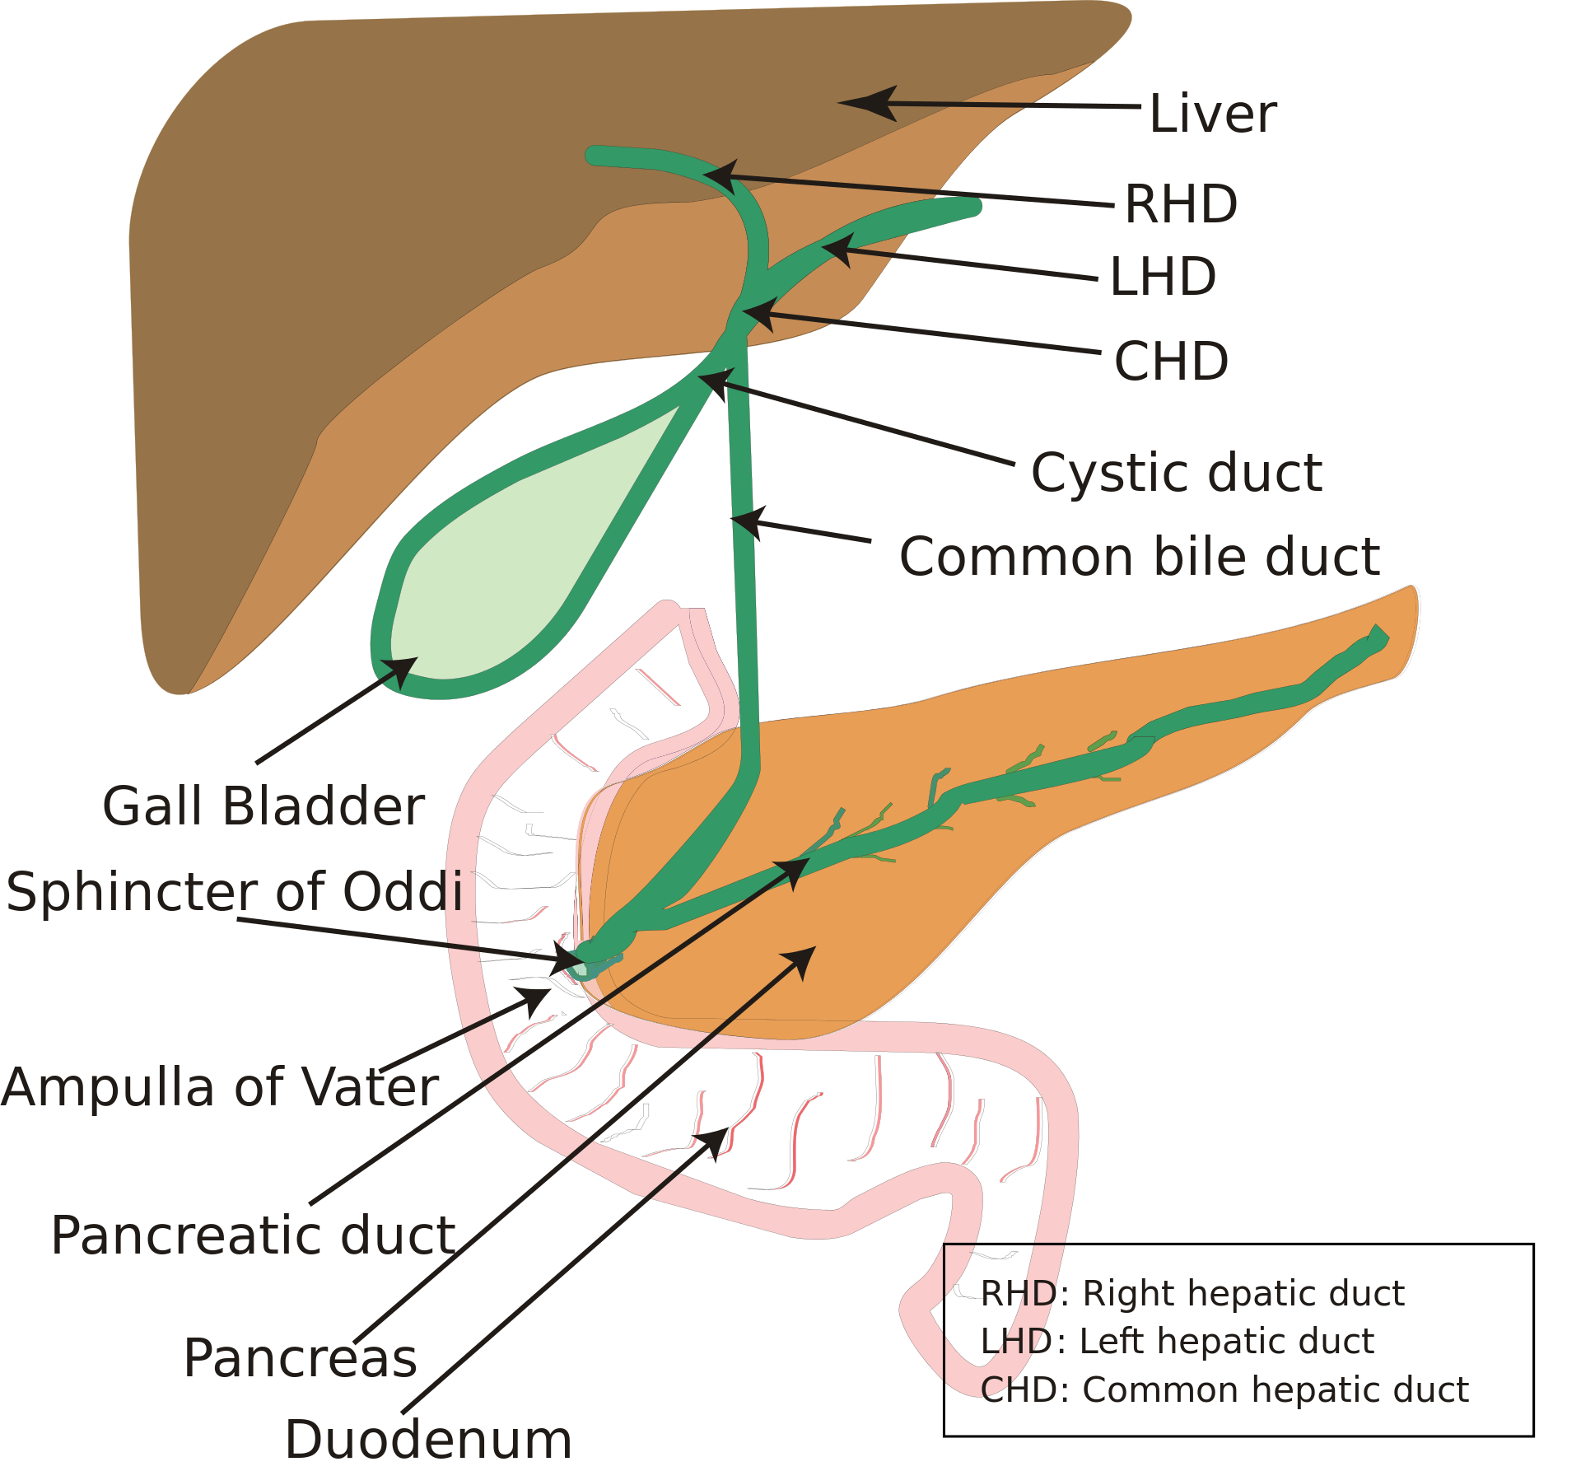
Hepatobiliary system
https://upload.wikimedia.org/wikipedia/commons/thumb/1/1e/Biliary_system_new.svg/1920px-Biliary_system_new.svg.png

Slide 56
Hepatobiliary diseases
Prolonged contraction of Sphincter of Oddi can lead to:
Biliary colic
False positive on intraop cholangiogram
Drugs that relax Sphincter of Oddi reducing biliary pressure:
Glucagon
Glycopyrolate
Atropine
Naloxone (not a good idea for an anesthetized pt)
Nitroglycerine

Slide 57
Hepatobiliary diseases
Decreased flow or stoppage of bile (Cholestasis) is most common cause of disease
Most common cause of obstruction:
Gallstones
Tumor
Stricture of hepatic duct or common bile duct

Slide 58
Hepatobiliary diseases
Obstruct cystic duct → Gallbladder distension, edema, perf risk, jaundice
Obstruct common bile duct → cholecystitis, jaundice, pancreatitis, peritonitis
Incidence ↑ with obesity, age, rapid wt loss, pregnancy, women>men
3 F’s: Fat, Female, Forty
Symptoms: fever, leukocytosis, pain in RUQ, Murphy’s sign (pain worse on inspiration)
Prolonged NPO or fasting → ↑ gallstone formation from lack of CCK release (stasis)
Cholecystitis = gallbladder inflammation → cholecystectomy
Cholelithiasis = gallstones → cholecystectomy
Choledocholithiasis = stones in common bile duct → ERCP (endoscopic retrograde cholangiopancreatography)

Slide 59
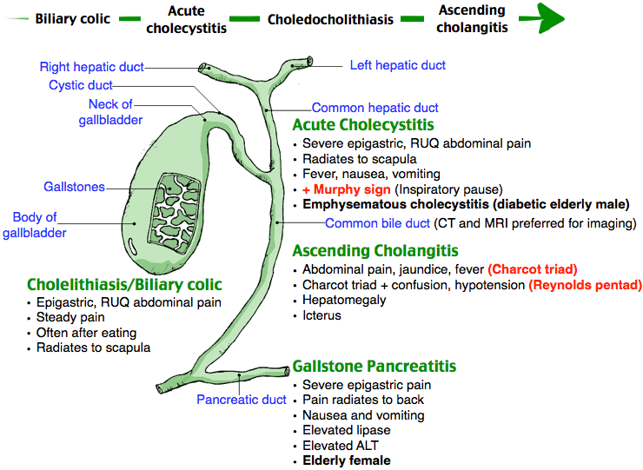
Hepatobiliary diseases
https://i.pinimg.com/originals/27/62/80/2762802c899bd2e3b9187a17ec813451.png

Slide 60
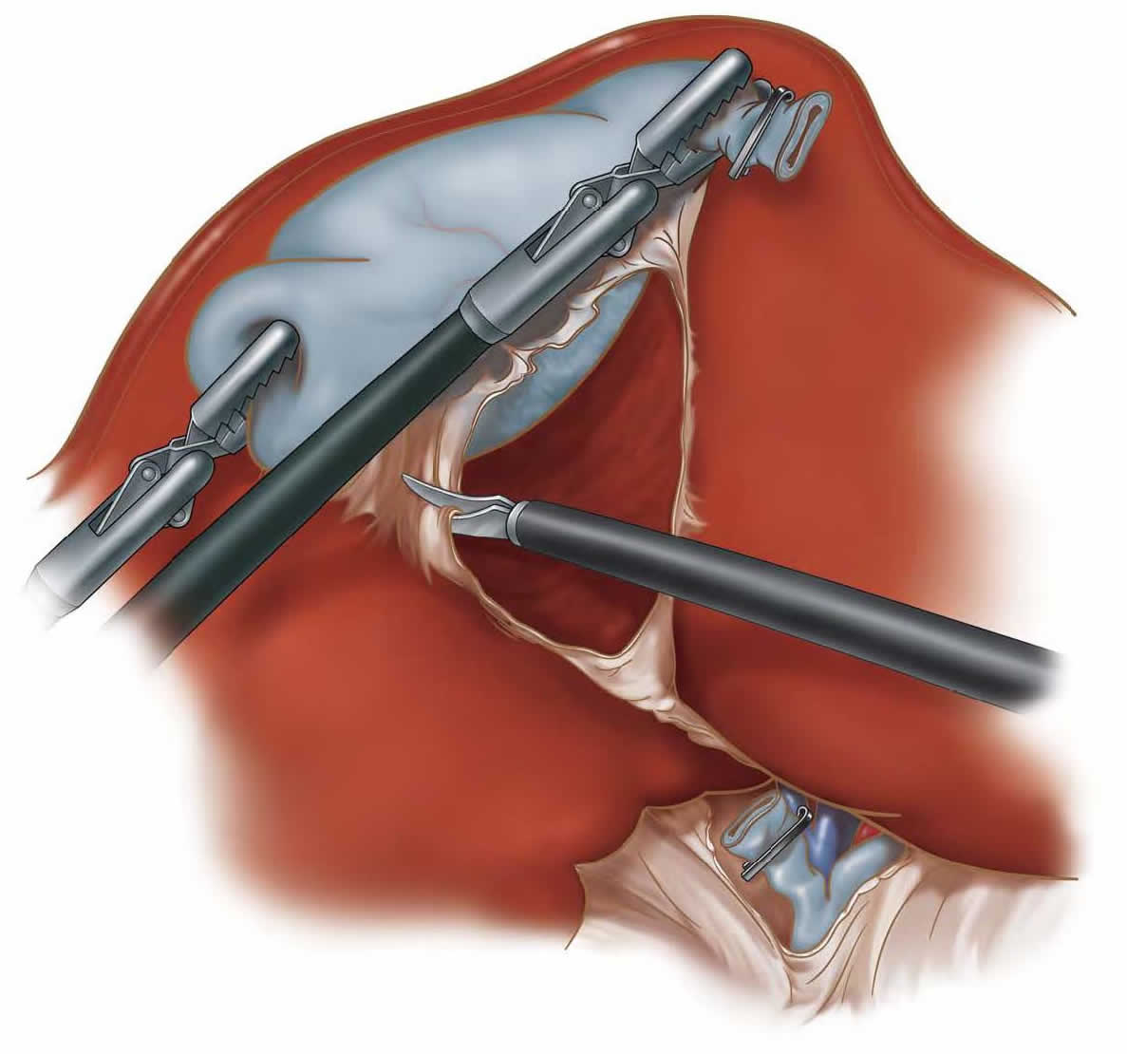
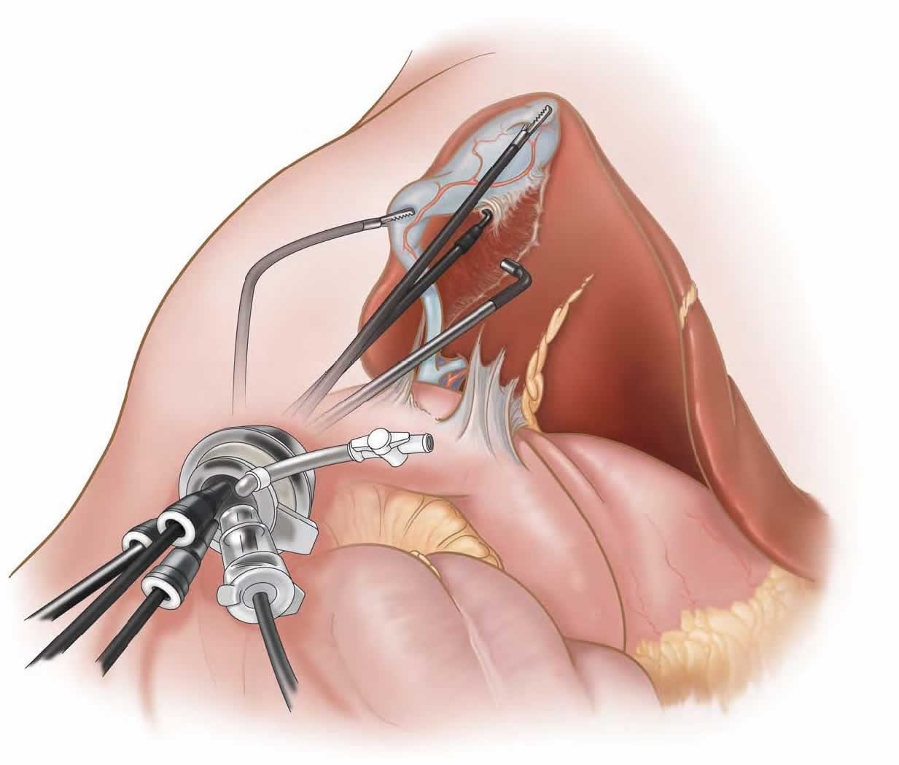
Laparoscopic cholecystectomy
Most common as laparoscopic procedure >90%, may see open, Robotic assisted laparoscopy becoming more popular.
Less postop pain with laparoscopic than open
http://www.laparoscopicexperts.com/wp-content/uploads/2016/09/laparoscopic-cholecystecomy-d.jpg
http://www.laparoscopicexperts.com/wp-content/uploads/2016/09/laparoscopic-cholecystecomy.jpg

Slide 61
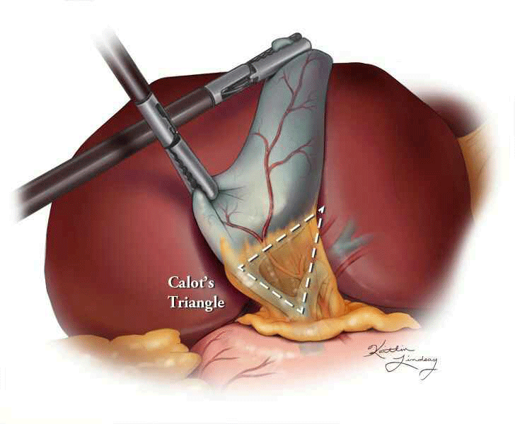
Laparoscopic cholecystectomy
Calot’s triangle (Cystohepatic triangle)
Cystic duct, Common bile duct,
and undersurface of liver
Contains vessels and ducts
dissected and sealed during
lap chole
https://www.meyersmedmal.com/wp-content/uploads/2015/06/calots-triangle.gif

Slide 62
Laparoscopic cholecystectomy
Preop considerations
Very common procedure, may do at night but depends on surgeon
Thorough history as usual
Contraindications – severe, uncorrectable coagulopathy or severe COPD or CV issues
Labs as needed – look at hx, Liver function
Will be on antibiotics – check last dose and if more needed and when, Max antiemetics, caution with narcs – Oddi constriction
Typically done outpatient or with overnight stay, postop pain typically minimal

Slide 63
Laparoscopic cholecystectomy
Preop considerations
Acalculus cholecystitis has high rate of perf and gangrene.
Combine Acalculus Chole with ascending cholangitis – very ill
Sy – fever/chills, jaundice, RUQ pain (Charcot’s triad), N/V,

Slide 64
Laparoscopic cholecystectomy
Intraop considerations
General with ETT only safe method due to abd inflation
May want to consider RSI
General monitors, one IV is adequate but make sure runs well
Position – often both arms tucked, steep reverse trendy
After intubation place OG to evac air in stomach
Caution with NDMB dose – sx can be very quick (Sugg game changer)

Slide 65
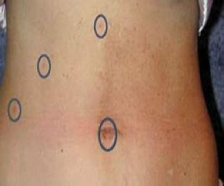
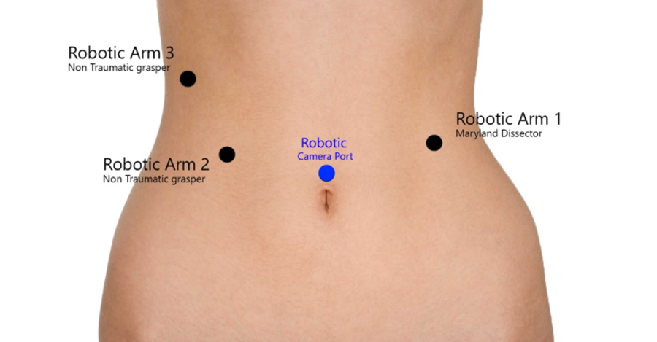
Laparoscopic cholecystectomy
Robotic vs non-robotic (old fashioned) lap chole
Further from patient with robot
Arms always tucked, no access to arms, 2 IVs
Cover face – robot arms swing wildly, can hit face
Laparoscopic holes
Robot holes
https://d2oc0ihd6a5bt.cloudfront.net/wp-content/uploads/sites/2288/2017/04/laparoscopic_cholecystectomy.jpg
http://assets.cureus.com/uploads/figure/file/14790/lightbox_38acdc003b2911e785a39dd76ccd4e51-Webp.net-resizeimage.png

Slide 66
Laparoscopic cholecystectomy
Effects of Pneumoperitoneum - ↑ abdominal pressure
Ventilatory:
abdominal contents and diaphragm pushed cephalad
↑ aspiration risk – ETT
↑ peak airway pressures + ↓ FRC = difficult ventilation (worse in obese)
Absorbed CO₂ → ↑ ETCO₂, adjust vent appropriately (pressure control?)
Avoid N₂O, Inflates bowel, obstructs view
May see vagal response – severe bradycardia with initial inflation
May see ↓ CO and CVP from press on vena cava and head-up position → hypotension

Slide 67
Open cholecystectomy
May be indicated with emergently ill, existing infection, or pt’s who pose technical challenge – morbid obese, adhesions
Much more postop pain, respiratory splinting
Potential for peritonitis
Pt’s usually very ill with CV compromise

Slide 68
ERCP
Used for CBD stones – diagnosis and removal.
Preop – same as for Chole but pts usually very ill
Intraop – Done like an EGD, pt usually sedated – heavily but may need pt cooperation
Potential for duodenal or pancreatic perf

Slide 69
Thank you

Slide 70
References
1. Barash, P. G., Cullen, B. F., Stoelting, R. K., Cahalan, M. K., Stock, M. C., Ortega, R., Sharer, S. R. & Holt, N. F. (2017). Clinical Anesthesia (8th ed.). Wolters Kluwer. 2. Hines, R. L. & Marschall, K. E. (2018) Stoelting’s Anesthesia and Co-existing Disease. (7th ed.). Elsevier. 3. Nagelhout, J. J. & Elisha, S. (2018). Nurse Anesthesia (6th ed.). Elsevier.

