Slide 1
Anesthetic Management for Renal and Urology Patients
Todd Walter DrAP, APRN, CRNA

Slide 2
Objectives
Discuss the pathophysiology of acute and chronic renal disease.
Outline anesthetic management goals for patients with renal disease.
Describe normal and abnormal renal function tests.
Describe effects of anesthetic medications on renal system.
Discuss perioperative considerations for renal and genitourinary surgical patients.

Slide 3
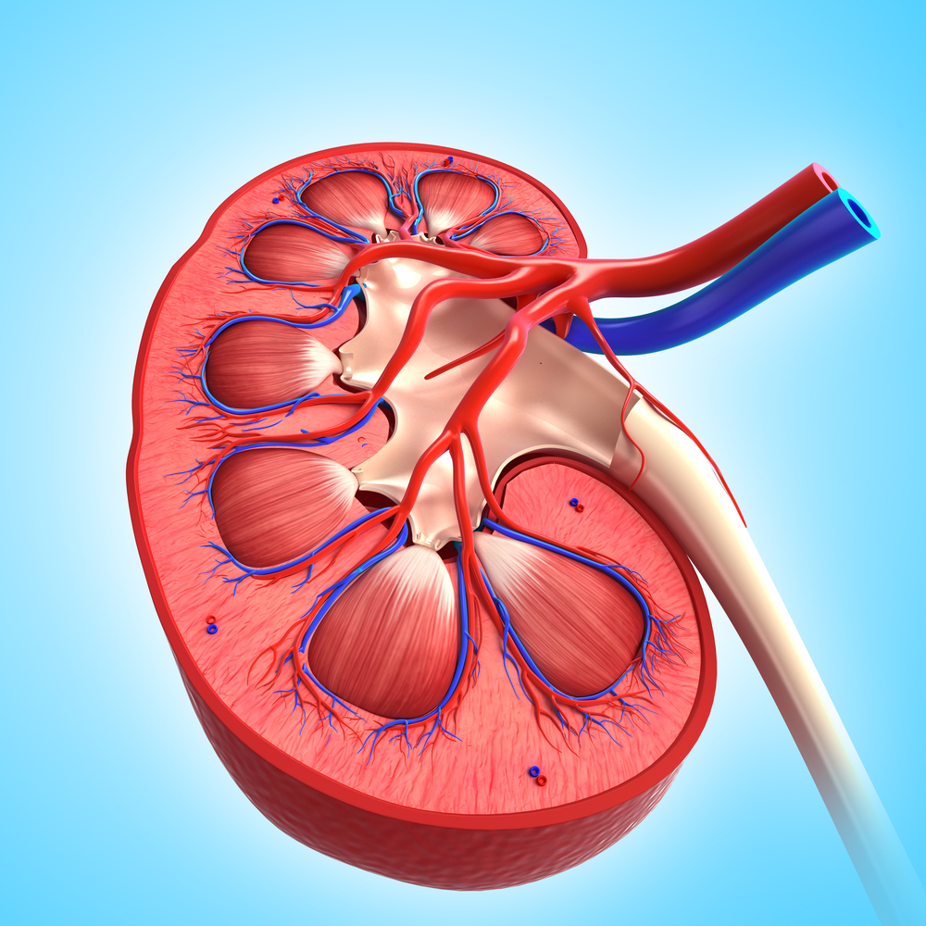
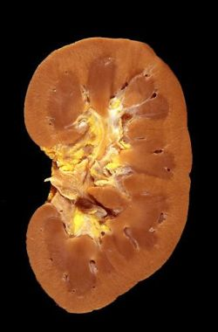
The Kidney
Depositphotos_14024810_s-2019.jpg (1000×1000) (econlib.org)
kidney.jpg (250×380) (wordpress.com)

Slide 4
By Armando Hasudungan Nephrology - Kidney Physiology Overview – YouTube Nephrology - Kidney and Nephron Overview - YouTube
Renal Physiology Overview

Slide 5
1. Fluid volume and composition regulation Aldosterone from Adrenal Cortex → reabsorption of Na and water ADH (Vasopressin) from hypothalamus → ↑ tubular permeability → ↑ H₂O reabsorption Also regulated: K⁺, Ch⁻, Phosphate, Magnesium, H⁺, bicarb, glucose, and urea 2. Regulation of BP Intermediate control via the Renin-Angiotensin-Aldosterone system Long-term control via thirst (intake) and excretion (output)
Basic Functions of the Kidney
Six Basic Functions

Slide 6
3. Toxin and metabolite excretion Filtration by glomeruli → excretion Kidney is capable of Phase I and II biotransformations 4. Acid-Base maintenance vital to enzyme and cellular function Titration of H⁺ in tubular fluid → acidic or basic urine Kidneys excrete non-volatile acids; Lungs excrete volatile acids (CO₂) 5. Blood Glucose Control Kidneys capable of Gluconeogenesis (glucose from amino acids)
Six Basic Functions cont.

Slide 7
6. Hormone Production Erythropoietin (EPO) Released due to ↓ PaO₂ from anemia, ↓ volume, or hypoxia Stims stem cells in marrow to produce erythrocytes Severe kidney dis → anemia Prostaglandins PGE2 and PGI2 dilate renal arts, Thromboxane A2 constricts Calcitriol (Active Vit D3) Inactive D3 (Calciferol) from skin → liver makes 25-hydroxycholecalciferol Kidney converts to 1,25-hydroxycholecalciferol (Calcitriol) Calcitriol controls serum Ca⁺⁺ Stims intestine to absorb more Ca⁺⁺ Causes Kidney to ↓ Ca⁺⁺ and Phosphate excretion Increases Ca⁺⁺ into bone
Six Basic Functions cont.

Slide 8
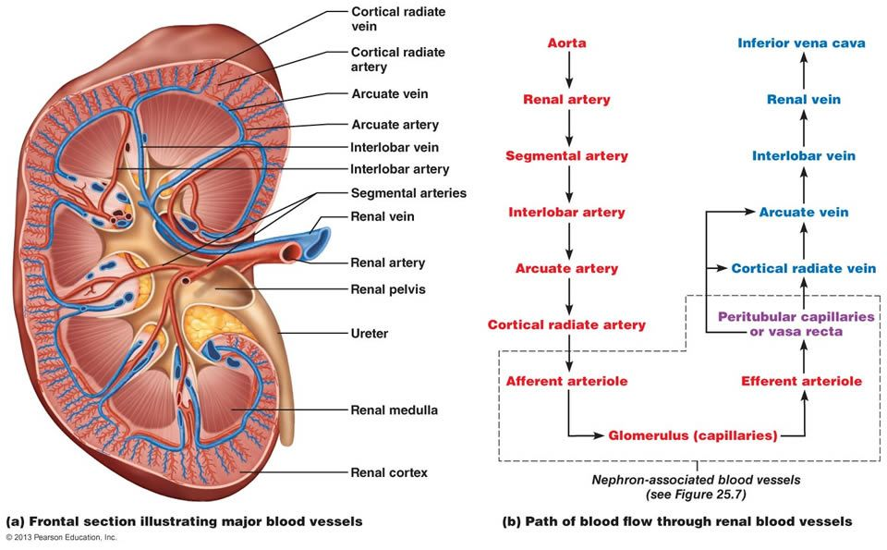
Kidneys receive 1100 – 1200 mls of bld per minute, 20 -25% of CO
Renal Blood Flow
18b6cba5e4f6a23e4744f4bc934c586a.jpg (960×595) (pinimg.com)

Slide 9
Regulation of Renal Blood Flow (RBF) RBF = (MAP - Renal Venous Pressure) / Renal Vascular Resistance Renal Cortex receives 90% of RBF while Medulla receives only 10% PO₂ in Medulla is only 10 mmHg compared to 50 in Cortex Medulla is very sensitive to hypoxia → ischemia RBF decreases 10% per decade after age 50
Renal Blood Flow

Slide 10
Autoregulation Blood flow remains normal despite change in pressure MAP range is 50 – 180 mmHg Filtration stops below 50 mmHg If renal perfusion too low → ↓ RVR → ↑ RBF If renal perfusion too high → ↑ RVR → ↓ RBF
Renal Blood Flow

Slide 11
Autoregulation Primary mechanisms Myogenic - ↑ renal artery pressure → constriction of afferent arteriole protecting glomerulus ↓ renal artery pressure → dilation of afferent arteriole ↑ blood flow Tubuloglomerular Feedback – Juxtaglomerular apparatus in distal tubule between afferent and efferent arterioles. Uses Na and Cl concentrations in distal tubule to affect arteriole tone. Negative feedback loop. Also see effects from: Renin-Angiotensin-Aldosterone System (RAAS), prostaglandins, atrial natriuretic peptide, and SNS from T-8 to L-1
Renal Blood Flow

Slide 12
Three mechanisms for renal vasodilation Prostaglandins Atrial natriuretic peptide Dopamine receptors (DA 1 in kidney) Renal-dose Dopamine does not really treat Acute Kidney Injury Fenoldopam – new DA 1 receptor agonist has shown to protect kidney function using low dose (0.1-0.2 mcg/kg/min)
Renal Blood Flow

Slide 13
Amount of glomerular filtrate formed each minute in all nephrons Filtration fraction is amount of renal plasma flow to become filtrate GFR / flow to one kidney = filtration fraction ~ 20% filtered by glomerulus, called ultrafiltrate Rest, ~ 80%, is unfiltered and enters peritubular capillaries ~ 99% of ultrafiltrate reabsorbed in peritubular capillaries Remaining ultrafiltrate (1-1.5L/day) excreted as urine Blood in peritubular caps empties into vena cava
Glomerular Filtration Rate (GFR)

Slide 14
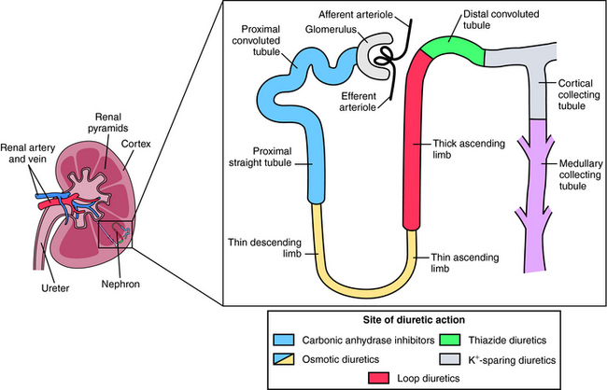
Know the different classes of diuretics and their effects on the kidney -Carbonic Anhydrase Inhibitors Acetazolamide & Dorzolamide -Osmotic Diuretics Mannitol, Glycerin, Isosorbide -Loop Diuretics Lasix, Bumetanide, Ethacrynic Acid -Thiazide Diuretics HCTZ, Chlorthalidone, Metolazone, Indapamide -Potassium-sparing Diuretics Spironolactone, Amiloride, Triamterine
Diuretics
image175.jpg (650×418) (doctorlib.info)

Slide 15
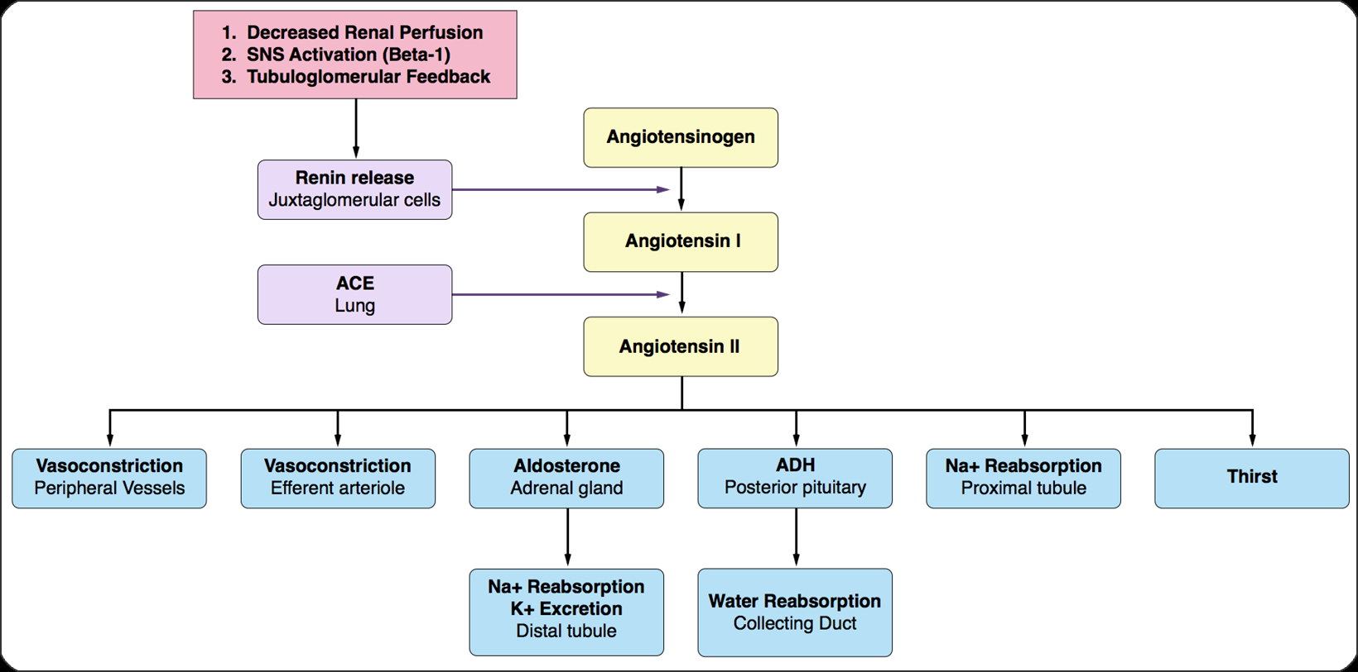
Controls salt and fluid retention via the Juxtaglomerular Apparatus
Renin-Angiotensin-Aldosterone System (RAAS)
Apexanesthesia.com

Slide 16
Hypotension → Renin release from Kidneys to start process Angiotensin II – Vasoconstriction Stimulates pituitary to release ADH Stimulates adrenal release of epi, norepi, and aldosterone Aldosterone – Causes distal tubules & collecting ducts to reabsorb Na & H₂O Increases intravascular volume May also be increased by ↑ K and ↓ Na
RAAS

Slide 17
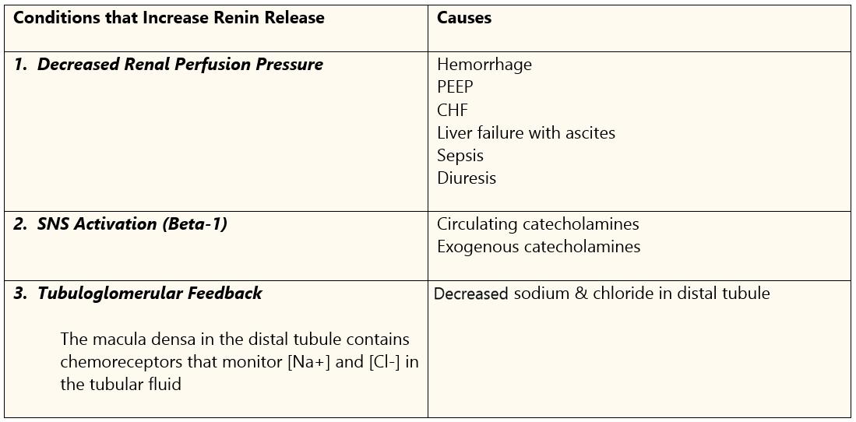
Apexanesthesia.com
RAAS

Slide 18
Produced in supraoptic and paraventricular nuclei of hypothalamus Stored and released by posterior pituitary gland Released by - Increased osmolarity of extracellular fluid (ECF) Osmolarity = # of osmols/Liter of solvent Osmolality + # of osmols/Kg of solvent Serum Osmolarity = 2[Na⁺] + (Glucose/18) + (BUN/2.8) Normal = 280-290 mOsm/L - ↓ blood volume
Antidiuretic Hormone (ADH)

Slide 19
How does it work? - Stimulates V 2 receptor in collecting ducts (↑ cAMP) Aquaporin 2 channels inserted into collecting duct walls H₂O reabsorbed → ↓ plasma osmolarity & ↑ urine osmolarity Result - ↑ Plasma volume - Stimulates V 1 receptor → peripheral vasoconstriction → ↑ SVR Half-life of ADH is 5-15 min Anesthesia effects ADH through BP and blood volume PEEP, Pos Press Vent, hypotension, and hemorrhage
ADH

Slide 20
Tests used to evaluate renal function
Renal Function Tests
Test | Reference Value
Glomerular Filtration Rate
Blood Urea Nitrogen concentration (BUN) | 10-20 mg/dl
Serum Creatinine Concentration | 0.6-1.3 mg/dl
Creatinine Clearance | 110-140 ml/min
Urine Protein (albumin) excretion | < 150 mg/day
Renal Tubular Function and/or Integrity
Urine Specific Gravity | 1.003-1.030
Urine Osmolality | 50-1400 mOsm/L
Urine Sodium Excretion | < 40 mEq/L or 1-3%
Glucosuria
Enzymuria N-Acetyl-β-glucosamidase Α-Glutathione S-transferase
Factors that influence interpretation
Dehydration, variable protein intake, GI bleeding, catabolism, advanced age, skeletal muscle mass, and accurate timing of urine volume measurement.

Slide 21
Urinalysis - Specific Gravity and Urine osmolality - Detects proteinuria and hematuria BUN - Low = liver disease and/or starvation - High = ↓ GFR and ↑ protein catabolism Creatinine - Directly related to muscle mass - Inversely related to GFR Creatinine Clearance (best indicator of GFR) GFR = [(140 – age) x body wt (kg)] / [72 x serum Cr (mg/dl)] (multiply by 0.85 for females)
Renal function Tests

Slide 22
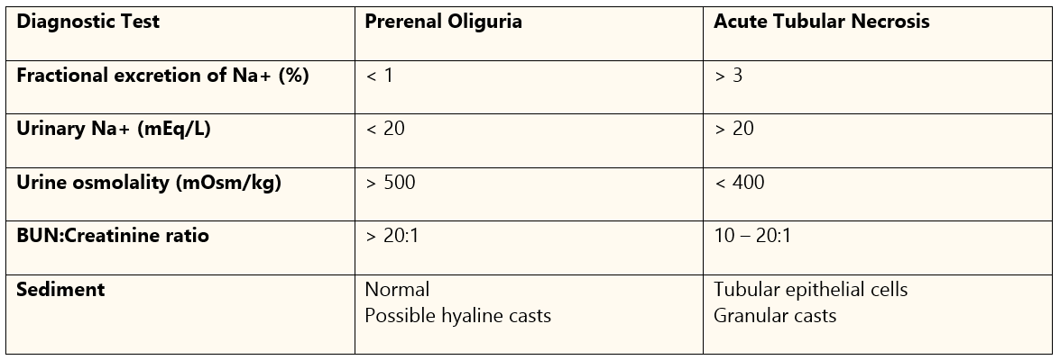
Differential diagnosis of prerenal oliguria vs acute tubular necrosis
Renal Function Tests
Apexanesthesia.com

Slide 23
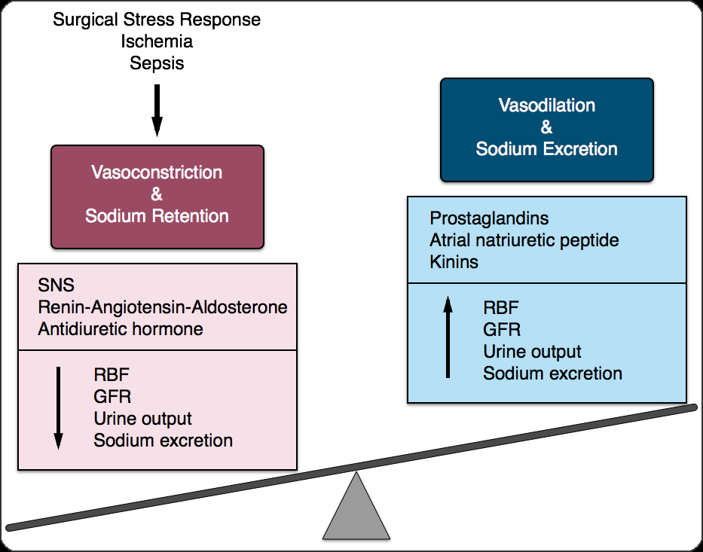
Normally SNS effects are overridden by internal autoregulation During stress (surgery) or injection of external catecholamines, SNS may reduce renal blood flow (vasoconstriction) and Na retention May last several days postop
Effects of Surgery on Renal Function
Apexanesthesia.com

Slide 24
Major causes of postop morbidity and mortality Too much or too little fluids! Postop renal failure -Mortality rate for hospital-acquired AKI > 20% -If dialysis required mortality > 50% -Only 15% of AKI pt’s recover full function
Surgery and the Kidney

Slide 25
General anesthesia leads to temporary depression of : RBF GFR Urinary flow Electrolyte excretion Less so with spinal/epidural Factors influencing depression: Type and duration of surgery Physical status of pt Volume and electrolyte status Depth of anesthesia and choice of agent
Anesthesia and Kidney Function

Slide 26
Anesthetics have both direct and indirect effect on renal function Effects on circulation, endocrine, and SNS → ↓ renal perfusion and/or ↑ renal vascular resistance Degree of impairment relates to degree of sympathetic block RBF may ↓ by 30-40% possibly due to impaired autoregulation Most changes are transient and rebound postop
Anesthesia and Kidney Function

Slide 27
Kidneys are vulnerable to toxic metabolites Fluoride ion toxicity from breakdown of inhalation agents Signs of fluoride nephrotoxicity: Polyuria Hypernatremia Serum hyperosmolality ↑ BUN and serum creatinine ↓ Creatinine clearance
Anesthesia and Kidney Function

Slide 28
Inhalation agents and fluoride toxicity Desflurane – Least toxic fluoride levels Isoflurane – Slightly more than Des but still well below toxic Sevoflurane – 5-8% metabolism to fluoride + hexafluoro-2-propranolol (HFIP) Most metabolites formed by liver and not in Kidney itself so less effect Rxn with CO₂ absorbent → Compound A (renal toxin) Factors assoc. with high levels of Compound A: High agent conc, ↑ absorbent temp, low flow rates, high CO₂ production, and strong base absorbents – sodium or potassium hydroxide. Still no studies show renal toxicity with sevo Methoxyflurane – Worst for Kidney, not seen anymore
Anesthesia and Kidney Function

Slide 29
Risk factors for periop AKI -Preexisting Kidney disease -Prolonged renal hypoperfusion -CHF -Elderly -Sepsis -Jaundice -High risk surgery
Acute Kidney Injury (AKI)

Slide 30
AKA Acute Renal Failure (ARF) Abnormality of the renal system appearing within 48 hrs Diagnosed by 0.3 mg/dl or 50% ↑ in serum creat and UO <0.5ml/kg/hr for 6hrs Typically occurs in hospital: 5-7% of all pts (15-40% of ICU pts) Community acquired AKI <1%
Acute Kidney Injury

Slide 31
3 physiological categories 1. Prerenal – hypoperfusion, no parenchymal damage to kidney -Causes : hypovolemia, ↓ CO, systemic vasodilation, renal vasoconstriction, or ↑ intra-abdominal pressure. (see box 32.1, p. 690, Nagelhout 6th ed f or more specific causes) -Treatment : restore RBF by hemodynamic support, renal prostaglandins for renal vasodilation – Avoid NSAIDS, If UO improves after IV bolus – confirmed Prerenal Maintain MAP >65 mmHg using crystalloids or colloids (avoid starches) Caution with excess saline and diuretics to ↑ UO
AKI

Slide 32
2. Intrinsic – Involves renal parenchyma Prerenal may progress to intrinsic if not treated Causes: Tubular injury – ischemia (from hypovol.) or Nephrotoxic drugs Tubulointerstitial injury, Glomerular injury, Renal microvasculature, & large vessels (See table 32.1 p. 690, Nagelhout 6th ed f or more specific causes) Treatment: Restore renal perfusion
AKI – 3 categories cont.

Slide 33
3. Postrenal (Obstructive) – Acute obstruction of urinary tract Block can be anywhere between collecting system and urethra. Causes may involve upper or lower urinary tract and be extrinsic or intrinsic. (See Box 32.2 p 691, Nagelhout 6th ed for more specific causes) Treatment: Remove blockage
AKI – 3 categories cont.

Slide 34
Old classifications based on UO – Oliguric, Nonoliguric, & Poliuric. Current classification based on creat clearance (more sensitive)as well as UO 1. RIFLE: Risk of renal dysfunction, Injury to kidney, Failure of Kidney function, Loss of function, and ESRD (end-stage renal disease) 2. AKIN: Acute Kidney Injury Network (stage I – III)
AKI

Slide 35
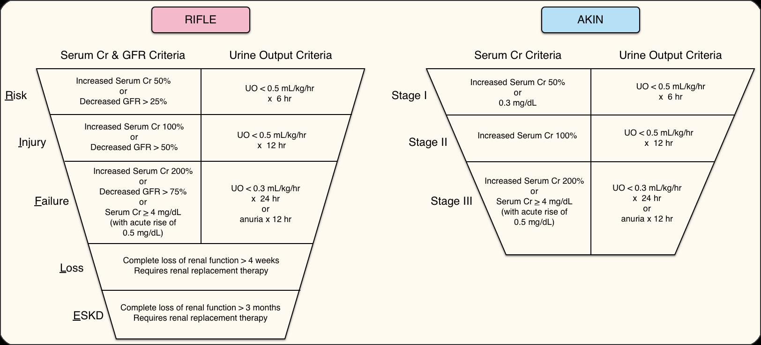
AKI RIFLE vs AKIN

Slide 36
ID and reverse causes For Oliguria – UO <0.5 ml/kg/hr (1-2 ml/kg/hr if on mannitol) Serial fluid boluses with 0.9 NS but avoid overload Caution with diuretics – hypovolemia worsens AKI Give diuretics if Oliguria persists with fluid bolus and hemodynamic stable Maximize cardiac function to maximize GFR May want central line
AKI Management

Slide 37
Fluid management with renal insufficiency Hydrate preop with saline 10-20 ml/kg for UO of 0.5-1 ml/kg/hr Replace volume deficits NS for 3rd space loss 2-3 ml/kg/hr Small blood loss – replace 3:1 with crystalloids Blood loss >10-15% - replace 1:1 with RBCs and Colloids Goal is to maintain blood volume
AKI Management

Slide 38
https://expertconsult.inkling.com/read/hines-stoeltings-anesthesia-co-existing-disease-7e/chapter-22/chronic-kidney-disease#fc93f70715f54f979576b7d6e794fc3e
Drugs used in Anesthesia relying on Renal Elimination
Class | Drugs
Induction agents | Phenobarbital Thiopental
Muscle relaxants | Metocurine Pancuronium Vecuronium
Cholinesterase inhibitors | Edrophonium Neostigmine
Cardiovascular drugs | Atropine Digoxin Glycopyrrolate Hydralazine Milrinone
Antimicrobials | Aminoglycosides Cephalosporins Penicillins Sulfonamides Vancomycin
Analgesics | Codeine Meperidine Morphine

Slide 39
https://expertconsult.inkling.com/read/hines-stoeltings-anesthesia-co-existing-disease-7e/chapter-22/acute-kidney-injury#befad90331b14df8b1293b005c290d64
Dose Adjustments with Renal Insufficiency
Drug | Adjustment Method | GFR > 50 mL/min | GFR 10–50 mL/min | GFR < 10 mL/min
Acetaminophen | ↑ Interval | q4h | q6h | q8h
Acetylsalicylic acid | ↑ Interval | q4h | q4–6h | Avoid
Alfentanil | ↔ Dose | 100% | 100% | 100%
Codeine | ↓ Dose | 100% | 75% | 50%
Fentanyl | ↓ Dose | 100% | 75% | 50%
Ketorolac | ↓ Dose | 100% | 50% | 25%–50%
Meperidine | ↓ Dose | 100% | Avoid | Avoid
Methadone | ↓ Dose | 100% | 100% | 50%–75%
Morphine | ↓ Dose | 100% | 75% | 50%
Remifentanil | ↔ Dose | 100% | 100% | 100%
Sufentanil | ↔ Dose | 100% | 100% | 100%
↑, Increase; ↓, decrease; ↔, no change; GFR, glomerular filtration rate.

Slide 40
Slow, progressive, & irreversible Definition – CKD is when GFR < 60 ml/min per 1.73 m² for 3 months Causes – Most common is diabetes mellitus followed by hypertension Others – Glomerulonephritis, Pyelonephritis, Hyperlipid, autoimmune dis, obesity, and congenital defects.
Chronic Kidney Disease (CKD)

Slide 41
5 stages of Kidney damage 1. Kidney damage with normal or increase GFR > 90ml/min/1.73m² 2. Mild decrease with GFR 60-89 ml/min/1.73m² 3. Moderately decreased with GFR 30-59 ml/min/1.73m² 4. Severe decrease with GFR 15-29 ml/min/1.73m² 5. End-stage Kidney failure – GFR <15 ml/min/1.73m² Requires dialysis
CKD

Slide 42
End Stage Renal Disease (ESRD) 95% loss of functioning nephrons Complications associated with ESRD Uremic Syndrome Uremic Bleeding Renal Osteodystrophy Anemia Neurologic changes Cardiopulmonary changes Acid-base and electrolyte changes Infection
CKD

Slide 43
Uremic Syndrome Cluster of symptoms (anorexia, N&V, pruritis, anemia, fatigue, & coagulopathy) Reflects decline in kidney function. Kidney fails to excrete toxins including – urea, p-cresol, & β₂ macroglobulin BUN good indicator of severity Tx – Protein restriction and dialysis
ESRD

Slide 44
Uremic Bleeding Increased bleeding tendency despite normal plt count, PT, & PTT Bleeding time is best test to determine risk May lead to GI bleed, epistaxis, hemorrhagic pericarditis, & subdural hematoma Tx – Desmopressin (vWf) IV or SQ 0.3 ug/kg May use Cryoppt but higher risk of infection Dialysis should be done within 24 hrs of sx
ESRD

Slide 45
Renal Osteodystrophy Changes in mineralization of bones Due to secondary hyperparathyroidism and ↓ Vit D production by kidneys → impaired absorption of Ca → ↑ PTH secretion → bone reabsorption Tx – goal to prevent bone loss Vit D supplements Antacids to bind phosphorus – caution with mag or aluminum antacids Ultimately subtotal parathyroidectomy
ESRD

Slide 46
Anemia Possible cause of many symptoms Normochromic and normocytic Due to ↓ erythropoietin production by kidney Tx – Recombinant Human Erythropoietin (epoetin or darbepoetin) Iron supplements also are given. Caution with bld transfusions – sensitization to HLA reduces transplant success.
ESRD

Slide 47
Neuro changes Due to impaired nerve conduction Early signs – impaired abstract thinking, insomnia, irritability May progress to – symmetric mixed motor and sensory neuropathy worse in legs, often hidden by diabetic neuropathy Finally to – seizures, encephalopathy, coma Tx – Dialysis may improve symptoms but no other treatment
ESRD

Slide 48
Cardiopulmonary changes RAAS activation → HTN and Na and fluid retention → CHF and Pul edema Also often see CAD, pericarditis and cerebrovascular disease HTN also speeds renal failure High triglycerides > 500 and/or LDL cholesterol > 100 →↑ mortality MI often silent due to neuropathy Hyperventilation seen as response to metabolic acidosis Tx – Dialysis is primary tx but does little for HTN Increasing doses of antiHTN drugs used, ACE inhibs may make ESRD worse
ESRD

Slide 49
Acid-base and electrolyte imbalance ↓ excretion of non-volatile acids → Gap metabolic acidosis Shift of oxyhemoglobin curve to the right Hyper-K from ↓ K excretion (!! Avoid Succ!!) Also see ↑ Phosphate, ↑ mag, ↑ uricemia, ↓ Ca, and ↓ albumin Tx – For K < 6 mEq/L Glucose (25-50g) + insulin (10-20 U) Hyperventilation (for each 10 mmHg ↓ in PaCO₂ →↓ serum K of 0.5 mEq/L Sodium Bicarb (50-100 mEq) For K > 6 – Dialyisis CaCl may reduce risk of fatal dysrhythmias from high K
ESRD

Slide 50
Infection Increased risk due to impaired white cell function and low protein diet Also many pts on immunosuppressant drugs Frequent blood transfusions open pt up to viral infections Tx – Antibiotics but caution due to increased renal toxicity
ESRD

Slide 51
Dialysis Ultimate treatment for renal failure until transplant 5 indications for use: 1. Volume overload unresponsive to diuretics 2. Persistent hyperK 3. Severe metabolic acidosis 4. Symptomatic Hyperuremia 5. OD with drug cleared by dialysis
ESRD

Slide 52
Dialysis is the separation of particles in a liquid based on the differences in their ability to pass through a membrane. Hemodialysis – moves blood through device with individually prescribed dialysate solutions across a semipermeable membrane. Requires anticoagulation CRRT (Continuous Renal Replacement Therapy) Blood moves from arterial cath by pump through membrane and pumped back via venous cath Peritoneal Dialysis – uses pt’s own tissue in abdominal cavity as filter No need for vasc access or anticoag, can be done at home Less effective than Hemodialysis and not as controlled Better for pts that cannot tolerate fluid shifts – CHF, unstable angina
Dialysis for ESRD

Slide 53
Complications of dialysis CNS – Disequilibrium syndrome most serious Rapid ↑ in brain intracellular volume from ↓ Na and BUN Also see dementia CV – Hypotension most common (30%), IV depletion, and arrhythmias Pulmonary – Hypoxemia GI – Ascites and ↓ motility Musculoskeletal – Cramping
Dialysis for ESRD

Slide 54
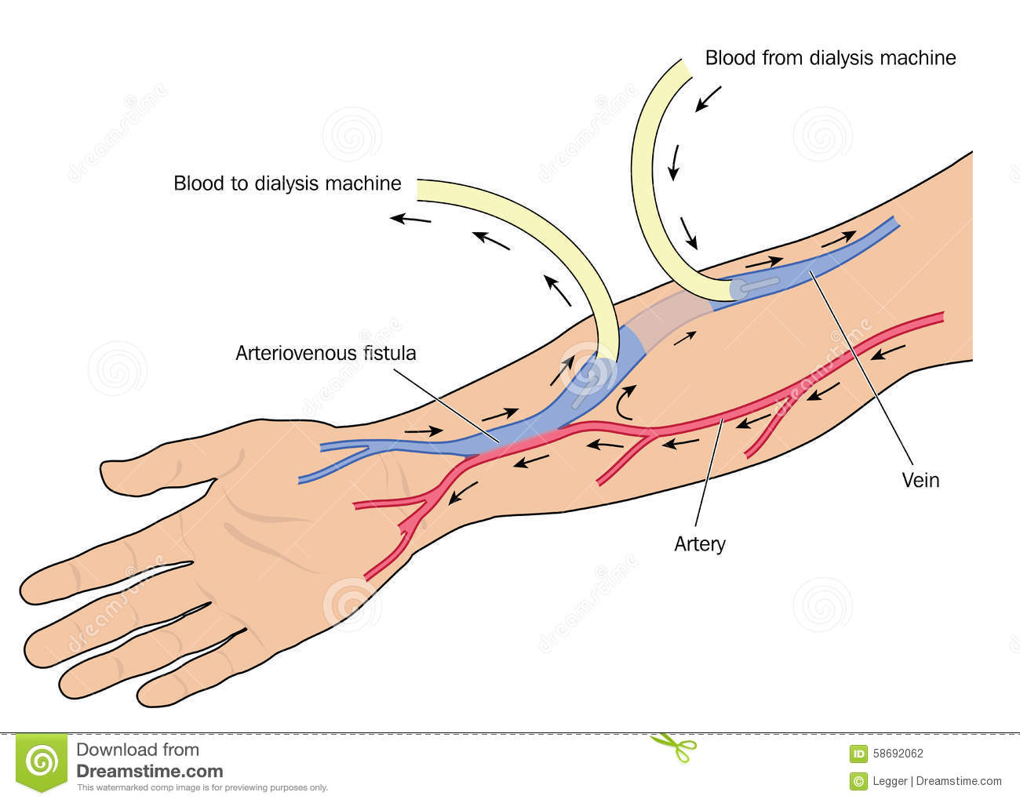
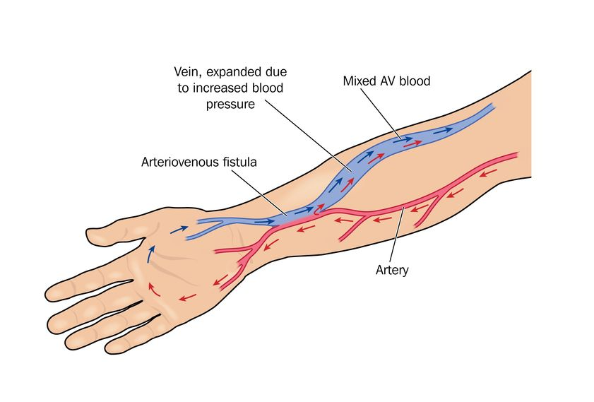
Fistula formation:
Dialysis for ESRD
dialysis-arteriovenous-fistula-blood-taken-patient-kidney-failure-using-arm-artery-vein-created-adobe-58692062.jpg (1300×1024) (dreamstime.com)
fistula.jpg (841×569) (wordpress.com)
AV-Fistula-for-Dialysis.jpg (805×453) (netdna-ssl.com)

Slide 55
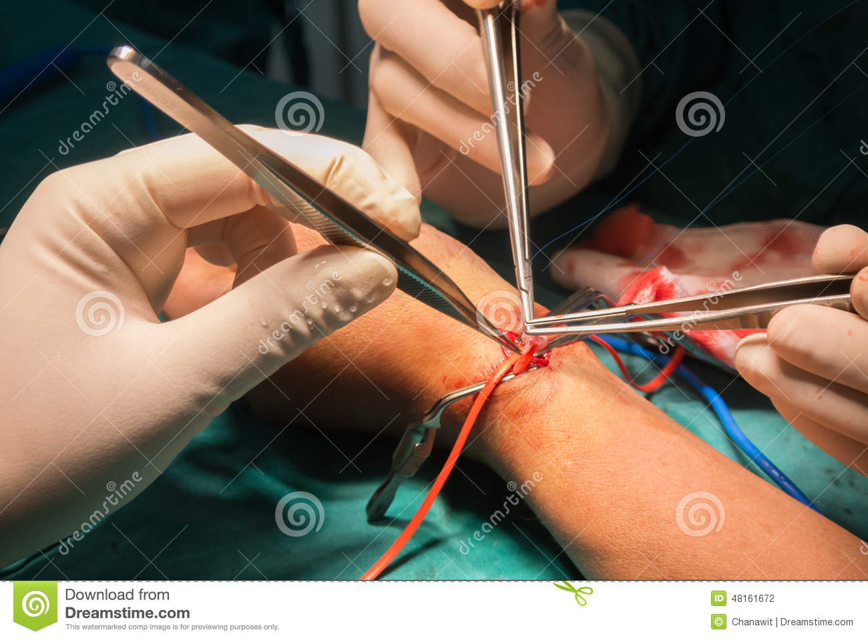
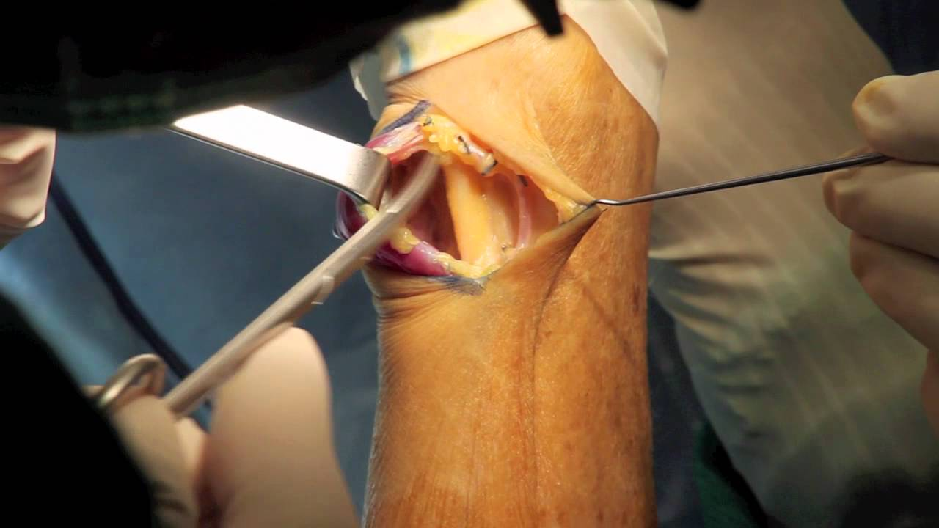
Fistula surgery:
Dialysis for ESRD
maxresdefault.jpg (1280×720) (ytimg.com)
arteriovenous-fistula-operation-dialysis-surgeon-do-48161672.jpg (1300×960) (dreamstime.com)

Slide 56
Anesthesia for Fistula surgery Pts are often very ill – MAC with local infiltration or Brachial plexus block Sedation requirements may be altered due to disease process and surgeon skill For operative arm – No IV, No BP cuff, No TQ unless required by surgeon Be prepared to give heparin per surgeon and reversal possibly Blood loss may be an issue depending on surgeon skill
Dialysis for ESRD

Slide 57
Altered response to anesthetics due to: -Active metabolites -Acidosis → ↑ nonionized fraction of drug -↑ free fraction of drug due to ↓ protein binding -Impaired elimination -Disruption of blood-brain barrier due to uremia May see exaggerated hemodynamics due to -Anti-HTN meds (particularly ACE inhibs) -SNS tone attenuation -Pos. Press. Vent Regional well tolerated but check coags first
Anesthesia and ESRD

Slide 58
Halogenated agents – see previous slide Succ – Safe to use as long as normal K⁺ level (Do NOT use if K >5.5) Avoid continuous infusion as metabolites may build up. Benzylisoquinolines – Cisatracurium and Atracurium Good due to lack of organ regulated metabolism Cis is better due to Atracurium histamine release Aminosteroids – Rocuronium, Vecuronium, Pancuronium Avoid Pan – Kidney elimination Vec will have longer duration due to ↓ elimination Roc is best of these but still may see altered duration
Anesthesia and ESRD

Slide 59
Reversal agents – Anticholinesterases + Anticholinergics and Suggamadex -Antichols both have renal elim. Sug is best Induction agents – Propofol is best but may need ↑ dose Opioids – Morphine metabolite more potent → resp. depression -Meperidine – metabolite may cause convulsions – AVOID -Hydromorph – questionable metabolite effect -Better choices – Fentanyl, Sufentanil, Alfentanil, & Remifentanil Dexmedetomidine – Safe to use but duration may be longer
Anesthesia and ESRD

Slide 60
Kidneys eliminate toxins but may be damaged by them as well Increased risk of toxin damage – Pre-existing dis, hypovol, sepsis, and CHF Radiographic contrast dye Due to cytotoxic effects and vasoconstriction of renal medulla → ischemia Prevention: Use nonionic iso- or low-osmolar dye Lowest vol needed No other nephrotoxic drugs Prehydrate with .9 NS Sodium Bicarb N-acetylcysteine – not as good
Nephrotoxins

Slide 61
Myoglobin from Rhabdomyolysis From muscle trauma, ischemia, or transfusion reactions Filtered by glomeruli but when combined with acidic urine → precipitate and blockage Prevention – Hydration -Mannitol for osmotic diuresis -Keep UO to > 100-150 mL/hr Sodium bicarb or Acetazolamide to neutralize urine
Nephrotoxins

Slide 62
Antibiotics Aminoglycosides – Gent, Tobramycin, Amikacin from free radical damage ↓ risk with hydration, correct risk factors, monitor serum trough levels Others – Amphotericin-B, Vanco, sulfonamides, Tetracycline, Cephalosporins NSAIDS – Avoid Calcineurin inhibitors – Cyclosporin and Tacrolimus Used for transplant pts, may cause HTN and renal vasoconstriction Sirolimus – better choice
Nephrotoxins

Slide 63
Kidney Resection – may be partial, radical, or simple ~ 46,000/yr for benign or malignant disease ~ 5,500/yr for donor kidneys All are with general anesthesia but may involve regional for postop pain Anesthetic management will depend greatly on disease state and comorbidity Thorough preop assessment is vital – why are they having surgery Donors are typically fairly healthy to qualify for donation
Nephrectomy

Slide 64
Preop considerations cont. Risk factors for renal cancer: Smoking Obesity Advanced age Male ESRD or CKD HTN (usually chronic and poorly controlled) All add to difficulty for anesthetic management
Nephrectomy

Slide 65
Resection due to infection – rare, usually related to DM 2 categories 1. Elective – Irreversible damage from pyelonephritis 2. Emergent – Critically ill, typically from acute emphysematous pyelonephritis Mortality rate ~ 43% Hereditary issues may be involved Birt-Hogg-Dube syndrome – may have pul cysts – spon pneumo von Hippel-Lindau syndrome – Pheochromocytoma + neuroendocrine tumors
Nephrectomy

Slide 66
Introp considerations General anesthesia – what you use depends on the pt Lines – may need A-line, Central access, more than 1 IV – fistula? Position – Depends on approach and surgeon preference Lateral with ‘kidney lift’, Supine, steep trendel, lithotomy, maybe even prone Laparoscopic with robot assist becoming more popular, adds new problems for us Be aware of positioning and lack of access, Face cushion
Nephrectomy

Slide 67
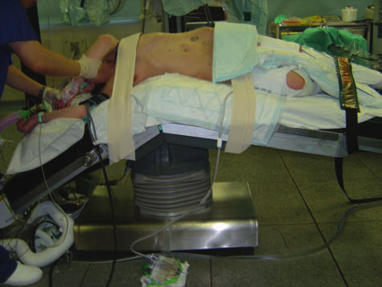
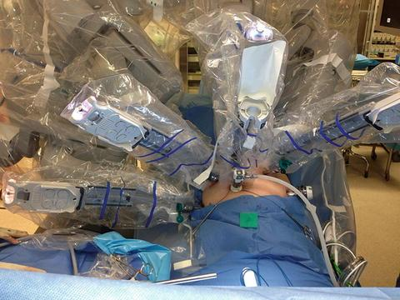
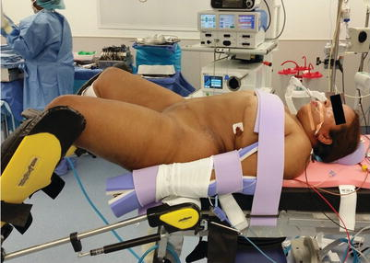
A307466_1_En_8_Fig21_HTML.jpg (480×360) (wp.com)
394592_1_En_10_Fig1_HTML.jpg (401×286) (springernature.com)

Slide 68
Potential intraop complications Major blood vessel injury (IVC, aorta) GI organ injury (spleen, liver, pancreas) Pneumothorax Blood products must be available in case of hemorrhage Hypothermia – Warm IV fluids, difficult to warm much else.
Nephrectomy

Slide 69
Post-op considerations 20% of pts will have postop complications Mortality of 2% Besides hemorrhage and organ injury – may see atelectasis, ileus, wound infections, renal failure of remaining kidney, and incisional hernia. Most common are organ and vascular injury, similar rates for open or lapscope May also see – MI, CHF, PE (air embolus possible with lapscope), CVA, pneumonia, & phlebitis
Nephrectomy

Slide 70
Most often done as an elective, controlled surgery. Cadaver kidneys can be preserved for 48 hrs and live donors are prescheduled Regional or General anesthesia will work but general most common Regional techniques are good for postop pain Lines are a must Be alert when clamps come off – Cardiac arrest from influx of K Biggest postop complication – rejection – removal is only tx With follow-on procedures – be alert to immunosuppression
Renal Transplant

Slide 71
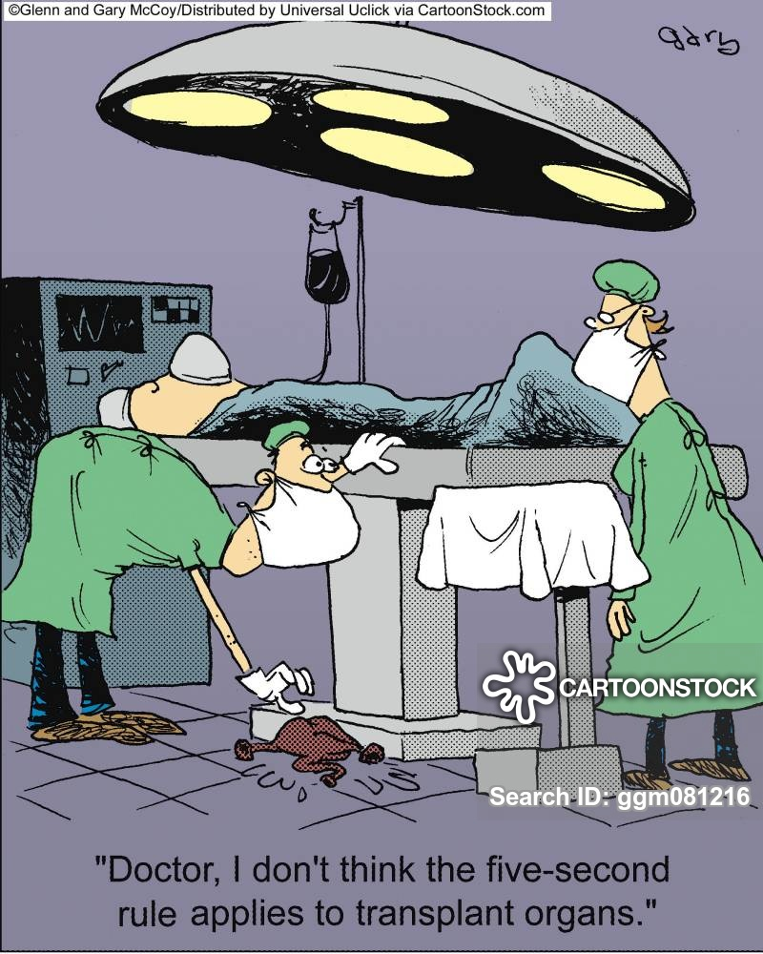
medical-doctor-surgeon-surgery-transplant-transplanting-ggm081216_low.jpg (800×1000) (cartoonstock.com)

Slide 72
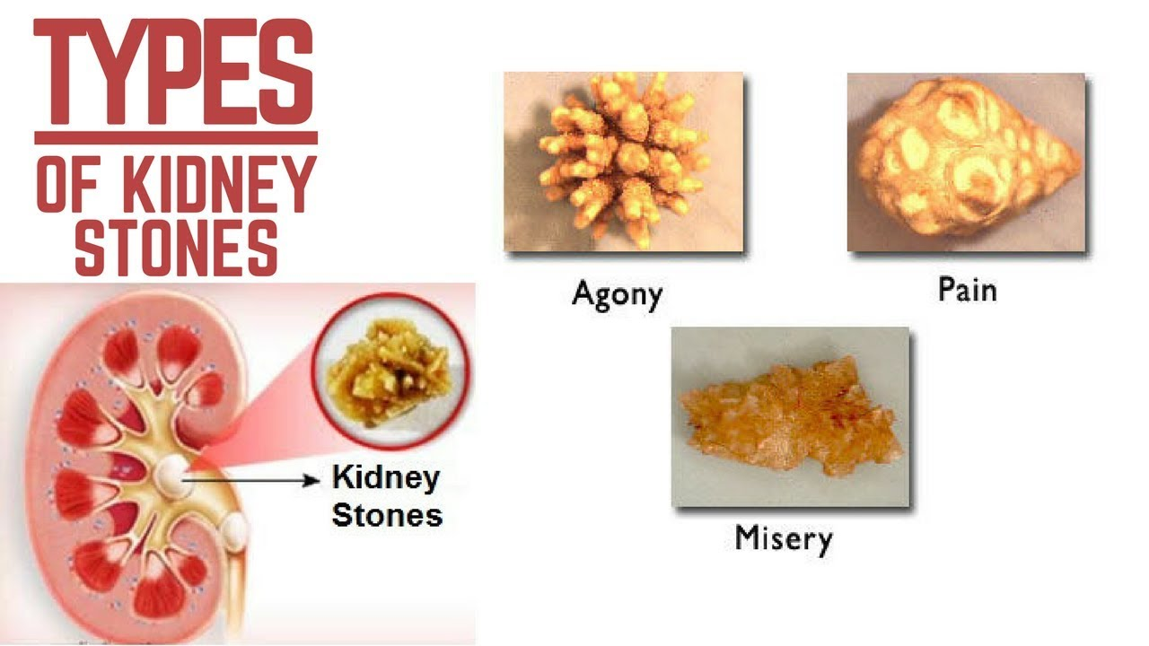
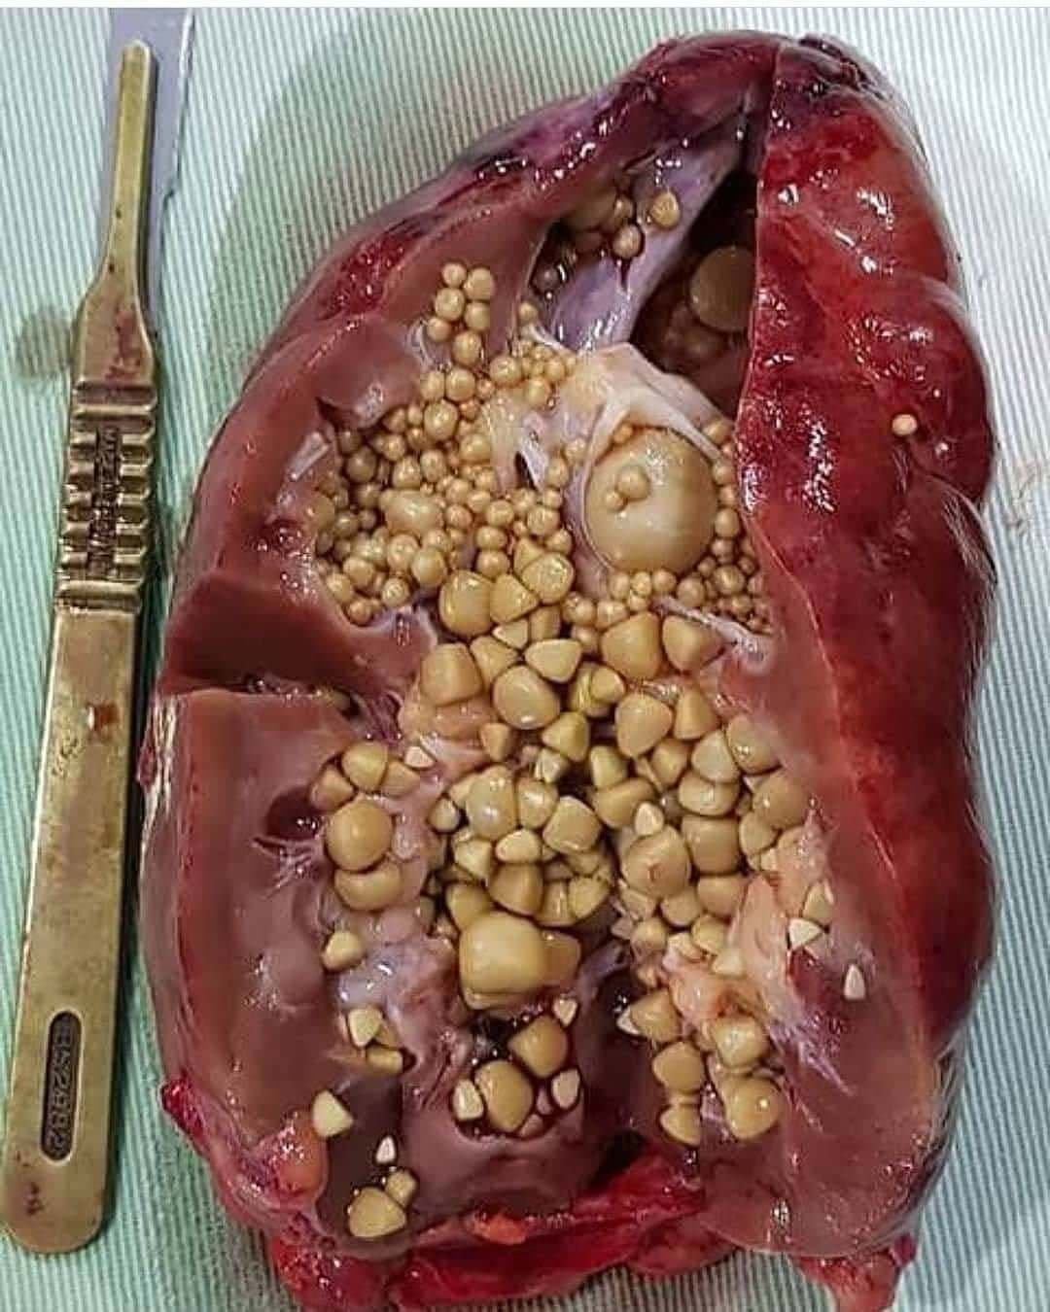
Urolithiasis (Kidney Stones, Renal Stones)
maxresdefault.jpg (1280×720) (ytimg.com)
58wRUCtMgLxVVXOvMEQvqArIomwWC1vef1Bcv4fEtiA.jpg (1080×1350) (redditmedia.com)

Slide 73
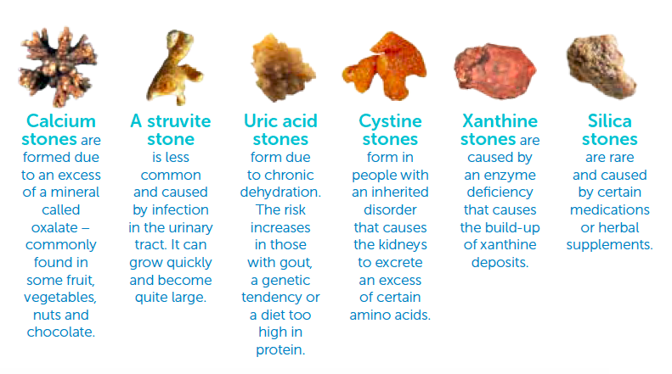
Incidence in US – 13% of men, 7% of women over lifetime Recurrence of 50% in 5 yrs, 80% in 10 yrs Cost of tx - $4.5 billion/yr
Urolithiasis
Stones < 5 mm usually pass
5-10 mm medical management
>10 mm need removal
Nephrolithiasis = Kidney stone
Ureterolithiasis = Ureter stone
Cystolithiasis = Bladder stone
80% of stones
Kidney stone.PNG (791×441) (healthhub.sg)

Slide 74
Extracorporeal Shock-wave Lithotripsy (ESWL) High energy ultra-sound or pneumatic shock waves or lasers Only noninvasive treatment For stones < 10-20 mm Success range 30-100% Most are done outpatient R wave of ECG used to trigger shock wave, placement is important General or regional will work but pt must not move, even breathing may move site Submersion in water or use of gel pad Contraindications – UTI, coagulopathy, distal obstruction, & pregnancy Complications – Tissue damage or organ perforation/rupture, arrhythmias, pain, hypothermia (with submersion), bruising, N&V
Urolithiasis Treatment

Slide 75
Cystoscopy Not open but still invasive May be to place stent, retrieve small stones, break up large stones Stones may be in Kidney, ureter, and/or bladder May use laser, US, or other to break up stones Done most often in lithotomy May be done MAC but typically general or regional Depends on length, goal of sx, and surgeon preference “Patient is Moving!!” (breathing) LMA often useful but some surgeons want paralysis Beginning is most stimulating so if general – deep for start.
Urolithiasis Treatment

Slide 76
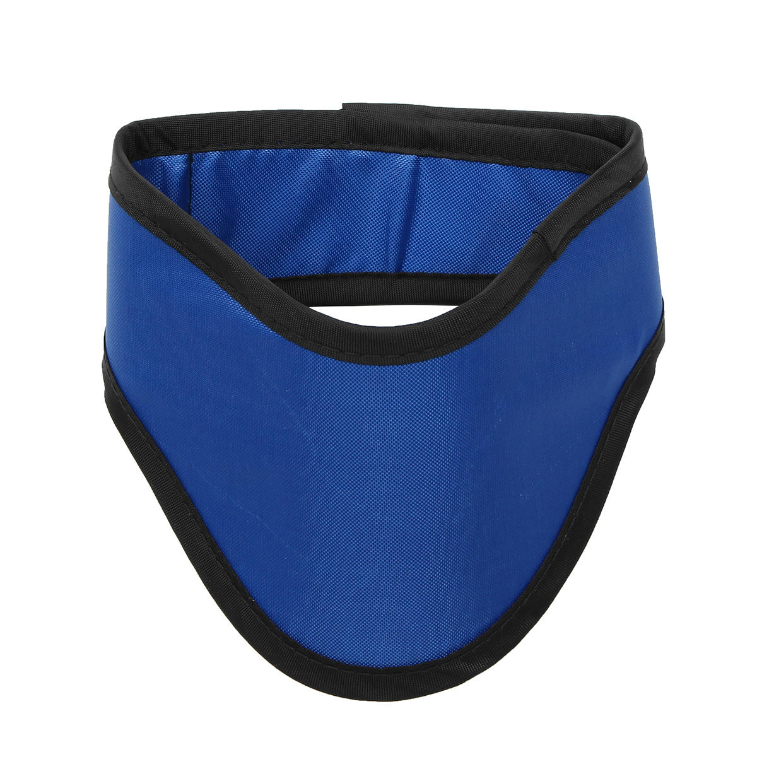
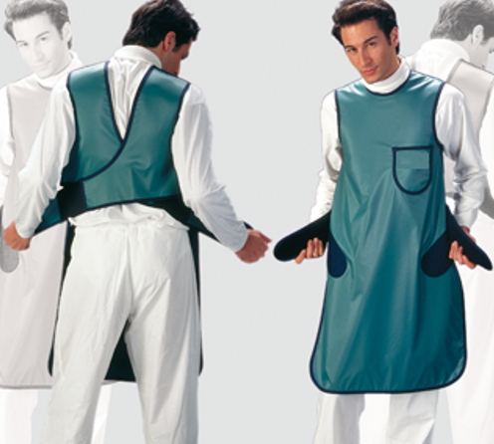
C-arm use Most Kidney stone removals use C-arm x-ray Protect yourself – Lead apron and Thyroid collar, Make sure enough are available
Urolithiasis Treatment
Hang them properly after use

Slide 77
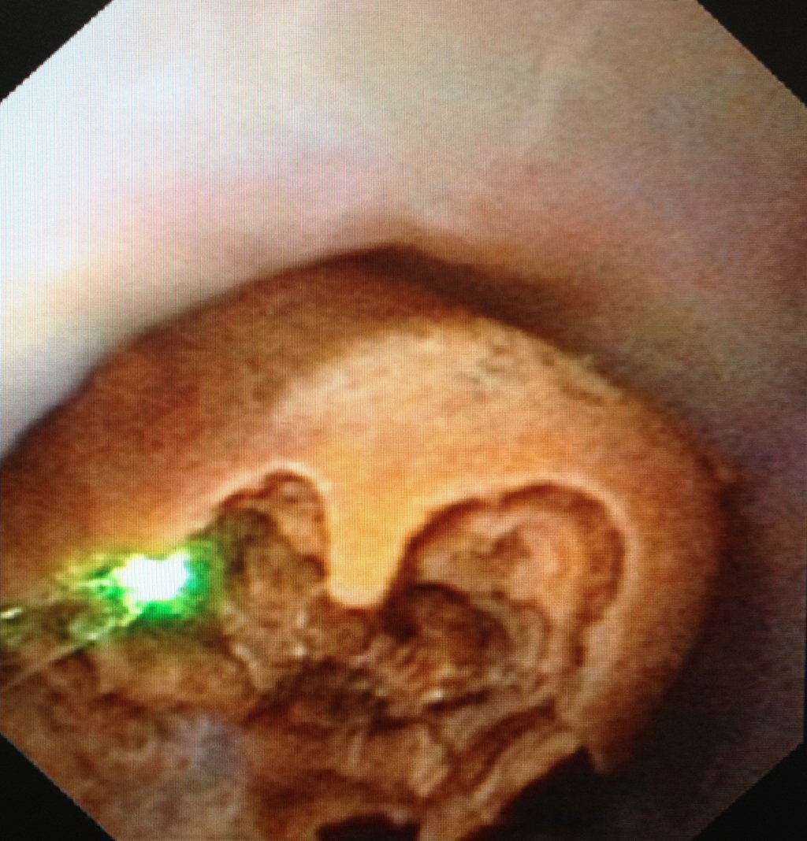
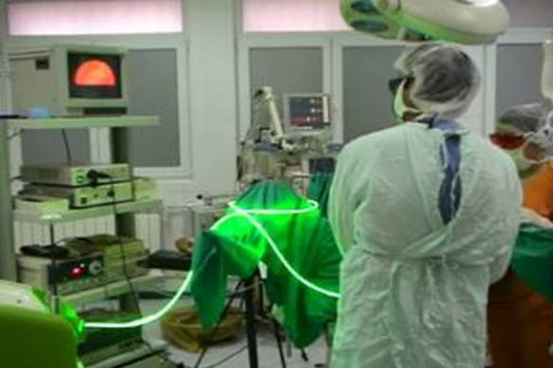
Laser use Different types of lasers in use Again: Protect yourself! Use eye protection, Also protect pt – glasses, damp sponges
Urolithiasis Treatment
Laser-Lithotripsy..jpg (1024×1068) (illpatient.com)
http://www.avantgardeurology.com/details.php?id=294&cat=279

Slide 78
Percutaneous Nephrolithotomy (dreaded Perc Neph) Typically for larger stones embedded in kidney out of reach of cystoscope Often done in Radiology department, heavy use of C-arm General is most often used Choice of agents depends on preop assess of pt comorbidities May start supine but often turned prone during procedure, may also be lateral Need to work around C-arm so need to be flexible Video of Perc Neph (~ 5 min) https://www.youtube.com/watch?v=xW7SKc7SkJE
Urolithiasis Treatment

Slide 79
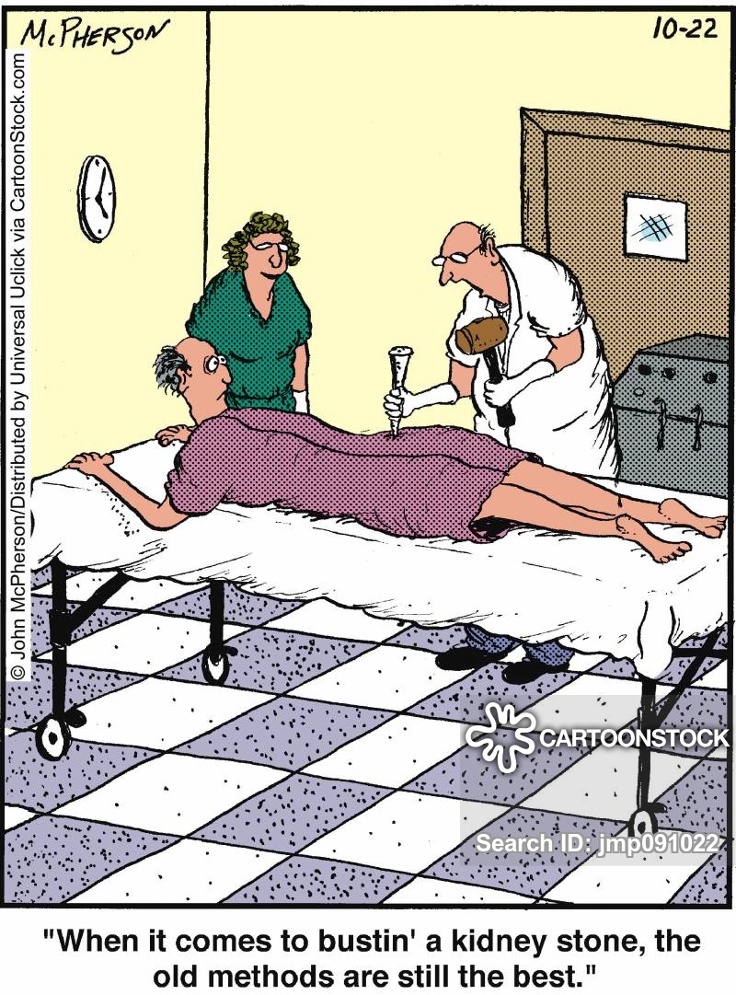
medical-kidney-stone-kidney_stone-doctor-surgeon-jmp091022_low.jpg (800×1081)

Slide 80
Prostate Procedures

Slide 81
Benign Prostatic Hyperplasia (BPH) Non-malignant enlargement of prostate Leads to blockage of urine flow from bladder Medical Tx with 5α-reductase inhibitor (Finesteride) α-adreneregics (tamsulosin) relax smooth muscle - ↑ flow When medical tx fails - Surgery
Prostate Procedures

Slide 82
Minimally invasive procedures Transurethral Microwave Thermotherapy (TUMT) Transurethral Needle Ablation (TUNA) Use heat to shrink prostate by necrosis of tissue Invasive Procedures Transurethral Incision of the Prostate (TUIP) Holmium Laser Enucleation of the Prostate (HoLEP) Photo Selective Vaporization of the Prostate (Greenlight Laser PVP) Transurethral Resection of the Prostate (TURP) Button TURP Bipolar TURP Radical Prostatectomy
Prostate Procedures

Slide 83
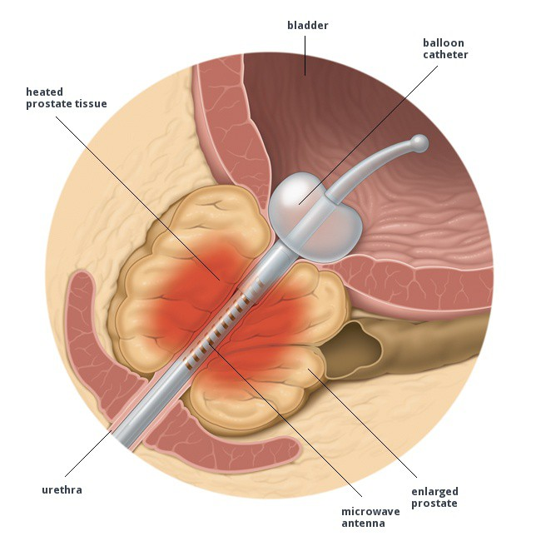
TUMT
Prostate Procedures
TUMT.jpg (650×650) (besthealthandbeautytips.com)

Slide 84
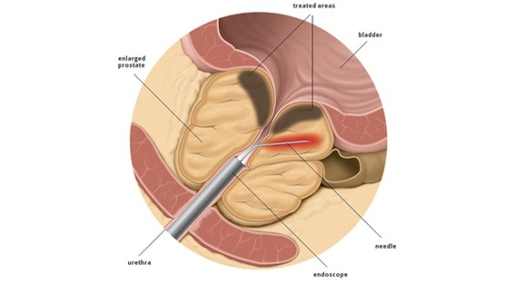
TUNA what-is-transurethral-needle-ablatio n-tuna.jpg (556×313) (prostatecancer911.com)
Prostate Procedures

Slide 85
TUIP
Prostate Procedures
endo-bph-45-638.jpg (638×479) (slidesharecdn.com)

Slide 86
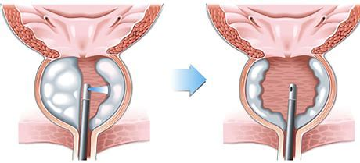
HoLEP
Prostate Procedures
1HoLEP.jpg (800×354) (urologyspecialist.com.au)

Slide 87
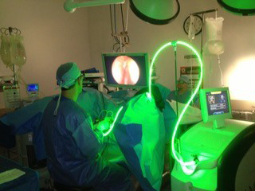
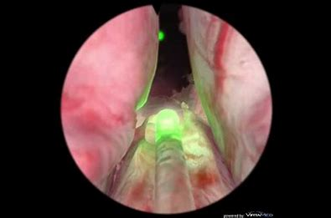
Photo Selective Vaporization of the Prostate (Greenlight Laser PVP) If condyloma present – wear N95 mask
Prostate Procedures
maxresdefault-1.jpg (1280×720) (wordpress.com)
greenlight-laser2018.jpg (320×240) (browardurologycenter.com)

Slide 88
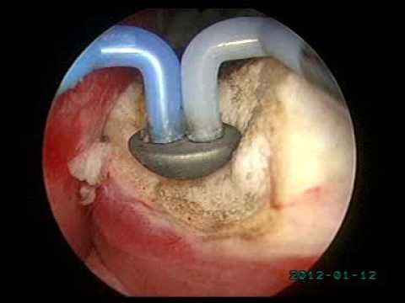
Button TURP (plasma kinetic or bipolar plasma vaporization of prostate - BPVP) Low temp plasma energy instead of heat May be least intrusive, fewer complications, faster healing
Prostate Procedures
hqdefault.jpg (480×360) (ytimg.com)

Slide 89
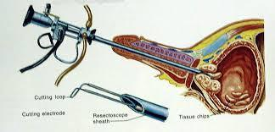
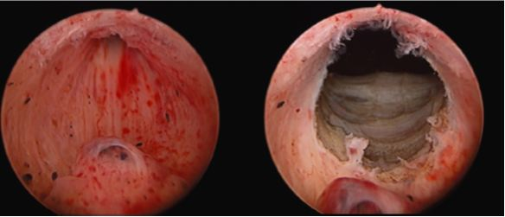
Bipolar TURP Resection of prostate tissue using electrocautery or sharp excision Gold standard and most common surgery in men >60 Outlet channel is opened by cutting away median and lateral lobes of prostate Bladder is distended and continuous irrigation is used
Prostate Procedures
trans-urethral-resection-of-prostate-surgery-500x500.jpg (324×156) (imimg.com)
PQ-TURP.jpg (584×251) (bjuinternational.com)

Slide 90
General or SAB can be done (Yes spinals do work well for these) SAB – Allows for patient evaluation based on their response hypervolemia, hyponatremia, perforation, TURP syndrome Only need level to T-10, length of block will depend on surgeon speed Irrigation fluid is absorbed through open venous sinuses in prostate 10-30 ml/min of resection time is absorbed, longer resection ↑ risks Resection time should not exceed 1 hr
TURP

Slide 91
Complications Intraop: Bladder perforation, skin burns, blood loss, arrhythmias, septicemia, TURP syndrome, hypothermia, & coagulopathy Postop: Inability to void, incontinence, bleeding (transfusion), clot retention, GU infection, & impotence
TURP

Slide 92
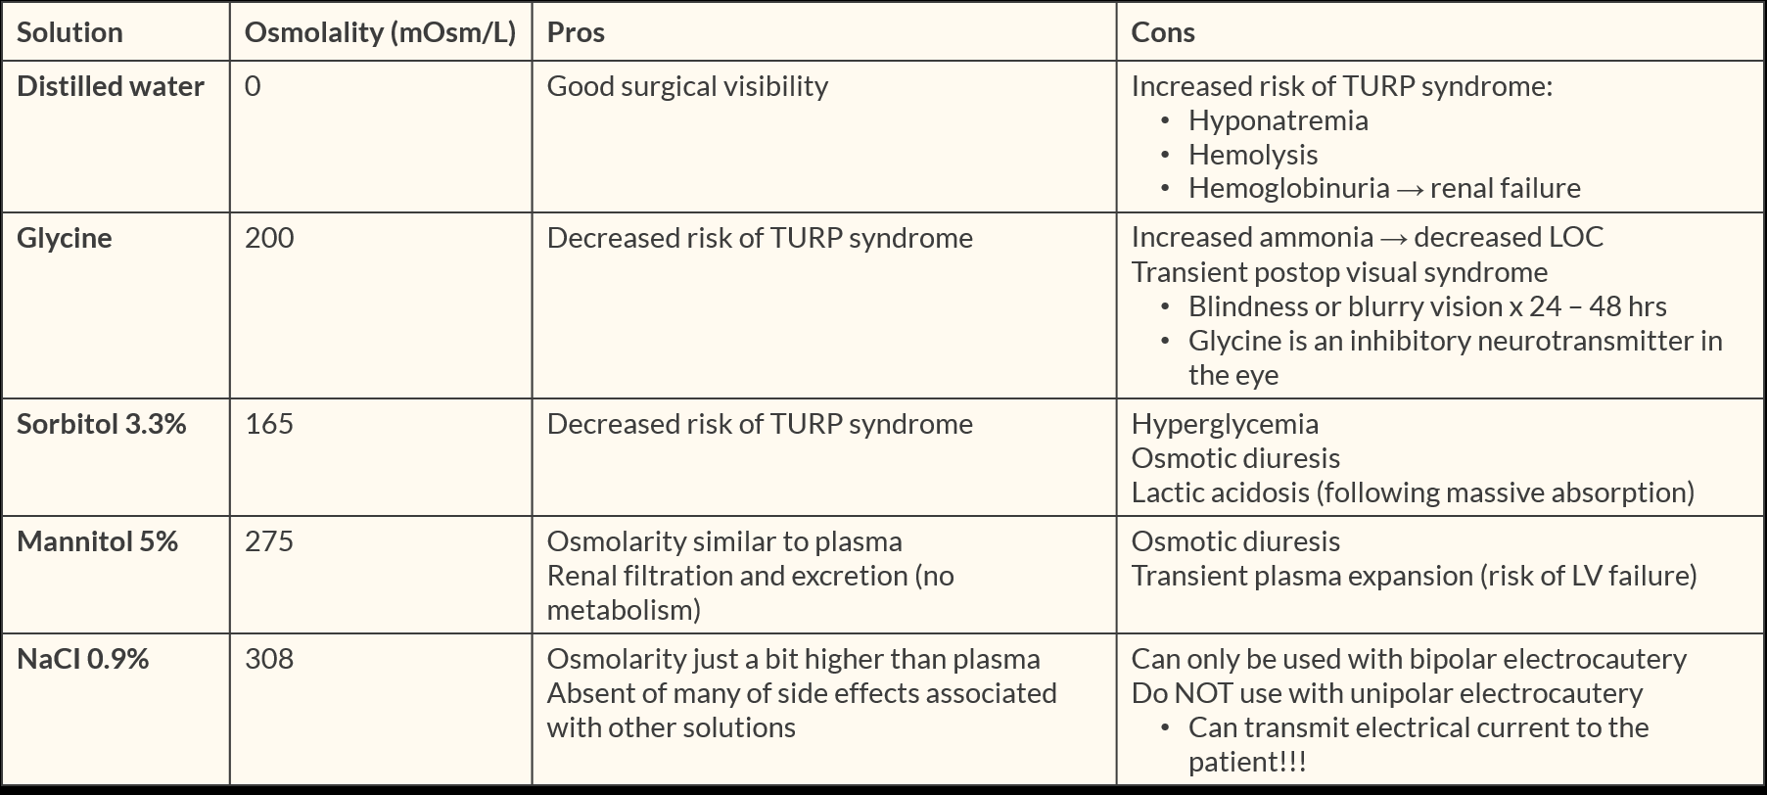
Irrigation solutions Ideally – clear, isotonic, and no toxicity 0.9 % saline or LR good but conduct electricity Water – no electrolytes, TURP syndrome
TURP
Apexanesthesia.com

Slide 93
TURP Syndrome Affected by: number and size of venous sinuses, resect time, hydrostatic pressure of irrigation fluid, venous pressure at irrigant-blood interface Rare but potentially fatal 0.78 – 1.4% occurrence Severe TURP syndrome very rare but mortality 25% Absorption of large volume of irrigation → classic triad: HTN, bradycardia, altered mental state May occur within 15 min of start or 24 hrs postop
TURP

Slide 94
Pathophysiology Clinical Features Fluid overload HTN, Bradycardia, arrhythmia, angina, Pul edema, CHF, hypotension Water intoxication Confusion, restless, twitching, seizures, lethargy, coma, dilated pupils (hypo-osmolality) papilledema, low-volt EEG, hemolysis Hyponatremia CNS changes, ↓ inotropy, wide QRS, low-volt ECG, inverted T-wave Glycine Toxicity N&V, headache, transient blindness, myocard depression, ECG changes loss of light and accommodation reflexes (can still blink) Ammonia toxicity N&V, CNS depression Hemolysis Anemia, acute renal failure, chills, clammy skin, chest tightness, bronchospasm hyperkalemia → malignant arrhythmias or asystole Coagulopathy Severe bleeding, primary fibrinolysis, DIC
TURP Syndrome Pathophys &Clinical features

Slide 95
Prevention: Most important – early recognition of symptoms Avoid Trendelenburg Limit resect time Keep prostate capsule intact until end Irrigation < 60 cm above gland level Check electrolytes during and after Regional with light sedation to check mental status
TURP Syndrome

Slide 96
Treatment Mild – Supportive tx – antiemetics, atropine, vasopressors, diuretics Close observation If detected intraop – Notify surgeon, finish procedure ASAP, Ensure O₂ and circulatory support Draw labs – Lytes, Creat, glucose, ABGs, 12 lead EKG Na > 120 mEq/L – fluid restriction and loop diuretics (Lasix) Na < 120 mEq/L – 3% NaCl IV at 100 ml/hr Correcting too fast → central pontine myelinolysis Midazolam for seizures Intubate and ventilate if difficulty breathing
TURP Syndrome

Slide 97
Prostatectomy Simple – For BPH with very large prostate, rare now with other treatments Most commonly done via retropubic approach Radical – Involves removal of entire prostate, seminal vesicles, and usually surrounding nerves and veins. Due to cancerous tumor May be done open or laparoscopically; perineal or retropubic approach Robot assist becoming more common
Prostate Procedures

Slide 98
Anesthetic Considerations Preop assessment – Often elderly men with comorbidities Do thorough preop eval with history Labs – Hbg, type & screen, be prepared for major blood loss A-line, CVP, 2 large IVs, PA Position – Lithotomy - Trunk flexion - Trendelenburg - Extreme Trendelenburg for robot (watch for air embolus)
Prostatectomy

Slide 99
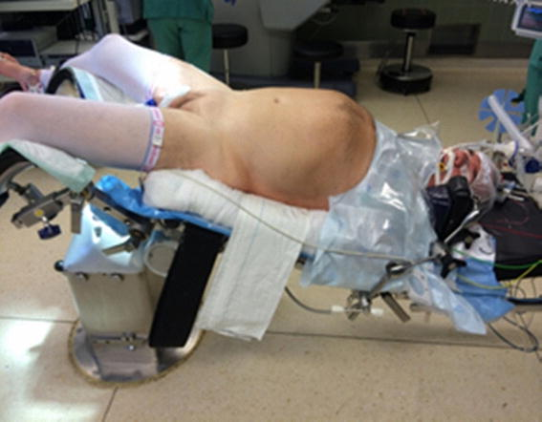
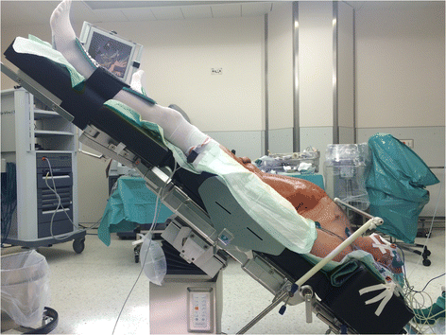
This is Ok. This is Not!!
Prostatectomy
11255_2015_1088_Fig1_HTML.jpg (567×442) (springernature.com)
12871_2017_333_Fig1_HTML.gif (472×354) (springernature.com)

Slide 100
Cystoscopy – Same considerations as Kidney stone retrieval Transurethral Bladder Tumor Resection (TURB) Similar considerations to TURP but usually less risk for TURP syndrome Cystectomy – Removal of all or part of Bladder. Radical – Bladder removal plus other organs and nodes Usually combined with diversion of urine flow (Ileal conduit with stoma) Anesthetic concerns similar to nephrectomy Blood loss is primary concern intra- and post-op
Bladder Procedures

Slide 101
Thank You

Slide 102
1.. Barash, P. G., Cullen, B. F., Stoelting, R. K., Cahalan, M. K., Stock, M. C., Ortega, R., Sharer, S. R. & Holt, N. F. (2017). Clinical Anesthesia (8th ed.). Wolters Kluwer. 2. Hines, R. L. & Marschall, K. E. (2018) Stoelting’s Anesthesia and Co-existing Disease. (7th ed.). Elsevier. 3. Nagelhout, J. J. & Elisha, S. (2018). Nurse Anesthesia (6th ed.). Elsevier.
References

