Slide 1
Obstetrical Anesthesia
Lisa Schaefer, MS, APRN, CRNA

Slide 2
Learning Objectives
Gain knowledge of common obstetric terms and abbreviations
Understand the anatomic and physiologic changes during pregnancy via Trello
Understand uteroplacental circulation and uterine blood flow
Understand placental function
Describe placental transfer and fetal effects of drugs
Understand pain in labor and delivery

Slide 3
Learning Objectives
Describe the stages of labor and delivery
NPO guidelines during labor
Understand the changes in fetal heart rate (FHR)
Describe accelerations and decelerations
Describe analgesic options for labor and delivery
Understand the various intravenous and inhalational options offered during labor and delivery

Slide 4
Learning Objectives
Understand the use of regional anesthesia during labor and delivery
Describe the various local anesthetics utilized in obstetrical anesthesia
Describe causes of a total spine and treatment options
Understand the importance of the test dose during epidural anesthesia
Describe the treatment of an intravascular injection of local anesthetics

Slide 5
Learning Objectives
Understand anesthesia during a cesarean section
Describe the use of Oxytocin during a cesarean section
Describe the use of transversus abdominal plane block in a cesarean delivery
Understand general anesthesia during a cesarean section
Describe the use and benefits of delayed cord clamping
Describe anesthetic complications during delivery
Describe the management of high-risk parturients including those with hypertensive disorders

Slide 6
Learning Objectives
Understand the function and uses of magnesium sulfate
Describe HELLP Syndrome
Understand maternal cocaine abuse
Understand prematurity and tocolytic options
Understand placental abnormalities
Describe amniotic fluid embolism
Understand anesthesia for multiple gestations
Understand external cephalic version
Understand anesthesia for pregnant patients undergoing non-obstetric procedures

Slide 7
Common Terms in Obstetrical
Anesthesia
Clinical Anesthesia - Paul Barash 7th ed.
Nurse Anesthesia - Nagelhout 6th ed. 2018
2021 Apex Anesthesia Review

Slide 8
Definitions
Gravida
Total number of times a woman has been pregnant
Primigravida - or “primip”
A woman pregnant for the first time
Multigravida - or “multip”
A woman pregnant more than once

Slide 9
Definitions
Para
How many living infants delivered
Gravida and Para go together
G1P0 - pregnant once, not delivered
G2P1 - pregnant twice, delivered once
G1P2 - pregnant once, delivered twins
G4P0 - pregnant 4 times, none delivered

Slide 10
Definitions
G#P# - gravida, para
G - total # of pregnancies
P - total # of delivered pregnancies
T- total term deliveries (after 37 wks)
P - total preterm deliveries (20-36 wks)
A - total abortions/miscarriages (<20 wks)
L - total of living children
G8P4-2-2-4 8 pregnancies, 4 term, 2 preterm, 2 abort, 4 living

Slide 11
Definitions
AB - may see SAB (spontaneous) TAB (therapeutic) or EAB (elective)
DM - diabetes mellitus or GDM (gestational)
EDC - estimated date of confinement (due date)
FHT - fetal heart tones
LGA - large for gestational age
SGA - small for gestational age
IUGR - intrauterine growth restriction

Slide 12
Definitions
PPD# - postpartum day #
VBAC - vaginal birth after c-section
TOLAC - trial of labor after c-section
ROM - rupture of membranes
AROM - artificial rupture
PROM - premature rupture (< 37 weeks)
SROM - spontaneous rupture

Slide 13
Definitions
PPH - postpartum hemorrhage
PDPH - post dural puncture headache
PIH - pregnancy- induced hypertension
Used interchangeably with preeclampsia

Slide 14
Amniotic Fluid Embolism
A rare occurrence but may occur during labor or delivery, both vaginal and cesarean
Signs and symptoms include; anxiety, dyspnea, hypoxia, hypotension, cardiovascular collapse, and coagulopathy
50% mortality in first hour
Caused by possible anaphylactoid reaction to amniotic fluid and not purely an embolic event
Clinical management includes; airway management, hemodynamic resuscitation, and treatment of coagulopathy
Treatment modalities consist A-OK = atropine 0.2mg, ondansetron 8 mg and ketorolac 15 mg.
Notes:
Seizure
7 coolers 3 RBC’s, 3 FFP every other platelet

Slide 15
AFE - amniotic fluid embolism
G2P1 IOL maternal request
EDC one week out. Baby LGA
No history of PIH
FHT looked good
Mom received her epidural in the late afternoon - no issues

Slide 16
Anatomic and Physiologic Changes During Normal Pregnancy
Physiologic changes occur during pregnancy as a result of increased metabolic demands and hormonal and anatomic changes
Changes occur early in pregnancy and continue into the postpartum period
These changes have significant implications for the anesthesia provider

Slide 17
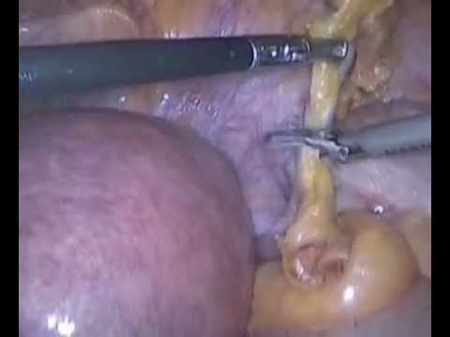
Nonobstetric Surgery During Pregnancy
Approximately 2% of parturients undergo nonobstetric procedures involving anesthesia each year
Most common procedures include; appendicitis, ovarian cyst, trauma, and cervical cerclage
IDEAL - elective surgery delayed 2-6 weeks postpartum
If nonobstetric surgery is necessary;
First trimester: increased risk to fetal organ development (organogenesis)
Second trimester: BEST TIME
Third trimester: Increased risk of premature delivery

Slide 18
Nonobstetric Surgery During Pregnancy
Maternal risks arise from the anatomic and physiologic changes associated with pregnancy
difficult intubation
increased risk of aspiration
Fetal risks include
growth restriction
low birth weight
Demise
Increased incidence of preterm labor (highest incidence in intra-abdominal and pelvic surgeries)

Slide 19
Nonobstetric Surgery During Pregnancy
Teratogenicity - can occur anytime during pregnancy, however, the risk is highest during organogenesis (day 13-60)
Concern that benzodiazepines administered during first trimester contribute to cleft palate. Some evidence of this in mothers receiving high-dose diazepam. Hines/Stoelting (2018) says that there is no data to justify this concern when midazolam is used for pre-op sedation
Nitrous oxide is linked to birth defects in animals who receive it for 1-2 days (inhibition of DNA synthesis) - human data lacking, though most practitioners avoid use during first two trimesters

Slide 20
Nonobstetric Surgery During Pregnancy
Anesthetic Management
Aspiration prophylaxis if parturient 18-20 weeks
Non-particulate antacid (sodium citrate) 15-30mL within 15 to 30 minutes of induction
Gastric prokinetic agent (metoclopramide) 1 hour before induction
RSI and 6.0 to 7.0 endotracheal tube
Left uterine displacement in second and third trimesters
Avoid hypoxemia, hyperventilation, hypotension, and acidosis
Normal maternal PaCO2 is 30 mmHg
Hyperventilation reduces placental blood flow (fetal asphyxia)

Slide 21
Nonobstetric Surgery During Pregnancy
Avoid NSAIDS after the first trimester, may close the ductus arteriosus
Be a minimalist - stick with drugs with a long safety record
Thiopental
Opioids
Inhalation agents
All muscle relaxants
Fetal heart tones auscultated before and after surgery

Slide 22
Trello
Hematologic Changes
Cardiovascular Changes
Respiratory Changes
Physiologic Changes; GI, Renal, Neuro

Slide 23
Hematologic Changes
Clotting factors
Anticoagulants
Fibrinolytic system
Anti-fibrinolytic system
Increased 1, 8, 9, 10, 12
Decreased - Antithrombin and Protein S
No change in protein C
Increased Fibrin breakdown
Decreased 11 and 13
Pregnancy creates hypercoagulable state
DVT 6 times higher in pregnant women
There’s a resistance to activated protein C
Counteracts state of hypercoagulability
Reduces fibrin polymerization
Bottom line; mom makes more clot but she breaks it down faster. Explains tendency to develop consumption coagulopathy
Notes:
Mom makes more clot but she breaks it down faster - consumption coagulopathy

Slide 24
Hematologic Changes
PT decreases up to 20% (normal range at term 9.6 - 12.9 seconds)
PTT decreases up to 20% (normal range at term 24.7 - 35 seconds)
Platelet count remains stable or decrease up to 10% (due to hemodilution and consumption)
Most common cause of thrombocytopenia during pregnancy is gestational thrombocytopenia. (This does not increase the rate of complications).
WBC count rises in pregnancy. In the 3rd trimester, the mean is 10,500, and in labor may increase to 20-30,000

Slide 25
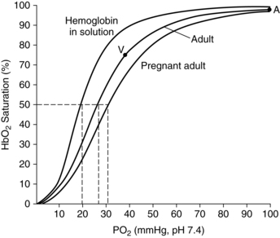
Cardiovascular Changes
Increased mineralocorticoid activity produces sodium retention and increased body water content
Plasma volume increases 45%
Erythrocyte volume increases 20%
Hemoglobin decreases 11-12 g/dL “relative anemia of pregnancy”
Increased intravascular volume prepares mom for hemorrhage of labor
Right shift in the Oxyhemoglobin Dissociation Curve - increased P50 facilitates unloading O2 to fetus. There is an oxygen gradient from mother to fetus
Maternal P50 is higher = 30 mmHg
Fetal P50 is lower = 19 mmHg
The higher P50 in the mother and lower P50 in the fetus ensures O2 offloading across the placenta

Slide 26
Cardiovascular Changes
Begin as early as 4th week of pregnancy into postpartum
Cardiac output increases 40% (uterus receives 10% of CO)
Heart rate increases 15% (higher metabolic demand)
Stroke volume increases 30% (function of increased intravascular volume)
Compared to pre-labor values
1st stage CO increases 20%
2nd stage CO increases 50%
3rd stage CO increases 80%
CO returns to pre labor values in 24-48 hrs
CO output returns to pre pregnancy values in 2 weeks
Twins cause CO to increase 20% above single fetus pregnancy

Slide 27
Cardiovascular Changes
No change in SBP
Decrease in DBP of 15%
Decrease in SVR of 15%
Decrease in PVR of 30%
The decreases in vascular resistance are due in large part to decreased resistance in uteroplacental, pulmonary, renal, and cutaneous vascular beds - in part to effects of progesterone
Progesterone is made early in pregnancy by the corpus luteum
At 10 weeks, production is taken over by the placenta
Progesterone levels rise throughout the 1st trimester and then plateau
Progesterone causes increases in nitric oxide production thereby causing vasodilation

Slide 28
Progesterone
RAAS activity | Vascular muscle relaxation | Minute Ventilation TV > RR
Blood volume | SVR and PVR | PaCO2
Cardiac output | Blood flow | Kidneys eliminate HCO3 to preserve pH

Slide 29
Cardiovascular Changes
During pregnancy the diaphragm rises - shifting the heart up and to the left
Ventricular wall thickens and end-diastolic volume increases
Benign grade 1 or 2 systolic murmur or third heart sound may be heard
The dilutional anemia also contributes to the reduction in SVR
No change in CVP or PAOP during pregnancy (however, filling pressures do increase during uterine contractions due to autotransfusion)

Slide 30
Peripartum Cardiomyopathy
Peripartum Cardiomyopathy (PPCM) - heart failure occurring in the final month of pregnancy or more commonly right after delivery
Rare - it is dilated cardiomyopathy with systolic dysfunction
Can be difficult to diagnose - SOB, retained fluid
Diagnosis - echo showing EF less than 45%, crackles in lungs
Risk factors include advanced maternal age and multiple gestation
Pts treated with loop diuretics, beta blockers, and hydralazine
Further evaluation is also needed if murmur is greater than grade 2 or accompanied by chest pain or syncope

Slide 31
Aortocaval Compression
“Syndrome of supine hypotension”
Caused by compression of the vena cava and aorta by the gravid uterus
Decreases venous return to the heart as well as arterial flow to the uterus and lower extremities
The decreased SV and ultimately CO compromises fetal perfusion and can cause LOC in the mother
Compression can be relieved by shifting the uterus to the left approximately 15 degrees
Should be done for anyone in their 2nd or 3rd trimester

Slide 32
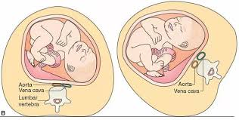
Left Uterine Displacement (LUD)
Common symptoms include; hypotension, sweating, pallor, nausea and tachycardia

Slide 33
Respiratory Changes
The parturient is at higher risk of difficult mask ventilation, difficult laryngoscopy, and difficult intubation
Increased progesterone, estrogen and relaxin cause vascular engorgement and hyperemia
Along with increased extracellular fluid - the upper airway is swollen. Also affected are the nasal passages, oropharynx, epiglottis, larynx and trachea

Slide 34
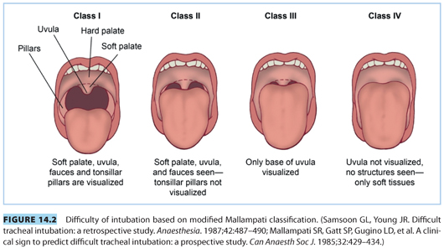
Respiratory Changes
Mallampati score increases during pregnancy
Airway tissues are susceptible to damage and bleeding. The nasopharynx is particularly affected - avoid nasal airways
Difficult and failed intubation is 8 times higher in full term pts
Glottic opening is narrowed so 6.5-7.0 tube should be used

Slide 35
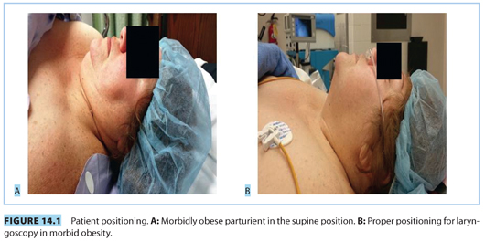
Respiratory Changes
Short handled laryngoscope blade is useful in women with larger breasts
Airway edema is made worse by pre-eclampsia, tocolytics, and prolonged Trendelenburg position

Slide 36
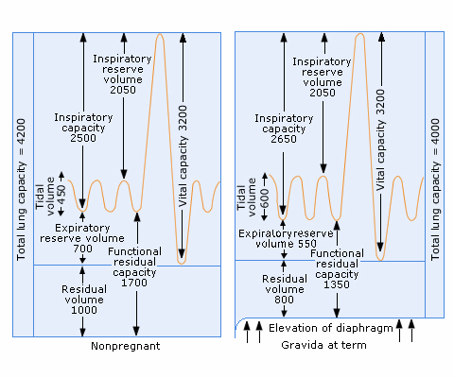
Lung Volume Changes in Pregnancy

Slide 37
Respiratory Changes
Relaxin relaxes the ligaments in the rib cage allowing the ribs a more horizontal position
This increases the anterior-posterior diameter of the chest giving the lungs more space
As the uterus grows, it shifts the diaphragm more cephalad changing the physiology of the lungs
FRC is reduced as a function of a decrease in expiratory reserve volume and residual volume
Increased oxygen consumption paired with a decreased FRC hastens the onset of hypoxemia
FRC falls below closing capacity, so airway closure can occur during tidal breathing
Total lung capacity decreases slightly and vital capacity is unchanged

Slide 38
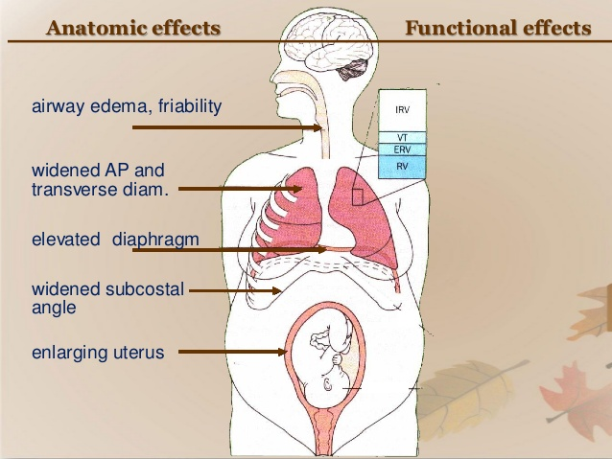
Respiratory Changes
Minute Ventilation increases 50%
Tidal Volume increases 40%
Respiratory rate increases 10%
Progesterone is a respiratory stimulant
Lung Volumes and Capacities
Total lung capacity decreases 5%
Vital capacity no change
FRC decreases due to upward pressure of the diaphragm (FRC = ERV + RV)
Expiratory reserve volume decreases 20-25%
Residual volume decreases 15-20%
Closing capacity no change

Slide 39
Respiratory Changes
Pregnant pt more likely to be in respiratory alkalosis or acidosis?
Progesterone is a resp stimulant - increasing MV by 50%
PaCO2 decreases to approx 30 mmHg (respiratory alkalosis)
Renal compensation - HCO3 decreases to 20 mEq/L (metabolic acidosis)
pH is unchanged or very slightly increased
A small reduction in physiologic shunt explains the mild increase in PaO2 (100 mmHg). This increases the gradient or the driving pressure of oxygen across the placenta and improves fetal oxygenation

Slide 40
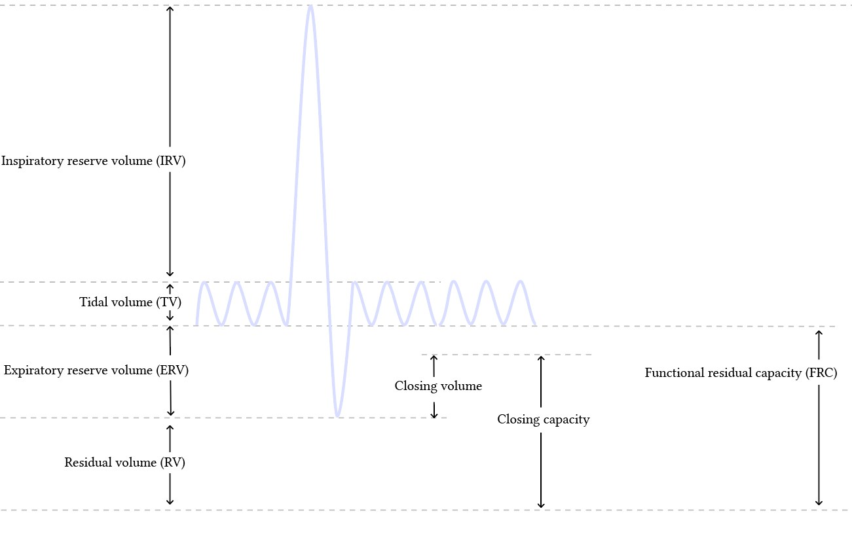
Respiratory Changes
Oxygen consumption
Term - increases 20%
First stage of labor increases 40% over prelabor
Second stage of labor increases 75% over prelabor
Increased oxygen consumption relative to FRC contributes to rapid arterial desaturation in the obstetric patient
Closing capacity no change - increase in CV + decrease in RV. (CC= CV + RV)

Slide 41
Metabolic Changes
Gestational Diabetes
Incidence - 3% of pregnancies
Results in; decreased placental perfusion and impaired oxygen transport
Diagnostic;
Glycosuria
Glucose challenge at 24-28 weeks, unless previously GDM, then done at 13 weeks
Increased C/S - bigger babies
Increased glucose in mother results in increased insulin in baby, hypoglycemia more evident in newborns and glucose must be checked

Slide 42
Nervous System Changes
Minimum alveolar concentration (MAC) for inhalation agents is decreased by 30-40% starting at 8-12 weeks of pregnancy - probably related to increased progesterone levels
Increased sensitivity of nerves to local anesthetics
Reduced doses of local anesthetics are required for spinal and epidural anesthesia in the parturient. Mechanical changes in the epidural space may play a role in the increased block height. Epidural veins become engorged as a result of increased intraabdominal pressure and cause a decrease in the volume of both the epidural and subarachnoid spaces
No change in ICP
2 patients with SMA - spinal muscle atrophy - neuromuscular disorder/loss motor nerves

Slide 43
Spinal Muscle Atrophy
Type I - most common (60%) and severe form. Diagnosed during infant’s first six months. Muscle weakness, trouble breathing, and difficulty swallowing. Life expectancy less than 18 months
Type II - Diagnosed after 6 months of age but before two years of age. First sign, is child not meeting motor milestones. Usually do not walk and require a wheelchair. Known as “floppy baby syndrome.”
Type III - Usually diagnosed after 18 months of age and before 3 years of age - but can be diagnosed as late as teen years. Initially able to walk, but have increasingly limited mobility - wheelchair
Type IV- rare but surfaces in adulthood - mild motor impairment. Usually after the age of 35, but may be seen as early as 18 years of age.
Symptoms and disease progression can vary among types and individuals
Notes:
GA is complicated by restrictive lung disease, sensitivity to nondepolarizing muscle relaxants, hyperkalemia with anectine, difficult intubation. Epidural/spinal challenging based on inadequate spread of LA especially if corrective back surgery

Slide 44
Gastrointestinal Changes
Parturient is at increased risk of regurgitation and aspiration of gastric contents because of anatomic and physiologic changes
Ultrasound studies have shown solid food in the stomachs of two-thirds of women undergoing neuraxial analgesia and in 40% of laboring moms who have not eaten in 12-24 hours
Increased levels of gastrin during pregnancy results in greater gastric volume and lower pH

Slide 45
Gastrointestinal Changes
Upward displacement of the stomach by the gravid uterus may result in mechanical obstruction to outflow through the pylorus
Gravid uterus may increase intra-abdominal and intragastric pressures
Elevated levels of progesterone, a smooth muscle relaxant, causes a reduction in lower-esophageal sphincter tone (thus the increased heartburn during pregnancy)
No change in gastric emptying before the onset of labor and a decrease after labor begins

Slide 46
Gastrointestinal Changes
Current obstetric anesthesia guidelines allow clear liquids in uncomplicated laboring pts
Guidelines allow for clear liquids up to 2 hour prior to induction of anesthesia in uncomplicated cesarean deliveries
Additional risks such as morbid obesity, diabetes, difficult airway may further restrict intake
Practice guidelines recommend the administration of nonparticulate antacids (bicitra) within 30 minutes of induction, H2 receptor antagonists (ranitidine) 1 hour prior to induction, and consider metoclopramide to facilitate gastric emptying
If mom is beyond 14 weeks gestation, secure airway with rapid sequence intubation

Slide 47
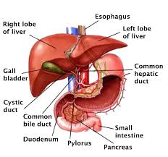
Hepatic Changes
Serum albumin concentration decreases and may result in increased free fractions of highly protein-bound drugs
Serum cholinesterase activity decreases by 30% during 1st and 2nd trimester, recovering slightly by term
Drugs that depend on cholinesterase for elimination (succinylcholine, remifentanil) do not tend to have prolonged duration of action if pt has genotypically normal cholinesterase enzymes

Slide 48
Hepatic Changes
High progesterone levels inhibit the release of cholecystokinin resulting in poor emptying of the gallbladder
Altered bile composition
Pregnancy also predisposes to gallstone formation

Slide 49
Hepatic Changes
Pt admitted initial BP of 220/110, headache, pale, abdominal pain
IV placed, labs drawn, labetalol given
Lab called as results were taking too long - they state we have to redraw as the results hemolyzed. They redraw and state the same thing. Dr Anderson states do you have any numbers to give me - yes AST and ALT are in the 2000 range- but we are trying to give you exact numbers. Platelets appear to be normal. Taken for immediate C/S
Acute fatty liver of pregnancy - rare, potentially fatal complication occurring often in the third trimester. Diagnosis can be difficult because of common features shared with preeclampsia.

Slide 50
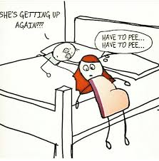
Renal Changes
Increased CO leads to increased renal plasma flow and increased GFR
Creatinine clearance rises to 140 to 160 mL/min
As a result, blood urea nitrogen and creatinine decrease
Glucose excretion is attributed to increased GFR and reduced reabsorption into the peritubular capillaries
Urinary excretion of protein in a normal pregnancy is slightly elevated toward the upper limits of normal

Slide 51
Musculoskeletal Changes
Elevated levels of relaxin throughout pregnancy help prepare for delivery by softening the cervix, inhibiting uterine contractions, and relaxing the pubic symphysis and pelvic joints
Ligamentous laxity of the spine increases the risk of back injury. This may contribute to the high incidence of back pain during pregnancy
Water retention - carpal tunnel

Slide 52
Kahoot

Slide 53
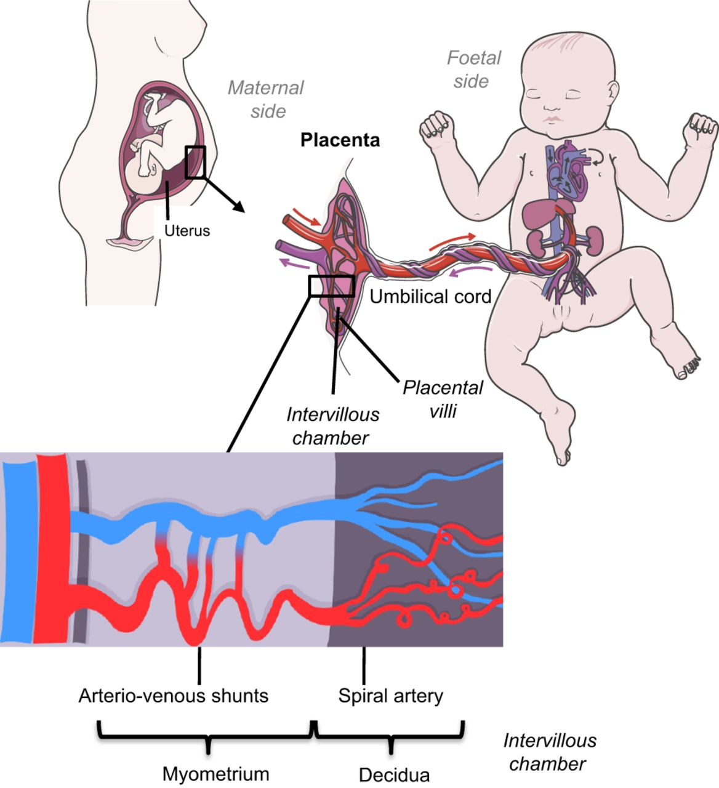
Uterine Blood Flow
Non pregnant 100 ml/min
At term 700 ml/min - uterus receiving approximately 10% of CO
Blood flow increases to meet both uterine and fetal metabolic demand

Slide 54
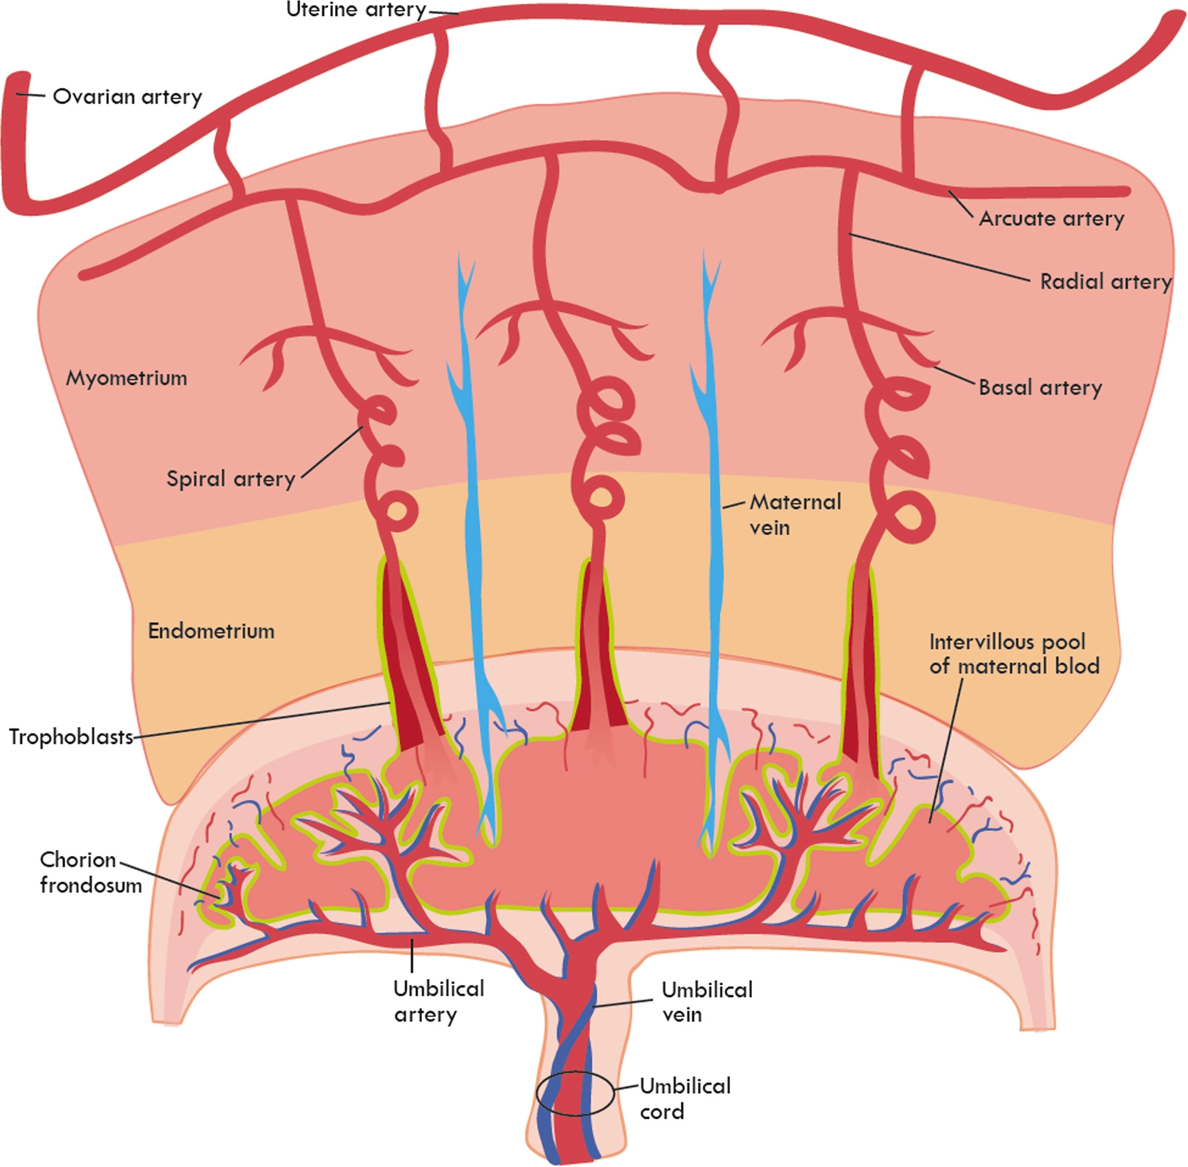
Uterine Blood Flow
Uterine blood flow is supplied by two uterine arteries that are thought to be maximally dilated throughout pregnancy
These uterine arteries branch into the arcuate, radial and spiral arteries - providing placental blood flow on the uterine side
Spiral arteries expel blood into the intervillous space

Slide 55
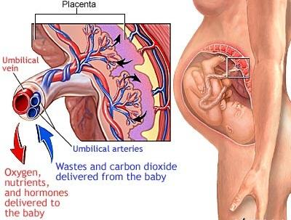
Uterine Blood Flow
Fetus sends O2-poor blood to the placenta via two umbilical arteries
These vessels perfuse capillary networks within placental villi that pool into the pool of maternal blood
Placental villi are small, fingerlike projections, the purpose of which is to maximize the placental surface area in contact with maternal blood
Each villi contains a capillary network that exchanges respiratory gases, nutrients, and wastes with maternal blood

Slide 56
Uterine Blood Flow
Uterine Blood Flow = Uterine Artery Pressure - Uterine Venous Pressure
Uterine Vascular Resistance
Both O2 and CO2 diffuse through placental tissue readily and are considered to be “perfusion limited,” meaning their transfer to the fetus is limited only by the perfusion of the placenta
Decreases in maternal uterine artery blood flow or increases in placental vascular resistance decrease fetal oxygenation
Uterine blood flow does NOT autoregulate - it is dependent on MAP, CO, and uterine vascular resistance. Since it is a low resistance system, uterine blood flow is primarily dependent on MAP and CO

Slide 57
Uterine Blood Flow
Causes of reduced uterine blood flow include;
Decreased Perfusion: Maternal hypotension (sympathectomy, hemorrhage, aortocaval compression)
Increased Resistance: Uterine contraction, hypertensive conditions that increase UVR
Classic teaching states that phenylephrine increases UVR and reduces placental perfusion. More recent evidence suggests phenylephrine is as effective as ephedrine in maintaining placental perfusion and fetal pH in healthy mothers. In fact, mothers that received phenylephrine had higher fetal pH values (less fetal acidosis)

Slide 58
Uterine Blood Flow
Effects of Vasopressors on Uterine Perfusion: Phenylephrine vs Ephedrine
Phenylephrine increases UVR and reduces placental perfusion. Recent evidence suggests that phenylephrine is as efficacious as ephedrine in preventing hypotension and produces no depression in fetal pH.
Mothers that received phenylephrine had higher fetal pH values (less fetal acidosis)
Phenylephrine can cause reflex bradycardia and reduce CO. Norepinephrine is gaining traction - however, apex says phenylephrine is a better choice

Slide 59
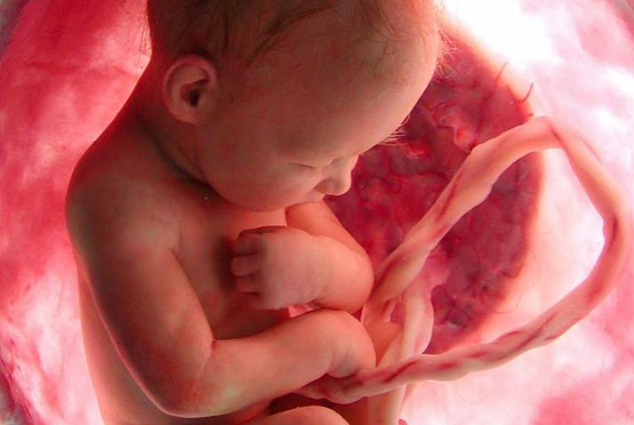
Fetal Acidosis
A fetal pH below 7.20 indicates fetal acidosis
A fetal capillary blood pH of 7.25 is the lowest limit of normal
Values between 7.20 and 7.24 are considered pre-acidotic

Slide 60
Fick’s Law
Rate of diffusion = Diffusion coefficient x Surface area x Concentration gradient (btwn mom and baby)
Membrane thickness
Most important variables are the diffusion coefficient (drug characteristics) and the concentration gradient between maternal and fetal circulation
Fetal acidosis can increase the concentration gradient - fetal trapping
Route of administration (how it affects peak plasma levels - IV higher than IM or SC)

Slide 61
Placental Transfer and Fetal Effects of Drugs
The Fick principle/law governs drug transfer across biological membranes
Rate of Diffusion= Diffusion coefficient x Surface area x (concentration gradients between mom and fetus)/ Membrane Thickness
The rate of transfer is directly proportional to:
Partial pressure difference (driving force)
Diffusion coefficient (solubility)
Membrane surface area
The rate of transfer is indirectly proportional to:
Membrane thickness
Molecular weight

Slide 62
Placental Transfer and Fetal Effects of Drugs
Factors that influence drug transfer from mother to fetus include:
Molecular weight of the drug (<500-1000 Da means greater transfer)
Lipid solubility (more lipophilic means greater transfer)
Cell membranes consist primarily of phospholipids such that a drug’s degree of lipid solubility favors its passage through the membrane
Molecular charge (non-ionized means greater transfer)
Ionized drugs are polar and water soluble, which inhibits diffusion through lipophilic cell membranes
Plasma protein binding (less binding means greater transfer)

Slide 63
Placental Transfer and Fetal Effects of Drugs
Factors that influence drug transfer from mother to fetus include:
5. Blood pH vs. drug pKa (greater non-ionized fraction means greater transfer)
Local anesthetics are examples of variable ionized basic compounds, whereby the degree of ionization is dependent on the ambient pH - the more alkaline the pH the greater the degree of nonionization. And it is the nonionized portion that crosses phospholipid membranes.
NDMR are large ionized drugs not affected by pH because of the quaternary group in their structure - and therefore do not cross the placenta
6. Free drug fraction (greater free drug fraction)

Slide 64
Placental Transfer and Fetal Effects of Drugs
7. Concentration gradient between mother and fetus (higher gradient means greater transfer)
Of these - a high concentration gradient (driving force) between mother and the fetus is the most important contributor of placental drug transfer

Slide 65
Placental Transfer and Fetal Effects of Drugs
Once the drug enters the fetal circulation, a variety of factors minimize the effects on the fetus - ie fentanyl
Dilution - before reaching the fetus, a drug is diluted in intervillous blood, absorbed by placenta, further diluted in placental blood, and then circulated to the fetus
Umbilical venous blood from the placenta must first pass through the liver, where it is subject to first-pass metabolism
⅕ of the fetal CO returns directly to the placenta because of shunt flow through the foramen ovale and ductus arteriosus - this shunted blood does not circulate
A fetus who has become acidotic will alter the degree of ionization of a drug - potentially leading to “ion trapping” - leading to accumulation
Notes:
Giving fentanyl during labor

Slide 66
Placental Transfer and Fetal Effects of Drugs
Significant Placental Transfer - tend to be lipophilic
Local anesthetics (except chloroprocaine due to rapid metabolism
IV anesthetics (usually not a problem)
Volatile anesthetics
Opioids
Benzodiazepines
Atropine
Beta-blockers
Magnesium (not lipophilic, but it is small)
Drugs with poor placental transfer tend to be highly ionized:
Neuromuscular blockers
Glycopyrrolate
Heparin
Insulin

Slide 67
Labor and Delivery
Labor is divided into 3 stages
First stage labor pain is the result of cervical distention, stretching of lower uterine segment, and possibly myometrial ischemia
Nonspecific visceral stimulation is carried to CNS by afferent unmyelinated C fibers that enter the cord and travels to T10 to L1 posterior nerve roots
Stage 1 - beginning of regular contractions to full cervical dilation (10cm)

Slide 68
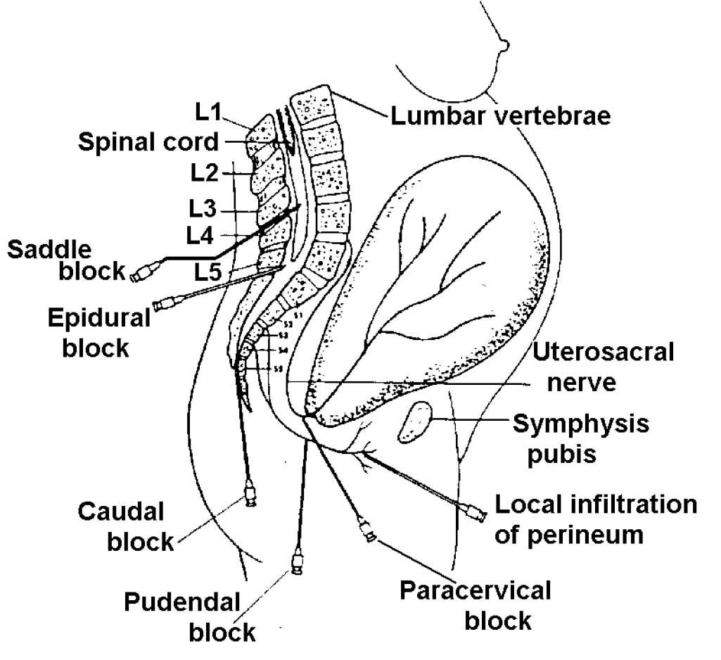
Labor and Delivery
Second stage labor begins when cervical dilation is complete and the delivery of the fetus
Compression and stretching of the pelvic musculature and perineum produce pain that is mediated by somatic afferent fibers carried via the pudendal nerves to the S2-S4 posterior nerve roots
Stage 2 - full cervical dilation to delivery of the fetus (pain in the perineum begins during stage 2)
Stage 3 - Delivery of placenta

Slide 69
Labor and Delivery
Afferent Pathway
Spinal Segments
Quality of pain
Regional Technique
Uterus and Cervix
Visceral C fibers - hypogastric plexus
T10-L1
Dull, diffuse, cramping
Neuraxial (spinal, epidural, CSE)
Paravertebral lumbar sympathetic block
Paracervical block (high risk of fetal brady)
Perineum
Pudendal nerve
S2-S4
Sharp, well localized
Neuraxial (spinal, epidural, CSE)
Pudendal nerve block
Neuraxial techniques that provide analgesia to T10-L1 during the first stage of labor must be extended to cover S2-S4 during the second stage of labor

Slide 70
Labor and Delivery
The experience of pain is highly individualized
Uncontrolled pain
Increased maternal catecholamines - HTN, and reduced UBF
Maternal hyperventilation - leftward shift of oxyHgb curve - reduced delivery of O2 to the fetus
3 essential components must work for parturient to deliver vaginally
Positioning of the fetus and size - occiput anterior with body facing towards the mother’s back (OP is painful)
Uterus must contract regularly and effectively
Pelvic outlet must be configured in a way that the fetus can pass through

Slide 71
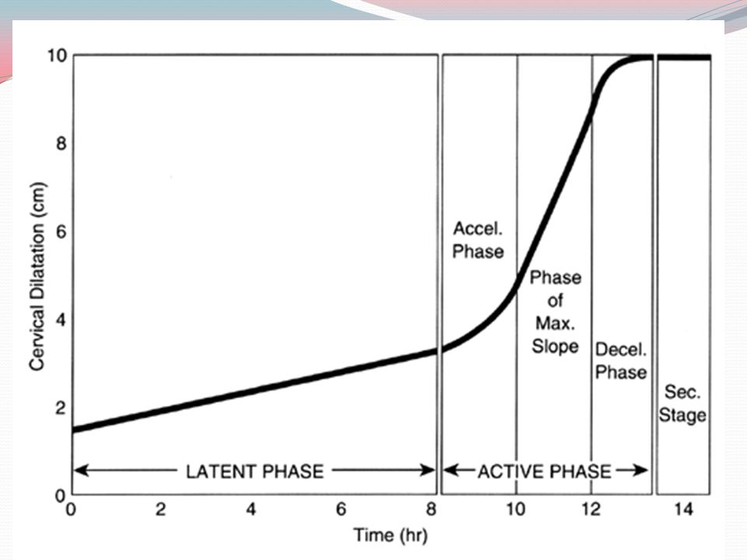
Labor and Delivery
First stage cervical changes consist of effacement and dilation
First stage further divided into the latent and active phases
Latent phase is of variable duration and is defined as the period between the onset of labor and the point at which the cervix begins to rapidly change
Active phase usually begins at 2-3 cm dilation and is the period during which the cervix undergoes its maximum rate of dilation
Dysfunctional labor occurs when labor does not follow the expected pattern. Oxytocin may be required to help the labor progress
Friedman curve illustrates the normal progress of labor

Slide 72
ASA Practice Guidelines for NPO Status
It doesn’t matter when mom last ate or drank - always considered a full stomach!
According to the ASA a laboring mom may;
Eat solid food up to the point a neuraxial block is placed
Drink a moderate amount of clear liquids throughout labor
If high probability of a surgical intervention requiring a general anesthetic, the pt should remain NPO

Slide 73
Intrapartum Fetal Evaluation
Fetal monitoring is a surrogate measure of overall fetal well-being and provides an indirect method to assess fetal hypoxia and acidosis
Continuous FHR monitoring is accomplished using either external Doppler ultrasonography or an internal fetal electrocardiography electrode
Internal method requires ruptured amniotic membranes and a partially dilated cervix
Continuous FHR is recorded in a two-channel format with the FHR displayed directly above a graphic representation of the uterine contractions

Slide 74
Intrapartum Fetal Evaluation
Uterine contractions are monitored either externally via a tocodynamometer or internally with an intrauterine pressure catheter attached to a transducer placed between the fetus and uterine wall
External monitors monitor contraction duration and interval, not strength
Internal monitoring is more reliable and allows for precise determination of intrauterine pressure and contraction strength
Information about the baseline status of the fetus should be obtained during the preanesthetic assessment and documentation placed in the chart - especially in nonobstetric surgery

Slide 75
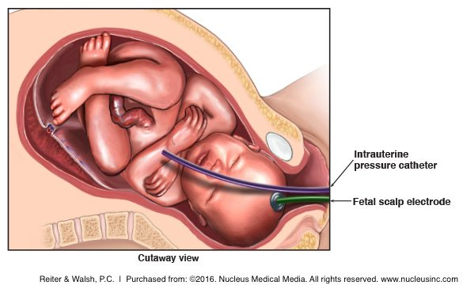
Fetal Heart Rate Monitoring

Slide 76
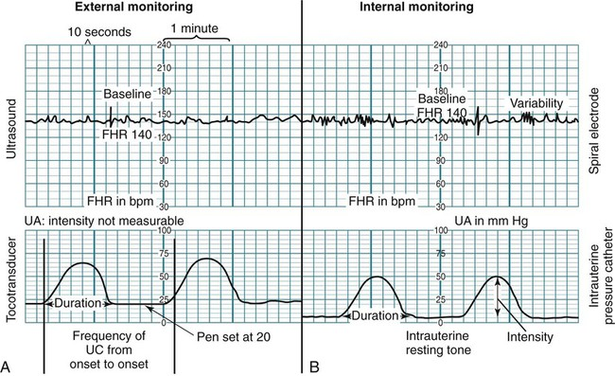
Changes in Fetal Heart Rate
FHR ranges from 110 to 160 BPM
Preemies have higher HR
Fetal tachycardia (> 160)
Fetal causes include; hypoxemia and arrhythmias.
Maternal causes include; chorioamnionitis, fever, drugs given to mom (atropine, ephedrine, terbutaline)
Fetal bradycardia (< 110);
Fetal causes include; asphyxia and acidosis or fetal head or cord compression.
Maternal causes include; hypoxemia and drugs that decrease uteroplacental perfusion

Slide 77
Categories for the Evaluation of FHR
The American College of Obstetricians and Gynecologists recommends the three-tier system for the evaluation of FHR
Category 1 (predictor of normal acid-base balance)
Baseline HR between 110-160
Moderate variability
Accelerations absent or present
Early decelerations absent or present
No late or variable decelerations

Slide 78
Categories for the Evaluation of FHR
Category II (do not predict abnormal acid-base balance and warrant continued observation
Bradycardia without absence of baseline FHR variability
Tachycardia
Variable variability
Absent or minimal acceleration with fetal stimulation
Recurrent variable decelerations

Slide 79
Categories for the Evaluation of FHR
Category III (predict abnormal acid-base status and require prompt intervention)
Bradycardia
Absent baseline variability
Recurrent late deceleration
Recurrent variable deceleration
Sinusoidal pattern

Slide 80
Variability
Fetal heart rate variability is thought to be the single best indicator of fetal wellbeing - indicator of adequate fetal oxygen reserves and a normal acid-base status (normally 6 - 25 BPM)
Variability is the result of the interaction between the fetal sympathetic and parasympathetic autonomic nervous systems
Baseline variability is defined as fluctuations in the FHR of two cycles per minute or greater that are irregular in amplitude and frequency
It is quantified by measuring the amplitude from peak to trough in beats per minute

Slide 82
Variability
Variability represents an intact CNS and normal cardiac function
Increased variability - occurs with advancing gestational age
Decreased variability; hypoxia, fetal sleep, acidosis, anencephaly, drugs (sedatives, anesthetic agents, barbiturates), and defects in fetal cardiac conduction system
Opioid administration to mother can decrease FHR variability for up to 30 minutes
Maternal Mg may also attenuate FHR variability
Variability refers to baseline FHR, does not include accelerations and decelerations
Beat-to-beat variability can be accurately assessed only by direct FHR monitoring with a fetal scalp electrode

Slide 83
Accelerations
An acceleration is an abrupt increase in the FHR above baseline
Occur in response to fetal movement and indicates adequate oxygenation
FHR pattern is said to be reactive when there are two or more accelerations in a 20 minute period

Slide 84
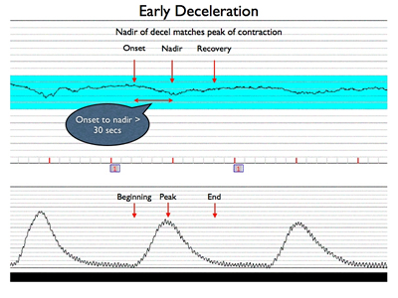
3 Types of Fetal Decelerations
Early Deceleration
Occurs at the time of the contraction
Begins and ends in parallel to the contraction
Uterine contraction compresses the fetal head
Are uniform in appearance
Are associated with a mild decrease in FHR (20 bpm or less)
Loses variability with each deceleration
lose
No risk of fetal hypoxemia
Notes:
Going to summarize common causes of fetal decelerations

Slide 85
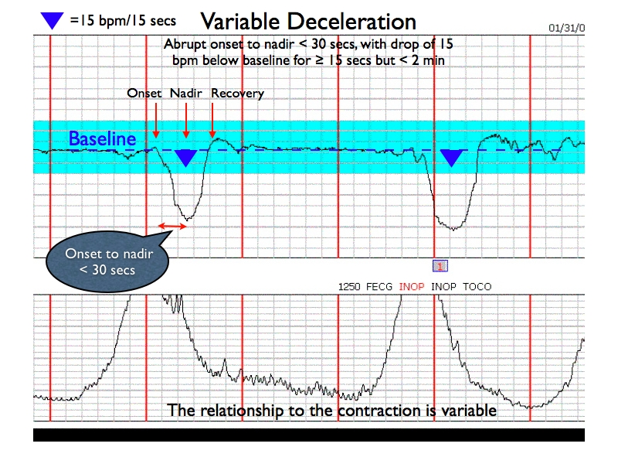
3 Types of Deceleration
Variable Decelerations
Abrupt in both onset and recovery and vary in occurrence, onset, depth, duration, and appearance
No consistent pattern btwn FHR and uterine contraction
Umbilical compression causes baroreceptor mediated reduction in FHR
Decelerations are usually self-limiting
Maintains variability during deceleration
Fetal compromise prolongs FHR recovery time
Risk for fetal hypoxemia - urgent assessment

Slide 86
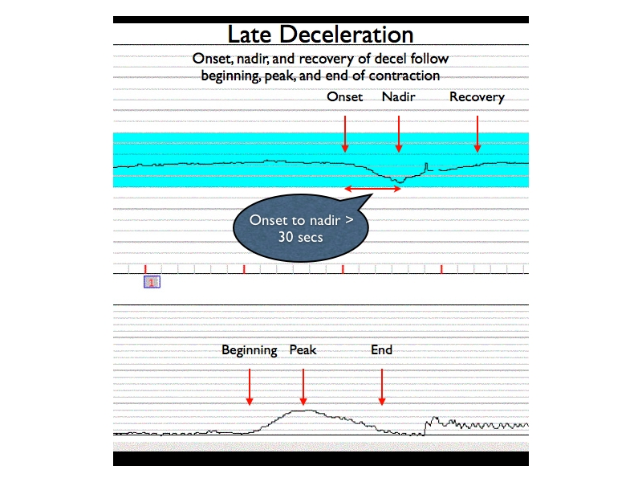
3 Types of Fetal Decelerations
Late Deceleration
Decreased uteroplacental perfusion leads to fetal compromise
FHR falls after peak of contraction then returns to baseline after contraction
Occurs with each contraction
Gradual (not abrupt) reduction in FHR
Caused by maternal hypotension, hypovolemia, acidosis, preeclampsia
Risk for fetal hypoxemia - urgent assessment

Slide 87
VEAL CHOP
Variable decels: Cord compression
Early decels: Head compression
Accelerations: OK or give oxygen
Late decels: Placental insufficiency

Slide 88
Anesthetic Considerations with Nonreassuring FHT
If the FHR suggests hypoxia in preanesthetic period - caution
Interventions to improve the condition of a compromised fetus in utero
Changing maternal position
Rapid infusion of IV fluids
Disconnect pitocin
IV pressor support - treat maternal hypotension
Tocolytic agents
Maternal oxygen administration

Slide 89
Intravenous Analgesia for Labor and Delivery
Meperidine
A parenteral opiate for labor analgesia
50 to 100 mg IM every 4 hrs
Crosses the placenta easily
Maternal half life 2.5 - 3 hrs
Normeperidine is an active metabolite with elimination half life of up to 30 hrs
Normeperidine remains in neonate for several days and may depress neonatal behavior assessment scores
Both Meperidine and Normeperidine can be antagonized by naloxone

Slide 90
Intravenous Analgesia for Labor and Delivery
Fentanyl
Highly potent with short duration of action
Highly lipid soluble and protein bound and can be detected in fetal circulation after 1 minute of IV administration
Depressive effects include a reduction in beat-to-beat variability
Dosages during labor vary from 25-100 mcg IV hourly
Morphine
No longer widely used due to high rates of maternal sedation, neonatal depression, and an undesirable prolonged duration

Slide 91
Intravenous Analgesia for Labor and Delivery
Butorphanol and Nalbuphine (Nubain)
Opioid agonist-antagonists that are associated with a “ceiling effect” whereby incrementally higher doses do not result in increasing respiratory depression
Typical butorphanol dose is 1 to 2 mg IV or IM (no active metabolites)
Butorphanol is five times as potent as morphine and has a half-life of 3 hrs
Unlike morphine, butorphanol increases pulmonary artery pressure and myocardial work
Nalbuphine dose is 5 to 10 mg IV, IM, or subq (equivalent to morphine 10 mg)
Nalbuphine results in a greater reduction in FHR variability compared to Meperidine
Avoid in opioid-dependent patients - due to significant antagonist properties

Slide 92
Intravenous Analgesia for Labor and Delivery
Remifentanil
Ultra-short acting opioid receptor agonist
Rapidly hydrolyzed by plasma and tissue esterases to an inactive metabolite
Suitable for use in PCA during labor
Crosses placenta readily but is similarly rapidly redistributed and metabolized by the fetus
PCA bolus of 0.25 mcg/kg with a lockout of 2 minutes and infusion of 0.025-0.05 mcg/kg per minute is common

Slide 93
Intravenous Analgesia for Labor and Delivery
Ketamine
Derivative of phencyclidine and an N-methyl-D aspartate (NMDA) receptor antagonist that produces a dissociative anesthetic effect
Profound analgesia at subhypnotic doses
Labor use limited due to short duration of action and high incidence of amnesia
Low dose preserves airway reflexes
Small intermittent doses can supplement suboptimal neuraxial anesthetic
Sympathomimetic properties that result in increased HR, BP, CO
Caution use in hypertensive, preeclamptic parturients
Agent of choice for induction in the patient with acute asthma requiring urgent c-section
Uterine arterial blood flow unchanged after administration
Does cross the placenta but neonatal depression has not been observed with maternal doses up to 1 mg/kg

Slide 94
Opioid Addiction
Effective medications include opioid antagonists; buprenorphine (Suboxone, Subutex), methadone, and extended release naltrexone (Vivitrol)
Opioid antagonists bind to opioid receptors to block the effects of opioids
Consider neuraxial techniques earlier
TAP blocks in cesarean section

Slide 95
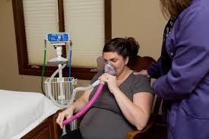
Nitrous Oxide
A non-invasive alternative for labor analgesia
50% nitrous oxide + 50% oxygen self-administered via face mask
When administered alone (no opioids) with 50% mixture, there is no associated hypoxia, loss of airway reflexes, or unconsciousness
N2O preserves uterine contractility and does not cause neonatal depression
Covid

Slide 96
Neuraxial Analgesia for Labor and Delivery
Neuraxial analgesia is currently the best method of pain relief for L and D
Common neuraxial techniques include; epidural, combined spinal-epidural (CSE), and spinal techniques
Early neuraxial technique may be considered in pts with morbid obesity, severe scoliosis, known difficult airway, multiple gestation, and severe preeclampsia
Earlier placement allows for better cooperation from the pt and adequate time to confirm proper block function

Slide 97
Neuraxial Analgesia for Labor and Delivery
Absolute contraindication include; patient refusal, inability to cooperate, uncorrected severe hypovolemia, uncorrected coagulopathy or pharmacologic anticoagulation, elevated ICP secondary to a mass, or infection at the site of insertion
Relative contraindications; preexisting CNS disease, chronic severe headaches, back pain, untreated bacteremia, and severe stenotic valvular lesions - require careful preanesthetic evaluation and consultation that considers risk vs. benefit
Platelet counts of > 80,000 or some prefer > 100,000

Slide 98
Neuraxial Analgesia for Labor and Delivery
Conditions to be aware of that may require a parturient to be taking anticoagulation therapy include; deep vein thrombosis, antiphospholipid antibody syndrome, factor V Leiden mutations, and protein S and C deficiencies
ASRA app - practice advisory on regional anesthesia
Anesthetic concern is potentially catastrophic complication of epidural hematoma
Epidural hematomas result from uncontrolled bleeding in the nondistendable epidural space, causing possible ischemia and neurologic dysfunction
Epidural hematoma is a rare complication 1 in 150,000 epidural and 1 in 220,000 spinal anesthetics
Diagnostic features of an epidural hematoma include; radicular back pain, lower extremity weakness, and bowel and bladder dysfunction
Suspicion warrants emergent MRI
Epidural abscess is more likely to present with fever

Slide 99
Neuraxial Analgesia for Labor and Delivery
Optimal to complete the pre-procedure assessment early in the labor process
Recognition of potential problems and provides time for additional work-up
Questions include information regarding pertinent systemic disease, current pregnancy course, and problems with previous pregnancies, deliveries, or anesthetics
Physical examination should include an inspection of the back, heart, lungs, and airway
A platelet count in a healthy patient with an uncomplicated pregnancy has not been shown to reduce overall complication rates

Slide 100
Neuraxial Analgesia for Labor and Delivery
Informed consent
Must include a description of the procedure, the risks, benefits, potential complications, and alternatives
Caveats
Whether a woman in great pain and distress has the ability to understand and reason
Studies have shown that women do retain the ability to reason and make informed decisions
Competence describes the legal authority to make a decision and is recognized in the US as occurring at 18 years of age
Various state laws recognize emancipation for minors who; graduate from high school, get married, join the military
Becoming pregnant does not necessarily constitute emancipation
Best to include the legal guardian in the informed consent process
Must have an understanding of local, state and institutional laws/guidelines

Slide 101
Local Anesthetics
Bupivacaine
Amide local anesthetic with long duration of action
Greater sensory block relative to other LAs
Minimal tachyphylaxis
Low placental transfer due to increased protein binding and increased ionization
Cardiac toxicity more common with R-enantiomer
Cardiac toxicity occurs before seizures
0.75% contraindicated via epidural due to risk of toxicity with IV injection

Slide 102
Local Anesthetics
Ropivacaine
Amide local anesthetic with long duration of action
S-enantiomer of bupivacaine + substitution of propyl group
When compared to bupivacaine
Decreased risk of cardiovascular toxicity
Decreased potency
Decreased motor block

Slide 103
Local Anesthetics
Levobupivacaine
Amide local anesthetic with long duration of action
Pure S-enantiomer of bupivacaine
Less cardiovascular toxicity compared to bupivacaine
Not available in the US

Slide 104
Local Anesthetic
Lidocaine
Amide anesthetic with intermediate duration of action
Rapid onset of action
Dense/strong motor blockade especially when given with epinephrine - makes it ideal for epidural anesthesia in C/S
Dense motor blockade makes it less ideal for epidural during labor
Risk of neurotoxicity if given in the subarachnoid space

Slide 105
Local Anesthetics
2-Chloroprocaine
Ester local anesthetic that is rapidly metabolized by ester hydrolysis (pseudocholinesterase in the plasma) - minimal placental transfer
Therefore, decreased risk of CNS and CV toxicity if given inadvertently in the IV
Used for emergency C/S when epidural is already in place -rapid onset brief duration of action
Antagonized opioid receptors (mu & kappa) in the spinal cord and reduces efficacy of epidural morphine
Risk of arachnoiditis when used for spinal anesthesia due to preservatives
Solutions without methylparaben and metabisulfite do not cause neurotoxicity

Slide 106
Structures involved in Epidural and Subarachnoid blocks
Epidural block
Skin - subcutaneous tissue - subcutaneous fat - supraspinous ligament - interspinous ligament - ligamentum flavum - epidural space
Subarachnoid block
All structures for epidural - dura mater - subdural space - arachnoid mater - subarachnoid space
The subdural space is not a true space, a potential space can be created by a bleeding vessel or injecting local anesthetic between the dura and arachnoid - total spinal can occur 15 to 25 minutes after epidural bolus dose
Paramedian approach to the subarachnoid space is useful when there is significant calcification of the interspinous ligament
Needle is directed 15 degrees of the sagittal plane
Needle is inserted 1 cm lateral and 1 cm below to the caudal edge of the vertebral spinous process directly above the interspace
Skin - subcutaneous tissue - ligamentum flavum - dura mater - subdural space - arachnoid mater - subarachnoid space

Slide 107
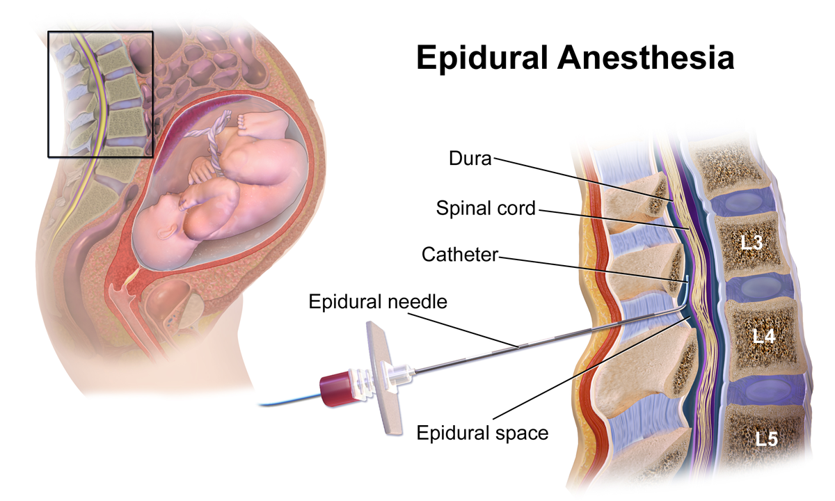
Epidural Anesthesia for Labor
Epidural catheter for labor analgesia is optimally inserted at the L2-L3 or L3-L4 interspace to allow for effective blockade of the T10-S4 dermatomes
Adequate anesthesia must be balanced against loss of the sensation of labor, especially during the second stage
Dilute concentrations of local anesthetics are utilized to provide satisfactory labor analgesia without significant motor blockade

Slide 108
Epidural Anesthesia for Labor
After epidural placement, the parturient should lie down on side to avoid aortocaval compression
Continuous bedside monitoring for first 60 minutes
L5 and S1 are most resistant to the effects of local anesthetics
Largest spinal nerves
L5-S1 interspace is the largest interspace in the vertebral column
Pts get really comfortable right away and as baby moves down - more uncomfortable - educate pt

Slide 109
Epidural Anesthesia for Labor
Most Important Factors that Determine Epidural Block Height
Drug Factors = volume, dose
Patient Factors = pregnancy, old age
Procedure Factors = level of injection
Less Important Factors that Determine Epidural Block Height
Drug Factors = concentration
Patient Factors = weight, height, relative pressure of body cavities
Procedure Factors = pt position
Factors not important at all: LA additives, speed of injection, and needle orifice orientation

Slide 110
Epidural Anesthesia for Labor
Continuous infusion of epidural medication is preferred over intermittent bolus doses
Less hypotension
Less total local anesthetic administered
More effective analgesia
Significantly reduced workload
Parturient analgesia level and degree of motor blockade should be frequently assessed and changes in the infusion rate adjusted
An epidural catheter originally placed in epidural space can migrate to subarachnoid space or intravascularly

Slide 111
Dosing Regimens for Labor Analgesia
Drug | Spinal Bolus | Epidural Bolus | Epidural Continuous Infusion
Local Anesthetics Bupivacaine Ropivacaine Levobupivacaine Lidocaine | 1.25 - 2.5 mg 2 - 3.5 mg 2 - 3.5 mg NA | 0.0625 - 0.125% 0.08 - 0.2% 0.0625 - 0.125% 0.75 - 1% Loading volume = 10-15 mL in divided doses | 0.05 - 0.125% 0.08 - 0.2% 0.05 - 0.125% 0.5 1% Lumbar infusion rate= 8-15 mL/hr
Opioids Fentanyl Sufentanil Morphine Meperidine | 15 - 25 mcg 1.5 - 5 mcg 125 - 250 mcg 10 - 20 mg | 50 - 100 mcg 5 - 10 mcg NA NA | 1.5 - 3 mcg/mL 0.2 - 0.4 mcg/mL NA NA
Adjuncts Epinephrine Clonidine Neostigmine | 2.25 - 200 mcg 15 - 30 mcg Not recommended | 25 - 75 mcg 75 - 100 mcg 500 - 750 mcg | 25 - 50 mcg/hr 10 - 30 mcg/hr 25 - 75 mcg/hr

Slide 112
Test Dose
Intended to identify epidural catheters that are inadvertently inserted into either the subarachnoid space or an epidural vein
Prior to test dose, essential to aspirate for blood or CSF after placing the epidural catheter
Prior to any additional manual boluses, check aspiration
Negative aspiration does not conclusively rule out intravascular or subarachnoid placement
The incidence of venous cannulation with an epidural catheter is approximately 6% in the OB population

Slide 113
Test Dose
Test dose commonly comprised of 3 to 5 ml of lidocaine 1.5% with epinephrine 1:200,000
Lidocaine dose if placed subarachnoid would produce noticeable but manageable spinal anesthetic within 3-5 minutes
Lidocaine placed intravascularly presents as circumoral numbness, lightheadedness, visual or auditory changes
Epinephrine dose given intravascularly reliably increases HR in the nonpregnant pt
Less specific in the laboring pt due to changes in HR that occur during uterine contractions
Concern exists that epi may cause significant uterine artery constriction in a small number of pt, resulting in decrease fetal O2 delivery
Nagulhout states the test dose is not universally accepted for use in obstetric anesthesia
However, Nagulhout states a test dose is necessary when administering larger and more concentrated doses such as those given in an epidural for cesarean delivery

Slide 114
Total Spinal
Complication that results from excessive and unintended cephalic spread of LA
There are several ways a patient can develop a total spinal
An epidural dose injected into the subarachnoid space
An epidural dose injected into the subdural space
A single shot spinal after a failed epidural block

Slide 115
Epidural dose Injected into Subarachnoid Space
Treatment; get ready to intubate and wait it out while stabilizing pt

Slide 116
Epidural Dose Injected into the Subdural Space
Epidural catheter is inadvertently placed in the subdural space - between the dura and the arachnoid. Neither catheter aspiration nor a test dose will rule out subdural placement
Within 10 - 25 minutes after epidural is dosed, pt will experience symptoms of excessive cephalad spread of LA
The subdural space is a potential space and holds very low volume
Treatment; HOB elevated and turn epidural infusion off. Monitor VSS and respiratory status

Slide 117
Single Shot Spinal after a Failed Epidural Block
Volume given during epidural can compress the subarachnoid space - might result in higher than expected spread with a given spinal dose
The dura is punctured during a single-shot spinal - LA from the failed epidural leaks through the hole to enter the subarachnoid space

Slide 118
Total Spinal
Presentation
Rapid progression of sensory and motor block
Symptoms include; dyspnea, difficulty phonating, and hypotension
Loss of consciousness occurs as a result of cerebral hypoperfusion secondary to severe hypotension
Bradycardia can occur resulting from blockade of the sympathetic innervation to the heart, which is located at the T1-T4 spinal cord segment
Management
Initial treatment includes; vasopressors, IVF, LUD, and elevation of legs
Intubate if pt loses consciousness
Differential diagnosis includes; anaphylactic shock, eclampsia, and amniotic fluid embolism
High cephalic spread of a neuraxial block remains one the the most common causes of anesthesia related maternal mortality in obstetrics

Slide 119
Treatment of Intravascular Injection
Local Anesthetic Systemic Toxicity (LAST)
Get help
Initial focus:
Airway management - ventilate 100% O2
Seizure management - benzodiazepines
ACLS
Infuse 20% lipid emulsion - precise mechanism of action unknown
Bolus 1.5 mL/kg (lean body mass) over 1 minute
Continuous infusion of 0.25 mL/kg per min if BP remains low
Repeat bolus once or twice for persistent CV collapse
Double the infusion 0.5 mL/kg per min if BP remains low
Continue infusion for 10 min after CV system restored
Upper limit of approx 10 mL/kg over the first 30 minutes

Slide 120
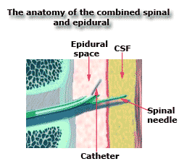
Combined Spinal Epidural Technique
CSE technique provides the dual benefit of a rapid onset of spinal anesthesia and the ability to prolong the duration of anesthesia with an indwelling epidural catheter
Needle through the needle technique is the most common approach
Epidural space is identified with the epidural needle
Spinal needle is placed through the epidural needle, and then LA and or opioid is injected into the intrathecal space
Spinal needle is removed
Epidural catheter is threaded through the epidural needle
Benefit of this technique, proper confirmation of epidural needle location

Slide 121
Combined Spinal Epidural Technique
Spinal component of a CSE can be dosed with either a lipid-soluble narcotic alone or in combo with isobaric bupivacaine
Fentanyl 15 to 25 mcg or sufentanil 10 mcg
Isobaric bupivacaine 0.25% - 1 mL (2.5mg)
The epidural volume extension technique involves injection of saline into the epidural space immediately after the LA is administered into the subarachnoid space
Adding volume to the epidural space compresses the subarachnoid space, this enhances the rostral spread of the LA
Administering a smaller dose of LA in the subarachnoid space provides a more stable hemodynamic profile as well as a faster recovery

Slide 122
Spinal Analgesia in Labor and Delivery
Single-shot spinal is rarely an appropriate anesthesia choice for a patient in labor due to its short duration and lack of flexibility
Usually reserved for multiparous patients in advanced stage of labor
Continuous spinal anesthesia (CSA) using an epidural catheter is an option in certain high-risk parturients
Extreme morbid obesity
Previous spinal surgery or deformity (epidural space may be disrupted)
Inadvertent puncture of dura with epidural needle

Slide 123
Spinal Analgesia in Labor and Delivery
To perform a CSA an epidural needle is used to identify the subarachnoid space and the epidural catheter is then intentionally threaded into the subarachnoid space
Not considered first-line technique because of increased risk of postdural puncture headache
There has been some evidence to indicate that a catheter left in the subarachnoid space for at least 12 hours results in fewer postdural puncture headaches
If a CSA is used, block level must be carefully monitored and line should be clearly labeled spinal catheter

Slide 124
Regional Opioids for Labor Analgesia
Combination of dilute LA with low-dose opioids allows for the reduced dose of both agents which results in decreased motor blockade while preserving acceptable analgesia
LAs work at the nerve axon whereas neuraxial opioids bind to receptors in the substantia gelatinosa within the dorsal horn of the spinal cord
Epidurally administered opioids are believed to be absorbed into the CSF and ultimately the spinal cord, to exert their action on the spinal opioid receptors

Slide 125
Regional Opioids for Labor Analgesia
Opioids administered within the epidural or subarachnoid space reach a “ceiling effect” whereby increasing the dose beyond conventional regimens does not result in an increased duration or quality of analgesia
Side effects of neuraxial opioid administration include; pruritus (most common) respiratory depression, nausea and vomiting
IV doses of an opioid antagonist (naloxone) or agonist-antagonist (nalbuphine) are effective at reducing or eliminating the undesirable effects without antagonizing the analgesia - often more effective in treating pruritus than antihistamines

Slide 126
Regional Opioids for Labor Analgesia
Fentanyl
When used in combination with LA in epidural doses of 50 to 100 mcg and subarachnoid doses of 10 to 25 mcg produces good to excellent analgesia in 5 to 10 minutes
Doses repeated as often as every 90 minutes has been shown not to affect Apgar scores, umbilical cord blood analysis, or neurobehavioral test results for up to 24 hrs after delivery
When opioid are used alone, much higher doses are needed to provide labor analgesia, and even those higher doses are not entirely effective during the second stage of labor
Most women have undetectable plasma fentanyl levels after receiving 100 mcg of epidural fentanyl
Duration of action in the epidural space is 60 to 140 minutes
Continuous epidural - fentanyl concentrations up to 2.5 mcg/mL and local anesthetic can be used without adversely affecting neonatal respiration or neurobehavioral scores

Slide 127
Regional Opioids for Labor Analgesia
Sufentanil
Dose of 5 to 10 mcg can be combined with bupivacaine or ropivacaine to initiate analgesia for first stage of labor
Continuous epidural - 0.3 to 0.5 mcg/mL
Sufentanil is commercially prepared as 50mcg/mL - extreme care must taken when administering neuraxial anesthesia doses

Slide 128
Regional Opioids for Labor Analgesia
Morphine
More ionized and therefore less lipid soluble as compared to fentanyl and sufentanil
When placed in epidural or subarachnoid space, it has a slow onset of action of 30 to 60 minutes - therefore not used often in labor analgesia
Used in postoperative analgesia when neuraxial anesthesia is utilized for a c-section

Slide 129
Summarize Regional Opioid Use
Depending on how lipophilic determines opioids tendency to stay inside the intrathecal space vs. its tendency to diffuse into the systemic circulation
More hydrophilic opioids:
Morphine and hydromorphone
Do not easily diffuse across biologic membranes, so they tend to remain in the intrathecal space
Due to this they tend to spread to higher levels - referred to as rostral spread
Produce a wider band of analgesia
More lipophilic opioids:
Sufentanil and fentanyl
Diffuse into the bloodstream faster - do not have as much rostral spread
Produce a narrower band of analgesia

Slide 130
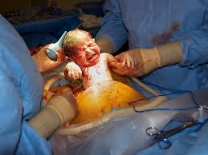
Anesthesia for Cesarean Section
Birth by C/S now accounts for over 30% of all deliveries
Common indications;
Cephalopelvic disproportion
Nonreassuring fetal status
Arrest of dilation
Malpresentation
Prematurity
Prior C/S
Prior uterine surgery

Slide 131
Anesthesia for Cesarean Section
The choice of anesthetic depends on maternal status, urgency of the surgery, condition of the fetus, and the patient’s desires
Neuraxial anesthesia has significant advantages;
Decreased risk of mortality from failed intubation and aspiration of gastric contents
Better neonatal outcomes from the use of less depressant agents
Ability of the mother to be awake for the delivery
Evidence suggests that general anesthetic agents are associated with apoptosis of fetal brain neurons in animal models

Slide 132
Anesthetic for Cesarean Section
Regardless of anesthetic technique, left uterine displacement should be provided as soon as possible
Blood loss is typically 500 mL to 1000 mL
Many factors affect blood loss; surgical time, surgical technique, blood pressure, fetal lie, fetal size, placental implantation, maternal coagulation status, and the ability of the uterus to contract after the placenta has been delivered
Normal amniotic fluid accounts for approximately 700mL

Slide 133
Neuraxial Anesthesia for Cesarean Section
Dermatome level of T4 is required to provide effective anesthesia for C/S
This level can result in profound sympathectomy that frequently causes maternal hypotension, and if untreated fetal compromise
Minimize hypotension with; LUD, IV fluids, and vasopressor use
Consider antiemetic - ondansetron
Prophylactic administration of antibiotics preop or after cord clamping
Preincision antibiotics have shown to decrease surgical site infections from 6.4% to 2.5%

Slide 134
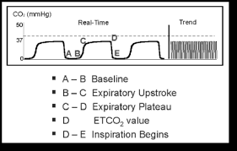
Neuraxial Anesthesia for Cesarean Section
Routine supplemental use of oxygen in the absence of preexisting fetal compromise or maternal hypoxemia has not been shown to be of any maternal or neonatal benefit
Consideration should be given to the use of end-tidal CO2 monitoring for those pts susceptible to intraoperative respiratory compromise or in those who have been provided IV sedation
We now check baseline CO2 on all patients

Slide 135
Neuraxial Placement in the OR
On arrival to OR, place BP and pulse ox on
Have pt sit on side of bed, or with feet on the bed (drop leg of bed if necessary)
Fluids are running wide open if medically acceptable
I give Zofran and connect phenylephrine gtt
Prep back and spinal placed
Lie pt down and tilt bed
Check BP while placing EKG and oxygen
Continue to watch BP closely and ask pt how feeling (if nauseated I give ephedrine)
Be aware - bolus of neo can cause headache
Make sure pt doesn’t disrupt prep
Talk to your pt

Slide 136
Spinal Anesthesia in Cesarean Section
Single-shot spinal anesthesia has become the most commonly used anesthetic technique for C/S
Rapid onset of action and provides a more reliable block
Uses smaller and therefore less toxic doses of LA
Drawbacks include;
Fixed duration of action
Rapid onset of sympathectomy - hypotension
Important to understand that the sympathectomy with spinal anesthesia can be as high 2-6 levels above the level of sensory blockade. This differs in epidural anesthesia where the sympathectomy is the same as the sensory level
Hyperbaric bupivacaine (0.75% 13 mg) is effective in 95% of pts, providing 90 to 120 minutes of surgical anesthesia

Slide 137
Spinal Block Height
Most important factors that determine spinal block height
Drug Factors = dose, baricity
Patient Factors = CSF volume, pregnancy, old age
Procedure Factors = pt position
Other Factors that determine spinal block height
Drug Factors = volume, concentration, temperature, viscosity
Patient Factors = height, weight, intraabdominal pressure
Procedure Factors = needle type, needle orifice orientation, level of injection
Factors that do not determine spinal block height
Vasoconstrictors and gender

Slide 138
Spinal Anesthesia in Cesarean Section
Compound curvature of the spine in the supine position serves to limit the upward spread of the block when hyperbaric LA are used
Decreased doses of bupivacaine cause less hypotension but increased risk of intraoperative pain, slower onset, and duration
Crystalloid preloading is not felt to be effective in treating hypotension
Crystalloid coloading (time of spinal) is somewhat effective
Hypotension is a primary cause of intraop nausea and vomiting
Hypotension may lead to cerebral hypoperfusion, which is thought to activate the vomiting center
Ephedrine and phenylephrine are vasopressors commonly used to treat maternal hypotension

Slide 139
Spinal Anesthesia in Cesarean Section
Ephedrine
Synthetic, nonselective, noncatecholamine sympathomimetic
Doses of 5 to 15 mg IV
A dose of 5 to 10 mg usually lasts for 5 minutes
Tachyphylaxis can occur with repeated administration of small doses resulting in noticeably reduced clinical effect
Metabolized in the liver and up to 40% is excreted unchanged by the kidneys
Elimination half-life of 3 hours
Causes direct beta stimulation and indirect alpha stimulation through the release of endogenous norepinephrine
Evidence suggests ephedrine crosses that placental barrier and stimulates feta beta-adrenergic receptors, raising fetal metabolic rate and results in a depression of fetal acid-base status

Slide 140
Spinal Anesthesia in Cesarean Section
Phenylephrine
Direct-acting alpha1-adrenergic agonist
Results in vasoconstriction and increased peripheral vascular resistance
Has been shown to be safe for the treatment of maternal hypotension during regional anesthesia when given in conventional dose range
Neonatal blood gas values and Apgar scores remain within normal limits in all healthy subjects after the administration of 80-100 mcg bolus doses
Dose dependent decrease in CO that parallels a decrease in HR
Many feel maternal HR should play a role in the selection of vasopressor
When HR is at baseline or above, phenylephrine may be used
When HR is below baseline, ephedrine will increase the BP and HR without further reductions in CO

Slide 141
Spinal Anesthesia in Cesarean Section
Maternal complaints of visceral pain occur occasionally even in the presence of an adequate T4 block
Common practice to add opioids to hyperbaric bupivacaine for C/S spinal anesthesia to provide additional intraop and postop analgesia without affecting the block height
Intraop block quality can be improved with fentanyl 10 -20 mcg, or sufentanil 2.5 to 5 mcg - onset 5 to 10 minutes and duration of 60 to 90 minutes
Morphine can be added to provide long-acting postop analgesia - onset of 60 to 90 minutes and duration of 12 to 18 hours

Slide 142
Spinal Anesthetic
Spinal nerves are anesthetized in the following order
Pre-ganglionic sympathetic
Temperature
Pin prick (fast pain)
Touch
Motor
Good to know for when the surgeon says they are still moving their feet
Spinal nerves recover in the opposite order in which they are anesthetized

Slide 143
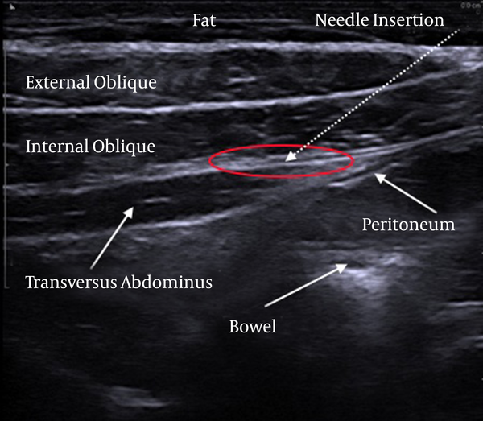
Transversus Abdominal Plane Block
Can be utilized to provide postop analgesia in pts who are not candidates for intrathecal morphine, when neuraxial anesthesia is contraindicated and pt undergoes general anesthesia
The sensory nerves that supply the anterior abdominal wall course through the fascial plane between the internal oblique and the transversus abdominis muscles
LA injected into this plane block sensory impulses from the anterior wall and are effective in relieving pain associated with a Pfannenstiel incision

Slide 144
Epidural Anesthesia for Cesarean Section
An epidural inserted in the OR for an elective C/S not often done due to slower onset of action and higher dose of LA required
May be beneficial when a prolonged surgical time is anticipated
Also, slower onset of sympathectomy reducing the risk of severe hypotension may be necessary in some pts
A parturient with an epidural in place for labor analgesia who progresses to needing a C/S - epidural catheter can be utilized
The selection of LA is largely determined by the urgency of delivery

Slide 145
Epidural Anesthesia for Cesarean Section
Sodium bicarbonate 1 mEq. 10 mL lidocaine 2% with epinephrine 1:200,000 will hasten the onset of anesthesia
Addition of sodium bicarbonate increases the biologically active non-ionized fraction of the drug
Sodium bicarbonate cannot be added to bupivacaine as it results in precipitation when the pH is raised
2-Chloroprocaine can be used to rapidly convert a labor epidural to a surgical anesthetic with little concern for toxicity
Duration of approximately 45 minutes, intraop augmentation will be required
Epidural morphine analgesia is diminished with use of 2-chloroprocaine

Slide 146
Epidural Anesthesia for Cesarean Section
In a well-functioning epidural used for labor, total volume required to raise the block level from the existing T10 to the required T4 is approximately 10 to 15 mL
Efforts should be directed toward avoiding the situation of a failed epidural in the OR
Early recognition and replacement of inadequate labor epidurals
If an inadequate epidural is identified in the OR, and the fetal status allows, consideration should be given toward replacing the epidural to a different interspace or replacing the epidural with a CSE technique
Spinal is injected with a reduced dose and the epidural is used to augment level
A single-shot spinal can produce unpredictable and often higher than expected block level

Slide 147
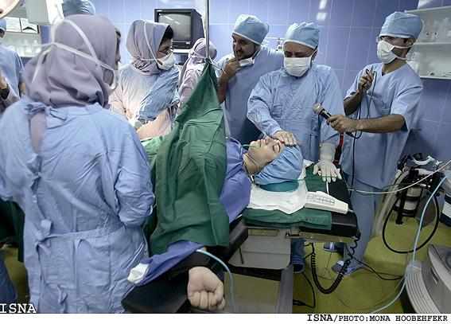
General Anesthesia for Cesarean Section
General anesthesia is required during a cesarean for a number of reasons;
Maternal hemorrhage
Coagulopathies
Pt refusal of regional anesthesia
Fetal distress
Contraindications to regional anesthesia
Mortality is 17 times higher with a GA in OB population
Triple prophylaxis against aspiration:
Sodium citrate to neutralize gastric acid
H2 receptor antagonist to reduce gastric acid secretion
Gastrokinetic agent (metoclopramide) to hasten gastric emptying and increase LES tone

Slide 148
General Anesthesia for Cesarean Section
Difficult Airway - plan for this!
Airway evaluation is an important part of preparation
Failure to intubate has been reported to occur as frequently as 1 in 250 obstetric pts - most common cause of maternal death
Soft tissue edema
Airway may change throughout labor
Breast enlargement
Cephalad displacement of the thorax
Rapid sequence induction/or awake intubation
Caution in blind nasal intubation due to swelling in the mucosa
Know unanticipated difficult airway algorithm

Slide 149
General Anesthesia for Cesarean Section
Induction
RSI using cricoid pressure after denitrogenation and preoxygenation for 3-5 minutes (esophagus is compressed between the cricoid ring and the sixth cervical vertebra)
BURP maneuver (backward, upward, rightward pressure on thyroid cartilage) improve view
Standard induction agent is propofol - 2 to 2.5 mg/kg
Propofol produces neonatal depression but is rapidly redistributed and cleared from the neonate quickly
Ketamine (1 mg/kg) or etomidate (0.3 mg/kg) are useful in parturients who have airway disease or are hemodynamically unstable
Ketamine has been associated with lower analgesic demands during the first 24 hours postop
Induction of anesthesia is delayed until all preparations for surgery are complete, prep, drapes, timeout
Minimize fetal exposure to depressant drugs
Succinylcholine (1 to 1.5 mg/kg) remains the muscle relaxant of choice
If contraindicated - Rocuronium (0.5 to 1.0 mg/kg) can be utilized or awake intubation

Slide 150
General Anesthesia for Cesarean Section
Maintenance of Anesthesia
GA can be maintained with a volatile inhalational agent with or without nitrous oxide
Predelivery goal of at least 0.8 MAC should be delivered with a relatively high fresh-gas flow rate consisting of 50% oxygen and 50% nitrous oxide to ensure adequate anesthesia and minimize intraop awareness. Emergent c/s have high rate of recall
If fetal distress or maternal saturation below 97% high concentrations of O2 may be used without N2O
Questions have been raised about the use of 100% O2 and the danger of free radical activity in neonates
Maternal hyperventilation should be avoided with mechanical ventilation because decresaed PaCO2 levels can result in decreased uterine blood flow and a leftward shift in oxyhgb dissociation curve (maintain PaCO2 levels at term pregnancy range of 30-32 mmHg)

Slide 151
General Anesthesia for Cesarean Section
Maintenance of Anesthesia
Volatile inhalational agents are tocolytic and result in decreased uterine contractility and tone that can result in increased post-delivery blood loss
The uterus continues to contract in response to oxytocin provided the MAC is less than 1.0
In the presence of uterine atony and hemorrhage, concentrations of VA can be decreased at delivery and anesthesia supplemented with narcotics and benzodiazepines
The use of intraoperative muscle relaxation is generally not necessary and can be left to the surgeon’s preference
Infants delivered under GA are more likely to be depressed and require active resuscitation - therefore, an individual other than anesthesia who is trained in neonatal resuscitation should be present at delivery
Length of time from uterine incision to delivery has been shown to correlate with the degree of neonatal acidosis - interval should be recorded
An interval of 3 minutes seems to be the critical value as neonates delivered after 3 minutes are more depressed
After completion of surgery, the patient is extubated awake (following commands) after full recovery of neuromuscular blockade

Slide 152
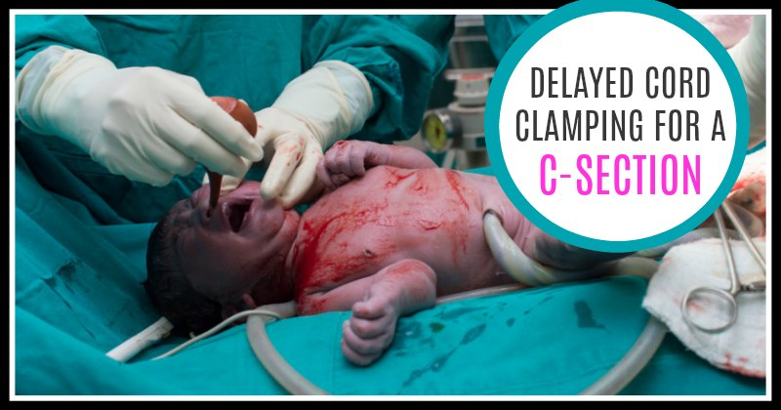
Delayed Cord Clamping
Benefits to both term and preterm infants in delaying cord clamping
Optimal timing of umbilical cord clamping is being debated (30 to 60 seconds)
Infant maintained at or below the level of the placenta because of associated neonatal benefits including; increased blood volume, reduced need for blood transfusion, decreased incidence intracranial hemorrhage in preterm infants, and lower frequency of iron deficiency anemia in term infants
Studies are showing a nearly 50% reduction in intraventricular hemorrhage in preterm infants
Not recommended in infants who are being delivered under general anesthesia

Slide 153
Complications of Regional Anesthesia
Hypotension - defined as a 20% decrease from baseline or a SBP less than 100 mmHg
Monitor BP at least every 2 minutes until stabilized
LUD, fluids, vasopressors
Nausea and Vomiting
Caused by hypotension, pain, delayed gastric emptying, administration of parenteral opioids, visceral traction with exteriorization of the uterus, and motion during transport
Some clinicians believe that a sympathetic block results in unopposed GI vagal stimulation
Opioids in epidural or subarachnoid space improve block quality and do not increase introp nausea

Slide 154
Complication of Regional Anesthesia
Nausea and Vomiting
Multimodal approaches combining antiemetics with different mechanisms of action may be more effective than a single drug modality
Metoclopramide (10 mg IV) is prokinetic that lifely reduces N/V
Can be given preop or at cord clamp
Ondansetron (4 mg IV) is a serotonin receptor antagonist
May be more effective compared to metoclopramide
Scopolamine patch - been shown to reduce post-cesarean N/V
Takes 2 to 4 hours to work (duration of action up to 48 hrs)
Side effects include dry mouth and dizziness
Decadron, antihistamines, propofol

Slide 155
Postdural Puncture Headache
PDPH occurs when the epidural needle punctures the dura and CSF leaks through it
Traction on the meninges and cerebral vasodilation cause the headache
Occurs in 1% to 2% of epidural placements
Headache occurs in 80% to 86% of women
Hallmark of PDPH is the postural component - headache relieved when lying down and returns upon sitting up or standing
PDPH symptoms include; frontal and occipital pain radiating to the neck and shoulders, nausea, vertigo, and low back pain are also seen
Ocular dysfunction as a result of a cranial nerve VI (abducens nerve) palsy is less common and can result in double vision and a deviated gaze

Slide 156
Postdural Puncture Headache
PDPH is not the only cause of headaches following regional anesthesia in the obstetric pt
tension/migraine and preeclampsia/eclampsia accounted for over 70% of reported headaches
More serious causes of postpartum maternal headaches include meningitis and intracranial pathology such as cortical vein thrombosis and subarachnoid hemorrhage
Case study of recent pt with PIH on Mg. Definite wet tap. Bleeding after delivery requiring blood.

Slide 157
Postdural Puncture Headache
Incidence of PDPH is inversely related to age and seen infrequently in those older than 70 and younger than 10 yrs old
Women slightly more susceptible than men, and pregnancy may increase the incidence
In general, large-diameter needles are more likely to be associated with PDPH when compared to small-diameter needles
With spinal anesthesia, the incidence of PDPH is significantly reduced with the use of pencil-point needles (Pencan, Sprotte, Whitacre) compared with the beveled cutting needles (Quincke)

Slide 158
Postdural Puncture Headache
Some evidence indicates that the bevel orientation relative to the dural fiber plays a role
Electron microscopy has confirmed that the collagen fibers composing the dura are primarily oriented longitudinally
Penetrating the dural fibers along their vertical axis may result in less CSF leakage compared with horizontal bevel orientation
When dural puncture occurs during epidural placement, there has been some evidence to indicate that placing a subarachnoid catheter reduces the incidence of PDPH and the requirement for epidural blood patch(EBP)
Recently happened and gave 1 ml 0.25% bupivacaine and ran 0.125% bupivacaine and 2 mcg/mL fentanyl at 2 ml/hr
The use of air as opposed to saline in the loss of resistance technique may also be associated with greater PDPH rates

Slide 159
Postdural Puncture Headache Treatment
PDPH can vary from mild irritation to debilitating
Conservative management includes;
IV hydration (increases CSF production)
Supine position (maintains higher CSF pressure in brain)
Caffeine (reverses cerebral vasodilation)
Theophylline (reverses cerebral vasodilation)
NSAIDS
Cosyntropin
Cosyntropin - a synthetic form of adrenocorticotropic hormone (ACTH)
Given as an IV infusion to stimulate adrenal gland
Risks of infusion are low
Pts with PDPH who are unresponsive to conservative therapy for 24 hrs should be considered for an EBP
EBP has an estimated treatment success rate of 75%

Slide 160
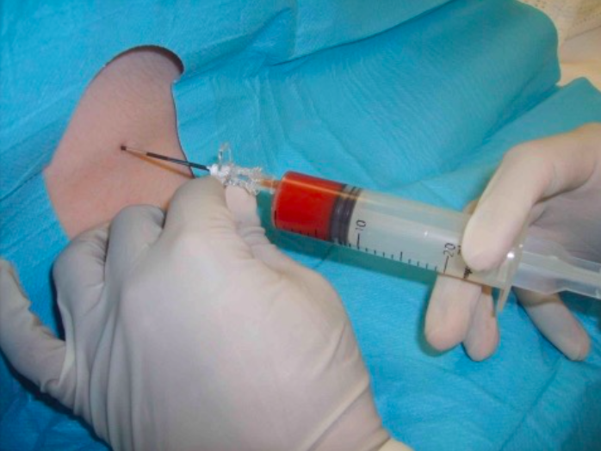
Epidural Blood Patch
An epidural needle is placed in the epidural space, preferably at the same interspace as the dural puncture or one space below
Studies under fluoroscopy have shown blood/dye spread one spinal segment below and 4 spinal segments above point of injection
Once needle is in place, an assistant performs a peripheral venipuncture and draws 20 mL autologous blood using strict aseptic technique
Blood is slowly injected into the epidural space (ideal volume is 15 to 20 mL)
Pt remains at rest for 1 hour
Mechanism of action of an EBP appears to be twofold;
The epidural blood covers the dural defect with a fibrin clot
Injected volume of blood compresses the epidural and subarachnoid spaces, which increases CSF pressure

Slide 161
Obstetric Complications
Postpartum Hemorrhage
Reminder - uterus receives 500 to 700 mL/min or 10% of CO - blood loss can be rapid and profound
PPH defined as an EBL greater than 500 mL after vaginal and 1000mL after C/S
Approximately 4% of all parturients who deliver vaginally experience PPH
Uterine atony (80%) is the most common cause of PPH and is associated with;
Multiparity, multiple gestations, polyhydramnios, and prolonged oxytocin infusion before delivery

Slide 162
Obstetric Complications
Postpartum Hemorrhage
Other causes of obstetric bleeding
Retained placenta/placenta fragments - IV nitroglycerine provides uterine relaxation for placental extraction
Laceration to the cervix or vaginal wall
Uterine inversion
Coagulopathy
When hemostasis is not achieved with uterine massage, oxytocin, ergot alkaloids - an intrauterine balloon may be necessary
Disseminated Intravascular Coagulopathy may be associated with:
Amniotic fluid embolism
Placenta abruption
Intrauterine fetal demise - occurring more frequently
Often accompanied by circulatory shock

Slide 163
Oxytocin
Oxytocin is a naturally occurring hormone synthesized in the supraoptic and paraventricular nuclei of the hypothalamus and released from the posterior pituitary gland
Endogenous oxytocin is released following stimulation of the cervix, vagina, and or breasts
In the mature uterus of a pregnant woman, oxytocin causes an increase in the frequency and strength of contractions
Pitocin is the clinically available synthetic equivalent of oxytocin
During a C/S pitocin should be given after the placenta has been delivered
Half life of oxytocin varies from 4 to 17 minutes
Metabolized by the liver, kidney, and plasma enzyme pathways in the parturient
Side effects; water retention, hyponatremia, hypotension, reflex tachycardia, coronary vasoconstriction

Slide 164
Oxytocin
Side effects include;
water retention, hyponatremia, hypotension, reflex tachycardia, coronary vasoconstriction
Commercially available preparations of oxytocin contain a preservative that may cause systolic and especially diastolic hypotension, flushing, and tachycardia at high doses
Amount of oxytocin/pitocin added to the IV bag should be tailored to the volume of solution remaining in the bag, flow rate of the IV, and the pt’s condition
If a large amount of blood is lost, a second IV may need to be placed for rapid fluid administration
In some cases, the obstetrician may choose to administer oxytocin directly into the uterine muscle

Slide 165
PPH Treatment
Postpartum Hemorrhage
Methergine
Ergot alkaloid
Second-line uterotonic (increases contractility) not a tocolytic (uterine relaxant)
Dose of 0.2 mg IM
IV administration can cause significant vasoconstriction, HTN, and cerebral hemorrhage (Do Not Give IV)
Hepatic metabolism
Half-life 2 hours
Contraindicated in pts with preeclampsia

Slide 166
PPH Treatment
Postpartum Hemorrhage
Prostaglandin F2 (Carboprost and Hemabate)
Third line uterotonic
Dose 250 mcg IM or injected into the uterus
Side effects include; N/V, diarrhea, hypotension, or hypertension, bronchospasm
Avoid in pts with asthma
Misoprostol (Cytotec)
Synthetic prostaglandin E1 analog
Binds to smooth muscle cells in the uterine lining to increase the strength and freq of contractions
Degrades collagen and reduces cervical tone
Oral, sublingual, and rectal
Antifibrinolytic agents (Tranexamic acid)
Strengthens fibrin clot by inhibiting enzymatic fibrinolysis

Slide 167
Obstetric Complications - Hypertensive Disorders
Gestational Hypertension
Occurs after 20 weeks
HTN
Preeclampsia
Occurs after 20 weeks
HTN
Proteinuria
Edema
Eclampsia
Occurs after 20 weeks
HTN
Proteinuria
Edema
Seizures
Classic triad of preeclampsia consists of HTN that develops after 20 weeks, proteinuria, and generalized edema. However, Anesthesia and Co-Existing Disease states edema is no longer required for diagnosis

Slide 168
Preeclampsia: Pathophysiology
Affects 5%-7% of the obstetric population
Etiology unknown - more common in mothers < 20 years old and those > 35 yrs old
Pts with chronic renal disease and those that are homozygous for the angiotensinogen T235 allele have the highest risk of developing preeclampsia
Prevailing theory suggests abnormal placental implantation creates an environment characterized by elevated vascular resistance and a reduction in placental blood flow
Placenta and fetus do not receive adequate supply of oxygen and metabolic substrate to develop normally
Healthy placentas produce thromboxane and prostacyclin in equal amounts
In preeclampsia, 7 times more thromboxane is produced than prostacyclin
Increased thromboxane favors; vasoconstriction, platelet aggregation, and a reduced placental blood flow
The diseased placenta releases cytokines that promote endothelial dysfunction, resulting in system-wide manifestations

Slide 169
Severity of Preeclampsia
SBP
DBP
Proteinuria
24 hr urine total
Generalized edema
Pulmonary edema
Cyanosis
Headache
Visual impairment
Epigastric pain
RUQ pain
HELLP syndrome
Platelet count
Fetal Growth
Mild Preeclampsia
< 160 mmHg
< 110 mmHg
< 5 g/24 hr
< 3 + dipstick
> 500 mL
Yes
No
No
No
No
No
No
No
> 100,000
Normal
Severe Preeclampsia
> 160 mmHg
> 110 mmHg
> 5 g/24 hr
> 3 + dipstick
< 500 mL
Yes
Yes
Yes
Yes
Yes
Yes
Yes
Yes
< 100,000
Impaired
Key Facts
Increased thromboxane - vasoconstriction
Increased thromboxane - vasoconstriction
Glomerular capillary endothelial destruction
Glomerular capillary endothelial destruction and renal edema
Decrease oncotic pressure and increase vasc perm
Heart failure, decreased oncotic pressure and increased vascular permeability
Cerebral edema
Vasoconstriction of ocular arterioles
Liver subcapsular hemorrhage, hypoxic liver
Hypoxic liver
Consumption by endothelial damage
Uteroplacental hypoperfusion
Preeclampsia can be mild or severe. Not all pts progress in a step-wise fashion from HTN, to preeclampsia to eclampsia. 25%-40% will be normotensive when they have their first seizure

Slide 170
Obstetric Management of Preeclampsia
Delivery is at present, the only definitive way of ending the disease process
The decision to deliver is based on the presence of complicating factors; uncontrolled HTN, eclampsia (seizures), pulmonary edema, placental abruption, or evidence of nonreassuring fetal status
In the absence of severe features, 24 -48 hour trial of corticosteroids may be administered to enhance fetal lung maturity
Treatment of preeclampsia is directed toward preventing eclampsia

Slide 171
Eclampsia
The presence of seizures differentiates preeclampsia and eclampsia
Magnesium sulfate is routinely used to prevent seizures in severe preeclampsia both before and after delivery
Mg is a calcium antagonist - relaxes smooth muscle by turning off myosin light-chain kinase in the vasculature and the uterus. Also, it hyperpolarizes membranes in excitable tissue
Mg Level (mEq/L) 2-3.5 seizure prophylaxis, 4-6.5 loss of patellar reflex, N/V, diplopia and somnolence, 6.5-7.5 skeletal muscle weakness and apnea, > 10 cardiac arrest

Slide 172
Magnesium Sulfate
Will see Mg levels presented differently
mg/dL appears to be the most common type of measurement
Side Effects
Pulmonary edema
Hypotension
Skeletal muscle weakness
CNS depression
Reduced response to ephedrine and phenylephrine
Treatment for Hypermagnesemia
Supportive measures
Diuretics (facilitate excretion of Mg)
IV Calcium (antagonize Mg)
10 mL of 10% calcium gluconate IV
Serum level (mg/dL)
1.8 - 3
4-8
7-9.5
10-12
12-18
>18
>25
Clinical effect
Normal level
Tocolysis
Anticonvulsant
Patellar reflex abolished
Respiratory depression
Apnea
Cardiac arrest

Slide 173
Anesthetic Management for Preeclampsia
Fluid management is balanced between a volume contracted pt and a “leaky” vasculature from endothelial dysfunction
Neuraxial anesthesia is generally preferred as it assists with blood pressure control and provides better uteroplacental perfusion
Must check platelet level prior to neuraxial anesthesia
Higher incidence of difficult intubation due to airway swelling
Exaggerated response to sympathomimetics and methergine
If receiving Mg, increased sensitivity to nondepolarizing muscle relaxants - rocuronium has increased onset time and prolonged recovery time of 25% >
Mg relaxes the uterus and increases the risk of postpartum hemorrhage
Labetalol is generally considered the first line drug for SBP > 160 mmHg, esmolol has also been used safely

Slide 174
HELLP Syndrome
HELLP syndrome consists of hemolysis, elevated liver enzymes, and a low platelet count
5% to 10% of women with preeclampsia develop HELLP syndrome
Clinical signs of HELLP include; epigastric pain, upper abdominal tenderness, proteinuria, HTN, jaundice, N/V
Definitive treatment is delivery of fetus
Pts are at higher risk for DIC and intra-abdominal bleeding from the liver

Slide 175
Maternal Cocaine Abuse
Cocaine is an ester-type LA that inhibits NE reuptake in the presynaptic SNS neuron. Flooding the synaptic cleft with NE increases SNS tone
CV risks include tachycardia, dysrhythmias, and myocardial ischemia
Acute cocaine abuse increases MAC
Chronic cocaine abuse decreases MAC
Parturient risks include; spontaneous abortion, premature labor, placental abruption, and low APGAR scores
Treat HTN with vasodilators
Beta blockers can cause heart failure if the SVR is significantly elevated
Hypotension may not respond to ephedrine (d/t catecholamine depletion) Phenylephrine is the best option
Chronic cocaine abuse is associated with thrombocytopenia - check platelet level

Slide 176
Prematurity and Tocolysis
Premature delivery is described as delivery occurring before 37 weeks
Leading cause of perinatal morbidity and mortality
Risk of prematurity increases with multiple gestations and PPROM
Complications of premature delivery include; respiratory distress syndrome, intraventricular hemorrhage, hypoglycemia, hypocalcemia, hyperbilirubinemia, and necrotizing enterocolitis
Corticosteroids (betamethasone) hasten fetal lung maturity
Takes effect within 18 hours, with peak benefit at 48 hrs

Slide 177
Prematurity and Tocolysis
Tocolytic agents stop labor for 24-48 hours, providing the time to allow steroids to work
Antibiotic prophylaxis for chorioamnionitis may also be given
Tocolytics or corticosteroids are seldom given after 33 weeks gestation
Beta-2 agonists (terbutaline and ritodrine)
Beta-2 stimulation increases intracellular cAMP which turns on protein kinase, thereby turning off myosin light-chain kinase and ultimately relaxing the uterus
Also increases progesterone release, which contributes to myometrial relaxation
Side effects
Hyperglycemia results from glycogenolysis in the liver
Newborn at risk for post-delivery hypoglycemia, mother’s glucose supply is gone but the insulin in the neonatal circulation remains
Hypokalemia results from an intracellular potassium shift
Beta-2 agonists cross the placenta and may increase FHR

Slide 178
Prematurity and Tocolysis
Calcium channel blockers
Block influx of Ca+2 into the uterine muscle, which reduces Ca+2 release from the SR. In turn, this turns off myosin light-chain kinases and relaxes uterine muscle
Nifedipine may be given orally
Co-administration with Mg can contribute to skeletal muscle weakness
Initiate MgSO4 infusion for neuroprotection - mechanism not clearly understood
Reduction of oxygen free radicals
Reduction of inflammatory cytokines

Slide 179
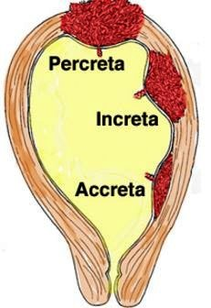
Disorders of the Placenta
The placenta normally implants into the endometrium
Three types of abnormal placental implantation
Accreta - the placenta invades the desidual layer of the endometrium and attaches to the surface of the myometrium (80%)
Increta - the placenta invades the myometrium (15%)
Percreta - the placenta extends beyond the uterus (5%)
Closely associated with placenta previa and previous C/S
Uterine contractility is impaired and there is a potential for tremendous blood loss
GA is preferred, may require hysterectomy

Slide 180
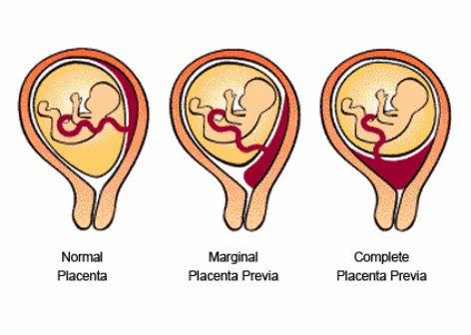
Disorders of Placenta
Placenta Previa
Present when the placenta has implanted in the lower uterine segment
Either partially or completely covering the opening of the cervix
Incidence of 1%
Painless vaginal bleeding
Potential for hemorrhage
Often requires C/S - diagnosed by ultrasound
Risk factors include; previous C/S, and history of multiple births

Slide 181
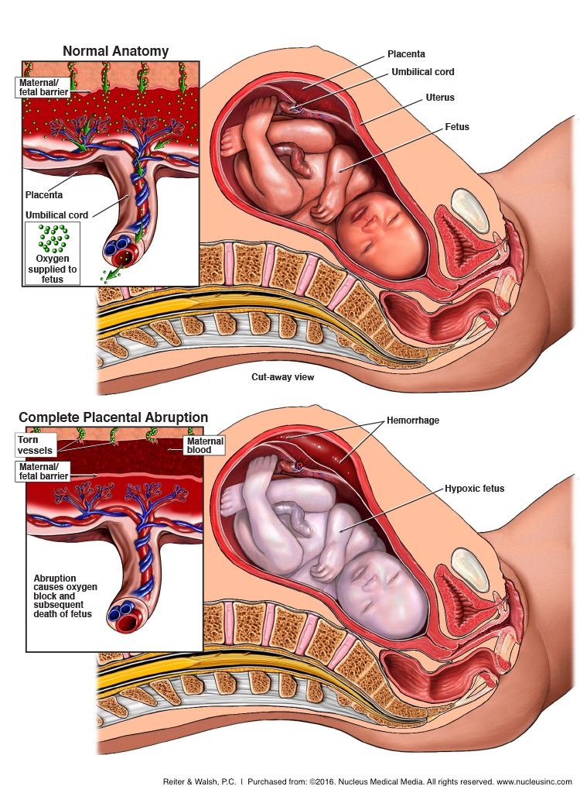
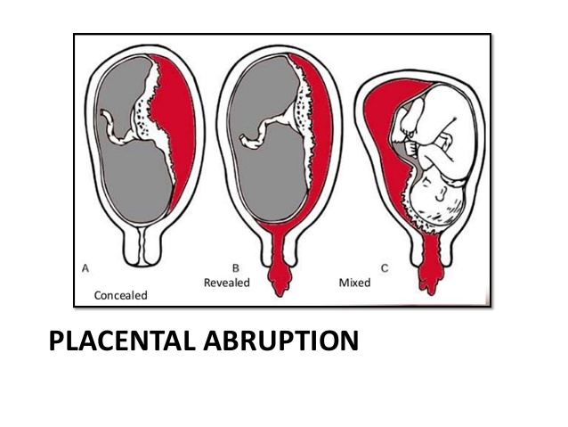
Placental Abruption

Slide 182
Disorders of Placenta
Placental Abruption
Partial or complete separation of placenta from the uterine wall prior to delivery
Results in massive hemorrhage and fetal hypoxia along with abdominal pain
May not see vaginal bleeding because it is behind the baby - case after epidural placement, low BP
Vaginal delivery is possible if fetus is stable, prepare for C/S
Obtain large bore IV and have blood products available
Risk of amniotic fluid embolism leading to DIC because of open venous sinuses in the uterine wall that may allow amniotic fluid to enter maternal circulation
Risk factors include;
PIH
Preeclampsia
Chronic HTN
Cocaine use
Smoking
Excessive alcohol use

Slide 183
Uterine Rupture
Can range from incomplete to total rupture
Always presents with severe abdominal pain
Referred shoulder pain is the result of diaphragmatic irritation secondary to intraabdominal blood
Uterine rupture can be masked by an existing epidural
Any patient with an existing epidural who develops new onset abdominal pain should be evaluated for uterine rupture

Slide 184
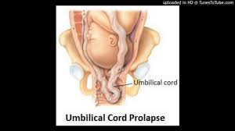
Prolapsed Cord
Umbilical cord protrudes out of cervix ahead of the fetus
Each contraction and pushing further compresses the cord resulting in decreased perfusion of O2 to fetus
EMERGENCY!
Treatment; push head back in and proceed to C/S

Slide 185
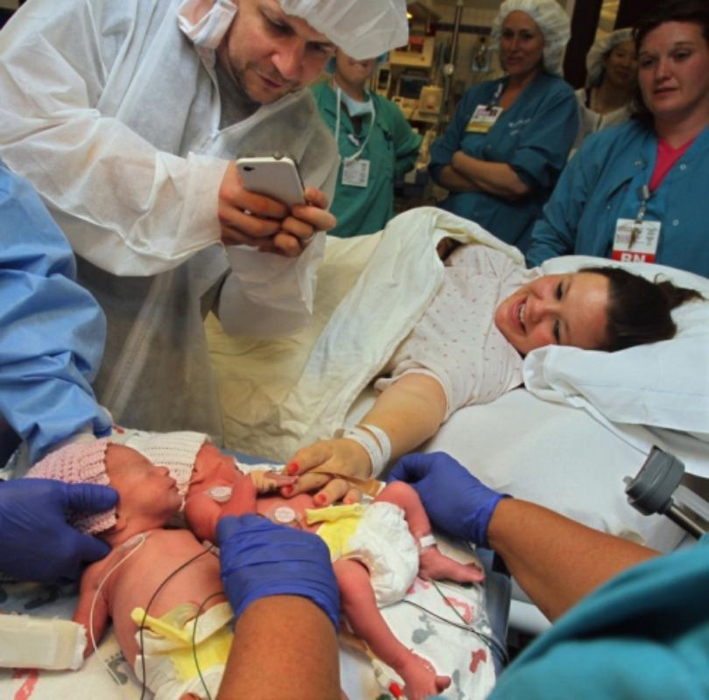
Multiple Gestations and Anesthesia
Double setup in OR for potential C/S
Risks for Twin B;
Cord prolapse
Premature placental separation
Entrapment - uterus contracts down
May need to undergo GA for delivery of second baby

Slide 186
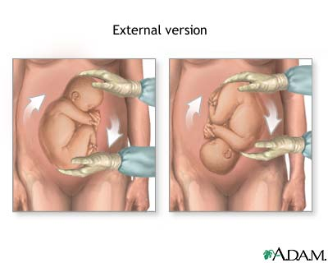
External Cephalic Version
External abdominal pressure to turn fetus
May result in;
Fetal bradycardia
Placental abruption
Uterine rupture
AFE
Fetal demise (cord compression)
OR must be ready

Slide 187
Apgar Score
The Apgar score is used to assess the newborn and guide resuscitative efforts
Five parameters are evaluated at 1 and 5 minutes after delivery
The 1 minute score correlates with fetal acid-base status
The 5 minute score may be predictive of neurologic outcome
Normal = 8-10
Moderate distress = 4-7
Impending demise = 0-3

Slide 188
Apgar Scoring
 | 0 | 1 | 2
Heart Rate | Absent | < 100 bpm | > 100 bpm
Respiratory Effort | Absent | Slow, irregular | Normal, crying
Muscle Tone | Limp | Some flexion of extremities | Active motion
Reflex Irritability | Absent | Grimace | Cough, sneeze, or cry
Color | Pale, Blue | Body pink, extremities blue | Completely pink

