Slide 1
Neonatal Anesthesia
Objectives
Discuss prematurity and the implications for anesthesia care.
Identify and plan the anesthesia care for potential problems when providing care to neonates/ infants.
Discuss congenital abnormalities and their implications for anesthesia care
Discuss etiology of hypothermia and strategies to avoid and treat hypothermia.

Slide 2
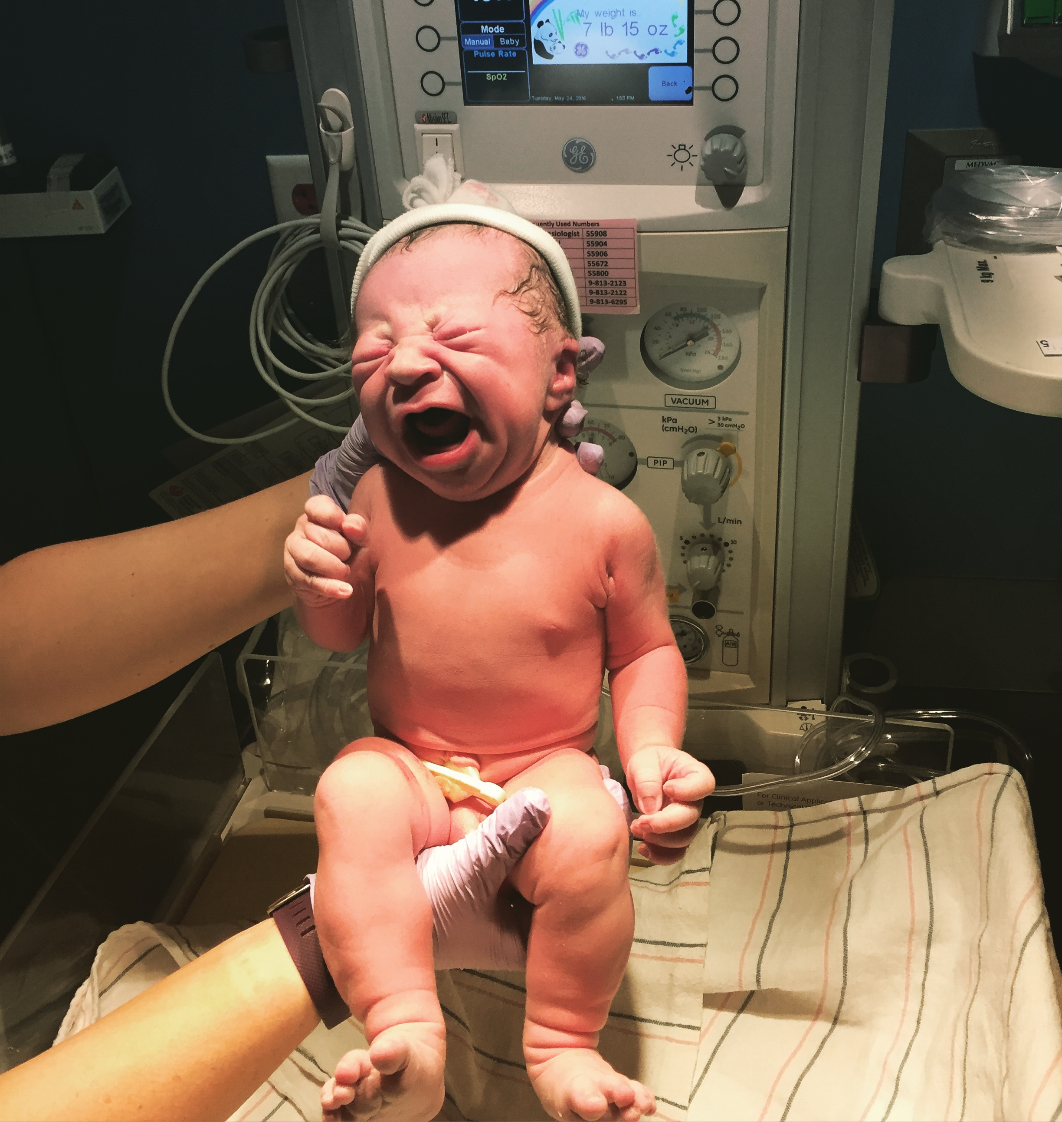
Neonatal Physiology
Neonatal: First month of life
Significant changes in the first 72 hours of life
Cardiovascular system
Pulmonary system
Renal system
Newborn: First 24 hours of life

Slide 4
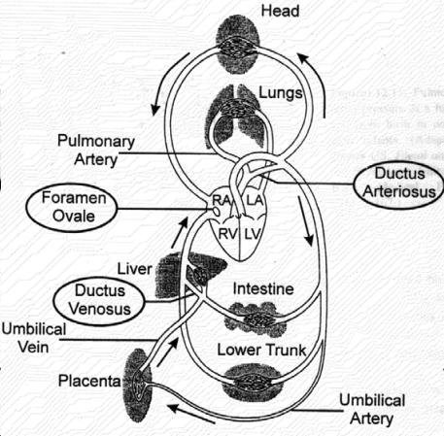
Cardiovascular System
Fetal Circulation is parallel
High resistance and low flow of pulmonary circulation.
Low resistance and high flow of placental circulation.
Presence of SHUNTS
Changes at birth
Pulmonary vascular resistance decreases
PDA closes (PGE2)
Stronger parasympathetic nervous system
↓ Frank Starling Law (fixed strove volume)
↓ Baroreceptor response (decreased peripheral vasoconstriction)

Slide 5
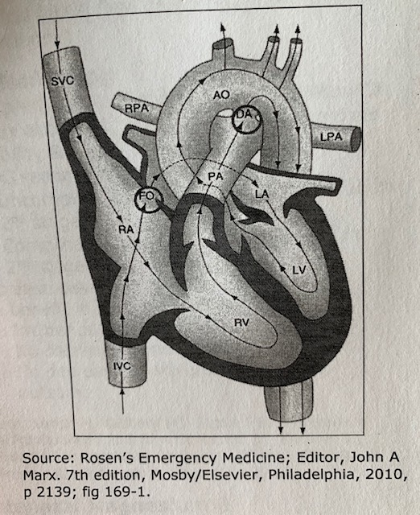
Fetal Circulation

Slide 6
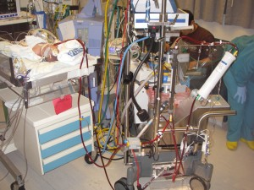
Pulmonary System
Increased minute ventilation
Double the O2 consumption of adults
7cc/kg/min for infant VS 3 cc/kg/min in adults
lung compliance chest wall compliance
Diaphragmatic fatigue (lack of type 1 fibers)

Slide 7
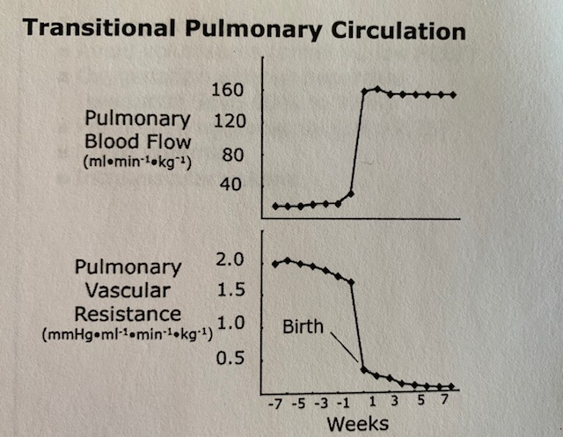
Pulmonary complications
Persistent Pulmonary Hypertension / Persistent fetal circulation
High pulmonary artery pressure
PDA and foramen ovale remain open = shunting = hypoxemia
Causes: Asphyxia, Meconium aspiration, Sepsis, CDH
Treatment , mechanical ventilation, nitric oxide, ECMO
Respiratory distress Syndrome
Caused by a deficiency of surfactant, infection, barotrauma, O2 administration
Characteristics: fibrosis, enlarged alveoli, smooth muscle hyperplasia
Tx: bronchodilator, preO2, post op ventilation
Develop BPD, chronic

Slide 8
Circling the Drain….

Slide 9
Renal System
CO from 3% inutero to 25%
Low GFR and decreased tubular function (until 2yrs old)
Unable to concentrate urine
Blood volume
Term newborn 85mL/kg
Preterm 90mL/kg

Slide 10
Hepatic System
Less P450 activity
Low albumin levels (more unbound free drug)
Vitamin K deficient
Low glycogen stores
IV D10% or D5%
MORPHINE – prolonged half life
CAFFEINE- unmetabolized
VECURONIUM- longer lasting?

Slide 11
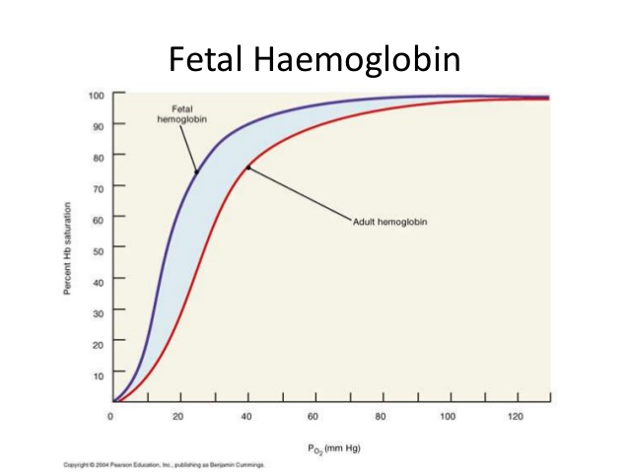
Fetal Hemoglobin
Neonate has 60-90% fetal hemoglobin
Fetal Hemoglobin has a high affinity for Oxygen
Less Oxygen release to tissues
LEFT SHIFT
Newborn 12-20 gm/100mL
Premature 8 gm/100mL
Fall in Hemoglobin at 9-12 weeks of age, curve shifts right. No compromise in O2 delivery.
Stable at 3 months ( 12gm/100mL)

Slide 12
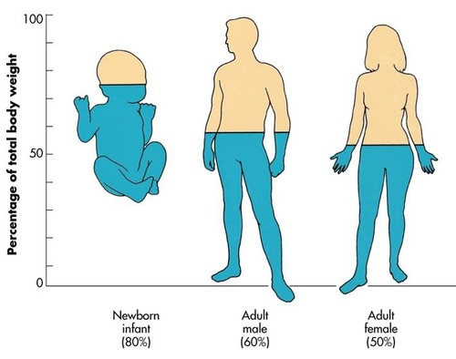
Drugs and Neonates
More water: larger volume of distribution
Less Proteins: more free drug, increased toxicity of protein bound drugs
Less Fat: less redistribution

Slide 13
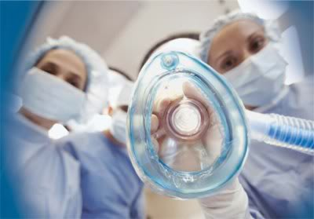
Versed + fentanyl = hypotension
Atropine 10 mcg/kg before induction
Ketamine 2 mg/kg (cardiac patients)
Fentanyl = apnea sensitive, chest wall rigidly
Large does of Succinylcholine (Larger ECF) **ATROPINE**
Muscular dystrophy
Rocuronium, similar duration as child??
Neostigmine with glycopyrrolate
Sevoflurane
Local anesthetic , caudal, spinal and infiltration.

Slide 14
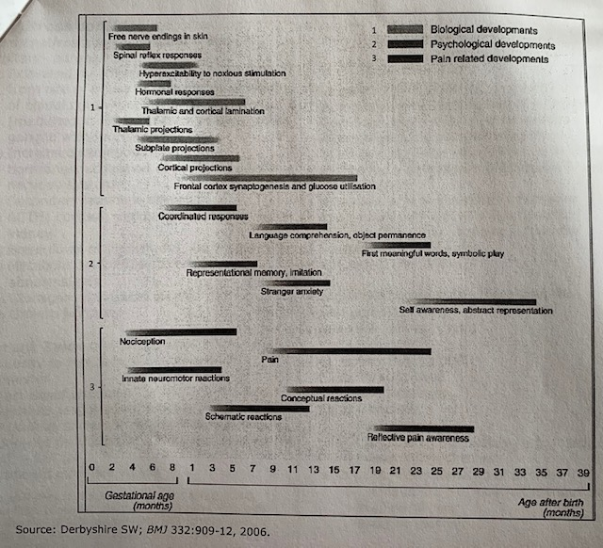
Fetal Pain
“The subjective phenomenon of pain has not been, and perhaps cannot be, assessed adequately in the human fetus.
pain is a multidimensional, subjective, psychological construct that can exist in the absence of physical stimuli,
which includes emotional and affective components that require higher-level cortical processing.”
When the fetus has the capacity to feel pain is controversial.

Slide 15
Anesthetic Management: The Obvious
The more premature and the lower the birth weight the higher the morbidly and mortality.
Neonates have a similar stress response as adults.
The presence of one congenital anomaly increases the likelihood of another one.

Slide 16
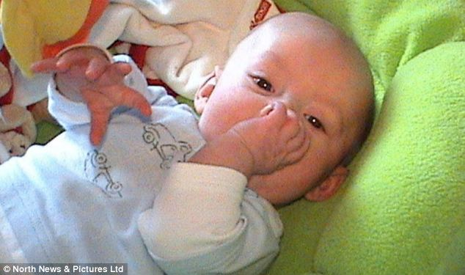
Preoperative
Gestational age
Type of delivery
Maternal history
IUGR
Hydration of infant (glucose)
Airway exam? (breathing pattern)
No premed (no separation anxiety)

Slide 17
Intraoperative
Standard monitors
PRECORDIAL (heart tones and rate)
Temperature monitoring , axillary
Preductal VS Postductal saturations
Inhalation VS IV induction
Premed with Atropine?
Uncuffed Vs cuffed ETT (must have leak)
Pressure Controlled Ventilation
No bubbles
TO4 monitoring
Larger gradient between Capnograph and arterial PCO2
Oxygen use
Congenital heart disease
ROP keep SpO2 96%-99% until 44 weeks postconceptual age

Slide 18
SEVOFLORANE
Faster Uptake
Ratio of alveolar ventilation to FRC
CO to vessel rich organs (heart & Brain)
Higher CO relative to body mass
Lower blood gas coefficient for agents
Premature infant MAC decreases 30%
Immature nervous system
Progesterone from mother
Immature blood brain barrier
Endorphins in CNS ?

Slide 19
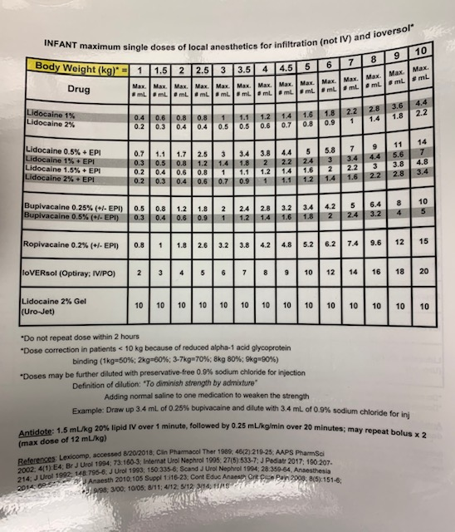
Regional Anesthesia

Slide 20
Temperature Control
Newborns at risk
Unable to shiver
Unable to vasoconstrict
Larger body surface area to weight ratio
Low levels of subcutaneous fat
NONSHIVERING THERMOGENESIS
SNS> increased serum norepi levels > Metabolism of brown fat
Ketone production, increased O2 consumption, CO diverted to kidneys, pulmonary vasoconstriction

Slide 21
Brown fat metabolism
Brown Fat: Highly specialized tissue – brown color is due to an abundant number of mitochondria
Mitochondria have special proteins called thermogenin (also called uncoupling proteins) that have the unique ability to uncouple oxidative phosphorylation resulting in heat production instead of generating ATP.
Brown fat makes up about 5% of the neonate/infant’s body weight
Located in the nape of neck, the axilla, mediastinum, between the scapulae, and around the adrenal glands and kidneys
Cold Stress
Release of norepinephrine (NE)
NE binds to adrenergic receptors on surface of brown adipocytes
Triggers the activation of adenylate cyclase
Adenylate cyclase converts ATP to cAMP
cAMP activates protein kinase A (PKA)
PKA activates lipases that break triglycerides into glycerol and free fatty acids
The free fatty acids bind to thermogenin, triggering an uncoupling of the
proton gradient and the release of heat

Slide 22
Temp Control Continued
Consequences:
Increased metabolic rate and O2 consumption
Left shift of oxyhemoglobin dissociation curve
Hypoxemia
Acidosis
Apnea, respiratory distress
Pulmonary vasoconstriction
Prevention:
Heated OR, decrease convective heat loss
Warming lights
Bair hugger
HME

Slide 23
Postoperative
Waking up:
Grimace
Pulling up legs
Arm strength
Floppy fish
Apnea and Bradycardia
Decreased response to hypoxia and hypercarbia
Respiratory muscle fatigue
Bradycardia is a late sign of hypoxia
Hypothermia and anemia
Tx: prolonged ventilation, caffeine , regional
monitor all infants younger than 60 weeks postconceptual age overnight
Postconceptual age:
Ex: 25 weeks at birth, now 15 weeks old. PCA = 40 weeks

Slide 24
Central Apnea
Definition: decreased respiratory center output caused by poor organization and integration of afferent input from proprioceptive receptors(receptors located in the diaphragm and intercostal muscles) and from medullary and peripheral chemoreceptors
Causes: mainly idiopathic. Also changes in oxygenation, pulmonary mechanics, brain hemorrhage, hypothermia, hypoglycemia, hypocalcemia, or airway stimulation. The responsiveness of chemoreceptors to hypercarbia and hypoxia develops with age.
Risk Factors: Low postconceptional age, low hematocrit, major surgery, h/o apnea of prematurity, h/o chronic lung disease.
Incidence: 20% of Infants undergoing surgery with history of prematurity, apnea, or chronic lung disease experience apnea in the postoperative period
Management of postoperative apnea: close observation spo2, HR, RR, and ECG; IV caffeine or Theophylline, prevention of anemia and hypovolemia. Increase oxygen delivery, increase fraction of inspired oxygen, Nasal CPAP or intubation may be required for several days postop.

Slide 25
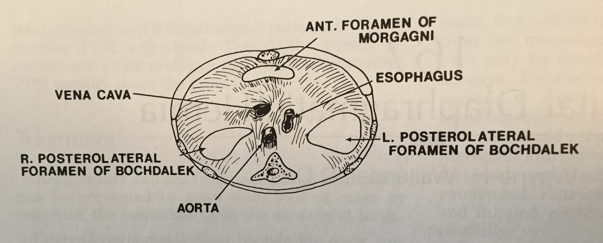
Congenital Diaphragmatic Hernia
Prenatal Diagnosis
Possible hypoplastic lungs
Possible mediastinal shift
Liver/stomach herniation
Bowel in chest on x-ray
Stable before the OR
Permissive hypercapnia
NO
Oscillator
ECMO
Anesthetic Management
Fentanyl & Vecuronium
Control pulmonary HTN (avoiding hypothermia)
Ventilate without barotrauma
Thorascopic approach
Foramen of Bochdalek , LEFT side, most common

Slide 26
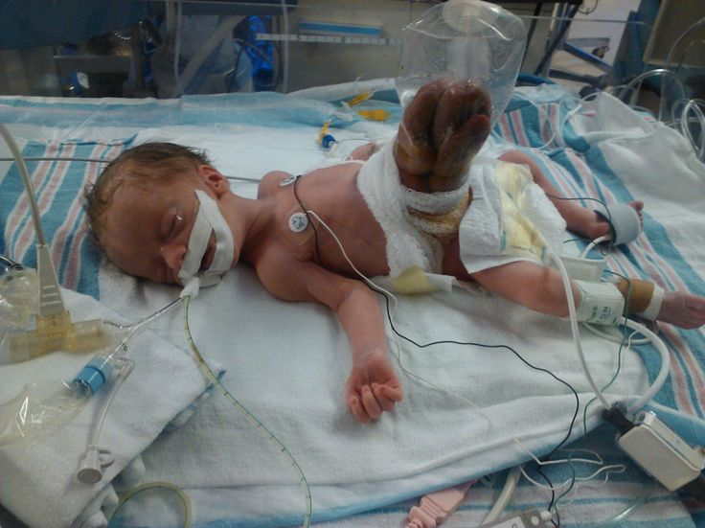
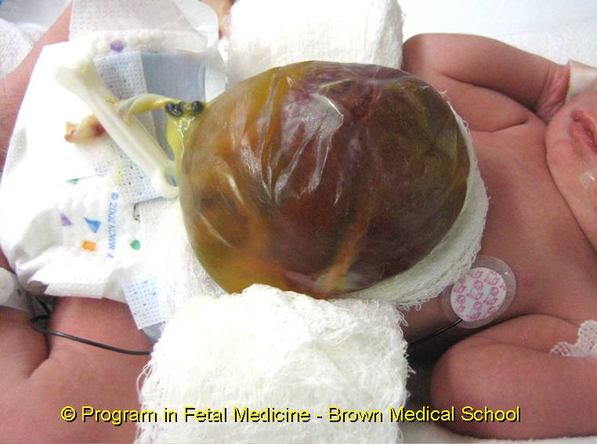
Omphalocele
Gastroschisis
Develops 5-10th week of life
Covered in membrane – amnion
Congenital anomalies
Beckwith-Wiedemann Syndrome
Downs syndrome
Cardiac anomalies
Heart lesions 20%
Develops later
Ischemia and atrophy of abdominal wall
Susceptible to infection and ECF loss
Silo
Anesthetic management:
Fluid shifts
Bladder pressures
Pulse ox of foot
Airway pressures

Slide 27
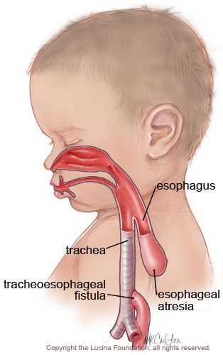
Tracheoesophageal Fistula
Anesthetic Management:
Routine infant set-up
Vent G-tube
RSI
Low Peak airway pressures
ETT below the defect but above the carina, verify with fiberoptic
Positioning may be lateral
Hand ventilation
Return to NICU intubated
V-Vertebral defects
A-anal atresia
C-Cardiac anomalies
T-Tracheosopheageal fistula
E-Esophageal atresia
R-renal dysplasia
L-limb anomalies

Slide 28
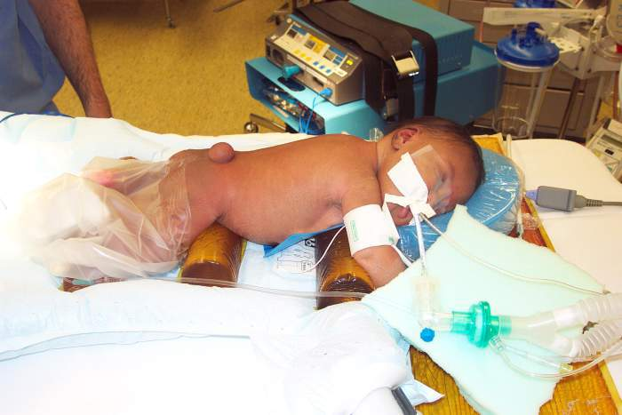
Myelomeningocele
Failed neurotube closure
Lumbosacral area
Associated with Chiari (Cerebelllum through foramen magnum)
Stridor
Apnea
Swallowing difficulties
Weak cry
Hydrocephalus → VPS
New treatment: open fetal surgery
Anesthetic management:
Supine in donut for intubation, then Prone position
Warm room
Careful of cervical flexion during intubation
Extubation at end of case, apnea monitoring

Slide 29
Necrotizing Enterocolitis
Intestinal Mucosal injury from ischemia due to reduced mesenteric blood flow caused by decreased CO, or possibly the result of early feeding.
Dx: Free air in the abdomen
Tx: antibiotics, OGT, TPN, peritoneal drain, pressors
Call to the OR…. Perforaton = Exploratory laparotomy emergency. SICK & SEPTIC
Anesthetic Management:
Good access, PIV or central line
Fluid reseccitaion, correct third space losses
Blood products/ albumin
Correct metabolic acidosis
Fentanyl & Vecournium
SpO2 mid 90s for ROP

Slide 30
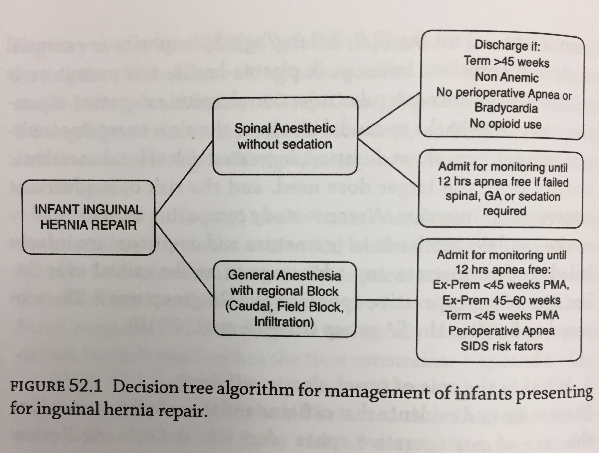
Hernia repair for the neonate
Done before premature babies discharged home (incidence 25%)
Consider use of spinal / inguinal block
Speed of surgeon
Apnea and bradycardia monitoring if intubated
Tx: Caffeine

Slide 31
Pyloric Stenosis
Hypertrophy of the pyloric smooth muscle
Persistent vomiting : Hypochloremic Hypokalemic Metabolic Alkalosis
↓K
↓Na
↓Cl
Medical rather than surgical emergency, correct acid/ base abnormalities and dehydration 1st.
Anesthetic management:
OG suction
True rapid sequence induction
Laproscopic case
Awake extubation
Post op apnea risk

Slide 32
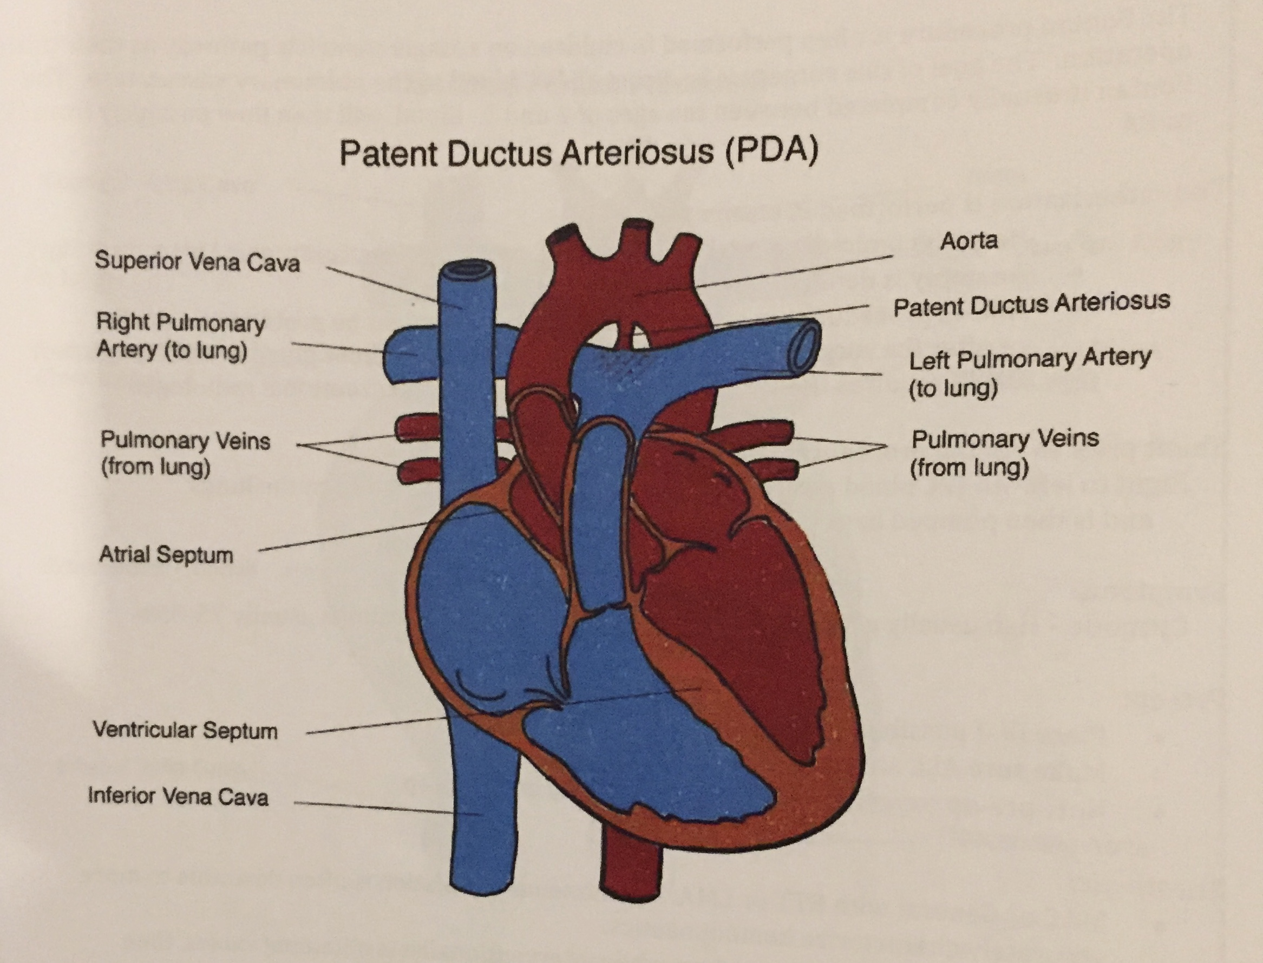
PDA ligation
When indomethacin fails
Continuous systolic and diastolic murmur
Anesthetic management:
Temperature management, transport in isolette
Tiny patients (650 grams)
Blood in room
Fentanyl & Rocurnioum
Remain intubated after procedure

Slide 33
Syndromes
Down Syndrome
Treacher Collins
Goldenhar Syndrome
Apert Syndrome
Beckwith-Wiedmann Syndome
Klippel-Feil Syndrome
Hurler Syndrome
Pierre-Robin Syndrome

Slide 34
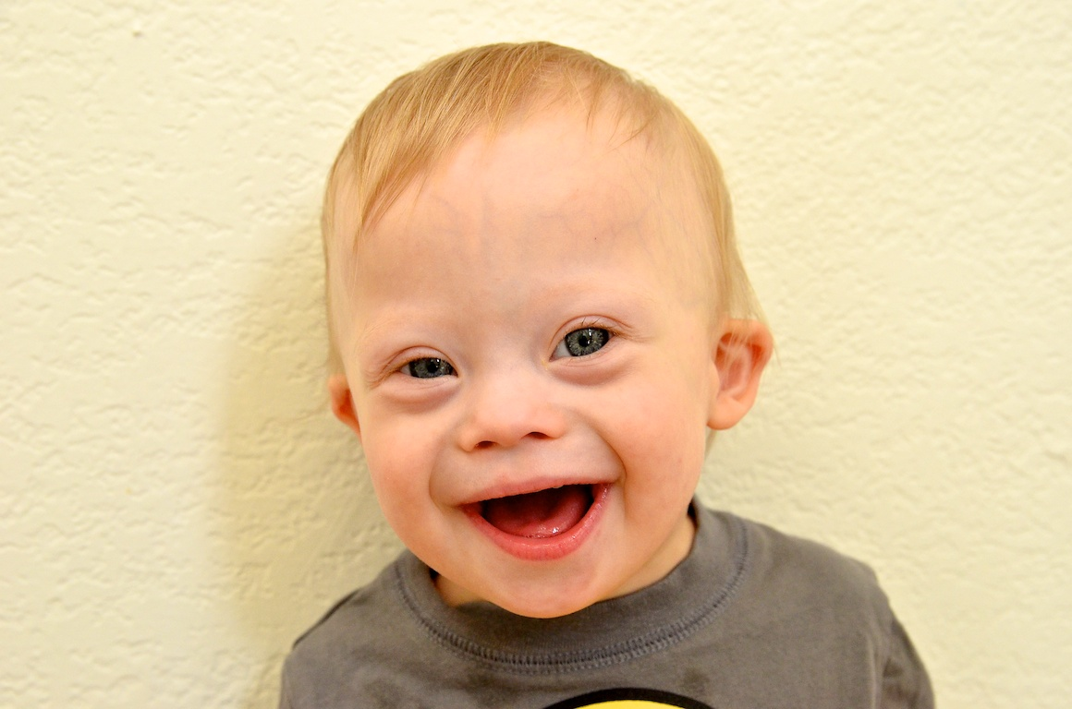
Down Syndrome/ Trisomy-21
Features: | Most common 1:700 to 1:1,000 births, Narrow nasopharynx, flat nasal bridge, macroglossia, tonsil/ adenoid hypertropy, micrognathia, higher incidence of leukemia and Hirschsprung Dz
Airway Concerns: | Chronic upper airway obstruction, OSA,
Anesthetic Concerns: | 50% congenital heart disease, hypotonia, friendly but prefer routine, cervical instability (neutral spine) , small trachea, increased intraop bradycardia, hypothyroid

Slide 35
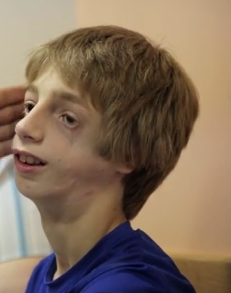
Treacher Collins
Features: | Mandibular and pharyngeal hypoplasia, coloboma of lower lid, external ear abnormalities, hearing loss, absent parotid gland, normal intelligence
Airway Concerns: | Narrow airway due to pharyngeal hypoplasia, possible tracheostomy, small mouth
Anesthetic Concerns: | Present for plastic surgery, Difficult intubation, airway improves with age.

Slide 36
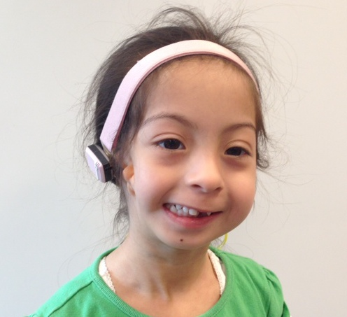
Goldenhar Syndrome
Features | Asymmetric ocular anomalies, vertebral anomalies, hypoplasia of facial bones. (possible fetal vascular accident) normal intelligence
Airway concerns | Limited mouth opening, deviation of mandible, micrognathia, cleft palate, abnormal tongue, TEF, laryngeal anomalies
Anesthetic concerns | Difficult airway, gets worse with age, difficult mask, “prior surgery should not be considered reassuring” OSA 24%, Possible cardiac defects, possible hydrocephalus, possible renal disease.

Slide 37
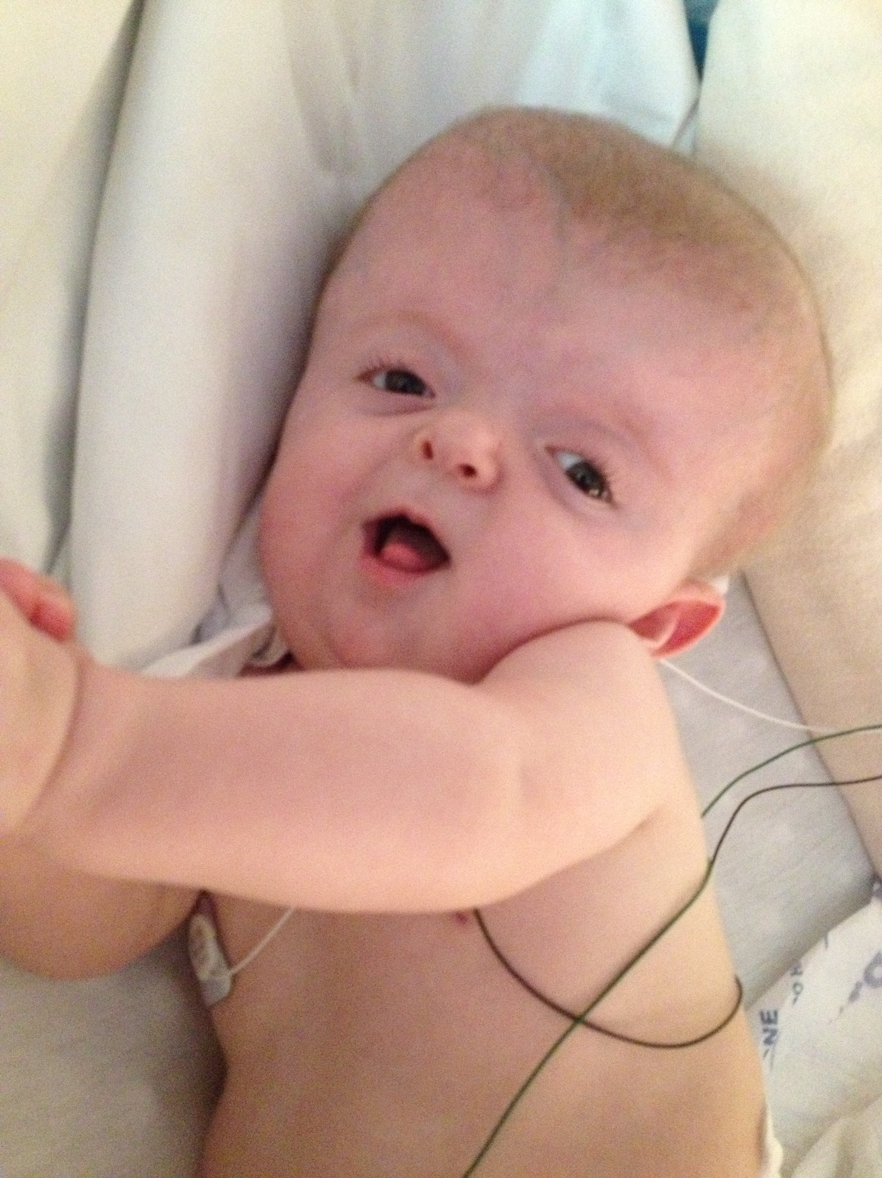
Apert Syndrome
Features | Crainosynostosis, midface hypoplasia, high forehead, shallow orbits, beaked nose, narrow palate, syndactyly, 10% cardiac defects, 10% genitourinary anomalies
Airway concerns | Upper airway compromise d/t small nasopharynx, choanal stenosis or atresia, and tracheal stenosis.
Anesthetic concerns | Difficult IV access, difficult intubation d/t small nasopharynx or cervical spine fusion. (obtain preop C-spine X-rays) possibly maxillary distractors. Reduced ability to clear secretions, unable to place nasal airway or NGT, monitor renal function.

Slide 38
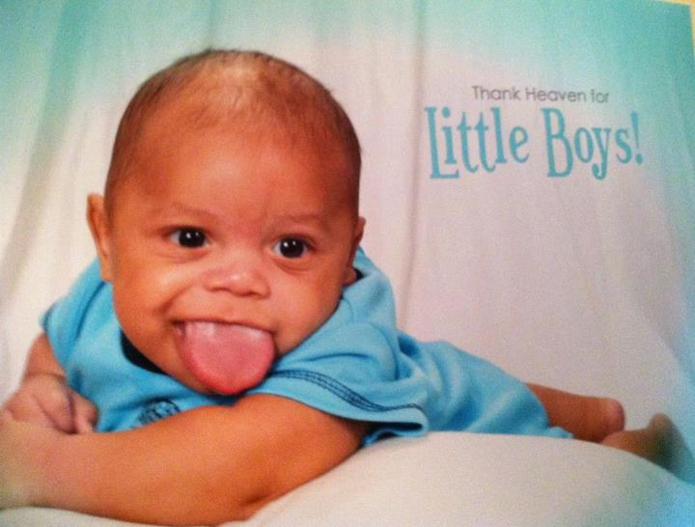
Beckwith-Wiedemann Syndrome
Features | Macrosomia, macroglossia, omphalocele, increased subcutaneous tissue, increased risk of intraabdominal tumors
Airway concerns | Airway obstruction, feeding difficulties
Anesthetic concerns | Difficult IV access, post op airway obstruction (glossectomy)

Slide 39
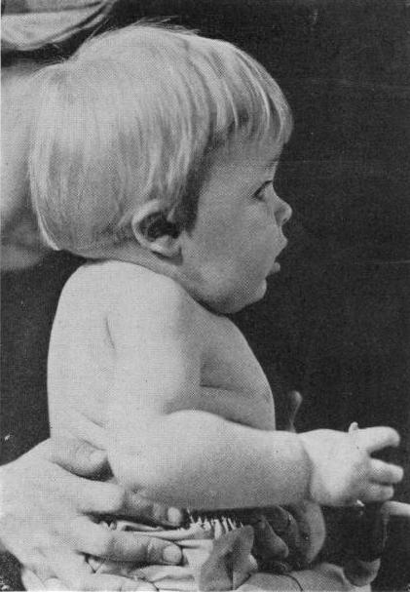
Kippel-Fiel
Features: | Short neck, limited cervical spine mobility, hearing loss, webbed neck, “subclavain artery supply disruption syndrome”
Airway Concerns: | Skull malformations, micrognathia, limited neck mobility worsens with age
Anesthetic Concerns: | Possible VSD, Syncope with sudden neck rotation, no neck lines

Slide 40
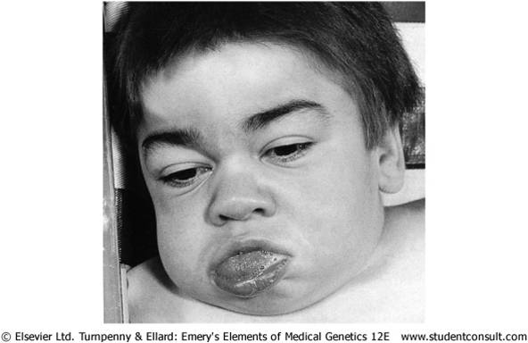
Hurler Syndrome
Features: | Death at several years of age from obstructive airway disease. Tongue, tonsils, adenoids and lips are large. Mouth breathers with nasal drainage. Widely spaced teeth narrow, flat trachea. Small cervical vertebrae with high epiglottis, short neck.
Airway Concerns: | “worst airway problem in pediatric anesthesia” thickening of soft tissues with age, enlarged tongue short neck, DIFFICULT MASK, oral airway can displace epiglottis downward.
Anesthetic Concerns: | Possibly bone marrow TX pt, coronary artery narrowing, ischemic Dz, valve defects, mucopolysaccharide deposits in epidural space and on nerve sheaths, also in nose (difficult nasal airway)

Slide 41
Pierre-Robin Syndrome
Features: | Micrognathia, Glossoptosis, Cleft Palate Mandible catches up with age
Airways Concerns: | Neonates may need prone positioning with spontanous respirations. A nasopharyngeal airway or tongue stich.
Anesthetic Concerns: | Fiber optic intubation, or LMA. Urgent trach. Awake extubation with possible nasal tumpet.

Slide 42
Congenital Airway Abnormalities

Slide 43
Case Study
7 y/o Female Hx: Pierre Robin, Severe scoliosis with spinal rods, RAD. 20kg
Dx: Velopharyngeal Insufficiency
Case: Celft Palate Repair,
Sphincter pharyngoplasty.
Induction- Easy mask a/w, DL x1 with peds D Blade on Storz
Extubation- AWAKE, spontaneously breathing but not exchanging.

Slide 44
Sources
http://www.medicaldaily.com/gloves-after-hand-washing-best-protects-preemies-infections-neonatal-intensive-care-unit-297632
www.basicsofpedsanestesia.com Myelo photo
Baum, Victor. And Jennifer O’Flaherty. Anesthesia for Genetic, Metabolic, & Dysmorphic Syndromes of Childhood. Library of Congress 2007.
Brett, Claire. The Pass Machine, Neonatal. 2013.
Rollins M, Rosen M: Anesthesia for Fetal Surgery and Other Intrauterine Procedures. Chestnuts Obstetric Anesthesia, 2014.

