Slide 1
Pediatric Trauma
Megan Flanigan MS, APRN, CRNA

Slide 2
Pediatric Trauma
What is it?
Forceful disruption of bodily homeostasis that affects physical, psychological, and family function
Pediatric Statistics
Pediatric trauma accounts for 25% of all traumas in the United States
According to CDC, in the U.S. over 10,000 pediatric deaths occur due to injury every year
For every 400 pediatric injury
250 require treatment in the ED
16 are admitted to the hospital
1 dies

Slide 3
Pediatric Trauma
A quarter of all adults report having been physically abused as children.
One in 5 women and 1 in 13 men report having been sexually abused as a child.
Every year, there are an estimated 41,000 homicide deaths in children under 15 years of age
Every five seconds, a child under the age of 15 dies
Over 70% of mortality from trauma occurs at the time of injury

Slide 4
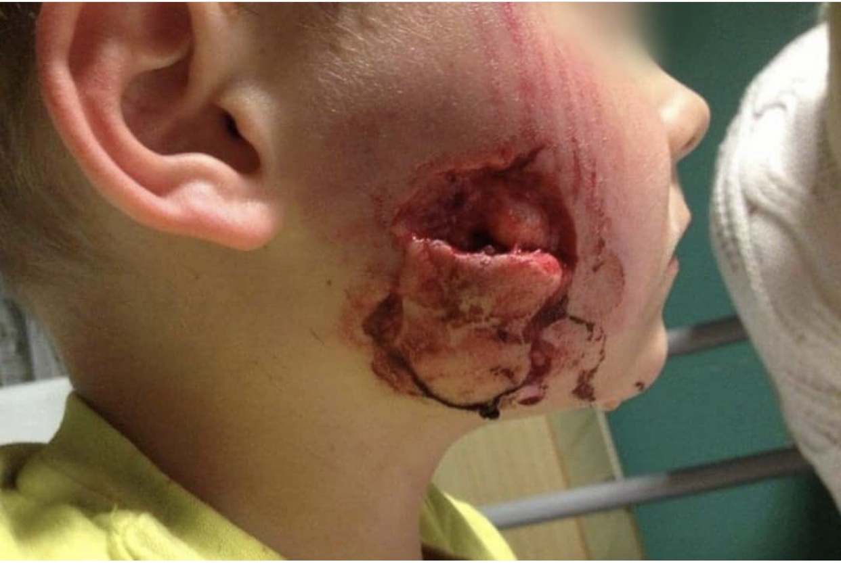
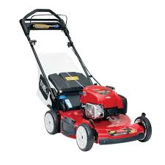
Pediatric Trauma
Mechanism of Injury
Unintentional
Males > Females
Falls
Aspirations
Lawnmower
Dog bites
Drownings
MVA
Responsible for 75% of pediatric traumatic deaths
Lap- Belt Complex
Intentional or Nonaccidental
Abuse
Self harm

Slide 5
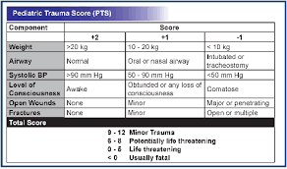
Pediatric Trauma
Trauma Systems
Levels I through Level V
Can have different designations for adult and pediatric trauma
Trauma Scoring Systems
Glasgow Coma Scale (0-15)
Revised Trauma Score
Alert, Verbal, Painful, or Unresponsive Scale (AVPU)
Pediatric Trauma Score

Slide 6
Pediatric Trauma
Primary Assessment
Incorporates the ABCs
All life threatening injuries are identified and treated
Continually assess, intervene, & reassess
Secondary Assessment
Complete physical exam
Patient history (SAMPLE)
Lab tests
Imaging
A – Airway with cervical spinal control
B – Breathing and ventilation, pulse oximetry, and oxygen
C – Circulation with hemorrhage control
D – Disability and neurologic control
E – Exposure/environmental control
S - Symptoms
A – Allergies
M – Medications
P – Past Illness
L – Last meal
E – Events/environment

Slide 7
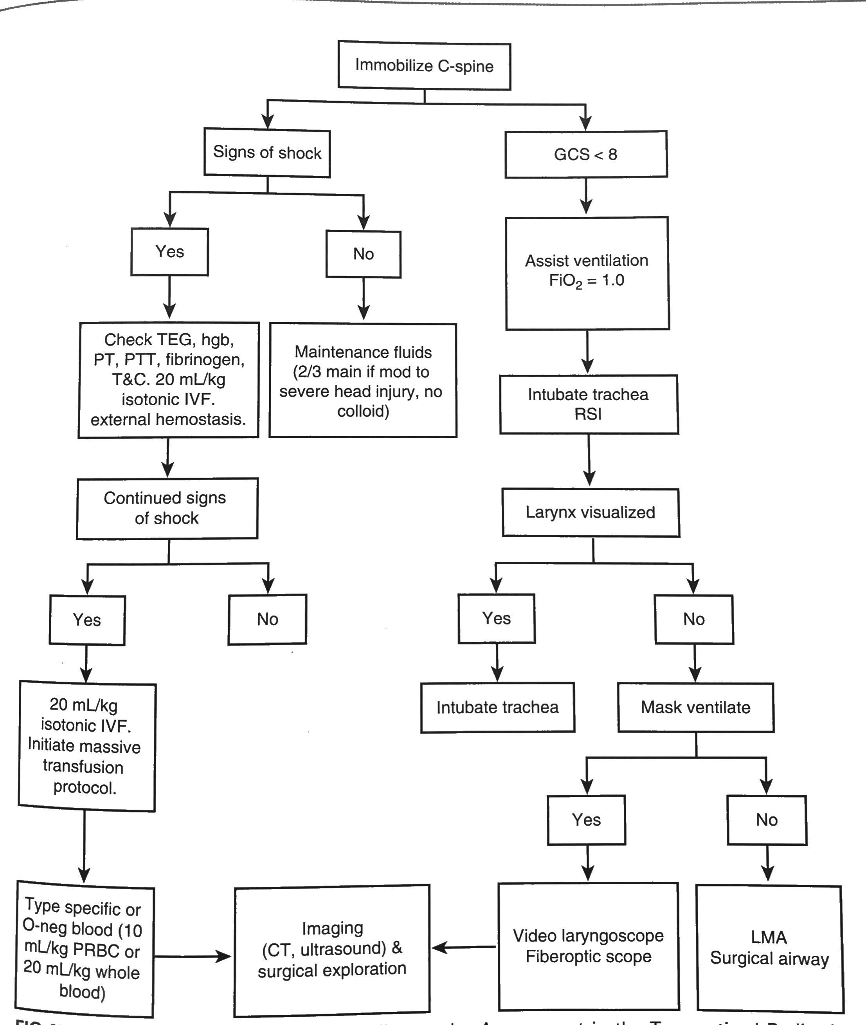

Slide 8
Pediatric Trauma
Airway, Airway, Airway
Indications to intubate
Inability to oxygenate and ventilate
Need to protect the airway against aspiration
Pediatric Airway management may present a challenge
Larger tongue
Larynx and glottis opening are more anterior
Smaller diameter & shorter in length
R mainstem intubations
Undesired extubation with small position changes
Airway edema in already smaller structures

Slide 9
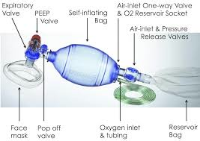
Pediatric Trauma
Airway, Airway, Airway
Airway Obstruction is common
Blood, vomit, teeth, and foreign bodies
Pediatrics are often placed in cervical collars too large for them
Creating a patent airway
Jaw thrust + suction
Placement of oral or nasal airways
Bag- Valve- Mask ventilation
With a jaw thrust

Slide 10
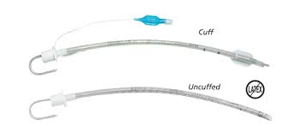
Pediatric Trauma
Airway, Airway, Airway
Intubation
Full stomach & possible cervical spine injury
RSI with
Etomidate or Ketamine
Succinylcholine or Rocuronium
Cuffed ETT + Stylet
Inline axial stabilization (2 providers)

Slide 11
Pediatric Trauma
D- displaced ETT/ disconnection
O- obstruction in ETT (vomit, blood, fluid)
P- pulmonary pathology ( pneumothorax, aspiration, bronchospasm, anaphylaxis)
E- equipment failure
Breathing & Ventilation
Best assessed by auscultation and observation of chest motion
Rate & work
Breath sounds & symmetrical movement
Always reassess following intubation
PPV can cause tension pneumothorax/ enlarge a pneumothorax
Cartilaginous rib cage = severe internal damage w/o external damage
Mortality rate increases 10-fold
Treatment = midclavicular second intercostal space
DOPE pneumonic to aid in assessment of respiratory decline

Slide 12
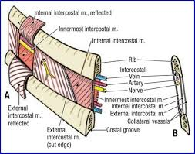
Pediatric Trauma

Slide 13
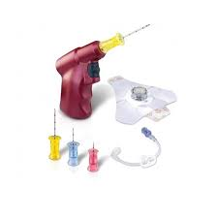
Pediatric Trauma
Circulation & Hemorrhage Control
Peds maintain a normal BP until 25% to 35% of circulating blood volume is gone
Due to high sympathetic tone
Tachycardia is an early sign of impending shock vs hypotension
Establish large bore IV/IO access as early as possible
Initial fluid bolus = warmed isotonic crystalloid 20ml/kg x3 if needed
If hypotension remains, consider other causes
Pericardial Effusion and Tamponade
Shock, muffled heart sounds, pulsus paradoxus, distended neck veins = pericardiocentesis
Pneumothorax
Ipsilateral tympany, shift of trachea, distended neck veins, decreased breath sounds

Slide 14
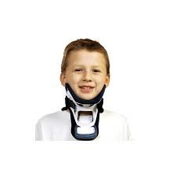
Pediatric Trauma
Disability & Neurologic Control
Assessment of GCS or AVPU
Any change in mental status requires reevaluation of ABCs
Pediatric patients with traumatic injury are suspected to have spinal injury until proven otherwise

Slide 15
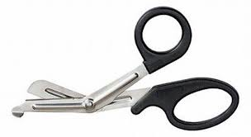
Pediatric Trauma
Exposure
Removal of all patient’s garments
Log rolling while maintaining cervical spine precautions is NECESSARY
Warm room temperatures + warmed IV fluids + blankets
Children are more prone to hypothermia due to their larger surface area to volume ratio
Lethal Triad = increased mortality in trauma patients
Hypotension
Acidosis
Hypothermia

Slide 16
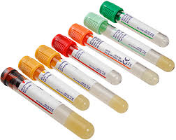
Pediatric Trauma
Secondary Survey
Radiologic examinations
Most common cause of a distended abd in a child is swallowed air
Liver & spleen highly vulnerable
Laboratory testing

Slide 17
Pediatric Trauma
Anesthetic Management
Clear communication throughout
ALL trauma patients at risk for aspiration regardless of NPO time
Pain, anxiety, opioid administration = delayed gastric emptying
BMV in the field = abdominal distention
Induction with consideration of injuries
Nitrous oxide is best avoided in all trauma patients
Sevoflurane is the preferred agent of anesthetic gases
Warm up the OR
Myocardial dysfunction
Cardiac irritability
Dysrhythmias
Acid- base disturbances
coagulopathies

Slide 18
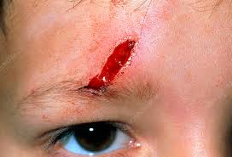
Pediatric Trauma
Child Abuse
Any act of commission or omission by a parent or other caregiver that results in harm, potential harm, or threat of harm to a child
Most recognizable forms
Physical
Sexual
Psychological or emotional
Neglect
Maltreatment is inversely related to age
Most prevalent among children under 1 year of age
Children with disabilities, chronic illness, or special needs

Slide 19
References
Coté Charles J.., Lerman, J., & Anderson, B. J. (2019). A practice of anesthesia for infants and children (6th ed.). Philadelphia, PA: Elsevier.
Davis, P. J., & Cladis, F. P. (2017). Smiths anesthesia for infants and children (9th ed.). St. Louis, MO: Elsevier.

