Slide 1
Pediatric Emergencies
Megan Flanigan MS, APRN, CRNA

Slide 2
Pediatric Emergencies
Objectives
Discuss the respiratory lesions that can require emergent intervention
Clinical presentation
Treatment
Anesthetic Management
Discuss foreign body aspiration symptoms, treatment, & management
Compare and contrast epiglottitis and laryngotracheobronchitis (croup)

Slide 3
Pediatric Emergencies
Emergent respiratory lesions
Choanal atresia and stenosis
Laryngeal and upper tracheal webs
Congenital subglottic stenosis
Subglottic Hemangioma
Foreign Body Aspiration
Post- Tonsillectomy Bleed
Epiglottitis & Croup

Slide 4
Pediatric Emergencies
Choanal atresia
A nasal obstruction due to failure of the bone or membranous portion of the nasopharynx to undergo regression during development
Unilateral or bilateral
Associated with CHARGE syndrome
Incidence 1:5000-7000 births

Slide 5
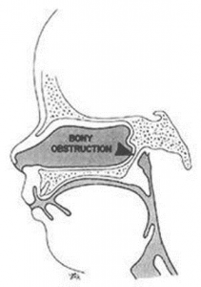
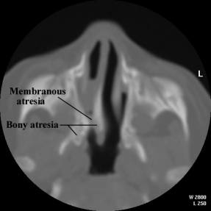
Pediatric Emergencies
Choanal Atresia

Slide 6
Pediatric Emergencies
Choanal atresia
Clinical presentation
Bilateral obstruction leads to:
Acute respiratory distress
Intermittent cyanosis (relieved by crying)
Inability to feed (choking episodes)
Cyanosis at rest
Ventilation maintained with placement of airway
Infants are obligate nose breathers until 4-6 weeks

Slide 7
Pediatric Emergencies
Choanal atresia
Treatment
Nasal stent (nasal trumpet, small ett)
Choanal atresia corrective surgical repair
Anesthetic Management
Inhalation induction + oral airway or jaw thrust maneuver
Awake extubation

Slide 8
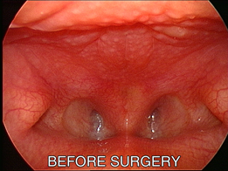
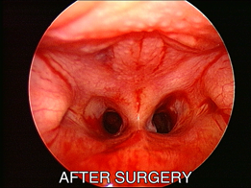
Pediatric Emergencies
Choanal atresia

Slide 9
Pediatric Emergencies
Subglottic Stenosis
Airway stenosis usually located at the cricoid cartilage
Congenital Stenosis 10%
Webs
Congenital subglottic stenosis
Blocks of cartilage
Acquired Stenosis 90%
Trauma due to prolonged intubation
Too large of ETT
Edema & inflammation related to infection

Slide 10
Pediatric Emergencies
Webs (laryngeal/tracheal)
A fibrous membrane that causes obstruction of the larynx or upper trachea
Classified by type I to IV
Class III and IV can require emergent intervention

Slide 11
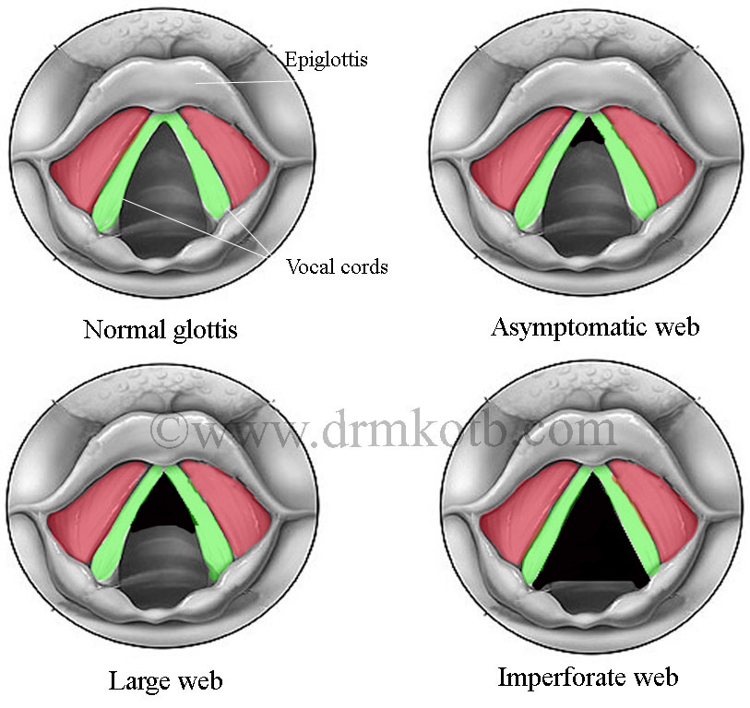
Pediatric Emergencies
Classify these webs (type I-IV)

Slide 12
Pediatric Emergencies
Webs (laryngeal/tracheal)
Type I
Anterior web ≤ 35% of glottis
rarely obstructive
slightly abnormal voice
Type II
Anterior web 35-50% of glottis
little if any obstruction
husky voice

Slide 13
Pediatric Emergencies
Webs (laryngeal/tracheal)
Type III
Anterior web 50-75% of glottis
subglottic narrowing
severe vocal dysfunction
artificial airway frequently required
Type IV
Anterior web 75-90% of glottis
significant subglottic obstruction
tracheotomy often required immediately after birth

Slide 14
Pediatric emergencies
Webs (laryngeal/tracheal)
Clinical Presentation
Severity based on type
Inspiratory stridor (laryngeal)
Expiratory stridor (tracheal involvement)
Acute respiratory distress shortly after birth

Slide 15
Pediatric emergencies
Webs (laryngeal/tracheal)
Treatment
Incomplete Web
oral intubation to stent open the airway
Complete Web
oral intubation, needle cricothyrotomy, tracheotomy
Corrective surgery
CO₂ laser or excision
Laryngotracheal reconstruction (LTR)

Slide 16
Pediatric Emergencies
Webs (laryngeal/tracheal)
Anesthetic management
Inhalation induction
Maintain spontaneous respiration for flexible bronchoscopy
Muscle relaxant only after airway established
Laser precautions for CO₂ laser if used
Awake extubation

Slide 17
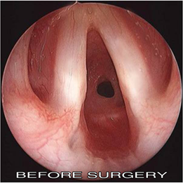
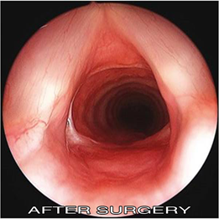
Pediatric emergencies
Congenital subglottic stenosis
Congenital narrowing at the level of the cricoid cartilage, classified Grade I to IV

Slide 18
Pediatric emergencies
Congenital subglottic stenosis
Grade I
50% or less obstruction
Grade II
51-70% obstruction
Grade III
71-99% obstruction
Grade IV
No detectable lumen or opening

Slide 19
Pediatric emergencies
Congenital subglottic stenosis
Clinical presentation
Differs based upon the grade
Stridor
Croup-like symptoms
Anterior chest wall retractions

Slide 20
Pediatric emergencies
Congenital subglottic stenosis
Treatment
Specific classification with flexible and rigid bronchoscopy
Mild stenosis
Observe, often no surgery, q6 month bronch
Severe stenosis
50% need trach, serial dilations, laryngotracheal reconstruction (LTR)

Slide 21
Pediatric Emergencies
Congenital subglottic stenosis
Anesthetic Management
Same as any flex or rigid bronch
Muscle relax after ventilation is established with rigid bronchoscopy
Multiple endotracheal tubes on hand for sizing of stenosis
Awake extubation

Slide 22
Pediatric emergencies
Subglottic hemangioma
Hemangioma
A common benign vascular tumor in infants comprised of excessive endothelial blood vessel lining cells
Subglottic hemangioma
When present on the subglottic wall can cause congenital airway obstruction
Presentation within first 2-3 months of life

Slide 23
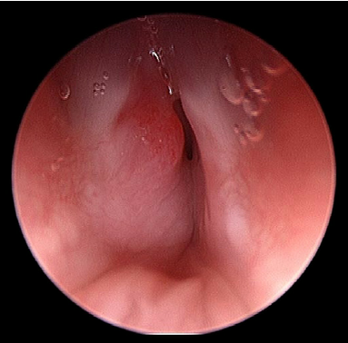
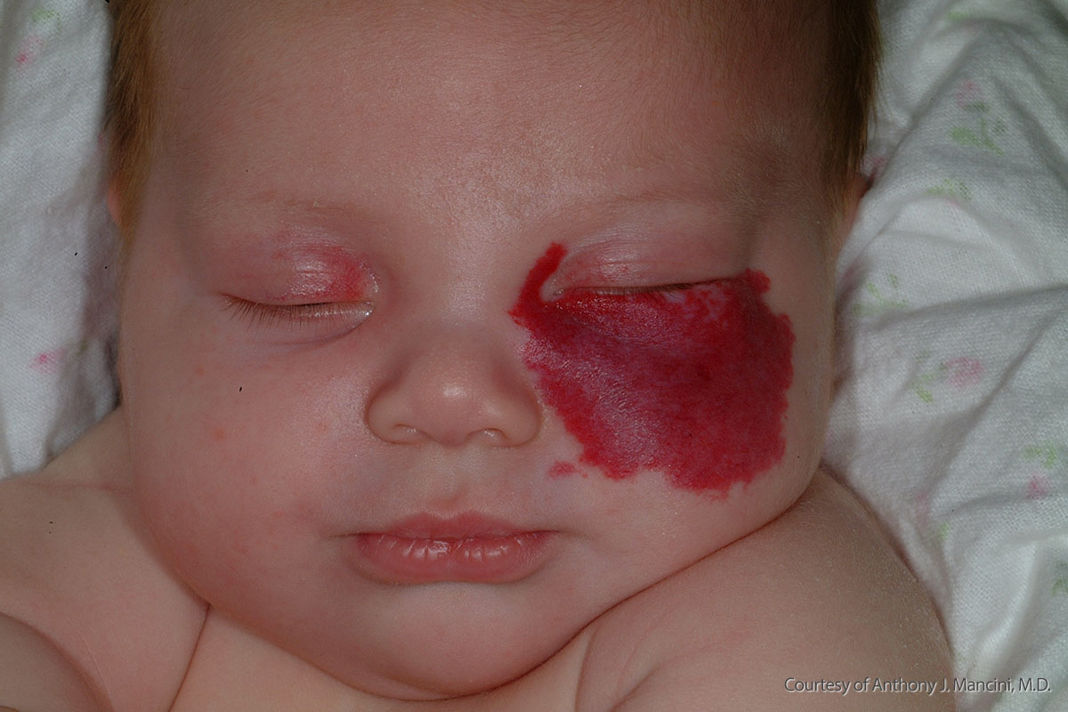
Pediatric emergencies
Subglottic hemangioma

Slide 24
Pediatric emergencies
Subglottic hemangioma
Clinical presentation
Airway compromise that worsens with agitation due to vascular engorgement
Stridor and upper airway obstruction that is exacerbated by URI

Slide 25
Pediatric emergencies
Subglottic hemangioma
Treatment
Diagnostic flexible bronchoscopy
Placement of trach beyond lesion and allow spontaneous regression
CO₂ laser bronch for small lesions
Large cavernous lesions can’t be lasered

Slide 26
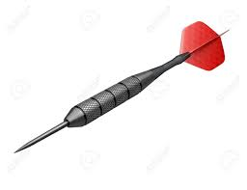
Pediatric emergencies
Foreign body aspiration
Occurrence
Highest in 1-3 year olds
Food > plastic/metal objects
Right mainstem > left mainstem
Less frequent in larynx and trachea
Notes:
1.

Slide 27
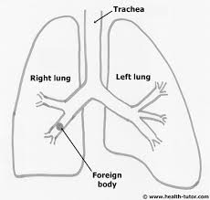
Pediatric emergencies
Foreign body aspiration
Clinical presentation
Cyanosis, agitation, tachypneia, tachycardia
Classic triad
coughing
wheezing
decreased unilateral breath sounds
History of choking and cyanosis with eating

Slide 28
Pediatric emergencies
Foreign body aspiration
Clinical presentation
Chest x-ray
Most foreign bodies are radiopaque
Cause pathological changes visible on x-ray
Hyperinflation (air trapping)
Atelectasis
Pneumonia

Slide 29
Pediatric emergencies
Foreign body aspiration
Treatment
Stable respiratory status
Follow NPO, close monitoring, chest x-ray, and scheduled bronchoscopy
Unstable respiratory status
Immediate emergent bronchoscopy

Slide 30
Pediatric emergencies
Foreign body aspiration
Anesthetic Management
Inhalation induction (sevoflurane)
Yankauer suction available
Maintain spontaneous respirations
Minimize positive pressure ventilation
Handoff airway to ENT surgeon
Spray cords with 4% lidocaine
Ventilate through side port of rigid

Slide 31
Pediatric emergencies
Foreign body aspiration
Surgical considerations
Rigid bronchoscopy “gold standard”
Optical forceps, fogarty catheter, magnetic extractor
Flexible bronchoscopy
Thoracotomy (bad deal)

Slide 32
Pediatric emergencies
 | Epiglottitis | Laryngotracheobronchitis (croup)
Organism (general) | Bacterial | Viral
Organism (specific) | Hemophilus influenza Hemolytic steptococci Staphylococcus Pneumococci | Hemophilus parainfluenzae Respiratory syncytial virus Influenza A and B
Age of onset | 2-6 years old | 6 months- 3 years old
Onset of symptoms | Hours Rapid progression | Days Slow progression

Slide 33
 | Epiglottitis | Laryngotracheobronchitis (Croup)
Symptoms | Dysphagia + drooling Cough suppressed Voice muffled Slow respirations | No dysphagia or drooling Barking cough Voice hoarse Rapid respirations
Treatment | O₂ by mask Patient sitting IV access & hydrate Antibiotic therapy if bacterial Postop ICU care | O₂ with humidification Corticosteroids Racemic epi by aerosol IV hydration Intubate only for progressive CO₂ retention and hypoxia
Intubation | ENT surgeon present Inhalation induction with spontaneous RR Provide cpap to prevent airway collapse | Intubation rarely needed
Lateral neck x-ray | Swollen epiglottis (thumb sign) | Subglottic narrowing (steeple sign)

Slide 34
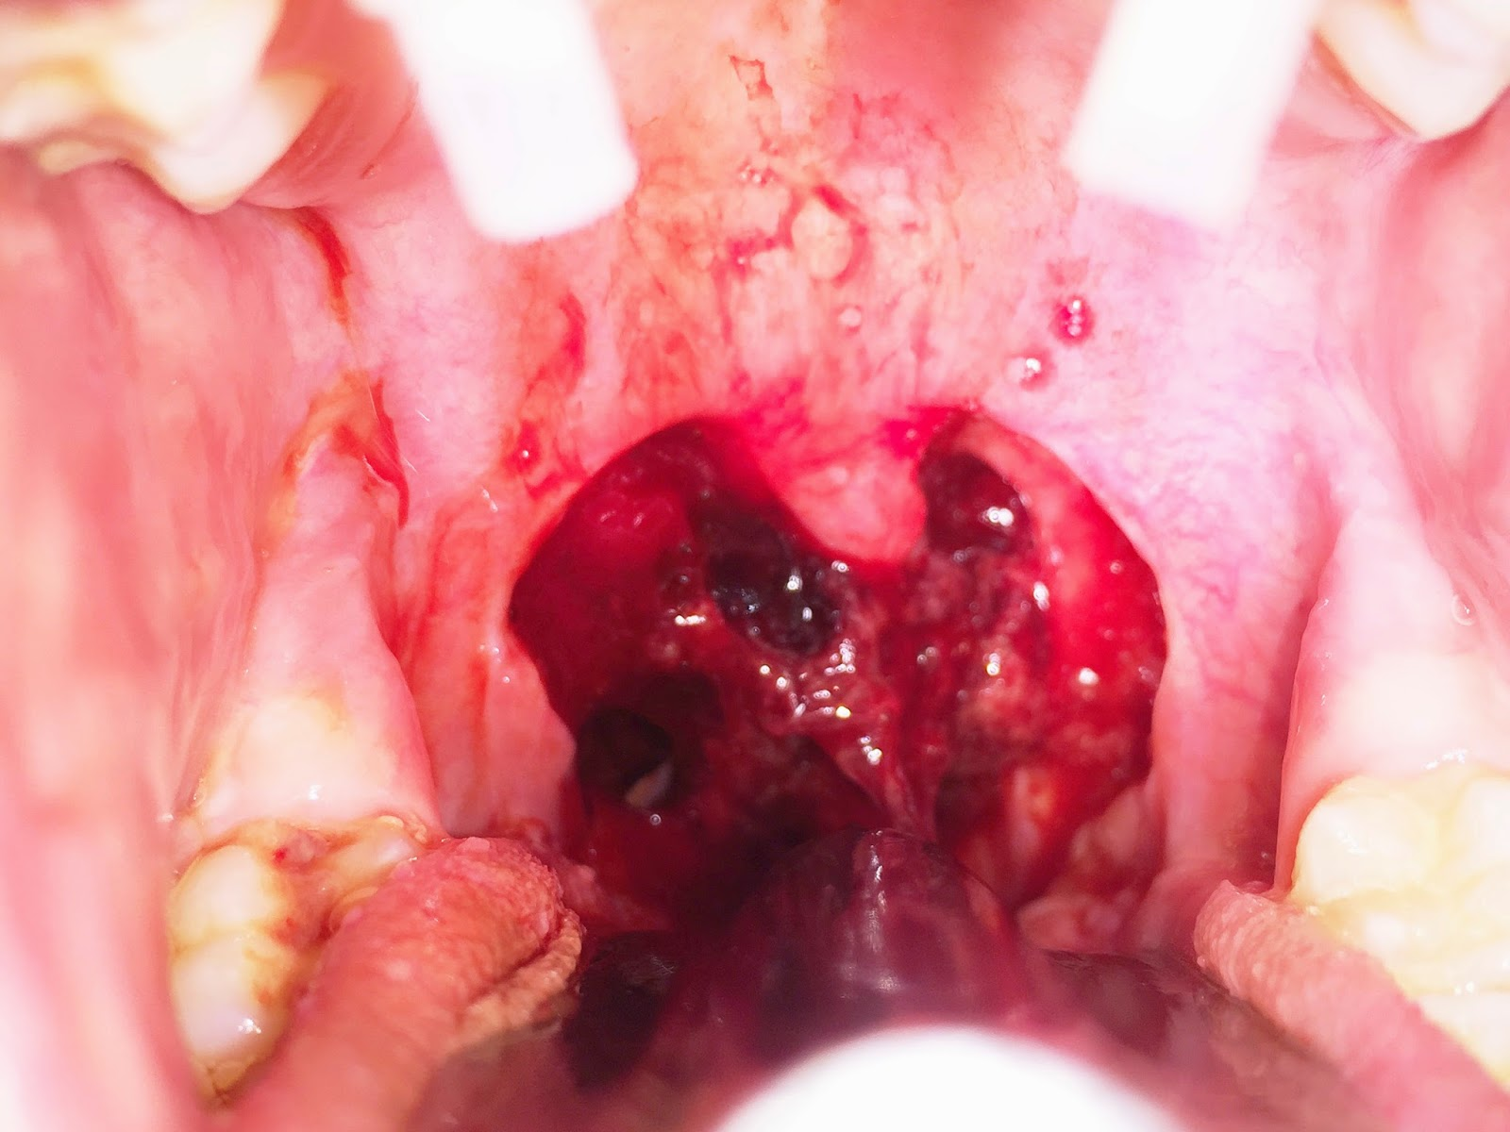
Pediatric emergencies
Post Tonsillectomy Bleed
Occurrence
Primary
Within first 24 hours
75% occur within 6 hours
Bleeding more brisk and profuse
Secondary
Five to 10 days following surgery
Eschar covering of the tonsillar bed retracts

Slide 35
Pediatric emergencies
Post Tonsillectomy Bleed
Clinical Presentation
Frightened child
Full stomach
Filled with swallowed blood
Hypovolemia
Anemia

Slide 36
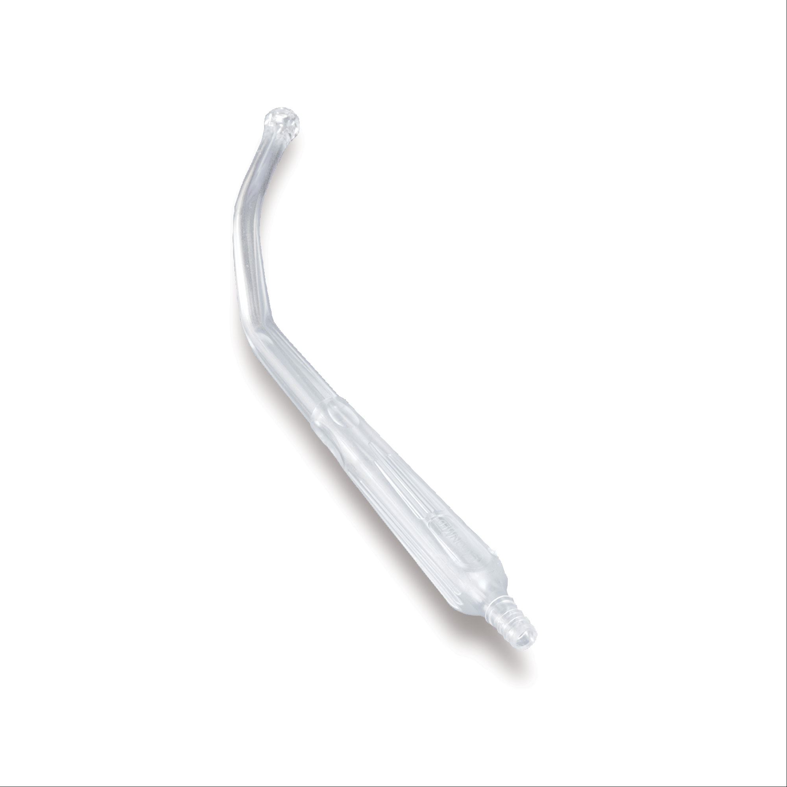
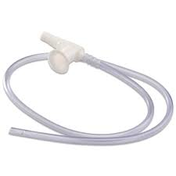
Pediatric emergencies
Post Tonsillectomy Bleed
Anesthetic Management
Anesthesia record from initial surgery
Tube size
Any difficulties with airway
Fluid management or blood loss
Preoxygenate prior to induction
Left lateral position with head down to promote drainage
Yankauer suction ready

Slide 37
Pediatric emergencies
Post Tonsillectomy Bleed
Anesthetic Management
Rapid Sequence Induction
Supine after preO2
Cricoid pressure held
Follow the bubbles
Salem sump tube to suction stomach content
Awake extubation

Slide 38
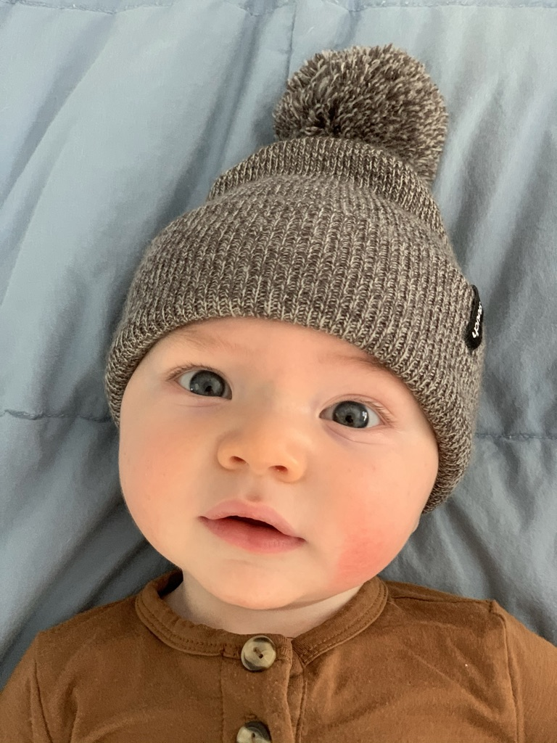
References
Coté Charles J.., Lerman, J., & Anderson, B. J. (2019). A practice of anesthesia for infants and children (6th ed.). Philadelphia, PA: Elsevier.
Davis, P. J., & Cladis, F. P. (2017). Smiths anesthesia for infants and children (9th ed.). St. Louis, MO: Elsevier.

