Slide 1
Unique Problems Pediatric Anesthesia They aren’t just small adults
Megan Flanigan MS, CRNA, APRN

Slide 2
Topics Unique to Pediatrics
Preoperative Considerations
Anxiety
Autism
Neuronal Apoptosis
Fasting Guidelines
Upper Respiratory Infection
Obstructive Sleep Apnea Syndrome
Obesity
Postoperative Complications
Emergence Agitation
Oxygen Desaturation
Laryngospasm
Bradycardia
Stridor
Negative Pressure Pulmonary Edema
Apnea in Premature Infants

Slide 3
Preoperative Considerations

Slide 4
Preoperative Anxiety
40-60% of children develop significant fear and anxiety before surgery
Separation from parents and the induction of anesthesia are the most stressful perioperative events
Consequences of preoperative anxiety:
Increased parental anxiety
Neuroendocrine changes
Increased: cortisol, epinephrine, growth hormone, adrenocorticotrophic hormone, and natural killer cell death
Tachycardia and hypertension

Slide 5
Risk Factors for Anxiety
Age 1-5 years
Previous experience with medical procedures
Trait anxiety
Parental characteristics causing elevated child anxiety:
Trait anxiety
Separated or divorced
Avoidance coping mechanisms
Parental anxiety predictors:
Moms > Dads
Child’s age < 1 year
Child with repeated hospital admissions

Slide 6
Pharmacologic Interventions
Primary goal is to facilitate an anxiety-free separation from parents and a smooth induction of anesthesia
Other effects:
Amnesia
Anxiolysis
Prevention of physiologic stress
Analgesia
Children receiving a sedative are less anxious and more compliant than those who are accompanied to the OR by a parent
Parental anxiety is also decreased when the child is given a sedative
So…..can’t we just sedate everyone?

Slide 7
Pharmacologic Interventions
Routine administration of sedative premedication:
Increases pharmacy costs
Requires more nursing care
Increases need for appropriately monitored bed-space
Unnecessary for children at low risk for anxiety
Age < 1 year
Easily redirected
Use of sedatives should be directed to children who are at a significant risk for anxiety

Slide 8
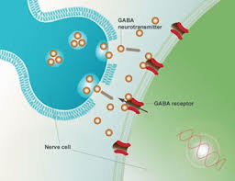
Midazolam
Benzodiazepine, acts through GABA neurotransmitter
Most widely used premedication in North America
PO, IN, PR, IM, IV
No delay in recovery or discharge for surgeries > 30 min duration
Dose increases with decreasing age
0.05 – 0.15 mg/kg IV
0.1 – 0.2 mg/kg IM
0.25 – 0.75 mg/kg PO, up to 20mg

Slide 9
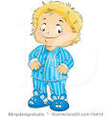
Ketamine
IM “dart” (also IV)
Dissociative medication providing sedation, pain relief, and amnesia
For older children and adolescents who are cognitively challenged, uncooperative, and/or behaviorally problematic
May be the only way to ensure safe delivery of the child to the OR
Possible co-administration of benzodiazepine and anticholinergic to treat side effects
Ketamine + Midazolam + Glycopyrrolate = “dart cocktail”
Expected onset of action of IM Ketamine is 3-5 minutes, with a duration of 30-40 minutes

Slide 10
Behavioral Interventions
Narrative information
Orientation of operative facility
Role rehearsal
Child life preparation
Coping education and relaxation skills
Children who receive behavioral preparation display significantly less emergence delirium and require less analgesia in the recovery room compared with children who receive only premedication.
Behavioral preparation doesn’t only smooth out induction. Its benefits carry all the way into the recovery process

Slide 11
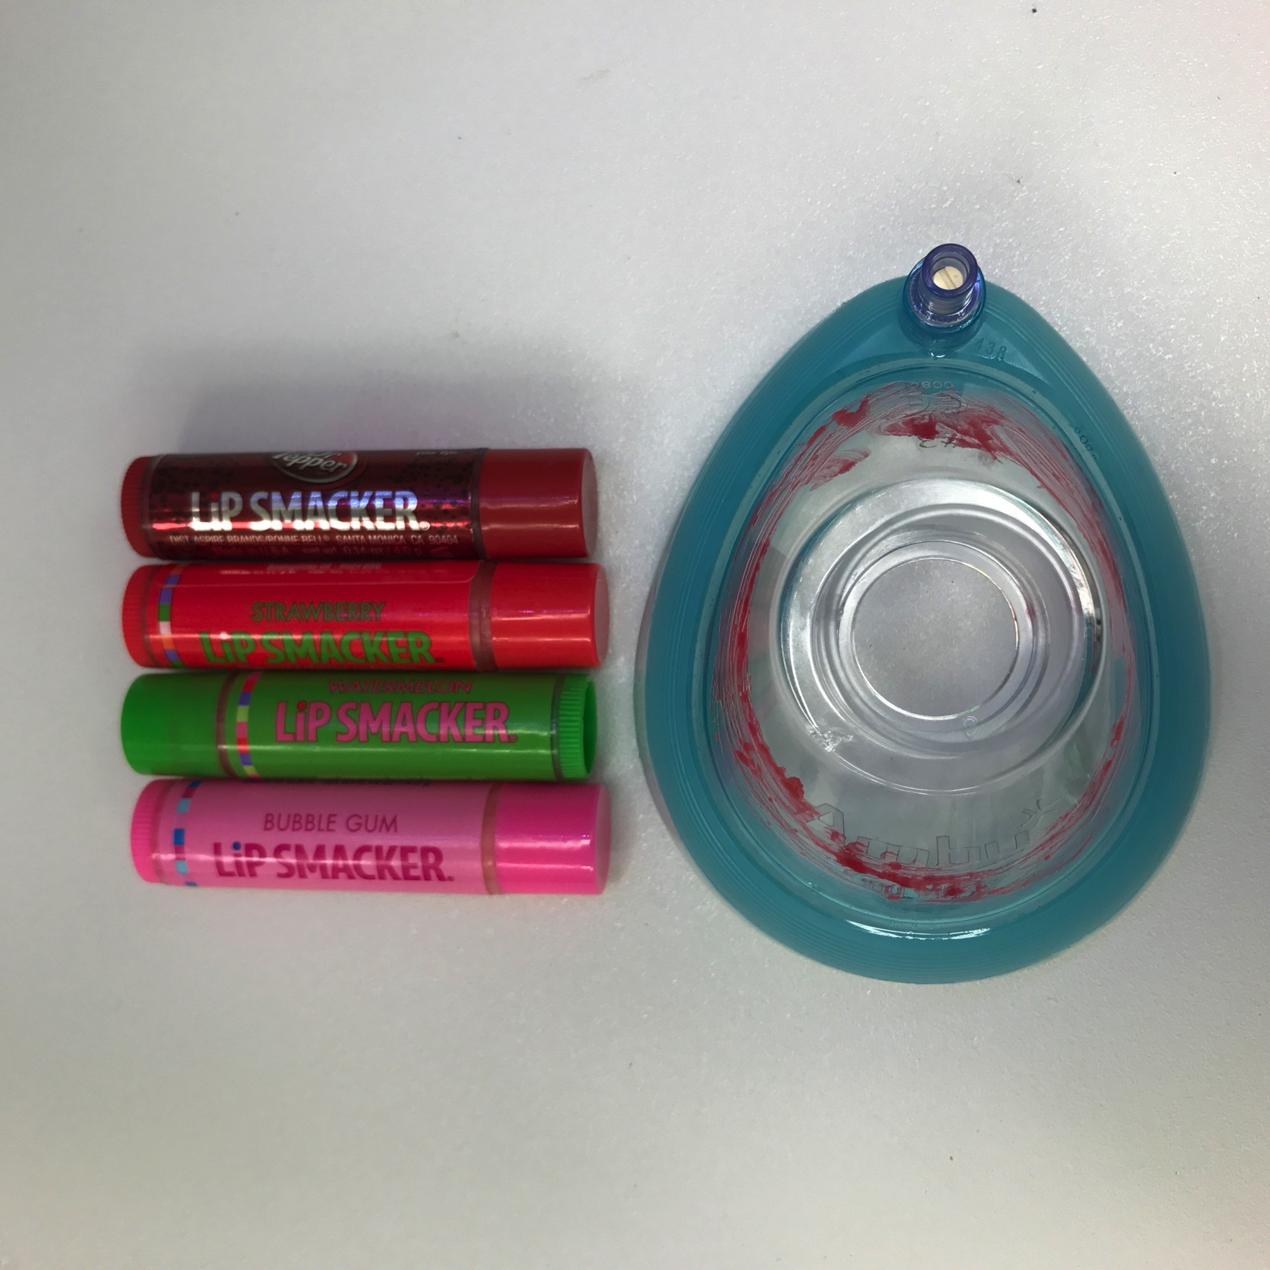
Distraction Techniques
Coloring books, games, stories, videos, and ipads
Have the child play with the facemask and pick out a lip balm flavor to smell
Establish rapport by engaging in conversation
Recent birthday, holiday, vacation
Even sing to them!
Choose your words carefully
Children are concrete thinkers
No “put you to sleep”

Slide 12
iPads
2016: study comparing use of iPads to Versed in its effectiveness to reduce anxiety (child and parent) at parental separation prior to anesthesia.
Children aged 4-10 years
Ambulatory surgery
Randomized trial (Versed group vs iPad group)
Findings:
Both parental and child anxiety levels similar in both groups
”However, the quality of induction of anesthesia, as well as parental satisfaction, were judged better in the iPad group.”

Slide 13
Parental Presence at Induction
Two systematic reviews established that PPI reduced the anxiety of parents, but not the children
Children aged 1-6 years may be most benefited
Do not permit parents to the OR if you sense they might become uncooperative
The entire OR team must have a plan for escorting the parent from the room
Parents must know what to expect during the induction of anesthesia
Where to stand/what their role is
Gently restraining the child if necessary
What phase 2 looks like

Slide 14
Autism
Characterized by a delay in the development of socialization and communication skills
The best studied form of pervasive developmental disorders
Reliable diagnosis made between ages 2-4
Overall prevalence of ASD in 1 in 59
15% increase in last two years (2016-2018)
Affects more boys than girls in a ratio of 4:1
Equal distribution in all socioeconomic groups

Slide 15
Autism
The preoperative time can be very stressful for the child with autism and their family
Do not respond well to any changes in routine
Very sensitive to sensory stimuli such as light, sound, touch, and pain
The focus for optimal management of these children is early communication to provide a flexible and individualized admission process and anesthetic plan
Find a quiet, private room
Premedication as indicated
Oral midazolam for mild anxiety, IM ketamine for severe cases
Be Flexible. Allow comfort items, clothing, etc.

Slide 16
Autism
For this population, parental presence at induction is most often beneficial in helping the child reach the operating room without incident
Parents of children with ASD are usually very good at anticipating their child’s behavior, and can help guide their care.
Appropriate use of parents in the PACU
Children who are reunited with their patents sooner require less pain medication and are discharged earlier in the ambulatory setting
Discharge from PACU?

Slide 17
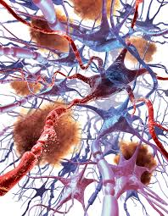
Neuronal Apoptosis
The human brain “growth spurt” begins in the 3rd trimester of pregnancy, peaks at 5 months, and lasts until 2-3 years of age
Apoptosis = programmed cell death, natural process of development and survival
Most general anesthetics and sedatives cause accelerated neuronal apoptosis in newborn rodents and non-human primates
Exception of dexmedetomidine and opioids
Occurs after relatively prolonged exposure (>4-5 hours)
May be a link between anesthesia at a young age and subsequent developmental delays

Slide 18
Neuronal Apoptosis
Does this apply to humans?
Most anesthetics in young children last <3 hours
The doses of IV anesthetics and sedatives given to rodents and nonhuman primates are up to 10-fold greater than in humans

Slide 19
Neuronal Apoptosis
2016: FDA releases a public safety warning to avoid general anesthesia in children younger than 3 years old, or in pregnant women during their third trimester.
“Avoid procedures lasting longer than 3 hours or if multiple procedures are required”
“May affect the development of children’s brain”
Panic Ensues

Slide 20
Neuronal Apoptosis
PANDA Study (2016)
Question: is a single anesthesia exposure in otherwise healthy young children associated with impaired neurocognitive development and abnormal behavior in later childhood?
Studied healthy sibling pairs (105) where one child underwent inguinal hernia repair before age 36 months. The other unexposed.
Studied IQ and behavior for 10 years following the anesthesia exposure
NO difference found in either

Slide 21
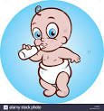
Fasting Guidelines (2,4,6,8)
Clear Liquids 2 hours
Breast Milk 4 hours
Infant Formula
Neonates 4 hours
>3 months 6 hours
Nonhuman milk 6 hours
Solids 8 hours

Slide 22
Fasting Guidelines
Children allowed to ingest unlimited clear liquids up until 2-3 hours before induction
No difference found in gastric residual volume or pH
Infants have a higher metabolic rate and a larger surface area-to-weight ratio than adults
More liberalized fasting guidelines may result in a reduced incidence of hypovolemia at anesthetic induction

Slide 23
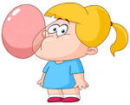
Chewing Gum
Doesn’t matter if it’s sugar-free or not
Results in doubling of gastric volume
Trivial increase in gastric pH
May proceed with elective surgery if it is expectorated
Doesn’t increase the risk of aspiration pneumonitis for elective surgery
If swallowed, elective case must be cancelled

Slide 24
Upper Respiratory Infection
20-30% of all children have a runny nose during a significant part of the year
65% of pediatric URIs are viral
Ideally, a child with a recent URI shouldn’t have elective anesthesia for 4-7 weeks after resolution
Young children have 6-7 URIs/year on average
2-4 weeks after resolution is acceptable

Slide 25
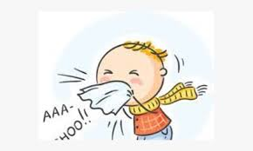
Upper Respiratory Infection
Increased risk for pulmonary complications:
Bronchospasm
Laryngospasm
Mucous plugs
Atelectasis
Desaturation events
Post-operative hypoxemia

Slide 26
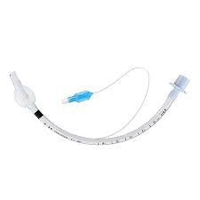
Upper Respiratory Infection
Methods to deal:
Avoid mechanical irritation of the airway
Mask > LMA >>> ETT (10-fold increased risk of bronchospasm)
Smaller size ETT if necessary
Dexamethasone 0.2-0.5 mg/kg
Deep plane of anesthesia before instrumenting the airway
Sevoflurane > Desflurane
Pretreatment with an inhaled bronchodilator

Slide 27
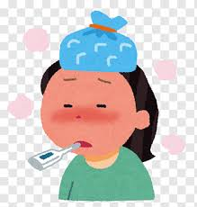
Criteria for Cancellation
Developing new symptoms
Fever >38 C
History of reactive airway disease
Cigarette exposure increases risk
Child <1 year old, ex-premie
High risk for lower respiratory tract infection (pneumonia)
Wheezing
Purulent nasal drainage
Productive cough
Lethargic, ill appearing

Slide 28
Obstructive Sleep Apnea Syndrome (OSAS)
Sleep-related breathing disorder characterized by periodic cesation of air exchange lasting longer than 10 seconds
Occurs in children of all ages (1-4% of all children)
Most common 2-8 years old
Corresponds to adenotonsillar hypertrophy
Greater occurrence in African American children
Polysomnography is the gold standard diagnostic modality

Slide 29
OSAS
Children at high risk:
Craniofacial abnormalities
Neuromuscular disorders
Obesity
Adenotonsillar hypertrophy
Signs of OSAS:
Daytime sleepiness
Irritability
Night terrors
Loud snoring (common)
Pauses/gasps during sleep
Failure to thrive
Speech disorders
Small size
Behavioral problems
Poor school performance

Slide 30
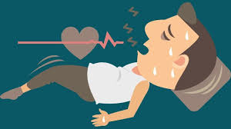
OSAS Considerations
May require overnight observation
*At risk for opioid sensitivity
Short-acting narcotics are preferred (Fentanyl)
Alternative analgesic strategies
Local anesthetic
NSAID agents
Ketamine
Alpha2-agonists
acetaminophen

Slide 31
Obesity
95% of childhood obesity is attributable to environmental and lifestyle factors
5%: Prader-Willi syndrome, inborn errors of metabolism, Cushing’s disease, and immobility
39% of overweight children have restrictive pulmonary pattern
Body fat encasing the pliable chest → decreased chest wall compliance, decreased FRC, and decreased vital capacity
17% with sleep-disordered breathing
20% with GERD
Gastric emptying rates and aspiration in obese children do not differ from those in normal children, unlike the corresponding adult population.

Slide 32
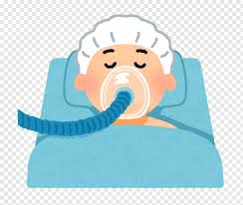
Obesity
Perioperative respiratory events are more common in obese children
Difficult mask ventilation
Bronchospasm
Rapid oxygen desaturation
Prolonged PACU times

Slide 33
Postoperative Complications

Slide 34
Emergence Agitation (EA)
A dissociated state of consciousness
Inconsolable
Screaming and thrashing around
Unaware of surroundings
Irritable and uncompromising

Slide 35
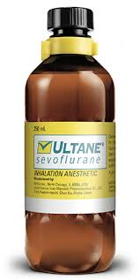
EA Risk Factors
Peak incidence ages 1-6 years
Sevoflurane > isoflurane > halothane
ENT and eye surgery
Preoperative anxiety
Temperament
Maladaptive
Lack social skills
Impulsive
Highly emotional

Slide 36
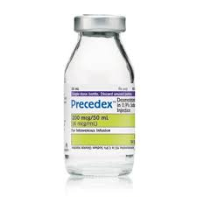
EA Pharmacologic Intervention
Propofol (0.5-1 mg/kg)
Opioids
Acetaminophen
Ketorolac
*Dexmedetomidine (0.25-0.5 mcg/kg bolus)
A centrally acting alpha 2 agonist that decreases the release of NE, thus decreases sympathetic nervous system activity
IV, IN
Anxiolysis, sedation, and analgesia
Does not cause respiratory depression

Slide 37
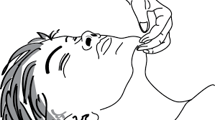
Oxygen Desaturation
Monitor SpO2 continuously in PACU
Failure to maintain Sp02 >94% should be investigated
Unrecognized hypoxemia quickly deteriorates to bradycardia and cardiac arrest
In healthy children, hypoventilation or airway obstruction are usually the cause
Head tilt
Chin lift
Oral or nasal airways
Jaw thrust
CPAP
Suction secretions

Slide 38
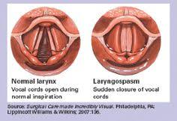
Laryngospasm
The reflex closure of false and true vocal cords
Complete = apposition of laryngeal surface
No air movement, no etco2
Incomplete = small gap in vocal cords
permits persistent INSPIRATORY stridor

Slide 39
Risk Factors for Laryngospasm
Risk increases with decreasing age
Infants > children > adults
Recent URI (< 2 weeks ago)
History of reactive airway disease/asthma
Exposure to 2nd hand smoke
Airway anomalies
Airway surgery
Airway devices (ETT/LMA)
Stimulation of glottis during light anesthesia
Secretions in the oropharynx
Inhaled anesthesia (des > sevo)
Inexperienced anesthesia provider

Slide 40
Laryngospasm Clinical Findings
Faint INSPIRATORY stridor
Suprasternal and supraclavicular in-drawing
Increased diaphragmatic excursions
Flailing of lower ribs
“Rocking horse” chest movement
Leads to silent inspiratory effort
Oxygen desaturation → Bradycardia → Cardiac Arrest

Slide 41
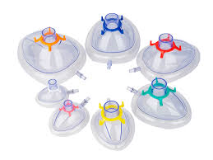
Laryngospasm Treatment
Tight mask seal
100% oxygen
CPAP
Suction secretions off the cords
Larson maneuver
Pharmacology: every situation is different!
Propofol
Rocuronium
Succinylcholine & Atropine
IM 3-4 mg/kg, IV 1-2 mg/kg (Succs)
IM/IV 0.02 mg/kg (Atropine)

Slide 42
Larson Maneuver

Slide 43
Bradycardia Definition
Infants < 100 bpm
Small children (1-5 years) < 80 bpm
Older children < 60 bpm

Slide 44
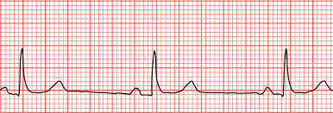
Causes of Bradycardia
#1 Hypoxia
#2 Succinylcholine
Other causes:
Vagal reflex
Increased intracranial pressure
Beta blockers, sevoflurane, remifentanil, etc.
Congenital heart disease/heart block
Hypothermia
Air embolism
Tension pneumothorax

Slide 45
Bradycardia Considerations
Children with down syndrome have 5x greater risk of bradycardia during the first 6 minutes of sevoflurane anesthesia
*Neonates and infants have a fixed stroke volume relying on HR for cardiac output
Treatment:
Atropine 0.01-0.02 mg/kg IV
Glycopyrrolate 0.01 mg/kg IV
Isoproternenol infusion 0.1 mcg/kg/min – 1 mcg/kg/min

Slide 46
Postoperative Stridor
Usually due to swelling of the airway
Reduction in cross sectional airway diameter
Increases pressure gradient across the airway
A complication of endotracheal intubation
ETT too large
Tracheal mucosa perfusion pressure is 25 cm H2O
Too much pressure → decreased tracheal perfusion → edema → narrowed subglottic airway → increased work of breathing
Rigid bronchoscopy

Slide 47
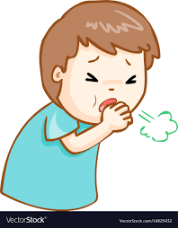
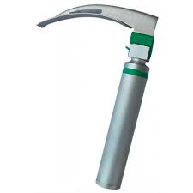
Postoperative Stridor
Risk Factors:
Age < 4 years
ETT too large
ETT cuff volume too high
Traumatic intubation
Prolonged intubation
Coughing
Head or neck surgery
Frequent head repositioning
History of post-intubation croup
Trisomy 21
URI

Slide 48
Postoperative Stridor

Slide 49
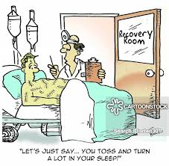
Stridor Treatment
Prevention! Air Leak < 25 cm H2O
Cool and humidified O2
Upright seated position
Light sedation (to decrease airway resistance)
IV dexamethasone (0.2-0.5 mg/kg)
Nebulized racemic epinephrine
Heliox
Helium + Oxygen: improves laminar airflow by reducing Reynold’s number
Reintubation if necessary

Slide 50
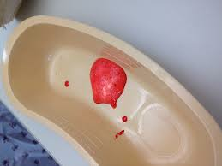
Negative Pressure Pulmonary Edema
Occurs when the upper airway is obstructed AND a large breath is attempted
Order of events:
Huge spike in negative intrathoracic pressure
Increases permeability from lung capillaries to alveoli
Fluid follows the path of least resistance
Lungs fill with fluid
Hypoxia and Spo2 desaturation
Pink frothy sputum

Slide 51
Negative Pressure Pulmonary Edema
When does this happen?
Patient is biting on ETT during emergence + taking deep breaths
Healthy muscular teens or adults
Recognition
Mimics laryngospasm while patient is somnolent and unresponsive
Mask ventilation with 100% O2 may fail necessitating reintubation
Once tube is in place, pink frothy pulmonary edema may appear

Slide 52
Negative Pressure Pulmonary Edema
Treatment:
Restore SpO2 with positive pressure ventilation, generous PEEP, and 100% O2
IV furosemide 0.5-1 mg/kg
Can resolve immediately or after 12-24 hours intubated and sedated

Slide 53
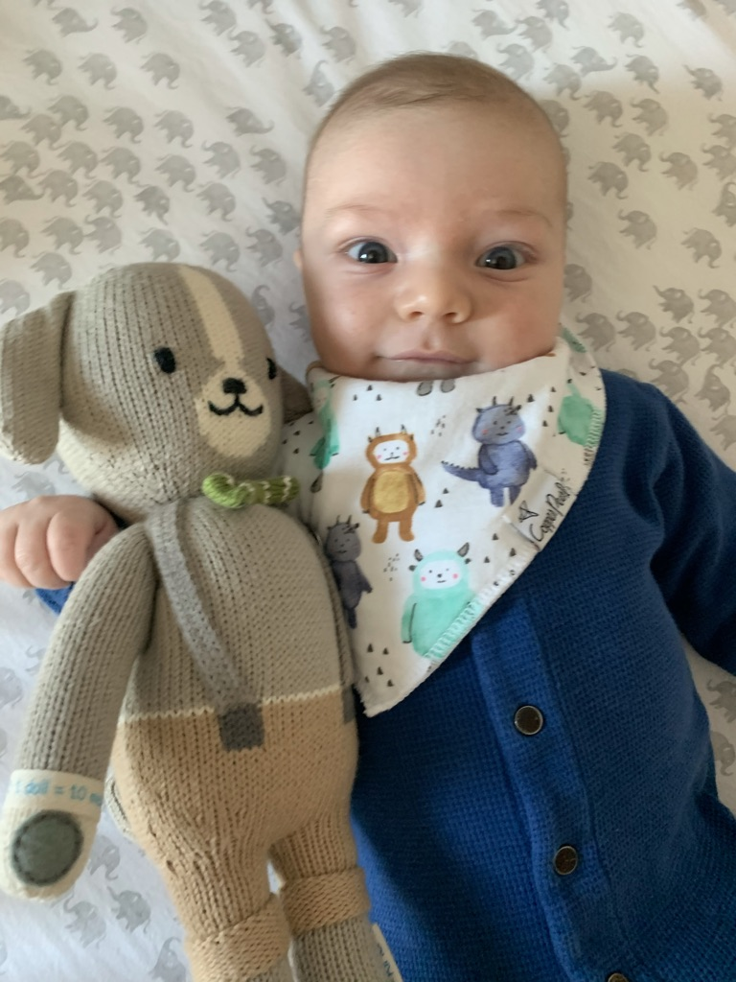
Apnea in Premature Infants
A pause in breathing >15 seconds with bradycardia (HR < 80 bpm)
Usually in clusters with or without arterial O2 desaturations
Preterm infant = < 37 weeks gestation
Low weight < 2500 grams
Very low weight < 1500 grams
Extremely low weight <1000 grams
Very low and extremely low weights are considered micro-premature infants or “micropremies”

Slide 54
Apnea in Premature Infants
Physiology:
Biphasic ventilatory response to hypoxia
1st- increase in ventilation
2nd- after minutes decrease ventilation, apnea
Ventilatory response to CO2 is decreased
Hypoxia worsens the CO2 ventilatory response
Anesthetic drugs depress the ventilatory response

Slide 55
Central vs Obstruction Apnea
Central Apnea is decreased respiratory center output
Caused by:
Poor organization and integration of afferent input from proprioceptive receptors
Poor organization from medullary and peripheral chemoreceptors
Responsiveness of chemoreceptors to hypercarbia and hypoxia develops with age
*Exacerbated by opioids

Slide 56
Central vs Obstructive Apnea
Obstructive apnea
Airway becomes obstructed due to lack of muscle coordination in hypopharynx and larynx
Anesthetic drugs worsen the obstruction
To relieve obstruction:
Head tilt
Chin lift
Jaw thrust
Oral or nasal airway
Prone position
CPAP

Slide 57
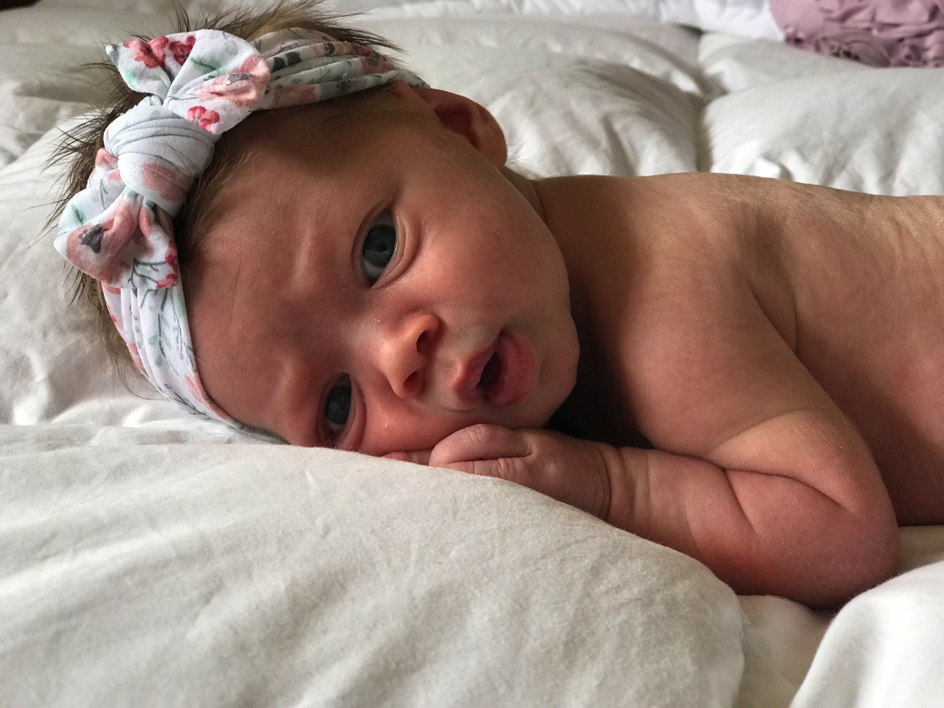
Risk Factors for Apnea in Infants
Low post-conceptional age
Low hematocrit
Major surgery
History of apnea of prematurity
History of chronic lung disease
20% of infants undergoing surgery with a history of prematurity, apnea, or chronic lung disease experience apnea in the postoperative period.

Slide 58
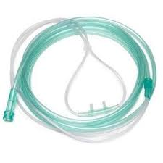
Management of Postoperative Apnea
Close observation and monitoring SpO2, HR, RR, ECG
IV caffeine or theophylline
Prevention of anemia and hypovolemia
Increase O2 delivery
Increase fraction of inspired oxygen
Nasal CPAP/intubation if required

Slide 59
Hospital Stay Recommendations
Overnight stay for those < 60 weeks post-conceptional age
12 hours apnea-free following surgery
The 12-hour clock starts over after each apneic episode

Slide 60
References
Center for Drug Evaluation. Drug Safety and Availability – FDA Drug Safety Communication: FDA review results in new warnings about using general anesthetics and sedation drugs in young children and pregnant women. https://www.fda.gov/drugs/drugsafety/ucm532356.htm. Published December 14, 2016.
Coté CJ, Lerman J, Anderson BJ. Coté and Lerman's a practice of anesthesia for infants and children. Philadelphia, PA: Elsevier/Saunders; 2013.
Barash PG, Cullen BF, Stoelting RK. Clinical anesthesia. Philadelphia: Lippincott Williams & Wilkins; 2006.
iPads as effective as sedatives for children before operations. ScienceDaily. https://www.sciencedaily.com/releases/2016/08/160829094027.htm. Published August 29, 2016.
Miller RD, Eriksson LI, Fleisher LA et al. Miller's anesthesia. Vol 2. 7th ed. Philadelphia, PA: Churchill Livingstone; 2010.
Patino M, Sadhasivam S, Mahmoud M. Obstructive sleep apnoea in children: perioperative considerations. BJA. 2013;111.
Reduque LL, Verghese ST. Paediatric emergence delirium. BJA Educ. 2012;10:1-3.
Sun LS, Li G, Miller TLK, et al. Association Between a Single General Anesthesia Exposure Before Age 36 Months and Neurocognitive Outcomes in Later Childhood. Jama. 2016;315(21):2312.

