Slide 1
Pediatric Regional Anesthesia, Pain Management & NORA
Megan Gustafson Feb 2022

Slide 2
Objectives
Describe differences in Pediatric Regional Anesthesia and Pain Management as compared to adults in regards to physiology and pharmacology
Describe unique pharmacological considerations for neonatal and pediatric populations
Identify and describe unique risks of regional anesthesia and pain management of the pediatric population
Identify anesthetic medications used in pediatric regional anesthesia and pain management

Slide 3
Regional Anesthesia
Use of Regional Anesthesia in children is increasing
Integral component of postoperative pain relief
Used to manage chronic pain syndromes
Widely viewed as safe

Slide 4
Physiologic Differences in Pediatrics
Growth (3kg – 50kg)
Congenital malformations, genetic disorders impair normal or expected development
Cartilaginous skeletal structure at birth
Implication: sharp needles should be avoided

Slide 5
Anatomy Review – Big picture
Spine
Ligaments
33 vertebrae
7 cervical
12 thoracic
5 lumbar
5 fused sacral
5 fused coccygeal
Spinal cord extends from foramen magnum to send of sacrum
As you grow, the vertebral column lengthens more than the spinal cord
(T12 in most adults, L3 in children)
Supraspinous ligament (T7- sacrum)
Interspinous ligament
Ligamentum flavum
31 spinal nerves
Spinal meninges have 3 layers:
Duramater
Arachnid (ends at S2)
pia

Slide 6
3 Most common regional techniques
Caudal
Indications: lower abdomen, lower extremity (ex: inguinal hernia repair, orchiopexy – dermatomal distribution below T10, *below umbilicus)
Contraindications: pilonidal cyst, abnormal superficial landmarks, hydrocephalus, intracranial tumors, meningomyelocele
Epidural
Indications: Surgery of Mid to Upper abdomen and thorax (ex: Wilms tumor removal)
Spinal
Indications: inguinal surgery for infants, <60 weeks gestational age, (below T6)
Contraindications: anticoagulation therapy, patient or parent who refuses consent

Slide 7
Pediatric Regional Anesthesia Network
Over 21 Children’s Hospitals participate in this national database that gathers data on all regional anesthesia submitted on patients <18yrs
Does NOT include data on blocks placed for chronic pain management or by other specialties (ER, surgeons)
Demonstrates a Significant effort to gather data and come to a greater agreement on doses, uses, and fuller understanding of complications and risks
Still most common block performed is the caudal

Slide 8
Example of diversity of single shot regional techniques from PRAM Data (2007-2015)
Complications in Pediatric Regional Anesthesia: An Analysis of More than 100,000 Blocks from the Pediatric Regional Anesthesia Network.
Walker, Benjamin; et. Al
Anesthesiology. 129(4):721-732, October 2018.
DOI: 10.1097/ALN.0000000000002372

Slide 9
Safety and Risks of Regional Anesthesia
In children, Regional anesthesia is most often performed with the child fully anesthetized
Disadvantage: Cannot verbalize pain or paresthesia's
Advantage: child is motionless and provider can safely place block (predominantly considered the standard of care)
Age related Risks of Local Anesthetic Toxicity
Direct Nerve toxicity
Infection
Compartment syndrome

Slide 10
Regional Anesthesia Safety Time Out
A Time-Out Checklist for Pediatric Regional Anesthetics.
Clebone, Anna; Burian, Barbara; Polaner, David; MD, FAAP
Regional Anesthesia & Pain Medicine. 42(1):105-108, January/February 2017.
DOI: 10.1097/AAP.0000000000000509

Slide 11
Local Anesthetics - Amides
Lidocaine, mepivacaine, bupivacaine, ropivacaine
90% protein bound in plasma
Alpha 1- glycoproteins
albumin
10% unbound is physiologically active
Infants < 6 months have plasma proteins and risk of toxicity
Adult levels of plasma proteins reached by age 1
Metabolized by Liver’s Cytochrome P450 system – which reach adult activity level by age 1
Take home: Use Carefully!

Slide 12
Local Anesthetics - Esters
Chloroprocaine and tetracaine
Metabolized by plasma esterases

Slide 13
Infants and Children have an INCREASED risk of Local Anesthetic Toxicity
Increased cardiac output
Increased systemic uptake of drug
Example: Lidocaine acts as an anticonvulsant when plasma levels are 2-4 mcg/mL but cause convulsions at 10 mcg/mL
Ropivacaine has a lower risk for CNS and cardiac toxicity than bupivacaine
IF Local Anesthetics are COMBINED (used at different sites) their toxicities are additive

Slide 14
Local Anesthetics (Table 16-2)
Local Anesthetic | Single Dose | Continuous Infusion | Continuous Infusion Infants (<6 months)
Bupivacaine | 3 mg/kg | 0.4-0.5 mg/kg/hr | 0.2-0.25 mg/kg/hr
Levobupivaine | 3 mg/kg | 0.4-0.5 mg/kg/hr | 0.2-0.25 mg/kg/hr
Ropivacaine | 3 mg/kg | 0.4-0.5 mg/kg/hr | 0.2-0.25 mg/kg/hr
Lidocaine | 5 mg/kg | 1.6 mg/kg/hr | 0.8 mg/kg/hr
Lidocaine w/ Epinephrine | 7 mg/kg | NA | NA
Davis, P.J., Cladis, F.P., Motoyama, E.K. (2011). Smith’s anesthesia for infants and children. Philadelphia, PA: Elsevier Mosby, pg 456

Slide 15
Test Dose
Somewhat controversial, requires use of Epinephrine
Increase in HR, increase in T-wave amplitude of 25% (most reliable for intravascular injection), increase in blood pressure 15 mm Hg
May be different with TIVA compared to Sevoflurane
Slow incremental dosing critical

Slide 16
Local Anesthetic Toxicity Symptoms
Neurotoxicity
Local Anesthetic Toxicity
Headache
Somnolence
Vertigo
Lingual paresthesia
Tremors
Twitching
Shivering
Convulsions
Not able to assess with GA
Muscular rigidity
Hypoxemia w/o other cause
Unexplained tachycardia
Dysrhythmias
Cardiovascular collapse

Slide 17
Treatment of LA toxicity
Oxygenation, Ventilation, CV resuscitation
Avoid hypercarbia
Intralipid
Initial dose: 1-1.5 mL/kg of 20% Intralipid over 1 min
Repeat every 3-5 min during resuscitation up to 3 mL/kg
Upon recovery start infusion at 0.25-0.5 mL/kg/min

Slide 18
Example:
A 18 month old, 12 kg child begins to have decreasing O2 Sats, becomes increasingly difficult to mask ventilate and ECG displays PVCs 5 min after caudal block is placed. What should you do?

Slide 19
Example:
Open airway and ventilate with 100% FiO2
Call for help with high suspicion of Local Anesthetic Toxicity
Begin administration of emergency medications and Intralipid
12-18 mL over 1 min, repeated every 3-5 min up to 36 mL
Upon recovery Begin infusion at 3 -6 mL/min

Slide 20
Caudal Blockade
Considerations
Target population is infants and children (<5-6 yrs)
Performed under general anesthesia
The most common pediatric block
Duration ~ 4-6 hours
Relatively easy to place
Well studied and proven safe
Decreases anesthetic requirement
Notes:
A caudal epidural is an epidural anesthetic administered via the sacral hiatus that acts on the sacral dermatomes.

Slide 21
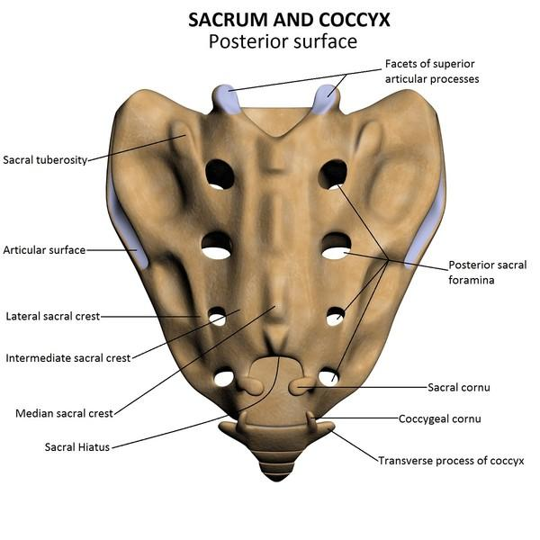
Caudal blockade – Anatomy Review
Notes:
The sacrum is the fusion of the 5 sacral vertebrae.
It articulates with the coccyx caudally and articulates with the 5th lumbar vertebrae at the lubosacral angle.
There are 4 pairs of dorsal foramina which the connect to the sacral canal via intervertebral foraminae which transmit the dorsal ramus of sacral spinal nerves
The caudal opening of the sacral canal is called the sacral hiatus.
The sacral hiatus is bordered inferiorlaterally by the sacral cornu.

Slide 22
Caudal blockade – Anatomy Review
The sacrum is the fusion of the 5 sacral vertebrae.
It articulates with the coccyx caudally.
It articulates with the 5th lumbar vertebrae at the lumbosacral angle.
There are 4 pairs of dorsal foramina which the connect to the sacral canal via intervertebral foraminae which transmit the dorsal ramus of sacral spinal nerves
The caudal opening of the sacral canal is called the sacral hiatus.
The sacral hiatus is bordered laterally by the sacral cornu.

Slide 23
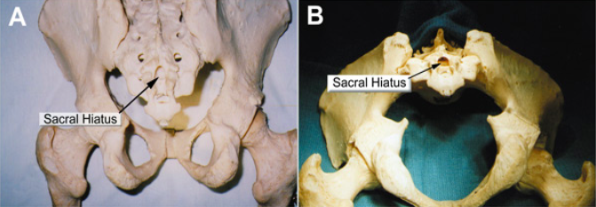
Caudal blockade – Anatomy Review
Notes:
A demonstrates the sacral hiatus and it’s relationship to the sacrum and coccyx. Note the sacral cornu
B Looking inferior to the sacral hiatus

Slide 24
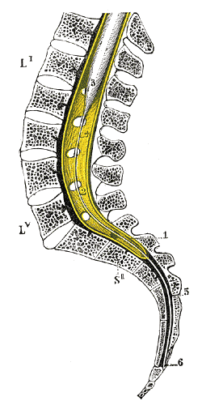
Caudal blockade - Anatomy Review
The spinal cord ends ~ L2
This triangular cone is termed the
conus meduallaris
Subarachnoid and subdural space
end at ~ S2 (can be S1-S3)
Filum terminale is a delicate strand of
pia mater that starts at L2 and
extends to coccyx and anchors the
spinal cord
Notes:
*** Spinal cord ends at L3 in newborn and migrates cephalad during childhood to L1-L2
In this picture at the lower portion of S2 note that the filum terminale along with the lower sacral spinal roots pierce through the arachnoid and dura maters and continue down to coccyx
The 5th spinal nerves emerge from the sacral hiatus

Slide 25
Caudal blockade – Anatomy Review
The sacral canal contains the cauda equina, filum terminale, and spinal meniges
Roofing the sacral hiatus is the sacrococcygeal ligament (a firm elastic membrane)
The epidural venous plexus generally terminates at S4 (can extend caudad) and is located anterolaterally in sacral canal.
Remainder of sacral canal is adipose tissue
Notes:
The sacrococcygeal ligament is an extension of the ligamentum flavum

Slide 26
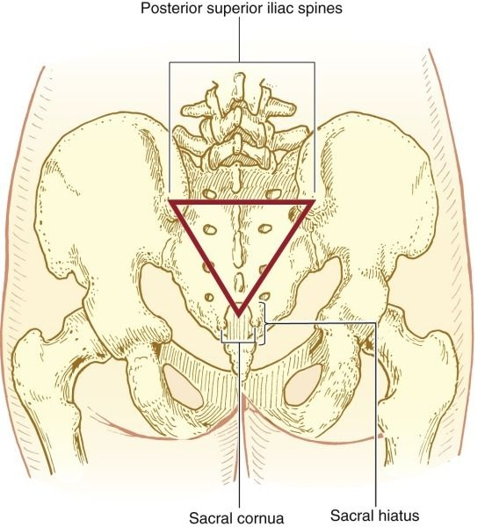
Caudal blockade
Anatomical Landmarks
Notes:
Key anatomical landmarks on the sacrum include the posterior superior iliac spines located superiolaterally to the sacral hiatus and the sacral cornua are palpated on each side of the sacral hiatus. Together the superior iliac spines and the sacral hiatus form a triangle.
The sacral hiatus is palpated as a depression directly above the coccyx and between the sacral cornua.

Slide 27
Caudal blockade
Age related anatomical changes
The adipose tissue in the sacral canal undergoes an age related decrease in density
May be responsible for transition from predictable spread in children to unpredictable in adults
As age increases the sacrococcygeal ligament thickens and palpating the hiatal margins becomes difficult
Due to the lack of a soft spot felt between the sacral cornua
Around age 7 the caudal space becomes more angular and perhaps more difficult to enter
Notes:
These are the reasons why caudal blocks are typically only used in young children

Slide 28
Photo of caudal procedure from Miller’s https://expertconsult.inkling.com/read/millers-anesthesia-7th/chapter-81/figure-81-5

Slide 29
Caudal blockade
Technique
Induction of anesthesia, airway placed, confirmed, secured
Patient placed in lateral decubitus (left handed → RLD, right handed → LLD)
Posterior superior iliac spines and sacral cornua are palpated
Skin prepped and dried, local anesthetic prepared
Skin at insertion site is cut with a blunt needle
Notes:
This blunt needle technique is to prevent the transfer of epidermis to the caudal space
Note: we do not do this at Children’s

Slide 30
Caudal blockade
Technique
22 gauge for ≤ 2 years, 20 gauge for > 2 years
At 45° angle needle is passed through subcutaneous tissue at or just below level of two cornua
A pop will be felt once it passes through the sacrococcygeal ligament
After the pop decrease angle to nearly flat (10° angle to skin)
Advance 2-3 mm through the ligament
Next the catheter is slipped off the needle and advanced 2-3 mm
Notes:
The pop will be similar to the pop of the ligamentum flavum during an epidural

Slide 31
Caudal blockade
Technique
If any resistance is met at this point, remove entire cannula and start over (not in caudal space)
Remove needle and observe for blood or CSF leaking back out of catheter (don’t apply negative pressure)
Connect syringe with local and inject 2-3 mL slowly every 2 minutes
Observe ECG for peaked T waves and increased ST segments (for inhalational anesthesia)
Observe for high BP (for TIVA)
Once injection complete, remove catheter, clean area, and position for surgery
Notes:
The epidural veins collapse easily with negative pressure
Peaked T waves or lengthened ST and high BP are all signs of inadvertent intravascular injection

Slide 32
Caudal blockade
Agents and doses
Bupivicaine
Dose Range 0.125 to 0.25% (with or without epi)
Volume 1 mL/kg
Ropivacaine
Dose Range 0.1 to 0.375% (with or without epi)
Volume 1 mL/kg
Notes:
Most Children’s hospitals are using ropivicaine because it has less cardiotoxicity than bupivicaine.
However bupivicaine is more effective than ropivicaine and provides excellent analgesia and short motor blockade ~ 1 hour.
We have seen the consequences of intravascular injection of bupivicaine at childrens and it included peaked T waves and long scary pauses/bradycardia that did resolve on its own after several minutes

Slide 33
Caudal blockade
Complications
Rare (1.5:1,000)
Cardiovascular complications
Intravascular or interosseous injection
ECG changes, vfib, cardiac arrest
Neurological complications
Subarachnoid injection
Epidural hematoma
Nerve injury
Infection
Could lead to meningitis

Slide 34
Video
https://expertconsult.inkling.com/read/davis-smiths-anesthesia-infants-children-8th/videos/central-neuraxial-blockades?librarySearchHighlight=%5B%22Caudal%22%5D
https://expertconsult.inkling.com/read/cote-practice-anesthesia-infants-children-6e/videos/video-42-3

Slide 35
Spinal Anesthesia
Overview
Can be used alone or in combination with GA
Sole spinal anesthesia useful in ex-premature infants at risk for apnea
Combined approach → early extubation in neonates
No opioids
No muscle relaxant
Less volatile anesthetic

Slide 37
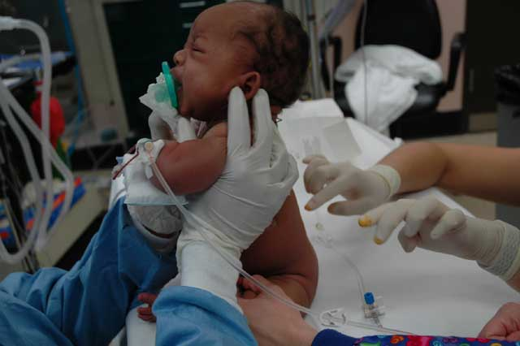
Spinal Anesthesia
Overview
Technically difficult to place
Requires great cooperation between surgeon and anesthesia provider
Place spinal awake, neonate held in seated position
Notes:
Due to the increasing advancements in general anesthesia it may be safer and more effective to perform GETA vs regional
Tell the story about the ex-premature patient that the MDA attempted a spinal on and what followed

Slide 38
Spinal Anesthesia
Total spinal anesthesia
Presents as respiratory distress/ failure
Infants lack normal sympathetic tone (thus they do not get hypotension from total spinal)
Therefore first sign of total spinal is decreasing oxygen saturations
https://expertconsult.inkling.com/read/cote-practice-anesthesia-infants-children-6e/chapter-42/figure-42-6
Notes:
A total spinal can be caused by a primary spinal technique or an attempted epidural placement

Slide 39
Epidural Anesthesia - Overview
Caudal placement of epidural catheters is preferred in neonates and infants
Epidural catheters can be placed in thoracic, lumbar, and caudal region
Caudal catheters can be threaded cephalad to desired level

Slide 40
Epidural Anesthesia
Technique
Performed the same as in adults
5 cm Tuohy 18G needles
Shorter distance from skin to dura
Agents and dosing
Bupivicaine 0.1% infusion of 0.4-0.5 mg/kg/hr
Ropivicaine 0.1-0.2% infusion of 0.4-0.5 mg/kg/hr

Slide 41
Regional Anesthetic Additives
Epinephrine
Ketamine
Clonidine (1-2 mcg/kg)
Opioids
May improve quality and duration of block but increase risk for respiratory depression, increased PONV, and peritus, urinary retention

Slide 42
Local Anesthetic Infiltration Dosing

Slide 44
Pain Management in Infants and Children
Complex social, psychological, philosophical, physical interaction in the experience and science of pain and pain treatment
Nerve pathways for perception and transmission of pain are present and functional by 24 weeks gestation
Peripheral nerve and spinal cord pain pathways are present at birth but not developed the same way adults are.
Immature inhibitory mechanisms of the dorsal horn of the spinal cord
Less Inhibition of nociceptive input from the dorsal horn than adult
Wider receptive fields and lower excitability thresholds in dorsal horn

Slide 45
Implications
Failure to treat pain may cause a ”rewiring” of nerve pathways in the dorsal horn of the spinal cord which causes increased pain perception in the case of future insults
Preventative or Multimodal Analgesia
Preoperative, interoperative, multiple sites along the pain pathways

Slide 46
History of Pain Perception, Assessment and treatment
WW2 – opioids more routinely used for acute surgical pain
1968: “children tolerate pain well – no need to treat pain”
1985: found that when Fentanyl was given to infants receiving PDA ligations outcomes were improved
1995: Pain as 5th vital sign
April 2019, Lancet (393, 10180) Does a series on Perioperative Opioids, post- op opioid prescription (over prescription), and acute pain leading to chronic pain
Multimodal pain treatment strategies
Opioid-induced hyperalgesia
opioid sparing techniques
use of dexmedetomidine

Slide 47
Assessment of Pain in Infants and Children
Wong’s FACES Scale
CRIES neonatal Pain assessment scale
FLACC
Comfort Scale
Find out what your institution uses (especially PACU)

Slide 48
Pain Assessment Scales

Slide 49
Pain Assessment Scale

Slide 50
Pain Assessment Scales

Slide 51
Pain Assessment Scales

Slide 52
Non-Opioid Analgesics
Acetaminophen
Oral 10-15mg/kg
Rectal 25-40mg/kg
IV 15mg/kg (over 15 min)
Know when the last dose was given* Careful not to exceed maximum daily dose
Maximum Daily Dose
Preterm infant: 60mg/kg/day
Term infant: 80 mg/kg/day
Older child: 90 mg/kg/day
Adult: 100 mg/kg/day
Ketorolac (0.5mg/kg)

Slide 53
Opioids
Fentanyl – 1-3 mcg/kg/hr (1-2 mcg/kg for post op doseing)
Morphine- 0.05-0.1 mg/kg/hr, 0.05-0.1 post op
Hydromorphone 3-5 mcg/kg/hr
Methadone
Tramadol 1-2 mg/kg
Remifentanil: 0.1-0.4 mcg/kg/min
Patient or Parent/Nurse Controlled Analgesia
If you can play video games- you can use a PCA
Often in the conversation when planning post-op pain and regional anesthesia plan

Slide 54
Analgesic adjuncts
Antidepressants
Antieplietptics
NMDA Antagonists
Alpha-Adrenergic Agonists
Clonidine (epidural, oral transdermal)
Dexmedetomidine

Slide 55
Dexmedetomidine
More selective for alpha2-adrenoreceptor (more so than clonidine)
Hyperpolarizes noradrenergic neurons in the locus coeruleus resulting in suppression of the locus coeruleus similar to normal sleep
Anxiolysis, sedation, analgesia without respiratory depression
Side effects: hypotension and bradycardia, possible delayed discharge times from PACU
Intramuscular, intranasal doses used as well
0.2-0.5mg/kg bolus dosing for emergence

Slide 57
Non-Operating Room Anesthesia (NORA)
MRI
Radiology (interventional, CT scans, Nuclear medicine procedures, NJ tube placements, x ray, sclerotherapy, PET scans)
Pulmonary function testing
Pediatric Sedation Units
Auditory Brain Stem Testing
ICUs
Hematology/Oncology services
And more!

Slide 58
What do you need to travel?
AANA Standards of Care
Monitors
Equipment
Medications
Anesthetics
Emergency Medications
Analgesics
Sedation
PONV meds
Appropriate personnel
BLS/PALS certified
Blankets
Positioning Devices
Fluids
Oxygen
Suction
Backup Equipment
What is available in your destination?

Slide 60
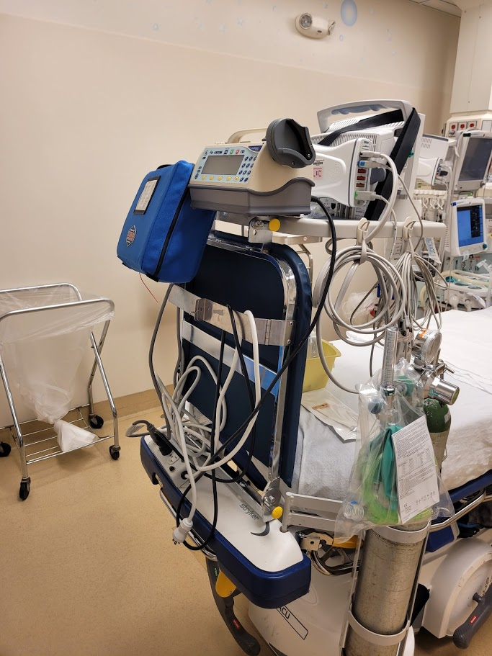

Slide 62
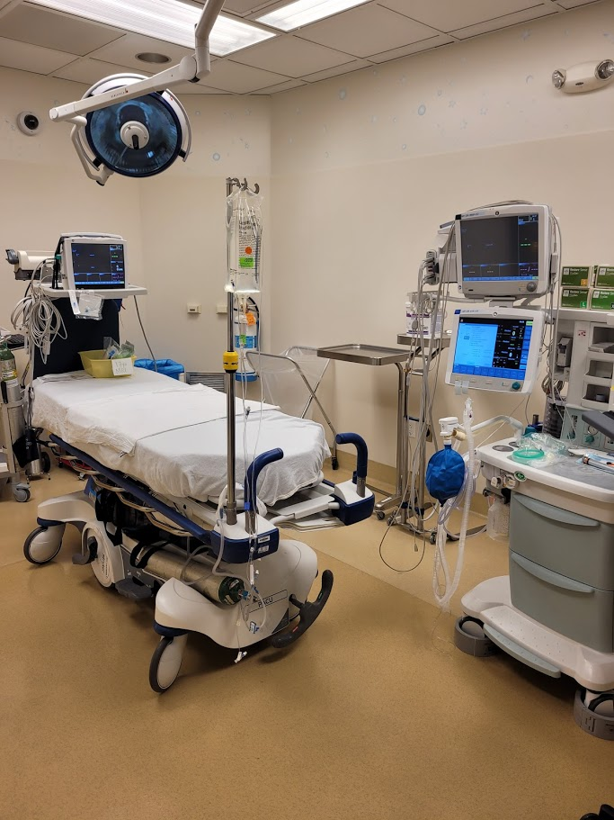

Slide 63
Activity
In Groups, Develop an Memorable pneumonic device to help you remember what essentials you need to travel to a remote location to provide safe anesthesia

Slide 64
Other Considerations
How does your system ‘pre-op’ and recover these patients?
Pre-screening phone call?
H &P?
Appropriateness of anesthesia for this patient and procedure?
NPO?
Arrival times?
Patient and family expectations
Staffing needs in the department
Communication between ordering provider, provider rendering the service, and the anesthesia team

Slide 65
Awareness of Surroundings
Specific Procedure Needs
Is it painful?
Could there be reactions to the procedure (IV contrast reaction?)
Positioning? (Will they be prone in the CT scanner?)
Blood draws, lab work, blood loss and ability to transfuse?
Resources and personnel available

Slide 67
Resources
Davis, P.J., Cladis, F.P., Motoyama, E.K. (2011). Smith’s anesthesia for infants and children. Philadelphia, PA: Elsevier Mosby
Barash, Cullen, Stoelting, Cahalan, Stock, Ortega, Sharar, Holt. (2015). Clinical Anesthesia. Philadelphia, PA: Wolters Kluwer Health/Lippincott Williams & Wilkins
Miller, R. D. (2010). Miller's anesthesia (7th ed.). Philadelphia, PA: Churchill Livingstone/Elsevier.
Brookins, J. (2018) Regional Anesthesia in the Pediatric Population. Lecture conducted from Saint Mary’s University, Minneapolis, MN, United States.
Recommended Reading:
Merella, F., Canchi-Murali, N., & Mossetti, V. (2019). General principles of regional anaesthesia in children. BJA education, 19(10), 342–348. https://doi.org/10.1016/j.bjae.2019.06.003
Greaney, D., & Everett, T. (2019). Paediatric regional anaesthesia: updates in central neuraxial techniques and thoracic and abdominal blocks. BJA education, 19(4), 126–134. https://doi.org/10.1016/j.bjae.2018.12.003
Shah, S. A., Guidry, R., Kumar, A., White, T., King, A., & Heffernan, M. J. (2020). Current Trends in Pediatric Spine Deformity Surgery: Multimodal Pain Management and Rapid Recovery. Global spine journal, 10(3), 346–352. https://doi.org/10.1177/2192568219858308
McCann, Mary Ellen et al. “Neurodevelopmental outcome at 5 years of age after general anaesthesia or awake-regional anaesthesia in infancy (GAS): an international, multicentre, randomised, controlled equivalence trial.” Lancet (London, England) vol. 393,10172 (2019): 664-677. doi:10.1016/S0140-6736(18)32485-1

