Slide 1
Care of the Cardiac Patient With Non-Cardiac Surgery
Melinda Huber CRNA, APRN, MS

Slide 2
Objectives
Examine anesthetic considerations specific to the patients with cardiovascular disorders
Derive care plans that include anesthetic considerations for patients with cardiovascular disorders.
Describe blood flow through the cardiovascular system
Identify the heart valves including location and size
Describe the cardiac cycle

Slide 3
Objectives
Identify the electrical activity of the electrocardiogram and factors that influence it
Describe the atrial, ventricular and aortic wave
Discuss the ventricular volume during the cardiac cycle
Identify the causes of murmurs
Explain the coronary circulation
Discuss the pressure volume curve
Describe preload, afterload, contractility and heart rate

Slide 4
Objectives
Identify placement of EKG electrodes
Explain three basic principles of circulatory system
Describe myocardial oxygen delivery
Identify risk factors related to cardiovascular complications
Explain contraindications to elective surgery in patients with cardiovascular disease
Formulate a preoperative assessment for patients with cardiovascular disease, hypertension, valvular heart disease

Slide 5
Objectives
Describe the anesthetic management for the patient with coronary artery disease including goal; induction, maintenance and postoperative period
Describe treatment of myocardial ischemia
Identify the classifications of hypertension and blood pressure parameters
Describe the anesthetic management for the patient with hypertension including goal; induction, maintenance and postoperative period

Slide 6
Objectives
Identify the two problems with valvular heart disease
Describe anesthetic considerations including goal; induction, maintenance and postoperative period of the patient with valvular heart disease
Explain the manifestations and anesthetic considerations with hypertrophic obstructive cardiomyopathy
Identify the 5 letter coding for pacemakers
Describe the factors that interfere with pacemakers and the treatment
List the anesthetic considerations for the patent with an ICD

Slide 7
Objectives
Explain the anesthetic management for the patient with congestive heart failure
Explain the anesthetic management for the patient with cor pulmonale
Explain the anesthetic management for the patient with cardiac tamponade

Slide 8
Introduction

Slide 9
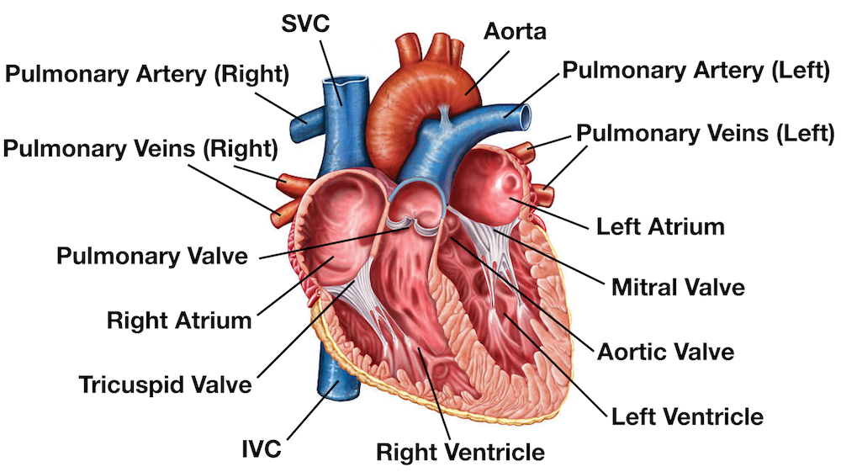
Heart Anatomy

Slide 10
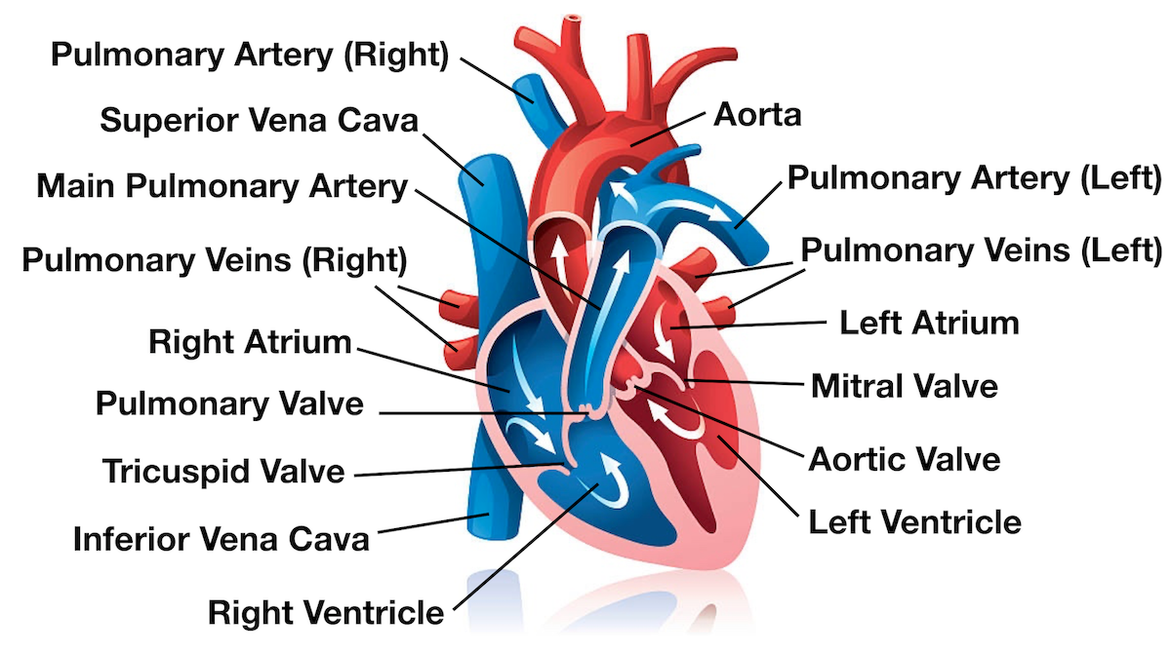
Blood flow through the heart

Slide 11
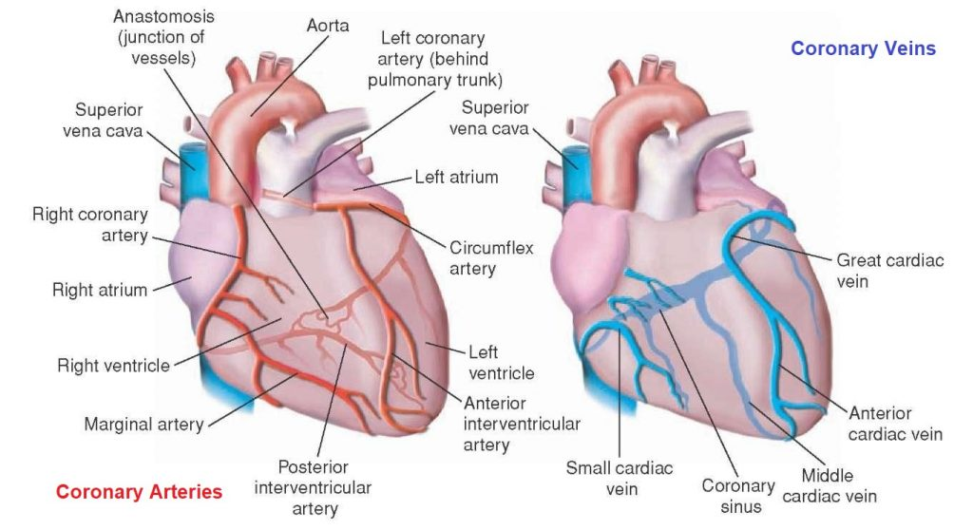
Coronary arteries and veins

Slide 12
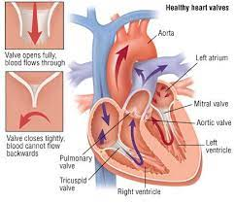
Valves
AV valves: Tricuspid and Mitral.
Tricuspid valve area-7 cm² (right)
Mitral valve area-4-6 cm² (left)
Semilunar valves: Aortic and pulmonary
Aortic valve area-2.5-3.4 cm²
Pulmonic valve area-2.5-3.8 cm²
Notes:
*** This is on boards
Mitral valve is the only bicuspid valve
The valves operate passively via pressure gradient.

Slide 13
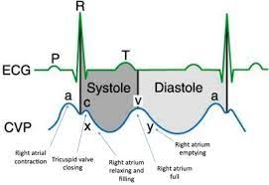
CVP waveform
Atrial Pressure Wave (CVP)
Normal values between 0-8 mm Hg on right and 1-10 Hg on left
a, c and v waves
Dicrotic notch
Notes:
Pressures on the right side of the heart are lower then the left. Know the ACV waves for boards and what corresponds with each. (on next slide)

Slide 14
CVP waveform
a wave-atrial contraction-expect to increase with AV valve stenosis (right after P wave starts)
c wave-back flow of blood from ventricles/reflects ventricular contraction
v wave-end of systole, filling of atria while AV valves are shut therefore would expect an increase with AV insufficiency or regurgitation
Notes:
Atrial pressure wave or CVP

Slide 15
Ventricular Volume
Ventricular volume
Inc volume during filling
EDV (end diastolic volume) 120 ml
Decrease in volume during systole
ESV (end systolic volume) 50 ml
EDV-ESV=SV (stroke volume)=70 ml****
EF = EDV-ESV /EDV normal ejection fraction=60%****
Determined by angiocardiography
Notes:
You are going to have to know this for boards - these are average/normal volumes
Along with the vent pressure, volume waves.
Did you cover this in AP??

Slide 16
Cardiac performance
External work External work=SV x pressure=area in loop
Left does 5-6 times the work of the right because it is pumping against 5-6 times the pressure (afterload)
Difference in external work is why left heart is more muscular

Slide 17
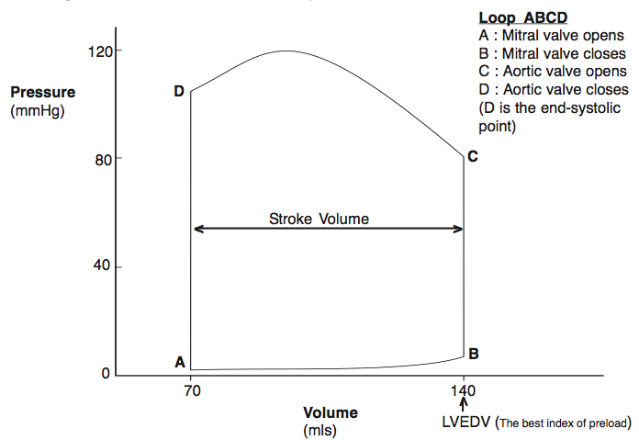
Ventricular pressure volume loop
Notes:
Know this like the back of your hands -
Vent pressure, volume loop
Systole: ventricular contraction
AV valves close (1st heart sound), increase in pressure - isovolumetric contraction
Semilunar valves open when pressure is greater in the ventricle compared to the artery - Ejection
Diastole: The heart relaxes and semilunars shit when the artery pressure is lower than the ventricle. Decrease in pressure leads to isovolumetric relaxation and AV vlaves open which starts filling.

Slide 18
Coronary Circulation
Coronary Circulation: right and left myocardial supply is derived from the coronary arteries.
Heart has high metabolic demands
Aerobic organ (Requires oxygen)
Left main ( LAD, circ, diagonal) and RCA
Venous drainage- coronary sinus and ant.cardiac veins empty directly into right atrium. Thesbian veins empty small amounts into heart chambers
Notes:
Coronary circulation happens during diastole.
Coronaries include
Left main which branches to LAD, Circ and Diagonal
RCA
Venous drainage is coronary sinusm anterior cardiac veins and thesbien veins.

Slide 19
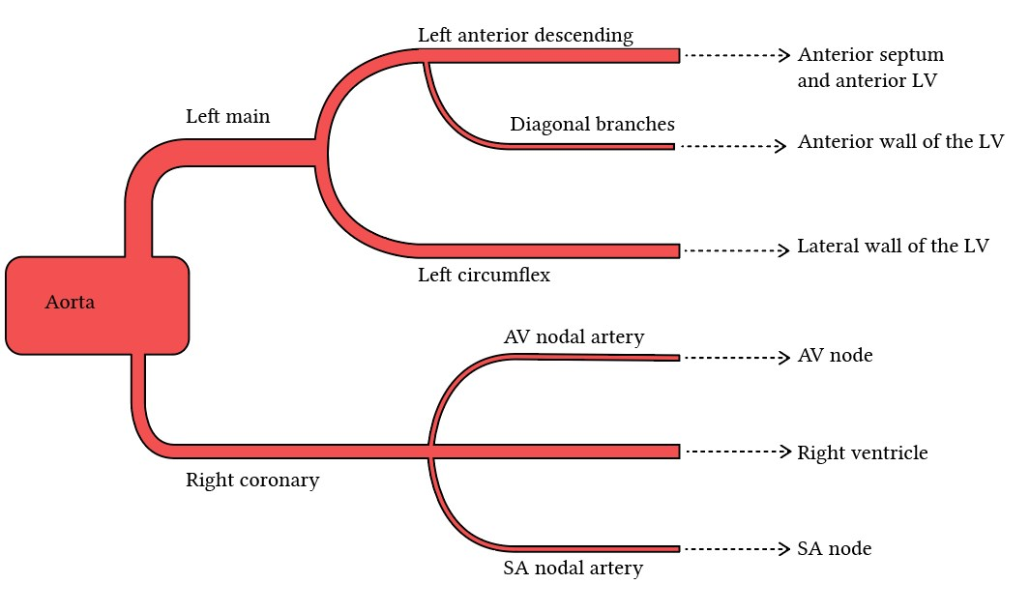
Coronary artery circulation

Slide 20
Cardiac performance
Cardiac function and energy expenditure influence by:
Preload
Afterload
Contractility
Heart rate

Slide 21
Cardiac performance
Preload
Tension on muscle before it contracts
Stretch on muscles
Ventricular volume at EDV
Frank-Starling mechanism
Cardiac function curve
Notes:
I always think of preload as stretch - too little stretch or too much stretch the heart isnt going to benefit, just the right amount of stretch will give the muscle what it needs to contract well.
think of a rubber band.

Slide 22
Cardiac performance
Afterload
Ventricular wall tension or force the ventricle is pumping against
The systolic arterial pressure
Related to total peripheral resistance (TPR)
To keep cardiac output constant, pressure inc with an inc in resistance (Ohm’s Law)
Notes:
Resistance
How much resistance is the heart pumping against at a given moment, too much and the volume of the blood getting ejected each beat will drop.
Ohm’s law is on boards.

Slide 23
Cardiac performance
Afterload
Usually does not interfere with Frank-Starling relationship unless pathologically very high (>150 mm Hg systolic) or very low
If inc afterload + venous return= inc SV
Notes:
if you give phenylephrine. increases afterload - therefore increasing preload , more stretch - increasing stroke volume - increasing efection fraction and blood pressure.
“clamped down” - need volume also.

Slide 24
Cardiac performance
Cardiac Contractility
Related to the rate of cardiac muscle shortening which is dependent on intracellular Ca²⁺ concentration during systole.
Altered by neural, hormonal and pharmacological factors.
Contractility is decreased by large doses of anesthesia, antiarrhythmics, hypoxia, acidosis, depletion of catecholamine stores in the heart and loss of functioning muscle mass from ischemia or infarction.

Slide 25
Cardiac Performance
Heart rate
Increased heart rate with same or inc SV ➔inc CO
Limits in heart rate (40-200)
Inc HR (>120), decrease diastole more than systole, starts interfering with time for filling
Around 200 BPM is peak of cardiac output
Notes:
increase in heart rate will decrease diastole and will interfere with time of filling.

Slide 26
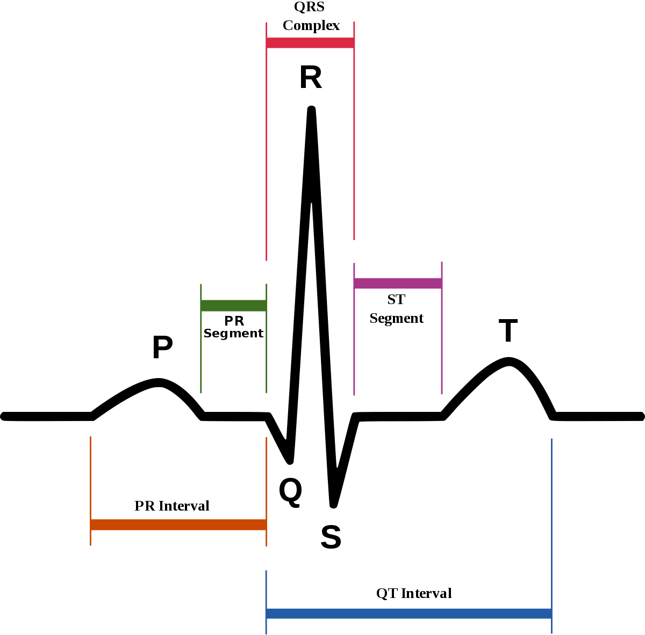
Electrocardiogram
Sum of all electrical activity in heart – reflects excitation NOT contraction
Components of normal ECG
Depolarization and repolarization of various parts of heart

Slide 27
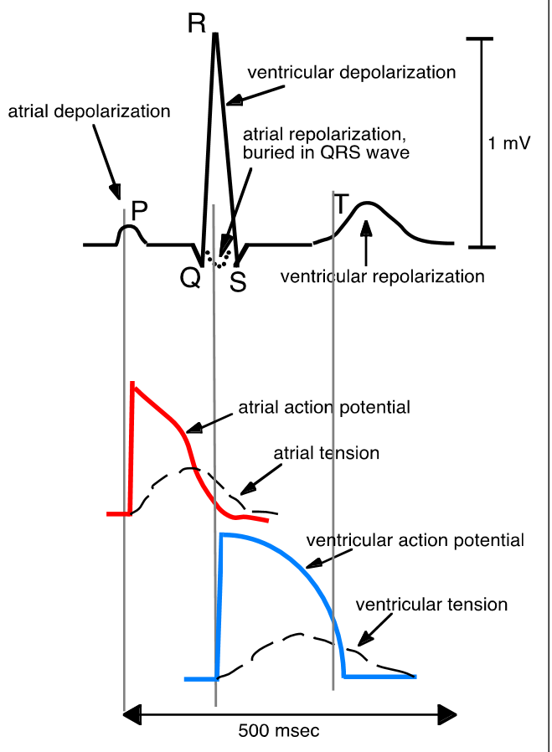
Combined EKG and Muscle action potential

Slide 28
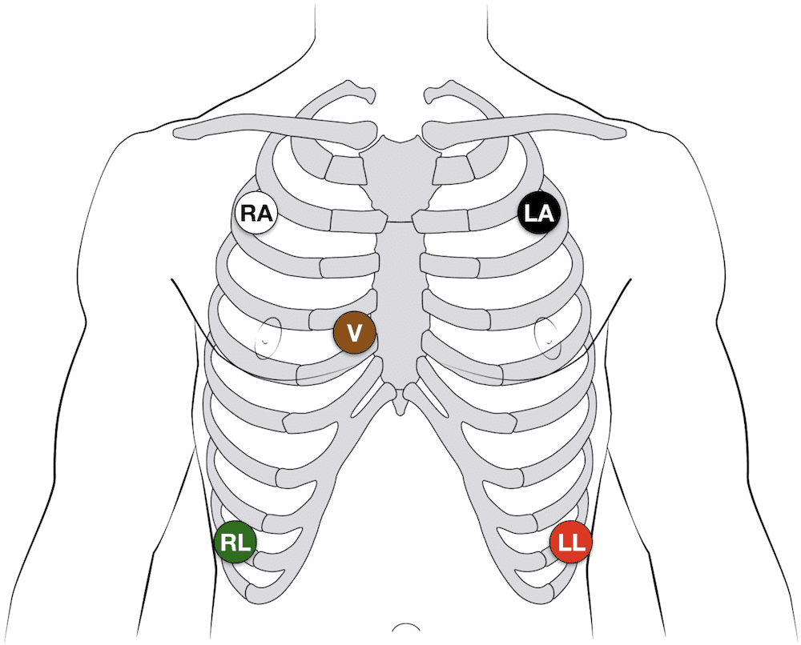
Electrocardiogram
Leads
Limb leads
Chest leads
Augmented leads
https://youtu.be/kwLbSx9BNbU
Notes:
Einthovens triangle

Slide 29
5 lead EKG
Lead II- (RCA and P wave) identifying dysrhythmias
V5 (at 5th ICS/AAL)- identifying ST changes
Ischemia is > 1mm ST depression or elevation
Other causes of ST depression
Dysrhythmias, conduction disturbances, digoxin, abnormal electrolytes, ↑temp
Notes:
will want to know this for boards and everyday practice. ITs the leads we monitor in the OR. Know the baseline rhthym for your patient and if anything deviates.

Slide 30
Circulation
Flow is pulsatile in large arteries then becomes laminar in systemic capillaries. The mean pressure in large veins is 20mmHG.
Largest pressure drop is across arterioles where pressure decreases by 50%. The arterioles are account for the majority of SVR.
Blood flow is directly proportional to pressure gradient and Blood flow is inversely proportional to resistance (based on analogy to OHM’s Law) MAP=SVR x CO
MAP can be estimated by: MAP=DBP + 1/3 pulse pressure (pulse pressure is the difference between SBP and DBP)

Slide 31
Circulation
Blood pressure
Measured in mmHg
Actual force blood exerts on a column of Mercury
100 mm Hg raises mercury column 100 mm
Blood in vessel is a column of water which can measure BP in cm of water (conversion 1 mm Hg =1.36 cm H2O)

Slide 32
Circulation
Homeostatic mechanisms control blood pressure:
Immediate: Autonomic reflexes sense changes in centrally (brainstem and hypothalamus) and peripherally (baroreceptors).
Central receptors decrease in blood pressure will increase sympathetic tone, increase adrenal secretion (epi) and decrease vagal stimulation
Peripheral receptors are located in common carotid bifurcation and aortic arch. Increases in blood pressure will increase baroreceptor discharge, inhibit systemic vasoconstriction and change vagal tone.
ALL volatile anesthetics will decrease baroreceptor responses.
Notes:
Q=P/R - flow is equal to pressure / resistance. Know how to calculate the MAP for boards.
To sum it up - if increase in resistance - decrease in flow. the more pressure the increase the flow.

Slide 33
Circulation
Intermediate changes:
RAS activation will occur in response to decrease BP. Secrete vasopressin which is a potent vasoconstrictor to increase SVR and increase blood pressure.
Long term changes for blood pressure issues: the kidneys will eventually start changing sodium and water balance to either increase or decrease fluids to help with blood pressure changes.

Slide 34
Myocardial oxygen balance
Myocardial oxygen demand: most important determinant of myocardial blood flow. Increase in demand (i.e. increase in heart rate) = increase in supply.
The myocardium extracts 65% of the oxygen in arterial blood as compared to regular tissue which extracts 25%
The myocardium cannot compensate for oxygen reductions as normal tissues can. Any increase in myocardial demand must be met by an increase in supply.

Slide 35
Myocardial oxygen balance
Supply:
Can estimate by calculating: Coronary perfusion pressure = aortic diastolic pressure – ventricular end diastolic pressure (Cpp=adp-edvp)
Left ventricle obtains blood flow is during diastole
Right ventricle obtains blood flow is during systole and diastole
Notes:
Point out that left Vent is during diastole,
RV during systole

Slide 36
Myocardial Oxygen Delivery
Supply
Heart rate: affects diastolic time and therefore perfusion to the left ventricle
Coronary perfusion pressure
Oxygen content
Arterial oxygen tension
Hemoglobin concentration
Diameter of coronary artery
Notes:
SO - LV will get less flow in diastolic time is decreased.
how much oxygen is available in arterial blood and if the hgb is low - unable to carry the oxygen.
if coronary artery small - increase in resistance - decrease in flow.

Slide 37
Myocardial Oxygen Requirements
Demand (relative contributions to oxygen requirements
Basal requirements: 20%
Heart rate: 1%
Preload/Afterload or volume work: 15 %
Contractility/wall tension or pressure work : 64 %

Slide 38
Coronary Artery Disease
Up to 25-50 % of deaths occurring after non-cardiac surgery are related to cardiovascular complications.
This is why we care so much about the cardiovascular system when performing anesthesia. S#*t happens in anesthesia and preventing cardiac events in the operating room plays a large part of our job.
Notes:
50% is ALOT - very important to monitor patients closely with CAD.

Slide 39
Coronary Artery Disease
5 common complications with known cardiovascular disease
MI
Pulmonary edema
CHF
Dysrhythmias
Thromboembolism

Slide 40
Risk Factors
Recent myocardial infarction: AHA recommendation is to wait 6 months or more after an MI or cardiac event for a patient having an elective surgery.
Active congestive heart failure: dyspnea or pulmonary edema present
Risk of perioperative MI
General public-0.1-0.7%
MI within last 6 months-6%
MI within 3-6 months-15%
MI within 3 months-30%
Notes:
Know this risk for boards and test

Slide 41
Risk Factors Con’t
Preoperative factors
MI within 6 months
CHF (S3 or elevated jugular venous pressure)
Abnormal ECG (>5 PVC/min, non-sinus rhythm, PACs)
Significant aortic stenosis or mitral stenosis
Age > 70
Poor general condition

Slide 42
Risk Factors Con’t
Intraoperative factors
Emergency surgery
Intrathoracic, intraperitoneal or aortic surgery
Surgical time > 3 hours
Wide hemodynamic variations
Notes:
know that intrathoracic surgery has more risk to the patient with CAD, and when performing surgery on a patient with known CAD - there will most likely be wide HD variations. The anesthesia records on these patients are not train tracks, but look like peaks and valleys. They will most likely be hard to maintain - have phenylephrine, ephedrine and pain meds available.

Slide 43
Contraindications To Elective Surgery
Recent MI (<3 months)
Uncompensated heart failure
Severe aortic or mitral stenosis
Unstable angina
Stent placement
Metal-4-6 weeks
Drug eluding-12 months
Notes:
Know the contraindications to elective surgery

Slide 44
Interventions To Decrease Cardiac Complications
Medications
Beta blockers
Nitroglycerin
Calcium channel blockers
Statins
Aspirin
Anticoagulants

Slide 45
Interventions To Decrease Cardiac Complications
CABG
Percutaneous coronary intervention (PCI)
Normothermia
Pain management
Notes:
CABG to increase flow, PCI to put in a stent,
Normothermia to decrease workload and pain management to help prevent surgical stimulation and increases in blood pressure.

Slide 46
Preoperative Assessment
Patient risk factors
Family history
Age
Emergency surgery
Functional capacity/status
Valvular disorders
Ventricular dysfunction
Smoking

Slide 47
Functional Capacity/Status
Functional capacity/status
Risk index
Exercise tolerance
Measured in metabolic equivalents (METs)
1 MET Energy consumed at rest (70kg 40yr man)
1 MET Eat, dress
4 MET Climb a flight of stairs
10 MET Swimming, skiing, running
Notes:
MET - metabolic equivalents

Slide 48
Functional Capacity/Status
Activities requiring >4 MET
Moderate cycling, climbing hills, ice skating, roller-blading, skiing, jogging and singles tennis
Activities using <4 MET
Baking, slow ballroom dancing, golfing with a cart, walking at a speed of 2-3 miles per hour
Notes:
looking for what the patient can tolerate. Indicates how their cardiovascular status is.

Slide 49
Preoperative Assessment
ECG
Lead | Coronary artery | Area
II, III, aVF | RCA | RA, SA node, AV node, RV
V3-V5 | LAD | Anterolateral left ventricle
I, aVL | Cx | Lateral left ventricle
Notes:
Know this for boards.

Slide 50
Preoperative Assessment
Assess ECG for:
Rhythm: if not SR, is it a new rhythm change?
Ischemia/infarction: new?
Electrolyte disturbances
Stress Tests
Exercise-type of stressor
Thallium scan-radionuclide imaging
Dobutamine-type of stressor
Notes:
what rhythm is baseline
is there evidence of ischemia/infarction (old?)
Do they have hypertrophy
How is the electrolytes balance - CA, K, NA, Mag,
HGB
On another slide

Slide 51
Preoperative Assessment
Echocardiograms
EF <50% associated with severe disease
Wall motion decreases with ischemia
Labs
H&H- ↓ hgb will ↑ CO and HR to meet oxygen demand
Electrolytes-hypokalemia→arrhythmias, decreased contractility, labile BP; and with chronic hypokalemia→myocardial fibrosis
Renal function
Perioperative morbidity is ⇧with BUN > 50 mg/dL or K+ below 3.0 mEq/L
Notes:
Note the EF and wall motion, also not valves

Slide 52
Preoperative Assessment
Patient Medications
Beta blockers
Nitrates
Calcium channel blockers
Ace inhibitors
Should be continued through the day of surgery
Ask when the last dose was taken
Notes:
I always ask my patient if they took any meds that day - what did they take and when.
If they missed a cardiac med - be ready for HD variations - may need to give metroprolol IV.
ACE inhibitors - be especially aware of hypotension that does not respond to phenyl or ephedrine. Sometimes the patient will respond to both when used together - or you may have to increase the dose exponentually, always be ready to use vasopressin in this population.

Slide 53
Preoperative Assessment
Patient interview
Smoking
Past medical history
Information about pain, dyspnea, cardiac reserve and functional capacity
Angina or prior MI
Notes:
Can you climb a flight of stairs, how far can you walk without getting short of breath - are they short of breath just talking to you??

Slide 54
Preoperative Assessment
Patient Interview
Blood pressure
Breath sounds
Heart tones
Dyspnea with speaking or moving

Slide 55
Anesthesia Management With CAD
Goal: vitals within 20% of patients normal
Remember ischemia can occur from decreased myocardial perfusion and oxygenation without changes in hemodynamics
Note- when ekg leads applied look at your rhythm and note the baseline. Compare this baseline to your egg throughout the case.
Notes:
Keep the patient as close to 20% of normal as you can.
Also remember that the patient may have been nervous the day of surgery - look back to H and P or a clinic visit to see what the normal BP, might be very different. I go by the H and P or clinic visit BP when maintianing BP.

Slide 56
Induction
Preoxygenate
Induction drugs (1 agent has not been proven to be better over another)
Slow administration is the key because it can prevent cardiovascular depression
Provide adequate ventilation because hypercarbia is associated with hypertension
Notes:
Slow induction - maintain O2 - 100% with mask.

Slide 57
Induction
Limit DVL to < 15 seconds d/t sympathetic activation (these patients can exhibit severe htn when airway is being manipulated
Medications may decrease sympathetic activation
Lidocaine
Nitroprusside
Esmolol
Fentanyl
Nitroglycerine
Notes:
if a difficult intubation anticipate and use glidescope. limit amount of time spent DLing - this is very stimulating and can increase your blood pressure and heart rate. MD’s might give a little Esmolol to decrease this reponse.

Slide 58
Maintenance
Anesthesia technique is based on patient’s LV function
Normal function-Volatile or intravenous is safe and appropriate
Impaired function- lower amounts of volatile and intravenous is safe, however titrating for impaired cardiac performance is key.
Regional anesthesia-prevent/treat ↓BP with ephedrine/phenylephrine and fluid to maintain coronary perfusion
Phenylephrine↑ afterload and oxygen requirements
Ephedrine ↑ HR and oxygen requirements
Notes:
volatile anesthetics will depress the LV function - so monitor for this and use less if you have too - sometimes an opioid/nitrous combo may be used.

Slide 59
Maintenance
Hypertension intra-op: look for reversible causes and treat
Inadequate anesthetic depth:↓ SVR w/ volatile anesthetic
Untreated pain, hypoxemia or hypercapnia
Desflurane will↑ BP and HR briefly when concentration is greatly increased
Other medications Beta-blockers (esmolol, labetalol) or nitrates
Notes:
will see a decrease in your blood pressure - be gentle with your dose.

Slide 60
Maintenance
Coronary Steal
A diseased coronary artery does not dilate as much as normal coronary artery
Blood follows path of least resistance and results in decreased flow to ischemic area, where it is needed the most.
Can occur with isoflurane
Notes:
Know the Isoflurane for boards.
Results in increase flow away from the diseased artery.

Slide 61
Maintenance
Muscle relaxant-balance oxygen supply and demand of the myocardium
Vecuronium/Roc have benign circulatory effects due to not activating histamine
Atracurium will modest BP effect
Pancuronium has modest circulatory effects because it activates histamine (↑BP/HR)
Can be beneficial with negative inotropic and chronotropic anesthetic drugs (i.e. Fentanyl and Sufent)
Notes:
ROC - ok to use also

Slide 62
Maintenance
Other
Maintain normothermia
Reversal of muscle relaxant
Safe
HR- glycopyrrolate < atropine affect

Slide 63
Treatment of Myocardial Ischemia
Stable hemodynamics with ST changes (rare occurrence but indicative of severe ischemia, vasospasm or infarction)
Nitroglycerin
Calcium channel blocker
Hypotension with ST changes
Phenylephrine
Nitroglycerin
Decrease anesthetic depth
Fluid if volume depleted
Notes:
Know these for boards and how to treat.

Slide 64
Treatment of Myocardial Ischemia
Tachycardia with ST changes (most common sign or ischemic episodes intra-op)
Beta antagonist
Calcium channel blocker
Treat pain if indicated
Hypertension and ST changes
Increased anesthetic depth
Nitroglycerin
With all scenarios switch to 100% oxygen
Notes:
beta blocker - esmolol, or labetalol

Slide 65
Postoperative
Prevent oxygen demands
Shivering ↑ oxygen requirements- keep patient normothermic
Treat pain if indicated
Increase oxygen supply
Give patient supplemental oxygen
Especially beneficial with narcotic associated hypoventilation

Slide 66
Hypertension
One-third of adults have HTN
One-third of them don’t know they have HTN
Most common cardiovascular disease
Definition
Prehypertension 120-139/80-89
SBP > 140 and/or DBP > 90
After age 50, systolic blood pressure is more important than diastolic blood pressure

Slide 67
Hypertension
Category | SBP (mm Hg) | DBP (mm Hg)
Normal | < 120 and | < 80
Prehypertension | 120-139 or | 80-89
Stage 1 hypertension | 140-159 or | 90-99
Stage 2 hypertension | >= 160 or | >= 100

Slide 68
Hypertension
Two classifications
Essential hypertension-cause unknown
Secondary hypertension-known cause
Pheochromocytoma
Coarctation of the aorta
Renal artery stenosis
Renal diseases (pyelonephritis, glomerulonephritis)
Primary aldosteronism (Conn’s disease)
Hyperadrenocorticism (Cushing’s disease)
Pregnancy
Estrogen therapy

Slide 69
Hypertension
Drugs used in the treatment of hypertension
Diuretics
Angiotensin-Converting Enzyme Inhibitors
Calcium Channel Blockers
Vasodilators
Beta blockers
Angiotensin II Receptor Blockers

Slide 70
Hypertension
Anesthesia Management
Goal: Normotensive patient without major organ compromise
Myocardial ischemia
Cerebral ischemia
Acute tubular necrosis
History
Identify cause of HTN
Antihypertensive medications
Potential side effects of antihypertensive drugs
Organ dysfunction

Slide 71
Hypertension
History con’t
Assess
Chest pain
Dyspnea
Exercise tolerance
Dependent edema
Postural lightheadedness
Syncope
Claudication
Amaurosis (loss of sight)

Slide 72
Hypertension
History con’t
Assess heart tones
Tests
Monitors
ECG-monitor for ischemia
Arterial line especially for uncontrolled HTN
Urinary output-foley if surgery > 2 hours
TEE if LV dysfunction
Notes:
Arterial line for whenever you think you are going to need to keep tight control on blood pressure.
Urine output is important for renal circulation. If blood pressure too low - will be decreased flow to kidneys and result in ATN
Look at echo - ekg (II, V5)

Slide 73
Hypertension
Stimuli that alter hemodynamics
Induction
Laryngoscopy
Surgical stimulation (incision)

Slide 74
Hypertension
Induction
Hypotension may occur with induction agents from vasodilation and hypovolemia
Slow administration may decrease hypotension from induction agents
Hydration-may prevent post-induction hypotension
Decrease morbidity if DBP remains <110

Slide 75
Hypertension
Induction Agents: 1 technique or agent has not been proven to be better then another in most cases. Some considerations:
Etomidate
SV and CO preserved
Ketamine
Sympathetic stimuli may augment ↑ BP (not ideal)
Adequate ventilation
Hypercarbia → HTN
Notes:
dont use ketamine if possible.
you want a lower ETCO2 - this will decrease blood pressure during induction.

Slide 76
Hypertension
Induction
DVL and tracheal intubation
↑↑↑ BP and myocardial ischemia
1.5 MAC may block sympathetic stimulation
Use combination of opioids and volatile agents

Slide 77
Hypertension
Induction
Limit DVL to 15 seconds
If > 15 seconds anticipated:
Lidocaine 1.5mg/kg-1
Esmolol 100-200 mg
Nitroprusside 1-2 mcg/kg-1
Fentanyl 2-3 mcg/kg

Slide 78
Hypertension
Maintenance
Goal: ↓ wide swings in BP with adequate anesthesia depth
Prevent hypoxemia and hypercapnia
Anticipate surgical stimuli
Volatile agents
Help with rapid adjustments in depth
Attenuates sympathetic nervous system
Notes:
ANTICIPATE!!! Know what your surgeon is doing and try to prevent wide swings in HD if you are able to.

Slide 79
Hypertension
Maintenance con’t
Nitrous oxide/opioids/muscle relaxants or TIVA (total IV anesthesia)-acceptable
May need:
NTP
Labetalol
Esmolol
Calcium channel blocker
Alpha-1 blocker

Slide 80
Hypertension
Maintenance
Muscle relaxant
Pancuronium increase in BP may not be seen with HTN
Histamine release from atracurium or mivacurium may cause hypotension
Vecuronium or rocuronium may not have adverse effects for HTN patients
Notes:
Use VEC, ROC

Slide 81
Hypertension
Maintenance
Be mindful of hypotension and treat fairly rapidly
Phenylephrine
Ephedrine
↑ fluids
↓ anesthetic depth
Correct rhythm if needed
Preoperative extreme hypertension (>180/120)
Keep BP high normal range, within 20% of patients normal
Notes:
Need to treat any extreme hyper/hypotension in the OR. if you are unable to correct it (meds, increase anes depth, fluids, etc) - call for help(MDA, another CRNA), let the surgeon know.
If art line - note transudcer height
Hypotension - bleeding
Hypertension - may need to start a gtt, stop surgery

Slide 82
Hypertension
Maintenance con’t
Regional anesthesia
Sympathectomy and high level
Hypotension from hypovolemia
Treat with fluid and vasopressors
Crystalloid or colloid
Phenylephrine
Ephedrine

Slide 83
Hypertension
Postoperative
HTN in recovery maybe from SNS activity or hypervolemia
Look for a differential diagnosis of HTN
Arterial hypoxemia
Hypothermia
Cuff too narrow
Transducer height/calibration
Bladder distension
Pain control
Medications to treat htn: beta blocker, hydralazine, ntg

Slide 84
Hypertensive Crisis
Acute diastolic BP greater than 130
Decrease MAP less than 20% during first 2 hours.
If decrease SBP to quickly may get target organ ischemia or infarction
Causes:
Chronic essential hypertension
Renin-angiotensin-aldosterone activation
Sudden withdrawal from antihypertensives
Street drugs
Head injury
Guillain-Barre syndrome

Slide 85
Hypertensive Crisis
Causes cont
Pregnancy induced hypertension
Spinal cord injury
Thoracic aorta dissection

Slide 86
Hypertensive Crisis
Nitroprusside – drug of choice for treatment.
Hydralazine may increase ICP. Not likely selected for crisis associated with encephalopathy
Nitroglycerine – good choice for treatment

Slide 87
Valvular Heart Disease
Valvular heart disease creates two problems with the heart:
Pressure overload
Volume overload
Therefore, forward blood flow is hindered from the heart to systemic circulation.

Slide 88
Valvular Heart Disease
Preoperative evaluation
Category of valve dysfunction
Stenosis
Insufficiency
Mixed
Status of LV loading
Volume overload
Pressure overload
Volume underloading

Slide 89
Valvular Heart Disease
Preoperative evaluation
Acute vs chronic
Cardiac rhythm and heart rate
LV function
Secondary effects
Pulmonary vasculature
RV
Anticoagulation and antibiotics
Notes:
Baseline rhythm and rate, look at a recent echo for baseline function, do they have wet lungs (increase in CVP)

Slide 90
Valvular Heart Disease
Preoperative evaluation
PMH
Rheumatic fever
Angina
Symptoms
Dyspnea
Orthopnea
Fatigability
Anxiety
Diaphoresis
Resting tachycardia

Slide 91
Valvular Heart Disease
New York Heart Association Classification
Class I Asymptomatic
Class II Symptoms with ordinary activity but comfortable at rest
Class III Symptoms with minimal activity but comfortable at rest
Class IV Symptoms at rest

Slide 92
Valvular Heart Disease
Preoperative assessment
Prosthetic heart valve assessment:
Mechanical dysfunction or leak
CHF
Anticoagulation
Heart tones-valve itself or new murmur

Slide 93
Valvular Heart Disease
Preoperative assessment
Prosthetic heart valve assessment (cont):
Echo and cardiac catheterization- function
Antibiotics-dental/surgery
Labs- bilirubin and retic count (hemolysis)
Notes:
bili and retic count - looking for hemolysis, damaged RBC’s from increased trauma from going through bad vavle - lots of turbulance

Slide 94
Valvular Heart Disease
Preoperative assessment
Tests
Blood
ECG
CXR
ABG
Catheterization/angiography
Echo

Slide 95
Valvular Heart Disease
Preoperative assessment
Exam
Heart tones
Systolic murmur
Aortic/pulmonic stenosis
Mitral/tricuspid insufficiency
Diastolic murmur
Mitral/tricuspid stenosis
Aortic/pulmonic insufficiency
Notes:
Know this for boards and test

Slide 96
Valvular Heart Disease
Aortic Stenosis
Cause:
Calcification and stenosis of congenital abnormal bicuspid valve
Associated with:
Rheumatic fever
Mitral valve disease
Notes:
Know this problem like the back of your hand and how to do an anesthtic with it.
AS has an abnormal bicuspid valve is most common
this architecture produces alot of turbulance that traumatizes the vavle and results in stenosis. It is rarely isolated - usually associated with MV disease and aortic regurg (insuff)

Slide 97
Valvular Heart Disease
Aortic Stenosis
Onset:
Asymptomatic for 30 years
Symptoms
Angina
Dyspnea on exertion
Syncope
Notes:
Can be asymptimatic for 30-60 years. there is usually a gradual decompensation, of the ventricle and ability to maintain SV which results in concentric hypertrphy - this enables the ventricle to maintain SV by generating a significant pressure gradient.
the classic triad of symptoms arre angina, DOE and syncope, this results from a decrease in LV compliance. These are noted in advanced AS.

Slide 98
Valvular Heart Disease
Considerations with AS
Severe stenosis
*transvalvular pressure gradient > 50mmHg
*aortic valve orifice < 1 cm² (normal 2.5-3.5 cm²)
Sudden death in 15% without surgery in 5 years
Concentric ventricular hypertrophy
Low-to-intermittent risk for CAD with mild-to-moderate AS
Notes:
Know these values for boards -
Severe stenosis - is critical to repair.
The aortic valve orfice is normally 2.5-3.5cm2, is severe as it is reduced to 0.5-0.7cm2.
in mild - mod as the orfice is 0.7-0.9 cm2

Slide 99
Valvular Heart Disease
Anesthesia Management of AS
Avoid decreases in cardiac output
Maintain sinus rhythm
Need atrial kick
Avoid bradycardia (50-60 beats is the goal)
Avoid tachycardia→
↓filling time
↓coronary perfusion time
Notes:
Know this for test and boards and for pracrtice.
The cardiac output is much like in pediatrics - itis rate dependent in this population (60-90 optimal). So maintain SR- if in A fib with rapid rate - need to convert ASAP. if you lose the atrial kick it leads to quick deterioration. Patient will be very senstitive to bp changes and intravascular volume changes.

Slide 100
Valvular Heart Disease
Anesthesia Management of AS
Avoid sudden changes in:
SVR
CPP
Optimize fluid volume to maintain:
Venous return
LV filling
Defibrillator in the room d/t ineffective chest compression
Consider Beta-blocker protocol
Notes:
Have a defib in room -
esmolol preferred if tachycardic.

Slide 101
Valvular Heart Disease
Induction for AS
General anesthesia preferred
IV induction agents-no contraindications
Succinylcholine induced bradycardia-avoid
Consider anticholinergic if succinylcholine needed
Notes:
General anesthesia- most important to follow these guideline with severe AS or moderate AS who are symptomatic.
avoid succ- give with glyco ( or have it available)
narcotic technique, etomidate, benzo’s will decrease cardiac depression

Slide 102
Valvular Heart Disease
Maintenance for AS
Treat persistent tachycardia with esmolol
SVT-cardioversion
Hypotension-phenylephrine
Mild aortic stenosis
Epidural anesthesia slow onset that allows treatment of hypotension
No regional anesthesia with severe AS
Notes:
NO regional with severe AS - can do a spinal with mild AS - but use caution, phenyl available/fluids.

Slide 103
Valvular Heart Disease
Anesthetic Management of AS (cont)
Remember
SLOW
Sinus rhythm with rate preferable < 80
FULL
Adequate preload
FORWARD
The two above
Maintain BP & contractility at all times
Notes:
Review
Heart rate slow- 80
Give fluids, dont let patient get dry
Maintain SVR with phenyl - and dont depress the myocardium excessivly, use caution with volatile agents.

Slide 104
Valvular Heart Disease
Aortic Regurgitation/Insufficiency
Acute
Infection (endocarditis)
Trauma
Aortic dissection
Notes:
acute develops quickly, chronic develops slowly and is progressive

Slide 105
Valvular Heart Disease
Aortic Regurgitation/Insufficiency
Chronic
Rheumatic fever
HTN
Collagen vascular dz (marfan syndrome, rheumatoid arthritis...)
Aortic root abnormality or aortic valve abnormality.
Notes:
collagen ds - Marfans syndrone, rheu arthritis. This population can have a valve disorder with or without aortic root abnormality.

Slide 106
Valvular Heart Disease
Considerations for aortic regurgitation/AI
Chest pain
Severity
Eccentric hypertrophy
Notes:
There is a volume overload to the LV due to a decrease in SV because of the backword flow of the blood during diastole. a decrease in SVR and decrease in dbp will enhance vent ejection.
Acute presents with sudden onset of pulm edema and hypotension
Chronic will be asympotmatic for 10-20 years, they will present wil insidious CHF which gives them a 5 year survivial rate after they present with symptoms.
In chronic the eccentric hypertrophy is due to the progressive dilation of the LV, These patients have the largest EDV of all cardiac patients. Remember that with acute patients this does not happen. Chronic patients will have a massively dialted LV in which the chamber gets bigger and bigger to accomadate the increase in EDV.

Slide 107
Valvular Heart Disease
Anesthesia Management of aortic insufficiency (AI)
Maintain forward stroke volume
Maintain aortic diastolic pressure
Maintain coronary perfusion pressure

Slide 108
Valvular Heart Disease
Anesthesia Management of AI
Avoid
Decrease HR (slightly ↑ and SR)
Increase SVR
Myocardial depression
Notes:
A decrease in heart rate will increase regurg vol.
an increase in DBP will also increase regurg vol due to increase in pressure gradient.

Slide 109
Valvular Heart Disease
Induction for AI
General preferred
Maintenance for AI
Ventilation
Normal PaCO₂
Allow venous return
Replace intravascular volume
Regional anesthesia with fluid
Notes:
Allowing for venous return - decrease peep and have nipride ready.
use ephedrin for a presser - phenyl will increase your SVR and increase regurg vol.

Slide 110
Valvular Heart Disease
Anesthetic Management of AR (cont)
Remember :
Fast
Sinus Tachycardia
Full
Preload
Forward
Vasodilator & inotropic agents
Notes:
Review
Tachy - 80-100
maintain your preload - but dont overload
do not increase your SVR and no excess myocaridial depression (volatile agents) (Des?)

Slide 111
Valvular Heart Disease
Mitral Stenosis
Cause: Almost always rheumatic fever
Onset: Symptoms develop after 20 years
Mitral valve orifice normally 4-6 cm²
Symptomatic when size < 50% of normal
Notes:
Almost always due to rheumatic fever, in mostly female population, is a progessive fusion of the leaflets.
onset 20-30 years.
Orfice size ( BOARDS) symptomatic when size is <2cm2
about 50% have isolated MS, 25%will have aortic valve involvement
The leaflets become thick, calcify and become funnel shaped, the chorda tendinae shorten and bow during diastole. The LA then dialates, blood flow slows and becomes stasis and promotes thrombi formation. SO - AFIB and embolic events are very common with this population

Slide 112
Valvular Heart Disease
Mitral Stenosis
LAP ↑ w/orifice < 1 cm² to maintain CO
1/3 pts dev atrial fibrillation
Pulmonary edema with stressors
Increase incidence of PE
Notes:
There is an increase of incidence with PE, hemoptysis, and recurrent bronchitis in this population. May also develop hoarseness due to compression of left recurrent laryngeal nerve by the enlarged left atrium

Slide 113
Valvular Heart Disease
Anesthesia Management of MS
Prevent decrease in cardiac output
Prevent increase volume
Prevent decrease in SVR**
Prevent hypoxia, hypoventilation
Notes:
the increase in volume with lead to pulm edema, use phenylephrine to prevent a decrease in SVR, Avoid large increases in CO - avoid tachycardia and dont overdo the fluids. Keep the patient hydrated.

Slide 114
Valvular Heart Disease
Induction for MS
Any agent except ketamine
Muscle relaxant
Avoid HR, BP, SVR effects
Avoid
Hypoxemia
Hypoventilation
Notes:
You dont want SNS activation in these patients so no ketamine, Use a muscle relaxant that has no histamine SE, be cautious with nitrous use due to an increase in PVR.

Slide 115
Valvular Heart Disease
Maintenance for MS
Epidural > spinal
Avoid fluid overload
Notes:
Use an epidural if posible to decrease vasodilation
intraop tachycardia - either deepen the anesthesia or use a beta blocker
A-fib - control vent rate with dilt or dig
SVT will lead to rapid deterioration and may need to be cardioverted ASAP
REVIEW
keep heart rate slow and SR
Maintain preload and afterload
maintain contractility
Slow, full, regular, not too tight, not too strong

Slide 116
Valvular Heart Disease
Mitral Regurgitation/Insufficiency
Causes:
Acute mitral regurge d/t rupture papillary muscle dysfunction from MI or infection
Rheumatic fever
Onset:
Asymptomatic for 30 years
Notes:
Acute from MI or infection (endocarditis) or chest trauma.
Chronic often from RF, MS or a congenital abnormal valve.

Slide 117
Valvular Heart Disease
Mitral Regurgitation/Insufficiency
5 year mortality reaches 50% with symptoms
Regurge depends on:
Size of orifice
HR (filling time)
Pressure gradient (LA/LV during systole)
Notes:
Decrease in forward flow (SV) to the LA during systole, LV dialates due to ***increase in afterload.
Chronic - eccentric hypertrophy with progressive impairment of contractility and a decrease in EF <50%

Slide 118
Valvular Heart Disease
Anesthesia Management of MR
Avoid decrease in cardiac output
Avoid decrease on HR
SV depends on HR
Avoid increase SVR
Decompensation of LV
Notes:
if you decrease SVR or increase LA pressure - decrease regurg vol.

Slide 119
Valvular Heart Disease
Anesthesia Management of MR
Want
Increase HR
Decrease SVR
Notes:
SRT with 80-100

Slide 120
Valvular Heart Disease
Induction for MR
General anesthesia preferred but regional theoretically beneficial
Maintenance for MR
Maintain preload
Venous return with ventilation
Replace volume
Notes:
For anesthesia - look at LV function - if preserved then will do well with most techniques
mod-sev LV dysfn will be senstive to volatile anes. so avoid cardiac depression and no brady.
REVIEW
heart rate high, SR
maintain or decrease SVR
mantain or increase preload,
maintain contractility
avoid increases in PVR

Slide 121
Valvular Heart Disease
Mitral Valve Prolapse
Most common valve dysfunction
Symptoms
Palpitations
Chest pain
Dyspnea
Fatigue
Orthostatic hypotension
Notes:
In 5% of the population will hear a midsystolic clock - most are asymptomatic and associated with connective tissue ds (Marfans). Can also be assoicated with embolic events, arrythmia’s and endocartitis.

Slide 122
Valvular Heart Disease
Anesthesia management with MVP
Avoid decrease in cardiac output
Avoid decrease in HR
Avoid increase SVR (N says ok with sympathetic blockade)
Watch for cardiac dysrhythmias and acute MR
Increased LV emptying can enhance MVP
Notes:
Avoid hypovolemia, may be more prone to intraop vent arryth following sns activations to treat use a beta blocker or lido.

Slide 123
Hypertrophic Obstructive Cardiomyopathy
Manifestations
Left ventricular outflow tract obstruction
Left ventricular pressure overload
Mitral regurgitation
Notes:
LV outflow obstruction - cause by asymmetric hypertrophy of intravec septum. Is the venturi effect- the MV leaflet gets pulls into the outflow tract and further causes an obstruction.
The LV rpadily dialates and decrease in SV occurs (CHF symp present in ⅔ of patients). It can be genetic, other causes include HTN, CAD, Valve dysfxns,.
This is the most common cause of Peds and young adult cause of sudden death.
This was Idopathic hypertrophic subaortic stenosis.

Slide 124
Hypertrophic Obstructive Cardiomyopathy
Anesthetic considerations
Maintain SR
Maintain intravascular volume
Maintain SVR
Avoid increased contractile states
Cardiac pacing
Notes:
You want to alliviate the obstruction
Control heart rate and maintain SR.
Volume
no decreases in SVR
No increase in contraction!!!
Use pacing to control heart rate if needed.
Use fluids and phenyl for hypotension
continue the patient’s beta blockers if on before surg.
Avoid dysrh and correct quickly if they do occur.

Slide 125
Cardiac Rhythm and Conduction Abnormalities
Dysrhythmias
Cardiac impulse conduction abnormality
Impulse formation abnormality
3 factors determine tolerance
HR
Duration
Cardiac disease
Notes:
WPW is the most common pre excitation syndrome - 0.3% of the population has. Presents with a short PR and wide QRS - paroxysmal atrial tachy. Avoid anxiety or drugs that increase SNS (ketamine)
(Boards)

Slide 126
Perioperative Dysrhythmias
Causes
Arterial hypoxemia
Electrolyte disturbances
Acid-base disturbances
Altered activity of ANS
Increased myocardial fiber stretch
Myocardial ischemia
Drugs
Co-existing cardiac disease
Notes:
Arterial hypoxemia will cause PVC’s
eletrolyte dist - i.e. decrease/increase in K or Ca
increase in Co2
PVC’s- treat wil lido
VT - >120bpm - treat with lido, amio,
SVT - cardioversion

Slide 127
Perioperative Dysrhythmias
Anesthesia considerations
Antidysrhythmic drugs potentiate Nondepolarizing Muscle Relaxants
Notes:
NOTE - LIDOCAINE

Slide 128
Pacemakers
Indications
SA node dysfunction
Acquired AV block
AV block with MI
Tachydysrhythmias
Notes:
2-3degree AV blocks
Sick sinus
EKG and art line, have isoproterentol, atropine, ext pacer available

Slide 129
Pacemakers
Five letter coding system for pacemakers
The first three letters are most commonly used
1st letter is the chamber paced
2nd letter is the chamber sensed
3rd letter is the mode of activity
4th letter is it’s programmability
5th letter describes the defibrillator
Notes:
Know this for the test and boards esp 1st 3
so if i give you VVO - you should know what that is

Slide 130
Pacemakers
First letter | Second letter | Third letter
Chamber paced | Chamber sensed (O-none) | Response (O-none)
A (atrial) | A (atrial) | I (inhibited)
V (ventricle) | V (ventricle) | T (triggering)
D (dual) | D (dual) | D (dual)

Slide 131
Pacemaker
Factors that interfere with pacemaker
Cautery
Occurs with unipolar
Rare with bipolar
Pacemaker not between cautery pad and surgical site
Medications (sense intrinsic activity or rate)
Succinylcholine
Etomidate
Notes:
Note the unipolar and avoid succs and etomidate

Slide 132
Pacemaker
Converting to an asynchronous mode
Magnet over the patient’s pacemaker
Locate the site after positioning
Electrocautery without magnet placement
Ask the surgeon to stop if there is noted interference
Place the magnet over the pacemaker & it will begin in a fixed rate (asynchronous mode)
Post op evaluation of pacer
Notes:
when placing the magnet - tape onto the skin over the patient’s pacer - may hear a beep and it will convert to a set rate. (70-80)
if you notice interference during surgery ask the surgeon to stop - put magnet on - and make sure it gets interrogated.
I usually put a magnet on no matter what - unless we are not using cautery.

Slide 133
ICD
Implantable cardioverter-defibrillator
Detects ventricular tachycardia or fib. Terminates dysrhythmia by overdrive pacing or delivery of synchronized high energy shock
Anesthesia considerations
Turned off for surgery
Use magnet
If off, have defibrillator with patches on the patient
Know how to operate the defibrillator

Slide 134
ICD
Anesthesia considerations
Placement-anesthesia is needed when device is tested to provide amnesia.
Be aware that defibrillation threshold and effectiveness of the device decreases with amiodarone or other antidysrhythmic

Slide 135
Electrophysiology Study & Ablation
MAC is provided for most patients with propofol, midazolam and fentanyl
General is needed at ANW for atrial fibrillation: Endotracheal tube needed so that a rectal/esophageal temperature probe can be placed.
Monitor during radio-frequency ablation of the left posterior atrium to prevent rupture, esophageal injury and death

Slide 136
Congestive Heart Failure
4 causes of congestive heart failure
Valve abnormality
Ischemic heart disease/CMP → impaired contraction
Hypertension
Pulmonary hypertension

Slide 137
Congestive Heart Failure
Pathophysiologic hallmarks
↓ cardiac output
↑ ventricular end-diastolic pressure
Peripheral vasoconstriction
Metabolic acidosis

Slide 138
Congestive Heart Failure
Adaptive mechanisms
Frank-Starling relation
Inotropic state
Afterload
Heart rate
Myocardial hypertrophy and dilation

Slide 139
Congestive Heart Failure
Preoperative evaluation
Left ventricular failure
Right ventricular failure
Medications

Slide 140
Congestive Heart Failure
Anesthesia management
Induction agents
Ketamine or etomidate
Prevent myocardial depression
Titrate volatile agents
Opioids with severe CHF

Slide 141
Congestive Heart Failure
Anesthesia management
Positive pressure ventilation
↓ congestion
↑ oxygenation
Monitor A-line & CVP
Dopamine or dobutamine to maintain cardiac output

Slide 142
Congestive Heart Failure
Anesthesia management
Medication interactions with digoxin
Succinylcholine-increase Parasympathetic NS (no dysrhythmias)
Sympathomimetics, beta agonist, pancuronium→dysrhythmias
Calcium-increases digoxin effects

Slide 143
Congestive Heart Failure
Anesthesia management
Regional anesthesia- extremity OK
Spinal/epidural- not a reliable control of SVR; general preferred

Slide 144
Cor Pulmonale
Definition: right ventricular enlargement
Treatment is aimed at decreasing PVR by
Supplemental oxygen
Diuretics
Digoxin
Vasodilators
Anticoagulant
Antibiotics
Heart-lung transplant

Slide 145
Cor Pulmonale
Anesthesia management
Avoid respiratory depression
Prevent bronchospasm
Avoid regional that high level needed; OK with extremity surgery

Slide 146
Cardiac Tamponade
Life threatening.
Definition: Accumulation of fluid in the pericardial space causing an increase in cardiac pressure and decreased ventricular filling.

Slide 147
Cardiac Tamponade
Signs and symptoms
Hypotension (Beck’s triad)
JVD (Beck’s triad)
Distant muffled heart tones (Beck’s triad)
Tachycardia
Pulsus paradoxus
EKG-low voltage and electrical alternans
High CVP

Slide 148
Cardiac Tamponade
Signs and symptoms con’t
SNS activated-vasoconstriction
Tachypnea
Narrowed pulse pressure

Slide 149
Cardiac Tamponade
General anesthesia can cause:
Vasodilation
Myocardial depression
Decreased venous return
Maintain patient with high sympathetic tone
Have 2 large bore IVs

Slide 150
Cardiac Tamponade
Avoid decreasing cardiac output
Use ketamine or etomidate
Minimize positive pressure ventilation (↓venous return)

Slide 151
Cardiac Tamponade
If emergency
Prep patient
Then induce patient if general anesthesia needed

Slide 153
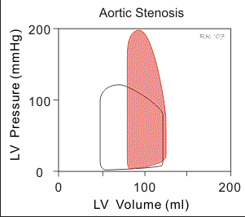
Aortic Stenosis Cardiac Loop

Slide 154
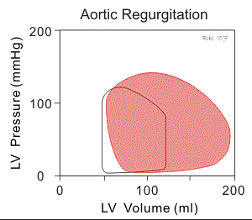
Aortic Insufficiency Cardiac Loop

Slide 155
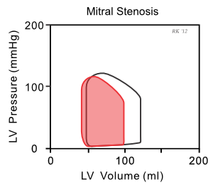
Mitral Stenosis Cardiac Loop

Slide 156
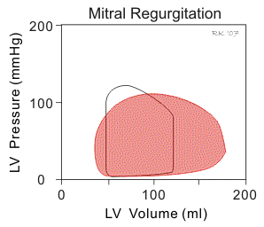
Mitral Insufficiency Cardiac Loop

Slide 157
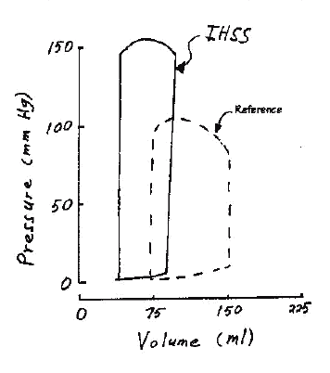
IHSS Cardiac Loop

Slide 158
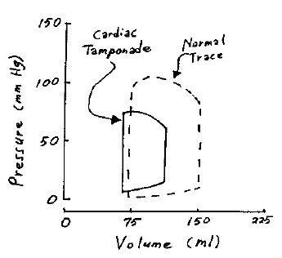
Tamponade Cardiac Loop

