Slide 1
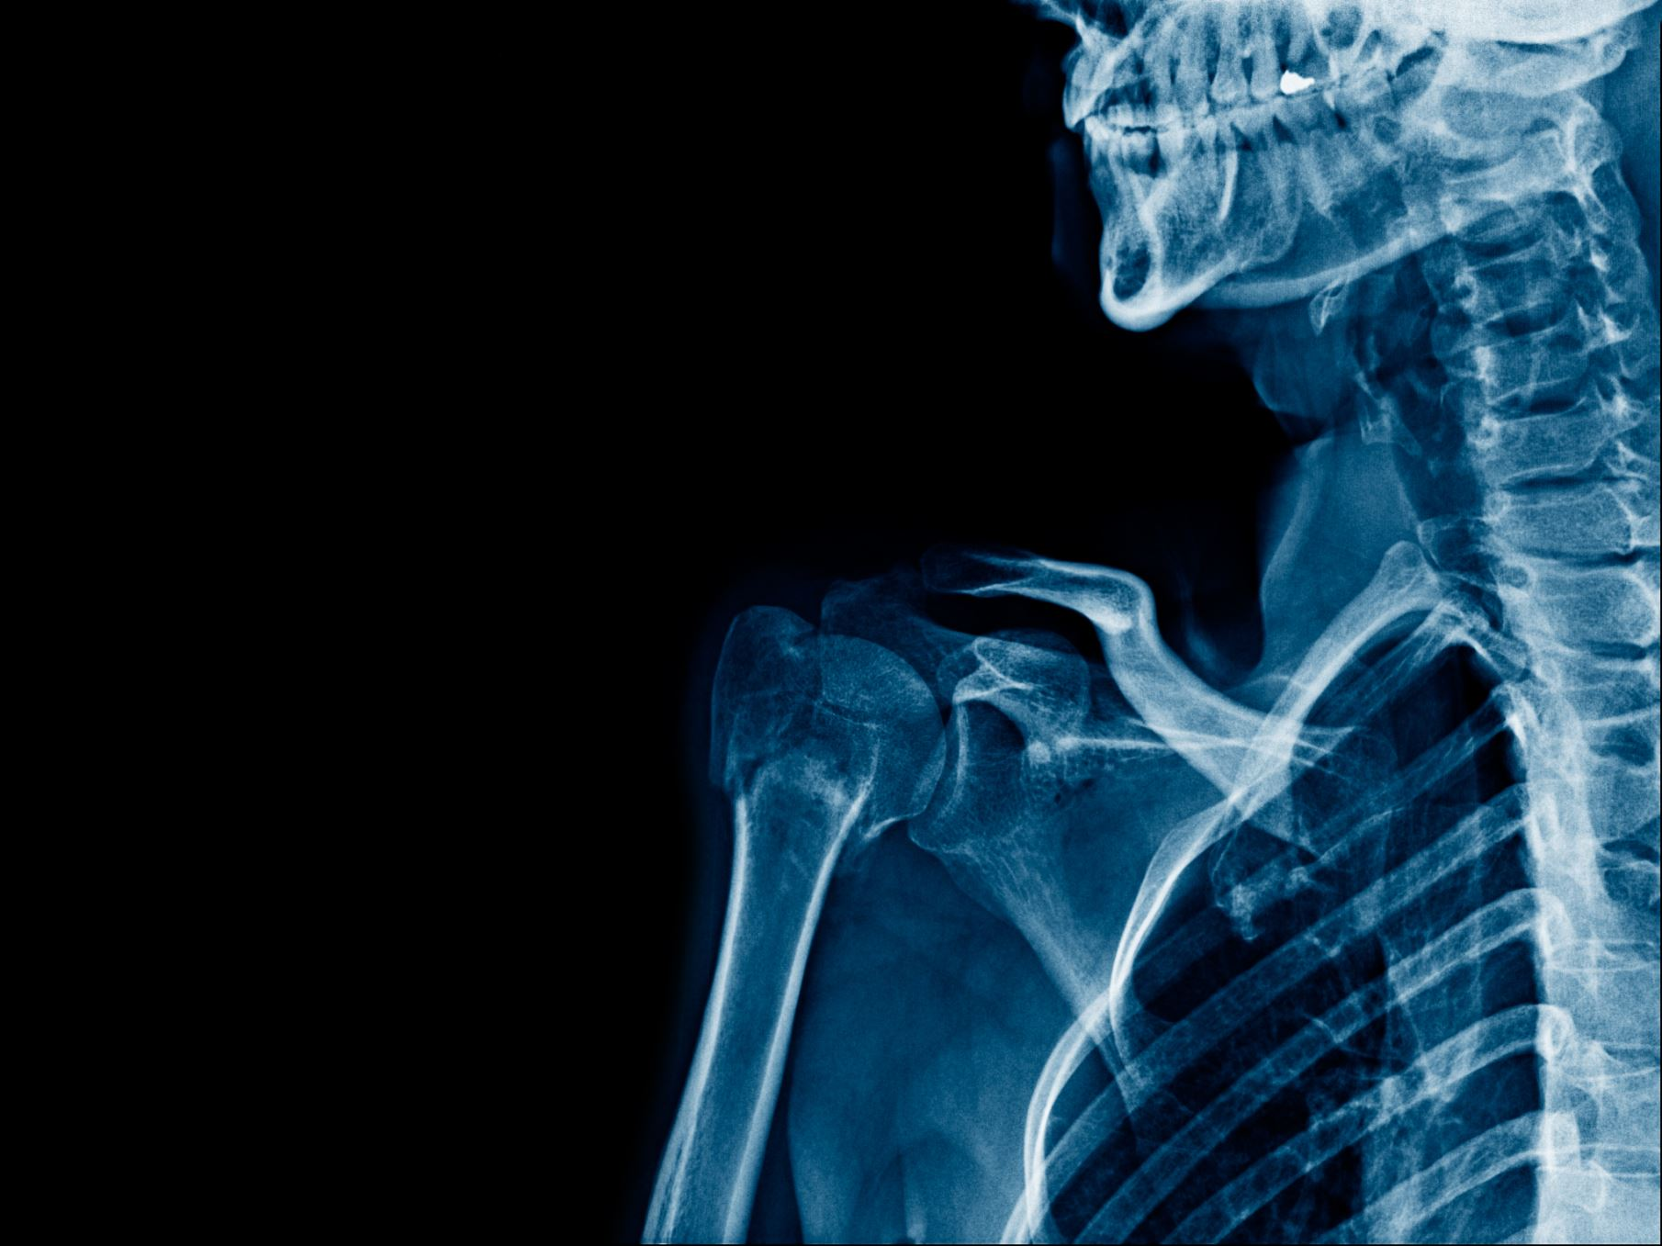
Acute Pain Management
Rachel Edgerton DNAP, APRN, CRNA
St. Mary’s School of Nurse Anesthesia
January 19th, 2022

Slide 2
Objectives
Discuss the Joint Commission Pain Management Standards
Understand the definition of pain
Differentiate between nociceptive and neuropathic pain
Distinguish between the different pain physiological process
Differentiate between the excitatory and inhibitory neurotransmitters involved in pain
Describe the different medications that can inhibit pain transmission
Review the physiological responses associated with pain
Explain the components of a preoperative pain assessment
Compare and contrast the different pain medications utilized in acute pain management
Discuss opioid dependence, addiction and tolerance
Differentiate between the different acute pain adjuncts
Describe the different regional pain management techniques utilized for acute pain management
Evaluate the different options for opioid free acute pain management for patients

Slide 4
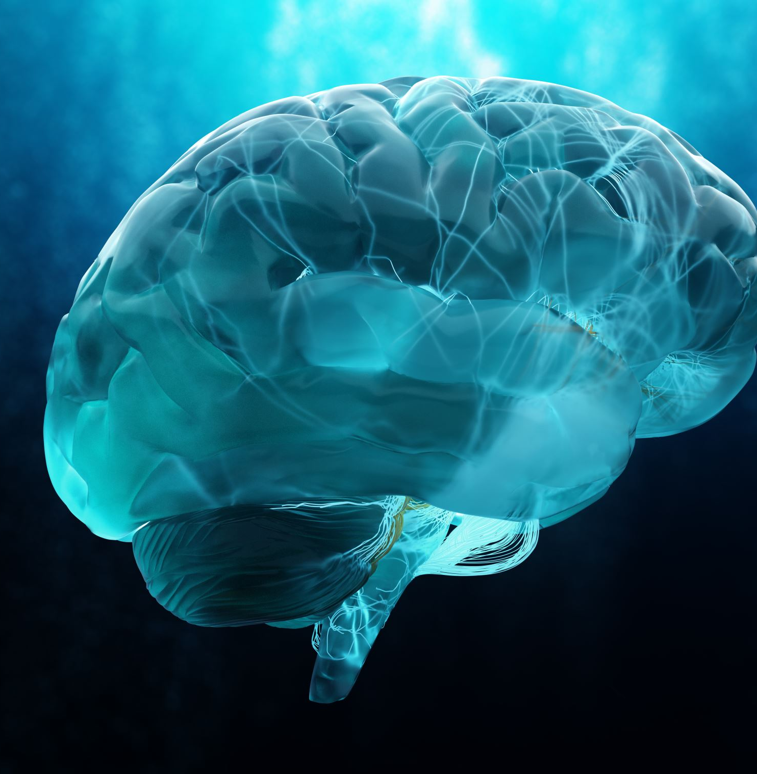
Definition of Pain
An unpleasant sensory and emotional experience associated with actual or potential tissue damage or described in terms of such damage
Pain is a physiological, emotional and behavioral experience.

Slide 6
Joint Commission Pain Management Standards
Recognize
Recognize the right of patients to appropriate assessment and management of pain
Screen
Screen patients for pain in their initial assessment, including the nature and intensity of the pain
Record
Record the results of the assessment in a way that facilitates regular reassessments and follow-up
Establish
Establish policies and procedures that support the appropriate prescriptions or ordering of effective pain medications
Educate
Educate patients and their families about effective pain management
Address
Address patient needs for symptom management in the discharge planning process
Ensure
Ensure staff education regarding pain assessment and management

Slide 8
Common pain terminology
Algesia: Increased sensitivity to pain
Algogenic: Pain producing
Allodynia: A normally nonharmful stimuli is perceived as painful
Analgesia: Absence of pain in presence of normally painful stimuli
Dysesthesia: An unpleasant painful abnormal sensation, whether evoked or spontaneous
Hyperalgesia: A heightened response to a normally painful stimulus
Neuralgia: Pain in distribution of a peripheral nerve
Neuropathy: Abnormal disturbance in the function of nerves
Paresthesia: Abnormal sensation whether spontaneous or evoked

Slide 9
Pain Classifications
Based on longevity (acute vs chronic) and/or the underlying pathophysiology
Nociceptive
Non–nociceptive: neuropathic
Notes:
Visceral distension of organ or obstruction can cause N&V, and diarrhea – autonomic reflexes

Slide 10
Nociceptive pain
Nociceptive pain is associated with the stimulation of specific nociceptors and can be either somatic or visceral
Nociceptors are free nerve endings that sense pain

Slide 11
Nociceptive Pain
Somatic pain refers to pain that has an identifiable location as a result of tissue damage causing the release of chemicals from injured cells that mediate pain
Localized, sharp in nature, and hurts at the point or area of stimulus
Visceral pain is diffuse, can be referred to another area and described as dull cramping squeezing or vague
Associated with the distention of an organ capsule
Often accompanied with autonomic reflexes such as nausea, vomiting and diarrhea

Slide 12
Non-nociceptive pain: Classified as being neuropathic or idiopathic (Chronic Pain)
Neuropathic
Caused by damage to peripheral or central neural structures
Results in abnormal processing of painful stimuli and CNS excitation
Often described as burning, tingling or shock like
Idiopathic
Psychogenic pain is also associated with chronic pain states and is used to describe pain that has no apparent cause
Psychological symptoms present

Slide 14
Somatic Nociceptive Pain
Pain physiology 1. Transduction
2. Transmission
3. Perception
4. Modulation

Slide 15
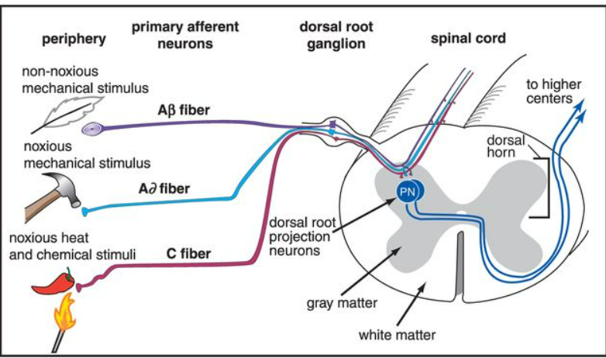
Transduction
The transformation of noxious stimuli into an action potential
Noxious stimulus is detected by pain receptors (Nociceptors)
Conducted to the dorsal horn of the spinal cord
Categorized according to morphology (diameter, myelination, and conduction velocity)

Slide 16
Nociceptors
A-delta and C-fibers carry the action potentials from the stimulus to the spinal cord
A-delta fibers conduct FAST pain (LARGE fibers, myelinated)
6-30m/s
Initial alert of tissue damage
Sharp or piercing pain
Mechanical/thermal pain (response is pulling limb away)
Crushing of limb or body part
Hot or cold detected in a body part
C-fibers conduct DULL pain (small fibers, unmyelinated)
0.5-2 m/s
Mechanical/thermal and chemical
Throbbing, aching, burning

Slide 17
Transmission
Process by which an action potential is conducted the periphery to the CNS
Multiple pathways carry the noxious stimulus to the brain
A-δ and C fiber afferents are found in the dorsal root ganglion. They proceed to the dorsal cord, divide and ascend or descend 1-3 segments in the tract of Lissauer.

Slide 18
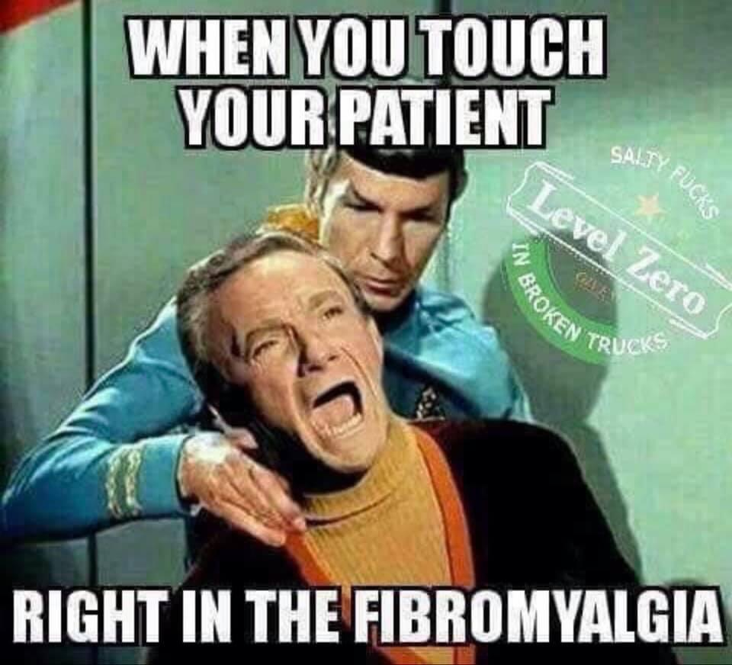

Slide 19
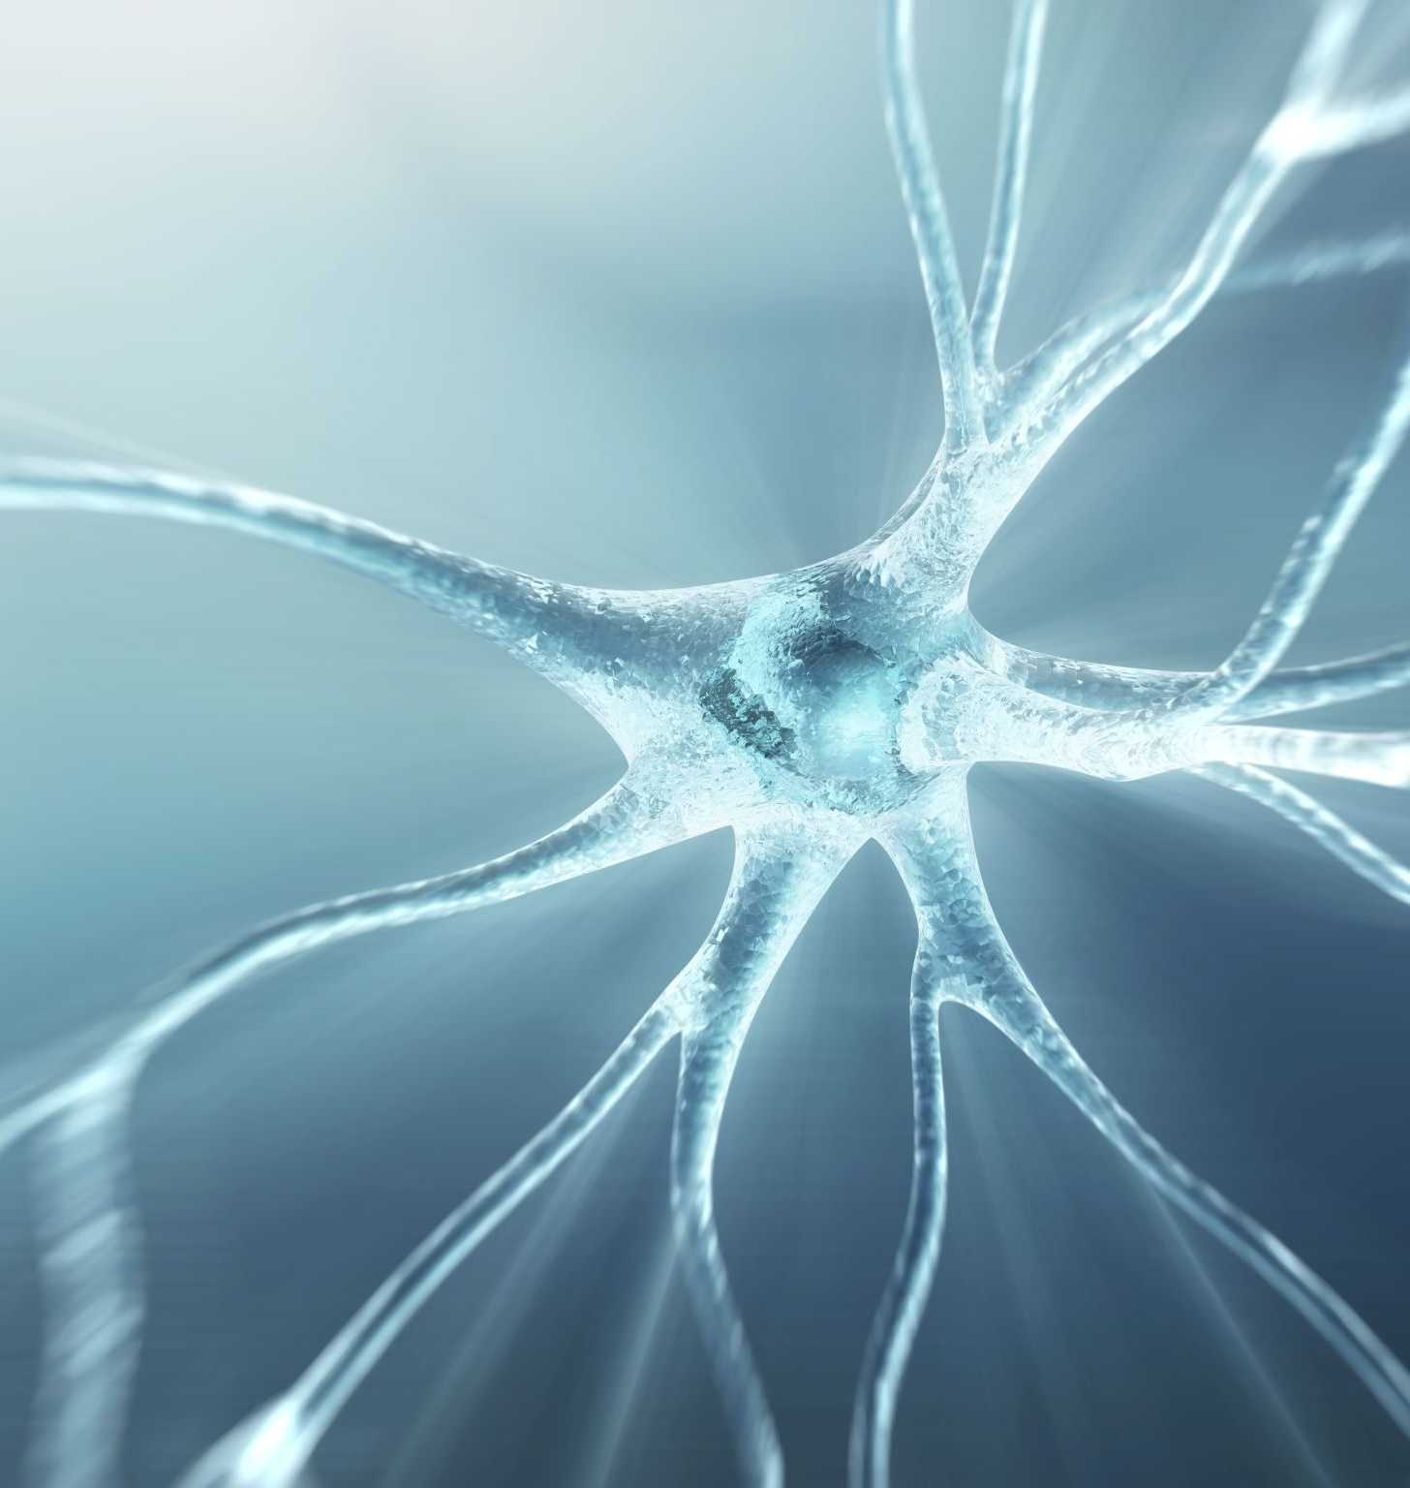
A Delta fibers
Pathway for fast-sharp pain- after leaving tract of Lissauer, the axons of the A-δ fibers enter the dorsal horn and terminate in Rexed’s lamina I, V. Second order neurons leaving lamina I or lamina V cross to the contralateral lateral spinothalamic tract and ascent to the brain

Slide 20
C Fibers
Pathway for slow-chronic pain- The C fibers terminate primarily in lamina II and also lamina III. Interneurons transmit C fiber impulses to lamina V from lamina II and III. Neurons leaving lamina V cross immediately to the contralateral lateral spinothalamic tract and ascend to the brain

Slide 21
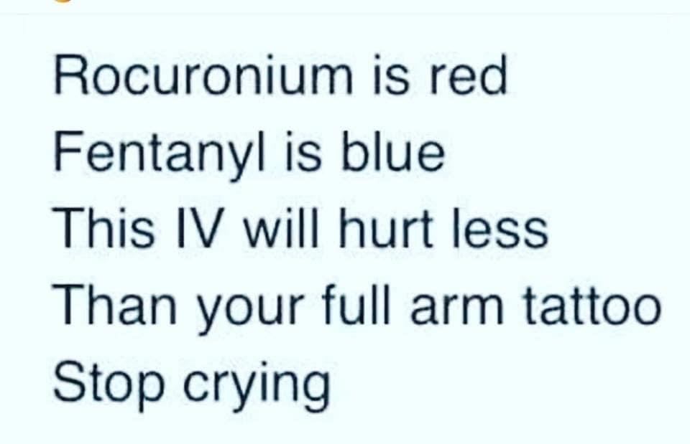

Slide 22
Second Order Neurons
Second order neurons terminate primarily in Rexed’s lamina I, II, and V.
Two types of second order neurons
Nociceptive neurons-input from primary afferent Aδ and C fibers
Wide dynamic range (WDR) neurons-input from both nociceptive (Aδ and C fibers and non-nociceptive A-β primary afferents-activated by a variety of stimulants

Slide 23
Second order Neurons Perception
Second order neurons cross the midline of the spinal cord through the anterior commissure and ascend in the anterolateral pathway of the spinothalamic tract to the thalamus
In the lateral thalamus and the intralaminar nuclei, second order neurons synapse with third order neurons which then send projections to the cerebral cortex
Perception of pain occurs once the signal is recognized by various areas of the brain: amygdala, somatosensory areas of the cortex, the hypothalamus and the anterior cingulate cortex

Slide 24
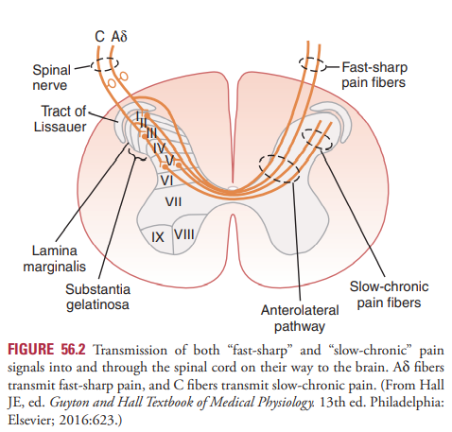
Notes:
Transmission- process by which an action potential is conducted the the periphery to the CNS
Multiple pathways carry the noxious stimulus to the brain
A-δand C fiber afferents are found in the dorsal root ganglion. They proceed to the dorsal cord, divide and ascend or descend 1-3 segments in the tract of Lissauer.
Pathway for fast-sharp pain- after leaving tract of Lissauer, the axons of the A-δfibers enter the dorsal horn and terminate in Rexed’s lamina I, V. Second order neurons leaving lamina I or lamina V cross to the contralateral lateral spinothalamic tract and ascent to the brain
Pathway for slow-chronic pain- The C fibers terminate primarily in lamina II and also lamina III. Interneurons transmit C fiber impulses to lamina V from lamina II and III. Neurons leaving lamina V cross immediately to the contralateral lateral spinothalamic tract and ascend to the brain
Second order neurons terminate primarily in Rexed’s lamina I, II, and V.
Two types of second order neurons
Nociceptive neurons-input from primary afferent Aδ and C fibers
Wide dynamic range (WDR) neurons-input from both nociceptive (Aδ and C fibers and non-nociceptive A-β primary afferents-activated by a variety of stimulants

Slide 27
Transmission
The process by which an action potential is conducted from the periphery to the CNS

Slide 28
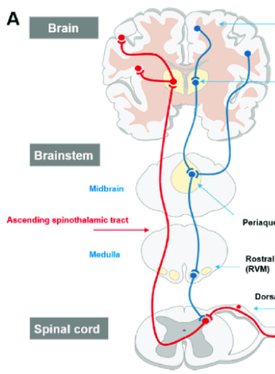
Notes:
(A) Simplified depiction of ascending and descending pain signaling pathways. Ascending pain pathway = red; modulatory descending tracts = blue. Afferent nociceptive input enters the spinal cord via the DRG. Secondary order projection neurons ascend in the contralateral spinothalamic and spinorecticular tracts that relay the signal to cortical centers. Descending pathways projecting from the periaqueductal gray (PAG) in the midbrain and the rostral ventromedial medulla (RVM) to the dorsal horn and modulate pain transmission. (B) The Rexed laminae of the spinal cord gray matter.

Slide 30
Spinothalamic/ Anterolateral system
Carries pain signals from trunk and lower extremities

Slide 33
Anatomy and Physiology

Slide 34
Chemical mediators/ Neurotransmitters
SUBSTANCE P- peptide found and released from the peripheral afferent nociceptor C fibers
Involved with slow chronic pain-acts via the G-protein linked nurokinin-1 receptor
Vasodilation
Extravasation of plasma proteins
Degranulation of mast cells
Sensitization of the stimulated sensory nerve
Glutamate- major excitatory neurotransmitter released in the CNS and A-delta and C primary afferent nerve fibers –fast sharp pain
Notes:
G protein – protein that acts as molecular switch inside cells. Transmitting signals from stimuli outside a cell to its interior

Slide 35
Chemical mediators/ Neurotransmitters
Bradykinin- peptide released during the inflammation process
Directly stimulates peripheral nociceptors by specific bradykinin receptors (B1/B2)
Causing algesia (increased sensitivity to pain)
Histamine- an amine released from mast cell granules, basophils, and platelets via substance P
Vasodilation and edema

Slide 36
Chemical mediators/ Neurotransmitters
Serotonin (5-HT) –is an amine stored and released from platelets after tissue injury.
Reacts with multiple receptors and exhibits algesic effects on peripheral nociceptors.
Prostaglandins (PG’s)- together with thromboxanes and leukotrienes, are a metabolite of arachidonic acid. Are synthesized from cyclooxygenase-1 and cyclooxygenase-2.
Associated with chronic pain
PG’s sensitize peripheral nociceptors, causing hyperalgesia

Slide 37
Chemical mediators/ Neurotransmitters
Cytokines – are released in response to tissue injury by immune and nonimmune cells via the inflammatory response.
Cytokines like interleukin-Iβ interleukin-6 and tumor necrosis factor-α (TNF) can lead to the increased production of PGs
Causing excitation and sensitization of nociceptive fibers
Calcitonin gene related peptide (CGRP)
Peptide found and released from peripheral C fibers.
Producing local vasodilation, plasma extravasation, and sensitization of the sensory nerve

Slide 38
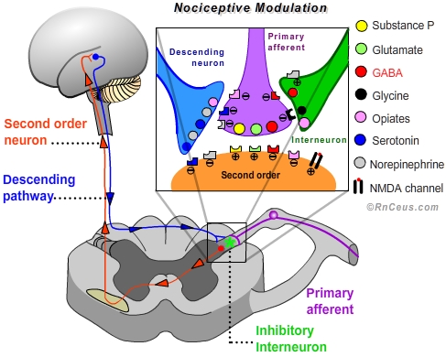
Pain-transduction Major Neurotransmitters
Major neurotransmitter released from A-δ fibers is glutamate which binds to AMPA and NMDA receptors on the postsynaptic membrane
Major neurotransmitter released from C fibers is substance P which binds to NK-1 neurokinin-1 receptors on the postsynaptic membrane
https://www.rnceus.com/ages/nociceptive.htm

Slide 39
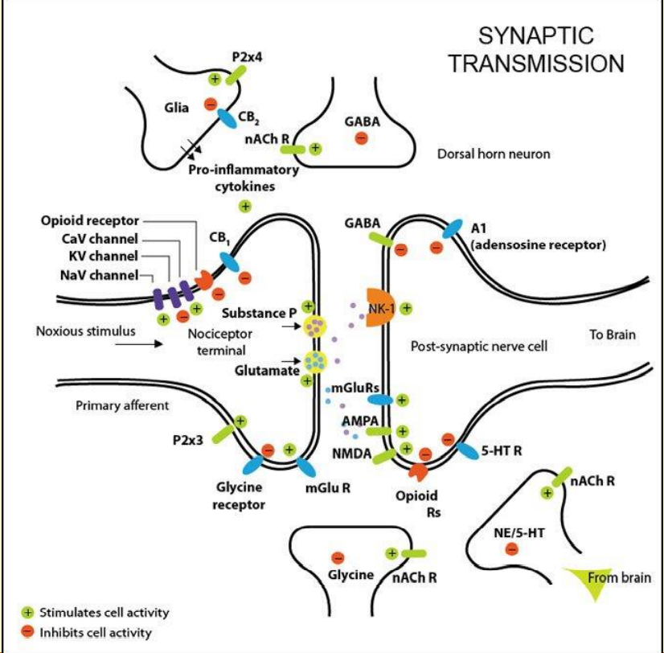

Slide 41
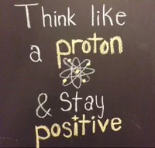

Slide 42
Somatic Nociceptive Pain Modulation
Descending dorsolateral efferent pathway is activated via a noxious stimulus
Descending axons from the cerebral cortex hypothalamus, thalamus, periaqueductal gray area, nucleus raphe magnus, and locus coeruleus, via the dorsolateral funiculus synapse with and suppress pain transmission in the brainstem and the spinal cord dorsal horn

Slide 43
Somatic Nociceptive Pain Modulation
Inhibitory endogenous opioids (enkephalin/endorphins/dynorphin)-
Action potentials arrive at the substantia gelatinosa via the dorsolateral funiculus and activate enkephalin-releasing neurons
Enkephalin then binds to the opiate receptors on presynaptic first-order or postsynaptic second-order afferent fibers, which decrease substance P release, suppressing ascending pain transmission
Other inhibitory neurotransmitters released via the descending pathway include glycine, norepinephrine, serotonin & GABA

Slide 44
https://www.bing.com/images/search?view=detailV2&ccid=EztWOFlN&id=8B149206FD4122F591EF1F9D7D252FB88DF795D6&thid=OIP.EztWOFlN13fDnTs_YtuTswHaEJ&mediaurl=https%3a%2f%2fs3.amazonaws.com%2fclassconnection%2f939%2fflashcards%2f5070939%2fpng%2fscreen_shot_2015-02-15_at_105431_am-14B8E97D5E4138D51B8.png&exph=639&expw=1141&q=enkephalins+function&simid=608033491257592442&ck=DDB3465692D04E5BEDAA0782A0CAC94B&selectedIndex=2&FORM=IRPRST&ajaxhist=0

Slide 47
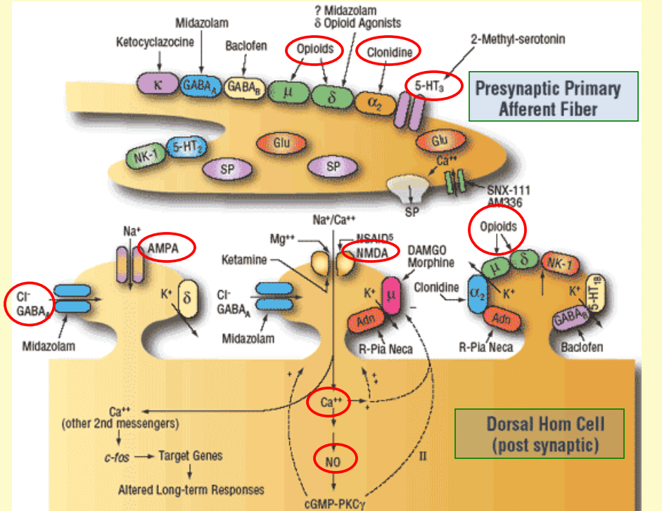

Slide 48
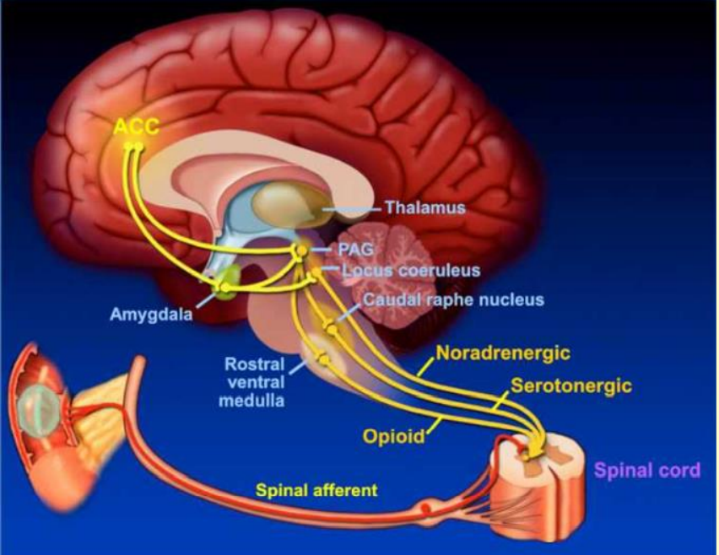

Slide 49
https://www.alamy.com/stock-photo-a-cross-section-of-the-lower-cervical-segment-of-the-spinal-cord-showing-24898355.html

Slide 50
https://www.physio-pedia.com/images/3/3b/Descending-inhibitory-pathway.jpg

Slide 51
https://www.bing.com/images/search?view=detailV2&ccid=fxe0GZ1y&id=94A41799A7B30781F545416584FA594FAC6C74C9&thid=OIP.fxe0GZ1yP0954b7bD0DYAwHaFj&mediaurl=http%3a%2f%2fimage.slidesharecdn.com%2fendorphinanaturalanalgesicandpleasanthormone-120203040501-phpapp01%2f95%2fpresentation-on-endorphin-hormone-15-638.jpg%3fcb%3d1422634626&exph=479&expw=638&q=Endorphins+Function&simid=608022143957992903&ck=B40E0A337A527A1B1F0135079899C968&selectedIndex=2&FORM=IRPRST&ajaxhist=0

Slide 55
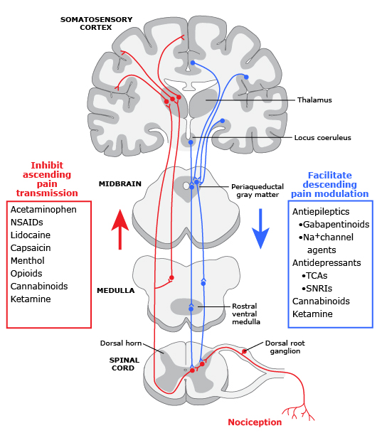
What can inhibit transmission and facilitate pain modulation?
https://www.uptodate.com/contents/image/print?imageKey=ANEST%2F127212

Slide 56
Anatomy and Physiology Somatic Nociceptive Pain-Modulation
Pain modulation is enhanced in the presence of central sensitization
Central sensitization refers to the neural plasticity that occurs in the CNS
Repetitive stimulation of tissue or neural injury causes activation of nerves and changes in neurotransmitter levels and signaling in the CNS
Repetitive firing of dorsal horn nociceptors causes activation of lower non-nociceptive threshold mechanoreceptors to trigger a pain response
Central sensitization is associated with chronic pain
Peripheral sensitization
This happens in the periphery as well resulting in over exaggeration of pain responses

Slide 58
Acute Pain – Physiological Responses
Caused by noxious stimulation due to trauma (chemical, thermal or mechanical) surgery, or acute illness
Social, cultural and personality factors may interfere with healing
Poorly controlled acute pain may lead to chronic pain states- optimal pain management is crucial in expediting the healing process and to prevent chronic pain states
Activation of the sympathetic nervous system
Increased release catecholamines from the SNS and adrenal glands + increased cortisol release
increased HR
increased vascular resistance (peripheral , systemic and coronary)
increased myocardial contractility
Increased BP
Increased myocardial oxygen demand and myocardial oxygen consumption

Slide 59
Acute Pain
Effects on respiratory system
Most pronounced in patients with upper abdominal area and thorax
Inadequate pain management causes decrease in tidal volume
Decrease in vital capacity (VC) inspiratory capacity (IC) and functional residual capacity (FRC)
Inability to clear secretions
Respiratory muscles may have limited movement
Inability to cough and deep breathe leads to atelectasis and pneumonia

Slide 60
Acute Pain-assessment

Slide 61
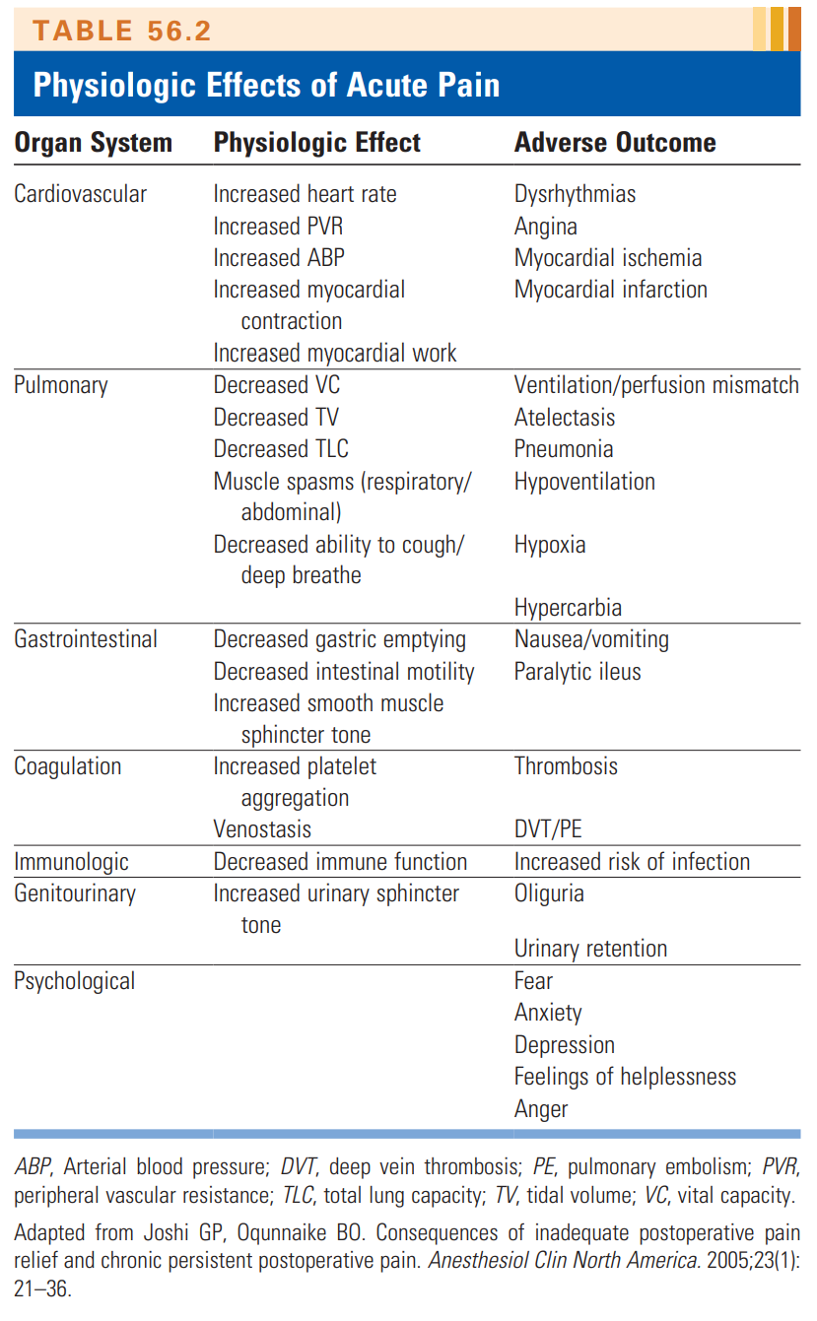

Slide 62
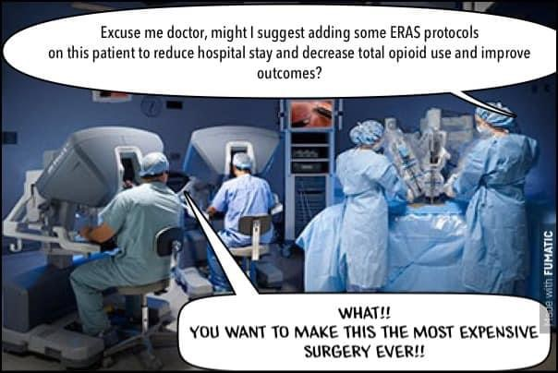

Slide 63
Preemptive Analgesia – Can we help decrease pain?
Preemptive analgesia operates on the premise that peripheral and central sensitization results from noxious stimulation, thereby causing an increase in postoperative pain
Preemptive analgesia remains controversial
Either way, multimodal therapies are done in order to maintain adequate pain control to acute and chronic pain management
Multi-modal management consists of using a combination of analgesics that work on a variety of receptors with different mechanism of action both peripherally and centrally resulting in additive or synergistic effects to mange pain

Slide 64
Acute Pain Analgesics-NSAIDS
Used in combination with opioids, produces a synergistic effect and overall decreased dose of opioids and decreased opioid side effects
All NSAIDS have anti-inflammatory, antipyretic and analgesic properties
Inhibits cyclooxygenase and thereby prevents conversion of arachidonic acid to prostaglandins
Prostaglandins (PGE1 and PGE2 are responsible for sensitizing and amplifying peripheral nociceptors to the inflammatory mediators (substance P, bradykinin, and serotonin) which are released when tissue is traumatized
Prostaglandins do not directly produce pain but contribute to hyperalgesia
Centrally, prostaglandins enhance pain transmission by enhancing the release of substance P and glutamate in first-order neurons, increasing nociceptive transmission at second- order neurons, and inhibit the release of descending inhibitory neurotransmitters

Slide 65
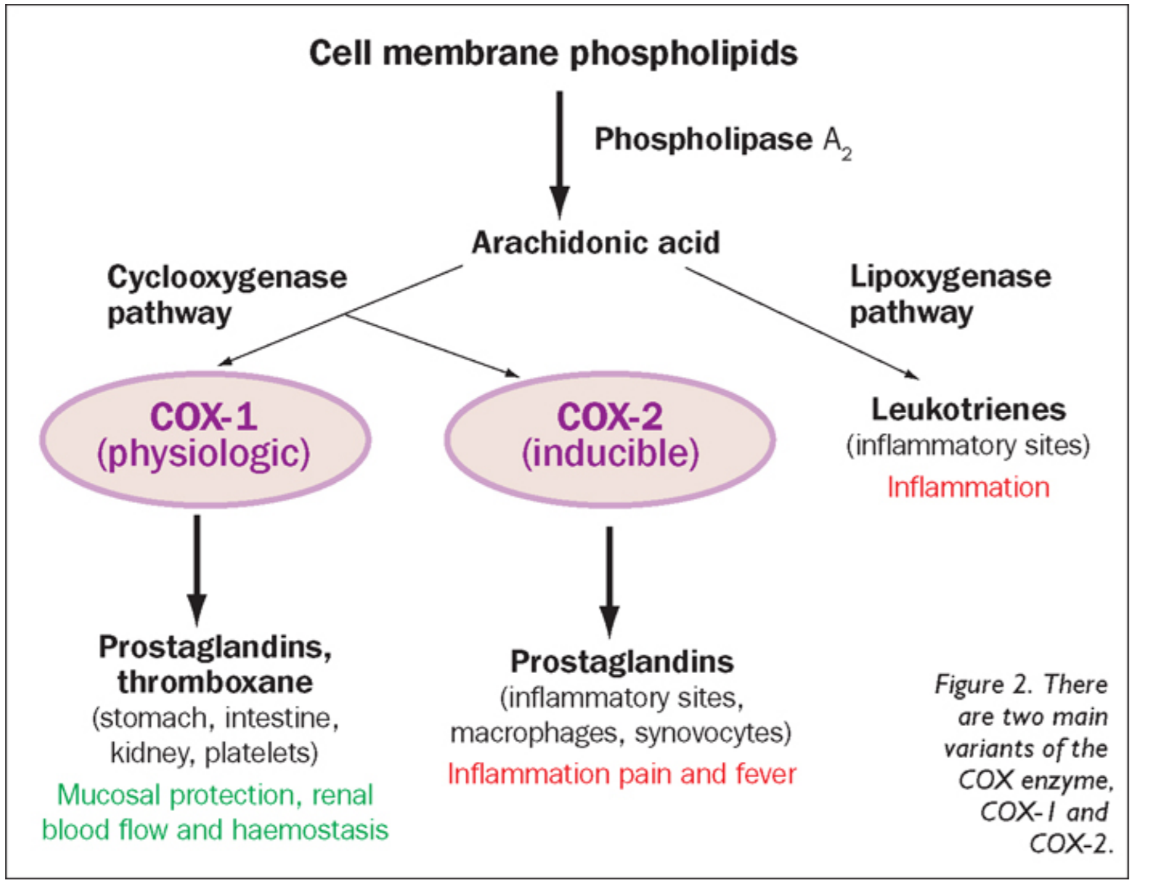

Slide 66
Acute Pain Analgesics-NSAIDS
Ketorolac
A nonselective COX inhibiter
Short term acute postoperative pain alone or in combination with other analgesic modalities
Oral, IM, IV or intranasal
30 mg Ketorolac equal to 12 mg Morphine IM
Should not be used more than 5 days because is blocks COX-1
Contraindications include renal impairment, GI bleeding, history of asthma, hypersensitivity to NSAIDS and surgeries that have a high risk of bleeding
Controversy regarding bone healing and ketorolac administration
Interrupts normal prostaglandin effects on osteoblasts and osteoclast functioning that promotes healing

Slide 67
Acute Pain Analgesics-NSAIDS
Celebrex
Analgesic, antipyretic and anti-inflammatory effects
Shown to decrease postoperative pain when used with opioids compared to opioids alone
COX-2 only
Decreases risk of GI, bleeding and ulceration, CV events, and renal dysfunction
Thought to be lower with COX-2 NSAID
Dosing 200 to 400 mg 1 hour preoperatively
Contraindicated in patients undergoing CAB surgery
Animal studies have shown a link between bone nonunion after orthopedic surgeries and use of NSAIDS but has not been in humans. So controversial
Observational studies have suggested that NSAID use may increased risk of anastomotic leakage after colorectal surgery. No recommendation to exclude it’s use in these patients
Always have a discussion with all providers to determine if using

Slide 68
Acute Pain Analgesics-NSAIDS
Acetaminophen
Reduces prostaglandin synthesis by an uncertain mechanism
Minimal anti-inflammatory effects with mainly analgesic and antipyretic properties
Suitable for acute mild to moderate postoperative pain and fever ideal drug fro multimodal analgesia for surgical pain
Metabolized primarily by the liver and is contraindicated in patients with liver failure
Parental acetaminophen (orfirmev) available for the treatment of acute mild to moderate pain and is effective in treating moderate to sever pain with adjunctive opioid analgesics
Dosing for adults weighing over 50 kg = 1000mg every 6 hours to a maximum of 4000mg/day
Onset is 10 minutes with a duration of action of 4-6 hours

Slide 70
Opioids
Drug class of choice for treatment of moderate to severe pain in the early postoperative period
Binds to and activates G-protein coupled opioid receptors peripherally and in the CNS
Centrally, opioid receptors are predominantly found:
In the dorsal horn of the spinal cord, specifically Rexed’s lamina II of the substantia gelatinosa
Supraspinal in the periaqueductal grey area, medial thalamus, amygdala, and limbic cortex
Peripherally, they are found on afferent sensory nerve fibers as well as in the gastrointestinal tract, lungs, and joints
Mu delta and kappa are the principal opioid receptors
When these receptors are bound by opioids presynaptically, a biochemical change occurs that decreases adenylate cyclase activity, inhibiting calcium channels, resulting in a decreased release of excitatory neurotransmitters such as substance P
Postsynaptic, there is an increase in outward potassium conductance with a hyperpolarization and an inhibition of excitatory neurotransmission

Slide 71
Opioids
Fentanyl
Analgesic property IV is 80-100 times more potent than morphine
Onset of action 2-5 min
Ideal opioid for treating acute pain
Duration 30 minutes to 1 hour
Can be administered intrathecally, epidurally, and intravenously via postoperative PCA, transdermally for chronic pain
Highly lipophilic - administration intrathecally is very short-2 hours
Epidural single shot also lasts only about 2 hours

Slide 72
Opioids
Morphine
Prototypical opioid by which all other are compared
Most widely used for acute and chronic pain management
Metabolism via hepatic glucuronidation resulting in the metabolites morphine-3-glucuronide and morphine-6-glucuronide(M6G)with M6G being the active metabolite
Both metabolites are excreted via the kidney
Can be administered IV, PCA, intrathecally, epidurally, or orally
Can be give single dose or continuous infusion
Onset 20 min IV
Duration 4-5 hours
Hydrophilic making penetration of the blood-brain barrier and spinal cord more difficult
Results in a delayed onset of action 20-30 minutes
Results in a delayed duration of action 8-24 hours

Slide 73
Opioids
Hydromorphone
Derivative of morphine and is approximately 7-8 times more potent
Metabolism is via hepatic conjugation; however, unlike morphine it lacks the active metabolite M6G
Ideal opioid for moderate or severe acute perioperative pain and is used for chronic pain management
Safe in renal patients
Oral, intrathecal epidural, intrarticulate, and IV PCA
IV administration onset is 15 minutes
Duration of action 4-5 hours
Intrathecal or epidural onset of action is more rapid than morphine (15 min) with duration of 12-15 hours
Studies conclude that side effects are like morphine at high doses and there were no differences between efficacy of pain control or in opioid related sided effects while receiving IV PCA

Slide 74
Opioids Addiction
US consumes 80% of all opioids in the world with only 5% of the population
Declared a public health emergency 2017
42,000 deaths in 2016 from overdose
There has been an increase of 70% since 2016
6% on opioids at one year with 5 day use
13.5% on opioids at one year after 8 day use
30% on opioids at one year after 31 day use
50% of surgical patients are discharged with prescription opioids

Slide 75
Opioid Dependence
Physical dependence: can be physiologic or psychologic
Dependence is a pharmacologic property of opioid drugs
“Withdrawal syndrome” occurs after abrupt discontinuation of an opioid
Opioid withdrawal symptoms include autonomic system responses: irritability, restlessness, tremors, chills, muscle cramps, sweating, mydraisis, abdominal pain, diarrhea and tachycardia
NEED TO TAPER discontinuation of opioids
Daily scheduled opioids should be continued perioperatively
Psychological dependence “…need for a specific psychoactive substance, either for the positive effects or to avoid negative effects associated with its abstinence

Slide 76
Opioid Addiction/Pseudoaddiction
Addiction: primary, chronic disease of brain reward, motivation, memory, and related circuitry
Dysfunction can lead to biological, psychological, social, and spiritual manifestations
Fears of addiction include cravings, obsessive thinking about a drug, impaired behavioral control, compulsive drug taking, and inability to recognize one’s problems
Incidence of addiction is rare in those patients taking chronic opioids
Pseudoaddiction
Often confused with psychological dependence
In that they are drug seeking – which is not true
Origin of this behavior is inadequate analgesia
Once analgesia is established, they do not exhibit drug seeking behavior

Slide 77
Opioid Tolerance
Change in dose-response relationship
Repeated exposure to a drug requires a higher dose to maintain analgesia effect
Maybe the result of mechanisms such as enzyme induction caused by continued opioid administration, or the down-regulation of opioid receptors
Other mechanisms
Drug-receptor interactions
Cellular alterations
Long-term adaptations in gene expression
With suspected tolerance
Opioid rotation is suggested
Can improve analgesia and decreased side effects

Slide 78
Opioid-induced hyperalgesia
Occurs with chronic opioid therapy
Worsening pain and higher doses of opioids needed
Demonstrated in animal studies but limited in human studies
Manifestations
Pain in different locations than original pain area
Whole body hyperesthesia
Allodynia
Agitation
Myoclonus
Seizures
Can be improved by reducing or discontinuing the opioids
Mechanism of action is not fully understood

Slide 79
Opioid-induced hyperalgesia
Proposed theories
Central activation of NMDA receptors via glutamate may play a role in OIH
Shifting from a pain modulation system from the descending inhibitory to a pronociceptive pathway
Neuroinflammation
Diagnosis is difficult
Resembles opioid tolerance
Treatment
Weaning patients from high-dose opioids and starting nonopioid analgesics
NMDA receptor antagonists
NSAIDS
COX-2 inhibitors

Slide 80
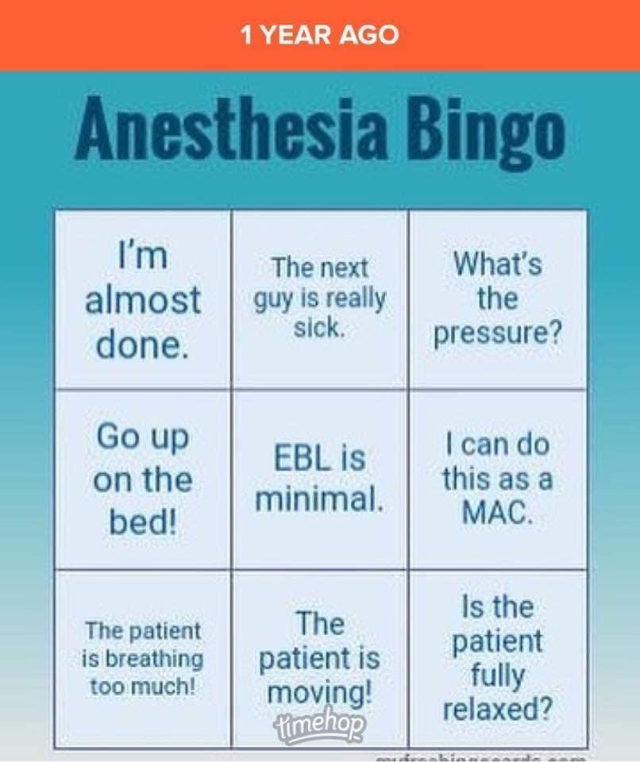

Slide 81
Acute Pain Adjuncts-NMDA
N-Methyl-D-Aspartate (NMDA) Antagonists-Ketamine
A non-competitive NMDA antagonist and a phencyclidine derivative
Used as an induction agent and as a part of a multimodal approach for perioperative pain control
Ketamine prevents the activation of the NMDA receptor, which along with the AMPA receptor is associated with central sensitization and chronic pain states
The NMDA receptor at rest is closed due to a magnesium plug
Activation of the receptor involves the simultaneous binding to the excitatory neurotransmitter glutamate, which causes an influx of calcium resulting in an increase in second messengers
Up-regulation of second messengers produces a hyper excitability of the NMDA receptors which cause neuronal plasticity and excitability
In chronic neuropathic pain states such as complex regional pain syndrome type I and phantom limb pain, it is will established the ketamine is beneficial in reducing hyperalgesia and allodynia (allodynia =normally nonpainful stimulus is painful)
Helpful in reducing acute perioperative pain and also exhibits anti-inflammatory effects
IM nasal, rectal, epidural and intrathecal
Bolus prior to incision and at closure of 0.15-2 mg/kg +/- infusion
Panel suggests 0.5 mg/kg bolus with infusion of 10 mcg/kg/min intraoperatively, +/- postoperative infusion
Rapidly acting-30-40 seconds duration of 80-180 minutes
Metabolized primarily by the liver and produces norketamine
Low risk of hallucinations
Good for chronic pain patients and PTSD

Slide 82
Acute Pain Adjuncts-NMDA
Dextromethorphan
D-isomere of the codiene analog levorphanol
Noncompetetive NMDA receptor antagonist
NMDA receptor antagonism where analgesia is mediated
Can give orally,IV or IM
Can reduce PCA requirements of Morphine

Slide 83
Acute Pain Adjuncts-Alpha₂ Adrenergic Agonists
Clonidine
Centrally acting selective partial α₂ agonist
Can be administered oral, IV, rectal, transdermal, intrathecal, epidural and intra-articulate
Half-life is 5-13 hours
Metabolism via the liver
Exerts its effects on both α₂ and α₁ receptors (220:1) side effects such as sedation hypotension and bradycardia can occur
Decreases postoperative morphine requirements when used with maintenance infusions intraop
Can combine with local anesthetics in peripheral nerve blocks and or intrathecal administration

Slide 84
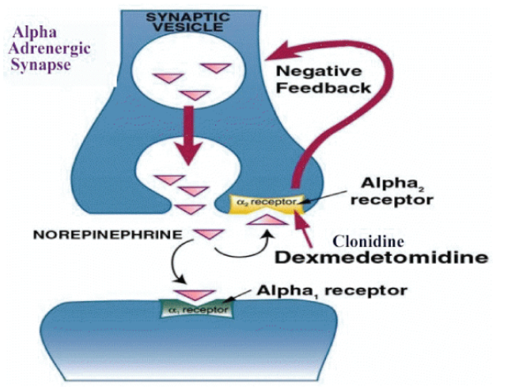
Acute Pain Adjuncts-Alpha₂ Adrenergic Agonists
Dexmedetomidine
Highly selective α2 adrenergic agonist
7-10 times more selective for the α2 receptor than clonidine (1620:1)
Exhibits sedative, anxiolytic, analgesic, sympatholytic and vagomimetic effects with little or no respiratory depression
Most commonly administered IV
Can be administered IM transdermal or intranasal
Rapid onst-5 min (need bolus!!!)
Short duration of action and elimination half-life of 3 hours
Metabolized via extensive hepatic glucuronide conjugation with the absence of active metabolites
May be prolonged clearance of drug in patient with hepatic disease
Contraindicated in patients with cardiac blocks, ie 1st degree etc
Often used for procedural sedation in non intubated patients, sedation for intubated and mechanically ventilated patients, and for a general anesthesia adjunct
Decreases postoperative analgesic requirements and decreases postoperative morphine consumption

Slide 85
Acute Pain Adjuncts-Alpha₂ Adrenergic Agonists
Clonidine and dexmedetomidine are α₂ adrenergic agonists that are used as analgesic adjuncts for multimodal anesthesia
Interact with G-coupled α₂ receptors, both centrally (dorsal horn of the spinal cord) and peripherally
Activation of the α₂ receptor results in inhibition of adenylate cyclase and decreased cAMP levels
Activates postsynaptic potassium channels while inhibiting presynaptic voltage-gated calcium channels thereby reducing neurotransmitter release
Activation of central α₂ adrenoreceptors in the locus coeruleus are responsible for supraspinal analgesia

Slide 86
Acute Pain Adjuncts-Local Anesthetics
Inhibit conduction of action potentials along a nerve fiber
Local anesthetics block sodium channels in both afferent and efferent neuronal membranes thereby inhibiting pain transmission
Often the sole anesthetic but usually give with adjunct medications
Nerve morphology affects the sensitivity of the nerve blockade achieved
Amides are metabolized primarily by the liver
Esters metabolized via plasma cholinesterase
Peripheral nerve blocks can be administered as a single injection or via a continuous catheter technique

Slide 87
Acute Pain Adjuncts-PCA
Self administration of predetermined doses of analgesics
Gives the patient ability to self-medicate to his/her pain needs allowing more effective pain control
Different variables in administration for different PCA models
1)Loading dose 2) a demand dose or bolus dose 3) a lockout interval 4) a basal continuous infusion rate 5) 1-hour and 4-hour maximal dose limits
Morphine, hydromorphone, and fentanyl are most common PCA medications but can also use local anesthetics, ketamine, and clonidine
Meperidine is not recommended because of the neurotoxic metabolite, normederidine

Slide 88
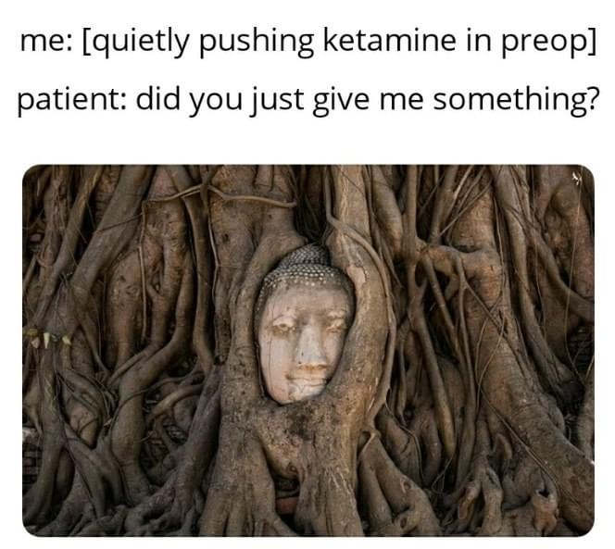

Slide 89
McLott Mix for opioid free anesthesia
The McLott Mix is a combination of 4 medications that is administered to decrease or prevent the incidence of peripheral and central sensitization. McLott Mix is composed of dexmedetomidine, ketamine, magnesium, and lidocaine.
Dexmedetomidine decreases the release of Substance P preventing central sensitization
Ketamine is an NMDA antagonist preventing central sensitization
Magnesium helps prevent central sensitization
Lidocaine is administered for its anti-inflammatory properites and decreases peripheral sensitization

Slide 90
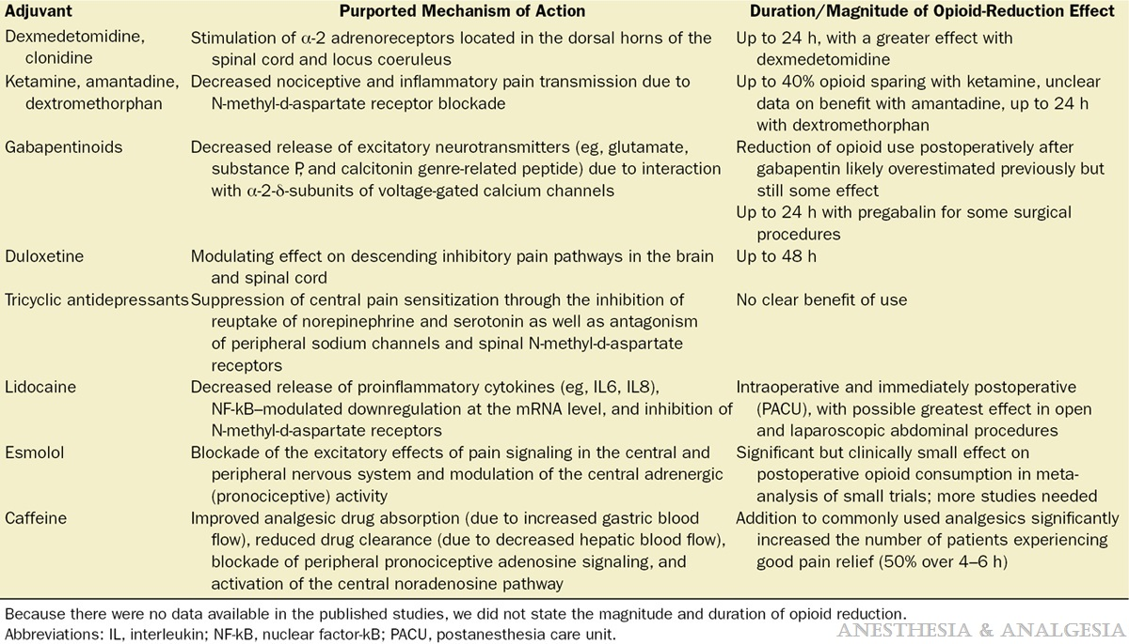
Kumar K, Kirksey MA, Duong S, Wu CL. A Review of Opioid-Sparing Modalities in Perioperative Pain Management: Methods to Decrease Opioid Use Postoperatively. Anesth Analg. 2017 Nov;125(5):1749-1760. doi: 10.1213/ANE.0000000000002497. PMID: 29049119.

Slide 91
Acute Pain Neuraxial Anesthesia
Epidural
Efficacy determined by technique
Catheter incision site congruency
Choice of analgesic drug
Rate of infusion
Duration
Type of pain
Combination of local and narcotic = synergy
Hydrophilic Narcotics in epidural have slow onset, long duration and mechanism of action that is primarily spinal
Lipophilic Narcotics have fast onset, short duration and mechanism of action that is primarily supraspinal
Can add ketamine, clonidine, dexamethasone, dexmedetomidine
Spinal
Hydrophilic opioids surround the spinal cord and bind to specific pre- and post-synaptic receptors within the dorsal horn
Intrathecal clonidine has promising adjunct qualities without the incidence of respiratory depression and pruitis as with morphine

Slide 92
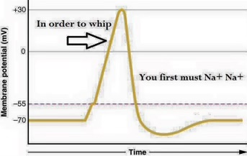

Slide 93
Benefits of Neuraxial/Regional Anesthesia
Avoidance of large doses of multiple IV medications
Possible avoidance of general anesthesia and its inherent potential complications throughout the perioperative period
Less hemodynamic compromise if no general anesthetic
Less PONV
Attenuated neuroendocrine stress response
Decreased thromboembolic complications
Less time for ambulation and/or discharge, dependent on block utilized
Less use or no use of opioid agents

Slide 94
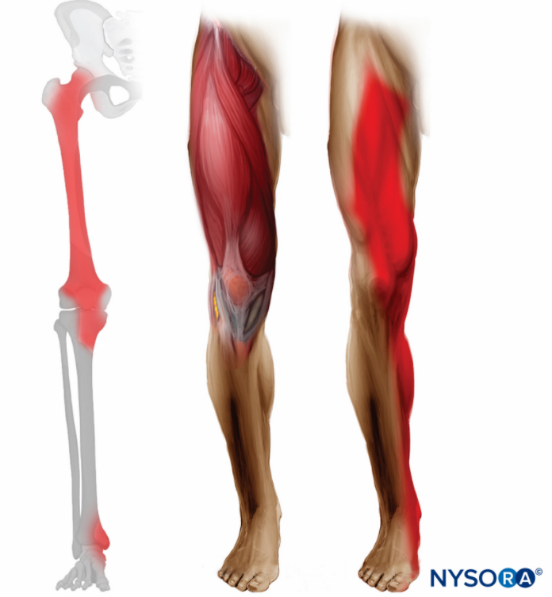
AcutePain Peripheral Nerve Block
Lumbar Plexus (not used a lot anymore)
Indicated for TKA ACL PCL repair
Pt lies lateral
Reliably blocks femoral lateral femoral, and obturator nerves
Used alone in outpatient setting for knee scopes in combination for more painful surgery
Emerging use of catheters
Femoral nerve block
Largest terminal branch of lumbar plexus
Femoral nerve is positioned 0.5 cm lateral to the femoral artery
Motor innervation to the quadriceps femoris, sartorius, and pectineus. Sensory innervation to the anterior thigh, knee and medial aspect of the lower extremity terminating as the saphenous nerve
Good for ACL …except when hamstring autograph is done because of the postoperative pain in the sciatic nerve not blocked.
Femoral Nerve Block

Slide 95
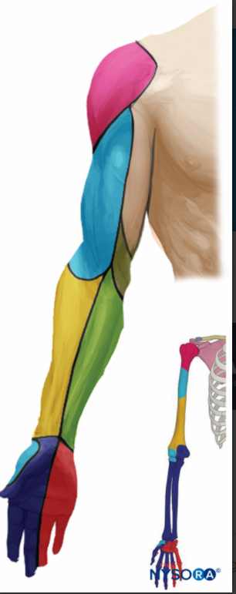
AcutePain Peripheral Nerve Block
Brachial Plexus-above the clavicle
Interscalene block
Ultrasound or electric stim
Single injection
Continuous catheter techniques 0.2 % Ropivacaine
Supraclavicular approach
Higher incidence of pneumothorax
Safer with ultrasound
Single shot
0.25% or 0.5 % bupivacaine with epi
Interscalene Block
Supraclavicular Block

Slide 96
AcutePain Peripheral Nerve Block
Brachial Plexus-below the clavicle
Infraclavicular block
Procedures below the mid humerus
Higher risk of pneumo
90% success with block with ultrasound
Axillary artery becomes an important landmark
Beginning to use continuous catheter

Slide 97
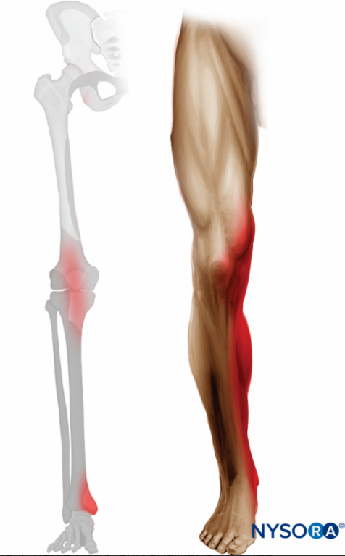
Acute Pain Peripheral Nerve Block
Saphenous nerve block/Adductor Canal block
Used in combination with lateral popliteal or sciatic block
Only branch of lumbar plexus below the knee
Largest sensory terminal branch of the femoral nerve
Provides sensory innervation to the medial anteromedial and posteromedial part of the knee, leg and medial malleolus and medial aspect of the large toe.

Slide 98
Different blocks being used now for pain management
Fascia Iliaca Plane Block – Hip surgeries
PENG Blocks – Hip Surgeries
Quadratus Lumborum – Abdominal Surgeries
PEC Blocks – Breast Surgery
Erector Spinae Blocks – Chest surgery
Transversus Abdominis Plane Blocks

Slide 100
Opioid Free Anesthesia
Avoiding mu-receptor agonists intraoperatively
Manage peripheral sensitization
Manage central sensitization
Prevention of Opioid induced hyperalgesia
Opioids not completely absent, still used as a rescue
Reduce negative effects of opioid
Controversial
I believe you still need some narcotics UNLESS you use all types of medications

Slide 102
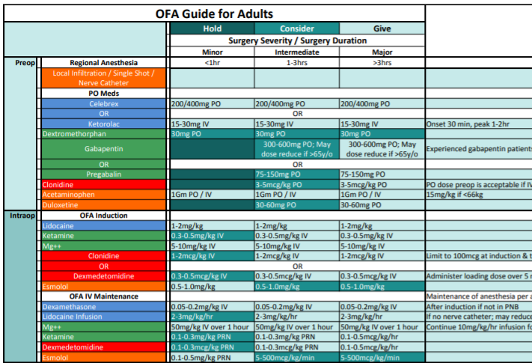

Slide 103
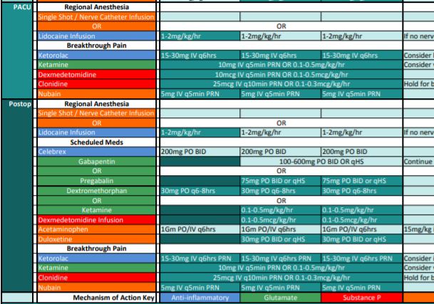

Slide 105
Questions?
Rachel Edgerton DNAP, APRN, CRNA
dredgerton@hotmail.com

Slide 106
Resources
Nagelhout JJ, Elisha S. (Ed.) Nurse Anesthesia. 6th ed. Philadelphia: Elsevier Health Sciences; 2018. Chapter 56/57
Barash, PG (2013). Clinical anesthesia. Philadelphia, Pennsylvania: Wolters Kluwer/Lippincott Williams &Wilkins, (2013)
Guyton AC, Hall JE. Textbook of Medical Physiology 10th ed.W.B. Saunders Company; 2000. Chapter 48
Openanesthesia.org
Uptodate.com

