Slide 1
Chronic Pain Management
Rachel Edgerton DNAP, APRN, CRNA
St. Mary’s School of Nurse Anesthesia
January 19th, 2022

Slide 2
Objectives
Define
Define chronic pain and its pathophysiology
Understand
Understand pain “WIND UP”
Describe
Describe the types of chronic pain
Describe
Describe the pharmacological treatments for chronic pain
Understand
Understand common chronic pain syndromes and their treatment

Slide 3
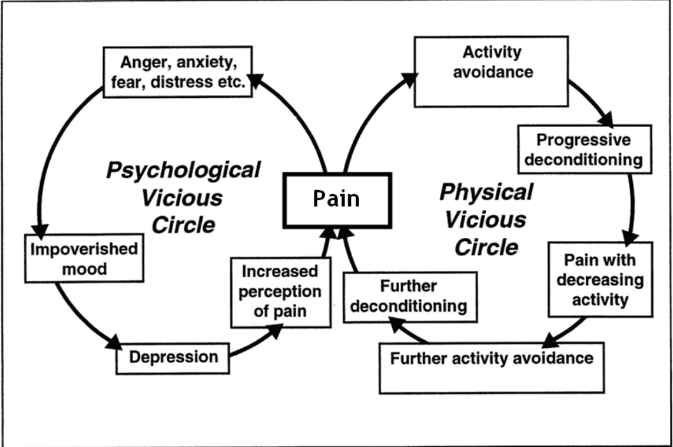
https://brainworksrehab.com/chronic-pain-cycle/

Slide 4
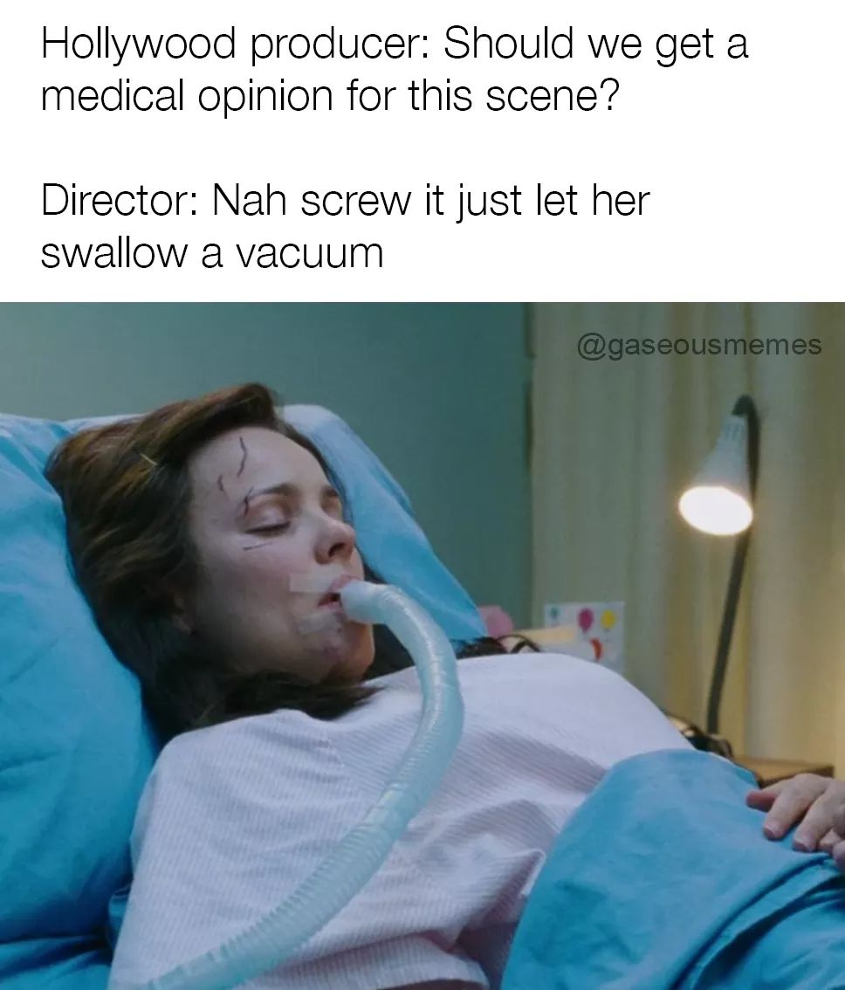

Slide 5
Chronic Pain
Uninterrupted persistent pain lasting 3 months or more
Includes negative sensory and emotional experience
Linked to divorce, poverty, homelessness, despair, and sometimes suicide
Determination of the source is not always clear
Classified as malignant(relating to cancer and its treatment) or nonmalignant
Nonmalignant
Aimed at reducing pain, improving activities of daily living and enhancing functioning
Interdisciplinary approach to chronic pain management with a pain specialist, psychologist, physical therapist, occupation therapist, and the patient to develop a treatment plan

Slide 6
Chronic Pain
Presence of pain for an extended period of time creates dysfunction in the peripheral, spinal and cerebral areas
Results in altered pain recognition and response
We can’t just remove the stimulus of pain generation
Address the source of pain being soft tissue or nerve damage
Determine the extent of impaired inhibitory mechanisms
Decrease the incidence of a painful stimulus and avoid it

Slide 8
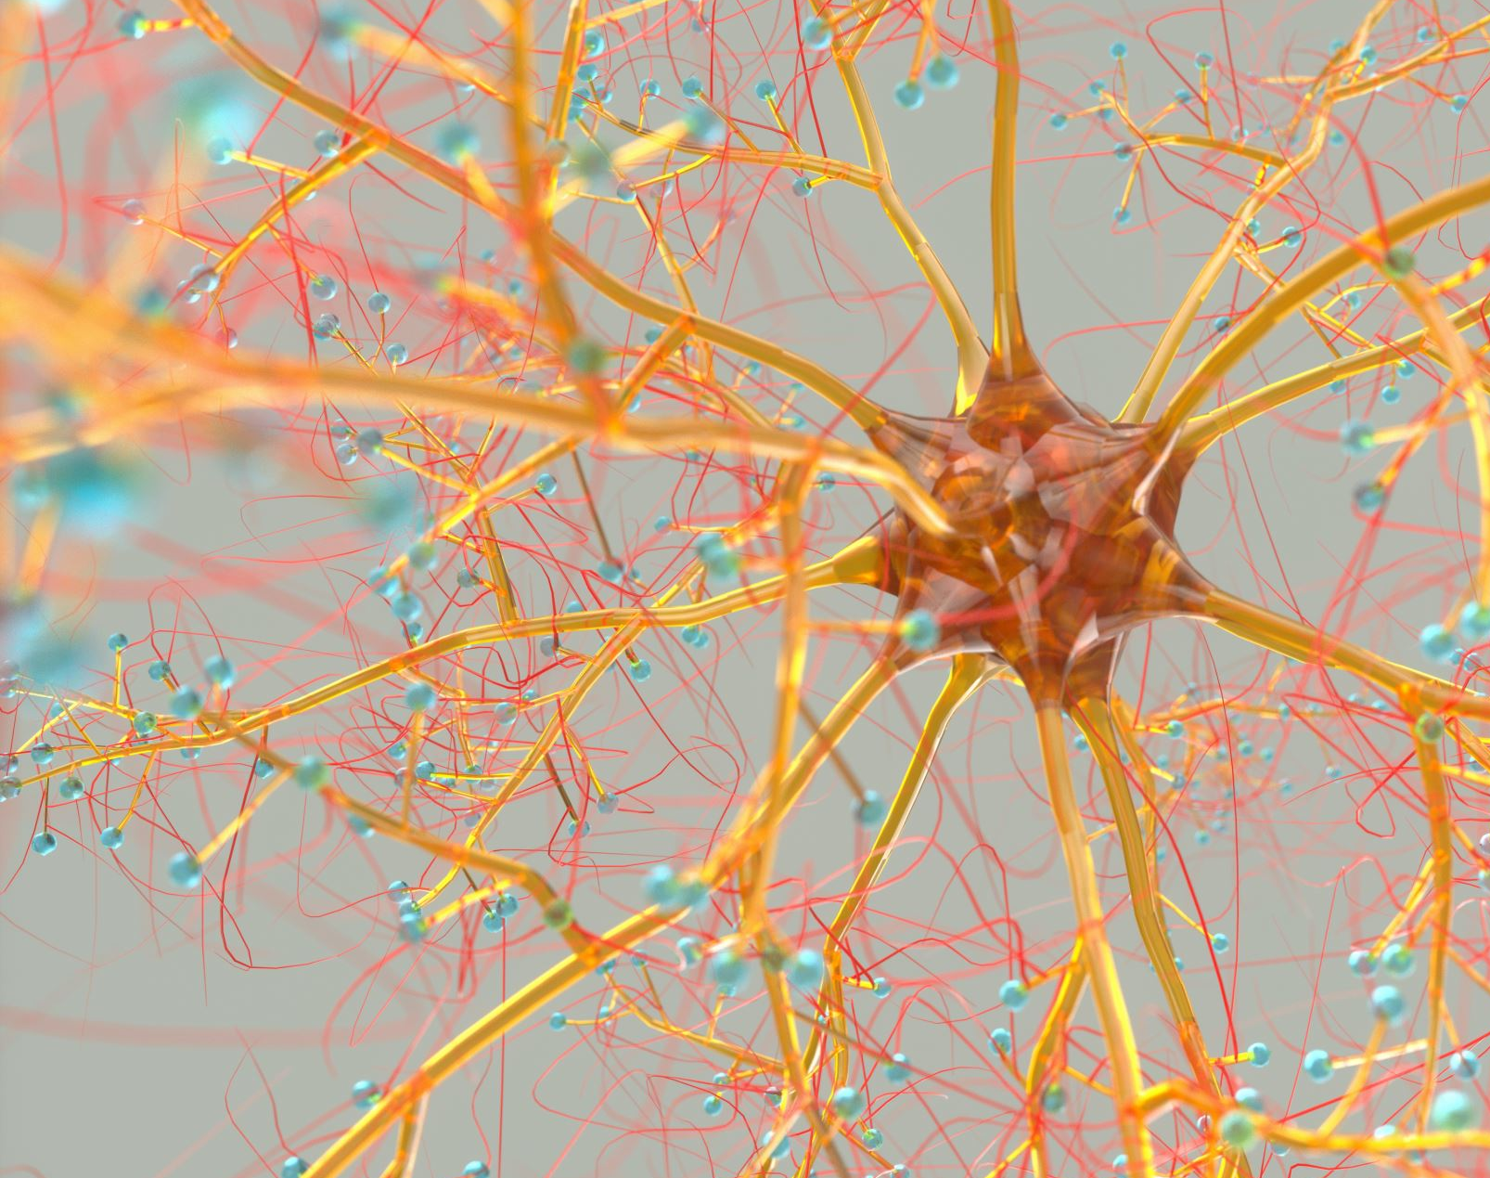
Chronic Pain-pathophysiology
Transition from acute pain to chronic can be caused by or maintained by peripheral and or central mechanisms
Physiologic mechanism of acute pain includes changing the chemical environment within the area of the nerve fibers that results from the inflammatory process
Changes from release and accumulation of substances (bradykinin, serotonin, prostaglandin) and with the release of neurotransmitters (substance P, glutamate)

Slide 9
Chronic Pain-pathophysiology
Opioid-induced hyperalgesia (OIH) is defined as a state of nociceptive sensitization caused by exposure to opioids. The condition is characterized by a paradoxical response whereby a patient receiving opioids for the treatment of pain could become more sensitive to certain painful stimuli. The type of pain experienced might be the same as the underlying pain or might be different from the original underlying pain.
Peripheral sensitization refers to reduced threshold and augmented response of the sensory nerve fibers in the peripheral to external stimulus, which is manifested as enhanced stimulus-dependent pain called primary hyperalgesia
Changes also can occur directly to nerve ending when nerve injury is present
Can result in sprouting of new hyper-excitable nerve endings which fire ectopically
OR if nerve ending doesn't sprout, a neuroma can form causing abnormal mechanosensitivity
Regenerated and or damaged nerves also have reduced thresholds which cause them responsive to non-noxious stimuli
Pain that is caused or initiated by changes in the peripheral or CNS is defined as neuropathic pain-shooting, burning, or stinging sensations accompanied by hyperalgesia and allodynia

Slide 10
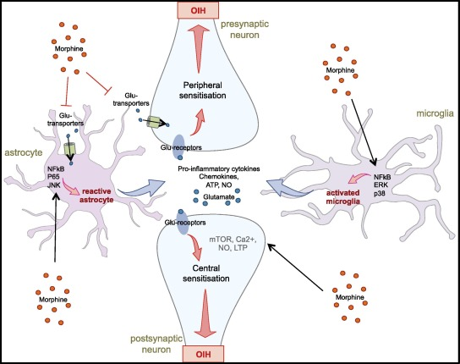
Opioid Induced Hyperalgesia (OIH)

Slide 11
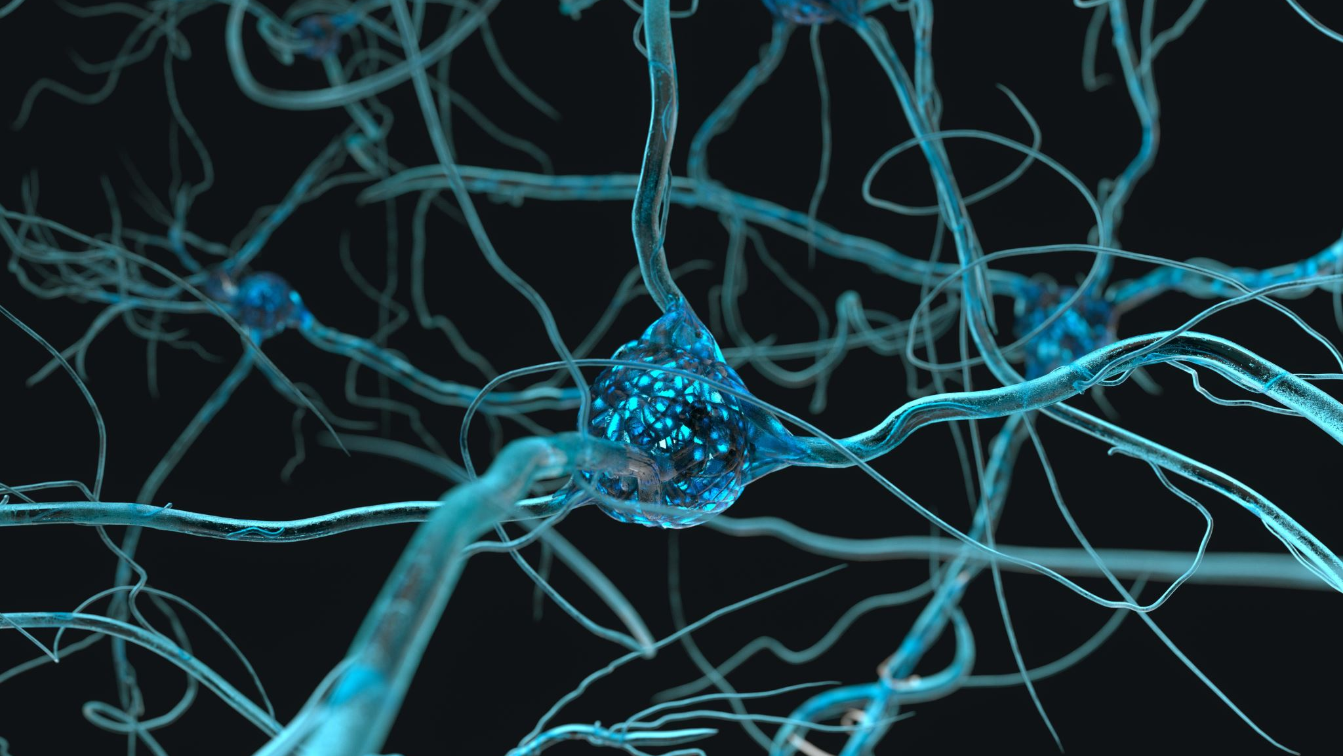
Chronic Pain-pathophysiology
Central mechanisms of chronic pain
Continuous effects of chronic inflammation with hyperexcitability and sanitization of second-order neurons in the dorsal horn
Increase in the release of excitatory neurotransmitters glutamate results in a phenomenon termed wind up
Repetitive stimulation of afferent C fibers causes a longer sustained depolarization of the cell with subsequent susceptibility to afferent input and sensitizes low threshold afferents ➔increased neuronal receptive field size

Slide 12
Chronic Pain-pathophysiology
Glutamate released by primary afferent in the dorsal horn
Acts at several excitatory receptors sites in the dorsal horn including the metabotropic, kainate, AMPA, and NMDA receptor
Activation of NMDA receptor (closed by magnesium plug at rest) binds glutamate which causes an influx of calcium inside the cell and results in an increase in second messengers such as protein kinases and phospholipases
Substance P and calcitonin-gene-related peptide (CGRP) bind to and activate their receptors also triggering up-regulation of these second messengers
Up-regulation of second messengers produces hyperexcitability of the NMDA receptors, resulting in long term neuronal plasticity, excitability and eventually gene transcription changes, all which contribute to central sensitization and chronic pain states

Slide 13
Evolution of Chronic Pain – WIND UP
Repetitive stimulation from chronic inflammation or nerve damage
Causes WIND-UP, which is an abnormal pain response and chronic pain sensation
2 Phases of WIND-UP
Hyperalgesia – less and less stimulation is required to initiate pain
Fibers that normally do not carry painful stimulation are recruited and start transmitting pain
Can cause physical and psychological debilitation
Prevention
Treat the underlying conditions and not ignore a patient's symptoms
Chronic pain is not a psychological condition, but can lead to psychological dysfunction

Slide 15
Types of Chronic Pain
Psychogenic Pain
Still being used although pain providers feel it is meaningless
Because ALL pain has a psychological component
Difficult to validate pain solely on psychosomatic pain without a physical condition that exists
Inflammatory
Tissue damage results in a cascade of neurochemical responses
This response serves to protect and prevent further damage
These include increased histamine, bradykinin, and substance P release
Specifically, substance P is associated with inflammation

Slide 16
Types of Chronic Pain: Neuropathic
Neuropathic
Pain radiates from a damaged nerve along a pathway
Continuation of this will result in allodynia which is an exaggerated pain response from stimuli which would normally not cause pain
Patients have intense burning sensation
Caused by small changes in temperature or light touch
Travels along the dermatome of the injured nerve
Pain remains persistent
Little evidence of tissue healing
Inflammatory response continues
Not able to be managed with nonsteroidal anti-inflammatory agents

Slide 17
Types of Chronic Pain: Chronic Postsurgcial Pain
Chronic postsurgical Pain (CPSP)
Chronic pain in 5 to 50% of patients, depending on procedure
Cause for this has not been determined
International Association for the Study of Pain defines CPSP:
“a persistent pain state that is apparent more than 2 months postoperatively that cannot be explained by other causes such as recurrence of disease, apparent inflammation or other”
Appears to be neuropathic in nature without an identifiable nerve injury
Common procedures include: Most common thoracotomy or thoracic penetration
Others include: Mastectomy, thoracotomy cholecystectomy, nephrectomy, sternotomy, other chest and upper abdominal procedures.
High incidence of CPSP: amputation, and inguinal surgery procedures (hernia repair)
Suspected that the cause is nerve compression, entrapment or other type of nerve damage

Slide 18
Types of Chronic Pain: Chronic Postsurgcial Pain
Chronic postsurgical Pain (CPSP)
Predictors of CPSP include functional and/or psychological factors
One study showed preoperative pain was most significant predictor of CPSP
Others have indicated thyroid function, occult wound infection, or secondary gain (exaggerated pain to gain financial/housing support)
Autoimmune disease can also predict incidence of CPSP
Treatment
Reduce central sensitization
Regional anesthesia, preoperative anti-inflammatory medications or antihyperalgesic medications such as ketamine
Postoperatively use of antidepressants for first line treatment, short-term opioid use, anticonvulsants, topical agents and NMDA antagonists

Slide 20
Pharmacology
Some pharmaceuticals are effective in reducing the dysfunctional activity associated with chronic pain development
Can assist in returning the body to normal function
OR it will only treat pain perception without reducing the dysfunctional cycle of chronic pain

Slide 21
Pharmacology
Nonsteroidal Anti-inflammatory Drugs
Reduce development of chronic pain or treat chronic pain syndromes
Blocking Cyclooxygenase (COX), reducing the release of prostaglandins which cause inflammation activity (vasodilation, erythema, edema, and fever)
Long term use can lead to nephrotoxicity, thrombotic events, peptic ulceration and bleeding
Remember a COX-2 inhibitor is best to reduce inflammation, fever and pain than using one that is both COX-1 and COX-2.
Absorbed in the stomach and small intestine
Elimination primarily through the liver
Acetaminophen (typically included in NSAIDS class but lacks anti-iflammatory properties)
Thought to reduce the nociceptor activity in the CNS
Leading cause of acute liver failure in the US, secondary to overdose
Related to the fact that many pain medications contain acetaminophen with patients not aware leading to overdosing

Slide 22
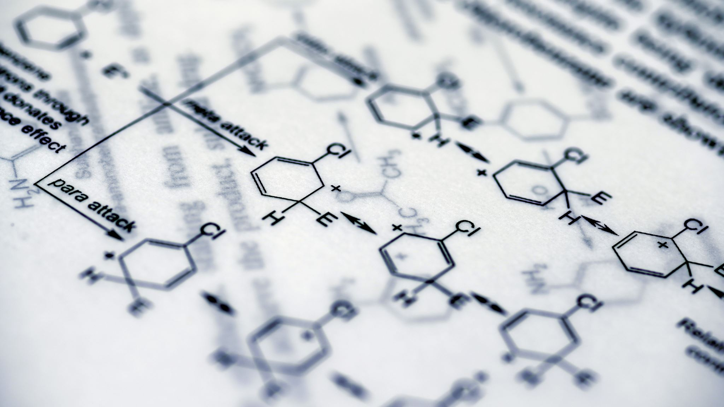
Pharmacology
Aspirin
Nonselective COX inhibitor
Antipyretic and anti-inflammatory properties
More serious side effect including prolonged platelet aggregation
Often not used for pain secondary to side effect potential

Slide 23
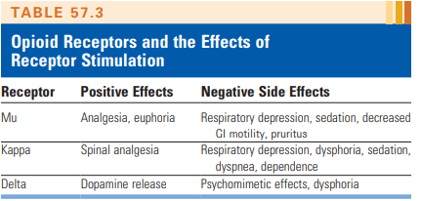
Chronic Pain - Opioids
Act in the CNS but not at the periphery
This prevents them from being effective at the source of pain
Can be used for short term relief
Binds to the opioid receptors in the CNS that inhibit nociception
Many opioids side effects are caused by opioid metabolites
Some of which can cause hyperalgesia
Morphine is opioid to which all opioids are compared
Acts at mu and delta pain receptors
Oxycodone
Most widely used, has high kappa affinity leading to addiction
Others: Oxymorphone, hydromorphone, hydrocodone, and methadone
Long term opioid therapy for chronic pain is not adequate for these patients
Negative side effects
Not looking for the real source of pain
Tolerance develops over time
Patients need individual treatment plans
Dosing strategies to maximize value of each drug
Rotation of opioids improves analgesia and reduces side effects

Slide 24
Chronic Pain-Analgesics and Adjuncts
Controversial use - Some say beneficial others say it isn’t
Anti-convulsants-inhibit neuronal excitation and stabilize nerve membranes to decrease repetitive neural firing
First generation anticonvulsants -Carbamazepine or Phenytoin- for neuropathic pain
Second generation anticonvulsants more popular-Gabapentin (Neurontin) & Pregabalin (Lyrica)
Mechanism of action-blocks alpha 2delta (α2δ) subunit of the presynaptic voltage-gated calcium channels in the CNS-preventing excitatory neurotransmitter release
Structural analogs of GABA
Patients should continue taking anticonvulsant regimens preoperatively
Both drugs have been utilized for modest pain reduction for diabetic neuropathy and postherpetic neuraligia

Slide 25
Chronic Pain and NMDA Receptors
Ketamine blocks NMDA
Useful in the treatment and prevention of chronic pain
Low-dose 0.25-0.5 mg/kg successfully during general anesthesia and reduce postoperative opioid requirement
Boluses and/or infusions
Side effects have concerned providers
Low dose and postoperative infusions safe
Reduction in nausea was also common
No reports of hallucinations and vivid dreams

Slide 26
Chronic Pain-Analgesics and Adjuncts
Antidepressants used for chronic neuropathic pain-may exert their analgesic effects by blocking the reuptake of serotonin and norepinephrine in the CNS, thereby increasing their availability
As we know, antidepressants can also improve a patient's mood, increase their compliance with taking the medication and reduce opioid use
Some patients do not want to take these because they may feel like they are being psychologically impaired
TCA- most commonly used for postherpetic neuralgia, headaches, and fibromyalgia
Amitriptyline (Elavil) Nortriptyline (Pamelor) Imipramine (Tofranil)
SNRIs-better tolerated than TCA because of the lack of affinity for the adrenergic, histaminergic, and cholinergic receptors - preferred in those with cardiac disease- use of SNRIs with SSRI’s is not recommended because this may precipitate a serotonin syndrome (acute toxicity of serotonin manifesting as anxiety agitation delirium seizure hyperthermia diaphoresis, tachycardia, hypertension or hypotension, hyperreflexia, myoclonus, and muscle rigidity)
Venlafaxine (Effexor) Duloxetine (Cymbalta) Milnacipran (Savella)
SSRIs-Still under investigation for the treatment of chronic pain
Fluoxetine (Prozac) Citalopram (Celexa)

Slide 27
Chronic Pain – Muscle Relaxants/Topical/Sleep Aids
Cylobenzaprine (Flexeril)
Most prescribed
Chemically related to the antidepressant: amitriptyline
Short term relief of spasms
Effectiveness declines within 4 days
Topical Agents
NSAIDS/anesthetics
Therapeutic effect
Absorption is better than use of oral preparations of the same
Continuous delivery of the medication may help reestablish a normal peripheral pathway to inhibit nociceptors
Sleep Aids
Sleep is important for healing and cell regeration
Chronic pain disrupts sleep
Promotion of quality sleep is important for chronic pain therapy
But…some sleep aids may interrupt the rapid eye movement thereby disrupting the quality of sleep
Also good pillows, mattress, stretching, white noise

Slide 29
Chronic Pain -Adjuncts
Lidocaine Patch, Capsaicin Patch, Mexiletine, and IV lidocaine
Lidocaine Patch: Analgesia is by local sodium channel blockade and not by systemic effects
700 mg lidocaine in patch max of 3 patches for max of 12 hr/day
3% is absorbed systemically
Capsaicin cream : reduces nerve fiber density
Daily applications
Mexiletine: oral Lidocaine like IV lidocaine
Intravenous Lidocaine Infusions: resistant neuropathic pain syndromes
5mg/kg given over 30 minutes (studies show equal to morphine, gabapentin, and amitriptyline in treating neuropathic pain)

Slide 30
Chronic pain-Corticosteroids
Exogenous corticosteroids (glucocorticoids)
Oral, IV, epidural, caudal intraarticular
Multiple effects on body-Autoimmune/Anti-inflammatory/Antiedema/Antiallergic
Treatment of acute and chronic pain syndromes and disease process
Primarily known for anti-inflammatory effect because they prevent the release of arachiadonic acid by inhibiting phospholipase A2 on cell membranes
Decreases inflammatory cytokines IL—6,IL-1,TNF-α, and prostaglandins
Epidural corticosteroids
exhibit nociceptive properties by blocking C fiber transmission
suppress ectopic firing of nociceptors in the presence of nerve injury, which produces a direct membrane stabilizing effect
Side effects of corticosteroids are reflective of supraphysiologic doses that usually exceed the rate of endogenous steroid production- which is approximately 20 mg per day of hydrocortisone or its equivalent

Slide 31
Chronic pain-Methadone
Synthetic opioid used for the treatment of opioid addiction in detox or treatment programs
Use of methadone is increasing for the treatment of severe acute pain as well as for chronic cancer and noncancer pain management
Structure- racemic mixture of two enantiomers
d-isomer (S-methadone) –antagonizes the NMDA receptor and inhibits serotonin and norepinephrine uptake-helps neuropathic pain, along with the prevention of opioid tolerance and hyperalgesia
l-isomer (R-methadone) binds to opioid receptors giving an analgesic effect
Administered oral, IV, rectal, and subq
Highly lipid soluble-well absorbed via the gastric mucosa with peak analgesic effects in 30-60 min
Long half-life 15-60 hours
Metabolism CYP450 enzyme
Side effects similar to other opioids including respiratory depression and excessive sedation, prolongation of QT interval
EKG should be done when a patient is taking more than 100mg/day

Slide 32
Chronic pain-Methadone
Use of preemptive analgesia for acute pain management
Preincisional methadone injection study for spine surgery had significant reduction in pain requirements 48-72 hours after surgery intraoperative and postop pain management was similar to those receiving a sufentanil infusion
EKG is warranted if using as preemptive or intraoperative pain management prior to surgery to compare QT interval—increased risk factors include the concomitant use of antiarrhythmic agent, TCA, calcium channel blocker, hypokalemia, and history of prolonged QT interval

Slide 33
Chronic Pain - Dexmedetomidine
The mechanism of dexmedetomidine analgesia has not been fully clarified, but the main mechanisms might be as follows:
(1) peripheral analgesic effect, an analgesic effect produced by inhibiting the transmission of pain signals by inhibiting Aδ and C fibers;
(2) central analgesic effect, mainly depolarizes the blue plaque and the descending noradrenergic pathway of the spinal cord to the presynaptic membrane, inhibiting the release of substance P and other nociceptive peptides in the presynaptic membrane and thereby inhibiting the spinal cord via the transmission of angular noxious stimuli, which in turn terminates the signaling of pain
(3) local analgesic effect, modulation of hyperalgesia by stimulating the α2 receptor (Zhang and Bai, 2014). In the past, opioids were mainly used to relieve acute postoperative pain, but opioids can cause toxic side effects such as nausea, vomiting, respiratory depression, and itchy skin (Gupta and Bah, 2016).

Slide 34
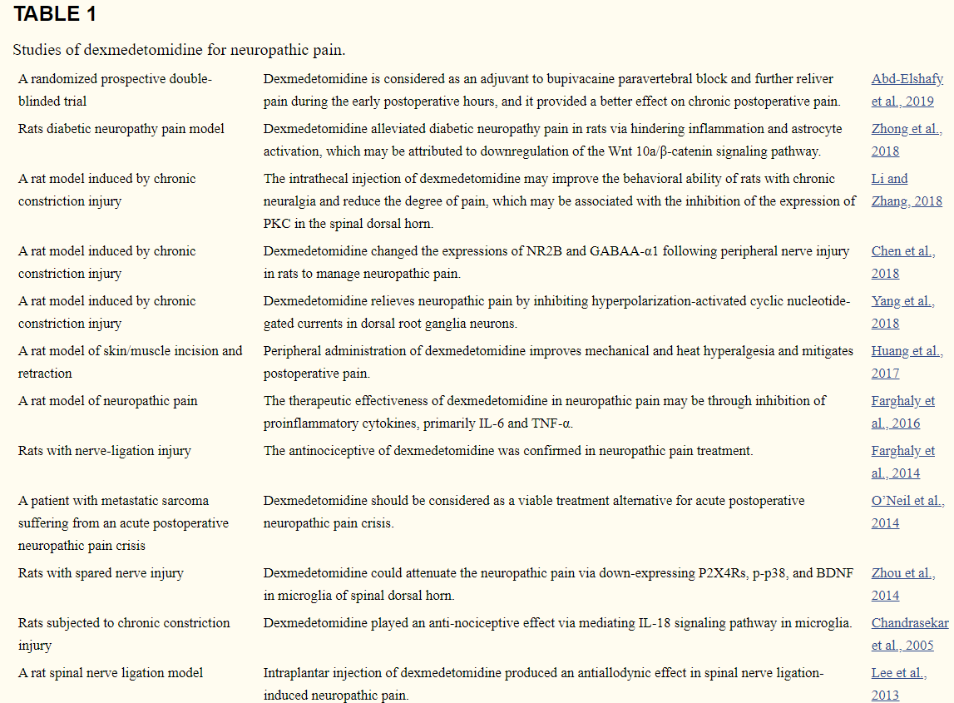

Slide 35
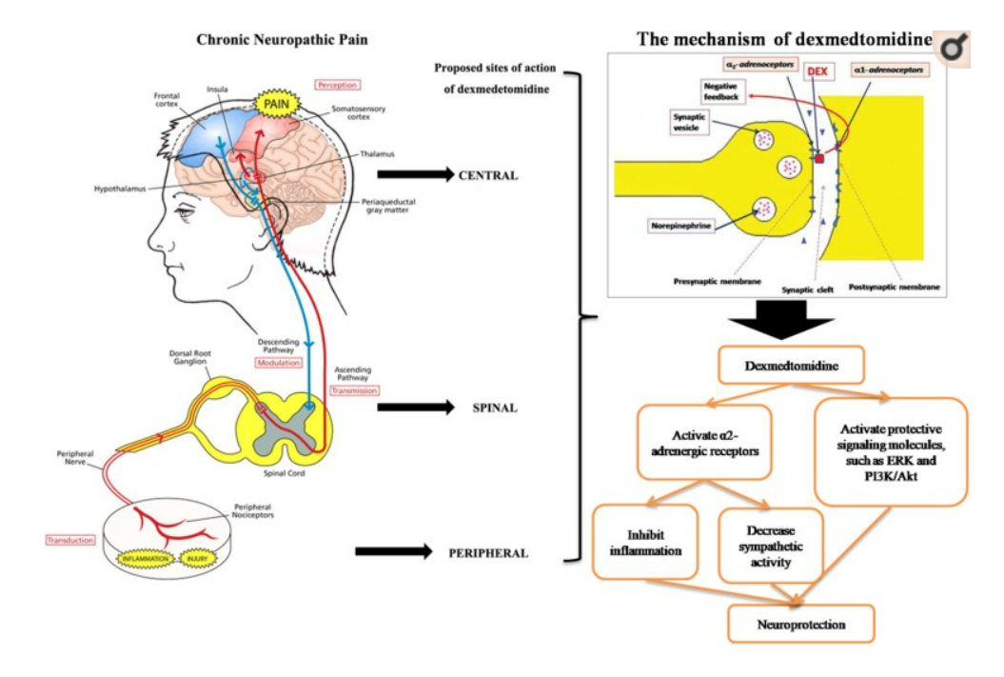

Slide 37
Chronic Opioid Therapy and Perioperative Pain Management
Chronic Opioid Therapy (COT) is used for the treatment of chronic nonmalignant pain and demonstrates a large population who will require surgery
Risk for higher-than-normal levels of postoperative pain and slower pain resolution
Multimodal treatment plan is a must
Preop- Chronic opioid therapy including methadone should be continued throughout perioperative course- know dosages that patient is receiving
Leave fentanyl patches on
Give fentanyl preop if patient did not take scheduled dose of opioid
Implanted intrathecal or epidural opioid infusion should continue perioperatively
Other medications for chronic pain should be continued on the day of surgery
Adjuncts prior to surgery includes benzodiazepines
Regional techniques discussed

Slide 38
Chronic Opioid Therapy and Perioperative Pain Management
Intra op
No specific opioid noted to control pain intraoperatively for the patient on COT ;nor is there specific guidelines
Provider preference
Opioid selected should provide adequate baseline requirements as well as intraop and postop requirement considered
Opioids may be increased 30-100% expect increase in inhalation agent
Titrate to blood pressure and heart rate response, respiratory rate and depth and pupil size
If a specific opioid is not effective opioid rotation is recommended
Avoid opioid antagonists and agonist-antagonists because these will precipitate an acute withdrawal syndrome
Nonopioid analgesic adjuncts should be a part of the multimodal approach (ketamine, clonidine, and dexmedetomidine)
Ketamine infusion at 10mcg/kg/min
Ketamine bolus 0.5mg/kg on induction
Magnesium 2 -3 grams
Regional anesthesia with local anesthetics and opioids should be a part of the anesthetic plan whenever possible in COT patients-Continue opioids even with regional for baseline maintenance to avoid withdrawal

Slide 39
Chronic Opioid Therapy and Perioperative Pain Management
Postop
If patient not a candidate for regional or did not benefit from it then IV PCA should be considered
Can be very challenging
Monitor for respiratory depression
Goal is to get to preoperative regimen
Consultation of pain specialist beneficial to facilitate PCA dosing and opioid conversion is highly recommended

Slide 40
Management of Common Pain Syndromes
Low Back Pain: Radicular Pain Syndrome
Pain due to disc is due to mechanical nerve root compression and the inflammatory process
Conservative management… then, epidural steroid injection
Inflammation by inhibition of phospholipid A₂
Steroids to be used are interlaminal=Methylprednisolone, triamcinolone, or betamethasone …Lumbar transforminal=betamethasone or triamcinolone….Cervical= dexamethasone
Methylprednisolone block transmission of C fibers but not the Aβfibers
Methylprednisolone has the largest particle size
Fluoroscopy should be used
Injury to the brain or spinal cord can occur
Trauma to the vertebral artery, vasospasm from steroid, embolism of the particulate steroid

Slide 41
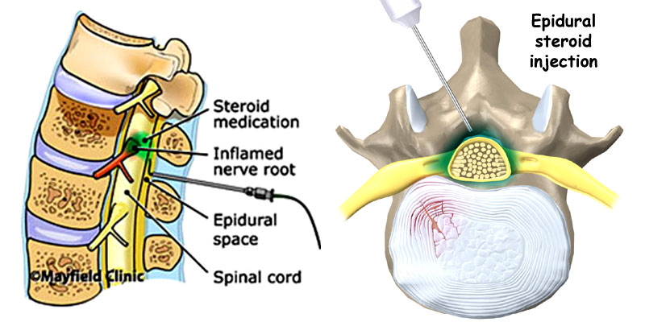
Management of Common Pain Syndromes
Epidural Steroid Injections are more effective in patients with acute radicular symptoms but not so much with chronic lumbar radiculopathy
Surgery for herniated disc produces short term pain relief
Surgery has better outcome with spinal stenosis

Slide 42
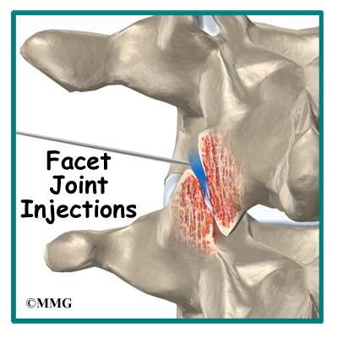
Management of Common Pain Syndromes
Facet Syndrome
Pain in the low back that radiates to the ipsilateral posterior thigh and ends at the knee
Paraspinal tenderness and reproduction of pain with extension-rotation maneuvers of the back
Facet joint injections with use of local anesthetics
After medial branch blocks without relief then thermal radiofrequency rhizotomy of the medial branches should be performed
Rhizotomy lasts 3-12 months

Slide 43
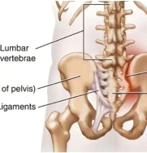
Management of Common Pain Syndromes
Sacroiliac Joint Syndrome
Pain is in the region of the affected sacroiliac joint and the medial buttock
Pain may radiate to the groin
Treatment include PT, manipulation, intra-articular steroid injections radiofrequency denervation, and surgical fusion of the joint
Injection of local for temporary relief is the medial branch of the dorsal rami of L5 and the lateral branches of the dorsal rami of S1 to S3 –relief may lasts weeks

Slide 44
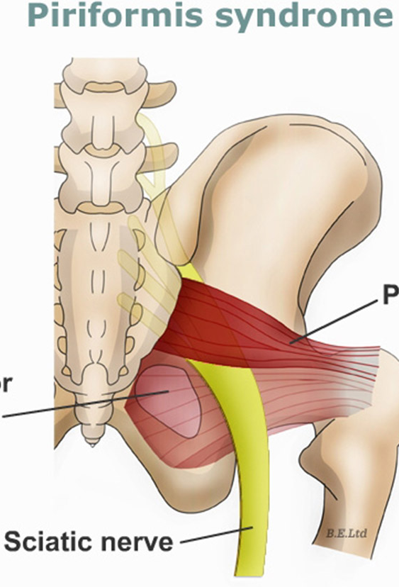
Management of Common Pain Syndromes
Piriformis Syndrome
Originates in the buttock
Components of the sciatic nerve as it runs between two divisions of the piriformis muscle

Slide 45
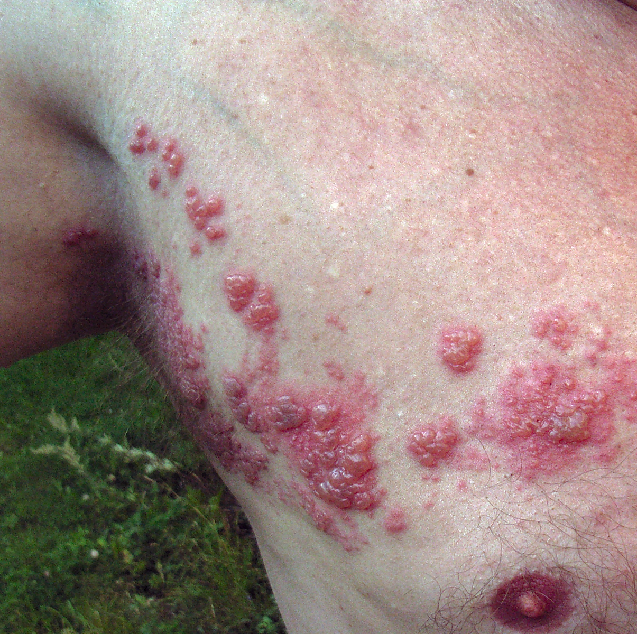
Neuropathic Pain Syndrome
Herpes Zoster and Postherpetic Neuralgia
10% develop postherpetic neuropathy (PHN)
Pain lasts > 3 months post rash
Antiviral drugs decrease duration of shedding of virus, increase healing of the rash, reduce incidence of PHN
Intrathecal methylprednisolone (more beneficial than epidural in this group)
Block done with 2-4 weeks of onset of rash have best benefit with block
Mainstay of tx for PHN is pharm managed
Gabapentin + opioids, Gabapentin +antidepressants
Spinal cord stimulator
Alcohol neurolysis of the spinal thoracic dermatomes affected

Slide 46
Neuropathic Pain Syndrome
Complex Regional Pain Syndrome
Two types
Type I- reflex sympathetic dystrophy
Trauma, surgery, nerve injury, work related injuries, females
Type II- causalgia
nerve injury
Signs and symptoms: Spontaneous pain, hyperalgesia, allodynia, trophic, sudomotor, vasomotor abnormalities and active and passive movement disorders
Treatment for CRPS
Sympathetic block, PT, oral meds
Meds include: gabapentin, memantine, and ketamine infusion
Spinal Cord Stimulator

Slide 47
Cancer Pain
25 % of patients have significant pain
Can be somatic, visceral, or neuropathic
Somatic= opioids, NSAIDs cyclooxygenase 2 inhibitors, and is amenable to treatment with neural blockade
Visceral= responds to sympathetic blocks
Neuropathic pain=responsive to anticonvulsants, opioids, tricyclic antidepressants, SSRIs, or combination
Opioids are mainstay of tx
Neurolytic blocks and intrathecal opioids are considered when pharm management is not effective

Slide 49
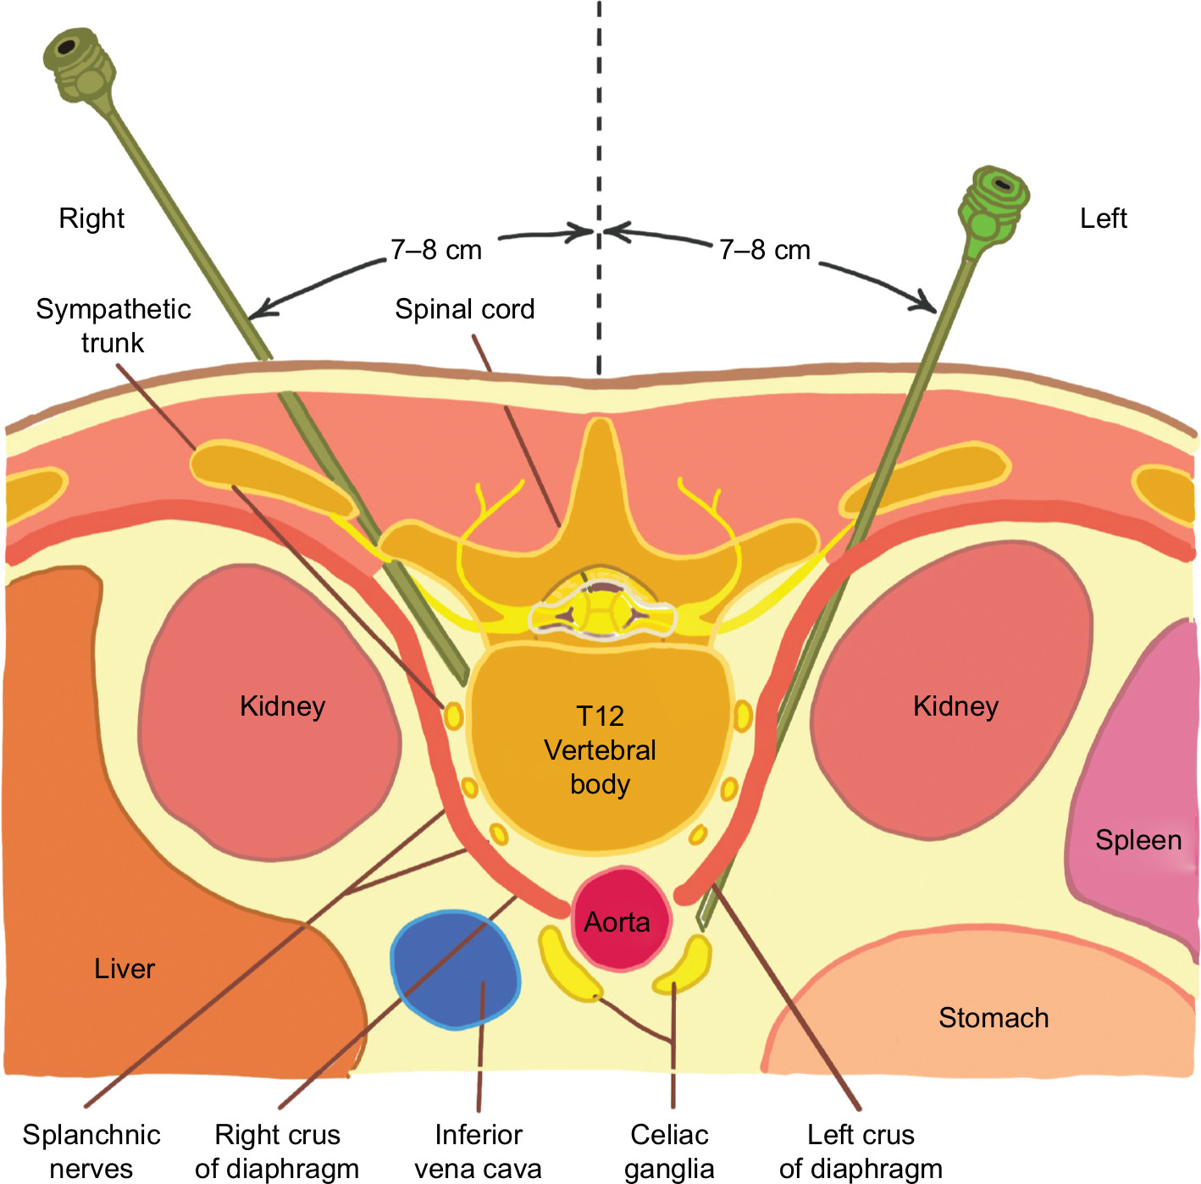
Cancer Pain-Neurolytic Blocks for Visceral Pain
Celiac Plexus Block
Innervates all of the abdominal viscera except the left side of the colon and pelvic viscera
Contains two large ganglia that receive sympathetic fibers from the greater, lesser, and least splanchnic nerves
Also receives parasympathetic fibers from the vagus nerve
Splanchnic nerves are located retroperitoneally at level T12 and LI
Celiac plexus are anterior to the crura of the diaphragm and surrounds the abdominal aorta and the celiac and superior mesenteric arteries.
Blockade is achieved by retrocrural approach, aterocrural approach, or by neurolysis of the splanchnic nerves

Slide 50
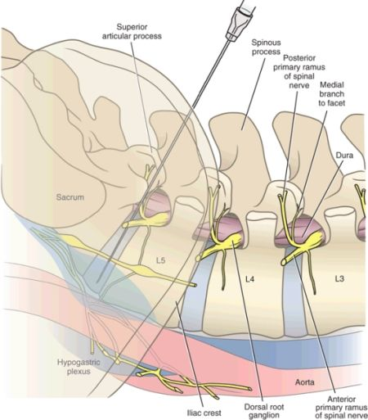
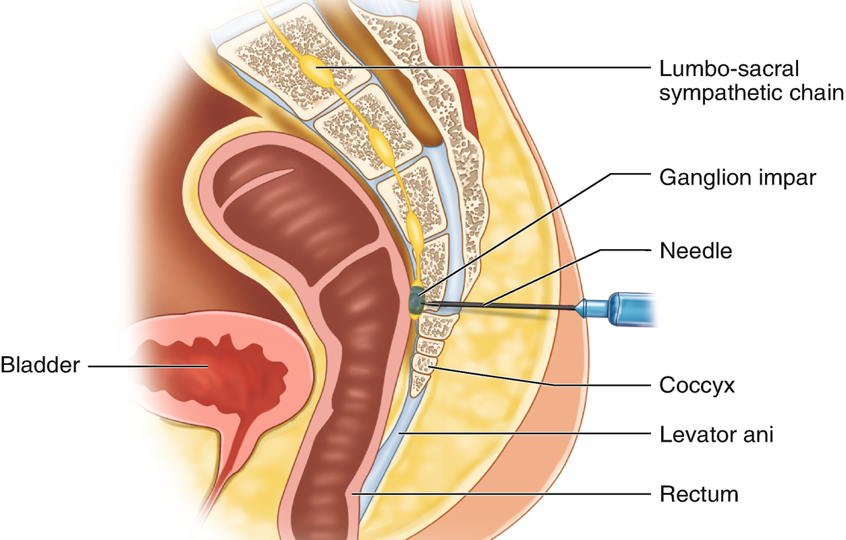
Cancer Pain-Neurolytic Blocks for Visceral Pain
Superior Hypogastric Plexus Block
Indicated for pelvic pain from cancer and non-malignant conditions
Needles at L5 S1 disc space 6-8 mls of local anesthetic then phenol or alcohol is placed for neurolysis
Ganglion Impar Block
Perineal pain from malignancy/ilioinguinal neuralgia
Similar to Superior hypogastric block but needle in anococcygeal ligament and directed to reach the sacrococcygeal junction

Slide 51
Cancer Pain-Neurolytic Blocks for Visceral Pain
Celiac Plexus Block
Tip of the needle is directed toward body of L1
No difference in efficacy between the 3 approaches
Fluoroscopy is required
50 % alcohol or 6-10 % phenol is used for neurolytic blocks-30-40 mls
Pain relief is noted at 89% at 2 weeks and 90% at 3 months
Complications include orthostatic hypotension, back pain, retroperitoneal hematoma, reactive pleurisy, hiccups, hematuria, diarrhea and abdominal aortic dissection, transient motor paralysis, and paraplegia

Slide 52
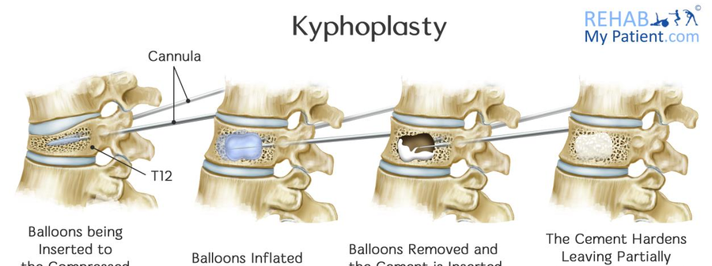
Kyphoplasty &Vertebroplasty
Percutaneous interventional modalities to treat vertebral compression fractures
Osteoporosis in the elderly
Vertebroplasty injects polymethylmethacrylate into the affected vertebral body
Kyphoplasty involves the insertion of a balloon prior to the injection of the cement
Improves strength of the vertebral body
Can be done under sedation
Patient should remain supine for 3-5 hours after the procedure
Cement leakage is a potential for both procedures however kyphoplasty has a lower rate of leakage because the cement is higher viscosity
Can cause PE
Neurologic complication include radiculopathy, spinal casudication, and paraplegia

Slide 53
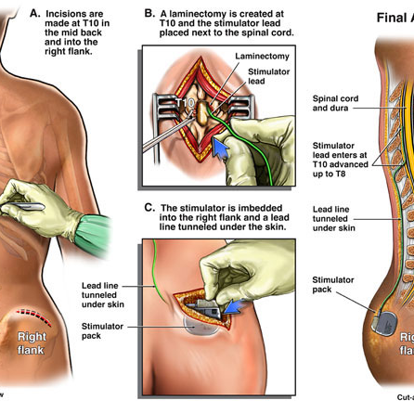
Spinal Cord Stimulator
Indicated for:
Failed back surgery syndrome, complex regional pain syndrome, angina, and critical limb ischemia
Done under sedation
Patients pass a psychological evaluation
Patients have a trial that proves increased pain relief

Slide 54
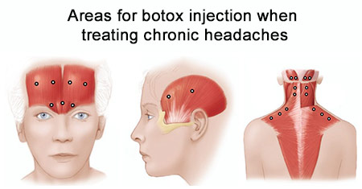
Botox for migraines
Mechanism of action
Affects presynaptic membrane of NMJ and prevents ACH release (and muscle contraction)
Lasts until nearby NMJ form in junction plates on new areas of muscle walls
Studies done on reducing spasticity in dystonias and migraines
Modest benefit of botox with migraine intensity but not quantity

Slide 57
Resources
Nagelhout JJ, Elisha S. (Ed.) Nurse Anesthesia. 6th ed. Philadelphia: Elsevier Health Sciences; 2018. Chapter 56/57
Barash, PG (2013). Clinical anesthesia. Philadelphia, Pennsylvania: Wolters Kluwer/Lippincott Williams &Wilkins, (2013)
Guyton AC, Hall JE. Textbook of Medical Physiology 10th ed.W.B. Saunders Company; 2000. Chapter 48
Openanesthesia.org
Uptodate.com

