Slide 1
Early Interventions in Acute Trauma Resuscitation
Harold Rayford, APRN, MS, CRNA

Slide 2
General Objectives
Identify the primary components of the Triad of Trauma
Pathophysiology of acute trauma
Resuscitation utilizing an anesthesia checklist

Slide 3
Specific Objectives
Optimize ventilation to achieve adequate tissue oxygenation
Fluid, blood, and blood product transfusion based on clinical indications and lab results
Warm fluids, warm ventilation gases, convection warming devices, increase OR room temperature
Correction of coagulopathy
Correction of body temperature
Optimization of vital organ perfusion
Close communication with surgical team
General stabilization for definitive transfer to Surgical Intensive Care Unit

Slide 4
History of trauma care in America parallels our history of caring for injured military personnel.
President Abraham Lincoln drove the creation of the first trauma manual.
1980 the American College of Surgeons established guidelines for categorizing hospitals as level I, II, III, or IV.

Slide 5
150,000–214,000 deaths are related to trauma each year, and over 3 million non fatal injuries annually.
Fourth leading cause of death in the US.
Number one cause of death from age 1-46.
Annual cost of Trauma is $671 billion in healthcare and lost productivity.

Slide 6
For those aged 1–46, hemorrhage accounts for 40% of those that die, and remains as the leading preventable cause of trauma related death.

Slide 7
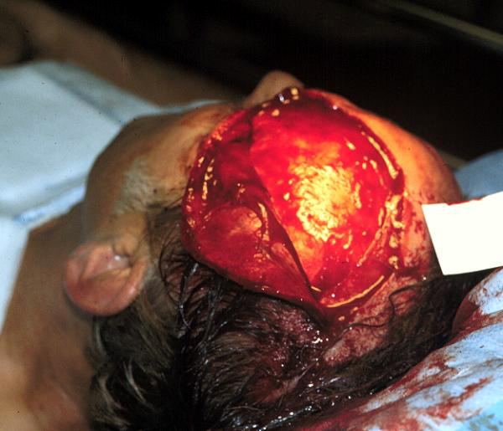

Slide 8
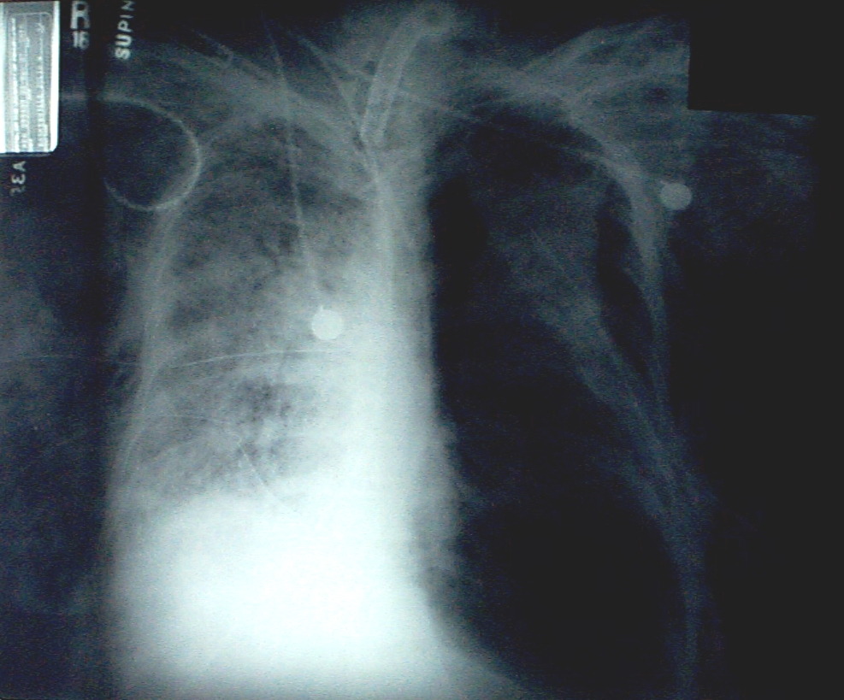
Tension Pneumothorax

Slide 9
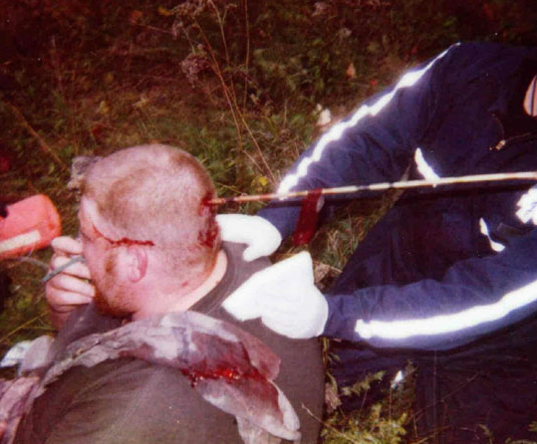
Hunting accident

Slide 10
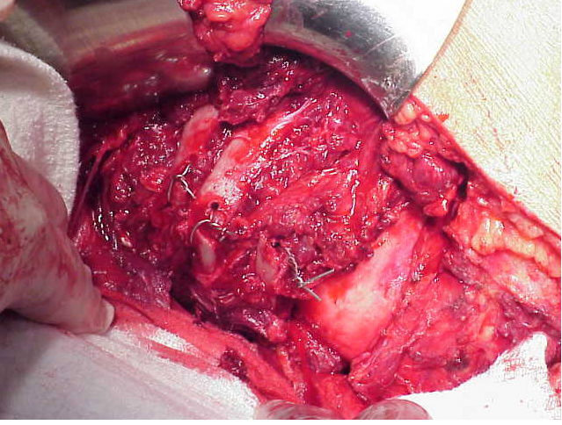
Surgical intervention

Slide 11
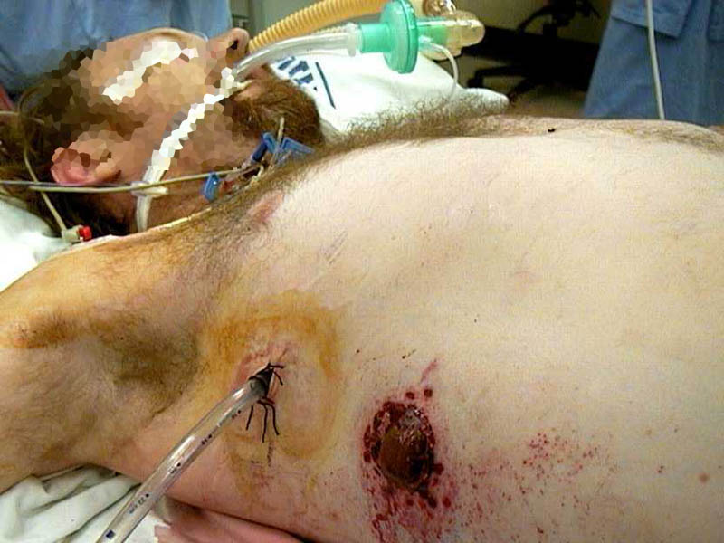
Massive Hemothorax

Slide 12
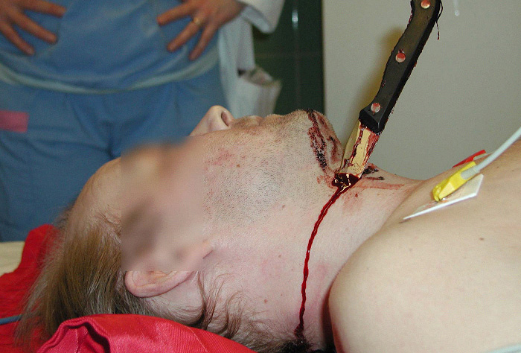
Knife injury - neck

Slide 13
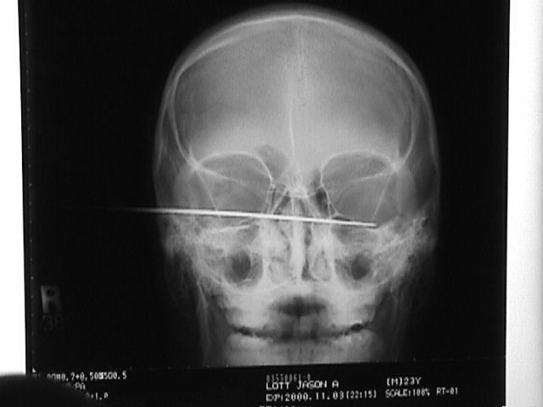
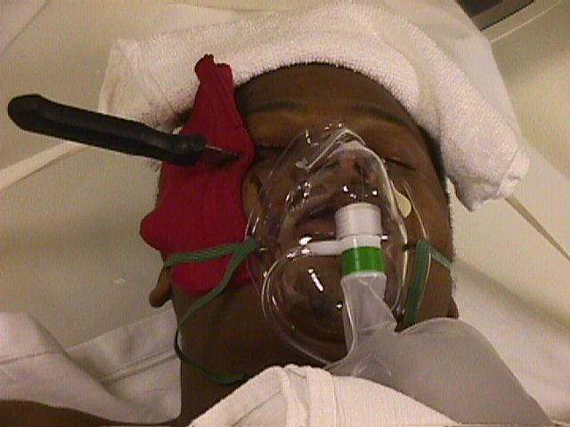
Knife Wound

Slide 14
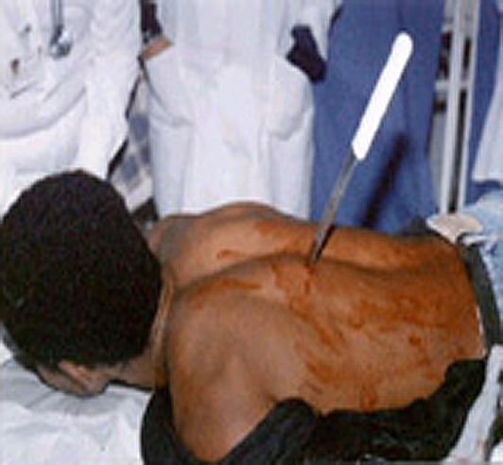
Knife Wound

Slide 15
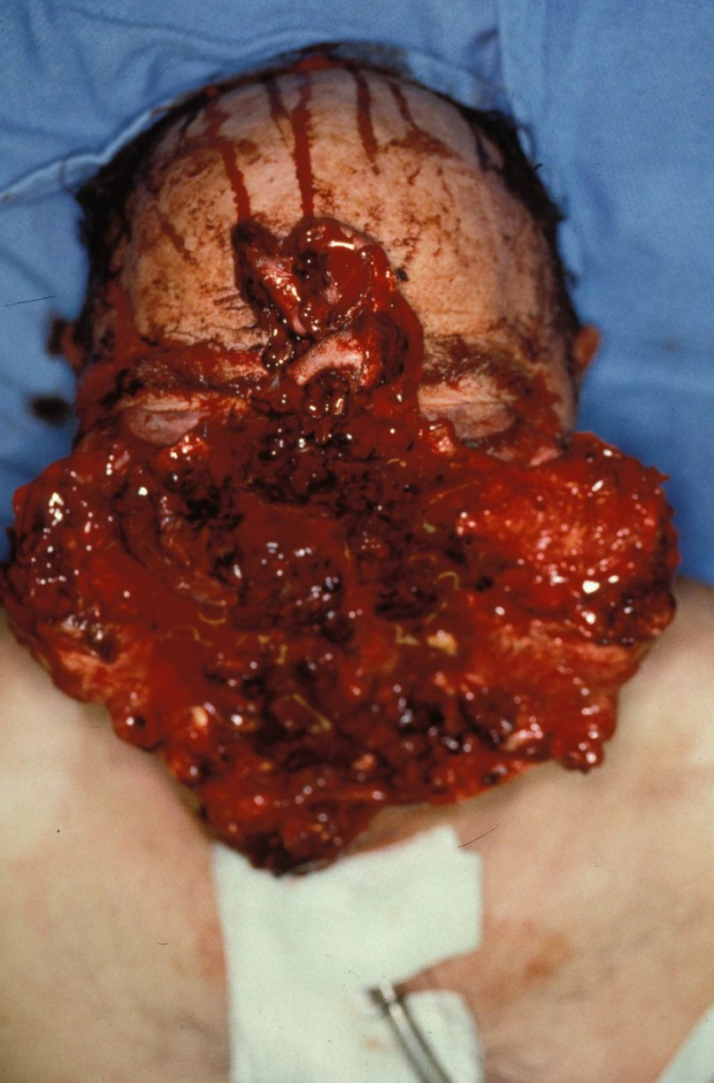

Slide 16
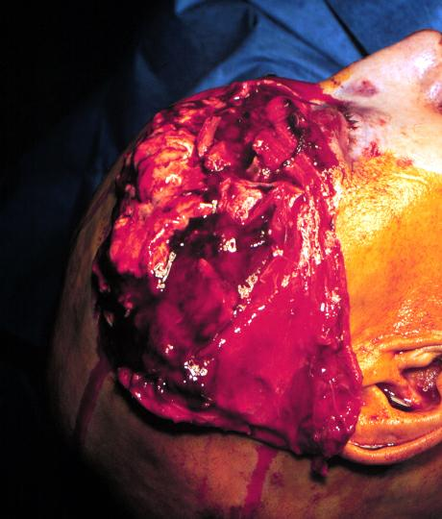

Slide 17
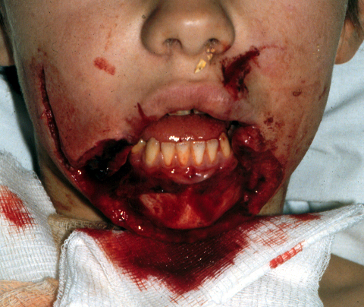
What type of intubation?

Slide 18
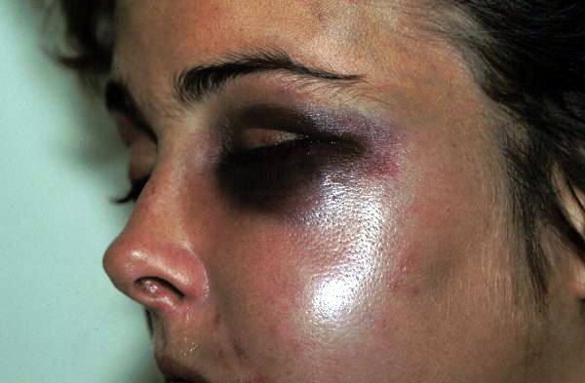
What type of intubation?

Slide 19
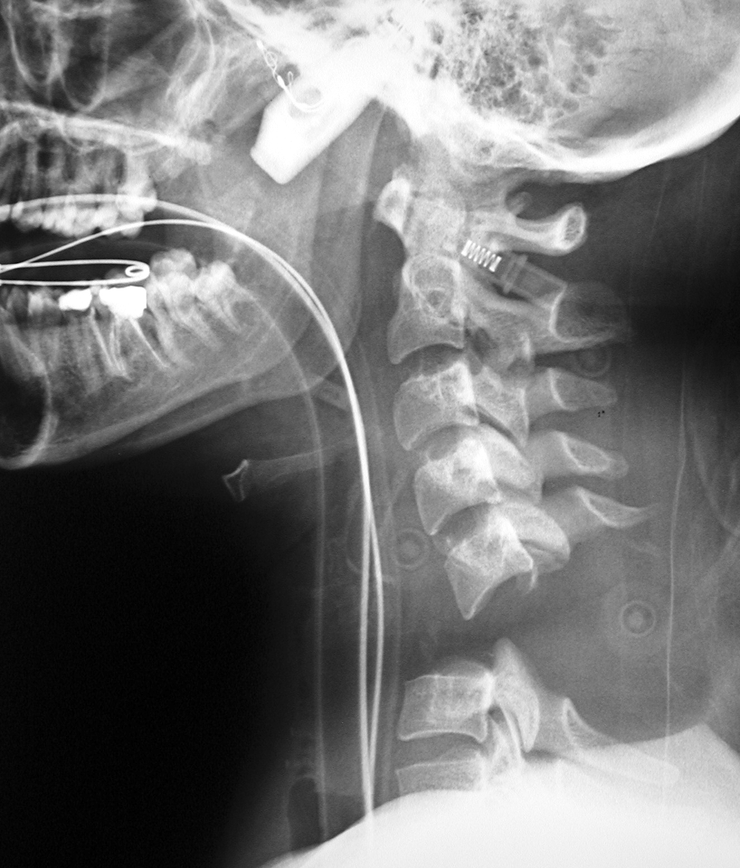
Cervical Spine Intubating Injury

Slide 20
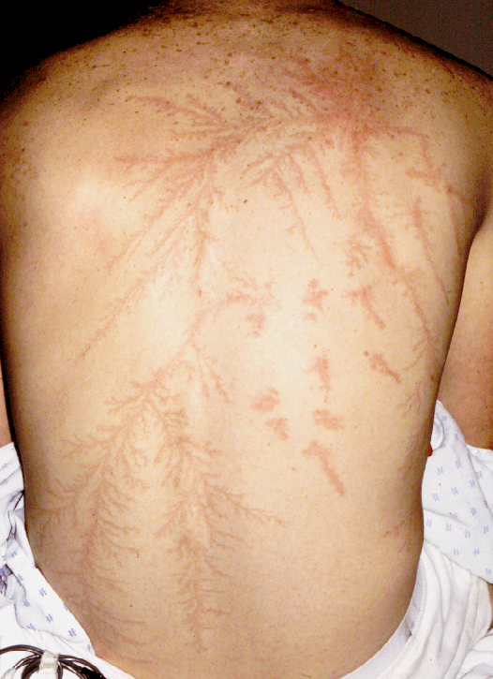
Lightening Strike: Ferning

Slide 21
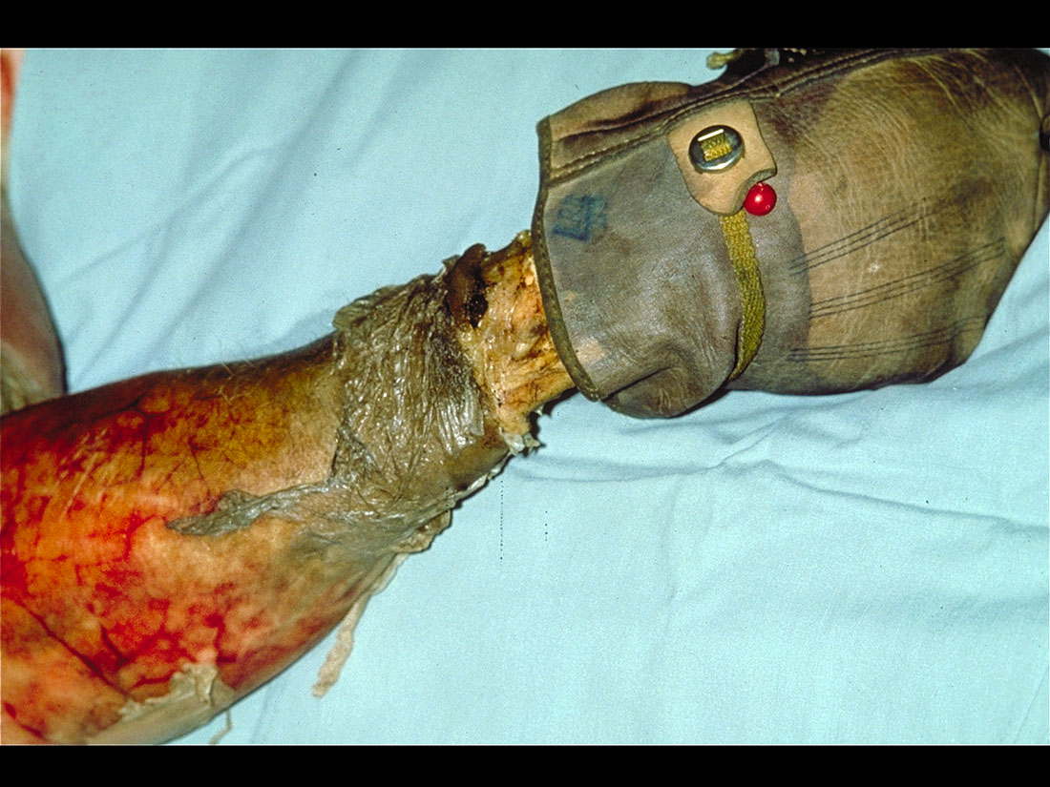

Slide 22
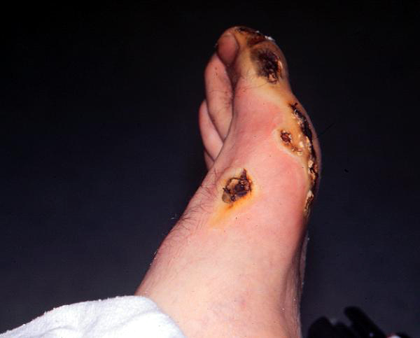
Electrical Burn: Exit Wound

Slide 23
Trauma’s Lethal Triad of Hypothermia, Metabolic Acidosis & Coagulopathy
Coagulation system
Coagulopathy
Hypothermia
Metabolic acidosis
Lethal triad

Slide 24
Major consequences of hypothermia in trauma patients
Decreased cardiac output and myocardial ischemia
Decreased cardiovascular response to catecholamines (epinephrine)
Impaired tissue oxygen delivery
Arrhythmias such as atrial fibrillation and v fib
Decreased function of coagulation factors and platelets to make clot and thus stop hemorrhage
Decreased number and function of white blood cells
Increased risk of wound infection, pneumonia and sepsis

Slide 25
Major consequences of severe acidosis in trauma patients
Decreased cardiac output and arterial blood pressure
Decreased cardiovascular response to catecholamines (epinephrine)
Reduced threshold for developing v fib
Hyperventilation
Decreased strength and increased fatigue of respiratory muscles
Decreased mental status and coma
Decreased function of coagulation factors and platelets to make clot and thus stop hemorrhage

Slide 26
Major consequences of coagulopathy in trauma patients
Hypothermia and acidosis inhibit coagulation by impairing platelet, plasma and fibrinogen function.
Organ dysfunction and multiple organ failure
Widespread activation of coagulation system may result in a systemic inflammatory response and possible sepsis
Coagulopathy increases morbidity and mortality in traumatic brain injuries

Slide 27
Hypothermia
Normal body temperature is 35.6-37.8 degrees C
Hypothermia is defined as “a core temperature < 35 degrees C”
Hypothermia in trauma is associated with a significant increase in mortality.
Coagulation system is a temperature and pH-dependent series that results in the formation of blood clots to stop internal and external hemorrhage.
It results in impaired platelet function, inhibition of the clotting factors, and inappropriate activation of clot breakdown.
Causes can include a multitude of factors, i.e. hemorrhagic shock, traumatic brain injuries, and alcohol intoxication. All impair the body’s ability to regulate its core temperature.
Most at risk include patients at the extremes of age and those with medical conditions.
Lastly, an important care consideration is the temperature of IV fluids and blood products.

Slide 28
Acidosis
A pH level is a measure of the blood’s acidity from a scale of 0-14
Healthy individuals maintain a healthy pH of 7.35-7.45
Acidosis is defined as an arterial pH of less than 7.35
Severe acidemia is defined as a pH < 7.2
Additional causes of acidosis in trauma patients is excessive fluid resuscitation using unbalanced crystalloid solutions.
Lastly, a trauma patient may also have respiratory acidosis, secondary to hypoventilation due to respiratory depression or obstruction, thereby increasing CO2 levels.

Slide 29
Coagulopathy
Coagulopathy in trauma is a common occurrence, present in nearly 1 in 4 severely injured patients arriving at the ED. Also associated with a four-fold increase in mortality.
Occurs as a result of hypothermia, acidosis, and as a result of losing clotting factors through hemorrhage and hemodilution.
Depletion of both platelets and clotting factors.
Dilutional coagulopathy occurs with excessive resuscitation with fluids or blood products.
Abnormal and excessive activation of the coagulation system rapidly consumes the body’s remaining clotting factors, resulting in further hemorrhage.
Ultimate goal is to maintain tissue perfusion and to avoid overly aggressive fluid administration.

Slide 30
A Checklist for Trauma and Emergency Anesthesia

Slide 31
Before Patient Arrival Prevent Hypothermia
OR temp should be 25ºC or greater. Maintaining a warm OR reduces hypothermia.
Have additional warming devices, including forced air systems, fluid warmers, warm IV fluids, thermal head covers, and warm blankets.
Verify that a warm IV line is available.
Have a system to warm all solutions to be us in the surgical field.

Slide 32
Trauma Room Setup
Anesthesia machine checked and placed in standby mode
Airway setup
Glidescope
Arterial and central line kits
Pressure bag with transducer
Difficult airway cart
Belmont rapid infuser
Trauma cart
Hemocue and I-Stat monitoring

Slide 33
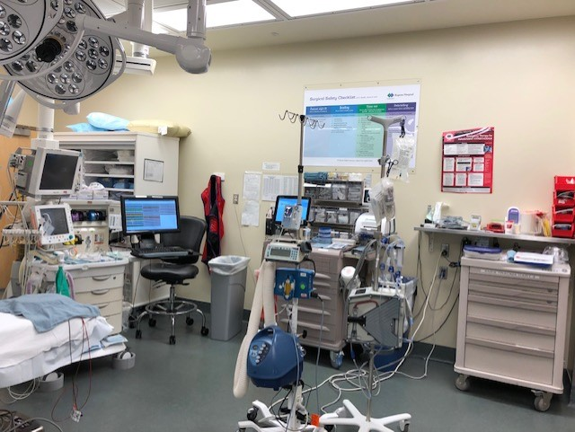

Slide 34
Blood Products
Verify that 6 units of “O Negative” packed red blood cells (PRBCs), 6 units “AB” fresh frozen plasma (FFP), and 1 six pack of random donor platelets (1 standard adult dose) are available.
Activate the mass transfusion protocol. Although there is no significant difference in the ratio of red blood cells to FFP, administration is typically a 1:1 ratio. Timely and effective communication with Blood Bank ensures a steady supply of products to help control blood loss.

Slide 35
Transfusion Related Issues
Tranexamic Acid / TXA synthetic lysine derivative / effective antifibrinolytic. 1 g over 10 minutes, followed by 1 g IV infusion over 8 hours
Used both in military and civilian settings / best benefit when administered within 3 hours of injury.
After significant blood transfusion, consider administration of calcium. Citrate preservatives in blood products lower calcium levels. Lower calcium levels contribute to hypotension.
Hypocalcemia in patients requiring mass transfusions may increase mortality.

Slide 36
Induction
Rapid sequence intubation
IV induction anesthesia
Ketamine: Dissociative analgesic and sedative. Produces surgical anesthesia while maintaining airway reflexes and mean arterial blood pressure.
Propofol: Common sedative and hypnotic. May result in hypotension in patients with hypovolemic shock and should be used in reduced dosages.

Slide 37
Etomidate: Produces hypnosis and does not decrease systemic vascular resistance. May suppress the hypothalamic-pituitary-adrenal axis, thereby decreasing cortisol levels.
Succinylcholine: Produces intubating conditions within 30 to 45 seconds. Should not be administered after 24 hours with acute burns, or paralysis.
Rocuronium: Produces intubating conditions in 60 to 90 seconds. Excellent alternative for RSI if succinylcholine is contraindicated.

Slide 38
Intubate avoiding manipulation of the cervical spine. Have a videolaryngoscope and an airway cart available. Communicate with surgical team after OETT placement.
Placement of an oral gastric tube for decompression. Avoid OG placement if esophageal or gastric injury is suspected. Avoid placement of a nasogastric tube if a basilar skull fracture is suspected.

Slide 39
Initiate volatile or IV anesthesia. Avoid nitrous oxide.
Placement of arterial and central lines. Obtain labs, ISAT and Hemoccue. Type and cross, ABG, coagulation profile.
A reasonable goal is to maintain a MAP of 60 mm Hg until definitive surgical control of bleeding is achieved.
Avoid excessive crystalloid resuscitation. Best to initiate early transfusion of blood products as needed.

Slide 40
Currently, American and European evidence-based guidelines recommend early intervention with FFP without a preset FFP:PRBC ratio.
Follow mass transfusion protocol: 6 units of PRBCs to 6 units of FFP, followed by one 6 pack of platelets until hemostatis is established.

Slide 41
Additional Considerations
Consider administration of hydrocortisone 100 mg during remitting hypotension. Adrenal suppression is a well described phenomenon in critical illness.
Administer antibiotics:
Most common /Cefazolin, Clindamycin, Vancomycin, Invanz, and Unasyn.
Consider bolus administration of Vasopressin 1 to 2 Units / titrate to effect. Potent vasoconstrictor which spares cerebral, pulmonary, and cardiac beds.
Traumatic brain injury, maintain blood pressure higher than 90 mm Hg, and O2 Sats greater then 90%. Hyperventilation is no longer recommended.

Slide 42
Postoperative Plan
Secure an ICU bed assignment early in the process
Communicate with receiving Intensivist / ICU RN
Transport with a transport vent and initiate low lung ventilation. Recommended tidal volumes of 6-7 ml/kg
IV carrier fluid with phenylephrine and Nicardipine. Code Box with emergency drugs for transport.

Slide 43
Conclusion
The lethal triad of trauma: hypotension, metabolic acidosis, and coagulopathy are both recognizable and preventable. Early intervention can slow the progression of an otherwise adverse outcome.
We also know that implementation of a trauma and emergency anesthesia checklist improves communication, and also improves patient outcome. Checklist assure that critical steps are not missed in the process of resuscitation.

