Slide 1
Diagnosis
Check pupil response – dilatation and sluggish response are signs of compression of the oculomotor nerve by the medial portion of the temporal lobe.
Maximally dilated and blown pupil indicates uncal herniation.

Slide 2
Anesthetic Management of the Patient With Head Trauma

Slide 3
Head Injuries
Approx. 2.8 million/yr U.S.
250,000 requiring hospitalization
60,000 deaths / 30% of all injury related deaths in the U.S.
70-90,000 permanent neurologic injury
$100 billion spent annually for care
Moderate brain injury may increase the mortality rate of patients
with other injuries.

Slide 4
Common Early Complications
Intracranial hypertension
Brain herniation
Seizures
Neurogenic pulmonary edema
Cardiac dysrhythmias
Bradycardia
Systemic hypertension
Coagulopathy

Slide 5
Major Stages of TBI
Primary Injury
Occurs at the scene
Damage irreversible
Treat consequences
May be focal or diffuse
Includes skull fractures, vascular injuries, subdural, epidural, subarachnoid hemorrhage, contusions, diffuse axonal injury

Slide 6
Major Stages of TBI
Secondary injury
Can occur anytime after primary event
Potentially preventable causes: systemic hypotension, hypoxemia, hypercapnia, hyperthermia
Mechanisms: inflammation, reperfusion, superoxide production, excitotoxic amino acid release with subsequent necrosis and apoptosis

Slide 7
Contributing Risk Factors to Secondary Brain Injury
Cerebral Factors
Increased ICP
Expanding mass lesions
Hypercapnia
Hypoxemia
Venous obstruction
Systemic hypotension
Excessive hyperventilation
Posttraumatic vasospasm (papaverin)
Seizures

Slide 8
Contributing Risk Factors to Secondary Brain Injury
Systemic Factors
Hypotension
Hypoxemia
Anemia
Hypovolemia
Hyperglycemia
Hyponatremia
Hypo-osmolar state
Coagulopathy

Slide 9
Head Injuries
Decreased O₂ delivery, as a result of hypotension and hypoxia, has the greatest negative effect.
30% of patients are hypoxic on admission as a result of central respiratory depression or associated chest injuries.

Slide 10
Diagnosis
Hypoxia and shock must be considered first.
Consciousness continues to be depressed despite ventilation and fluid replacement.
Baseline neuro exam should be done before any sedative or muscle relaxation is given. Repeat frequently.
GCS – sum of the scores correlates with the state of consciousness, severity of head injury, and prognosis.

Slide 11
CT Scans – Positive Findings
Midline shift
Distortion of the ventricle and cisterns
Effacement of the sulci in the uninjured hemisphere
Presence of a hematoma at any location in the cranial vault
Fractures
Intracranial air

Slide 12
Head Injuries
Severe head injury requires immediate intubation using C-spine stabilization and techniques that avoid increasing ICP.
7%-10% of all head injured patients have C-spine injuries; 40%-50% have multiple injuries.

Slide 13
Types of Injuries
Scalp lacerations
Concussion
Skull fractures
Hematomas
Diffuse injury

Slide 14
Scalp Lacerations
Most frequent type of injury.
Extensive lacerations can result in significant blood loss and occasional air embolization.

Slide 15
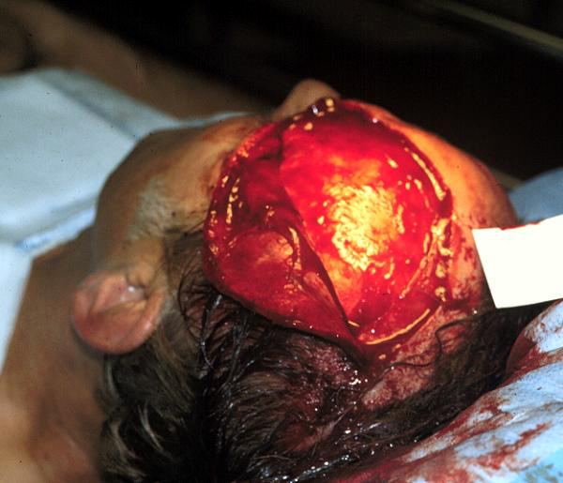
Scalp Laceration

Slide 16
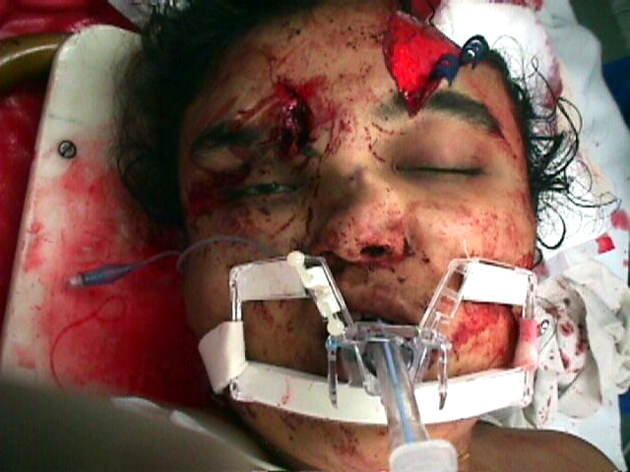
Degloving Laceration

Slide 17
Concussion
Results from a violent shock or jarring.
Can have LOC
Potential for transient amnesia, vertigo, nausea, weak pulse, and slow respiration.

Slide 18
Skull Fracture
Open, depressed, basilar
May or may not be associated with intracranial lesions
Presence should increase index of suspicion for underlying brain injury
Open fractures include those with deep scalp lacerations and fractures extending into the sinuses.
Require early surgery to decrease risk of meningitis.

Slide 19
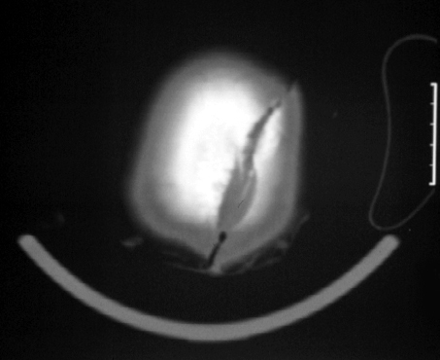
Skull Fracture

Slide 20
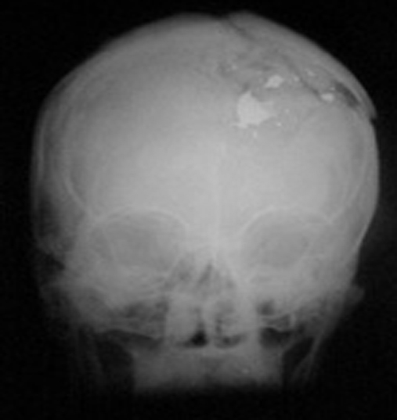
GSW

Slide 21
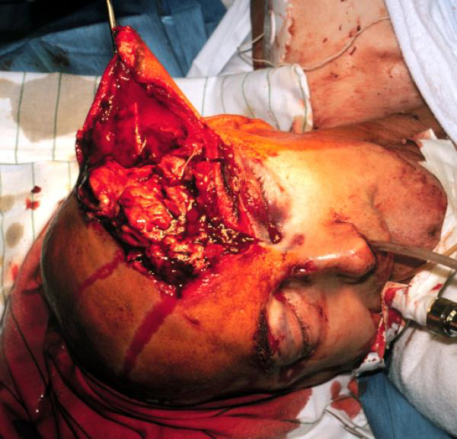
Open Skull Fracture
Requires debridement within 24 hours.

Slide 22
Depressed Skull Fracture
May require elevation
Depends on location and depth of depression.

Slide 23
Basilar Skull Fracture
Linear fractures that occur in the floor of the cranial vault.
Require more force to cause than other areas.
Occur as the only fracture in only 4% of severe head injury patients

Slide 24
Basilar Skull Fracture: Signs
Blood in the sinuses
CSF leak from the nose or ears
Periorbital ecchymosis – Racoon’s Eyes
Retroauricular ecchymosis – Battle’s Sign (bruising over the mastoid process)_

Slide 25
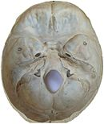
Base of the Skull

Slide 26
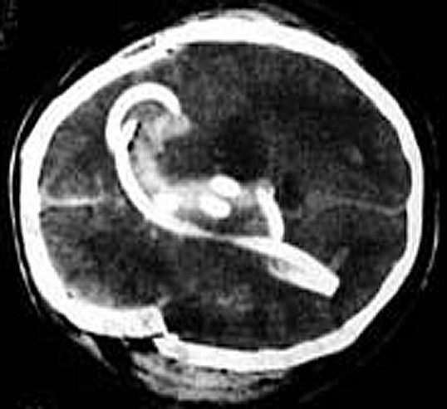
Basilar Skull Fracture

Slide 27
Subdural Hematoma
Most common focal intracranial lesion
Highest mortality rate of all lesions
Located between the the brain and the dura
Has a crescent shape
Usually caused by tearing of the bridging veins connecting the cerebral cortex and dural sinuses by a acceleration-deceleration movement

Slide 28
Characteristics of SDH Affecting Outcome
Hematoma thickness
Magnitude of midline shift
Associated contusions and edema
Outcome worsens as the amount of midline shift exceeds the thickness of the hematoma.
Management: immediate surgical decompression

Slide 29
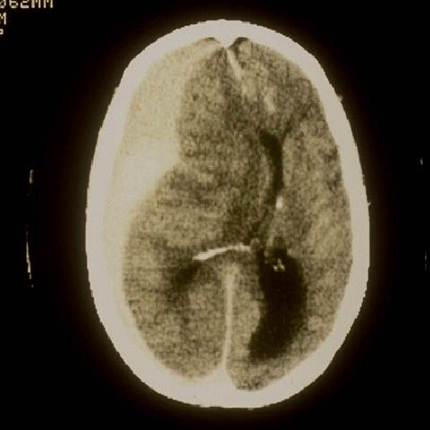
Subdural Hematoma

Slide 30
Epidural Hematoma
Generally have better prognosis than SDH
Are biconvex and located between the dura and skull
Result from torn middle meningeal artery
May also result from skull fracture or bridging veins
Symptoms: HA, vomiting, seizure, HTN, difficulty breathing

Slide 31
Epidural Hematoma
Often have only brief LOC followed by period of lucidness
As hematoma develops, patient deteriorates (classic walk and die)
Mortality: 0%-5% in patients who do not fall into a coma
Comatose patients: 11%-41%

Slide 32
EDH - Treatment
Small EDH with no pressure on the brain: observation
Severe HA and deterioration of brain function, or an EDH larger than 1 cm at its thickest point, surgery.
Surgical intervention: decompression

Slide 33
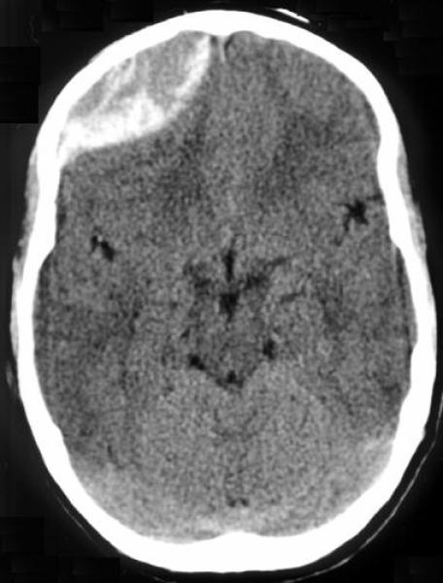
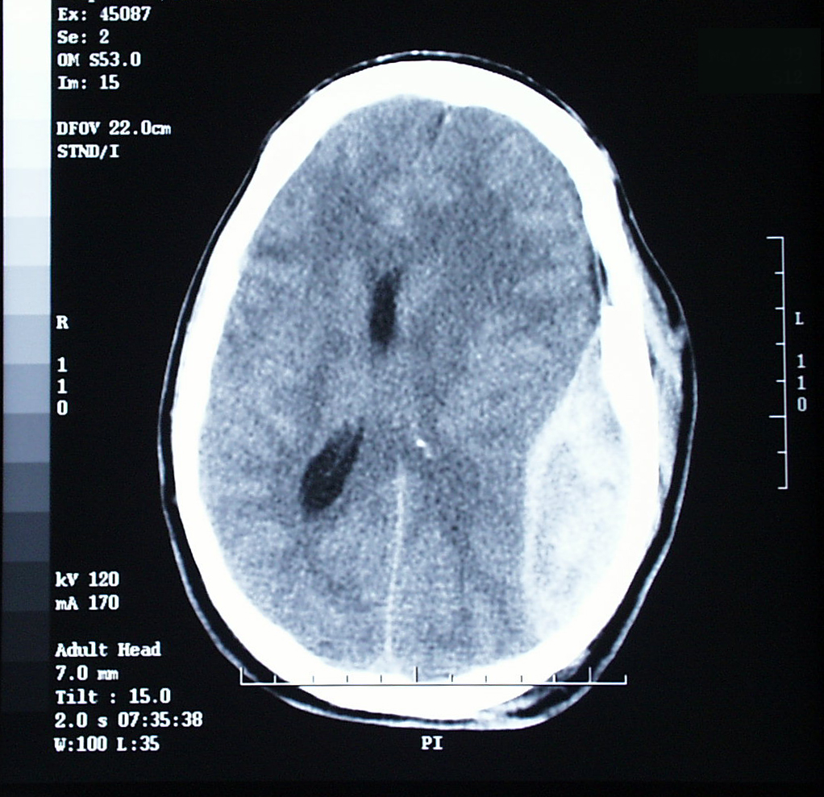
Epidural Hematoma

Slide 34
Cerebral Hematoma
Collection of blood within the brain parenchyma
Appearance on CT may be delayed for up to 24-48 hrs.
19% of patients had delayed presentation
Symptom onset: deterioration of neuro status

Slide 35
Cerebral Hematoma
Determinants of outcome:
GCS
Presence of hypoxia
Hematoma volume
Management:
Surgical evacuation with/without decompressive craniectomy if intracranial HTN refractory to medical treatment

Slide 36
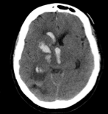
Cerebral Hematoma

Slide 37
Diffuse Axonal Injury
Caused by sudden deceleration or rotational forces that most often occur at the gray-white matter junction (high speed MVC, Shaken Baby Syndrome)
Best diagnostic test: MRI
Extent of injury usually worse than depicted by imaging
DAI causes downstream deafferentation and disconnection in the brainstem leading to coma

Slide 38
DAI
Brainstem function remains intact – rarely cause of death
Most frequent cause of persistent vegetative state following trauma
Damage occurs at time of injury and then when secondary swelling occurs
Immediate LOC, most have no period of lucidity

Slide 39
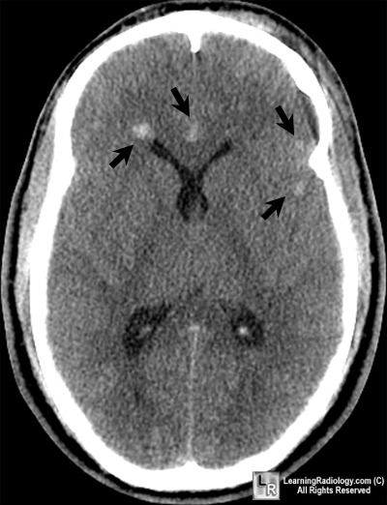
DAI

Slide 40
Physiology
Skull is a rigid container
Contains the brain, CSF, blood perfusing the brain
Head injury: ICP increases because of changes to one or more of these fixed volumes

Slide 41
Increased ICP
Reduces blood flow to the brain
Cerebral perfusion pressure (CPP) is defined as the difference between the MAP and either ICP or CVP, whichever is highest.
If ICP rises sufficiently, CPP is reduced resulting in ischemia to the brain.
Normal upper limit of ICP is 10-15 mmHg.
ICP monitoring recommended in all patients with a GCS < 8 and abnormal head CT on admission.
Notes:
SBP < 90
Age > 40

Slide 42
Increased ICP
Increased ICP can also result in brain herniation.
Herniation can occur across the meninges, down the spinal canal, or through an opening in the skull.
Can rapidly lead to neurologic deterioration and death.

Slide 43
Symptoms of Increased ICP
HA, vomiting, papilledema, drowsiness, LOC, behavioral changes
Other sxs: pathologic (decerebrate) posturing, oculomotor nerve palsy, abnormalities of brain stem reflexes, abnormal respiratory patterns – probably caused by brain stem distortion or ischemia secondary to elevated ICP.

Slide 44
Symptoms of Increased ICP
Cushing Reflex:
Consists of HTN, bradycardia, and irregular respirations.
Probably due to medullary ischemia
Generally occurs when ICP approaches systemic arterial pressure.

Slide 45
Methods for Controlling ICP
CSF
Mannitol or other hypertonic solution
External CSF drainage (ventricular catheter, lumbar drain, VP shunt, serial LP)
Brain
Mannitol or hypertonic solution ± furosemide
Decompressive craniectomy
Resection of contusion or other mass lesion
Blood volume

Slide 46
Methods for Controlling ICP
Blood Volume
Mannitol
Hyperventilation
Hypothermia
Head elevation, neutral neck position
Deep propofol or barbiturate sedation ± paralysis
Control of seizures

Slide 47
Cerebral Blood Flow (CBF)
Brain receives 15% of CO
CBF autoregulates with pressure changes
In normal patients, the MAP can vary from 50-150 mmHg.
CBF will remain constant because of an adjustment of cerebral vascular resistance.
Chronic HTN shifts this autoregulation to higher pressures.

Slide 48
CBF
Autoregulation can be abolished by trauma, hypoxia, and certain anesthetics.
When blood pressure exceeds the autoregulation range it can cause disruption of the BBB and lead to cerebral edema.
Partial pressure of CO₂ in arterial blood is a powerful vasodilator that increases flow.
Doubling PaCO₂ doubles the flow, reducing PaCO₂ by half, halves the flow.

Slide 49
Resuscitation of Head Injured Patients
ATLS principles (Advanced Trauma Life Support)
Secure the airway
Hyperventilation
Diuretics
Intravascular volume expansion

Slide 50
Airway
If patient arrives in the ED/OR intubated, confirm proper placement with CO₂ detector.
If not intubated, prepare to secure the airway.
Indicators for intubation: decreased LOC, increased risk of aspiration, hypoxia, hypercarbia.

Slide 51
Airway Considerations
Skill and expertise of the provider
Potential for cervical spine injury
Risk factors for C-spine injury: MVA and a GCS < 8.
All attempts at intubation should include in-line stabilization of the neck.
Have a backup plan
Oral intubation is preferred

Slide 52
Drugs to Facilitate Intubation
Avoid hypo and hypertension
Propofol: 2-2.5 mg/kg
Etomidate: 0.2-0.3 mg/kg
Lidocaine 1.5 mg/kg
Muscle relaxants: succinylcholine or rocuronium
Avoid nitrous oxide
Initial ventilation parameters: 100% O₂, arterial CO₂ in low range (35 mmHg)

Slide 53
Circulation
Establish adequate circulation so organ perfusion is maintained.
Isotonic IVF should be given as indicated to restore intravascular volume and avoid hypotension.
Goal is to maintain CPP in the range of 60-70 mmHg
Vasopressors and inotropes
MAP 70-80 mmHg
Notes:
Hypertensive usually = 150 Systolic

Slide 54
Neurologic Exam
Standard method is GCS
Useful because of ease and prognostic information
Mild head injury: 13-15
Moderate head injury: 9-12
Severe head injury: 3-8
Should be calculated once the patient has been resuscitated and is normotensive.
Pupil status

Slide 55
Ventilation
Hyperventilation effective way to reduce ICP.
Useful in setting of acutely increased ICP.
Causes cerebral vasoconstriction, reducing blood volume.
Reduction in cerebral blood volume achieved at the expense of CBF, however.
Controversial: degree and duration of hyperventilation that can be used safely is uncertain.

Slide 56
Ventilation
Excessive or prolonged hyperventilation may cause cerebral ischemia by decreasing CBF.
Current recommendations: head injured patients should be maintained at normocapnia except when hypocapnia is necessary to control acute increases in ICP.
Chronic hyperventilation should be avoided if possible.

Slide 57
Coagulopathy
Brain is rich in tissue thromboplastin.
Severe TBI with contusion can lead to consumption coagulopathy and/or DIC.
Presence of coagulopathy in TBI is indicative of poor prognosis.
FFP is indicated when INR > 1.4

Slide 58
Coagulopathy
Platelets should be given when count < 100K or if patient is on ASA and there is clinical bleeding despite normal platelets count.
Activated rFVII may be useful as an immediate therapeutic measure under these circumstances.
Systemic hypothermia can aggravate coagulopathy.

Slide 59
Fluids
Hypertonic or isotonic crystalloid is the preferred fluid in patients with TBI.
Blood is the preferred colloid when indicated.
Albumin is preferable to hydroxyethyl starch.

Slide 60
Anesthetic Management

Slide 61
Monitors
All ASA monitors
Arterial blood pressure
2 large-bore IVs
CVP
UO
Esophageal/bladder temp
ICP monitoring as indicated

Slide 62
Emergent/Neurosurgical
Tracheal intubation if not already done
Be aware of other systemic injuries
GCS, pupils, CT findings
Note presence of intoxication/psychoactive drugs
Risk of aspiration
Assess volume status
Labs

Slide 63
Emergent/Neurosurgical
May present without ICP monitoring
Should be hyperventilated until dura is opened.
Management of BP:
Hypertension: should be tolerated until cranium opened.
Hypotension: MAP should be at least 80-90 mmHg. Combination of fluid and vasopressors may be used.

Slide 64
Emergent/Neurosurgical
Anesthetic agents
Nondepolarizing agents to prevent coughing/movement
Volatile agents
Nitrous increases CMRO₂, CBF, and ICP in head-injured patients.
Opioids can be used safely as long as BP not compromised and patient adequately ventilated.

Slide 65
Emergent/Nonneurosurgical
Patient may need to go to OR for life-saving procedures prior to undergoing an adequate neurological examination or head CT.
Main goal: resuscitation and correction of hypotension.
Most immediately life-threatening condition must take priority.
Need history on LOC and pupil exam
Neurosurgeon may place ICP monitor
Surgery-stabilization-head CT-possible return to OR for definitive neurosurgical management.

Slide 66
Other Considerations
Assess defects before and after procedures.
Be careful moving from OR table to bed – may need to keep head elevated.
Be mindful of whether ICP catheter is open/closed.
Table may be turned away from you – consider circuit extensions, IV line extensions.
Can have large blood loss.
Have drips ready (phenylephrine, nicardipine)

