Slide 1
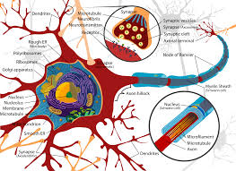
Anesthetic Implications of Patients with Neurological Diseases
Melinda Stone
APRN, CRNA, MS
Adapted lecture from Julie Zupfer Anderson

Slide 2
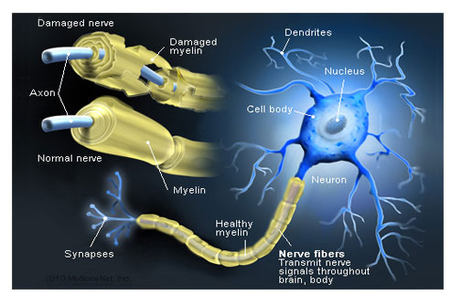
Multiple Sclerosis₁
Inflammation & demyelination of brain & spinal cord; both white & grey matter affected
Symptoms depend on demyelination site
Brainstem → nystagmus, diplopia, trigeminal neuralgia, autonomic dysfunction & ventilation Δ → hypoxemia & resp failure
Spinal cord → weakness & paresthesias (legs > arms), bowel retention & urinary incontinence
Course characterized by unpredictable symptom exacerbations over years
Barash chapter 23
http://www.onhealth.com/content/1/multiple_sclerosis_ms

Slide 3
Multiple Sclerosis₂
Diagnosis criteria
Age of onset 10-50 years
S & S of CNS white matter disease
2+ attacks separated by a month or more
Involvement of 2 or more non-contiguous anatomic areas
IgG & albumin in CSF
MRI provides evidence of demyelination plaque locations in CNS
Treatment
Immune modulators--Interferon, IV & PO agents, monoclonal Ab, steroids
Diazepam, dantrolene &/or baclofen for spasticity
Carbamezepine for dysethesias, tonic seizures & ataxia
Notes:
Dysesthesia—unplease, abnormal sense of touch

Slide 4
Multiple Sclerosis₃
Anesthetic management
Risk of exacerbation/relapse with either regional or GA
Spinals have been associated with relapse
Demyelinated SC areas more sensitive to LA, causing neuortoxicity
Epidural analgesia safely provided with lower bupivacaine concentrations per Barash
Demyelinated fibers extremely sensitive to temp, which blocks impulse conduction; avoid hyperthermia as it can cause exacerbation
Autonomic dysfunction may enhance hypotensive effects of gas
If monitoring with SSEPs or MEPs, may see prolonged latency

Slide 5
Multiple Sclerosis₄
Anesthetic management
risk of cardiotoxicity from immunosuppressants
Altered response to MRs
Baclofen sensitivity to NDMRs
Anticonvulsants = resistance to NDMRs
Succs can produce K⁺ release
Respiratory involvement (muscle weakness or resp control dysfunction) likelihood for support during post-op period

Slide 6
Epilepsy₁
Seizure is common manifestation of many CNS disease
Epilepsy (idiopathic seizures) begins in childhood
Sudden seizure onset in adults may be d/t focal disease (tumor)
Seizures after 60 years of age may be result of cerebrovascular disease, head injury, tumor, infection or metabolic disorders
Despite many anti-seizure drugs available, 30% of epileptic pts poorly controlled & sudden deaths occur

Slide 7
Epilepsy₂ )
Anesthetic management
Volatile anesthetics (including N₂O) have been reported to produce seizure activity Iso & des < sevo
Avoid ketamine d/t risk of seizure activity
Fentanyl, sufenta & remi may produce myoclonic activity or chest wall rigidity
Local anesthetics can ↓ seizure threshold but there’s no evidence that regional anesthesia seizure risk
Be aware of anti-seizure meds side effects: leucopenia, anemia, hepatitis & hepatic failure, pancreatitis, coagulopathy, cardiotoxicity, hypothyroidism & skin rash
Vagal nerve stimulator complications: vocal cord paralysis, facial palsy, bradycardia/asystole & airway obstructions
Have appropriate back-up airway equipment & anticonvulsants available

Slide 8
Parkinson Disease₁
Degenerative CNS disease caused by dopaminergic cell loss in brain basal ganglia
Characterized by Lewy bodies in substantia nigra neurons
Lewy bodies are aggregations of damaged proteins
Etiology is theorized to be genetic predisposition & unidentified environmental factors
S & S caused by dopamine deficiency & diminished inhibition of extrapyramidal motor system → resting tremor, cog-wheel rigidity of extremities, dyskinesias, bradykinesia, shuffling gait, stooped posture & facial immobility
Other S & S orthostatic hypotension, dysphagia, diaphragmatic spasm, bladder dysfunction, oculogyric crisis, dementia, depression, seborrhea & sialorrhea (excessive salivation)

Slide 9
Parkinson Disease₂
Medical treatment directed towards increasing dopamine levels
Levodopa single most effective drug; admin with carbidopa & entacopone to avoid side effects & bioavailability
Monoamine oxidase-B inhibitors (selegiline & rasagiline) improve function
Anesthetic management
Levodopa has short ½-life; should be given am of surgery; interruption > 6-12 hour → severe skeletal muscle rigidity
Avoid dopamine antagonists—droperidol, metoclopramide (reglan), phenothiazines
Slow admin of fentanyl & alfenta to avoid dystonic rx
Ketamine OK to use but reports of exaggerated SNS response with tachycardia & HTN
Reports of pts taking selegiline or meperedine & having agitation, muscle rigidity & hyperthermia

Slide 10
Parkinson Disease₃
Anesthetic management cont
Dopamine agonists → risk for neuroleptic malignant syndrome
Autonomic dysfunction common; orthostatic hypotension aggravated by vasodilation d/t anti-Parkinson drugs
Excess salivation & esophageal dysfunction → risk for aspiration pneum
Peri-op resp complications common with upper airway obstruction d/t poor muscle coordination & neurotransmitter imbalance
Higher risk for post-op confusion & confusion
Youtube video
https://www.youtube.com/watch?v=ie5WXDlxPWo
Start at 5:20

Slide 11
Alzheimer’s Disease₁
Stats from Alzheimer’s Association (https://www.alz.org/documents_custom/2016-facts-and-figures.pdf)
2016 estimated 5.4 million Americans have Alzheimer’s Disease (AD)
81% of people with AD are 75 or older
32% of people 85 or older have Alzheimer’s
2/3 of AD pts are women
Older African-Americans & Hispanics more likely to develop AD
Lifetime risk of development at age 65 is 1 in 6 (17%) women & 1 in 11 (9%) for men
By 2025 people age 65 or older with AD projected to be 7.1 million; by 2050 13.8 million!

Slide 12
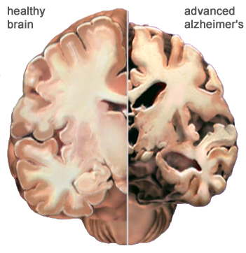
Alzheimer’s Disease₂
Disease process
Deposit of amyloid β peptides → amyloid plaques & neurofibrillary tangles & apoptotic cell death
Cognitive impairment, poor decision making, language deterioration, gait disturbances, agitation, seizures, psychosis
Treated with cholinesterase inhibitors & NMDA receptor antagonists
Side effects of cholinesterase inhibitors include N/V, bradycardia, syncope & fatigue
How would use of cholinesterase inhibitors affect non-depolarizing MRs?
May also be taking antidepressants, anticonvulsants & antipsychotics
https://www.alz.org/braintour/healthy_vs_alzheimers.asp
Notes:
Cholinesterase inhibitors (donepezil, rivastigmine, and galantamine) may antagonize the effect of non-depolarizing neuromuscular blocking agents—meaning paralysis doesn’t happen

Slide 13
Alzheimer’s Disease₃
Anesthesia Management
Careful consideration of pt’s meds & anesthetic concerns
Pt may be confused & uncooperative d/t dementia; post-op cognitive dysfunction can occur
Avoid sedation
If anticholinergic required, glycopyrrolate preferred d/t ∅ BBB
Pts on cholinesterase inhibitors → prolonged response to succs; resistance to NDMRs
Notes:
Cholinesterase inhibitors tacrine (cognex); donepezil (aricept); rivastgmine (exelon); galantamine (razadyne)

Slide 14
Post-Op Cognitive Decline Article
Possible Paper Topic!
Here’s an excellent article:
Prog Neuropsychopharmacol Biol Psychiatry. 2013 Dec; 47: 10.1016/j.pnpbp.2012.06.011.
Published online 2012 Jun 21. doi: 10.1016/j.pnpbp.2012.06.011
PMCID: PMC3509241
NIHMSID: NIHMS394929
Anesthesia, Surgery, Illness and Alzheimer’s Disease
Roderic G. Eckenhoff and Krzysztof F. Laudansky
Author information ► Copyright and License information ►

Slide 15
Amyotrophic Lateral Sclerosis (ALS) Disease₁
Degenerative motor neuron disease (upper & lower)
Four patterns of clinical presentation
Limb onset
Bulbar onset
Pure upper motor neuron
Progressive muscular atrophy
S & S influenced by affected neurons
Skeletal muscle weakness & fasciculations initial symptoms
Bulbar atrophy results in dysarthria & dysphagia
PFts ↓ VC & max voluntary ventilation; resp failure eventually develops
Cause of death is respiratory failure or circulatory collapse
Autonomic dysfunction → resting tachycardia, orthostatic hypotensive & epi & norepi circulating levels
Notes:
Dysarthria = speaking

Slide 16
Amyotrophic Lateral Sclerosis (ALS) Disease₂
Anesthesia Management
No evidence supporting “best” anesthetic approach
Neuromuscular transmission markedly abnormal
Can be very sensitive to NDMRs
At risk for succs-induced hyperkalemia
Need for post-op vent support likely

Slide 17
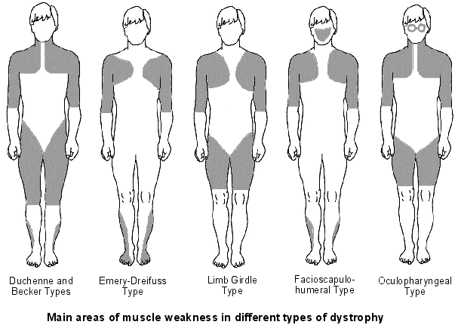
Muscular Dystrophy
Associated with muscle membrane
abnormalities
Progressive loss of skeletal muscle
function
Cardiac & smooth muscle
dysfunction less evident but contributes to significant M & M
Duchenne MD
Sex-linked recessive trait; caused by dystrophin absence in muscle membrane cytoskeleton
Characterized by skeletal muscle painless degeneration & atrophy; starts proximally
http://patient.info/health/muscular-dystrophies-an-overview

Slide 18
Muscular Dystrophy₂
Duchenne MD cont
Symptoms appear 2-5 years of age; significant limitations by age 12
Common surgical procedure is intervention for kyphoscoliosis
Cardiac dysfunction includes cardiomyopathy, ventricular dysrhythmias & mitral regurg
Other clinical manifestations include ineffective cough d/t ↓ muscle strength → retention of pulm secretions & pneumonia
Smooth muscle involvement causes intestinal hypomotility, gastroparesis & delayed gastric emptying
Meds may include ACE inhibitors & β-adrenergic blockers

Slide 19
Muscular Dystrophy₃
Becker MD
Reduced amount of dystrophin
Milder clinical course with respect to skeletal muscle dysfunction compared to DMD
Cardiac more prevalent in BMD vs DMD
May also have epilepsy, macroglossia & color blindness
Emery-Dreifuss MD
Characterized by contractures of elbows, ankles, spine & humeropectoral weakness
Skeletal muscle manifestations usually mild
Cardiac conduction defects can be fatal; ICD often placed

Slide 20
Muscular Dystrophy₄
Limb-girdle MD
Weakness of shoulder & pelvic girdles
Cardiomyopathy & AV conduction defects can occur
Facioscapulohumeral MD
Diverse S & S such as weakness of facial, scapulohumeral, anterior tibial & pelvic girdle muscles
Also retinal vascular disease, deafness & neurologic dysfunction
Cardiac conduction defects & dysrhythmias also occur
Oculopharyngeal MD
Presents in late adulthood with ptosis & dysphagia 2º to pharyngeal & esophageal muscle weakness
Onset of recovery from NDMRs may be delayed although recovery appears normal

Slide 21
Muscular Dystrophy₅
Congenital MD
Early onset (infancy) of hypotonia, developmental delay, feeding difficulties & respiratory dysfunction
Includes a whole bunch of muscular dystrophies I’ve never heard of
Severe resp dysfunction but cardiac involvement not as prominent as other MDs
Anesthesia Management
Anesthesia complications 2º to myocardial & skeletal muscle weakness
Numerous reports of rhabdomyolysis & hyperkalemia in DMD & BMD pts; have occurred with volatile agents alone or in combination with succs
These rhabdomyolytic episodes are unpredictable & may depend on state of muscle degeneration & regeneration
Use of volatile anesthetics in MD pts is controversial

Slide 22
Muscular Dystrophy₆
Anesthesia Management cont
Rhabdomyolysis may resemble malignant hyperthermia, doubtful that MD pts are more prone to MH
Close monitoring for rhabdo in peri-op period required
No succs for MD pts; may have normal or prolonged recovery from NDMRs
Increased risk of aspiration d/t degeneration of GI smooth muscle, intestinal hypomotility, delayed gastric emptying & impaired swallowing
Vigorous resp tx & mechanical ventilation may be required post-op

Slide 23
Myotonias₁
Myotonia = delayed skeletal muscle relaxation after voluntary contraction
Electromyography shows repetitive muscle fiber discharges that fluctuate
Abnormalities caused by muscle membrane ion channel dysfunctions
2 distinct types
Myotonic dystrophy type 1 most common
Affects the musculoskeletal, heart, respiratory, CNS & endocrine systems
Muscle weakness starts distally & progressed to proximal muscles, muscle wasting occurs
Pulmonary effects include restrictive ventilation pattern, mild arterial hypoxemia & diminished ventilatory response to hypoxia & hypercapnia; resp muscle weakness → ineffective cough & pneumonia; risk of aspiration
Cardiac manifestations include AV conduction delay, atrial tachydysrhythmias, diastolic dysfunction, cardiomyopathy, mitral valve prolapse
Sudden death may be 2º to 3rd heart block or ventricular dysrhythmias

Slide 24
Myotonias₂
Sudden death may be 2º to 3rd heart block or ventricular dysrhythmias
Other S & S include cataracts, DM, thyroid dysfunction, adrenal insufficiency & gonadal atrophy
Pregnancy may produce myotonic dystrophy exacerbation & CHF more likely to occur during pregnancy
C-section often required d/t uterine smooth muscle dysfunction
Only supportive treatment available
Sodium channel blockers (procainamide, phenytoin, mexiletine)
Tricyclic antidepressants (clomipramine, imipramine)
Benzos
Calcium antagonists, taurine
Prednisone
https://www.ncbi.nlm.nih.gov/pubmedhealth/PMH0013003/

Slide 25
Myotonias₃
Anesthesia Management
Type I have more peri-op complications d/t presence of cardiac & resp muscle dysfunction
Succs produces exaggerated contractures—AVOID
Response can be so severe that ventilation & intubation are difficult
Due to chronic myopathy that develops in type I pts, response to NDMRs may be enhanced; reversal with neostigmine may provoke myotonia
Response to peripheral nerve stimulators must be carefully evaluated because muscle stimulation could be misinterpreted as sustained tetany when significant neuromuscular blockade still exist (let’s think on this…)
Reversal of rocuronium with sugammadex attractive alternative
Very sensitive to respiratory depression from opioids, benzos, inhaled anesthetics & barbiturates

Slide 26
Myotonias₄
Anesthesia Management cont
No specific anesthetic technique shown to be superior
Carefully controlled propofol infusions have been used successfully; regional anesthesia has been used in both adults & children
If inhaled anesthetics used, cardiac rhythm & function should be carefully monitored
Post-op ventilatory support will most likely be needed
Skeletal muscle weakness & myotonia is exacerbated during pregnancy; labor generally prolonged with postpartum hemorrhage from placenta accreta
Both spinal & epidural anesthesia have been successfully used in parturients

Slide 27
Myasthenia Gravis vs. Myasthenic Syndrome₁
Myasthenia Gravis
Autoimmune disease with antibodies to acetylcholine receptors at NMJ
Auto-antibodies damage muscle membrane by complement activation, lysis of postsynaptic membrane & loss of postsynaptic folds
Clinical hallmark is skeletal muscle weakness, aggravated by repetitive use
Any skeletal muscle can be affected but those innervated by cranial nerves more likely
Initial symptoms can include diplopia, dysarthria, dysphagia or limb muscle weakness
Myasthenic crises occur in 20-30% of MG pts; caused by poor control of MG, stress, hyperthermia or pulmonary infections; characterized by extreme muscle weakness & resp failure
Cardiac concerns include focal myocarditis, a fib, AV conduction delay & LV diastolic dysfunction

Slide 28
Myasthenia Gravis vs. Myasthenic Syndrome₂
Myasthenia Gravis cont
Pregnancy can cause remission or an exacerbation, with increased symptoms, including resp failure even into postpartum period
Treatment includes cholinesterase inhibitors (pyridostigmine), corticosteroids, immunosuppressants (azathioprine, Imuran), IV immunoglobulin (IVG) & plasmapheresis
Cholinesterase inhibitors concentration of ACh at postsynaptic membrane
MG control with pyridostigmine only can be challenging
Under dosing → residual muscle weakness
Over dosing → cholinergic crisis (abd pain, salivation, bradycardia, skeletal m weakness)
IVG & plasmapheresis used for rapid treatment
Thymectomy is treatment of choice

Slide 29
Myasthenia Gravis vs. Myasthenic Syndrome₃
MG Anesthesia Management
Main concern is anesthetic drugs that may exacerbate muscle weakness
Uncontrolled or poorly controlled MG pt exquisitely sensitive to NDMRs
Small doses can → significant resp muscle weakness
Best to completely avoid NDMRs
Use of volatile anesthetics may provide enough relaxation for intubation
although rocuronium with sugammadex may be good choice if muscle relaxation required
MG pts on anticholinesterases (pyridostigmine) are resistant to succinylcholine (may need dose of 1.5-2 mg/kg)
These pts are difficult to wean from mechanical ventilation
For OB pts, expect MG exacerbations during pregnancy
Epidural anesthetics can be used for L & D; amide local anesthetics preferred over ester as amide metabolism not affected by cholinesterase activity
Notes:
Normal succs dose 1-1.5 mg/kg per M & M

Slide 30
Myasthenia Gravis vs. Myasthenic Syndrome₄
Myasthenic Syndrome (Lambert-Eaton) or LEMS
Autoimmune disease frequently associated with cancer; categorized as paraneoplastic syndrome
LEMS pts have auto-antibodies which attack presynaptic voltage-gated calcium ion channels → decreased ACh release → muscle weakness
Weakness may appear months to years after cancer diagnosis
Small cell lung CA most frequently associated with LEMS
Typical LEMS pt is male, > 40 years of age with proximal muscle weakness in hips & shoulder → gait abnormalities & difficulty standing & climbing stairs
Autonomic dysfunction with dry mouth, constipation, ED & ↓ sweating
Paraneoplastic neurological syndrome also reported with breast & ovarian CA, lymphomas, testicular CA & neuroblastomas

Slide 31
Myasthenia Gravis vs. Myasthenic Syndrome₅
Myasthenic Syndrome (Lambert-Eaton) or LEMS cont
Treatment of underlying neoplasm may improve neuro condition
Most effective drug for muscle weakness is 3,4-diaminopyridine, which prolongs presynaptic action potential & ACh release
Corticosteroids, azathioprine, plasmapheresis &/or IVG may also be used
Anesthetic Management
LEMS pts are sensitive to both succs & NDMRs
Continue admin of 3,4-diaminopyridine until time of surgery
So MG sensitive to NDMRs but resistant to succs & LEMS sensitive to both NDMRs & succs

Slide 32
Guillain-Barre Syndrome₁
Also know as polyradiculoneuritis
Acute form of inflammatory neuropathies
Autoimmune disease triggered by viral or bacterial infection
Infectious agent produces substance that resembles host neural components & auto-antibodies are produced against gangliosides in peripheral nerves → molecular mimicry & cross-reactivity
Characterized by onset of skeletal muscle weakness or leg paralysis; paresthesias may proceed weakness
Paralysis progresses cephalad, involving trunk & arms
Maximal weakness usually occurs 2-4 weeks after onset
Most serious complication is respiratory dysfunction with 25% of pts requiring mechanical ventilation
85% of pts have good recovery, with 3-5% developing chronic neuropathy

Slide 33
Guillain-Barre Syndrome₂
Autonomic nervous system dysfunction → wide variety of CV affects
Similar to autonomic hyperreflexia, physical stimulation can cause HTN, tachycardia & dysrhythmias
Treatment with IVG & plasma exchange found to be effective
Anesthesia Management
ANS dysfunction may cause hypotension 2º to postural changes, blood loss or (+) pressure ventilation
Stress of DL & intubation can cause exaggerated HR & BP increases
Avoid succs d/t hyperkalemia risk; risk continues even after clinical recovery so NO SUCCS!
Cisatracurium or rocuronium (short-acting with minimal CV effects) OK
Reaction to NDMRs can range from extreme sensitivity to resistance
Will most likely need post-op vent support
Pronounced sensory disturbances may benefit from neuroaxial opioids

Slide 34
CSF Pathway Abnormalities/Hydrocephalus (Handbook of Anesthesia, 5th edition, Nagelhout & Plaus)
Abnormal CSF accumulation d/t either excessive production or ↓ absorption
Leads to intraventricular pressures, adjacent brain tissue compression & cranial size
Obstructive or non-obstructive
Early S & S: HA, apnea, bradycardia, N/V, head circumference, mentation changes, nystagmus, ↓ reflexes
Late S & S: bulging fontanelle, pupillary areflexia, nuchal rigidity, “setting sun” eyes, CN VI palsy, limb spasticity, ↓ LOC, widening pulse pressure, altered HR, visual changes & HTN
VP shunt is treatment
Anesthetic consideration
ICP already elevated; maintain baseline neuro status; minimal sedation & narcotics
Smooth induction & intubation; hyperventilate after to ↓ ventricle size
Sudden removal of large volumes of CSF → bradycardia & hypotension

Slide 35
Intracranial Aneurysms₁ (Barash ch 37 & Vargo Anesthesia Mega APP)
General info
Relatively common (1 in 50); women > men
Arise from congenital weakness in vessel wall; HTN, smoking, increased age & African Americans compared to Caucasians = risk
80-90% located in anterior (carotid), anterior & posterior communicating & middle cerebral arteries
May be asymptomatic with rupture S & S including severe HA, focal neuro deficits, lethargy & coma (rupture rate 1 in 8,000)
Surgical or endovascular interventions include craniotomy, aneurysm clipping &/or endovascular coiling
Maintaining aneurysm transmural or trans-membrane pressure to prevent rupture is most important for anesthesia provider (what would change transmural pressure & what can be done to avoid it?)

Slide 36
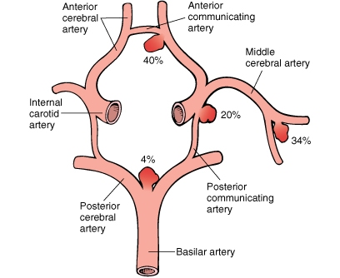
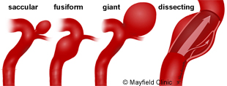
Intracranial Aneurysms
http://www.neuroems.com/2014/04/18/blood-flow-through-the-brain-pt-3-circle-of-willis/
http://www.mayfieldclinic.com/PE-AneurUn.htm

Slide 37
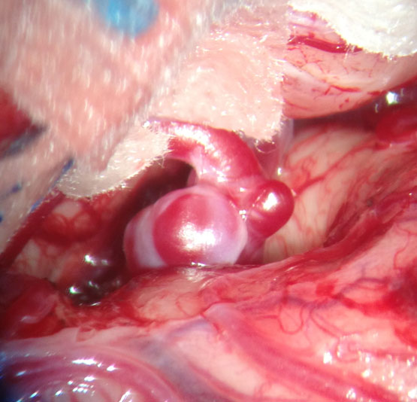
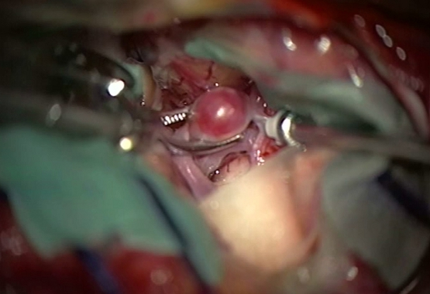
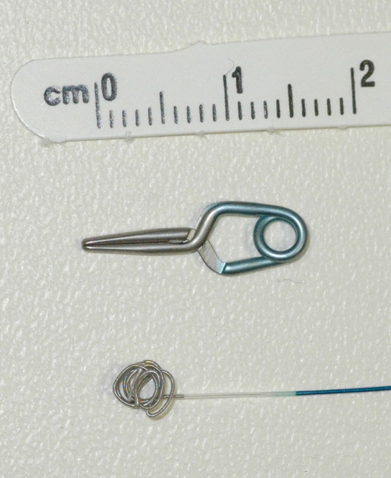
Cerebral Aneurysm Clipping
http://www.nvca.be/en/treatments/surgery_aneurysm

Slide 38
Intracranial Aneurysms₂ (Barash ch 37 & Vargo Anesthesia Mega APP)
Anesthetic Management Goals for elective surgery—Aneurysm Clipping
Maintain optimum CPP & this is dependent on stage of surgery
BP control is critical; DO NOT allow BP to rise above preop baseline as this will aneurysm transmural P & risk of rupture
have all push & gtts primed & ready to go
Esmolol prior to intubation to avoid BP spikes not a bad idea
Any reduction in ICP should be gradual until dura opened
Decrease intracranial volume → mannitol, lasix, hyperventilation & normovolemia
Decrease metabolic rate & CMRO₂
Accomplished through temp, gas & drugs
Allows brain to tolerate hypotension & ischemia if sudden ↓ MAP or CPP required

Slide 39
Intracranial Aneurysms₃ (Barash ch 37 & Vargo Anesthesia Mega APP)
Usual Anesthetic plan for Clipping (crani):
GA with muscle relaxation (Avoid succs & No N₂O)
0.5-1 MAC gas with propofol/remi/precedex gtts
What are you going to use to prevent BP spikes with stimulating events?
Pt may be in tongs & turned way away from you. Preparation is key
Possible worst scenarios (rupture, massive blood loss) & be ready!
A line, great IV access, typed & crossed blood ready to go
Drains in place & pt positioning to maintain CSF drainage & ICP
MRs—consider effects if pt on anti-convulsants
Communication with surgeon KEY!
BP goals (MAP where before & after clipping)
Positioning

Slide 40
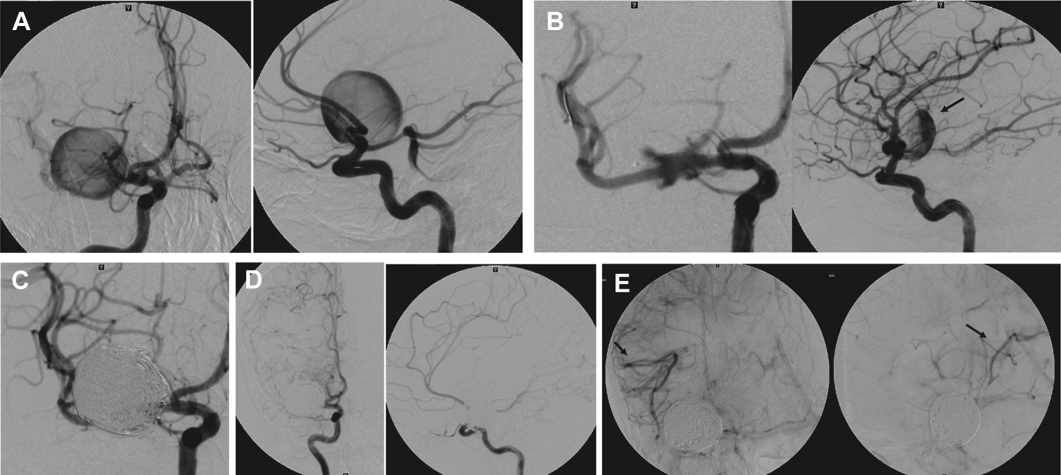
Cerebral Aneurysm Coiling
http://www.uhnj.org/stroke/risky.htm
http://www.neurosurgery-blog.com/wp-content/uploads/2012/08/Complications-After-Treatment-With-Pipeline-Embolization-for-Giant-Distal-Intracranial-Aneurysms-With-or-Without-Coil-Embolization.jpg

Slide 41
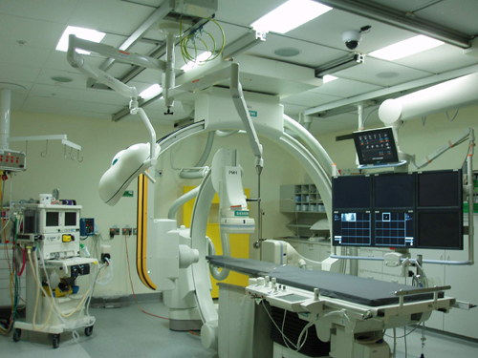
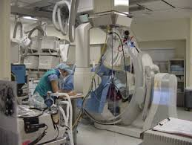
Cerebral Aneurysm Coiling
http://www.pmh.health.wa.gov.au/services/diagnostic_imaging/pmh/about_us/history.htm
http://rulacom.kz/asklepios/klinika_asklepios_altona/departament_neyroradiologii/

Slide 42
Intracranial Aneurysms₄ (Barash ch 37 & Vargo Anesthesia Mega APP)
Anesthetic Management Plan for elective surgery—Aneurysm Coiling
Endovascular procedure
May be long & you really won’t know what’s going on
Communicate with surgeon & don’t be afraid to ask what’s going on
Pt will be far away from you & you’ll want to stay out of radiation
You will have minimal access to pt so make sure everything is how you want it!
Special equipment set-up, extensions on all tubings, pressure lines & anesthesia circuit
Other special set-up per hospital
Maintain optimum CPP; BP control is critical
DO NOT allow BP to rise above preop baseline
have all push & gtts primed & ready to go
Esmolol prior to intubation to avoid BP spikes not a bad idea
A line required as heparin usually given & will need to check ACTs

Slide 43
Intracranial Aneurysms₅ (Barash ch 37 & Vargo Anesthesia Mega APP)
Possible Complications
Aneurysm rupture or “extravasation”
Coil moving out of aneurysm into more distal artery
Extension of thrombus out of aneurysm leading to thrombus formation in feeder vessel

Slide 44
Subarachnoid Hemorrhage₁
General info
Most commonly caused by intracranial aneurysm rupture; other causes trauma, vertebral & carotid artery dissection, dural & spinal AVMs, mycotic aneurysms, sickle cell disease, cocaine abuse, coagulation disorders & pituitary apoplexy
High M & M with only 33% of aneurysmal SAH pts being “functional” survivors
Direct effects of initial bleed, cerebral vasospasm & rebleeding
When aneurysm ruptures, critical ↓ CBF d/t ICP increasing to arterial diastolic values → vasospasm & ischemia
Common complications cardiac dysfunction, neurogenic or cardiogenic pulmonary edema, hydrocephalus & further bleeding; common ECG changes ST segment depression & T wave inversion
For survivors of initial bleed, emphasis is on aneurysm control (surgery or interventional neuroradiology)
10-23% of unsecured aneurysms will rebleed within 4-14 days (most within 6-12 hrs)
Rebleed mortality rate is 80%

Slide 45
Subarachnoid Hemorrhage₂
Vasospasm
PO nimodipine & statins found to be effective prophylaxis
Triple H therapy—hypervolemic, hypertensive & hemodilution is mainstay of treatment despite lack of evidence
Hypovolemia associated with poorer outcomes; volume expansion considered beneficial to optimize hemodynamics
Hypertension to help counteract loss of autoregulation association with vasospasm & improve pressure-dependent CBF
Hemodilution thought to improve microcirculatory flow
Common tx complications pulmonary edema & myocardial ischemia
BBB interrupted → aggravation of vasogenic edema & hemorrhagic infarction

Slide 46
Subarachnoid Hemorrhage₃
Common complications:
Hydrocephalus
Occurs in 25% of SAH pts
Blood in brain ventricular system obstructs CSF drainage & absorption sites
Permanent ventriculo-peritoneal shunt required in some pts
Seizures—occur in up to 13% of pts & are more common in pts with neuro deficits
Hyponatremia—occurs in up to 34% of pts
2 main causes
Syndrome of inappropriate antidiuretic hormone (SIADH)
Euvolemia or mild hypervolemia with excess free water
Tx is free water restriction
Cerebral salt wasting
Na⁺ & water depletion
Tx volume repletion & admin of Na⁺

Slide 47
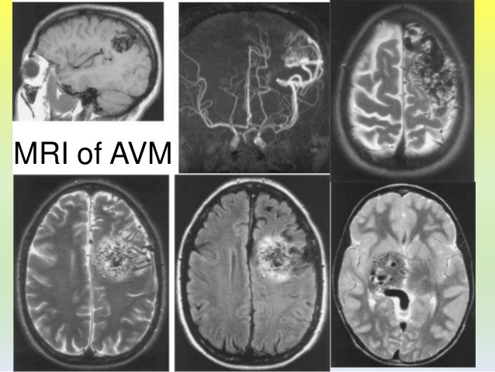
Arteriovenous Malformations (AVMs)
http://www.slideshare.net/DhavalShukla3/arteriovenous-malformation-avm-of-brain

Slide 48
Arteriovenous Malformations (AVMs) (Barash ch 37 & Vargo Anesthesia Mega App)
Direct arterial to venous connection without arterioles, capillary beds or venules to modulate pressure changes
No capillaries = no nutrients to surrounding tissues
Congenital & can occur anywhere in body
Many pts asymptomatic, especially young pts; common symptoms seizures or persistent HA; with rupture neuro deficits & LOC changes
Rupture can lead to stroke or death
Lack autoregulation & AVM is low-resistance pathway
Adjacent vessels may be chronically dilated to preserve perfusion & ∴ weaker
When AVM occluded, adjacent vessels may not be able to autoregulate & higher pressures may lead to “normal perfusion pressure breakthrough” → regional hyperemia at normal systemic pressures → vasogenic edema & hemorrhage
Pre-op embolization may be attempted to lessen this effect
BP control is critical & avoid coughing
IV labetalol or hydrazaline; Nicardipine gtt (plan anticipated & prophylactic vs reactive)
IV lidocaine for coughing

Slide 49
Autonomic Hyperreflexia
Pts with spinal cord injury above T₆ level
Stimulus below lesion site → vasoconstriction below site & HTN with bradycardia (sympathetic response) & cutaneous vasodilation (sweating, flushing & nasal congestion) above site (parasympathetic)
Reflex sympathetic stimulation below site unmodulated by supraspinal influence (parasympathetic) from above
Severe cases can lead to cerebral hemorrhage & myocardial ischemia
Deepening level of GA or spinal anesthetic, which blocks reflex stimulation may be ideal anesthetic; treat with nitroprusside
Main precipitants
Urological—bladder distension, urinary tract infection, urological procedures (cystoscopy, urodynamics), genital stimulation (including assisted ejaculation)
Gastrointestinal–rectal distension, anorectal conditions, anorectal procedures, acute abdomen
Musculoskeletal—fractures, dislocation, heterotopic ossification
Others—skin problems (ulceration, infection), pregnancy & labor
Notes:
Heteroropic ossification is the abnormal growth of bone in the non-skeletal tissues including muscle, tendons, or other soft tissue. When HO develops, new bone grows at 3 times the normal rate resulting in jagged, painful joints.

Slide 50
Complications of succs admin (Vargo Anesthesia Mega App)
Succinylcholine
ICP & IOP
Block prolonged by CCBs, lithium, MgSO₄, anticholinesterase agents, amide LAs, antibiotics
Can cause life-threatening hyperkalemia with following neuro conditions:
Duchenne’s MD, Becker’s MD or any unrecognized MD
CVA or spinal cord injury
MS
Gullain-Barre syndrome
Upper motor neuron lesions
Chronic muscle wasting
Myasthenia Gravis pts are resistant to Succs but sensitive to NDMRs
Myotonia pts can have such exaggerated contractures if given succs that intubation & ventilation may be very difficult
Excellent AANA article on Sugammadex
http://www.aana.com/newsandjournal/20102019/04wordwide-experience15.pdf

