Slide 1
Anesthetic Implications for Patients Undergoing Neurosurgery & Neurosurgical Procedures
Melinda H. Stone
APRN, CRNA, MS
(Adapted lecture from Julie Zupfer Anderson)

Slide 2
Objectives
Discuss neurophysiology of cerebral blood flow CBF, cerebral perfusion pressure CPP & autoregulation
Identify normal values for ICP & symptoms of intracranial HTN
Discuss management of intracranial HTN
Describe cerebral ischemia & protection
Discuss principles behind cerebral steal & inverse steal
Discuss fluid management for neurosurgical procedures
Discuss monitoring for neurosurgical monitoring & anesthetic implications
Describe principles of stereotaxy for craniotomy procedures
Discuss etiology & anesthetic management for pts with supratentorial mass lesions

Slide 3
Objectives
Discuss etiology & anesthetic management for pts with posterior fossa lesions
Identify risks and anesthetic management for sitting craniotomy procedures
Discuss etiology, monitoring & treatment for venous air embolism
Discuss paradoxical air embolism and pneumocephalus
Discuss etiology & anesthetic management for pt presenting for transphenoidal hypophysectomy procedures
Discuss anesthetic management for pts presenting for seizure-control surgery
Describe indication for awake craniotomy surgery & anesthetic management

Slide 4
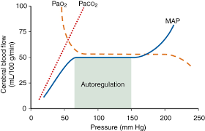
CBF, CPP & Autoregulation
Choroid plexus produces CSF; 150 mL volume in system
With normal vasculature, CBF avg 750 mL/min in adults (15-20% CO) in adults & has redundancy via circle of Willis
Cerebral metabolic rate & CBF tightly coupled
Monro-Kellie doctrine—BV, CSF & brain tissue must be in equilibrium
Autoregulation 60-150 mmHg & is highly variable per individual
Chronic HTN shifts both upper & lower limits → R and CBF requires higher MAP
Brain is only 2% of body wt yet accounts for 20% resting O₂ consumption!
Notes:
Brain is 2% of body wt yet accounts 20% of resting oxygen consumption

Slide 5
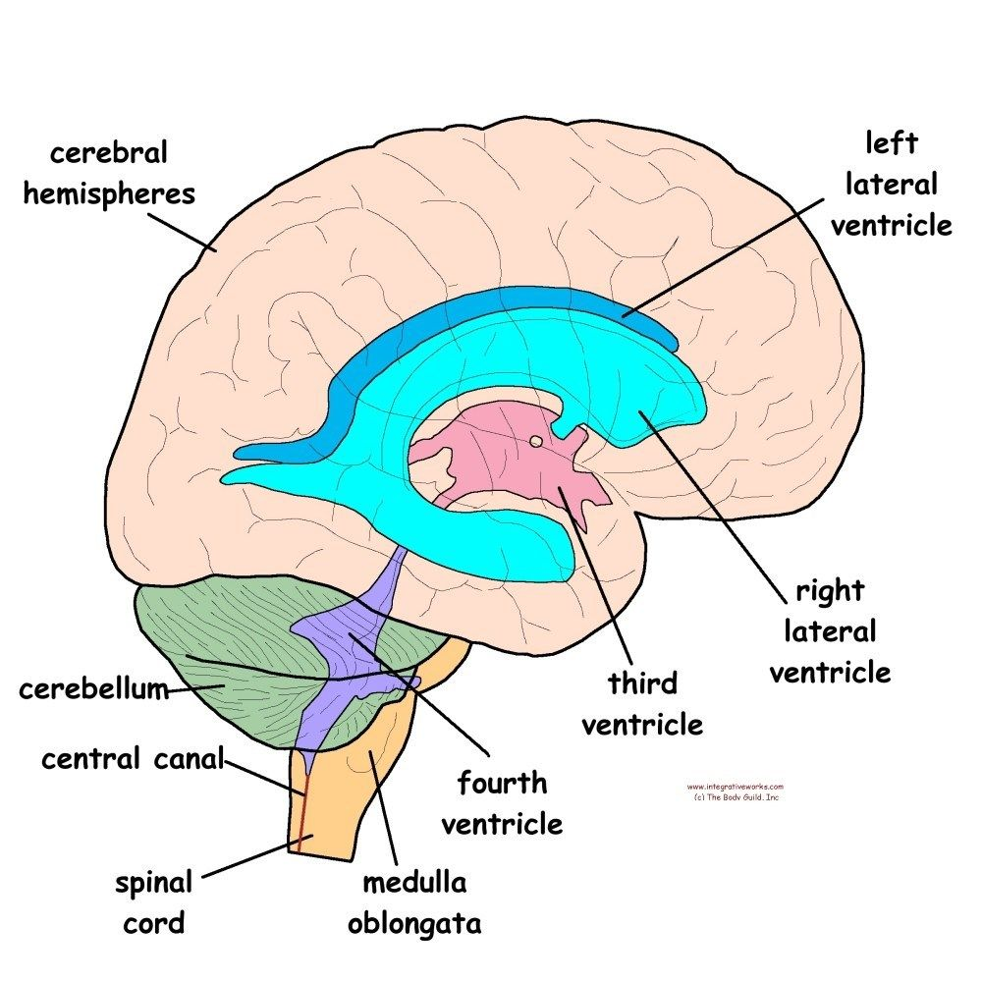
CSF Production
Produced by choroid plexus in lateral & 3rd ventricle → 4th ventricle via aqueduct of Sylvius → cranium subarachnoid spaces via foramen of Magendie & lateral foramina of Luschka
Some CSF moves into spinal cord subarachnoid spaces via foramen magnum (hint—make yourself a note card with the diagram & circulation)
Rate of production 15-20 mL/hour; total volume ~ 150 mL

Slide 6
Cerebral blood supply
Anterior Circulation
Anterior & Posterior spinal arteries
Anterior cerebral a → medial surface of cerebral hemispheres
Middle cerebral a → lateral surface of hemispheres
Striate a (branches of MCA) → internal capsule & its motor tracts (CVAs commonly involve striate a)
Anterior communicating a → connection between each hemisphere’s anterior cerebral a
Posterior communicating a → connection between middle & posterior a on each side
Posterior Circulation
Receives blood from vertebral (branches of subclavian) arteries; supplies posterior fossa structures
Verterbral a join to form basilar a
Vertebral & basilar a supply:
Cervical region of SC, brainstem, cerebellum, vestibular apparatus & cochlea of inner ear, parts of diencephalon, occipital & temporal lobes

Slide 7
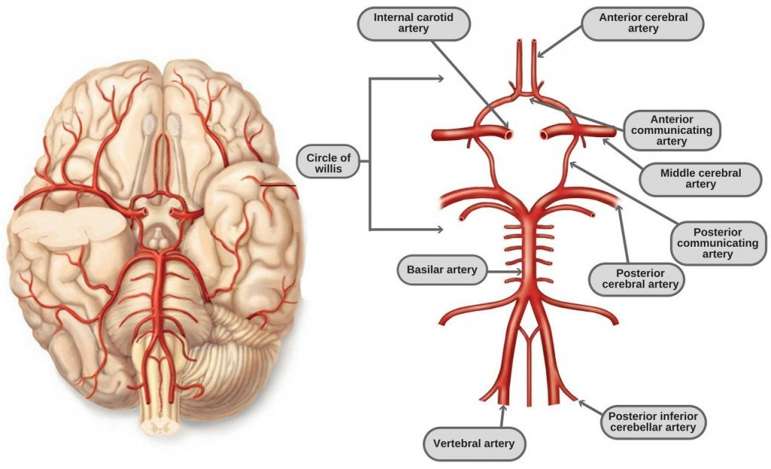
Circle of Willis
https://www.pinterest.com/pin/574138652469825270/
Notes:
Note location of major major supply & communicating arteries

Slide 8
Spinal Cord blood supply
Receives blood from 2 arterial sources (redundancy good!)
Anterior & Posterior spinal a—branches of vertebral a
Radicular a—branches of segmental vessels (cervical, intercostal & lumbar)
SC blood supply not continuous along its length, with blood being delivered preferentially by one supply source
Cervical cord → vertebral & radicular a
Thoracic & lumbar cord → intercostal & lumbar radicular a from respective area
Artery of Adamkiewicz—radicular a which enters SC at ~ T7 & supplies lumbosacral section. Interruption of flow from this artery = paraplegia

Slide 9
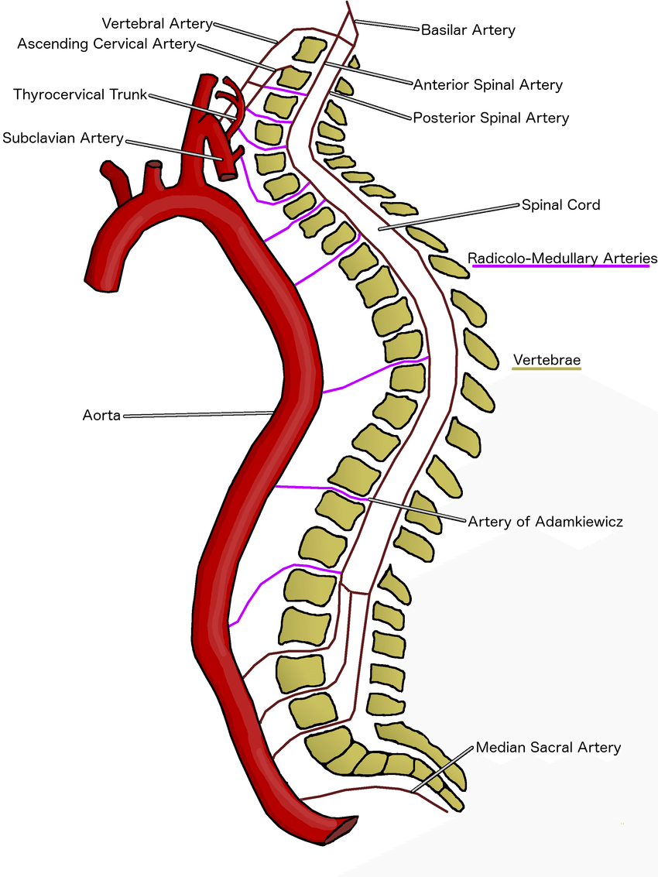
Spinal Cord Blood Supply

Slide 10
Spinal Cord Perfusion Pressure
Relative SCPP = MDAP - CSFP
During thoracic aortic clamping, SCPP < 22-25 = complete loss of SEP & paraplegia
Recommendation to keep SCPP > 40 by MDAP or ↓ CSF volume
Prevention of spinal cord ischemia by monitoring spinal cord perfusion pressure and somatosensory evoked potentials. Maeda S¹, Miyamoto T, Murata H, Yamashita K. J Cardiovasc Surg (Torino). 1989 Jul-Aug;30(4):565-71.

Slide 11
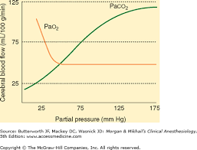
Factors influencing Autoregulation
Respiratory Gas Tensions
PaCO₂ key regulator of CBF
CBF α to PaCO₂ 20-80 mmg Hg
CBF Δ 3-4 % from baseline for every 1 mmHg Δ PaCO₂
CBF affects BV → relaxed brain & ↓ ICP
Hypocapnic vasoconstriction thought to be d/t
CO₂ effect on CSF & tissue pH
Marked hypoxemia (PaO₂ < 50) CBF
What can anesthetist control??
Temperature & CMRO₂
CBF changes 5-7% per 1⁰ C change in temp
Hypothermia ↓ CMRO₂ & CBF
Hyperthermia does the opposite—so avoid!

Slide 12
Factors influencing autoregulation cont.
Blood viscosity
¯ Hematocrit = ­ CBF through ­ CO & CPP and induced cerebral vasodilation but also ¯O₂ carrying capacity & delivery
Polycythemia can ↓ CBF
Autonomic sympathetic stimulation can cause vasoconstriction in intracranial
vasculature, leading to ↓ CBF
How does anesthetist cause sympathetic stim?
Notes:
The brain wants O2 but cerebral vasodilation can lead to ⬆ ICP

Slide 13
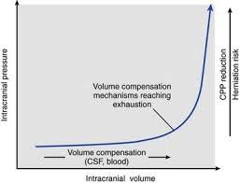
ICP & intracranial HTN
CPP = MAP-ICP normal ICP 5-15 mmHg CPP normal 50-70 mmHg
(MAP = (2 x DBP) + SBP/3
Intracranial HTN = sustained ICP 20-25 mmHg or higher (Nagelhout pg 704); some texts reference 15 mm Hg as low range of intracranial HTN
Symptoms HA, N/V papilledema, focal neuro deficits, altered ventilatory function, ↓ LOC, seizures, coma
ICP > 30, CBF decreases → ischemia leading to brain edema → ICP and cycle continues until pressure relieved or herniation

Slide 14
Management of Intracranial HTN
Cerebral edema
Vasogenic d/t disruption of BBB → entry of plasma-like fluid
Cytotoxic follows metabolic insults (hypoxemia, ischemia) where Na⁺ not extruded
Interstitial d/t obstructive hydrocephalus
Edema d/t intracellular H₂O 2º to acute ↓ serum osmolality
Monitoring &/or CSF drainage
Pt positioning—15⁰ HOB, head/neck position to avoid blocking outflow
Mild hyperventilation (PaCO₂ 30-35 mmHg) CBF ↓ 4% for every 1 mmHg PaCO₂ ↓
early hyperventilation in TBI associated with poor outcome
Optimize hemodynamics (MAP, CVC, PCWP, HR, CPP)
Sedation & analgesia
Hyperosmolar therapy (mannitol, hypertonic NS) & diuretics
Corticosteroids & Barbiturates (no steroids with TBI)
Other meds to avoid: precedex, droperidol, midazolam

Slide 15
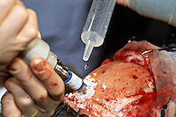
Cerebral Ischemia & Protection
Brain must have continuous supply of glucose, O₂ & ATP production
Ischemic brain insult = energy failure
Focal (incomplete)—embolic, hemorrhagic, atherosclerotic strokes & blunt, penetrating or surgical trauma
Global ischemia—cardiac or circ arrest, severe resp failure, asphyxia or drowning
http://shoutpictures.photoshelter.com/gallery/craniotomy-for-magligant-astrocytoma/G0000XF8MakfXgto/C0000uBzFMiFvxsc

Slide 16
General Anesthetic Considerations₁
Volatile gasses
all are vasodilatory & CBF & ICP and ↓ CMRO₂ & CPP; greater effects > 1.0 MAC
Greater ICP for Des > sevo & iso
All volatile gases interfere with auto-regulation
N₂O CBF & ↓ CPP, with variable effects on CMRO₂ & ICP
N₂O use after dural closing → tension pneumocephalus NO N₂O!
Traditional neuroprotection approach is to lower CMRO₂

Slide 17
General Anesthetic Considerations₂
IV Agents—
Both propofol & barbiturates are cerebral vasoconstrictor agents
¯ CBF, CBV & ICP
Barbiturates
Many texts refer to protective effects of sodium thiopental (barbiturates)
Shown to have short-term effects on focal ischemia but global effects controversial
No longer available; actual use of any barbs in clinical practice?
Ketamine is a cerebral vasodilator & should be avoided
Want tight control of BP
Should always have neo & nitroglycerine gtt primed & ready to go
Always have sticks of neo, ephedrine & diluted nitroglycerine ready
200 mcg/mL nitro → 1 mL nitro into 9 mL NS → 20 mcg/mL
→ 1 mL into 3 mL Ns → 50 mcg/mL

Slide 18
Neuroprotection
A note: There’s an absence of compelling evidence to dictate hard & fast practice guidelines
Volatile & IV anesthetics
Decrease CMRO₂ but evidence of suppression lacking
Animals studies with isoflurane show mitigation both as “pre-conditioner” & during insult
Volatile anesthetics at 1.0 MAC or > CBF & ICP and may inhibit cerebral autoregulation (Iso 0.6-1.1 MAC CBF normal, 1.6 MAC CBF 2x)
Barbiturates (thiopental) short term benefit in focal ischemia
Propofol similar protective effects (GABA), free radical scavenging & limiting lipid perioxidation; unknown duration
Barbiturates & propofol produce EEG burst suppression; pts undergoing temp occclusion > 20 mins may benefit
Notes:
Barbiturates effect through ↓ glutamate activity & intracellular Ca²⁺, GABA activity and NMDA antagonism

Slide 19
Neuroprotection
Mild vs. profound hypothermia
Mild (33-35º C) ↓ CMRO₂ & modulates immune & inflammatory rx
Profound (< 18º C) for circ arrest ↓ cerebral activity & CMRO₂
Evidence is inconclusive but hypothermia is most promising intervention against global ischemia
Maintain pt temp 35-36º C is appropriate for most procedures
Glucose control
Hyperglycemia & ischemic stroke → harmful
Hyperglycemia on day of CEA → worse outcomes
Reasonable practice guideline to shoot for 140-180 mg/dL range for neurosurgical pts with temporary focal ischemia
Goal for traumatic brain injury crani pts 90-180 mg/dL

Slide 20
Neuro-protection
General guidelines from Barash
Maintain optimal systemic & cerebral hemodynamics
Control respirator parameters, especially PaCO₂
Balanced IV or volatile/IV anesthetic appropriate
TIVA preferred for maximal brain “relaxation”
Reasonable to administer additional propofol prior to vessel occlusion
EEG monitoring helpful
Maintain euglycemia (140-180) with frequent checks
Keep pt temp at or below 36º C

Slide 21
Interventions for Inadequate CPP (Barash, pg. 1019)
Reduce brain water | Mannitol Hypertonic saline Furosemide
Remove CSF | External ventricular drain Lumbar drain (hypertonic fluid)
Decrease CBV | Head-up tilt Neutral neck position Metabolic suppression (propofol, barbiturate) Mild-to-moderate hyperventilation
Elevate MAP | Adequate intravascular volume resuscitation Support with vasopressor

Slide 22
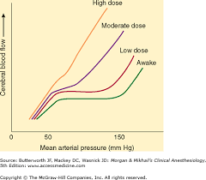
Luxury perfusion & Steal
(Diagram is dose-dependent depression of cerebral autoregulation by volatile anesthetics—higher dose = lose of normal auto-regulation)
Luxury perfusion (theoretical best case)—combo of ↓ CMRO₂ & CBF (metabolic supply)
Circulatory steal phenomenon (what we don’t want!)
arterioles in ischemic areas max dilated & will not respond to vasodilators like gas, sodium nitropruside or nitroglycerine
Normal brain regions vessels do vasodilate & get more BF
Inverse Steal (theoretical “Robin Hood”)
Hypocapnia causes vasoconstriction & ↓ BF to normal responsive areas & ∴ redistribution to ischemic areas
Notes:
The all-important balance! Hypercapnia vs hypocapnia

Slide 23
Fluid Management
Maintain normovolemia (or slight hypervolemic) to ensure adequate CPP; exception is AVM
Maintain serum tonicity (↓ serum Na = brain edema)
Avoid
Dextrose-containing fluids
Hespan: interferes with Plts & Factor VIII (coagulopathy); dilutional ↓ of coag factors
Dextran—interferes with Plts
LR is hypotonic—avoid in large volume resuscitation
Albumin in TBI pts
Colloids have no proven advantage over crystalloids
Na⁺ most important osmotic factor; check during long cases (MOD—where the sodium goes, water follows) ↓ Na⁺ = brain edema because Na⁺ higher in tissue & water leaves vasculature to equilibrate
Notes:
Na⁺ most important osmotic factor; check during long cases (MOD—where the sodium goes, water follows) ↓ Na = brain edema because Na⁺ higher in tissue & water leaves vasculature to equilibrate

Slide 24
Fluid Management
Maintenance fluids: 0.5-1mg/kg/hr NS or LR
NS preferred by most practitioners
Watch urine output and replace fluids if needed
Avoid hypervolemia
CVP/PCWP can be useful to guide fluid management
Hypertonic solutions: give cautiously in patient’s with pre-exisiting CV disease
may precipitate LV failure due to transient increase in intravascular volume).
Notes:
Na⁺ most important osmotic factor; check during long cases (MOD—where the sodium goes, water follows) ↓ Na = brain edema

Slide 25
Monitoring
Standard monitors: NIBP, EKG, Pulse OX, airway, temp
May require: Foley, Arterial line, CVP, 2 IVs, fluid warmer
EEG: used to detect ischemic changes during surgeries such as CEA, cardiac-pulmonary bypass, aneurysm clippings or vascular bypass
depolarization of cortical neurons measured on scalp
Provides assessment of brain function, ischemia, seizure activity, burst-suppression & depth of anesthesia
EEG is broken down into a series of wave frequency patterns. (Delta, Theta, Alpha, Beta)
A progressive decrease in CBF will produce a reliable pattern change in EEG that is useful in CEA when the clamp goes on.
Propofol, Isoflurane and thiopental can be associated with isoelectric EEG changes (isoelectric EEG is not the goal of monitoring!)
Monitoring placed pre-op; lots of wires to get in your way!
Goal is consistent level of anesthesia (usually 0.5 MAC gas, propofol gtt, no N₂O)

Slide 26
Monitoring
SSEP: Somatosensory Evoked Potentials
Monitors ascending pathway (peripheral to brain)
Electrical stimulation applied to specific sensory input; intact pathway from peripheral necessary for signal generation
Useful for spinal surgeries to detect any problems in pathway; used in cranis & CEAs also
Stimulation is usually done to regions of median, ulnar and posterior tibial nerve; cranis/carotid are on cortical area
Disruption of neural pathway → complete loss of SSEP
If ischemia present will present as ↓ amplitude & latency
Clinically significant = 50 % ↓ amplitude or 10% latency
Need adequate MAP for good signals

Slide 27
Monitoring
MEP: Motor Evoked Potentials
Monitors descending pathways (cerebral cortex, past NMJ to peripheral muscle group) & represents integrity of autonomic areas of spinal cord
Compliments SSEPs by providing info on anatomically different SC areas
Stimulation applied to motor cortex in transcranial fashion & electrodes pick up signal from muscles, usually in train of four (TOF) fashion
Stimulation can cause pt movement ∴ testing timing important
Soft bite block required to prevent pt biting tongue
Very sensitive to anesthesia, particularly inhalation agents (use as little gas as possible)
Propofol & remi gtts; ketamine helpful; may need long-acting pain meds
No muscle relaxant (may be used for induction, but ∅ redose & may be asked to reverse)
Also affected by hypothermia, hypoxia, hypotension
Caution when used on patients with seizure hx, skull fractures or implanted metal devices.
Amplitude only; clinically significant = >50% from baseline

Slide 28
Monitoring
BAEP: Brainstem Auditory Evoked Potentials
Monitor 8th cranial nerve during surgery that put auditory nerve at risk (acoustic neuroma, brain stem)
This is LEAST (barely) sensitive to anesthetics
VEP: Visual Evoked potentials
Monitors visual pathways from retina via optic nerve
Used in surgeries near optic chiasm, occipital lobe surgery, however rarely used
MOST (very) sensitive to anesthetic agents.
EMGs—elicited response at muscle level; no MRs
Sensitivity to anesthetics order: VEP > MEP > SSEP > BAEP

Slide 29
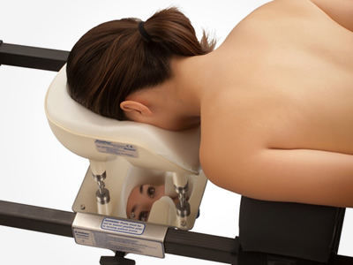
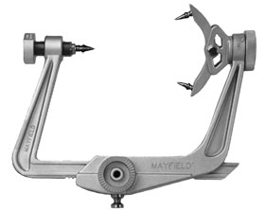
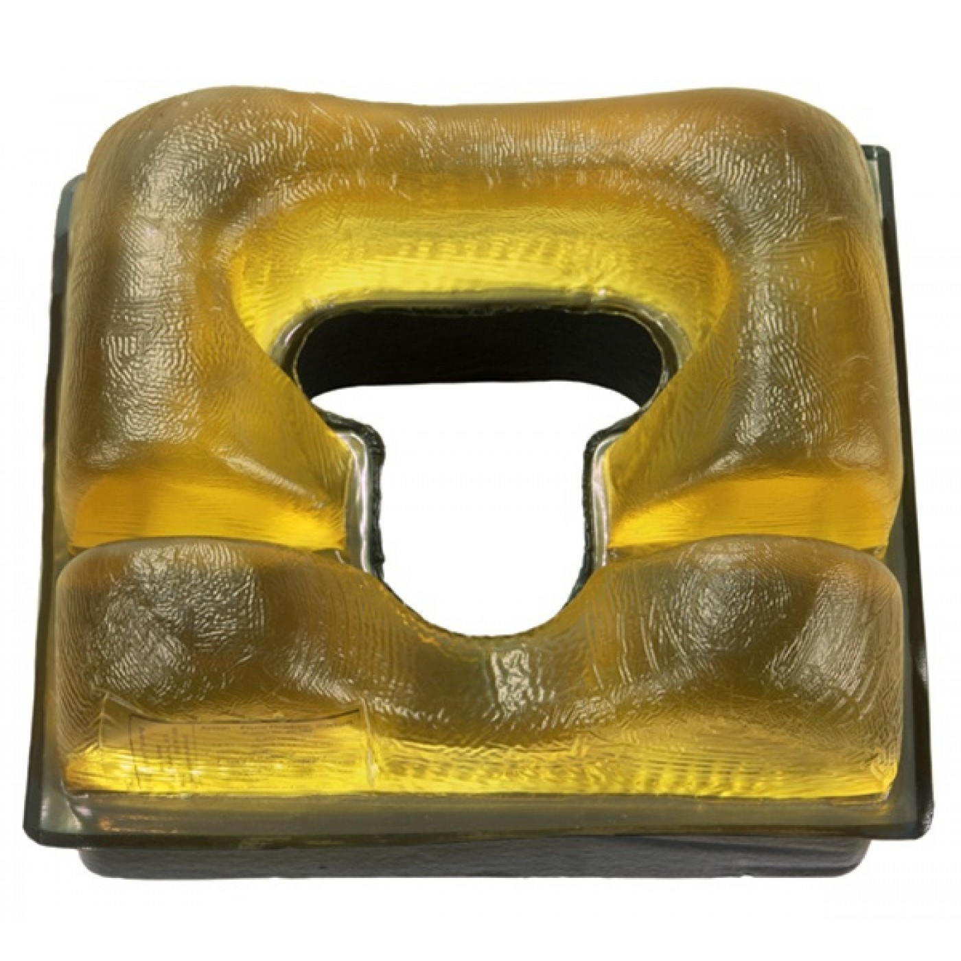
Head support
http://www.medicalexpo.com/prod/mizuho-osi/product-91205-676879.html
http://www.universalmedicalinc.com/all-products/patient-positioning/gel-positioners/head-neck-gel-positioners.html
http://www.mayfieldclinic.com/Bio_Mayfield.htm

Slide 30
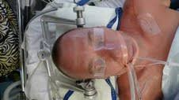
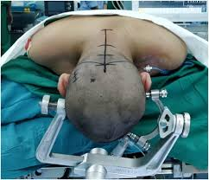
Application of Mayfield Tongs
Let’s talk about what we want to make sure doesn’t happen…

Slide 31
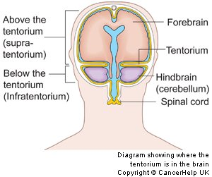
Brain Anatomy
Supratentorial region—area above tentorium cerebelli; contains cerebrum
Infratentorial (subtentorial) region—area below tentorium cerebelli; contains cerebellum & brainstem
https://commons.wikimedia.org/wiki/File:Diagram_showing_where_the_tentorium_is_in_the_brain_CRUK_386.svg

Slide 32
General Craniotomy considerations₁
Pre-op considerations
Intracranial HTN, CT/MRI-brain edema, mid-line shift, ventricular size Δ?
Pt evaluation—assess baseline LOC, focal neuro deficits & document
Are there acute or chronic Δ s? Acute potentially more sensitive to anesthetic effects
Access & monitors—2 IVs, fluid warmer, A line, central line?, nerve stim on feet, foley
Talk to surgeon—pt position, head securement device, BP range, brain protection meds to have ready
Bed will be turned—extensions on tubing, secured connections
Head may be turned to one side & flexed—reinforced ETT?
Will any type of evoked potential monitoring be used (SSEP, BAEP, MEP); if so what is anesthetic plan? 0.5 MAC with propofol &/or remi gtt?
Check labs—lytes, CBC, anticonvulsant levels
Already intubated? Usually go back to ICU intubated; no PACU

Slide 33
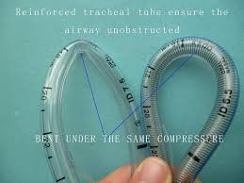
General Craniotomy considerations₂
Med considerations
Pt on meds to control ICP & seizure activity?
Best to avoid opioids & benzos if ICP concern
Sedation → hypoventilation & hypercapnia dilates cerebral vessels
Is pt on steroids? May be hypoadrenal → refractory hypotension
(may need vasopressin)
NDMR duration of action reduced by many anticonvulsants (not nimbex)
Anectine increases ICP but not as much as hypoxia & hypercarbia
Mannitol, lasix &/or steroids might be requested intra-op by surgeon
http://www.diytrade.com/china/pd/12325301/Reinforced_endotracheal_tube_with_cuff.html
https://www.google.com/search?hl=en&tbm=isch&source=hp&biw=1094&bih=746&ei=LDlzWseAI8HEjAP88ZyAAg&q=oral+rae+endotracheal+tube&oq=oral+rae&gs_l=img.1.2.0l4j0i30k1l2j0i24k1l2.1493.6189.0.10815.10.8.1.1.1.0.121.900.0j8.8.0....0...1ac.1.64.img..0.10.915....0.V7jspcsZEEk#imgrc=X3Dx4smYTOkq4M:

Slide 34
General Craniotomy considerations₃
Med combinations used for 0.5 MAC & monitoring
Fentanyl or remi bolus for induction
Fent 5-10 mcg/kg or remi 1-3 mcg/kg given over 1 minute
Remi gtt 0.5-1 mcg/kg/min maintenance
Propofol 50-150 mcg/kg/min maintenance
Precedex gtt
Neuro monitoring general guidelines
SSEP <0.5 MAC is best, OK to paralyze
MEP <0.5 MAC is best, don’t paralyze
EMG full MAC ok, don’t paralyze

Slide 35
General Craniotomy considerations₄
Intra-op considerations
Smooth & gentle induction & intubation; don’t want hypotension or HTN; have neo, nitroglycerine gtt & stick available; beta-blocker ready
Bed will be turned & you’ll have minimal access to pt—plan & get ready for turn; once surgeon is in room things will move quickly
Get baseline ABG before incision; check EtCO₂ on vent vs. PaCO₂
Does surgeon want hyperventilation to relax brain? N₂O not a good idea
Vent TV 6-8 mL/kg; Mild hyperventilation to EtCO₂ 30-35
OVER-ventilation → hypocarbia & ↓ CPP
Avoid PEEP > 10 → ↓ venous drainage & ICP
Positive pressure ventilation (PPV) generally used to allow PaCO₂ control
If you haven’t noticed yet, everything is all connected & a good anesthetic
technique is all about BALANCE & vigilance!

Slide 36
General Craniotomy considerations₅
Intra-op considerations
Communication with surgeon is critical!
Brain has no pain receptors, so anesthetic requirements ↓ after dura opened
Fluid management (adequate volume vs. cerebral ischemia & ICP)—keep pt isovolemic, isotonic & iso-oncotic
Don’t use crystalloids to correct hypotension
Maintain hematocrit 25-30%
Paralytics
PONV very common & should be avoided through meds
Monitor & maintain adequate UOP

Slide 37
General Craniotomy considerations₆
Towards the end of the case
Planning for turning off gtts & smooth wake-up
When should propofol gtt be turned off & what should you have ready for too-early wake-up?
If using remi gtt, what about pain control after gtt off?
Deep vs. awake extubation
Don’t reverse paralytic until dressing on
Emergence
Pt has compromised BBB—want smooth, controlled emergence
Also want quick emergence from anesthesia to access neuro function
Control BP, ICP & CBF
BP should be at baseline; have beta-blocker available
Prevent bucking & coughing ( consider lidocaine 1.5 mg/kg 1-2 mins prior to suctioning & extubation)

Slide 38
General Craniotomy considerations₇
Possible reasons for slow wake-ups:
Elevated ICP
Residual anesthesia or too much opioid
Narcan administration—titrate very slowly, allow the drug to work & re-assess frequently
Residual paralytic—does pt need more or different reversal?
CO₂ narcosis, hypoxia, or hypercarbia

Slide 39
Posterior Fossa (infratentorial) Procedures
S & S—cerebellar dysfunction (HA, ataxia, nystagmus, dysarthria) & brainstem compression (CN palsies, altered LOC, abnormal gag reflex, dysphagia, laryngeal irregularities, abnormal respirations); can obstruct CSF outflow (hydrocephalus)
Special concerns: blood loss, cardiac arrhythmias, BP variation, VAE, damage to cranial nerves, brainstem, reticular activating system
Atropine at the ready—retraction on brainstem → ischemic loss of function of nuclei that control hemodynamics & ventilation → sudden brady
Notify surgeon & may need to give atropine
Vagus nerve stim can also cause bradycardia
Sudden HTN d/t stimulation of 4th ventricle, medullary reticular formation or
trigeminal nerve
Usually abrupt & resolved by time treatment given

Slide 40
Supratentorial Mass Considerations
Supratentorial area largest of brain; contains cerebrum
Cerebrum divided into R & L hemisphere → frontal, temporal, parietal & occipital lobes
Cerebrum functions: initiation & coordination of movement, temp, touch, vision, hearing, judgment, emotion, reasoning, problem-solving & learning
S & S—HA, seizures, hemiplegia, aphasia

Slide 41
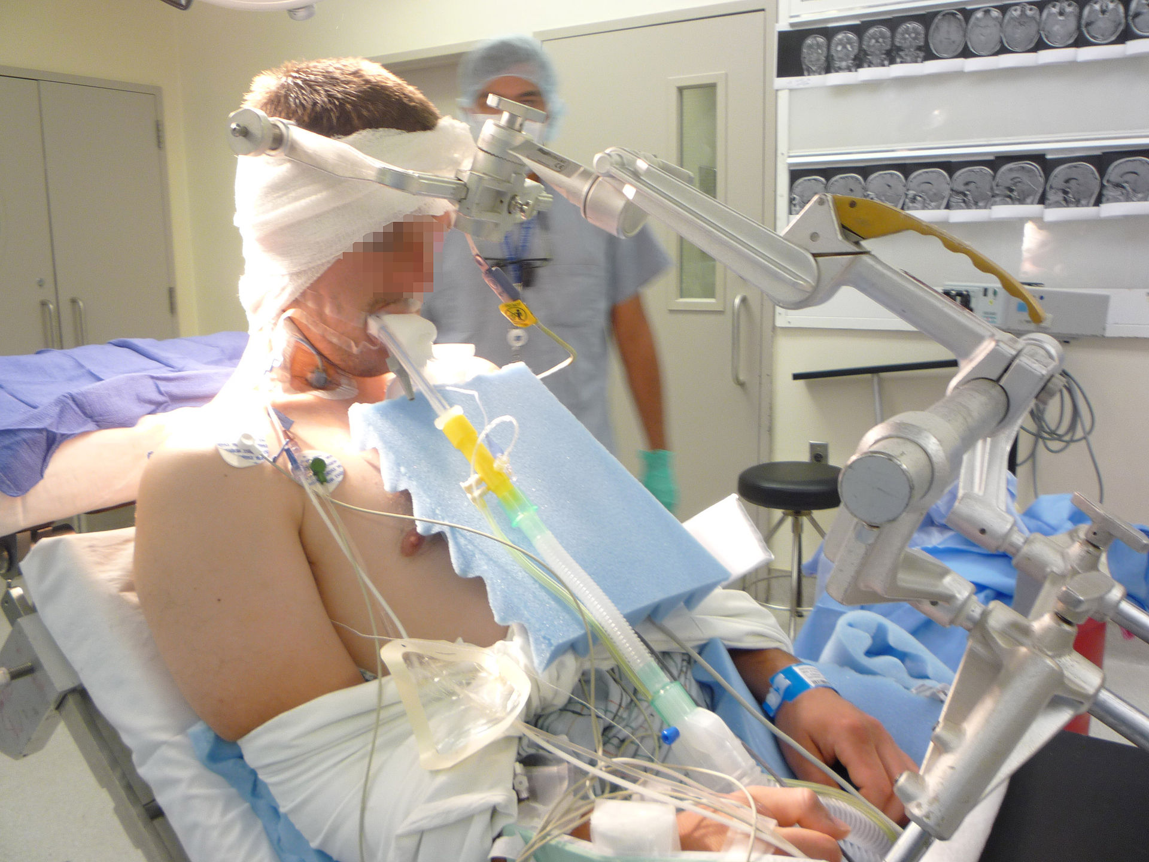
Sitting Craniotomy
By Allurimd (talk) - I (Allurimd (talk)) created this work entirely by myself., CC BY-SA 3.0, https://en.wikipedia.org/w/index.php?curid=28499803

Slide 42
Sitting Craniotomy₁
Pre-OP considerations: CV or pulm concerns, PFO?, assess & document pt condition
What monitors/access do you want—TEE, central line, art line, IVs
Pt typed & screened
Prep in OR: Bed will be turned away from you (maybe even 180º) & you will have limited access to pt
2 good IVs with extensions on tubing; fluid warmer, consider rapid infuser
Other equipment—glucometer or ISTAT (ABGs)
BP control—neo & nitro ready to go
Pt will be paralyzed—where are you going to check TOF?

Slide 43
Sitting Craniotomy₂
Positioning:
Pt will be put in tongs—this is very stimulating—have propofol stick, narcotic or increase MAC before surgeon places tongs! (Communication is key with this and most surgeons will ask you if the patient is ready).
Protect & pad pt; does pt need soft bite block?
Head in neutral position?
Make sure ETT & tube securely connected; no elbow
Run all tubings on top of blankets & down the bed (preparing for turn)
YOU are in charge of when bed gets turned, disconnect circuit before turn, communicate with OR team.
Other things to keep in mind
Keep pt paralyzed when in tongs
2 good IVs with extensions on tubing; fluid warmer, consider rapid infuser
Other equipment—glucometer, ISTAT (ABG)
BP control—neo & nitro (this med may change at different facilities) ready to go
Pt will be paralyzed—where are you going to check TOF?

Slide 44
CPP consideration with Sitting Crani
Maintain CPP at all times.
Autoregulation continues from MAP 50-60 through 150-160 mmHg in normotensive individuals, higher in hypertensive individuals
MAP decreases 0.7 mm Hg/cm above heart (or approx 1.5 mm Hg/inch)
In sitting procedures MAP at head level is most important!
Many practitioners place A line transducer at head level instead of heart & make a note in chart to make sure cerebral perfusion remains adequate

Slide 45
Venous Air Embolus (VAE)₁ (Reference material Vargo Anesthesia Mega App)
In sitting position IV pressure above heart is negative relative to atmospheric pressure
Excision of non-collapsible vein (in skull bone or dura) allows air to be pulled into venous system → travels to R atrium
Reported 20-40% incidence rate in sitting cranis vs. other positions
Consequences for pt depend on
Volume & rate of air entry
Presence of R-to-L intracardiac shunt (10-25% incidence of PFO) which can facilitate air into arterial circulation (paradoxical air embolus)
Ability of pt to clear embolized air from pulmonary system (pre-existing CV or pulm)
N₂O can markedly accentuate effects of even small amounts of air so do not use N2O
Monitoring TEE (most sensitive)** or pre-cordial doppler (most sensitive non-invasive
Pre-cordial doppler placed L sternal border, 2 & 4th intercostal space
Notes:
Entrained air exceeds rate of pulm clearance → PAP pressures rise → Co decrease d/t increased RV afterload

Slide 46
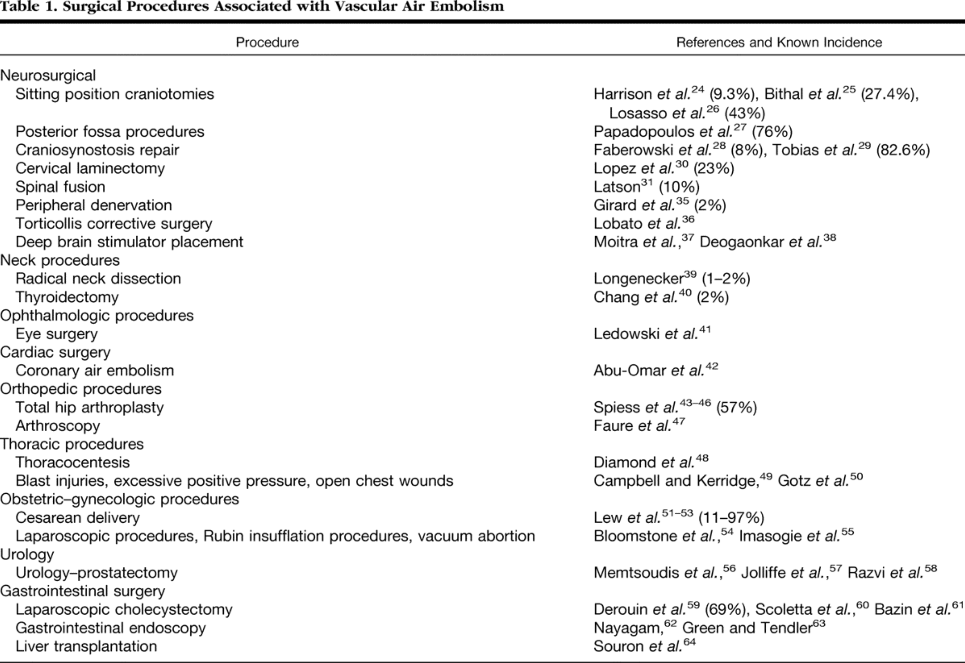
Date of download: 1/21/2018
Copyright © 2018 American Society of Anesthesiologists. All rights reserved.

Slide 47
Venous Air Embolus (VAE)₂ (Reference material Vargo Anesthesia Mega App)
Early S & S
**Sudden drop in EtCO_{2.}
end tidal N₂
Air seen on TEE
­ PAP
Late S & S
­ CVP
Hypotension
Hypoxemia
Ventricular ectopy
“mill wheel” murmur on precordial doppler

Slide 48
Venous Air Embolus (VAE)₃ (Reference material Vargo Anesthesia Mega App)
Treatment goals
Main goal: Stop entrainment of air!
*Notify surgeon; flood field with NS
Call for help/code cart; give **100% O₂
Control BP
*Place pt in L lateral position with head down (Durant maneuver) or locate suspected air entry site below level of heart
*If central line, aspirate air from R atrium
Air in R side of heart—occurs “often” & goes unnoticed (air in venous system, R heart & pulm)
rarely does a massive VAE cause RV air lock → RV outflow obstruction
Obstruction of small pulm arteries & arterioles causes release of endogenous vasoactive agents → PVR, RV afterload, PAP & CVP → RV failure → hypotension & ↓ CO

Slide 49
Paradoxical Air Embolus (Reference material Vargo Anesthesia Mega App)
Paradoxical Air Embolus (i.e. Air in arterial system)
R → L shunt through septal defect, PFO or AV shunts in lungs
20-25% pop has residual PFO that’s functionally closed if
LAP > RAP
In sitting position, combo of air in RA, (+) pressure & PEEP vent settings will increase RAP, which may be enough to open PFO
This allows entrained air to travel to L side of heart → arterial embolism → obstruction of coronary vessels & cerebral vasculation →

Slide 50
Pneumocephalus
Sitting position also increases likelihood of air &/or gas introduction into cranial cavity (subarachnoid space)
¯ Intracranial volume d/t hypocapnia, venous drainage, osmotic diuresis, loss of CSF at surgical site
If cerebral atrophy present, there’s CSF loss with potential of air replacing CSF on brain surface & in lateral ventricles
Once dura closed & pt placed supine, CSF, venous blood & extracellular fluid returns → pneumo becomes unyielding mass awaiting absorption → brain compression
Can cause delayed awakening & impaired neuro function
Don’t use N₂O!

Slide 51
Postoperative Visual Loss (POVL)
Particular concern in PRONE SPINAL surgeries, but can occur in other settings
Occurs at rate as often as 2:1,000; associated with eye compression &/or head rotation → jugular or carotid compression
Anterior ischemic optic neuropathy (AION) more common in cardiac surgical pts; Posterior ischemic optic neuropathy (PION) more common in spine & neck procedures
Risks factors include long surgical duration in prone position, excessive blood loss, hypovolemia, hypotension, anemia, male gender, obesity, hypoxia, excessive fluid replacement, use of vasoconstricting agents, elevated venous pressure, head positioning and pt-specifc vascular susceptibility that may be anatomic or physiologic
Prevention:
Arterial line & prompt tx of hypotension; CVP for high risk; monitor Hct
Use of 3-pin head holder (mayfield tongs) vs. prone pillow
Head elevation 10º from horizontal (at level of heart or higher)
https://www.ncbi.nlm.nih.gov/pmc/articles/PMC4879842/
https://www.ncbi.nlm.nih.gov/pubmed/18358851

Slide 52
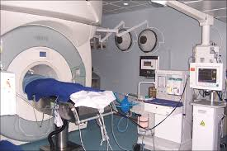
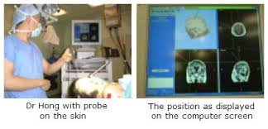
Stereotactic Brain Procedures

Slide 53
Stereotactic Brain Procedures₁
Real-time, 3-D system used to locate structures/locations within the brain
Minimally invasive
Similar to GPS; uses MRI imagining & computer program to generate 3-D image of patient’s brain; location equipment used in OR
Can be used with frame or without; frameless becoming more popular
Used to treat involuntary movement disorders, intractable pain & epilepsy or to dx & tx brain tumors; can be with or without frame
Thorough pt assessment prior to going to OR & document
Often performed as Asleep-Awake-Asleep to allow for cortical mapping & pt evaluation
DO NOT touch pt once they’ve been positioned (unless an emergency)

Slide 54
Surgery to control seizures₁
Epilepsy
Present in 0.5-2% population; 20% pts refractory to anti-seizure meds
High correlation between epilepsy & OSA
Long-term therapy (excluding levetiracetam) may alter metabolism of many anesthesia drugs d/t inducement of cytochrome p450 system (muscle relaxants & narcotic)
Can also cause liver damage
Specific anesthesia meds:
Benzos potential anti-convulsants & suppress EEG; effective control of status epilepticus
Propofol has anti-convulsant properties but can activate epileptogenic foci with bolus dose; useful in status epilepticus
Etomidate shows pro & anti-convulsant effects; dose & rate of admin determines effect
Ketamine activates epileptogenic focus & best avoided
Notes:
Anticholinesterases—neostigmine, physostigmine, pyridostigmine
Anticolinergics—robinul, scopolamine, atropine

Slide 55
Surgery to control seizures₂
Specific anesthesia meds:
Muscle relaxants– none shown to cause seizure activity; same with anticholinesterases & anticholinergics
Volatile gases—only sevo produces epileptiform EEG in pts with epilepsy
Opioids—large doses of fent/sufenta (CABG procedures) product cortical seizure activity in animal models; usual doses do not
Meperdine—with repeated or cont admin, metabolite normeperdine → neurotoxicity → seizures

Slide 56
Surgery to control seizures₃
Two types of surgery: intracranial electrode placement & surgical resection
considerations
Anti-convulsant meds, schedule of admin & drug levels
Hx of seizures, when was last one?
Positioning requirement
Type of brain monitoring to be used
Electrocorticography—avoid benzos & anticonvulsants
Anesthetic plan—GA, monitoring & access (a line, CVP?)
Will anesthesia be asked to induce seizure (hyperventilation or methohexital)
Will want quick wake-up for neuro assessment
Post-op complications: seizures, bleeding & cerebral edema

Slide 57
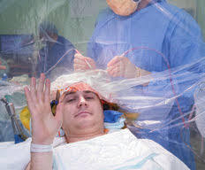
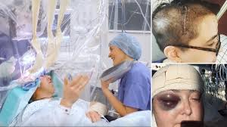
Awake Craniotomy Procedures

Slide 58
AWAKE BRAIN SURGERY (Uncensored) - Resection of Oligodendroglioma, Right Frontal Lobe

Slide 59
Awake Craniotomies₁
Indications for awake craniotomy:
Supratentorial tumors, eloquent cortex (motor strip cortex, Broca &/or Wernicke area; sensory cortex)
Intractable epilepsy; Parkinson’s disease
Deep brain nerve stimulator
AV malformations
Aneurysms
Benefits
Optimal tumor resection
Improved tumor diagnosis
Resection of non-operable (by open crani) tumors
Allows for intra-op speech, motor & sensory testing
AANA Journal article: Nonopioid Anesthesia for Awake Craniotomy: a case report
http://www.aana.com/newsandjournal/Documents/nonopioidanesthesia_0210_p29-32.pdf

Slide 60
Awake Craniotomies₂
Can the patient tolerate the procedure? Biggest factor.
Inclusions | Relative Exclusions
Normal airway exam | Obesity; BMA > 40 kg/m²
Able to lie still for extended period | Obstructive sleep apnea
Cooperative | Symptomatic GERD
 | Altered mental status
 | Communication barrier (language, dysphagia)
 | Extreme anxiety
 | Large vascular tumor or substantial dural involvement
 | History of substance abuse
 | History of violent awakenings from anesthesia

Slide 61
Awake Craniotomies₃
Anesthesia goal for procedure: adequate sedation, analgesia, pt awake & cooperative when needed, control over airway & BP
Challenges for Anesthetist:
Unprotected airway
Limited access to pt
An awake pt in the OR!
General plan
Asleep/sedated for surgical access
Awake to allow for testing/monitoring during procedure
Asleep/sedated for closure
Other things to consider
Length of procedure—foley, a line?
How to keep pt comfortable

Slide 62
Awake Craniotomies₄
Must be able to quickly convert to general for ventilation control &/or emergent crani so back-up planning includes:
Airway (LMA, ETT & possibly fiberoptic), oral/nasal airways
BP control (neo & nitro primed & ready to go), muscle relaxants, analgesia, mannitol/HTS, dexmedetomidine/remi?
Pt positioning; access to pt; BP cuffs/IVs on both arms?; extensions on all tubing, monitors; nerve stim on hands or feet
N/V prevention
Don’t touch patient once positioned; speak up when necessary
Anesthetic technique options
Propofol gtt with opioids
Dexmedetomidine (sedation & analgesia with minimal resp depression), in combo with opioids &/or midazolam and propofol gtt

Slide 63
Awake Craniotomies₅
AANA Journal Course Awake Craniotomy: A Practice Overview
University of Texas MD Anderson Cancer Center
Averages 75 awake cranis per year
Asleep-awake-asleep with LMA most widely used technique
LMA allows better control of ventilation, avoiding hypercapnia & hypoventilation; also facilitates deeper plane of anesthesia during painful parts
http://www.aana.com/newsandjournal/Documents/jcourse6_0212_p61-68.pdf
:

Slide 64
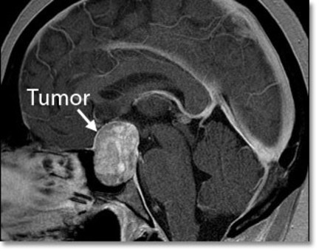
Pituitary Tumors
https://www.giveforward.com/fundraiser/6gg8

Slide 65
Pituitary Tumors
Tumor frequently confined to sella tucica & usually pituitary in origin
Can also be benign (meningioma, craniopharyngioma) & malignant (germ cell, lymphoma)
Typically recognized d/t symptoms, such as visual changes or hormonal systemic effects
Tumor can be secretory (50-80%) or nonsecretory
Secretory Tumors usually exclusive to anterior pituitary
corticotropin (ACTH) → Cushing disease (HTN, DM, osteoporosis, obesity, friable skin & connective tissue) & “cushingoid” habitus with difficult airway management, intraop hyperglycemia
Growth Hormone → acromegaly → increased size of bones & soft tissue, especially hands, feet & face; difficult intubation & risk CAD, HTN, cardiomyopathy, osteoporosis & hyperglycemia
Prolactin
TSH hypersecretion → hyperthyroidism with tachycardia; need to have thyroid meds & beta blockers continued
FSH, Luteinizing Hormone

Slide 66
Pituitary Tumors
Panhypopituitarism—will need hormone replacement continued peri-op
Cortisol, levothyroxine & possibly DDAVP
Diabetes Insipidus
May be pre-existing or develop d/t loss of antidiuretic hormone ADH production
Initially suspected on basis of large UOP & serum Na⁺
Surgical Approaches
Transsphenoidal—small tumors, decreased M & M d/t ↓ blood loss & brain manipulation → ↓ risk of panhypopituitarism & DI
Bifrontal intracranial—tumors > 10 mm
Endoscopic via transnasal approach—less invasive & less risk

Slide 67
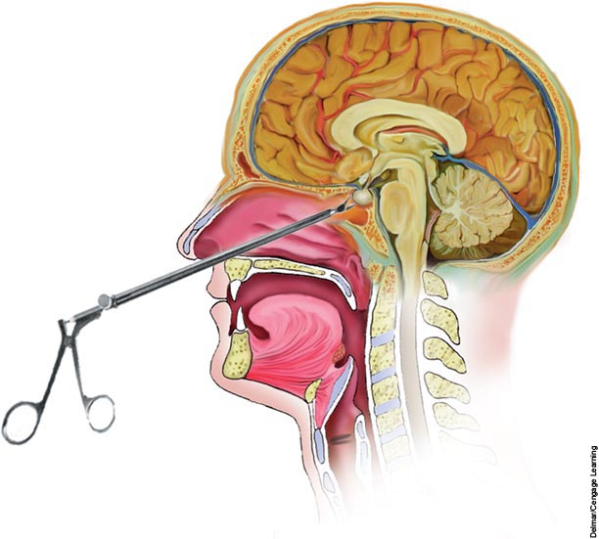
Transphenoidal Hypophysectomy Procedures
https://biology-forums.com/index.php?action=gallery;sa=view;id=9581

Slide 68
Transphenoidal Hypophysectomy Procedures
Pre-op considerations
S & S for specific manifestations; appropriate monitoring & tx
Labs: CBC, electrolytes, BUN, Cr
Oral rae ETT
Bed will be turned—IV access, monitoring, etc
Risk for massive hemorrhage—be ready!
Intra-op
Airway shared with surgeon—final position of ETT (lower L), ∅ nasal temp probe, make sure all connections secure
Pt positioning & padding; Eye protection! (tegaderm/blue goggles over eyes after taping?)
Admin of robinul to ↓ secretions
Hyperventilation avoided → reduced ICP & pituitary retraction
Avoid HTN—stay within 20% of baseline
N₂O risk
Topical application of cocaine or local anesthetic with epi—can lead to HTN & dysrhythmias; may need to increase gas & use beta-blocker (esmolol, labetalol or hydralazine)
Have NG tube ready to hand to surgeon after throat pack out
Use flexible suction catheter (∅ Yankauer) & be gentle when suctioning before extubation
Work to make wake-up smooth (free of coughing & bucking)– IV lidocaine 1.5 mg/kg 3 min before suctioning & extubation
Deep extubation? Some practitioners extubate deep & place LMA which is removed in PACU

Slide 69
Head Trauma₁
50% of deaths d/t trauma have head injuries as contributing factor
Head injury outcome depends on extent of neuronal injury but also any 2º insults
1º result of initial mechanical forces on brain
2º injury = progression of pathological insults
Ischemia, reperfusion & hypoxia
Systemic effects of hypotension, hypoxemia, hypo or hyperglycemia, & hypo or hypercarbia
Formation &/or expansion of epidural, subdural or intracerebral hematoma
Sustained intracranial HTN
Glasgow coma scale at scene correlates well with injury severity & outcome
Increased mortality or morbidity assoc with GCS of 8 and 5 mm midline shift & ventricular compression

Slide 70
Head Trauma₂
Airway protection is #1
Always assume c-spine involvement until excluded
Intubation carried out with in-line neck stabilization (glidescope to minimize neck movement)
Difficult airway cart & have multiple options available
RSI for full stomach; cricroid pressure controversial
Avoid nasal intubation d/t risk of basiliar skull fx; NG placed orally
https://www.google.com/search?q=nasogastric+tube+in+brain&client=safari&rls=en&source=lnms&tbm=isch&sa=X&ved=0ahUKEwiRq57Sv_PYAhUH1mMKHZ9EB-8Q_AUICigB&biw=1335&bih=779#imgrc=iWhBg8UjXXNRuM:

Slide 71
Head Trauma₃
Pre-op considerations for TBI
Most likely hypovolemic & hypotensive
Fluid resuscitation is important
Some evidence of benefit of hypertonic NS, especially in peds
Have vasopressors ready; avoid corticosteroids in TBI pts
Intubation drugs
Per Barash p. 1017 succs in not contraindicated d/t insignificant effect on ICP; other texts say use only if necessary
Propofol or etomidate (less hypotension but causes adrenal suppression)
Neo & ephedrine—important to prevent hypotension

Slide 72
Head Trauma₄
Intra-op considerations
Good IV access & Isotonic crystalloids for fluid resuscitation
If no ICP in place, assume some level of exists & use moderate hyperventilation
BP management is critical! For TBI maintain MAP > 60 mm Hg (hypertension increases risk of cerebral edema & hemorrhage)
Cushing response → hypertension, bradycardia & resp changes
Be prepared for profound hypotension after induction & after bone flap removed
Avoid hyperthermia

Slide 73
Head Trauma₅
TBI complications
DIC d/t release of brain tissue thromboplastin
ARDS or neurogenic pulmonary edema
Seizures
Intracranial hemorrhage
Sudden & profound hypotension following large hematoma decompression
Cerebral edema

