Slide 1
Spinal Cord, Abdominal, and Orthopedic Injuries

Slide 2
Spinal Cord Injuries
Approx. 10,000 spinal cord injuries each yr in U.S.
Median age at injury is 25 yrs
Leading cause of death – aspiration pneumonia.
Sustained from falls, MVA, assaults, diving injuries, other sports injuries.

Slide 3
Spinal Cord Injuries
Should be ruled out in any patient with trauma.
Mechanism of injury helps predict injuries.
Six conditions highly correlated with SCI
Paralysis
Pain
Position
Paresthesias
Ptosis
Priapism

Slide 4
Spinal Cord Injuries
There is no way to reverse the initial CNS damage.
The goal of medical and surgical management is to prevent further damage.
Most common avoidable complications contributing to further damage are ischemia due to hypoxemia, hypotension, tissue swelling, and delay in treatment.

Slide 5
Spinal Cord Injuries
Can involve bony structures, ligaments, and/or the cord.
Can be significant fractures with little or no neurologic impairment.
Stabilization of the spine with a traction device is important to prevent or correct dislocation, and can usually be accomplished under local anesthesia.
Injuries to the cord itself can occur because of penetrating injuries, stretching, compression, or interruption of blood flow.

Slide 6
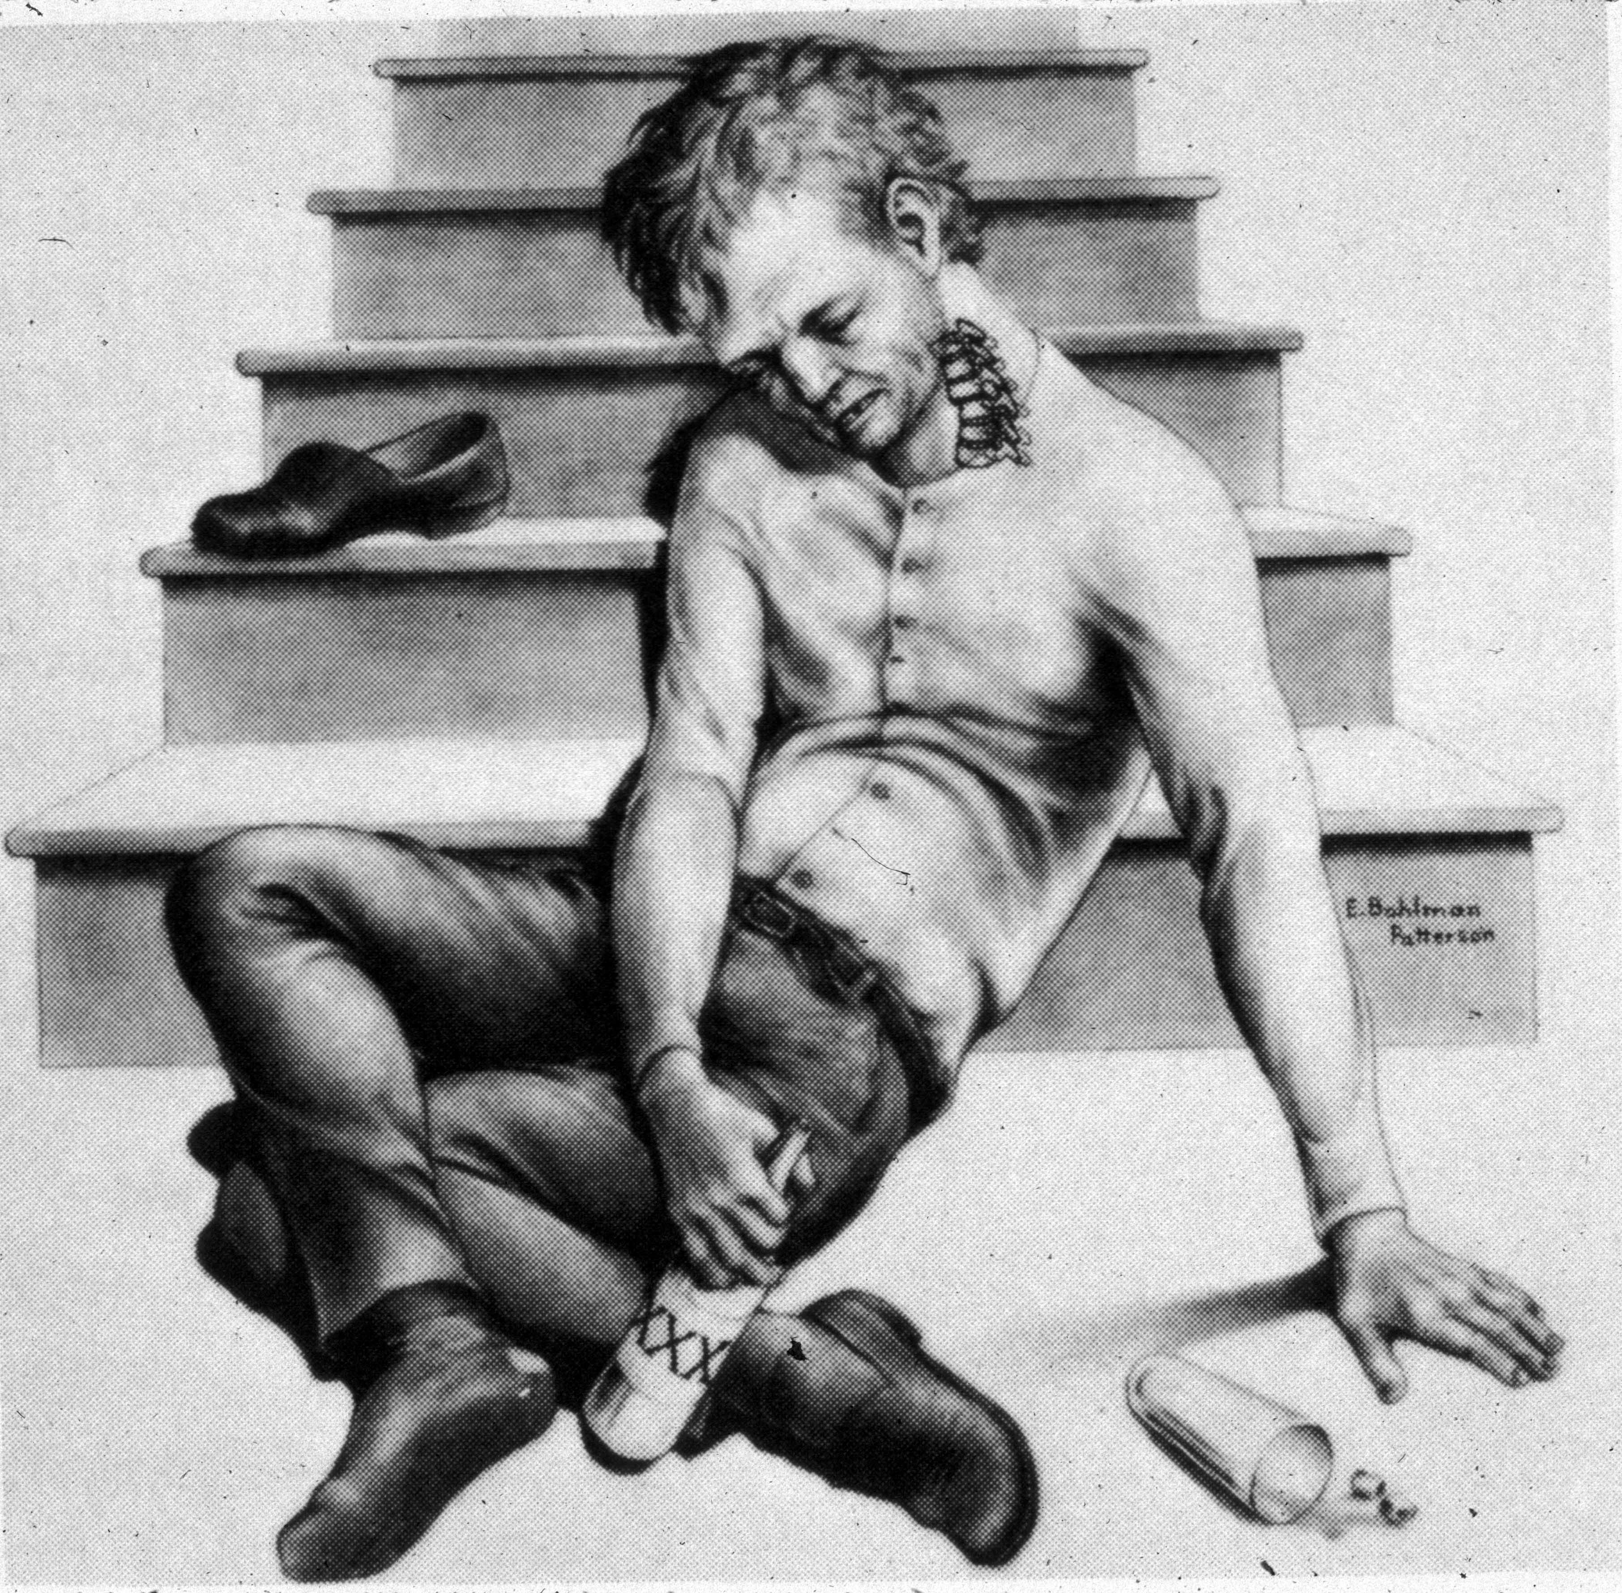
Mechanism of Injury

Slide 7
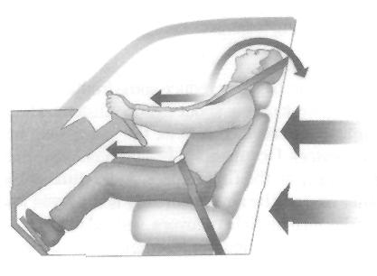
Mechanism of Injury

Slide 8
Assessment and Diagnosis
When time permits, complete neurologic assessment should be carried out prior to any manipulation of the head and neck.
Radiological assessment
Neurologic assessment

Slide 9
Radiological Assessment
Radiological assessment should include lateral and AP C-spine, and open mouth X-rays, T-spines, L-spines.
A swimmers view may be necessary if C7 can not be visualized on the lateral c-spine.
CT
MRI

Slide 10
Neurological Assessment
Includes an evaluation of motor and sensory responses.
Assessment in the patient with an altered LOC is more difficult.
Presence of spontaneous movement and response to painful stimuli are helpful but their absence may be due to head injury rather than spinal cord injury (SCI).
The evaluation should include a rectal exam.

Slide 11
Respiratory Sequelae of Acute SCI
The major cause of death in patients with acute SCI is respiratory failure secondary to paralysis of the respiratory muscles. The level of the SCI dictates the degree of ventilatory compromise.
Pentaplegia
Respiratory quadriplegia
Cervical lesions below C4
Cervical lesions at or below C6
Ondine’s curse

Slide 12
Pentaplegia
Describes a state of SCI at the junction of the brain stem and spinal cord.
Voluntary diaphragmatic contraction is not possible because of phrenic nerve paralysis.
In addition, accessory muscles of respiration are no longer under voluntary control.
The patient is chronically ventilator dependant.

Slide 13
Respiratory Quadriplegia
Results from cervical lesions at approximately C2-C3, sparing the cranial upper most cervical nerves.
Paralysis of the phrenic nerves and the nerves that innervate the accessory muscles of respiration.
This condition also results in chronic ventilator dependence.

Slide 14
Cervical Lesions Below C4
Permit partial functioning of the phrenic nerve, resulting in at least some degree of voluntary control of respiration.
Vital capacities, however, are approximately 20-25% of normal.

Slide 15
Cervical Lesions at or Below C6
Allow full diaphragmatic control.
However, accessory muscles of respiration are affected, depending on the level of the SCI.
Expansion of the rib cage via the accessory muscles contributes to approximately 60% of tidal volume in healthy people.

Slide 16
Ondine’s Curse
Also called idiopathic or primary alveolar hypoventilation syndrome may occur after surgical or traumatic injury to the brain stem and high cervical regions of the spinal cord (C2-C4).
This “curse” is a condition in which spontaneous ventilation occurs only with voluntary effort and ceases during periods of inattention to breathing or sleep.

Slide 17
Hemodynamic Changes with Acute SCI “Spinal Shock”
May persist for 1-3 weeks after acute injury.
Profound systemic hypotension may result from loss of vascular tone and consequent diminished preload.
Extent of hypotension is directly related to the level of the SCI and is more pronounced in cervical lesions.

Slide 18
Hemodynamic Changes With Acute SCI
Broad spectrum of cardiac dysrhythmias observed including sinus bradycardia, P-wave changes, ⬆ P-R intervals, ectopic beats, and complete heart block.
Bradycardia is noted in cervical lesions because of predominance of vagal tone at the SA node.
Results from lack of sympathetic input to the heart (cardioaccelerator fibers T1-T4).

Slide 19
Hemodynamic Changes With Acute SCI
Hypotension
Bradycardia
Irregular respirations

Slide 20
Anesthetic Concerns in the SCI Patient
Airway management
Cardiovascular status
Ventilation
Temperature regulation
Gastric distention

Slide 21
Airway Management
All severely injured patients are considered to have a C-spine injury until proven otherwise.
If possible, intubation is avoided until X-ray and neurologic exams have been completed and a traction device has been applied.

Slide 22
Airway Management
Awake blind nasal intubation after good topical anesthesia has been achieved.
Awake OETT (with topical anesthesia) under direct vision is an alternative, but it is not as well tolerated by the patient and may be difficult to accomplish with some traction devices in place.
Glidescope

Slide 23
Airway Management
Use of the fiberoptic (FO) bronchoscope can facilitate both oral or nasal intubation in either awake or anesthetized patients.
If patient is uncooperative, intubation should be done under general anesthesia using a rapid sequence technique.
Succinylcholine is probably safe in the 4-7 days after injury.
However, probably best to avoid in the paraplegic patient. Use rocuronium for RSI.

Slide 24
Airway Management
In the patient with facial injuries, intubation should be done under direct vision to avoid pushing bone fragment, tissue, or teeth into the trachea.
In extreme emergencies (e.g., apnea, obstruction, cardiac arrest), it will be necessary to establish an airway immediately by what ever means possible.
In these situations, the risk of spinal cord damage becomes secondary.

Slide 25
Airway Management
Regardless of the method of intubation, one person should be responsible for holding the head in a neutral position if traction is not in place.
If the patient has only a partial or no neuro deficit, awake intubation is desirable so the patient’s neurologic function can be reassessed after the intubation is complete.
Prepare for the unexpected: have FO, Glidescope, and other anesthesia providers close by to assist.
Always use in-line stabilization and maintain the head in a neutral position. Never extend the neck to get a better view—get better equipment.

Slide 26
Cardiovascular Status
Physiologic transection of the cord results in hypotension, which usually begins to resolve within 48 hours.
Maintaining adequate systolic pressure is important in preserving blood flow to the injured cord.
Sympathectomy results in bradycardia, which can contribute to hypotension.
Most profound episodes of bradycardia tend to occur on the 3rd to 5th post injury days, and can lead to cardiac arrest, especially during tracheal suctioning in the presence of hypoxia.

Slide 27
Cardiovascular Status
Treat hypotension with fluids and, if necessary, vasopressors.
Bradycardia should be treated with robinul or atropine.

Slide 28
Cardiovascular Status
Careful fluid administration to prevent fluid overload, which can precipitate pulmonary edema.
Monitor with CVP or PA catheter. The patient should also have an arterial line.
Avoid abrupt changes in position, especially under general or regional anesthesia, since these may result in hypotension.

Slide 29
Ventilation
Lesions at C4 and above will abolish phrenic nerve function and these patients will require mechanical ventilation.
Although patients with C3-C4 lesions can frequently be weaned from ventilatory support, they may be prone to sleep apnea, which can be enhanced by suppressant drugs.

Slide 30
Ventilation
Lesions above T1 abolish all abdominal and intercostal muscle function.
Vital capacity will be decreased to 35-50% of normal and residual volume, FEV1, and inspiratory reserve will also be decreased.
Patients will also be unable to cough effectively.
As a result, these patients are prone to pneumonia, atelectasis, and chronic hypoxemia.

Slide 31
Ventilation
If the patient is not intubated preoperatively, ventilation should be evaluated with spirometry and blood gases.
Avoid preoperative narcotics/sedation.
Avoid high inspiratory pressure since it can decrease blood pressure due to poor venous return.

Slide 32
Neurogenic Pulmonary Edema
A condition seen immediately after SCI, NPE is secondary to central nervous system insult, such as trauma to the spinal cord, stroke, increased intracranial pressure, seizures, tumors, or intracerebral hemorrhage.
Cause of NPE is controversial but the outcome is the same - pulmonary alveolar exudate and fluid accumulation.

Slide 33
Temperature Regulation
The patient with a SCI is poikilothermic (ambient temp) in the area below the lesion.
Prone to hypothermia in a cold environment because they can not sweat in the area below the lesion.
Monitor core temperature.
Unless the patient is febrile, use active as well as passive warming measures.

Slide 34
Gastric Distention
Gastric distention can impair movement of the diaphragm and may also predispose the patient to vomiting and aspiration.
An NG or OG tube should be place as soon as possible and connected to low continuous suction.

Slide 35
RSI With In-line Stablization
Keys to intubating C-spine injured patients are:
Being prepared: have the proper blade, FO, Glidescope, and extra anesthesia personnel.
Using proper technique to maintain head and neck in neutral position.
Pre-oxygenate well
Use proper amount of induction agents.

Slide 36
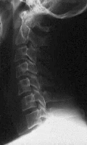
Normal C-spine?

Slide 37
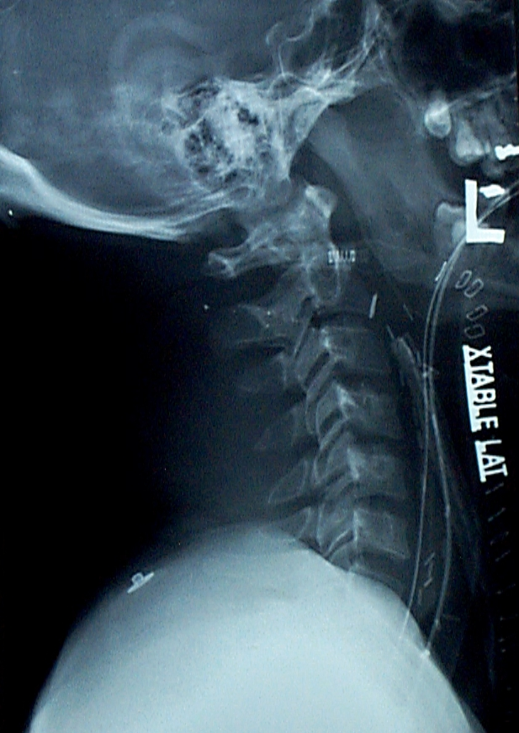
Normal C-spine?

Slide 38
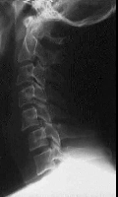
Unifacet

Slide 39
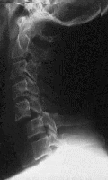
Bi-Facet

Slide 40
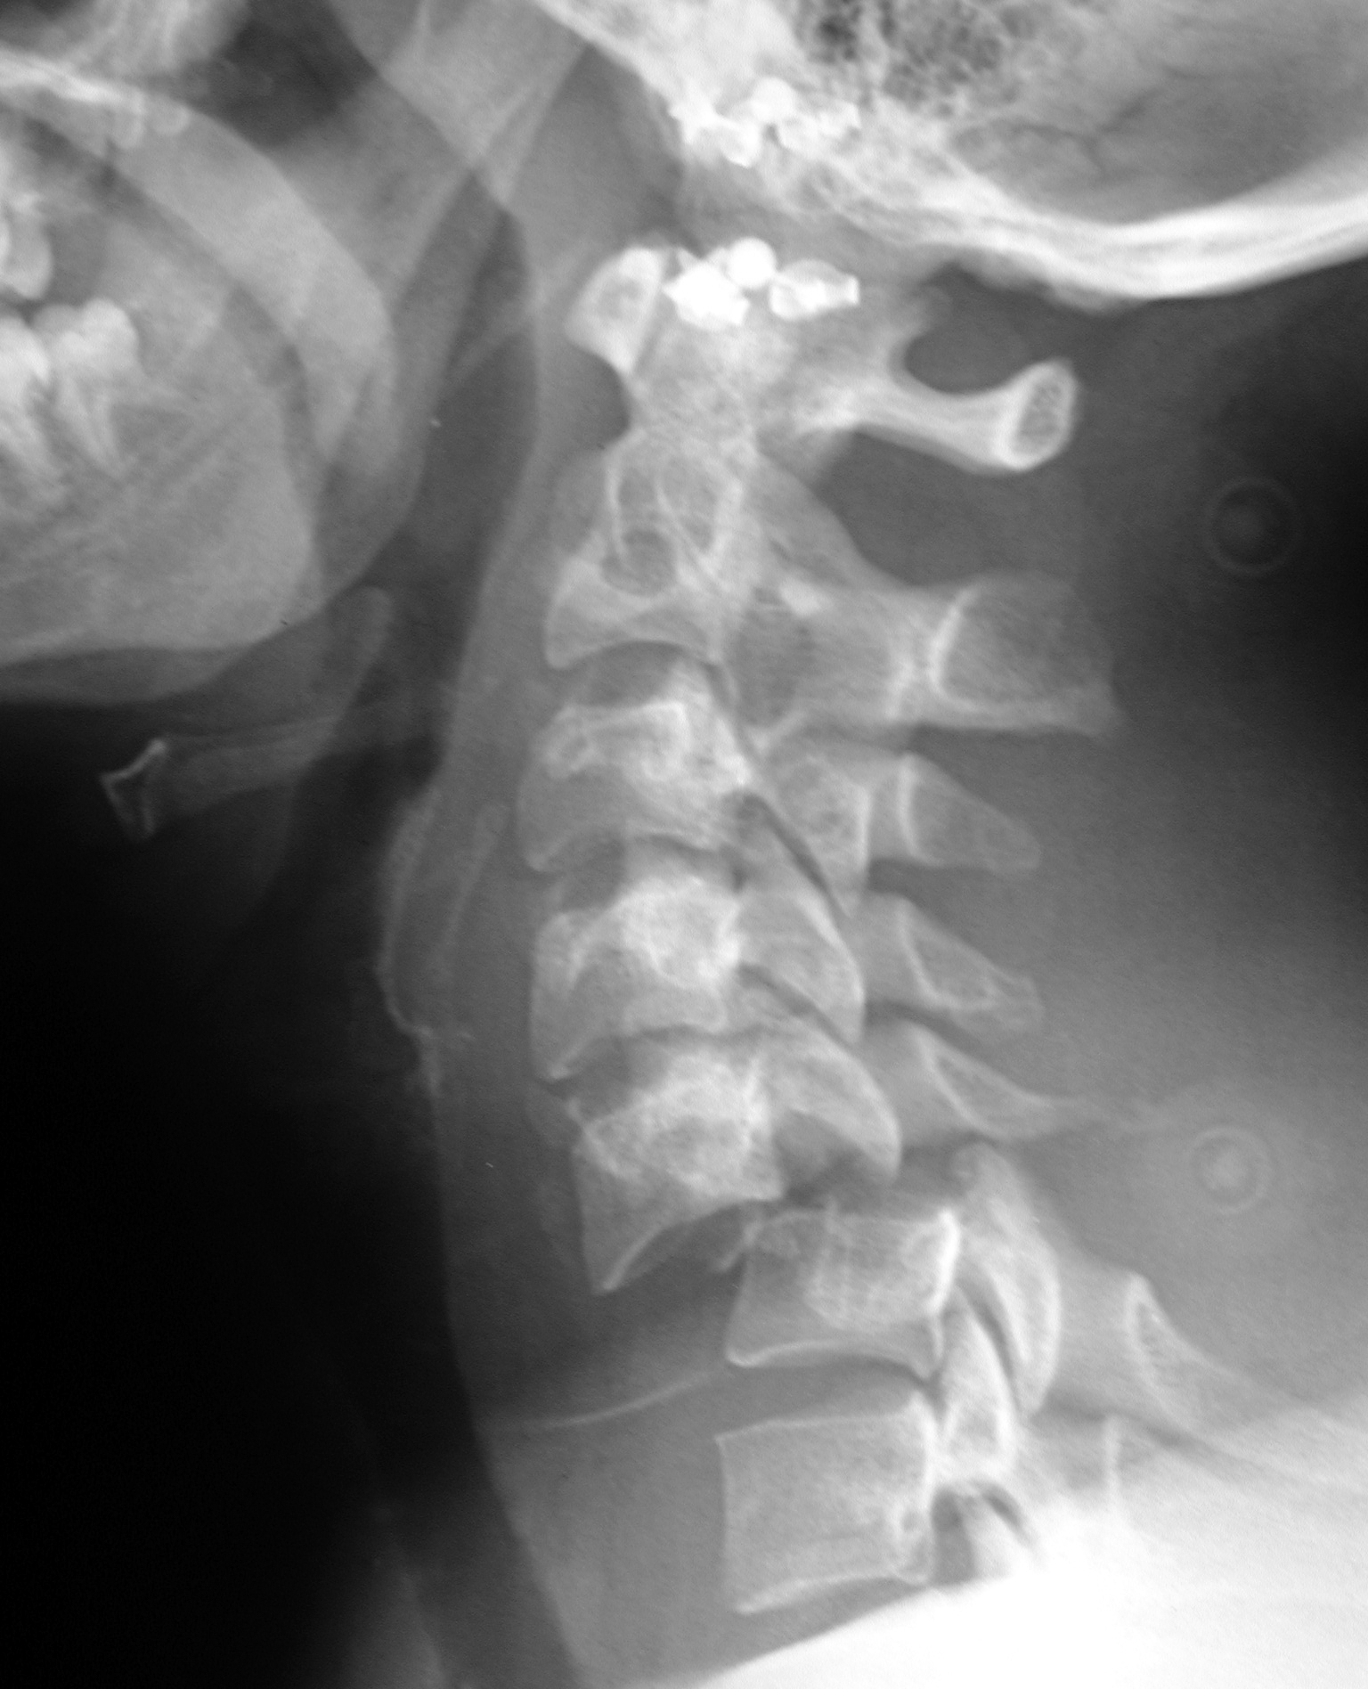
Cervical Spine Injury

Slide 41
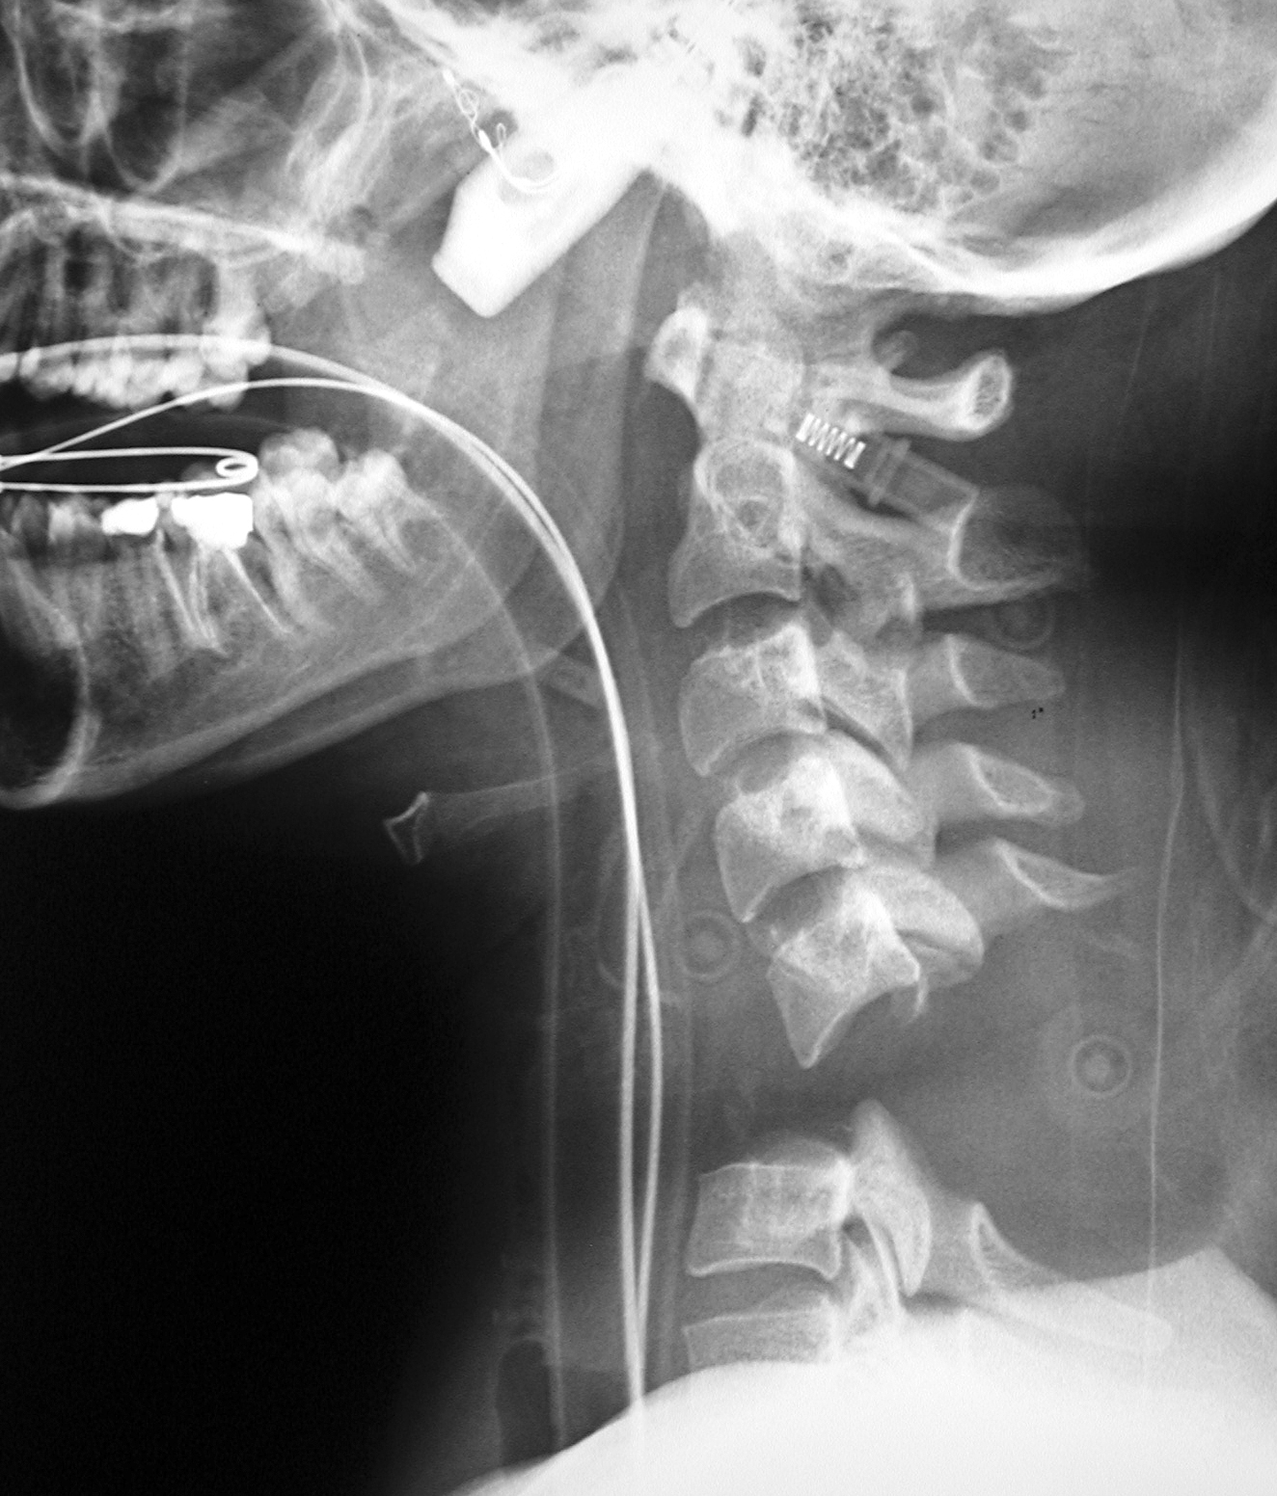
Cervical Spine Intubating Injury

Slide 42
Abdominal Trauma
Frequently injured following trauma
Major site for post traumatic bleeding
Injuries difficult to evaluate and monitor clinically
Mechanism of injury can suggest potential injuries
Death most commonly results from uncontrolled hemorrhage

Slide 43
Blunt Trauma
Two types of forces: compression and deceleration
Compression of the abdominal cavity against a fixed object such as a safety belt or steering wheel results in a rapid increase in intraluminal pressure.
Deceleration causes shearing and stretching of elements located between fixed and mobile structures.
Solid organs are most commonly injured by blunt trauma.

Slide 44
Blunt Trauma
Increased probability of intra-abdominal injury occurs when signs of seat belt trauma are present – abrasions or hematoma of the abdominal wall, or fracture of the lumbar spine.
Ecchymosis and abrasions on the neck and upper chest have been associated with cervical vascular injuries.

Slide 45
Penetrating Trauma
Size of the object
Location
Force transmitted to the organs

Slide 46
Anatomy
Abdomen divided into 4 compartments
Thoracic
Peritoneal (true abdomen)
Retroperitoneal
Pelvic spaces

Slide 47
Intrathoracic Abdomen
Lies beneath the rib cage
Includes the diaphragm, liver, spleen, stomach
During exhalation, the diaphragm often ascends to the third thoracic vertebra – high association of intra-abdominal injury occurs with concomitant blunt or penetrating trauma to the lower chest.

Slide 48
True Abdomen
The hollow viscera (stomach, small and large bowel) almost completely contained within the true abdomen.
Also contains the omentum, gravid uterus, and dome of the bladder when full of urine.
At the end of inhalation, liver and spleen pushed inferiorly by the diaphragm into the true abdomen.

Slide 49
Retroperitoneum
Great vessels
Kidneys
Pancreas
Ureters
Second and third portions of the duodenum
Some segments of the colon

Slide 50
Pelvic Space
Pelvic fractures often result in significant retroperitoneal hemorrhage

Slide 51
Diagnosis
Abdominal ultrasound
Peritoneal lavage
Gross blood on rectal exam
CT scan
MRI
Angiography

Slide 52
Indications for Exploratory Laparotomy
Unexplained hypotension or shock
Uncontrolled hemorrhage
Signs of peritonitis
GSW to abdomen
Ruptured diaphragm
Pneumoperitoneum on admission CXR
Evisceration of bowel or omentum

Slide 53
Surgical Priorities During Laparotomy
Locate and control hemorrhage
Locate bowel injuries and control fecal contamination
Identify injuries to other abdominal organs and structures
Determine whether temporizing measures are most appropriate vs definitive repair of injury should occur.

Slide 54
Liver Injuries
Most commonly injured solid organ following penetrating trauma
Second most commonly injured following blunt trauma

Slide 55
Clinical Findings Suggestive of Liver Injury
Fractures of the right lower ribs
Elevated right hemidiaphragm
Right pleural effusion
Pneumothorax
RUQ tenderness
Nonoperative management is now the initial treatment of choice for hemodynamically stable patients with isolated blunt liver trauma.

Slide 56
Spleen
Most commonly injured organ following blunt trauma
Frequently injured following penetrating trauma to the left thorax or abdomen

Slide 57
Clinical Findings
Hypotension from hemorrhage most common initial finding
Suspect splenic injury with left lower rib fractures
LUQ tenderness or left shoulder pain
With splenic injury, significant incidence of additional intra-abdominal damage

Slide 58
Pancreatic Injury
Usually due to an anteroposterior compression mechanism that crushes the pancreas against the vertebral column
Burning epigastric and back pain, tenderness
Ileus
Elevated amylase, lipase

Slide 59
Kidney
Commonly injured during deceleration injuries with extensive bleeding into the retroperitoneal space
Hematuria
Fractures of the lower ribs
Flank pain and tenderness

Slide 60
Stomach
Most common cause – penetrating trauma
Blood via mouth, NG
Rapid onset of epigastric pain
Peritonitis due to release of gastric contents into the peritoneum
Radiographic finding of free air, displaced NG, or extravasation of oral contrast medium

Slide 61
Small Bowel
Penetrating trauma – most frequent due to its relative volume
May present with only vague generalized pain
Duodenal injury may present with referred pain to the back

Slide 62
Colon
Common after GSW
Symptoms related to spillage of bowel contents rather than blood loss

Slide 63
Abdominal Vascular Injuries
Often present with profound hemorrhagic shock
Large bore IVs to upper extremities preferable to avoid fluid loss to the abdomen
Saphenous vein cutdown lines or femoral venous catheters must not be relied on in the setting of significant intra-abdominal trauma because of the possibility of inferior vena cava injury, and/or the need for temporary clamping

Slide 64
Pregnancy
Trauma leading cause of nonobstetric death in women between the ages of 14 and 44 yrs.
Fetal injury and death following blunt and penetrating abdominal trauma common.
Aggressive maternal resuscitation remains best chance for fetal survival.
Fetal mortality approaches 80% in cases of maternal shock.

Slide 65
Pregnancy
Major cause of fetal death is complete or incomplete placental separation
Other causes of fetal demise and peripartum hemorrhage include uterine rupture, direct trauma to the fetus, amniotic fluid embolism, and DIC

Slide 66
Pregnancy
If cardiac arrest occurs in the first half of gestation, the purpose of CPR is to resuscitate the mother; delivery of the fetus in this period may not improve mother’s chances of survival.
After 24 weeks, data suggest that delivery may improve maternal survival.
Delivery of the baby by C section should be started within 4 minutes of CPR and baby delivered by the fifth minute.

Slide 67
General Anesthesia for Trauma
Hypotension at induction of anesthesia for trauma is common and should be avoided.
Peri-induction hypotension can be triggered by numerous processes directly attributable to anesthesia:
Suppression of endogenous catecholamines
Direct myocardial effects and/or vasodilator effects of certain induction drugs
Initiation of positive-pressure ventilation

Slide 68
Possible Complications
Following induction, abdominal incision itself can cause hypotension by release of tamponaded abdominal bleeding.
Venous air embolism: results from pulmonary vascular or hepatobiliary injury
Minimize risk by maintaining adequate fluid volume
Early signs of VAE: hypotension, changes in ETCO2

Slide 69
Goals of GA for Abdominal Trauma

Slide 70
Re-establish and Maintain Normal Hemodynamics
For hypotension, fluids first, then vasopressors
Frequent evaluation of base deficit, hematocrit, UO

Slide 71
Maximize Surgical Exposure
Limit fluids according to need (minimize bowel edema)
Limit blood loss
Muscle relaxation should be optimized
NG/OG to decompress bowel
Avoid N2O

Slide 72
Limit Hypothermia
Monitor core temperature
Warm IV fluids and blood
Keep patient covered and room warm
Apply convective warming blanket

Slide 73
Help Limit Blood Loss and Coagulopathy
Encourage surgeon to stop and pack if blood loss excessive
Frequently monitor HCT, ionized Ca, coags
Provide calcium for large citrated product administration
Administer plasma, plts, cryo, and rFVIIa as clinically indicated

Slide 74
Limit Complications to Other Systems
Monitor ICP, maintain cerebral perfusion pressure > 70 mmHg
Monitor peak airway pressures and TV
Be vigilant for PTX
Measure UO
Monitor peripheral pulses

Slide 75
Orthopedic Injuries
Not usually life-threatening
Can be associated with significant blood loss – can lose liter with femur fracture
Pelvic injuries – can predict tearing of many blood vessels, possibly arterial tears. Nerve damage. Consider force necessary to cause these fractures – bladder rupture, vaginal damage, damage to bowel.

Slide 76
Anesthetic Considerations

Slide 77
Airway Considerations
RSI
Maintain C Spine stabilization
Careful positioning

Slide 78
Positioning
Fracture tables
Useful for hip, femur, or pelvic fractures
Usually put patient to sleep on bed then move to fracture table.
Advantages: constant traction on limb, easy C-arm access.

Slide 79
Fracture Table
Arms crossed and secured across chest or one arm opposite (opposite of affected limb) on arm board while other arm secured across chest.
Pad peritoneal post – can have severe pressure on pelvis, damage to genitalia and pudendal nerves.
Unaffected limb, being elevated, risk hypoperfusion

Slide 80
Positioning
Prone
Sitting
Lateral
Supine

Slide 81
Blood Product Replacement
Procedures often associated with major blood loss.
Management
Cell saver
Colloid
Banked blood

Slide 82
Infection Control
Surgeon will want preop antibiotics
May repeat every 4 hrs depending on antibiotic, redosing every 3 hrs at some facilities

Slide 83
Fat Emboli
Risks
Usually occurs within 72 hours of trauma
Trauma to long bones (femur biggest culprit)

Slide 84
Fat Emboli
Signs and Symptoms
Change in mentation
Petechiae
Fat in urine or sputum, increased serum triglycerides
Increased lipase, anemia, thrombocytopenia
Late in course – stiff lungs with decreased vital capacity

Slide 85
Fat Emboli
Treatment
Supportive
Increase FiO2
Intubation
PEEP
Steroids, heparin

Slide 86
Closed Reductions
Emergent when involves joint dislocations
Full stomach – RSI
Will require analgesia and near complete muscle relaxation
Tend to be short procedures

