Slide 1
Anesthesia Care for Patients with Endocrine Disorders
Todd Walter DrAP, APRN, CRNA
todwal@msn.com

Slide 2
Endocrine Objectives
1. Integrate factors that are unique to the patient with endocrine disorders into the preoperative assessment.
2. Derive a care plan for the patient with the following endocrine disorders: adrenal gland dysfunction, pituitary gland dysfunction and diabetes.
3. Discuss the interactions of the patient’s chronic medications with anesthetic agents and adjuncts.
4. Discuss the rationale and methodology for glucocorticoid replacement in steroid dependent patients.

Slide 3
Endocrine Objectives
5. Conduct a patient assessment in consideration of the systemic effects and complications of diabetes
6. Devise an anesthetic care plan taking diabetes into consideration
7. Describe interactions between insulin and other medications commonly used as anesthetic adjuncts.
8. List the surgical and anesthetic events that could impact a patient’s insulin requirements
9. Outline intraoperative glucose management

Slide 4
General Principles
Body Homeostasis is controlled by two major systems
Nervous system - Wired
Via neurotransmitters
Quick, short response
Endocrine or hormonal system - Wireless
Via hormones
Slow, prolonged response
Endocrine Glands/organs—secrete hormone directly into circulation
Purpose: regulation of behavior, growth, metabolism, fluid status, development & reproduction

Slide 5
General principles (cont.)
Functions:
Paracrine: Acts at sites adjacent to origin
Endocrine: Hormone enters blood stream to act at distant site.
Autocrine: Hormone acts at site of origin.
Receptors include:
Ion channels
G-proteins
Enzymes
Gene activation

Slide 6
Endocrine Response to Stress/Surgery
General activation of neuroendocrine system → ↑ plasma levels of catecholamines, vasopressin, cortisol & glucagon
→ hypertension, tachycardia, fluid retention & hyperglycemia
At same time, endogenous endorphins released to counteract stress response, pain & hyperadrenergic effects
General & regional anesthesia can blunt some effects peri-op, along with adequate pain control
Insulin resistance may be present for up to 10-14 days

Slide 7
Endocrine Glands - Primary
Hypothalamus
Pituitary gland
Pineal gland
Thyroid gland
Parathyroid glands
Thymus gland
Pancreas
Adrenal glands
Ovaries and Testes

Slide 8
Other Endocrine Glands
Placenta
Kidneys
Heart
Stomach
Small intestine

Slide 9
Be sure you know the glands, their function and what hormones they secrete!
Know the table in Nagelhout p. 783

Slide 10
Hormones
Carried in circulation to cells throughout body where they bind with receptors & initiate many actions.
Hormone effect can be general or tissue-specific

Slide 11
Classes of Hormones
Proteins and polypeptides
Steroids
Derivatives of amino acid tyrosine

Slide 12
Proteins and Polypeptides
Largest class of hormones
Produced in endocrine cell on rough end of endoplasmic reticulum
Synthesized first as larger proteins that are not biologically active → cleaved to form smaller pro-hormones (still in endoplasmic reticulum)
Next transferred to Golgi apparatus for packaging into secretory vesicles

Slide 13
Proteins and Polypeptides
Enzymes in vesicles cleave prohormones to produce smaller, biologically-active hormones & inactive fragments.
Vesicles are stored within cytoplasm, with many bound to cell membrane until they are needed.
Hormone secretion occurs when vesicles fuse with cell membrane & contents are extruded into interstitial fluid or directly into blood stream by exocytosis.

Slide 14
Proteins and Polypeptides
Exocytosis stimulus = cytosolic Ca²⁺ concentration caused by plasma membrane depolarization OR
Stimulation of endocrine cell surface receptor → ↑ cAMP & subsequent protein kinases activation that initiates hormone secretion
Peptide hormones are water soluble = easy entry into circulation

Slide 15
Proteins and Polypeptides
Anterior Pituitary
growth hormone
adrenocorticotropic hormone (ACTH)
prolactin
FSH
LH

Slide 16
Proteins and Polypeptides
Posterior Pituitary
Antidiuretic hormone (ADH/Vasopressin)
oxytocin
Thyroid
-calcitonin
Pancreas
insulin (β cells)
glucagon (α cells)

Slide 17
Proteins and Polypeptides
Parathyroid
parathyroid hormone (PTH)
Placenta
human chorionic gonadotropin (HCG)
human somatomammotropin
Kidney
renin
erythropoietin

Slide 18
Proteins and Polypeptides
Heart
atrial natriuretic peptide (ANP)
Stomach
gastrin
Small intestine
secretin
cholecystokinin (CCK)

Slide 19
Amine Hormones
Derived from tyrosine – two groups:
Thyroid
thyroxine (T₄)
triiodothyronine (T₃₎
Adrenal medulla
norepinephrine
epinephrine

Slide 20
Thyroid Hormones
Thyroid Hormones – synthesized and stored in thyroid gland & incorporated into thryoglobulin macromolecules
Hormone secretion occurs when the amines are split from thyroglobulin & free hormones are then released into blood stream
Once in circulation most of thyroid hormone combines with plasma proteins, especially thyroxine- binding globulin, which slowly releases hormones to target tissues
Sudden surge of Thyroid hormones may cause Thyroid Storm ( temp, tachycard, HTN, dysrythmias)

Slide 21
Amine Hormones
Epinephrine and norepinephrine are formed
in adrenal medulla
Taken up into pre-formed vesicles & stored
until secreted
Released from adrenal medullary cells by
exocytosis
Once in circulation/plasma, they can exist in free form or in conjugation with other substances

Slide 22
Steroid Hormones
Adrenal cortex
cortisol
aldosterone
Testes
testosterone
Ovaries/Placenta
estrogens
progesterone
Kidney
1,25 - dihydroxycholecalciferol

Slide 23
Steroid Hormones
Chemical structure similar to cholesterol & are usually synthesized from cholesterol
Lipid soluble – once synthesized hormones simply diffuse across cell membrane and enter institial fluid → blood

Slide 24
Regulation of Hormone Secretion
Neural Control
Biorhythms
Feedback Control

Slide 25
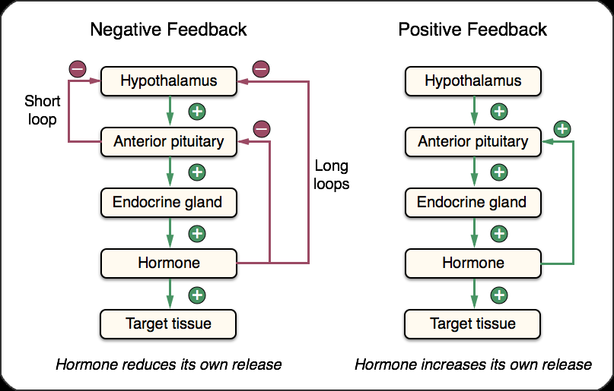
Feedback control
From Apexanesthesia.com

Slide 26
The Pituitary Gland

Slide 27
Pituitary Gland
Also called hypophysis (Master Gland)
~ 1 cm in diameter & weighs 0.5-1 g
(size of a pea)
Lies in bony cavity at base of brain –
sella turcica
Connected to hypothalamus by pituitary or hypophyseal stalk

Slide 28
Pituitary Gland
Two distinct portions
Anterior lobe
– Adenohypophysis
- Superior and/or middle hypophyseal artery
- Communicates with Hypothalamus by vasculature
Posterior lobe
– Neurohypophysis
- Inferior hypophyseal artery
- Communicates with Hypothalamus by Neural pathways

Slide 29
Pituitary Gland
https://biology.stackexchange.com/questions/36453/why-is-the-pituitary-gland-located-in-the-brain

Slide 30
Anterior vs. Posterior Pituitary hormones
https://www.flickr.com/photos/archives-poet-em/13283391033

Slide 31
Anterior Pituitary Lobe
Normally only one cell type for each major hormone formed here
Plays major role in control of metabolic
functions throughout body
Secretes 6 important hormones plus several
less important ones

Slide 32
Anterior Pituitary
FLAT PiG
Follicle stimulating hormone
Luteinizing hormone
Adrenocorticotropin
Thyroid stimulating hormone
Prolactin
ignore
Growth hormone

Slide 33
Anterior Pituitary
Hypothalamus controls synthesis of anterior pituitary hormones
Each hypothalamic neurohormone has a target cell in AP
Hormones are tissue-specific

Slide 34
Factors That Stimulate Secretion
↓ plasma glucose
↓ plasma free fatty acids
Starvation or fasting, protein deficiency
Trauma, stress, excitement
Exercise
Testosterone, estrogen
Deep sleep (stages II and IV)
Growth hormone-releasing hormone

Slide 35
Factors That Inhibit Secretion
↑ blood glucose
↑ blood free fatty acids
Aging
Obesity
Growth hormone inhibitory hormone
(somatostatin)
Growth hormone (exogenous)
Somatomedins (insulin-like growth factors)

Slide 36
Growth Hormone
Promotes skeletal development & body growth
Regulates protein & carbohydrate
metabolism
Synthesized by somatotrophs
Exerts its effects directly on almost all
cells

Slide 37
Adrenocorticotropin (ACTH)
Adrenocorticotrophic peptide-based hormone
Regulates adrenal cortex growth
Regulates cortisol (steroid) & androgenic hormone release
Synthesized by corticotropes
Target site = adrenal gland

Slide 38
Anterior Pituitary Disorders
Hyposecretion
Large pituitary tumors
Postpartum shock (Sheehan’s syndrome)
Irradiation
Trauma
Hypophysectomy
Infiltrative disorders (Sarcoidosis etc.)

Slide 39
Effects of Hyposecretion
Decrease in thyroid function, glucocorticoid production, and suppression of sexual development & reproductive function
Large tumors
Extend/compress surrounding brain tissue
Diplopia
Visual loss
Facial numbness or pain

Slide 40
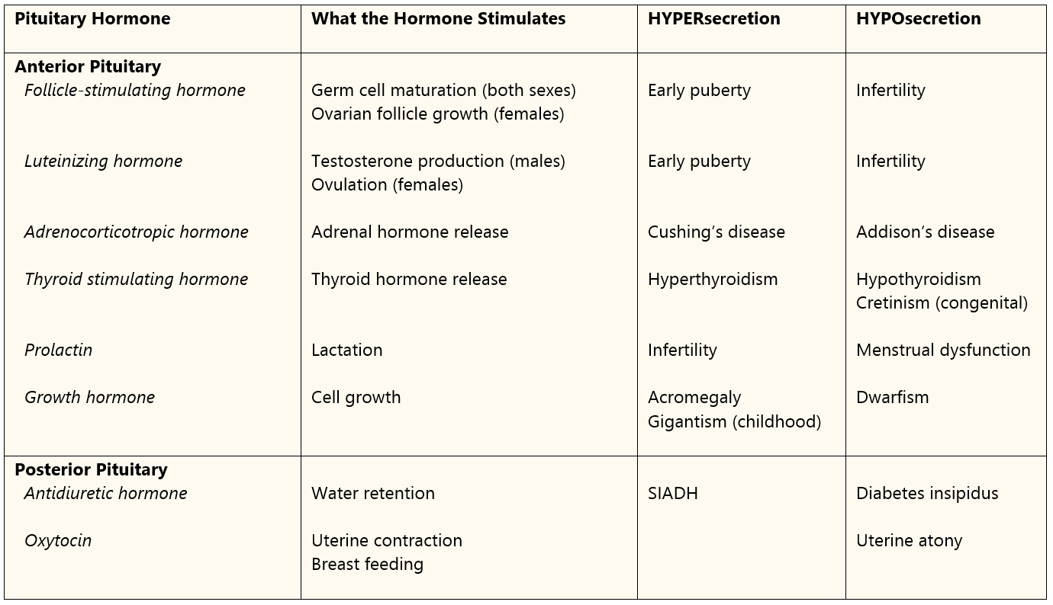
Pituitary hormones and associated diseases
From Apexanesthesia.com

Slide 41
Treatment of pituitary tumor
Surgical Intervention
Transsphenoidal usual approach
Sitting or half-sitting position (limited access to airway, potential for VAE)
Significant potential for blood loss
Epinephrine or cocaine-soaked sponges
Nasal packing

Slide 42
Transsphenoidal Approach
https://www.google.com/search?hl=en&biw=976&bih=775&tbm=isch&sa=1&ei=S2BbWpu7BNHQjwPUkqvwBw&q=pituitary+adenoma+transsphenoidal+surgery&oq=transphenoidal+su&gs_l=psy-ab.1.4.0i13k1l3j0i13i5i30k1l5j0i8i13i30k1l2.14037.27806.0.34103.38.28.1.1.1.0.200.2813.4j17j1.22.0....0...1c.1.64.psy-ab..20.11.1207...0j0i67k1j0i30k1j0i5i30k1.0.baajC6DfLKg#imgrc=zFSK-rpOGY_kbM:

Slide 43
Pituitary vs. Major Vessels
https://www.pinterest.com/pin/247486941997948892/

Slide 44
Beach chair
(every inch is 2 mm Hg)
https://www.cambridge.org/core/books/anesthesia-for-otolaryngologic-surgery/anesthesia-for-transsphenoidal-pituitary-surgery/2721D3048C7B8AE8C4D346BCC72D2B37

Slide 45
Notice where the anesthetist is!
https://www.cambridge.org/core/books/anesthesia-for-otolaryngologic-surgery/anesthesia-for-transsphenoidal-pituitary-surgery/2721D3048C7B8AE8C4D346BCC72D2B37

Slide 46
Venous Air Embolism
Be aware of this very serious potential complication.

Slide 47
Anesthetic Management
Patients may require peri-op corticosteroid coverage & long-term hormone replacement
If diabetes insipidus occurs – vasopressin
No nitrous
Anesthetic that allows for smooth extubation & rapid neuro assessment is desired

Slide 48
Anterior Pituitary Disorders
Hypersecretion
Usually secondary to hyperfunctioning pituitary adenoma (most common are those that produce ↑ prolactin, ACTH & growth hormone)
Treatment is focused on controlling hormone levels, decreasing tumor size & restoring normal gonadal function

Slide 49
Growth Hormone Disorders
Hypersecretion – Acromegaly
Skeletal overgrowth (enlarged hands & feet, prominent mandible)
Soft tissue overgrowth (enlarged lips, tongue, epiglottis)
Organomegaly (Cardiomyopathy most serious)
Osteoarthritis
Glucose intolerance
Peripheral neuropathy
Skeletal muscle weakness

Slide 50
Andre the Giant!

Slide 51
Acromegaly Treatment
Preferred therapy is microsurgical removal of tumor
Treatment options for non-surgical pts include administration of octreotide (long acting somatostatin) or bromocriptine & gland irradiation

Slide 52
Acromegaly Anesthetic Implications
Careful airway exam & careful consideration of mask & ETT size
Anticipate potential difficult intubation d/t large & thick tongue subglottic narrowing & vocal cord enlargement → may dictate smaller ETT
Avoid nasal intubation – enlarged turbinates
Cardiac Exam
Glucose and electrolyte monitoring

Slide 53
Growth Hormone Disorders
Hyposecretion
Can result in dwarfism, mild obesity, ↓ lean body mass &hypoglyclemia
Treatment with biosynthetic growth hormone

Slide 54
Posterior Pituitary Lobe
Secretes 2 hormones: ADH & oxytocin
ADH controls rate of water excretion into urine
Oxytocin stimulates lactation & uterine smooth muscle contraction
Both are synthesized in hypothalamus

Slide 55
ADH
Acts on renal collecting ducts to absorption of solute free water from tubules
Primary actions: ↑ urine osmolarity, ↓ serum osmolarity & ↑ increase blood volume
High levels cause potent systemic vasoconstriction
Promotes hemostasis by ↑ circulating levels of von Willebrand factor & factor VIII
Desmopressin (DDAVP) an arginine analogue of ADH is used to reverse coagulopathy associated with platelet adhesion defects
Release triggered by 1-4% rise in plasma osmolarity and/or 15-25% drop in BP or Bld vol.

Slide 56
Diabetes Insipidus (DI)
Inability to produce or release ADH from posterior pituitary - Hyposecretion
Neurogenic DI—due to posterior pituitary destruction
Nephrogenic DI—failure of renal tubules to respond to ADH → distal tubular segments cannot reabsorb H₂O in absence of ADH → large volume of dilute urine
Polyuria: Urine volumes can exceed 15L/day, greater than 50 ml/kg
(Expected adult urine output ~ 0.5ml/kg/hr → 30-40ml per hour in an average sized adult. For children, it is closer to 1ml/kg/hr.)

Slide 57
Di
Labs: ↓ urine osmolarity (< 290 mOsmo/L)
↑ serum osmolarity (>290 mOsm/L)
High serum sodium levels (>145 mEq/L)
Treatment with vasopressin 5-10 U IV/SC max 60 U/day or DDAVP (Desmopresin) 1-2 mcg IV/SC
DI developing during or immediately after pituitary surgery usually d/t reversible post pituitary trauma & is usually transient
Thiazide diuretics cause antidiuretic action in DI pts

Slide 58
DDAVP
Synthetic analogue of natural pituitary hormone 8-arginine vasopressin
Indicated as ADH replacement therapy in management of temporary polyuria & polydipsia following head trauma or pituitary surgery
Monitor s/s of hyponatremia: HA, N/V, ↓ serum Na⁺, restlessness, disorientation, depressed reflexes, altered LOC, muscle weakness, seizures
DDAVP does not work in nephrogenic DI

Slide 59
Hypersecretion - SIADH
High circulating vasopressin levels → excess H2O aborption by kidneys
Leads to serum Na⁺ dilution, ↓ serum osmolality & concentrated urine
Kidneys continue to absorb water despite Na⁺< 130 mEq/L; Osm < 270 mOsm/L → water intoxication ( Na <135, Osm <275 per Apex)
This triggers lethargy, headache & brain edema

Slide 60
SIADH Anesthetic Management
Surgical/medical treatment depends on
Na⁺ level; may include fluid restriction, NS or hypertonic Saline, diuresis, correct Na⁺ imbalance slowly
Delayed in awakening from anesthesia
Permanent neurological damage with central
pontine demyelination syndrome

Slide 61
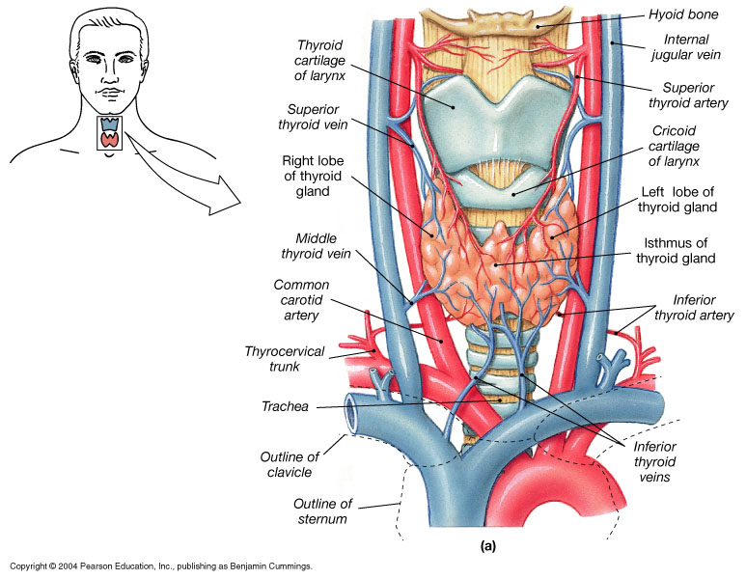
Thyroid
https://cdn.thyroid.com.au/wp-content/uploads/2011/12/thyroid-anatomy-detailed.jpg

Slide 62
thyroid
Right and Left lobes joined by Isthmus
Recurrent Laryngeal Nerve runs along both sides
Requires Iodine to produce hormones
Stores and secretes:
T4 – Thyroxine (prohormone)
T3 – Triiodothyronine (active)
Calcitonin
Goiter caused by low Thyroid hormone leading to increase in TSH leading to increase in thyroglobulin colloid but unable to make T3 or 4, gland swells. AWAKE INTUBATION

Slide 63
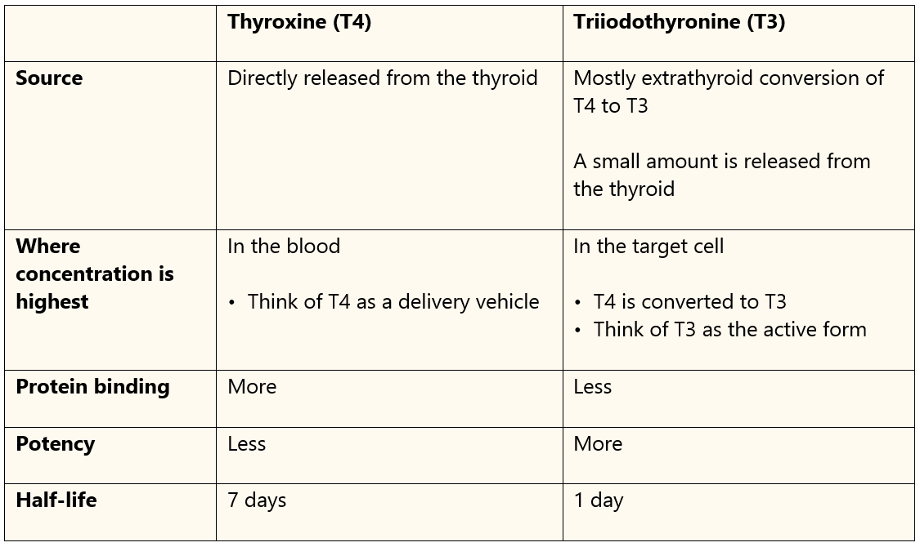
thyroid
Difference between T3 and T4
From Apexanesthesia.com

Slide 64
thyroid
Hyperthyroidism (Thyrotoxicosis or Graves’ Disease)
Signs – tachycardia, hyperventilation, diarrhea, tremors and weakness.
Diagnosed by abnormally high T3 and 4 plus low TSH
Tx – radioactive iodine or surgery
Be aware of structures around gland for anesthetic plan
Thyroid Storm: may be caused by surgery, may not occur until 18 hrs postop
Signs: Temp >38.5, tachycardia, confusion, tremor, weakness, dysrhythmias, N + V, HTN, heart failure, may mimic MH
Treatment – Time, hydration, O2, B-blockers (short-acting; Esmolol), glucocorticoids, Tylenol and ice to reduce temp

Slide 65
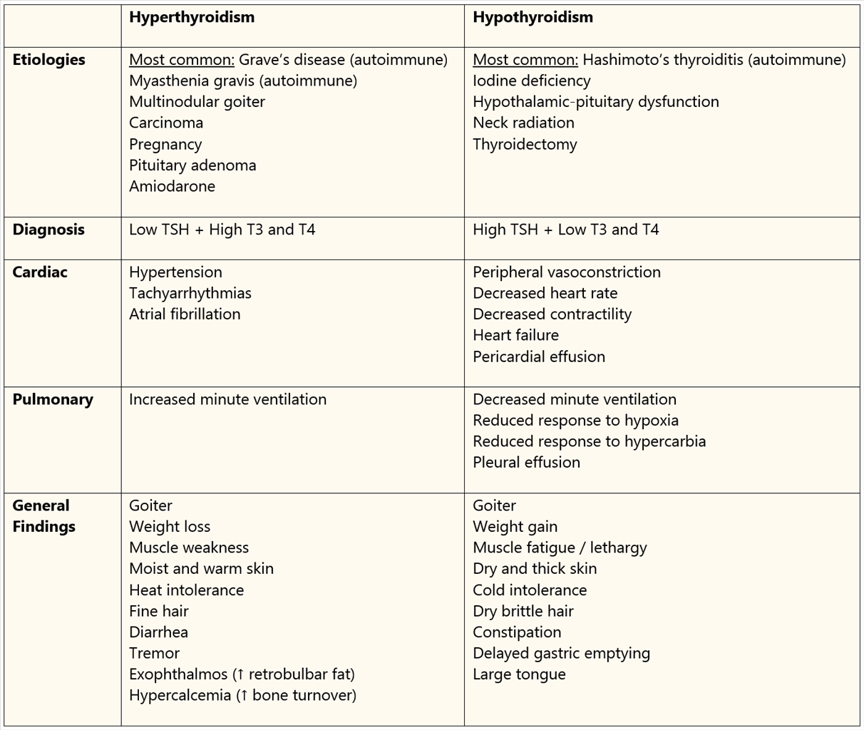
thyroid
Comparison of Hyper and Hypothyroid (From Apexanesthesia.com)

Slide 66
Thyroid
Hypothyroid – AKA Myxedema
Autoimmune form – Hashimoto’s Thyroiditis
Common cause – surgical thyroidectomy
Little concern for anesthesia as long as on supplements
Severe form – Myxedema Coma
Coma, hypovent., hypothermia, hypotension, & hyponatremia
Medical emergency – Only lifesaving sx allowed
tx – IV T4
T3 may be used but may get card. ischemia

Slide 67
Parathyroid
Small nodes attached to Thyroid glands
Regulates CA levels
High CA levels may cause serious arrhythmias
Brugada syndrome
Treatment – surgery is most often required
May need to draw labs – 2nd IV or A line
Similar considerations to Thyroid sx

Slide 68
Pancreas

Slide 69
Anatomy
Large compound gland which lies parallel & beneath stomach
Composed of 2 tissue types
Acinar cells
Producing exocrine hormones for digestion
Islets of Langerhans
Producing endocrine hormones for metabolism

Slide 70
Islets of Langerhans
1-2 million islets of Langerhans in pancreas
Organized around small capillaries
Contain 4 types of cells
⍺ (alpha) (25%) secrete glucagon
𝜷 (beta) (60%) secrete insulin & amylin
∆ (delta) (10%) secrete somatostatin
PP (pancreatic polypeptide) (5%)

Slide 71
Insulin
Synthesized in pancreas & stored within β-cell cytoplasm
Normal release 1 U/hr, meals 5-10/hr, total 40/day
200 units in storage
Stimulation causes exocytosis release into surrounding capillaries ➝ portal circulation
Half life averages ~ 7 minutes
Major site of hormone degradation – liver &
kidney

Slide 72
Stimulation of Insulin Release
↑ plasma glucose levels (primary factor) (meals)
Gastrointestinal hormones – gastrin, secretin, cholecystokinin & gastric inhibitory peptide
⍺ blockade
Autonomic (vagal) & β - adrenergic stimulation
Nitric Oxide
Acetylcholine

Slide 73
Inhibition of Insulin Release
Hypoglycemia & hypokalemia
Somatostatin
β-blockers
Thiazide diuretics
Insulin
Glucagon, cortisol, growth hormone
α2 - adrenergic stimulation
epinephrine
norepinephrine

Slide 74
Insulin Metabolic Effects
Liver
↓ gluconeogenesis
Glycogenolysis
Ketogenesis
Synthesis of glucose & fatty acids
↑ glucose uptake
Fat
↑ glucose uptake
Promotes fatty acid synthesis
Decreased glycolysis

Slide 75
Insulin Metabolic Effects
Muscle
↑ glucose uptake
↑ amino acid uptake
↑ glycogen synthesis
↑ protein synthesis
↓ protein breakdown

Slide 76
Insulin Metabolic Effects
Anabolism
Glucose & K⁺ entry into cells
↓ breakdown of glycogen, protein & lipids

Slide 77
Glucose
Normal levels: 70-100 mg/dL
Normally increases after meals to 120-
140 mg/dL
Returns to normal within 2 hours
Organs that require glucose – brain,
erythrocytes, adrenal medulla

Slide 78
Glucagon
Produced by pancreatic islets α cells
Biologic antagonist to insulin
Most important role is to enhance hepatic glucose output & ↑ plasma glucose
Works with epinephrine, growth hormone & cortisol to restore normal glucose levels during periods of hypoglycemic stress
Increases plasma blood glucose levels in nondiabetic surgical patients
Also good for B-blocker OD, CHF, low CO after MI, increasing MAP with anaphylaxis

Slide 79
diabetes
Comes in 2 types – Type I and Type II
Diagnosis by
Fasting plasma glucose >126mg/dl
Random glucose level >200mg/dl + symptoms
2 hour plasma glucose > 200 during tolerance test
A1c > 6.5% (good to know but will not alter anesthetic)

Slide 80
Diabetes Mellitus type I
Type 1—d/t pancreatic 𝜷 cell destruction → absolute insulin deficiency, usually autoimmune dis.
5-10 % of all cases; typically earlier onset
Pts more likely to have other autoimmune diseases, such as thyroid or Addison’s disease
Traditional thought of DM1 only in children & DM2 only is adults no longer true—both forms present in both age groups
CANNOT be controlled by diet & PO agents—requires insulin
Difficult to maintain optimal gluc level; more likely to become ketotic & sustain progressive end-organ damage

Slide 81
Diabetes Mellitus type II
Type II—relative insulin resistance
Typical gradual onset later in life d/t progressive loss of insulin secretion and insulin resistance
Pts often obese & may have normal or increased insulin levels initially
Milder disease can be controlled with diet, lifestyle changes & oral agents
Relatively resistant to ketosis & acidosis therefore disease may not be clinically apparent until stress of surgery or illness
Can develop nonketotic, hyperosmolar hyperglycemia

Slide 82
Other type of DM—caused by
Diseases that damage pancreas—pancreas surgery, chronic pancreatitis, cystic fibrosis, hemochromatosis
Endocrine diseases like glucagonoma, pheochromocytoma & acromegaly ↑ risk of developing DM
↑ glucocorticoid effects from Cushing’s or steroids, or tacrolimus treatment after organ transplantation
Thiazide diuretics & atypical antipsychotics (clozapine, olanzapine, risperidone, ziprasidone, quetiapine) ↑ risk

Slide 83
End Organ Complications with DM
Atherosclerosis—earlier onset & more widespread
CAD, PVD, cerbrovascular disease, renovascular disease
↑ post-op MI & complication rates; silent myocardial ischemia & infarct more common
Diabetic neuropathy rate 20-40 % & leading cause of ESRD
Cardiovascular neuropathy clinically most important
Presents as resting tachycardia, exercise intolerance, orthostatic hypotension
Pt at ↑ risk for intra-op hypotension requiring pressor support; ↑ risk of peri-op arrest & intra-op hypothermia

Slide 84
End Organ Complications with DM
GI neuropathies include esophageal enteropathy, gastroparesis (↑ aspiration risk), constipation, diarrhea & incontinence
Stiff joint syndrome with atlanto-occipital joint stiffness ↑ risk of difficult intubation
DM pts have ↑ risk of cognitive decline, dementia, fractures, cancer, OSA, poor healing & hearing disorders

Slide 85
DM Complications
Diabetic Ketoacidosis (DKA)
Abnormal fat and carb metabolism
Overproduction of Ketoacids by liver
See – Serum Glucose > 300 mg/dL
pH < 7.3
HCO₃- < 18
Serum Osmolarity < 320 mOsm/L
Treatment – saline bolus, insulin, and electrolytes

Slide 86
DM Complications
Hyperglycemic Hyperosmolar Syndrome
Severe Hyperglycemia, hyperosmolarity, & dehydration
Usually with an acute illness and evolves over days or weeks
See – Serum glucose > 600 mg/dL
pH > 7.3
HCO₃ > 15 mEq/L
Serum Osmolarity > 350 mOsm/L
Treatment – hypotonic saline bolus, insulin, & electrolytes

Slide 87
DM Anesthetic Considerations
Most common endocrine disorder you will encounter in surgical pts
Pts predisposed to diseases needing surgical intervention
Heart surgeries, cataracts, vascular repair (carotid endarterectomies, fem-pop bypass etc), kidney transplantations, ulcer debridement, getting parts of their feet & legs chopped off!
Have higher M/M in peri-op period than non-DM cohorts
Ischemic heart disease is most common cause of peri-op mortality

Slide 88
Prayer Sign
https://palmreadingperspectives.wordpress.com/tag/diabetes/

Slide 89
DM Pre-Op Considerations
Assess CV status
baseline BP, ECG (in all adult DM pts), angiogram
Assess for autonomic nervous system dysfunction
Anticipate labile BP & exaggerated responses (hypotension, tachycardia)
Delayed gastric emptying → ↑ risk of aspiration, N/V Want secure airway!
May have impaired response to hypoxia & may be sensitive to respiratory depressant meds
Carefully assess & document peripheral neuropathies
Anticipate potential difficult intubation
Diabetic neuropathy may mask hypoglycemia

Slide 90
DM Pre-Op Considerations
Asses volume & electrolyte status
Sustained hyperglycemia causes osmotic diuresis → possible electrolyte & fluid deficits
Chem 8
Urine output
Assess renal function
BUN, serum creatinine, UA
Renal impairment may influence med choice & dosage
Avoid nephrotoxic drugs
May want an A1c but not typical
Assess glycemic control & ensure optimization
What glycemic controls meds are they on? Last dose?
Avoid lactate-containing solutions d/t lactate being converted to glucose

Slide 91
DM Intra-op Management
Cases should be scheduled early in day
No specific anesthetic technique has been found to be superior
GA may induce hormonal changes → ↑ glycogenolysis & glucogenesis, making hyperglycemia worse
Regional anesthesia may have lesser effect on glucose homeostasis
Remember that surgical stress ↑ catecholamines, vasopressin, cortisol & glucagon
Frequent glucose monitoring; individual institutions differ on intra-op glucose monitoring
Most allow mild hyperglycemia (~180 or higher)
Hypoglycemia a much bigger problem! (<70mg/dl or <50 severe, give D50 and recheck in 15 min)
Insulin gtt may instituted or continued on pts having major, prolonged surgery, pts with poorly controlled DM or having concurrent serious illness
Careful positioning & padding

Slide 92
DM Medications Considerations
Sulfonylureas
Names: Glipizide, Glimepiride, Glyburide
Mechanism of Action: Increase insulin release from $β$-cells in the pancreas & increase peripheral insulin sensitivity
Avoid with sulfa allergies
Dosing regimens: Once daily oral tablets
PK considerations: Liver metabolized and renally cleared
Surgical considerations:
Can cause hypoglycemic events.
Short acting versions should be held the night before operation.
Long acting forms should be held 48-72 hours.

Slide 93
DM Medications Considerations
Biguanides
Names: Metformin**
Mechanism of action: Decreases hepatic glucose production, decreases intestinal absorption of glucose and improves insulin sensitivity.
Dosing regimens: One to two times daily. Max dose of 2000 mg daily.
PK considerations: Renally cleared and dose adjusted based on GFR.
Surgical considerations: Hold morning of procedure.
Does not cause hypoglycemia
May cause lactic acidosis

Slide 94
DM Medications Considerations
Thiazolidinediones
Names: Pioglitazone (Actos), Rosiglitazone (Avandia)
Mechanism of action: Selective agonist for peroxisome proliferator-activated receptor-gamma (PPARgamma). Decreases liver glucose production, increases insulin sensitivity of adipose, muscle, and liver cells
Dosing regimens: Typically daily dosing
PK considerations: No dosing adjustments
Surgical considerations: Hold dose morning of surgery
Other notes: Actos not on the market in parts of Europe due to bladder cancer concerns, and Avandia was previously off the market in the US for concerns regarding increased CV risk. Both exacerbate CHF.
Does not cause hypoglycemia

Slide 95
DM Medications Considerations
Meglitinides
Names: Nateglinide (Starlix), Rapaglinide (Prandin)
Mechanism of action: Increases insulin production and secretion by B-cells
Dosing regimens: Typically daily dosing
PK considerations: Renal clearance
Surgical considerations: Hold dose morning of surgery
Other notes: May cause cough or even bronchitis.
May cause hypoglycemia

Slide 96
DM Medications Considerations
DPP-4 inhibitors (-gliptins)
Names: Sitagliptin (Januvia), Linagliptin (Tradjenta)
Mechanism of action: Inhibits dipeptidyl peptidase IV resulting in prolonged active incretin levels. Incretin hormones increase insulin synthesis and release from pancreatic beta cells. Decreased glucagon secretion results in decreased hepatic glucose production.
Dosing regimens: Daily dosing
PK considerations: Renally cleared and dose adjusted
Surgical considerations: Hold morning dose prior to surgery. May see hypoglycemia.

Slide 97
DM Medications Considerations
SGLT2 Inhibitors (-flozin),
Names Canagliflozin (Invokana), Dapagliflozin (Farixiga), and Empagliflozin (Jardiance)***
Mechanism of action: Promote the renal excretion of glucose
Dosing regimens: Once daily dosing
PK considerations: Renally cleared and dose adjusted
Surgical considerations:
Hold morning dose of mediation
Tied to increased risk of UTI, genital infections, necrotizing fasciitis, and hypotension.

Slide 98
DM Medications Considerations
GLP-1 Receptor Agonists (-tides)
Names Exenatide (Byetta, Bydureon), Liraglutide*** (Victoza, Saxenda), Dulaglutide (Trulicity), and Semaglutide (Ozempic).
Mechanism of action: Incretin hormone which increases glucose-dependent insulin secretion, decreases glucagon secretion, increases B-cell growth/replication, slows gastric emptying, and decreases food intake
Dosing regimens: SQ from daily to weekly dosing.
PK considerations: Wide variation in drug half lives.
Surgical considerations
Hold morning of procedure
Known to cause pancreatitis
May cause hypoglycemia

Slide 99
DM Medications Considerations
Uncommon options
Alpha-glucosidase inhibitors (Precose, Acarbose)(inhibits metabolism of intestinal sucrose)
Taken with first bite of each meal. Causes significant flatulence, diarrhea, and abdominal pain.
Does not cause hypoglycemia
Bile Acid Binding Resins Colesevelam (Welchol)
Can cause constipation and bind to fat soluble vitamins
Dopamine Agonist (Cycloset)
Can cause hypotension and orthostasis
Amylin Antagonists(pramlintide)(slows gastric emptying and suppresses glucagon)
SQ injection used in T1DM and T2DM
May cause hypoglycemia

Slide 100
Combination Products
Metformin/glyburide (Glucovance)
Metformin/sitagliptin (Janumet)
Liraglutide/insulin degludec (Xultophy)
Metformin/glipizide
Metformin/canagliflozin (Invokamet)

Slide 101
Future potential options
T1DM vaccine aiming to stimulates the immune system to lower the levels of an inflammatory protein that is thought to be involved in multiple autoimmune diseases.
Oral GLP-1 agonists (Stage 3 trials)
Drugs aimed at increasing the microbiome diversity as a treatment for type 2 diabetes.
Drug that simultaneously targets the pancreas, the liver and the muscles to reduce blood sugar.
Designer drugs

Slide 102
Types of Insulin
https://www.rn.com/nursing-news/understanding-insulin-administration/

Slide 103
Duration of insulin
http://tmedweb.tulane.edu/pharmwiki/doku.php/insulin_regimens

Slide 104
Insulin Surgical Considerations
Regular or rapid acting insulins (e.g. Novolog, Humalog)
Hold day of surgery or procedure.
Only IV preparation
NPH Insulin (Novolin N or Humulin N)
Give 50-75% of the usual dose the morning of surgery or procedure.*
Long-Acting Insulin (e.g. Lantus, Levemir)
Give 60-100% of the usual dose the evening prior or morning of surgery or procedure
High risk of hypoglycemia - Be aware of glucose needs operatively. Monitor for need of D50 or insulin gtt needs.

Slide 105
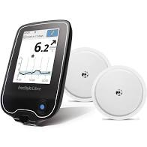
Monitoring Devices
https://www.google.com/url?sa=i&url=https%3A%2F%2Fwww.change.org%2Fp%2Fprime-minister-of-australia-we-need-government-rebates-for-life-saving-diabetes-equipment-this-petition-is-supported-by-diabetes-australia&psig=AOvVaw2UUU0ujuRLnCu0F_UvuA3Y&ust=1578009408279000&source=images&cd=vfe&ved=0CA0QjhxqFwoTCKjN8KPN4-YCFQAAAAAdAAAAABAM

Slide 106
Adrenal Glands
http://www.md-health.com/Adrenal-Gland-Cancer.html

Slide 107
Adrenal Gland Anatomy
Located at superior poles of each kidney
Two distinct anatomic and physiologic entities
Adrenal Medulla—comprises central 20%
Adrenal Cortex—outer part of gland

Slide 108
Adrenal Gland Hormones
https://www.dreamstime.com/stock-illustration-adrenal-gland-hormone-secretion-glands-sit-atop-kidneys-composed-outer-cortex-inner-medulla-which-image58867427

Slide 109
Adrenal Medulla
Central 20% of Adrenal Gland
Produces norepinephrine & epinephrine
Made in chromaffin cells
Lacks discrete synapses
Secretes norepinephrine & epinephrine directly into blood
20% Norepinephrine & 80% Epinephrine
Receives input from CNS via preganglionic fibers originating in thoracic spine T5-T11

Slide 110
Review of Epinephrine
Greater effect stimulating beta receptors
Weak constriction of blood vessels in muscle
5 to 10 times greater metabolic effect as
norepinephrine
↑ rate of glycogenolysis in the liver & muscle
↑ glucose release into blood
Greater affinity for β receptors

Slide 111
Review of Norepinephrine
Stimulates ⍺ and 𝜷 receptors
Causes constriction of essentially all blood vessels in body – ↑ PVR & elevates arterial pressure
↑ activity of heart
Inhibits activity of GI tract
Dilates pupils

Slide 112
Adrenal Cortex
All hormones secreted from adrenal cortex have steroidal structure & share common cholesterol backbone
Three Layers:
Zona Glomerulosa--Mineralcorticoids (Aldosterone)
Zona Fasiculata--Cortisol & Glucocorticoids
Zona Reticularis--Androgens

Slide 113
Adrenal Cortex Zona Glomerulosa
Cell layer just underneath capsule
15% of adrenal cortex
Secretes significant amounts of mineralcorticoid aldosterone
Secretion controlled by angiotensin II & K⁺

Slide 114
Adrenal Cortex Zona Fasiculata
Middle & thickest layer
Comprises 75% of adrenal cortex
Secretes glucocorticoids, cortisol & small amounts of adrenal androgens & estrogens
Secretion controlled by hypothalamic-pituitary axis via ACTH

Slide 115
Adrenal Cortex Zona reticularis
Deepest layer
Secretes adrenal androgens, small amounts of estrogens & some glucocorticoids
ACTH also regulates secretion of these cells

Slide 116
Mineralcorticoids
Aldosterone most potent mineralcorticoid; release controlled by renin-angiotensin system & serum K⁺
Binds to receptors in sweat glands, alimentary tract, & kidney distal convoluted tubule
Aldosterone is major regulator of extracellular volume and potassium homeostasis

Slide 117
Aldosterone
Secretion is stimulated by:
Hyperkalemia
↑ activity of renin-angiotensin system
Hyponatremia
ACTH
Targets distal convoluted tubules & causes Na⁺ reabsorption and excretion of H+ → ↑ ECF volume, ↑ blood volume & ↑ blood pressure
Most potent regulators: K+ concentration & renin-angiotensin system

Slide 118
Renin-Angiotensin System
Renin released from juxtaglomerular cells in kidneys
Acts on angiotensinogen to form angiotensin I
Angiotensin I is acted on by angiotensin- converting enzyme (ACE) to form angiotensin II, a potent vasoconstrictor and stimulus for aldosterone secretion

Slide 119
Adrenal Cortex Disorders
Adrenal Insufficiency
Adrenal Crisis
Cushings Disease/Syndrome
Aldosteronism

Slide 120
Adrenal Insufficiency (AI)
Primary Disease—Addison’s Disease
Secondary Disease—2 main causes
Hypothalamic-pituitary-adrenal (HPA) suppression from exogenous glucocorticoid therapy
ACTH deficiency 2º hypothalamus or pituitary gland dysfunction (tumor, infection, surgical or radiologic ablation)

Slide 121
AI Addison’s Disease
Absence of cortisol & aldosterone d/t adrenal cortex destruction
Most common cause in US are autoimmune dysfunction (DM1, Hashimoto thyroiditis, congenital AI, sarcoidosis, HIV, adrenal hemorrhage, malignancy or trauma)
S/S: weakness & fatigue, ↓ appetite & wt loss, abd pain, N/V, diarrhea, hypotension, hypoglycemia, hyponatremia, hypovolemia, hyperkalemia, mucosal & skin pigmentation & asthenia
Adrenal-pituitary axis intact with ↑ [ACTH] d/t ↓ cortisol production

Slide 122
Addison’s Disease Diagnosis & Treatment
Dx: baseline plasma cortisol <20 mcg/dl & cortisol level <20 mcg/dl after ACTH stimulation
Tx: replace both glucocorticoid & mineralocorticoid
Ave adult secretes 15-30 mg cortisol & 50-250 aldosterone daily
Typical PO replacement prednisone 5 mg AM & 2.5 mg PM or prednisone 20 mg AM & 10 mg PM; fludrocortisone 0.02-0.2 mg/day for mineralocorticoid

Slide 123
Addison’s Disease Anesthetic Considerations
Requires exogenous corticosteroid supplementation
Avoid etomidate d/t adrenal suppression
Pt may be sensitive to myocardial depression HOWEVER, benefits of pre-op treating are believed to outweigh risks of acute adrenal crisis, which can be life threatening
Addisonian crises can happen in all forms of adrenal insufficiency

Slide 124
Addison’s Disease Pre-op Glucocorticoid therapy
Preoperative glucocorticoid coverage for all AI (known or suspected)
Pts with history of glucocorticoid dosages of 20 mg/day for > 3 weeks within past year should receive pre-op glucocorticoid coverage
Pts receiving prednisone < 5mg daily, even for years do not demonstrate HPA suppression and do not need perioperative supplementation

Slide 125
Exogenous Glucocorticoid Therapy
Important to understand purpose of steroid (anti-inflammatory vs mineralocorticoid activity)
Major consequence is hypothalamic-pituitary axis (HPA) suppression
Unlikely if dosing < 1 week lower dose
Pts receiving > 1-3 weeks should be considered to have HPA suppression
6-9 months for levels to normalize
Supplementation for pts receiving ≤ 5 mg/day not usually required if normal daily dose taken pre-op
Consider surgical stress in peri-op dosing
High risk → 300 mg hydrocortisone divided into 3 doses over 24 hours
Low risk → 25 mg @ induction with 100 mg over next 24 hours

Slide 126
Table of comparative Corticosteroid Pharmacology
 | Glucocorticoid | Mineralo-corticoid | ~ equivalent Dose (mg) | Duration of action (hr)
Cortisol | 1.0 | 1.0 | 20 | 8-12
Cortisone | 0.8 | 0.8 | 25 | 8-36
Prednisolone | 4 | 0.8 | 5 | 12-36
Prednisone | 4.0 | 0.25 | 5 | 12-36
Methylprednisolone | 5 | 0.5 | 4 | 12-36
Betamethasone | 25 | 0 | 0.75 | 36-54
Dexamethasone | 30 | +/- | 0.75 | 36-54
Triamcinolone | 5 | 0 | 4 | 12-36
Fludrocortisone | 10 | 250 | 2 | 24
Handbook of Anesthesia, John J Nagelhout & Karen L. Plaus, 2014, p. 60

Slide 127
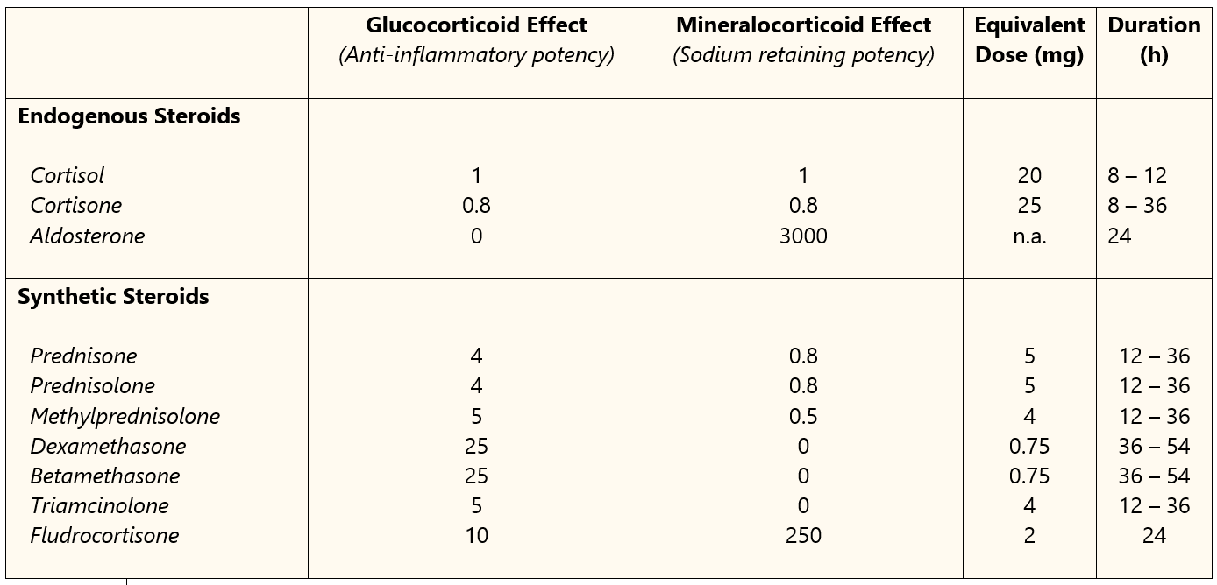
Glucocorticoid Preparations
Generic Name | Anti-inflammatory | Mineralocorticoid | Approximate Equivalent Dose (mg)
Short-acting
Hydrocortisone | 1.0 | 1.0 | 20.0
Cortisone | 0.8 | 0.8 | 25.0
Prednisone | 4.0 | 0.25 | 5.0
Prednisolone | 4.0 | 0.25 | 5.0
Methylprednisolone | 5.0 | — | 4.0
Intermediate-acting
Triamcinolone | 5.0 | — | 4.0
Long-acting
Dexamethasone | 30.0 | — | 0.75
Relative milligram comparisons with cortisol. The glucocorticoid and mineralocorticoid properties of cortisol
From Apexanesthesia.com

Slide 128
Addison’s Disease Anesthetic Management
Treatment of AI perioperatively with
Minimal doses of anesthetic agents and drugs d/t myocardial depression & skeletal muscle weakness
Glucocorticoids, replacement of fluids & Na⁺ deficits, vasopressor support
Isotonic IV fluids
Avoid etomidate – inhibits synthesis of cortisol transiently

Slide 129
Intra-Op Adrenal Crisis
Consider adrenal crisis as differential diagnosis with hemodynamic instability, especially when unresponsive to usual interventions
Hemodynamic instability → CV collapse
Suspect if pt has:
Hyperpigmentation
Hyponatremia
Hyperkalemia
History of autoimmune disease
Hypothyroidism
Diabetes
Recent use of steroids

Slide 130
Adrenal Crisis
Sudden exacerbation or onset of severe adrenal insufficiency
S/S: Weakness, nausea, hypotension, fever & decreased LOC
Caused by stress from infection, acute illness or sepsis
Rare event with high morbidity & mortality if untreated or unrecognized

Slide 131
Adrenal Crisis Treatment
Medical emergency requiring aggressive treatment of steroid insufficiency, electrolyte imbalance & volume depletion
Early recognition & intervention crucial!
Initial therapy—fluid resuscitation & steroids
Invasive monitoring helpful
Frequent monitoring of glucose & electrolytes

Slide 132
Etomidate & AI
Awareness of etomidate adrenal suppression
Single dose can cause acute adrenocortical insufficiency
Avoid in patients susceptible to AI

Slide 133
Cushing’s Syndrome (glucocorticoid xs)
Caused by overproduction of cortisol by adrenal cortex or exogenous glucocorticoid treatment
Majority cases d/t bilateral adrenal hyperplasia 2º ↑ ACTH production by anterior pituitary microadenoma or nonendocrine tumor
Signs & symptoms include
Truncal obesity & fat redistribution (moon face)
Hypertension & fluid retention
Hyperglycemia, hypokalemia and alkalosis
Muscle weakness & wasting and fatigue
Osteoporosis
Emotional lability (all the way to psychosis!)
Increased susceptibility to infections & poor healing

Slide 134
Cushing’s Syndrome
Cushing’s Disease = Cushing Syndrome caused by pituitary tumor
https://www.mayoclinic.org/diseases-conditions/cushing-syndrome/symptoms-causes/syc-20351310

Slide 135
Cushing’s Syndrome Anesthesia Considerations
Treating & optimizing hypertension, DM, volume status & correcting electrolyte imbalances
Careful positioning d/t osteoporosis & ↑ fx risk
General vs regional anesthesia—literature doesn’t support a superior approach
Judicious use of muscle relaxants—any time you hear muscle weakness or muscle wasting!
Etomidate has been used specifically for adrenal suppression to moderate steroid production
May bleed more easily and have higher CVP,
keep CVP on low end of normal (Miller)

Slide 136
Cushing’s Syndrome Treatment
Transphenoidal microadenomectomy (microadenoma) or resection of anterior pituitary
Pituitary irradiation & bilateral
adrenalectomy
Adrenalectomy for adrenal adenoma or
carcinoma

Slide 137
Primary Hyperaldosteronism
Conn’s Syndrome (Mineralcoricoid Excess)
Primary – excessive secretion of aldosterone from a functional tumor--more common in women, rare in children
Secondary – present when increased circulating concentrations of renin stimulate aldosterone release
Symptoms
Some patients asymptomatic
Hypertension (renin secretion is inhibited by hyperaldosteronism)
Hypokalemic metabolic alkalosis
Muscle weakness

Slide 138
Primary Hyperaldosterone Conn’s Syndrome
Diagnosis
Hypokalemia and Hypertension suggestive
Plasma aldosterone concentration < 9.5 ng/dL rules out primary aldosteronism
With secondary hyperaldosteronism, plasma renin activity is high
Chronic ingestion of licorice may present as hyperaldosteronism (hypertension, hypokalemia, suppression of renin-angiotensin system)

Slide 139
Primary Hyperaldosterone Conn’s Syndrome
Treatment
Supplemental Potassium
Spironolactone (competitive aldosterone antagonist)
Definitive treatment is surgical excision (adrenalectomy, may be bilateral)

Slide 140
Conn’s Syndrome Anesthetic Management
Correct hypokalemia and treat hypertension
Avoid hyperventilation – decreases plasma K⁺
Monitor cardiac filling pressures if cardiac involvement
Retrospective study showed more stable hemodynamically if BP & electrolytes controlled preop
Bilateral adrenalectomy may need intraop cortisol

Slide 141
hypoaldosteronism (Mineralocorticoid Deficiency)
Less common condition
Plasma renin activity is below normal & does not increase with sodium restriction or diuretic drugs
Causes:
Congenital
Occurring after unilateral adrenalectomy
Prolonged administration of heparin
Long standing diabetes & renal failure

Slide 142
Hypoaldosteronism
Signs & Symptoms
Hyperkalemia without renal insufficiency
Hyperchloremic metabolic acidosis
Heartblock secondary to hyperkalemia
Orthostatic hypotension
Avoid NSAIDs, may exacerbate condition
Treatment includes liberal sodium intake & fludrocortisone

Slide 143
Adrenal Medulla disorders
Pheochromocytoma
Very rare – 2-8 cases/million people
Catecholamine secreting tumors of medulla
May mimic thyroid crisis or MH during anesth.
Triad of symptoms in a hypertensive patient indicative of Pheo.
Diaphoresis, Tachycardia, and Headache
Other symptoms – pallor, nausea, tremor, weakness, anxiety, chest pain, dyspnea, etc.
Spells may last 15 min to several hours

Slide 144
Pheochromocytoma cont.
Treatment – surgical removal is best
Anesthetic management – 3 primary considerations
1. Use meds that do not stimulate catecholamine release
2. Invasive monitoring to quickly detect attack
3. React quickly to cardiovascular changes
3 critical periods
1. Induction and intubation – HTN
2. Surgical manipulation of tumor – HTN
3. Ligation of tumor’s venous drainage - hypotension
Most agents are good, avoid morphine and ?succ?

Slide 145
Pheochromocytoma cont.
Treatment – surgical removal is best
Anesthetic management – 3 primary considerations
1. Use meds that do not stimulate catecholamine release
2. Invasive monitoring to quickly detect attack
3. React quickly to cardiovascular changes
3 critical periods
1. Induction and intubation – HTN
2. Surgical manipulation of tumor – HTN
3. Ligation of tumor’s venous drainage - hypotension
Most agents are good, avoid morphine and ?succ?

Slide 146
Thank you

Slide 147
References
Hines, R. L. & Marschall, K. E. (2018) Stoelting’s Anesthesia and Co-existing Disease. (7th ed.). Elsevier.
Nagelhout, J. J. & Elisha, S. (2018). Nurse Anesthesia (6th ed.). Elsevier.
3. Barash, P. G., Cullen, B. F., Stoelting, R. K., Cahalan, M. K., Stock, M. C., Ortega, R., Sharer, S. R. & Holt, N. F. (2017). Clinical Anesthesia (8th ed.). Wolters Kluwer.

