Slide 1
Anemia & coagulopathy
Todd Walter DrAP, APRN, CRNA
todwal@msn.com

Slide 2
objectives
Discuss the clinical presentation, anesthetic implications and anesthesia care for patients with hematologic and coagulopathic diseases including:
Acute and chronic anemias
Coagulopathies
Sickle Cell Disease
DIC
Discuss criteria and process for safe transfusion of blood and blood products, both autologous and donor.
Review laboratory findings associated with anemias and coagulopathies.

Slide 3
The normal vessel wall
Hemostasis- balance the body maintains between bleeding & clotting
Vessel wall injury initiates chain of events that cause bleeding to stop via clot formation, allowing injury site to heal. This event is followed by clot dissolution.
Vessels are cylindrical & consist of 3 layers- the intima, the media, and the adventitia
http://medicalpicturesinfo.com/wp-content/uploads/2011/08/Blood-Vessel-1.gif

Slide 4
The normal vessel wall
Intima
inner layer
made of endothelial cells
Functions: hemostasis modulation by synthesizing & secreting many procoagulants, anticoagulants, & fibrinolytics

Slide 5
The normal vessel wall
Subendothelial layer
Thrombogenic & very active
Consists of collagen; a potent & important stimulus for platelet attachment to injured vessel wall
Also contains fibronectin which facilitates fibrin anchoring during clot formation

Slide 6
The normal vessel wall
Adventitia—Participates in blood flow control by influencing contractile state of vessel
Endothelial cells produce nitric oxide (NO) & prostacyclin, which influence adventitia
NO affects platelet function by inhibiting platelet adhesion, aggregation & binding of fibrinogen between glycoprotein IIb-IIIa psuedopods
Once vasodilation occurs, ↑ blood flow limits procoagulant mediators activity by simply washing procoagulant mediators away

Slide 7
Cell Wall Mediators
Mediators responsible for procoagulant, anticogulant & fibrinolytic activities in the vessel wall
Von Willebrand factor(vWF)— for platelets adherence to subendothelial layer
Tissue factor— from coagulation cascade, activates clotting cascade pathway when vessel injury occurs
Thromboxane A2 & Adenosine diphosphate (ADP)—control blood flow by influencing vasoconstriction
Nitric oxide & Prostacyclin control blood flow by blood vessel vasodilation and inhibiting platelet adhesion
Tissue factor pathway inhibitor—inhibits endothelial cell activated coagulation

Slide 8
Nitric oxide and vessel wall
http://www.bayerpharma.com/static/media/images/upload/kardiologie/en/pic_sgc.png
Under influence of Nitric oxide synthetase (NOS), l-arginine is converted to nitric oxide (NO). NO then diffuses into muscle cells & activates soluble guanylate cyclase, producing 2nd messenger (cyclic guanosine monophosphate) → muscle relaxation
Notes:
Under the influence of Nitric ocise synthetase, l-arginine is converted to nitric oxide (NO) NO then diffuses into the muscle cells and activates soluble guanylate cyclase, subsequently producing as econd messenger, cyclic guanosine monophosphate, causing muscle relaxation

Slide 9
Prostacyclin & platelets
Prostacyclin is a lipid molecule prostaglandin produced in endothelial cells
Prostacyclin is a powerful vasodilator that interferes with platelet formation & aggregation
Platelets are an essential component of thrombogenic response to bleeding
Disc-like & circulate freely
Formed in bone marrow from megakaryocyte; 150,000 – 300,000/mm³ & survive ~ 8-12 days
Thrombocytopenia is platelet level below 100,000
Smaller than WBC/RBC & get “pushed” to vessel wall where needed
Constantly circulate, patching up small continuous vascular injuries

Slide 10
Platelets
Do not contain a nucleus, RNA or DNA
Produce thrombin & activate other coagulation factors which influence platelet recruitment to injury site
Store proteins & non-proteins that synthesize prostaglandins which enable platelets to promote vascular & local tissue reactions
Must be adequate in quality & quantity or hemostasis will not be achieved
Inactive unless they become activated by vascular trauma

Slide 11
Activation
Under influence of tissue factor (extrinsic clotting pathway), platelet undergoes a conformational transformation as it becomes activated → Transformer!
Disk-like structure swells and becomes oval & irregular
Next glycoproteins IIa & IIIb on platelet get activated & project themselves outward
Link other activated platelets to form primary plug
Seals & heals the injury

Slide 12
Adhesion
vWF mobilizes from within endothelial cells & emerges from endothelial lining (remember vWF is responsible for platelet adhesion)
vWF makes platelets “sticky” and allows them to adhere to injury site
Glyoprotein Ib receptors emerge from platelet surface
GIb attaches to vWF and attracts platelets to endothelial lining
Nitric Oxide inhibits aggregation and adhesion

Slide 13
Aggregation
With platelet metamorphosis, alpha & dense granules, contractile granules, thrombin, & many important mediators get released into blood to promote pro-coagulation activity
These mediators are responsible for primary unstable clot formation
With small injury, this clot is enough to maintain hemostasis
With large injury, coagulation cascade is required for permanent repair to stabilize a secondary clot & stop bleeding

Slide 14
Coagulation Cascade
Cofactors are activated
Most cofactors are enzymes, (except factor V & VIII)
Factor VIII is bound to vWF & activated by thrombin
These factors are inactive & circulate until activated to assist in coagulation
Activation occurs from either tissue or organ damage
Process ends when stabilization of hemorrhage occurs
Two separate coagulation pathways—Intrinsic & Extrinsic
Common in both pathways is conversion of prothrombin to thrombin
Thrombin assists in activating factors V, VIII, I, and XIII & influences platelet recruitment to injured area
Enough thrombin must be available to activate adequate fibrin to form a stable clot
Notes:
Initiation of clotting casade from injury inside the cell begins with factor XII

Slide 15
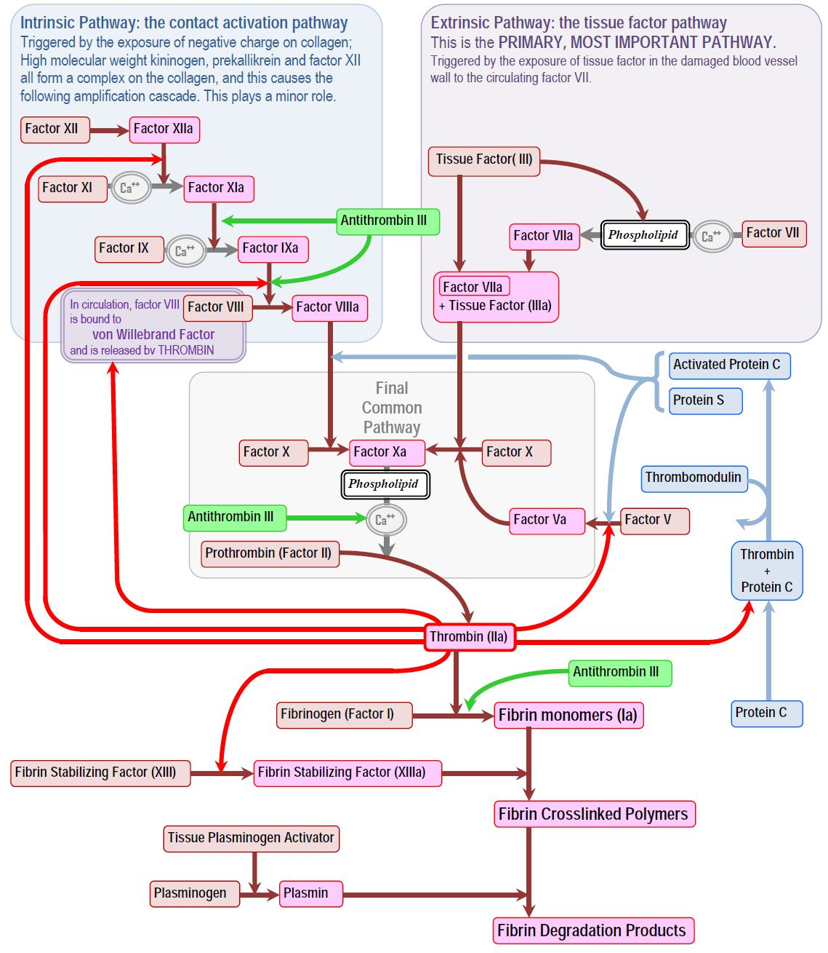
http://www.derangedphysiology.com/php/Pathology%20tests/images/coagulation%20cascade.JPG

Slide 16
thrombin & the common pathway
Thrombin behaves as an anticoagulant
prevents runaway clot formation by releasing tissue plasminogen activator (tPA) from endothelial cells
Stimulates protein C & S to inhibit clot formation
Forms relationship with antithrombin III to interfere with coagulation
Thrombin activates factor I (fibrinogen) to its active form Ia (fibrin)
Factor XIII (fibrin stabilizing factor) is required to ensure platelet plug will hold
Forms a cross-linked mesh to increase strength

Slide 17
thrombin & the common pathway
Fibrin (factor Ia) + Factor XIII = stablize secondary plug & bleeding stops
Once clot is made, vessel edges are woven together & healed
Common pathway is terminal pathway of coagulation cascade
Factor X has been activated by intrinsic & extrinsic pathways
Factor X requires help of factor V & calcium to convert factor II (prothrombin) to its active state (thrombin IIa)

Slide 18
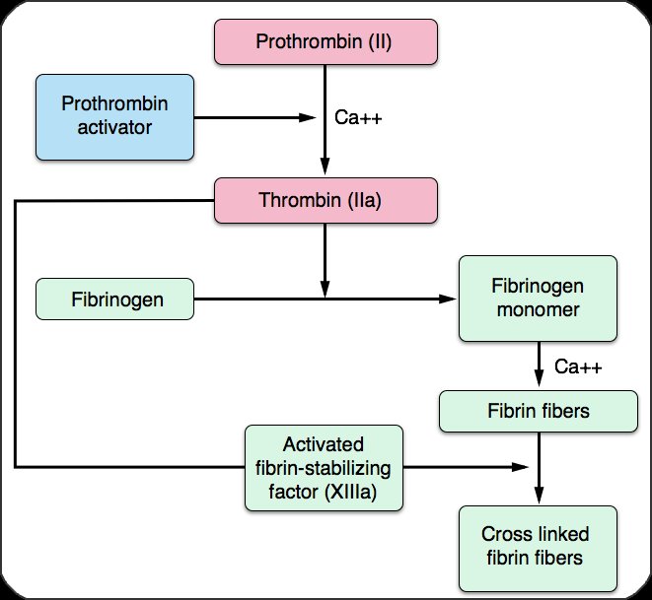
Common pathway
From apexanesthesia.com

Slide 19
Intrinsic vs. Extrinsic Pathway
Intrinsic Pathway
Initiated by damage INSIDE vessel
COAGULATION FACTORS XII ,XI, IX, VIII
IF you cannot buy the intrinsic pathway for $12, you can get it for $11.98
Extrinsic Pathway
Initiated in response to damage OUTSIDE vessel
COGULATION FACTORS III,VII
You can buy the extrinsic pathway for 37 cents

Slide 20
Common Final Pathway
Common final pathway coagulation factors are V, X, II, I, and XIII
“The final common pathway can be purchased at the five (V) and dime (X) for 1 (I) or 2 (II) dollars on the 13th (XIII).”
Other mnemonics found in Apex

Slide 21
Coagulation
Most coagulation proteins are manufactured in liver
Calcium (not a true factor) is needed to “line-up” factors on platelet surface
vWF is synthesized in endothelial cells
Utilization of Factors II, VII, IX, and X as well as proteins C and S are dependent on vitamin K

Slide 22
Cell-based coagulation
This theory describes hemostasis taking place in three phases:
Initiation
Amplification
Propagation

Slide 23
Cell-based coagulation
Initiation
Injury to the vessel triggers TF (tissue factor) that only some cell surfaces have
TF is exposed and the endothelial surface of the blood vessel changes, becoming acidic, making its phospholipid surface less repellent to platelets
TF down-regulates anticoagulants that reside in the subendothelial layer in an effort to promote coagulation
This new vessel enhances the many enzymatic processes that work to maintain hemostasis by encouraging aggregation and the activation of clotting factors to the site of injury
TF recruits platelets and activates factor VII
In the cell-based theory, TF/VII reaction results in the activation of factors X (common pathway) and IX (intrinsic pathway)
Factor X forms a complex with factor V, and they generate a small amount of thrombin for clot formation
The activation of factor IX from the TF/VII complex does not participate in this initiation stage because IX does not act on TF bearing cell surfaces
The platelet cell surface is where IX exerts its coagulation contribution to hemostasis
Factor IX attaches to the activated platelet cell surface binding with a receptor; resulting in the activation of factor VIII which in turn activates factor X
Additional thrombin is then produced

Slide 24
Cell-based coagulation
Propagation
All coagulation factors are actively influencing one another promoting coagulation and finally activating prothrombin, resulting in a large burst of thrombin
Must have enough thrombin to convert fibrinogen to fibrin in order to form a stable secondary hemostatic clot. The burst facilitates that request
Amplification
As injury perpetuates and TF is expressed, platelets mobilize to the site of injury
Thrombin generation gains momentum and activation of clotting factors persist
Thrombin activates factors V,VIII, and IX
Activated factor XI assists in generating more factor IX on the platelet surface
vWF promotes platelet aggregation through its adhesive properties with GpIb and the expression of the GpIIb-IIIa pseudopods from the surface of platelets facilitates aggregation of additional platelets

Slide 25
The cell based theory is another interpretation of coagulation. It explains how cell surfaces do not just express coagulation factors but work with platelets and coagulation cascade to maintain hemostasis.

Slide 27
Fibrinolytic system
After injured vessel is sealed, fibrinolytic system works to degrade fibrin
Initially there is ↑ blood flow at injury site
The increase in blood flow washes way ADP, thromboxane A₂ & other procoagulant mediators to encourage hemostasis and limit the size of the clot
Thrombin, which initially behaved as a procoagulant, now acts as an anticoagulant and activates additional anticoagulant mediators
TFPI (tissue factor plasma inhibitor) stops the action of TF
Protein C and protein S inhibit coagulation factors III,IV and VIII.
Antithrombin III inhibits thrombin activity by sequestering factors IX, X,XI, and XII
Antithrombin III is a mediator that gathers some of the factors present in clotting cascade and takes them out
Clot manufacture is now disrupted

Slide 28
Fibrinolytic system
The process of fibrinolysis is highly regulated by plasma proteins
A clot is composed mainly of plasminogen, plasmin, fibrin, and fibrin degradation products
Plasminogen is an enzyme synthesized in the liver
It is stored like clotting factors and is inactive
While the clot is forming plasminogen works itself into the clot
With the body's own tPA and urokinase, plasminogen is activated to plasmin
Plasmin then acts on the fibrin, causing fibrin to degrade into fibrin degradation products
Circulatory system removes clot waste products
α-Antiplasmin and tissue plasminogen activator inhibitor are important fibrinolytic mediators that stop fibrinolysis process when clot has been digested

Slide 29
Fibrinolytic system
http://classconnection.s3.amazonaws.com/804/flashcards/1758804/png/untitled1346105260244.png

Slide 30
Pre-op Anesthetic considerations
Patients with preexisting inherited disorders of coagulation must undergo an adequate preoperative workup prior to surgery with a hematology consult
Careful with laryngoscopy, orogastric/nasogastric tubes, line placement etc.
Know herbal remedies the patient is on and any other medications that may influence coagulation
Discuss possibility of blood transfusion with patient prior to surgery
Discuss options and risks with patient who declines blood based on religious reasons
Pharmacologic alternatives, erythropoietin hemodilution, cell salvage, recombinant factor VII or VIII and topical coagulants
Good H&P is best determinant of bleeding during surgery!
Question patient regarding any unusual bleeding or bruising (bleeding gums, nosebleeds etc.)
History of bleeding with dental procedures or previous surgeries?
Familial bleeding history?
Physical assessment: overt signs of bleeding or bruising
Disorders of malnutrition or liver insufficiency suggesting vitamin K deficiency?
Vitamin K created from gut bacteria is responsible for formation of factors II, VII, IX and X
Absorption problems? Cirrhosis, failure to secrete bile, check further for bleeding/coagulation problems

Slide 31
Jehovah’s Witnesses
Jehovah's Witnesses: Refusal of Blood Transfusions - Bing video

Slide 32
Pre-op Anesthetic considerations
Frequently encountered Medications that influence coagulation
Anticogulants
Heparins, Low-molecular-weight heparins, coumadin derivatives (warfarin), direct thrombin inhibitors
Procoagulants
Vitamin K
Antiplatelets
NSAIDS, Persantine, Thienopyridine (plavix and Ticlid)
Antifibrinolyltics
Amicar,Tranexamic acid
Nonherbal Dietary
Vitamin K, Vitamin E, Coenzyme Q10, Zinc, Omega-3 fatty acids
Herbal
Garlic, Ginger, Ginko, Feverfew, Fish oil, Flaxseed oil, Black cohosh, Cranberry

Slide 33
Procedures that may be performed without warfarin discontinuation
Ophthalmic
Cataracts
Trabeculectomies
Dental
Restorations
Endodontics
Prosthetics
Uncomplicated extractions
Dental hygiene treatment
Dermatologic
Mohs micrographic surgery
Simple excisions
Gastrointestinal
Upper endoscopy and colonoscopy with or without biopsy
ERCP
Biliary stent without sphincterotomy
Endosonography without fine needle aspiration
Push enteroscopy
Orthopedic or Podiatric
Joint and soft tissue aspirations and injections
Nail avulsions
Phenol matrixectomies

Slide 34
Laboratory tests
Determined by type of procedure, patient history & evaluation
Most frequently assessed tests are bleeding time, platelet count, INR, PT & aPTT
Together these tests evaluate vascular contraction, platelet function, coagulation, & fibrinolytic system
If labs fall outside normal range, hemostasis must be corrected prior to going to OR unless surgery is urgent. If urgent/emergent administer appropriate blood products or vitamin K 4-6 hours before surgery

Slide 35
Laboratory tests
Bleeding time | Evaluates the capability of microvascular contraction and the function of platelets
Platelet count | Actual number of platelets present in blood per cubic millimeter. Normal count does not mean normal function Platelets main role is to maintain vascular integrity, aggregate when a plug is necessary and help initiate the clotting pathways.
PT | Used to evaluate the efficiency of the extrinsic factors (III&VII) and common pathway factors (X,V,II,I) if able to generate enough thrombin to form fibrin to create a stable clot. Also used to monitor coumarin derivatives) test is not specific to which factor is causing the problem
aPTT | Used to evaluate the efficiency of the intrinsic coagulation pathway factors (XII, XI, IX&VIII) and the common pathway factors (X,V,II,I & XIII) to form fibrin and a stable clot. Test can identify abnormalities in all factors except III and VII. Also used to monitor patients receiving Heparin
ACT | Activated clotting time monitors the bloods ability to clot and to regulate heparin therapy. Not a sensitive test
INR | Evaluates the extrinsic and common pathway Normal is 1.5-2.5
TEG | Thromboelastogram measures the process of clot formation over time. Evaluates platelet reactions, coagulation, and fibrinolysis. Results can guide blood component therapy

Slide 36
Laboratory tests
Test | Value | Description
Bleeding time | 3-7 min | Measures platelet function; adhesion, aggregation. Not considered routine; modest prolongation; does not predict surgical bleeding; altered by aspirin and NSAIDS
Platelet count | 150,000-350,000mm³ | Thrombocytopenic:<100,000mm³ Surgical risk:<50,000mm³ Spontaneous bleeding:<20,000mm³
PT(extrinsic and common) | 12-14 sec | Prolonged with extrinsic pathway disorder &common pathway disorder altered by coumadin derivatives
aPTT(intrinsic and common) | 25-32 sec | Prolonged with intrinsic pathway &common pathway disorder; altered by heparin and lovenox
Thrombin time(common pathway) | 8-12 sec | Measures fibrinogen to fibrin reaction
ACT | 80-150 sec | Guides anticoagulant dosing
Fibrinogen | >150 mg/dL;200-350mg/mL | Measures fibrinogen level
Fibrinogen degradation products | <10mcg/mL | Measures by-products from clot dissolution
D-Dimer | <500 mg/mL | Measures degradation products secondary to fibrinolysis
Antithrombin III | 80%-120% | Measures antithrombin III levels; decreased level may explain sub therapeutic heparin; severely depressed in DIC

Slide 37
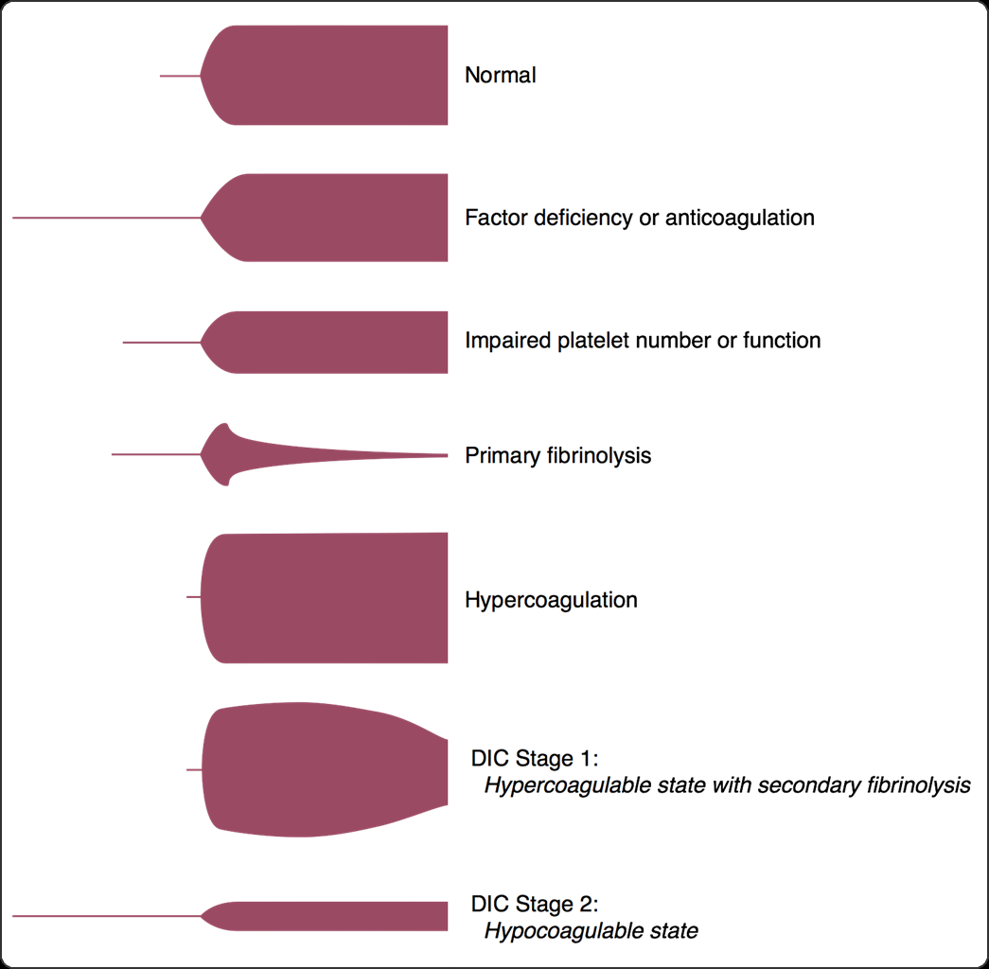
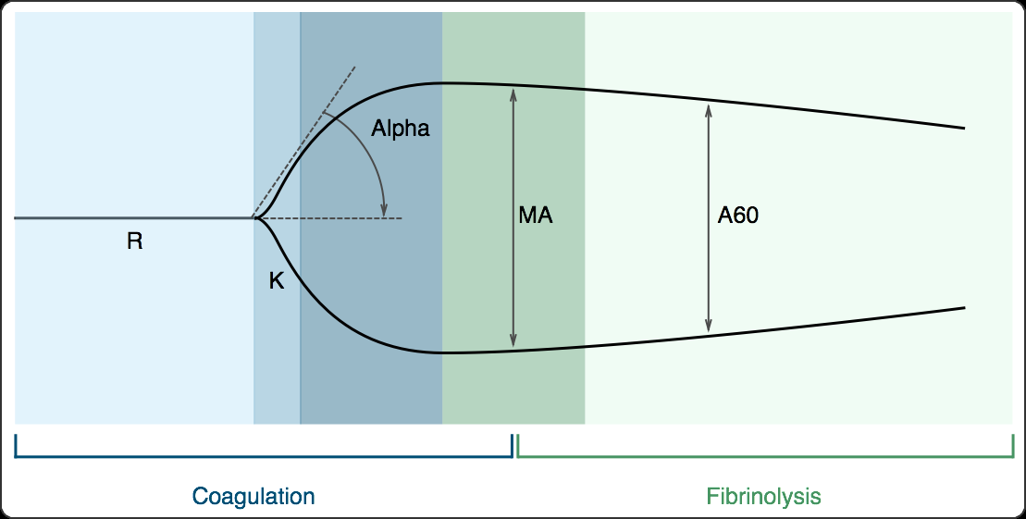
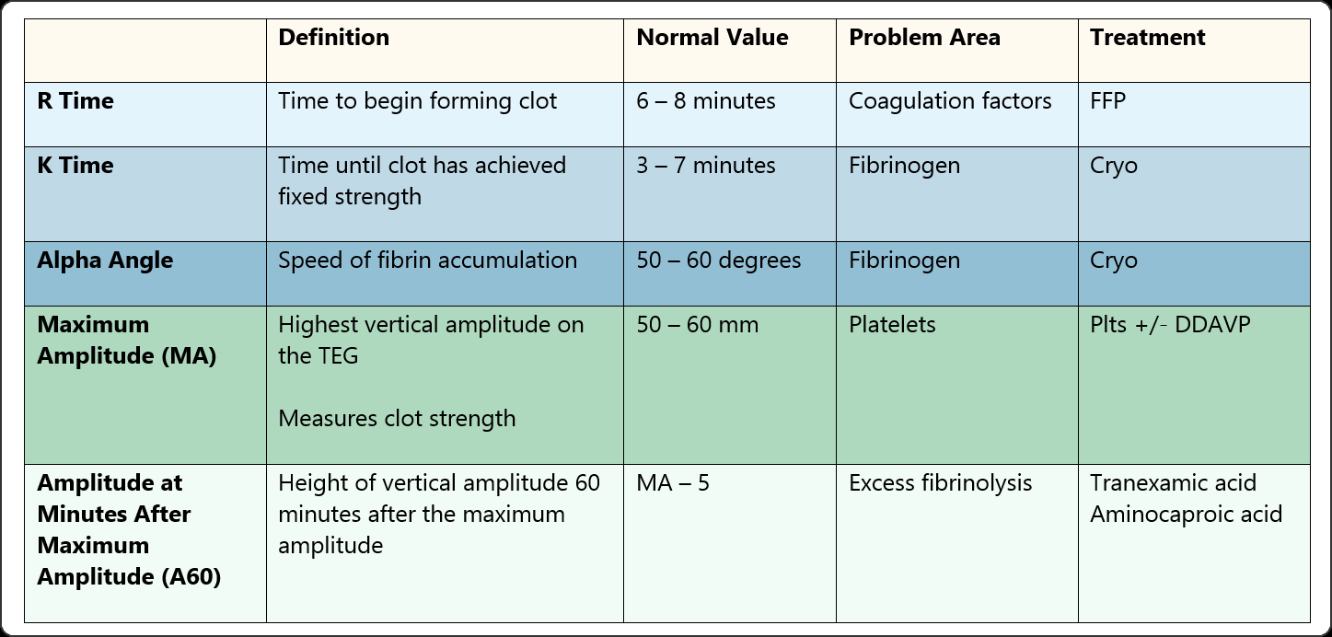
Thromboelastogram (teg)
Visual diagram of coagulation and fibrinolysis.
From apexanesthesia.com

Slide 38
Intra-op Anesthetic management
Recognize & efficiently control blood loss
Frequent evaluation of patients’ clinical status, surgical site, sponges, canisters, & OR floor!!
Communicate with surgeon & circulator – for acute changes in patient VS, find out from surgeon if there is a surgical reason
Transfusions are not without risk
Acute hemolytic transfusion reaction
Transfusion-related acute lung injury
Bacterial, viral & parasitic transmission
Reasons to transfuse in the operating room are to replace coagulation factors and improve oxygen-carrying capacity not necessarily volume.

Slide 39
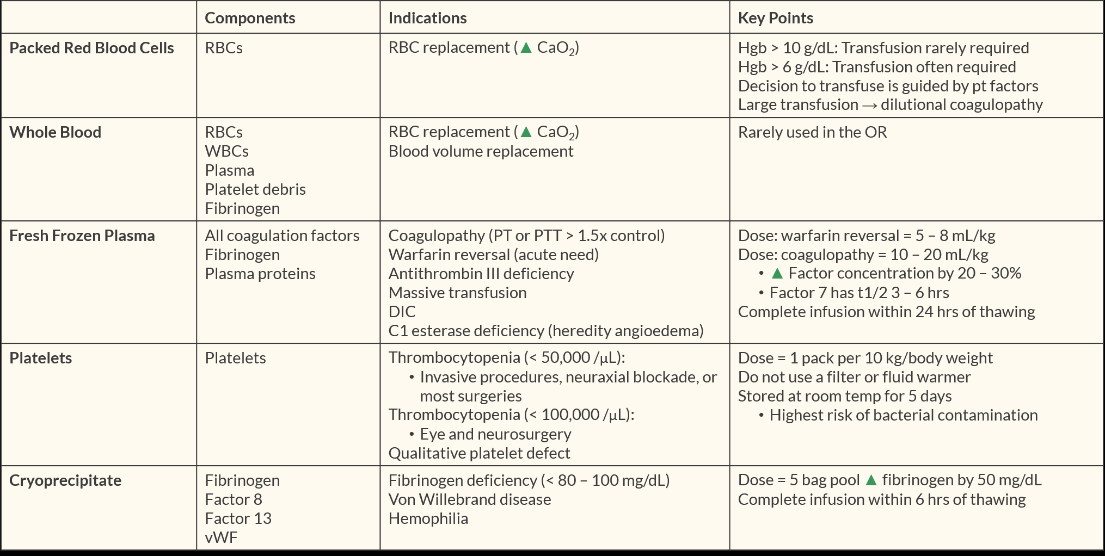
Blood Components
 | Blood Component Definition | Surgical Indication | Dose
PRBC | Red Blood Cells anticoagulated in plasma | Bleeding Increase O2-carrying capacity | 1 unit increases Hgb by 1g/dL
FFP All factors | Plasma separated from RBC and platelets Contains ALL clotting factors Contains naturally occurring inhibitors Source of antithrombin III One bag =200-250 mL Expires 12 months post-donation | Microvascular bleeding Coagulopathy due to factor deficiency PT/aPTT >1.5 xnormal massive blood transfusion reversal of warfarin acquired coagulopathy vonWillebrand disease unresponsive to DDAVP | 10-15 mL/kg
Platelets | Obtain from whole blood or platelet pheresis donations Contain platelets only One bag = random volume One bag pheresis =250-300mL | Massive blood transfusion Active bleeding: <5000=spontaneous hemorrhage 10,000-50,000=variable bleeding risk >50,000=spontaneous bleeding unlikely due to platelets | 1 unit/10 kg body weight 1 unit increases platelet leve 5000-10,000/mm³
Cryoprecipitate | Protein fraction taken off the top of FFP when being thawed then refrozen up to 1 year Contains factors I, vWF, VIII, fibrinogen, XIII One bag = 10-20 mL | Microvascular bleeding von Willebrand disease unresponsive to DDAVP | 1 bag/5 kg body weight 1 unit raises fibrinogen by 100 mg/dL
From Apexanesthesia.com

Slide 40
Transfusion guidelines
Different institutions (heck, different surgeons & anesthesiologists also!) have different guidelines
Past literature recommends a hemoglobin as10 g/dL as an indicator for RBC transfusion (old school) but one must look at clinical picture
HGB of 6 g/dL or 8 g/dL may be completely acceptable as long as ischemia or risk factors for cardiovascular disease are not present
Alternatives to transfusions include preoperative autologous donation(PAD), acute normovolemic hemodilution (ANH), blood-cell salvage (BCS), and recombinant factor VII
Off-label use of recombinant factor VII mode of action unknown.
Both theories suggest that it enhances thrombin generation by augmenting TF/VII at site of vessel injury and surface of platelet, ultimately it boosts thrombin to form fibrin for clot stabilization.

Slide 41
Maximum allowable blood loss (MABL)
Blood Volume
Calculate blood loss to set Hgb
MABL = EBV x $\frac{(starting Hgb − target Hgb)}{starting Hgb}$

Slide 42
Acute hemolytic reactions
Signs often masked by anesthesia
May see Hemoglobinuria, hypotension, bleeding
Others masked: fever, chills, CP, dyspnea, N&V, flushing
May lead to: Renal failure, DIC, hemodynamic instability
Treat: STOP TRANSFUSION
Give IV fluids, may need Mannitol or Lasix to increase U/O
Support Hemodynamics, may need pressors
Send unused product to lab to find out what happened

Slide 43
Transfusion related acute lung injury (trali)
Transfusion related pulmonary edema
At risk: critically ill, septic, burns, post bypass
Probable cause: Human leukocyte antigens in donor plasma
Diagnosis: Onset <6 hrs post infusion, infiltrates on CXR, PaO2/FiO2 < 300 mmHg or sat < 90% on RA
Treatment: Pulmonary support, Max PEEP, low TV, restrict fluids

Slide 44
Transfusion-associated circulatory overload (taco)
Volume overload beyond pt’s compensatory ability
Often due to overloading pt with CHF
May see: Pulmonary Edema, hypervolemia, LV dysfunction, MV regurge, Increased PA occlusion pressure, increased brain natriuretic peptide
Treatment: support hemodynamics

Slide 45
Intraoperative blood salvage
Typically used during major surgery when excess bld loss expected or if pt refuses donated product-Jehovah’s witness
Risks: contamination, fever, hemolysis
Contraindications: SCD, Thalassemia, topical drugs in field, infected site, oncology

Slide 46
Anticoagulation and Pharmacologic therapy
Antiplatelet therapy
Indicated for patients at risk for MI, CVA, or other vascular thrombosis
Many different avenues to go about inhibiting platelets (COX inhibitors, PDE inhibition, ADP receptor antagonism, and GP IIb/IIIa receptor antagonism)

Slide 47
Anticoagulation and Pharmacologic therapy
Cyclooxygenase (COX) enzyme
COX-1 (good COX) maintains gastric lining integrity, renal blood flow, and initiates TxA2 formation (important molecule for platelet aggregation
COX-2 (bad COX) responsible for synthesizing prostaglandin mediators of pain and inflammation
Celecoxib, Nabumetone
Nonselective agents COX 1+2
ASA, Diclofenac, Ibuprofen, naproxen, indomethacin, ketorolac

Slide 48
Anticoagulation and Pharmacologic therapy
Who should not receive NSAIDS?
Those with severe renal impairment
Those with active ICH or GI bleed
Those with a hx of gastric bypass surgery.
Effects of aspirin therapy last (8-12 days) and can only be reversed with platelet transfusion.
Latest research says do not need to stop aspirin but use low dose up to week preop
NSAID agents are competitive antagonists whose effects last only as long as drug’s elimination time stop 24-48 hours before surgery

Slide 49
Anticoagulation and Pharmacologic therapy
Phosphodiesterase Inhibitors--Antiplatelet therapy
Used for stroke prophylaxis because they increase cAMP production which is an active inhibitor of platelet aggregation
Usually used in conjunction with aspirin therapy
Stop dipyridamole 24-48 hours before surgery
ADP Receptor Antagonists P2Y12--Antiplatelet therapy
Prevents GP IIb/IIIa expression on surface of activated platelets, thereby inhibiting platelet adhesion & aggregation
Used for patients with coronary artery disease to prevent myocardial infarction, in-stent thrombosis, or the patients with cerebrovascular or peripheral artery disease to inhibit thromboembolism
Clopidogrel, Prasugrel, and Ticlopidine are noncompetitive, irreversible antagonist therefore stop 7 days before surgery
Ticagrelor is an allosteric antagonist and the blockage is reversible. (Also FYI is twice daily dosing.)

Slide 50
Anticoagulation and Pharmacologic therapy
GP IIb/IIIa Receptor Antagonists: Abciximab (ReoPro), tirofiban (Aggrastat) and eptifbatide (Integrilin)
Inhibits fibrinogen cross-linkage, the final step in common hemostatic pathway for platelet aggregation
IV administration and primarily used for acute coronary syndrome
Effects are monitored with ACT and are reversible with clearance of the drug
Renally excreted with half-life ~ 2.5 hours (except Reopro 12 hours)
Reopro stop 72 hours before surgery
Stop all others 24 hours before surgery

Slide 51
Heparin vs. Warfarin
Warfarin
Interferes with extrinsic pathway
Prothrombin time (PT) & INR assess extrinsic pathway
Heparin
Interferes with intrinsic and final common pathway
Partial thromboplastin time (PTT) & activated coagulation time (ACT) assess intrinsic pathway

Slide 52
Anticoagulation and Pharmacologic therapy
Heparin Therapy
Indirectly inhibits thrombin & factor Xa by binding to Antithrombin III
Used for emergent anticoagulation
Acute coronary syndrome, Pulmonary embolism
During cardiopulmonary bypass & vascular surgery
If patient resistant (from hereditary insufficiency of ATIII or acquired deficiency from prolonged heparin use) Give FFP (ATIII is replenished)
Clinical effects monitored with aPTT or ACT
Clinical effect reversed with Protamine 1 mg per 100 U heparin
Low molecular weight heparin

Slide 53
Anticoagulation and Pharmacologic therapy
Low molecular weight heparin: Enoxaparin (Lovenox) and Fondaparinux
Anti-factor Xa and Anti-thrombin agents
More specific inhibition to factor Xa
Preferred for DVT prophylaxis
For acute bleeding, Protamine should be given for Lovenox. No reversal agents available for Fondaparinux.
Lovenox should be discontinued 24 hours before procedure.
Anti-Xa levels can be used to monitor LMWH

Slide 54
Anticoagulation and Pharmacologic therapy
Vitamin K antagonist Warfarin
Oral anticoagulant therapy used as first-line agent for management of hypercoagulable disorders, venous thromboembolism, stroke prophylaxis, atrial fibrillation or mechanical heart valves
Competes with Vitamin K for its binding site & inhibits synthesis of vitamin K dependent clotting factors, II, VII, IX, and X
Also inhibits Proteins C & S (natural anticoagulants are dependent on vitamin K)
Stop Warfarin 2-4 days before surgery

Slide 55
Anticoagulation and Pharmacologic therapy
Reversal with administration of Vitamin K
Takes 4-8 hours (IV) to 24 hours (PO) to reverse effects of warfarin. Has no effect on heparin.
Emergency bleeding reverse with Prothrombin Complex concentrate (FII,VII,IX, and X) 25-50 units/kg (typically dosed base on INR).
FFP is recommended when Prothrombin Complex Concentrate is not available
Warfarin has a long onset and offset of action which puts patients at risk of thrombosis and bleeding especially in perioperative period
Vitamin K requires functional liver.

Slide 56
Anticoagulation and Pharmacologic therapy
Direct thrombin inhibitor: Dabigatran (Pradaxa) (oral option)
FDA approved for afib, DVT, and PE.
Do not need to monitor coagulation, but increased aPTT will correlate to presence of drug, but not concentration
Should be discontinued 24 hours before surgery when renal function > 50 mL/min
In acute bleeding, Idarucizumab (Praxbind) should be administered
Drug may be dialyzed in non-urgent situations.

Slide 57
Anticoagulation and Pharmacologic therapy
Direct thrombin inhibitor: Argatroban, and Bivalirudin (Angiomax)(IV option)
FDA approved for Heparin Induced Thrombocytopenia, acute MI, DVT, and PCI
Short half-life
Argatroban needs chromogenic factor 10 monitoring when bridging therapy with warfarin. DO NOT USE INR
Should be discontinued 24 hours before surgery
In acute bleeding, Prothrombin Complex Concentrates should be given

Slide 58
Anticoagulation and Pharmacologic therapy
Direct oral anticoagulants (DOACs): Apixaban (Eliquis), Betrixaban (BevyxXa), Edoxaban (savaysa), and Rivaroxaban (Xarelto)
Selective factor Xa inhibitors (typically reversible)
Lab monitoring not typical, but elevated Anti-Xa levels are correlated with presence of drug not concentration.
Short half lives. Should be discontinued 24 hours before surgery when renal function > 50 mL/min
In acute bleeding, Prothrombin Complex Concentrates should be given
Tranexamic Acid may be considered as adjuvant for non-life threatening bleeding.
Andexanet alpha is factor Xa and a specific reversal agent for DOACs. It is only indicated for life-threatening bleeding due to apixaban or rivaroxaban. $$$$$$$

Slide 59
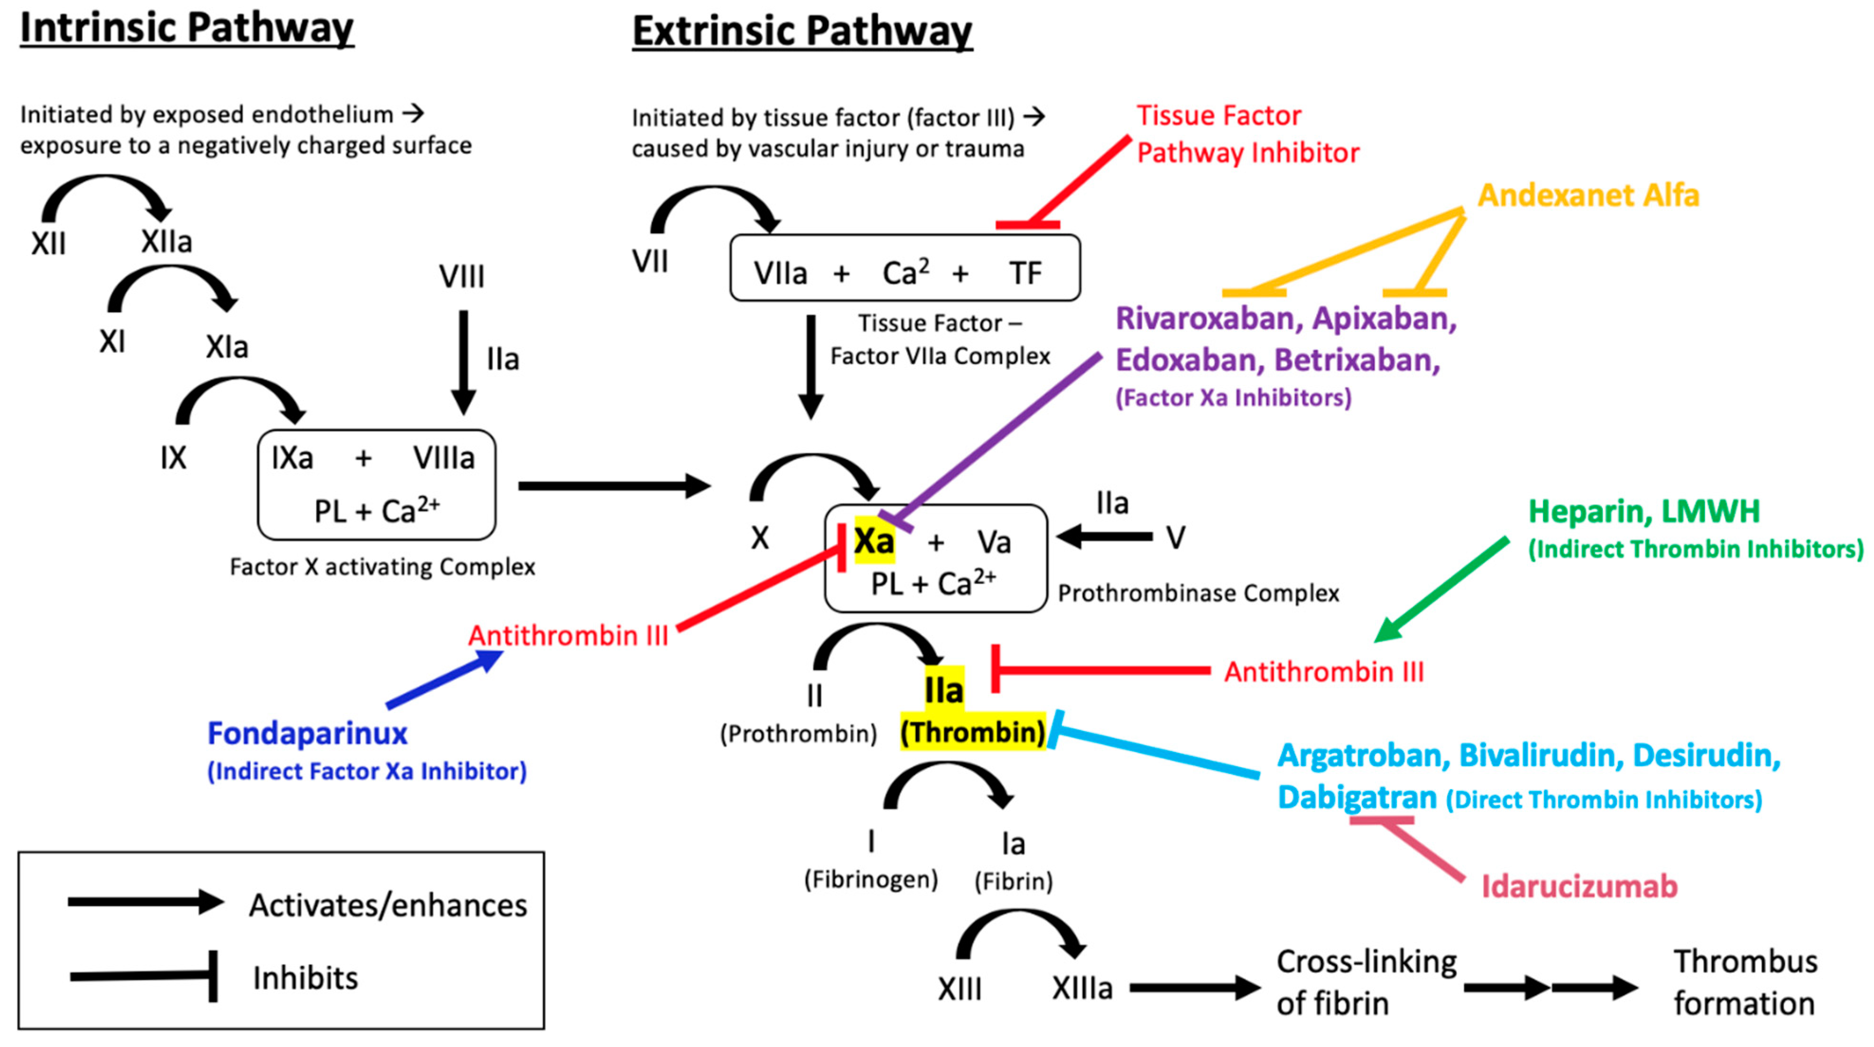
Anticoagulation and Pharmacologic therapy
Kustos, S.A.; Fasinu, P.S. Direct-Acting Oral Anticoagulants and Their Reversal Agents—An Update. Medicines 2019, 6, 103

Slide 60
Anticoagulation and Pharmacologic therapy
Reasons for elevated INR:
Acute alcohol consumption
Diarrhea
Fever/infection
Heart Failure
Hyperthyroidism
Malnourishment
Pain
Liver dysfunction
Drug interactions
Don’t just react to a number. See the whole picture.

Slide 61
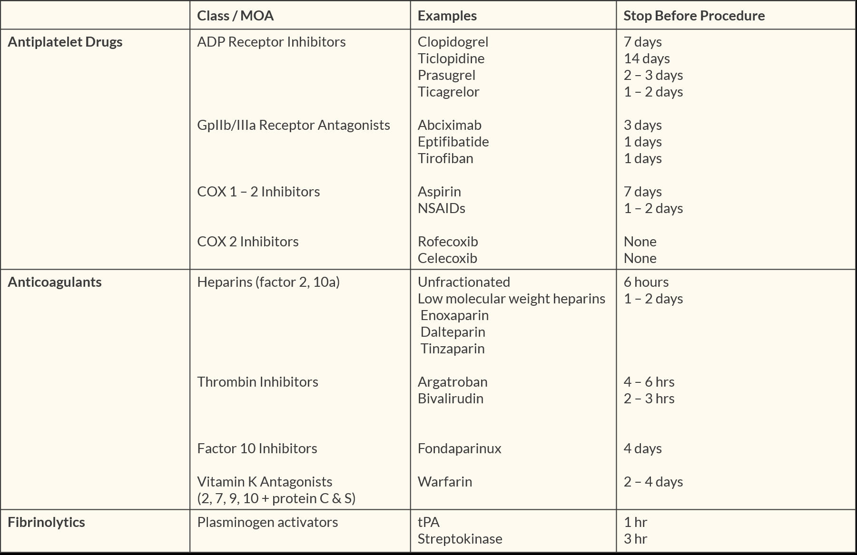
When to stop drug tx preop
From apexanesthesia.com

Slide 62
Prothrombin complex concentrates (PCC)
FDA approved for use in hemophilia, but given for reversal of vitamin K antagonists & critical bleeding management associated with major surgery, trauma, or liver failure
Includes vitamin K-dependent factors II, VII, IX, and X
Most factors are administered in inactive state (does activated state)
PCC drug of choice for emergent reversal of oral anticoagulant in place of rFVIIa and FFP
Dosing of PCC are dependent on INR
Only contraindication are those with HIT &/or DIC

Slide 63
Desmopressin
DDAVP is synthetic analog for endogenous antidiuretic hormone (ADH), vasopressin
Acts at V2 receptor which is found in nephron and within endothelial cells
Originally introduced for treatment of diabetes insipidus, but was found to improve hemostasis and platelet function
Drug of choice for treatment of vWD and mild hemophilia A
Causes the release of FVIII and vWF from within the endothelial cell and improving platelet function
Dose for hemostasis is 0.3 mcg/kg IV over 20 -30 min
Side effect is hypotension secondary to arterial vasodilation & NO release (give it slow)

Slide 64
Antifibrinolytic therapy
Lysine analogs
Epsilon-aminocaproic acid (EACA)
Tranexamic acid (TXA)
Both are synthetic derivatives of amino acid lysine
They competitively inhibit binding site on plasminogen –preventing cleavage to plasmin and resulting fibrinolysis
Used in cardiac surgery, liver transplantation, orthopedic operations and spine fusions
Lysine analogs are inexpensive and low-risk adjunctive agents to decrease intraoperative bleeding
TXA available oral tablet, IV, or with atomizer can be administered nasally.

Slide 65
Von willebrand factor (vwf)
vWF serves a central role in hemostasis
vWF’s functions are:
Anchors platelets to damaged subendothelium so platelet plug can be formed
Platelet aggregation at vascular injury site through interaction with GPIb receptor on platelet surface
serves as a carrier for coagulation clotting factor VIII:C
vWF circulates as a complex with FVIII (FVIII:C) providing stability to otherwise labile clotting factor until vWF binds to activated platelets via GP IIb/IIIa receptor
(factor VIII is released from vWF by the action of thrombin)

Slide 66
Von willebrand disease
Most common hereditary bleeding disorder at 1%
Severity of vWD varies on degree of genetic mutation and its effect on FVIII:vWF
3 types
Type 1: mild-mod reduction in vWF produced
Type 2: vWF produced does not work well
Type 3: severe reduction in vWF produced
3 diagnostic criteria:
History of mucosal bleeding or prolonged bleeding after dental procedures, or postpartum hemorrhage
Family history of bleeding disorders
Reduced levels of vWF (PTT & BT are often elevated)

Slide 67
Von willebrand disease TREATMENT
Two primary treatment options: DDAVP & Factor concentrates
Desmopressin (DDAVP)
Promotes cleavage of vWF from FVIII & increases availability of both; this is beneficial for most patient types with vWD
May not be therapeutic for all patients with specific type of vWF. These patients require treatment with additional hemostatic medications such as antifibrinolytics and FVIII concentrate (Heamate P/Humate P)
Cryoprecipitate or Concentrated VIII-vWF
Contains factors I, VIII, and XIII
Rich in factor VIII:vWF therefore can be effective if pt unresponsive to DDAVP or for Type 3

Slide 68
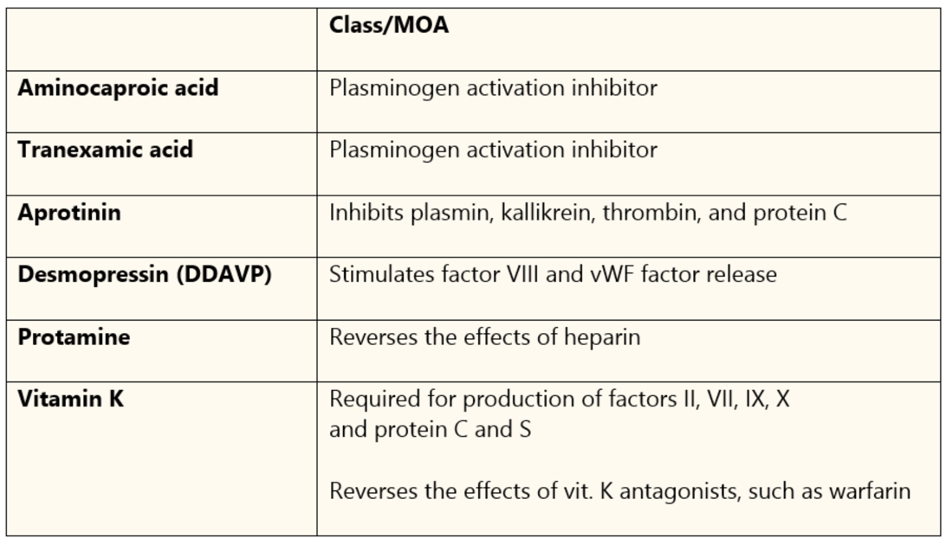
Summary of pro-coags
From apexanesthesia.com

Slide 69
Anemias
Anemia is a deficiency in concentration of circulating red blood bells
Nutritional
Hemolytic
Genetic
Compensatory mechanisms develop to offset decreased oxygen carrying capacity of blood
No universally acceptable hematocrit that demands transfusion. Symptoms do not usually develop until Hgb < 7 g/dL

Slide 70
Anemias
COMPENSATORY MECHANISMS TO INCREASE OXYGEN DELIVERY WITH CHRONIC ANEMIA
Increased Cardiac Output
Increased RBC 2,3–diphosphoglycerate (2,3-DPG)
Increased P-50
Increased plasma volume
Decreased blood viscosity

Slide 71
anemia
Megoblastic-An abnormally large nucleated RBC
Nutritional Deficiency Anemia--Three primary causes
Iron deficiency
A microcytic, hypochromic RBC is produced. Can be secondary to decreased oral intake or a related deficiency or a rapid turnover of RBC’s
B12 deficiency
Megoblastic anemia can be caused by decreased B12, folate, or refractory bone marrow disease. Absorption of vitamin b12 by the gastrointestinal tract depends on the release of intrinsic factor, a glycoprotein secreted by gastric parietal cells. Atrophy of gastric mucosa from chronic gastritis may be caused by parietal cell autoantibodies . Controversial whether it is ok to use N2O in this population as it has been shown that an exposure of short duration can cause megaloblastic red cell changes.
Folic acid deficiency
Also produces megoblastic anemia. Peripheral neuropathy may occur, but is not as common as with B12 deficiency. Causes include alcoholism, pregnancy, and malabsportion syndromes (celiac disease). Methotrexate and phenytoin are known to interfere with folic acid absorption.
Other cause is chronically ill patients- 75% of critically ill patients are anemic
Hepcidin production is increased during inflammation and can produce anemia in chronically ill patients.

Slide 72
anemia
Avoid: aspirin, penicillin, streptomycin, sulfonamides, quinidine, doxorubicin, methylene blue, nitroprusside and prilocaine in G6PD
Primary clinical manifestation is acute hemolysis that can be triggered by conditions that place oxidative stress on RBCs; infection, drug exposure, or ingestion of fava beans
Signs and Symptoms include; anemia, headache, substernal and abdominal pain, back pain, jaundice, tachycardia, and fatigue
Hemolysis begins 2-5 days after drug exposure
Drugs that trigger a hemolytic crisis are nonopioid analgesics, antibiotics, sulfonamides, and antimalarials
Hemolysis is self-limited
Patients with G6PD are unable to reduce methemoglobin produced by sodium nitrate; therefore, sodium nitroprusside and prilocaine should not be administered because it can cause cyanide toxicity
Hemolytic Anemia
Normal life span of an erythrocyte is 120 days
Abnormalities in the erythrocyte may result in premature destruction and hemolysis of the cell.
Causes of hemolytic anemia include structural erythrocyte abnormalities, enzyme deficiencies, and immune –mediated hemolysis
Glucose-6-phosphate Dehydrogenase Deficiency(G6PD)
Most common enzymopathy in humans and affects 400 million
African Americans, Africans, Asians, Indians, and Mediterranean populations are susceptible to G6PD
G6PD initiates the pentose monophosphate shunt that begins the metabolism of glucose in the RBC
This pathway where glucose is converted to pentose and nicotinamide-adenine dinucleotide phospate (NADPH) is abnormal and without NADPH, the RBC is vulnerable to damage by oxidation

Slide 73
Anemia
Thalassemia
Autosomal recessive
Underproduction of α or βglobin chains of the hemoglobin molecule
Alpha thalassemia –under production of alpha chains
Beta thalassemia- under production of beta chains
Net result = reduced globin synthesis that results in anemia secondary to a reduced concentration of hemoglobin in the RBC and decreased RBC production
Disease ranges from:
Thalassemia major- requiring regular RBC transfusion to maintain an adequate hemoglobin
Thalassemia intermedia- requiring occasional transfusion
Thalassemia minor -rarely require transfusion.
Successful bone marrow transplantation is curative for some patients
Bone marrow transplantation is typically used for children that develop early and severe complications from thalassemia

Slide 74
Anemia
Thalassemia
Frequent blood transfusions cause iron overload, can cause cardiac, hepatic, immune, and endocrine dysfunction. Cardiac dysfunction can be dysrhythmias, pulmonary hypertension, and congestive heart failure
Severe anemia stimulates bone marrow proliferation producing widespread skeletal abnormalities
ANETHESIA MANAGEMENT
Hemoglobin level
Evaluate cardiac, hepatic, and endocrine function
Blood should be cross-matched in advance
Airway management challenges with facial disfiguration
Neuraxial anesthesia difficulties with extramedullary bone marrow deposition in the spinal canal is a relative contraindication but has been done successfully
Cell saver has been done successfully and used for the thalassemia patient

Slide 75
hemophilia
All genetic diseases resulting from deficiencies or dysfunction in specific clotting factors
Hemophilia A- 85% of all cases (1:5000 males)
factor VIII:C deficiency; prolonged PTT, normal PT
Sex linked recessive genetic disorder-almost exclusively occurs in males; Female is carrier. If female carrier (mom) + hemophilia A male (dad), then female progeny can get it
Patients spontaneously bleed into joints, muscles & internal organs
Mild disease have about 5-30% of normal factor levels (50% patients)
Moderate-2-5% of factor levels (10% of patients)
Severe 1% of factor activity (40% of patients)
Normal level is 100-200 ng/mL

Slide 76
hemophilia
Hemophilia B (Christmas Disease)
Factor IX defect
14% 1:25,000 males
Treat with concentrated factor IX
Hemophilia C–rare
Factor XI genetic mutations

Slide 77
Hemophilia treatment
Patients must be type and crossed preop
Replace clotting factors through plasma transfusions & factor concentrate
Factor VIII (FVIII) concentrate (Hemophilia A) prior to surgery to augment thrombin generation & deter bleeding
1/2Life of 8-12 hrs, need to redose, tx for 2-6 wks postop
Up to 30% with severe disease develop antibodies to FVIII by adulthood
If antibodies or inhibitors to factor concentrates, prothrombin complex concentrate (FII,VII, IX and X) is useful in cases of urgent bleeding
Desmopressin (DDAVP) can also be given to increase plasma levels of FVIII and vWF for mild to moderate hemophiliacs
FFP & Cryoprecipitate contain low concentrations of VIII

Slide 78
Recombinant factor VII (FVII)
Approved for use in US 1999 for Hemophilia A (factor VIII) and B (factor IX), inhibitor disorders of factors VIII and IX, factor VII deficiency, and as a universal hemostatic agent
Off-label use has successfully treated coagulation insufficiencies associated with platelet dysfunction, intracranial hemorrhage, prostate surgery &trauma
It promotes hemostasis by complexing with tissue factor and activating coagulation factors in the intrinsic pathway
Factor Xa, complexed with other factors, converts prothrombin to thrombin and fibrinogen to fibrin to form a hemostatic plug. FVII administration boosts thrombin to form fibrin for clot stabilization
$$$$$
Should be used cautiously with patients predisposed to thrombosis

Slide 79
Thrombotic disorders
Antithrombin (AT) Deficiency
Congenital or acquired by overuse of heparin
Tx with AT concentrate or FFP
Protein C and S deficiency
Inhibition of Va and VIIIa causes unrestrained clot formation
Tx with heparin/warfarin possibly for life
Factor V Leiden mutation
Resistant to anticoagulation effect of Protein C
Only need anticoags if clots occur
Heparin-induced Thrombocytopenia

Slide 80
Heparin-induced thrombocytopenia
Affects 1-5% of patients receiving heparin after extended use
Associated with thromboembolic complications
Occurs in 5-10 days although a significant immune response can happen sooner
Two Type HIT-1 and HIT-2
HIT-1 → mild thrombocytopenia
HIT-2 → immune-mediated response & carries a significant risk of hypercoagulability.
Antibodies bind to heparin P4 complexes on platelet surfaces & initiate primary hemostasis and thrombin generation
Notes:
Lepirudin in metabolizied by kidney and will have prolonged effects in those with kidney disease
Bivalirudin is the shortest acting DTI with quickest onset of action drug of choc for patients with both renal and hepatic dysfunction good agent for cardiopulmonary bypass in those with HIT
Clinical effects of DIT with ACT or aPTT but reversal depends on clearance of the drug

Slide 81
Heparin-induced thrombocytopenia
Any type of heparin therapy can cause, most likely heparin vs LMWH
Diagnostic criteria is thrombocytopenia platelets < 150,000 or less than 50% of baseline, <50,000 is critical as well as a positive heparin induced platelet aggregation test
Clinical suspicion is confirmed with serotonin release assay (gold standard) or enzyme linked immunosorbent assay (ELISA)
Patients usually receive a Direct Thrombin Inhibitor such as Bivalirudin (Angiomax) or Argatroban

Slide 82
Polycythemia Vera (PCV)
Myeloproliferative neoplastic disorder; hyperactivity of myeloid progenitor cells leads to ↑ production of erythrocytes, leukocytes & platelets
Hgb > 18 g/dL & platelets > 400,000/mm³
Clinical manifestations include
↑ blood viscosity → ↑ incidence of vascular thrombosis (especially CV & CNS)
Digital ischemia → erythromelalgia (burning) in fingers & toes
Spontaneous hemorrhage from defective platelet function
splenomegaly

Slide 83
Polycythemia Vera (PCV)
Treatment is reducing Hct to 40% by phlebotomy
Anesthesia Considerations:
Uncontrolled PCV in surgical setting associated with high incidence of peri-op hemorrhage & post-op venous thrombosis
In emergency cases, reduce blood viscosity through crystalloid infusions as tolerated
NPO fluid deficit should be corrected early to assist in decreasing blood viscosity

Slide 84
Disseminated intravascular coagulation (DIC)
Common disorders associated with DIC
Obstetric complications (50%)
Sepsis (30-50%)
Malignancy (up to 20%)
Trauma and burns (rare)
Vascular disease (rare)
Sever organ dysfunction (rare)
Hemolysis (rare)
Disorder characterized by systemic overactivation of coagulation
Associated with infection, inflammation, or malignancy causing a widespread activation of coagulation cascade
Involves diffuse thrombosis that may lead to multi-organ system failure
Supportive care and treatment of the underling disorder are priority of management
Severe cases of DIC treated with factor and fibrinogen replacement, anticoagulation, or other pharmacotherapy

Slide 85
Acute DIC in Surgical Pts
Treatment
Treat underlying cause
FFP is mainstay of replacement therapy (all factors are present in FFP except platelets)
Specific factor replacement along with use of LMWH
Potential use of Antithrombin-III and Activated Protein C are being investigated
Bleeding with oozing from tubes, wounds & vascular access sites
Shock, ischemia & infection are the most common precipitating factors of acute DIC
Laboratory values reflect consumption of clotting factors and enhanced fibrinolysis
↓ platelets
↓ fibrinogen
↓ levels of FV,VIII, and XIII
↑ fibrin degradation (split products)

Slide 86
Sickle cell disease
RBC life span is 12-17 days vs. 120 days in normal RBC
Valine (a single amino acid) is substituted for glutamic acid on β-globin chain
Damaged RBCs are prone to hemolysis & removal by spleen
When hemoglobin S is exposed to low O₂ concentrations, (PO2 <50 mm Hgb), molecule becomes unstable and polymerizes with other hemoglobin S molecules to form a crystalline gel that deforms RBC into sickle shape
Hemoglobin S has a lower affinity for O2. (P₅₀ is 31 vs 26 for normal Hgb)

Slide 87
Sickle Cell disease
Many of clinical manifestations result from obstruction of small blood vessels, tissue ischemia & chronic anemia
Incidence of asthma 50% & pulmonary hypertension is 10%
Disease severity is pt-specific
Ranges from death at an early age to few symptoms
Therapy for SCD includes oral penicillin prophylaxis, hydroxyurea, & pneumococcal vaccination

Slide 88
Problems associated with SCD
Vaso-occlusive crisis
Often 1st & most frequent SCD manifestation
Secondary to tissue ischemia and infarction
Pain can be mild to severe and require pain medication, hydration, supplemental oxygen
Perioperative incidence is 10%
Triggers: Hypoxemia, hypothermia, infection, dehydration, venous stasis, acidosis, and pain

Slide 89
Problems associated with SCD
Acute Chest Syndrome (ASC)
Represents single greatest threat to SCD pt; mortality 1-20%
Incidence 10-20% after abdominal surgery; children at higher risk
Diagnosis: new lung infiltrate on a chest x-ray in presence of chest pain, cough, dyspnea, wheezing, or hypoxemia.
Mechanisms of ACS are thrombosis, embolism & infection
Factors associated with ACS in post-op period include:
Pain, splinting, narcotic analgesia & hypoventilation
Incidence reduced by pre-op transfusion & post-op incentive spirometry

Slide 90
Problems associated with SCD
Sequestration Crisis
Spleen removes RBCs faster than produced
Leads to anemia and instability
Transfuse RBCs possibly splenectomy
Aplastic Crisis
Due to short 1/2L of HbgS any bone marrow suppression will cause anemia
Pneumococcal Disease
Children at high risk
May need PCN daily until 5 y

Slide 91
SCD Anesthesia Management
Preoperative evaluation is directed at identifying which organs have been damaged
Preop hemoglobin
Preop echo indicated in patients with limited physical activity, hypoxemia, respiratory distress, frequent episodes of VOC or ACS, or symptoms consistent with cor pulmonale
Common echo findings are: left ventricular hypertrophy, right ventricular dilation & atrial enlargement
Preoperative RBC transfusion depends on SCD severity & type of proposed surgery; most authors suggest transfusion

Slide 92
SCD Anesthesia Management
Typical hemoglobin in patient with SCD is 5-8 g/dL
Optimal to raise to 10 g/dL prior to surgery & maintain Hgb of 10 g/dL intra-op
Cell saver blood ok
Maintain normothermia & euvolemia
Avoid extremity tourniquets unless critical for performing surgery complication rate of 12%
Maintain hydration and oxygenation
Pain causes postoperative ACS; promote strategies to provide best analgesia possible; regional technique if possible

Slide 93
Thank you

Slide 94
References
Hines, R. L. & Marschall, K. E. (2018) Stoelting’s Anesthesia and Co-existing Disease. (7th ed.). Elsevier.
Nagelhout, J. J. & Elisha, S. (2018). Nurse Anesthesia (6th ed.). Elsevier.
3. Barash, P. G., Cullen, B. F., Stoelting, R. K., Cahalan, M. K., Stock, M. C., Ortega, R., Sharer, S. R. & Holt, N. F. (2017). Clinical Anesthesia (8th ed.). Wolters Kluwer.

